Slide 1


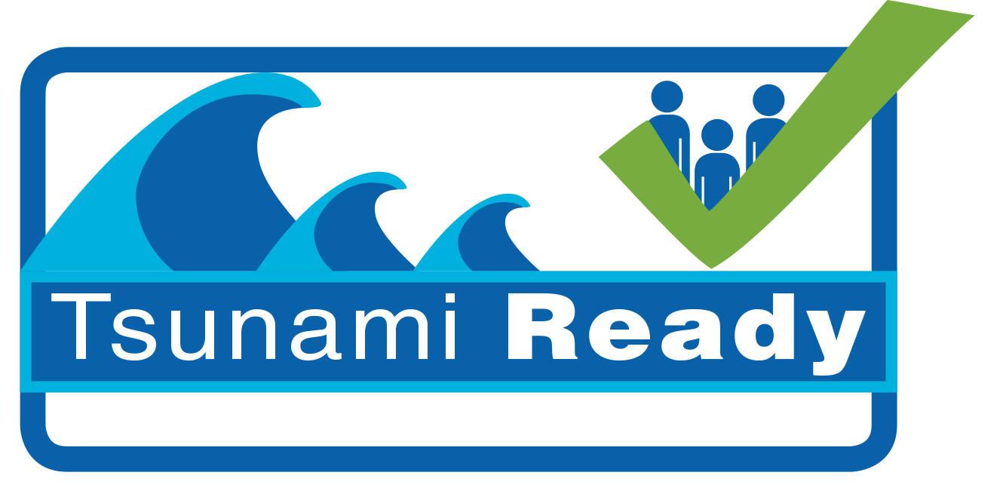
Draft Toolkit for
UNESCO-IOC Tsunami Ready Sign

Slide 2
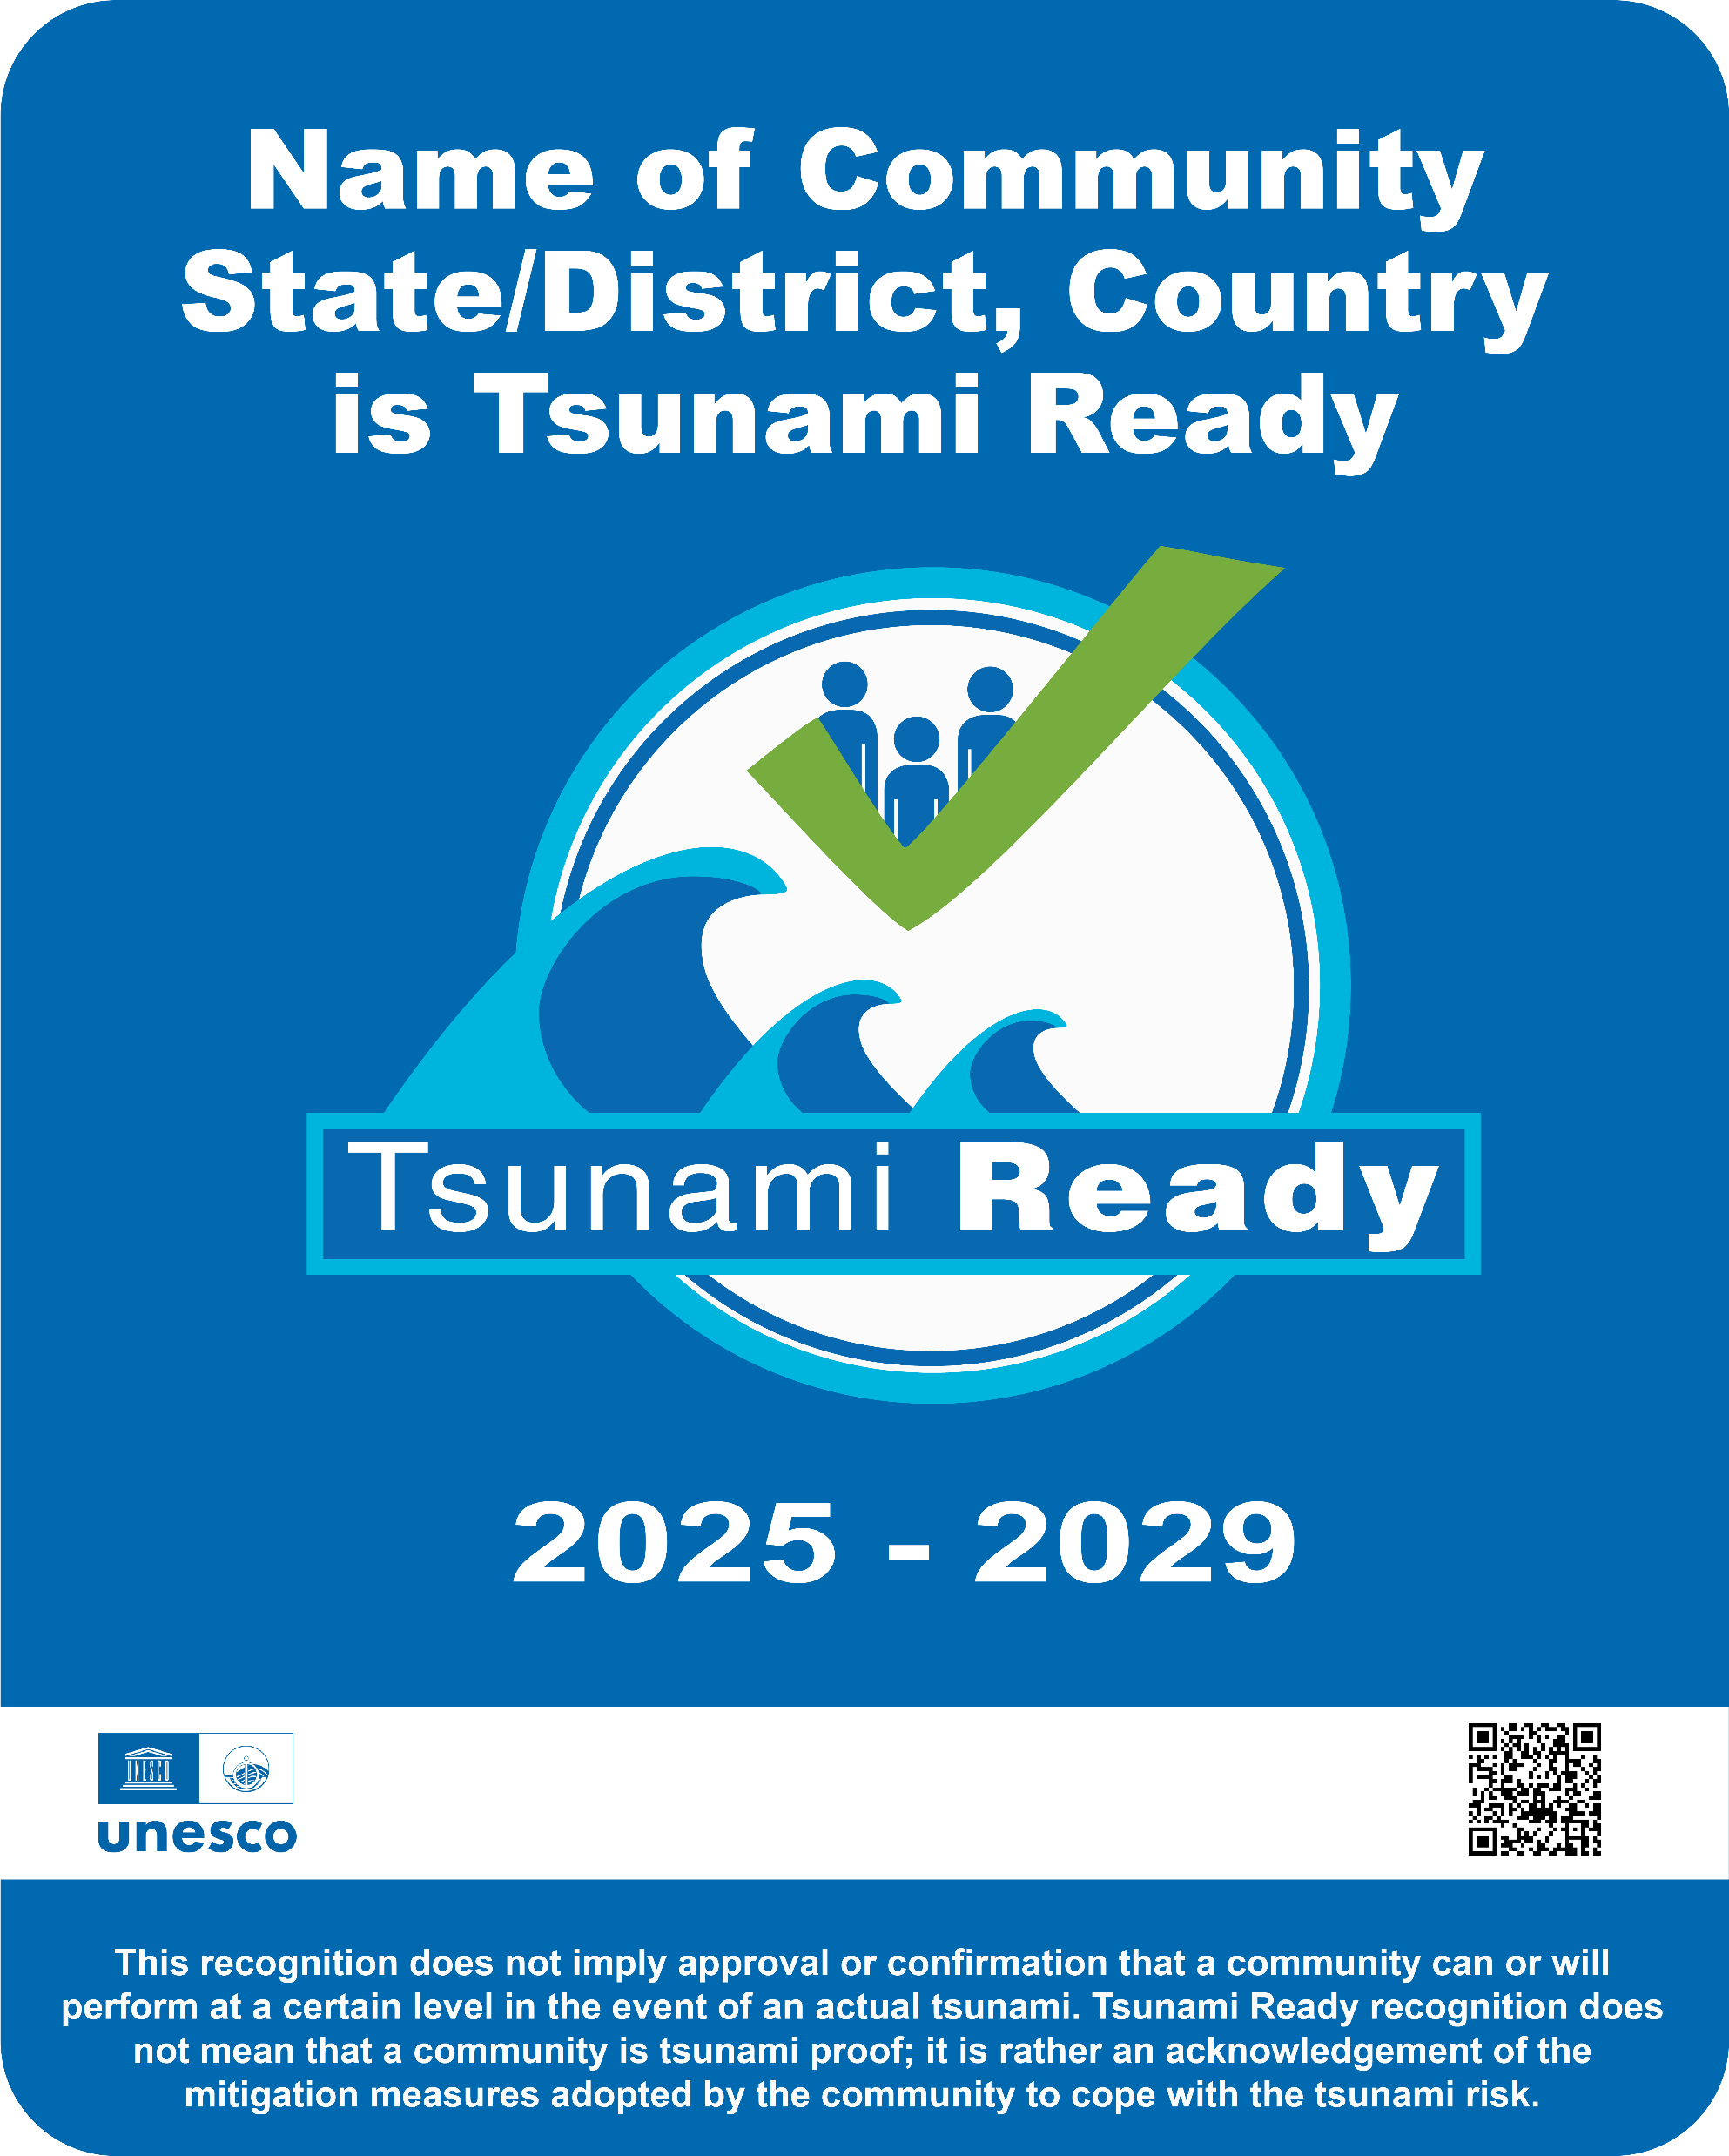
Tsunami Signage Standard
60 cm
Community Name
Line 1: Name of Community
Line 2: Name of State/District, and Country
Line 3: “is Tsunami Ready”
Font: Arial Black 110pt
Color: White
In the case of recognition by country/nation, this will only be two lines, the font size can be adjusted accordingly.
Size
Landscape WxH: 75x60 cm
Portrait WxH: 60x75 cm
Square WxH: 60x60 cm
Color: Blue
RGB: 0,105,175
CMYK: 94, 59, 3, 0
HEX # 0069af
Tsunami Ready Logo
The Validity Year of the Tsunami Ready Recognition
Font: Arial 110pt
Color: White
75 cm
QR Code to UNESCO-IOC Tsunami Ready Website.
Disclaimer Text:
“This recognition does not imply approval or confirmation that a community can or will perform at a certain level in the event of an actual tsunami. Tsunami Ready recognition does not mean that a community is tsunami proof; it is rather an acknowledgement of the mitigation measures adopted by the community to cope with the tsunami risk.“
Font: Arial Bold 36pt
Color: White
White Box for Logo placement
H: 6cm w: 60 cm Color: White
Logo Placements (Left to Right):
UNESCO IOC, TICs, National Supporting Agencies, Local Supporting Agencies, donor / funding agencies.

Slide 3
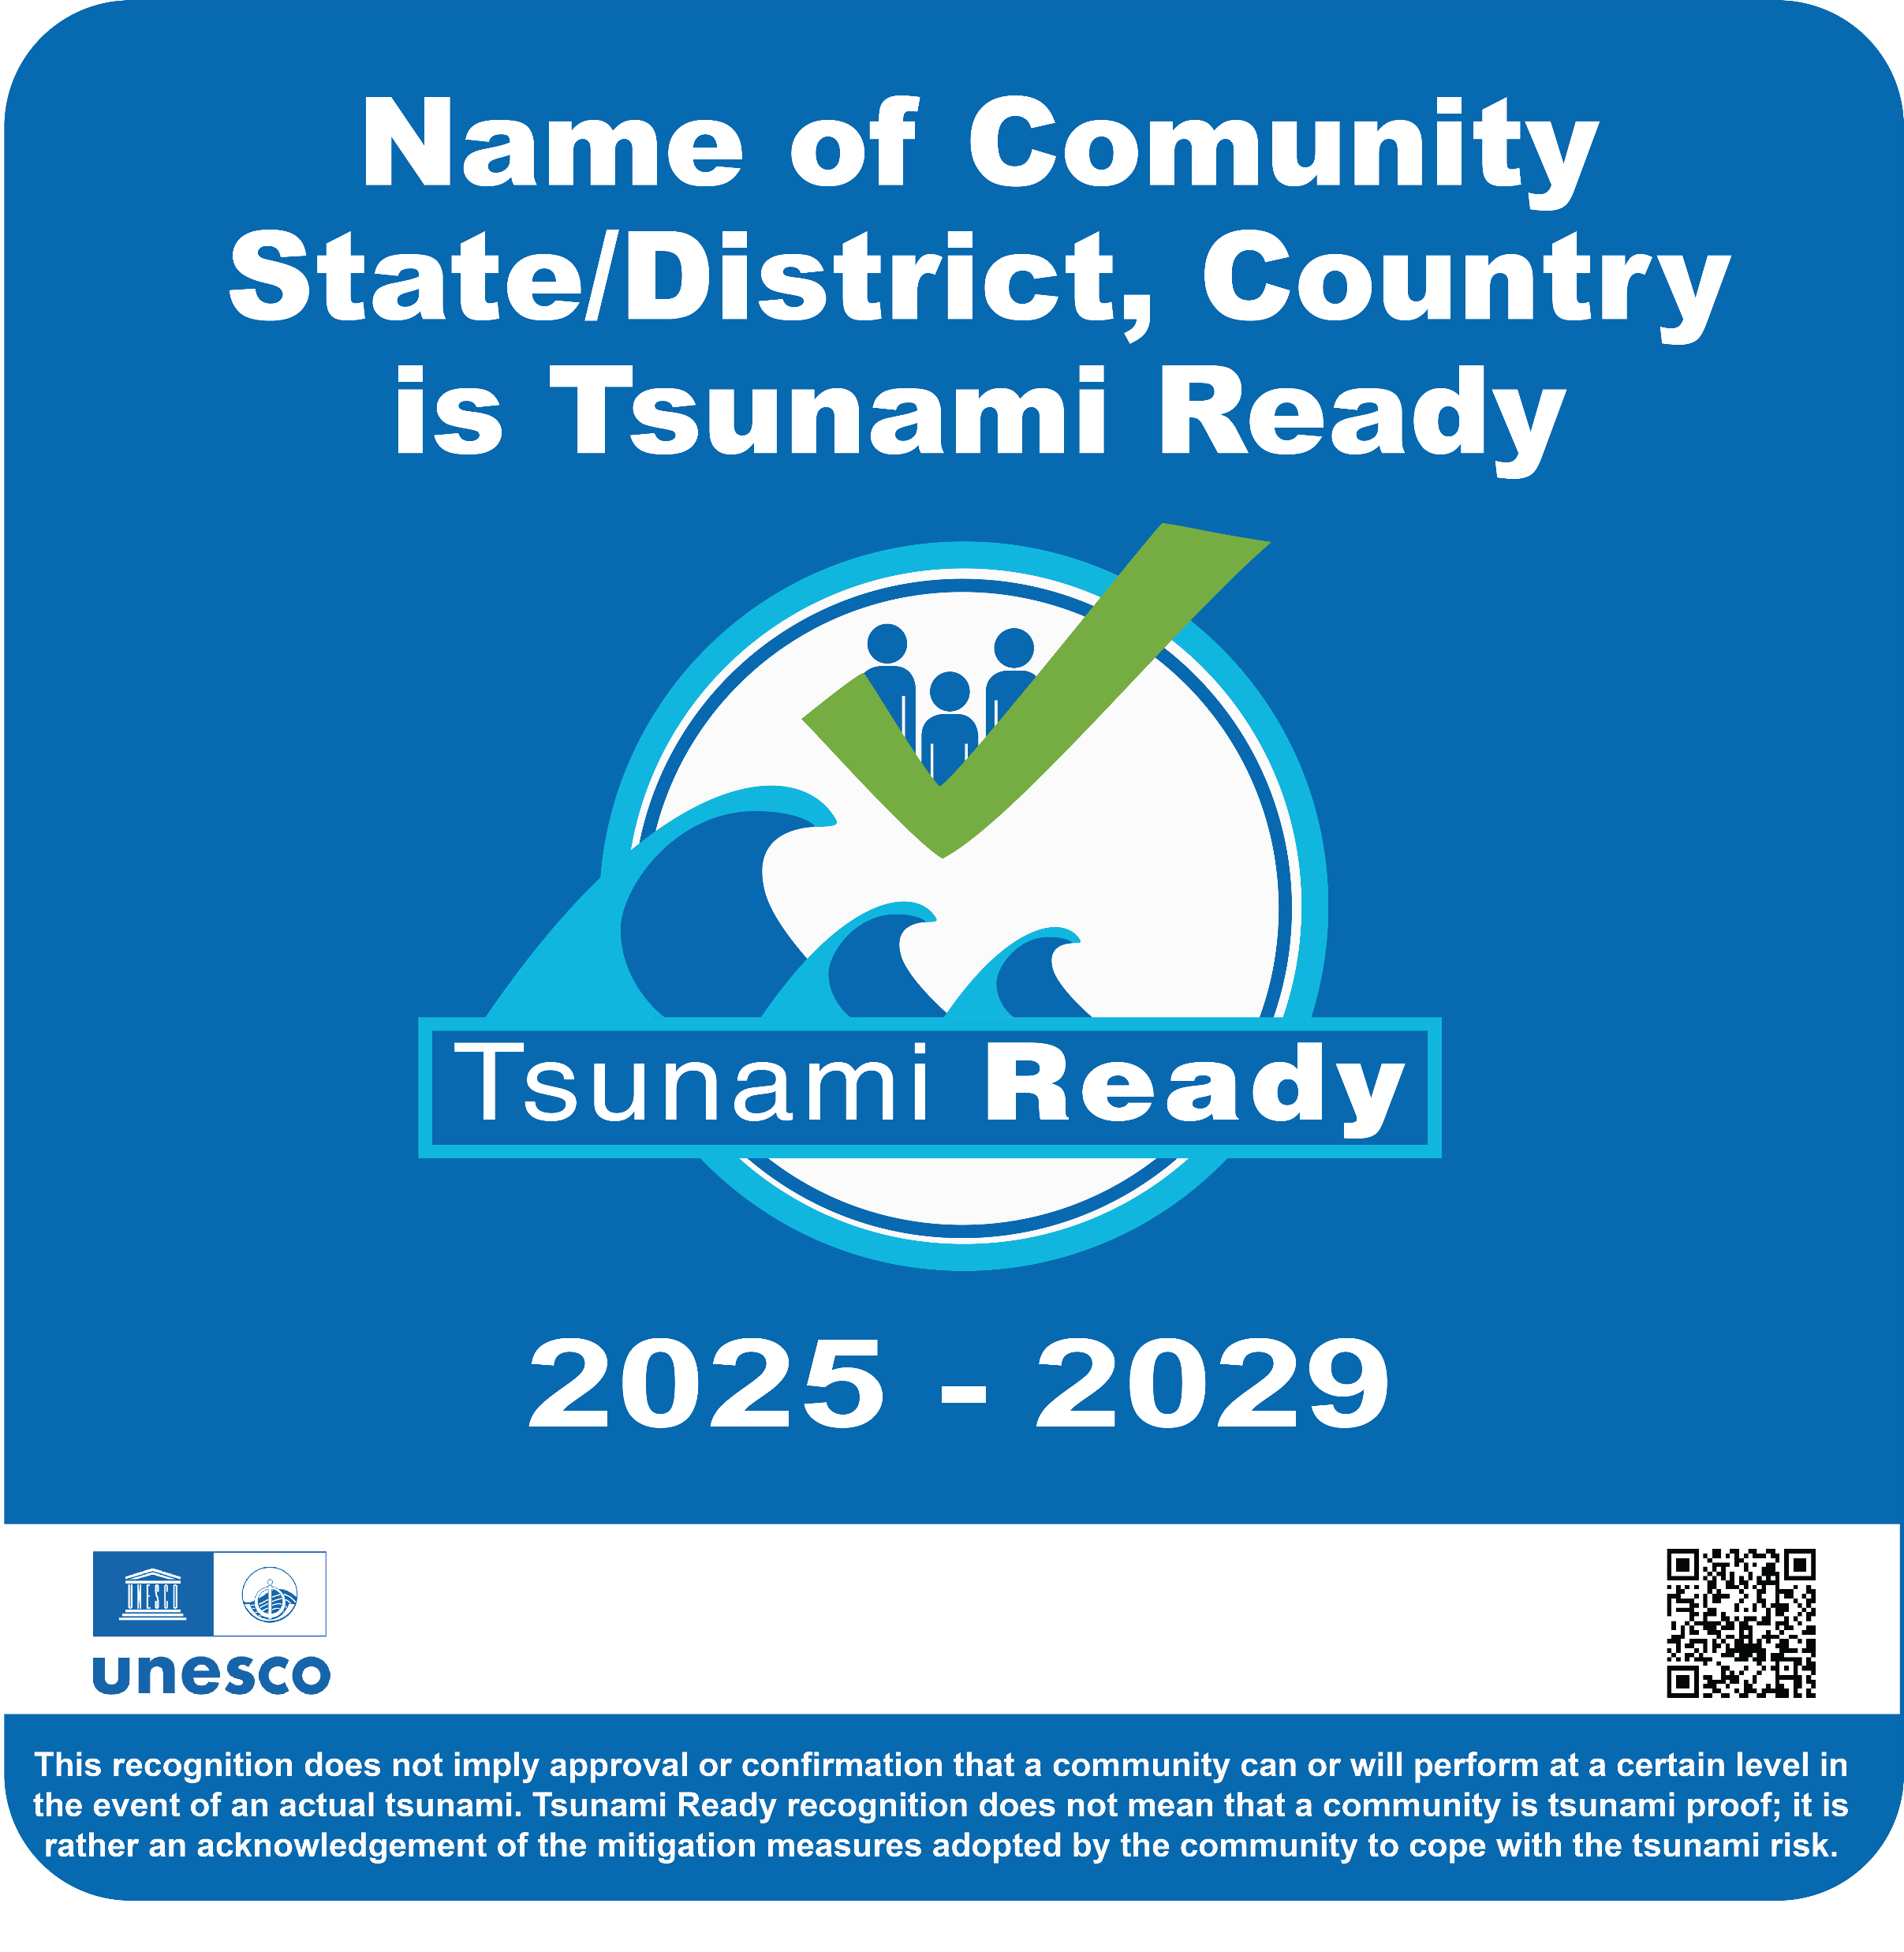
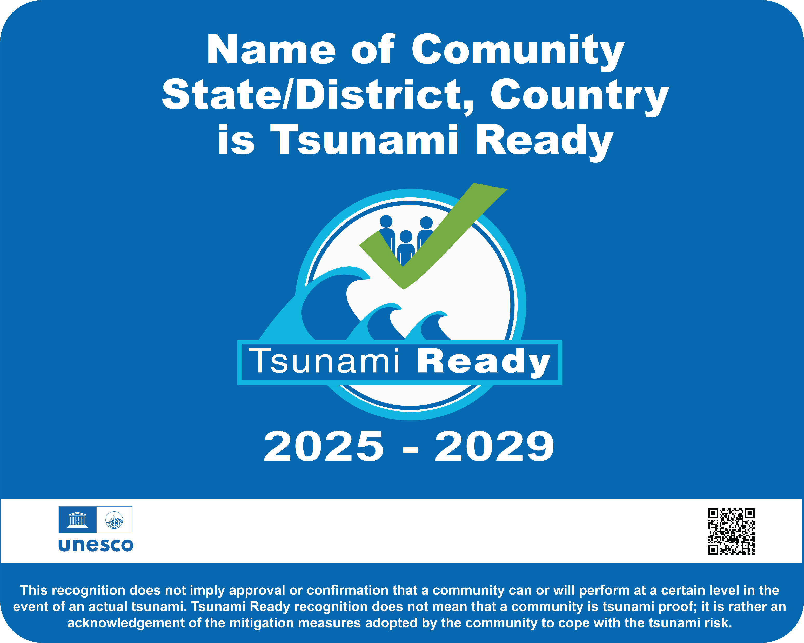
TR Signage format and sizes
60 cm
60 cm
75 cm
75 Cm
60 cm
Vertical
Square
Horizontal

