Slide 1

The Intergovernmental Coordination Group for the Tsunami and Other Coastal Hazards Warning System for the Caribbean and Adjacent Regions (ICG/CARIBE-EWS)
XIX Session
April 22-24, 2026
4.2 WG2: Working Group 2: Tsunami Detection, Analysis and Forecasting
Progress Report and Recommendations

Slide 2
Tasks of the Group: General
Support the operations of a fully interoperable regional tsunami warning system.
Support and integrate the work of the subgroups.
Present a progress report based on the Key Performance Indicators related to the UN ODTP.
Establish strategies to enhance the warning system by including the detection, analysis and forecasting of other coastal hazards.
Promote the sharing of experience and expertise, and capacity building essential to effective tsunami source characterization, detection and forecasting.

Slide 3
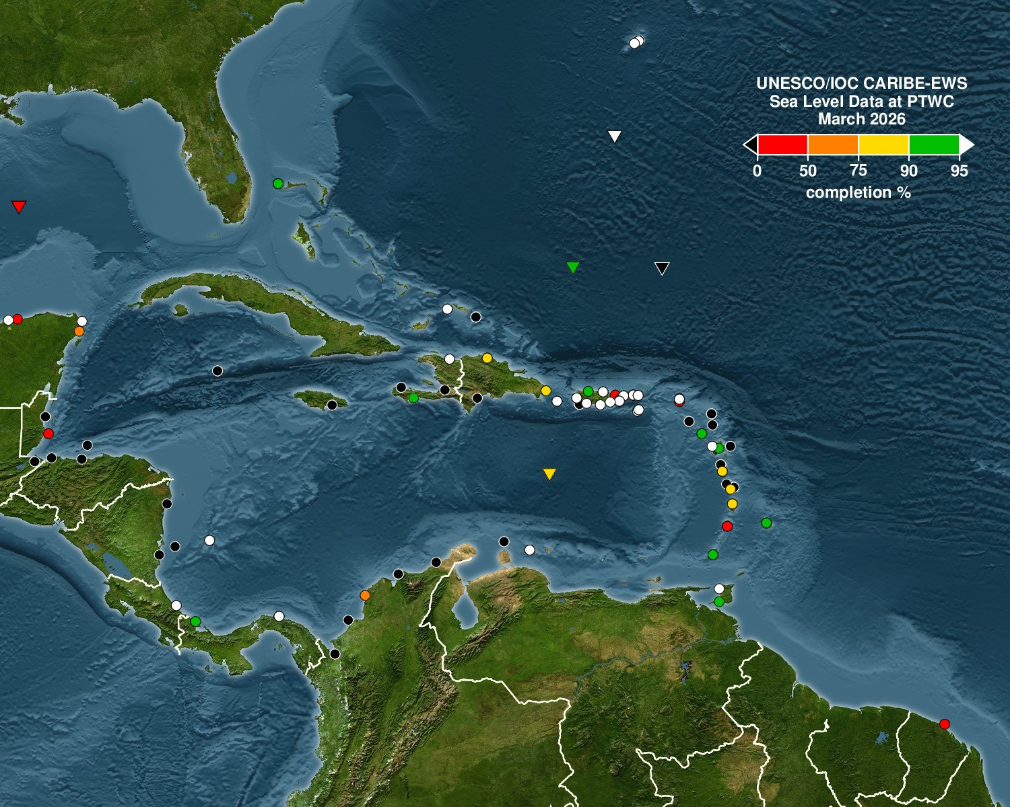
Current Sea Level Status: March 2026
Note Gaps in coverage especially in NW and Southern Caribe
Highlights need for sea level station maintanence and capacity building in the region

Slide 4
Sea Level Training: Barbados Nov 2025
Theoretical and Practical training
Field trip to a local station for training
Classroom lectures
Classroom Exercises
24 students and 4 in-person instructors
Certificates presented to participants upon course completion
Student to teacher ratio critical for successful trainings

Slide 5
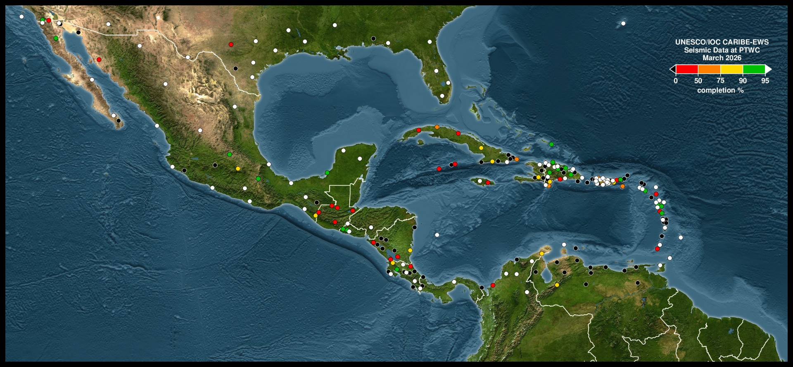
Seismic Station Status: March 2026

Slide 6
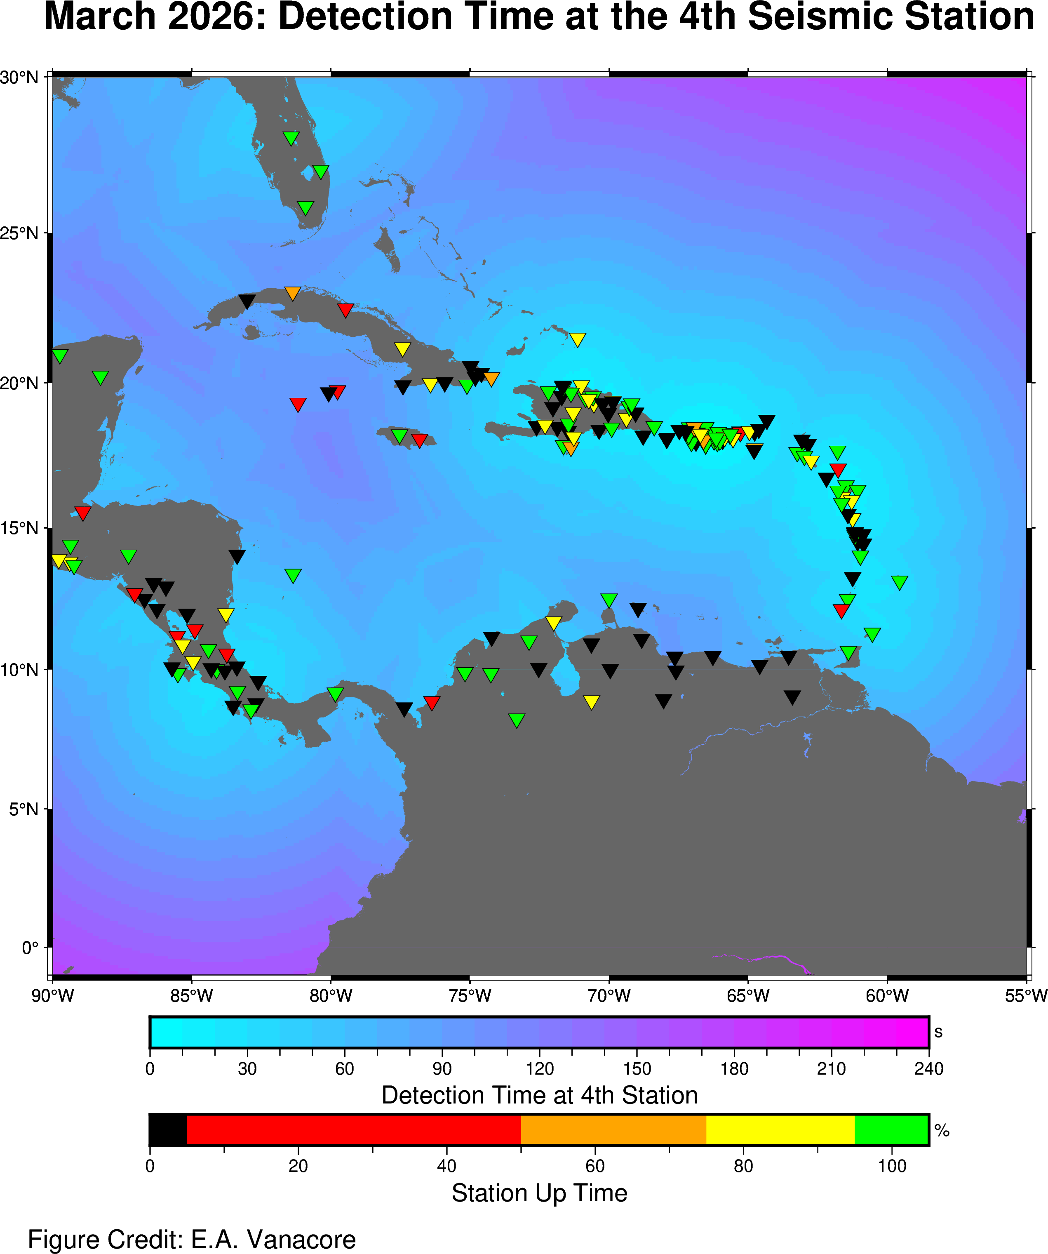
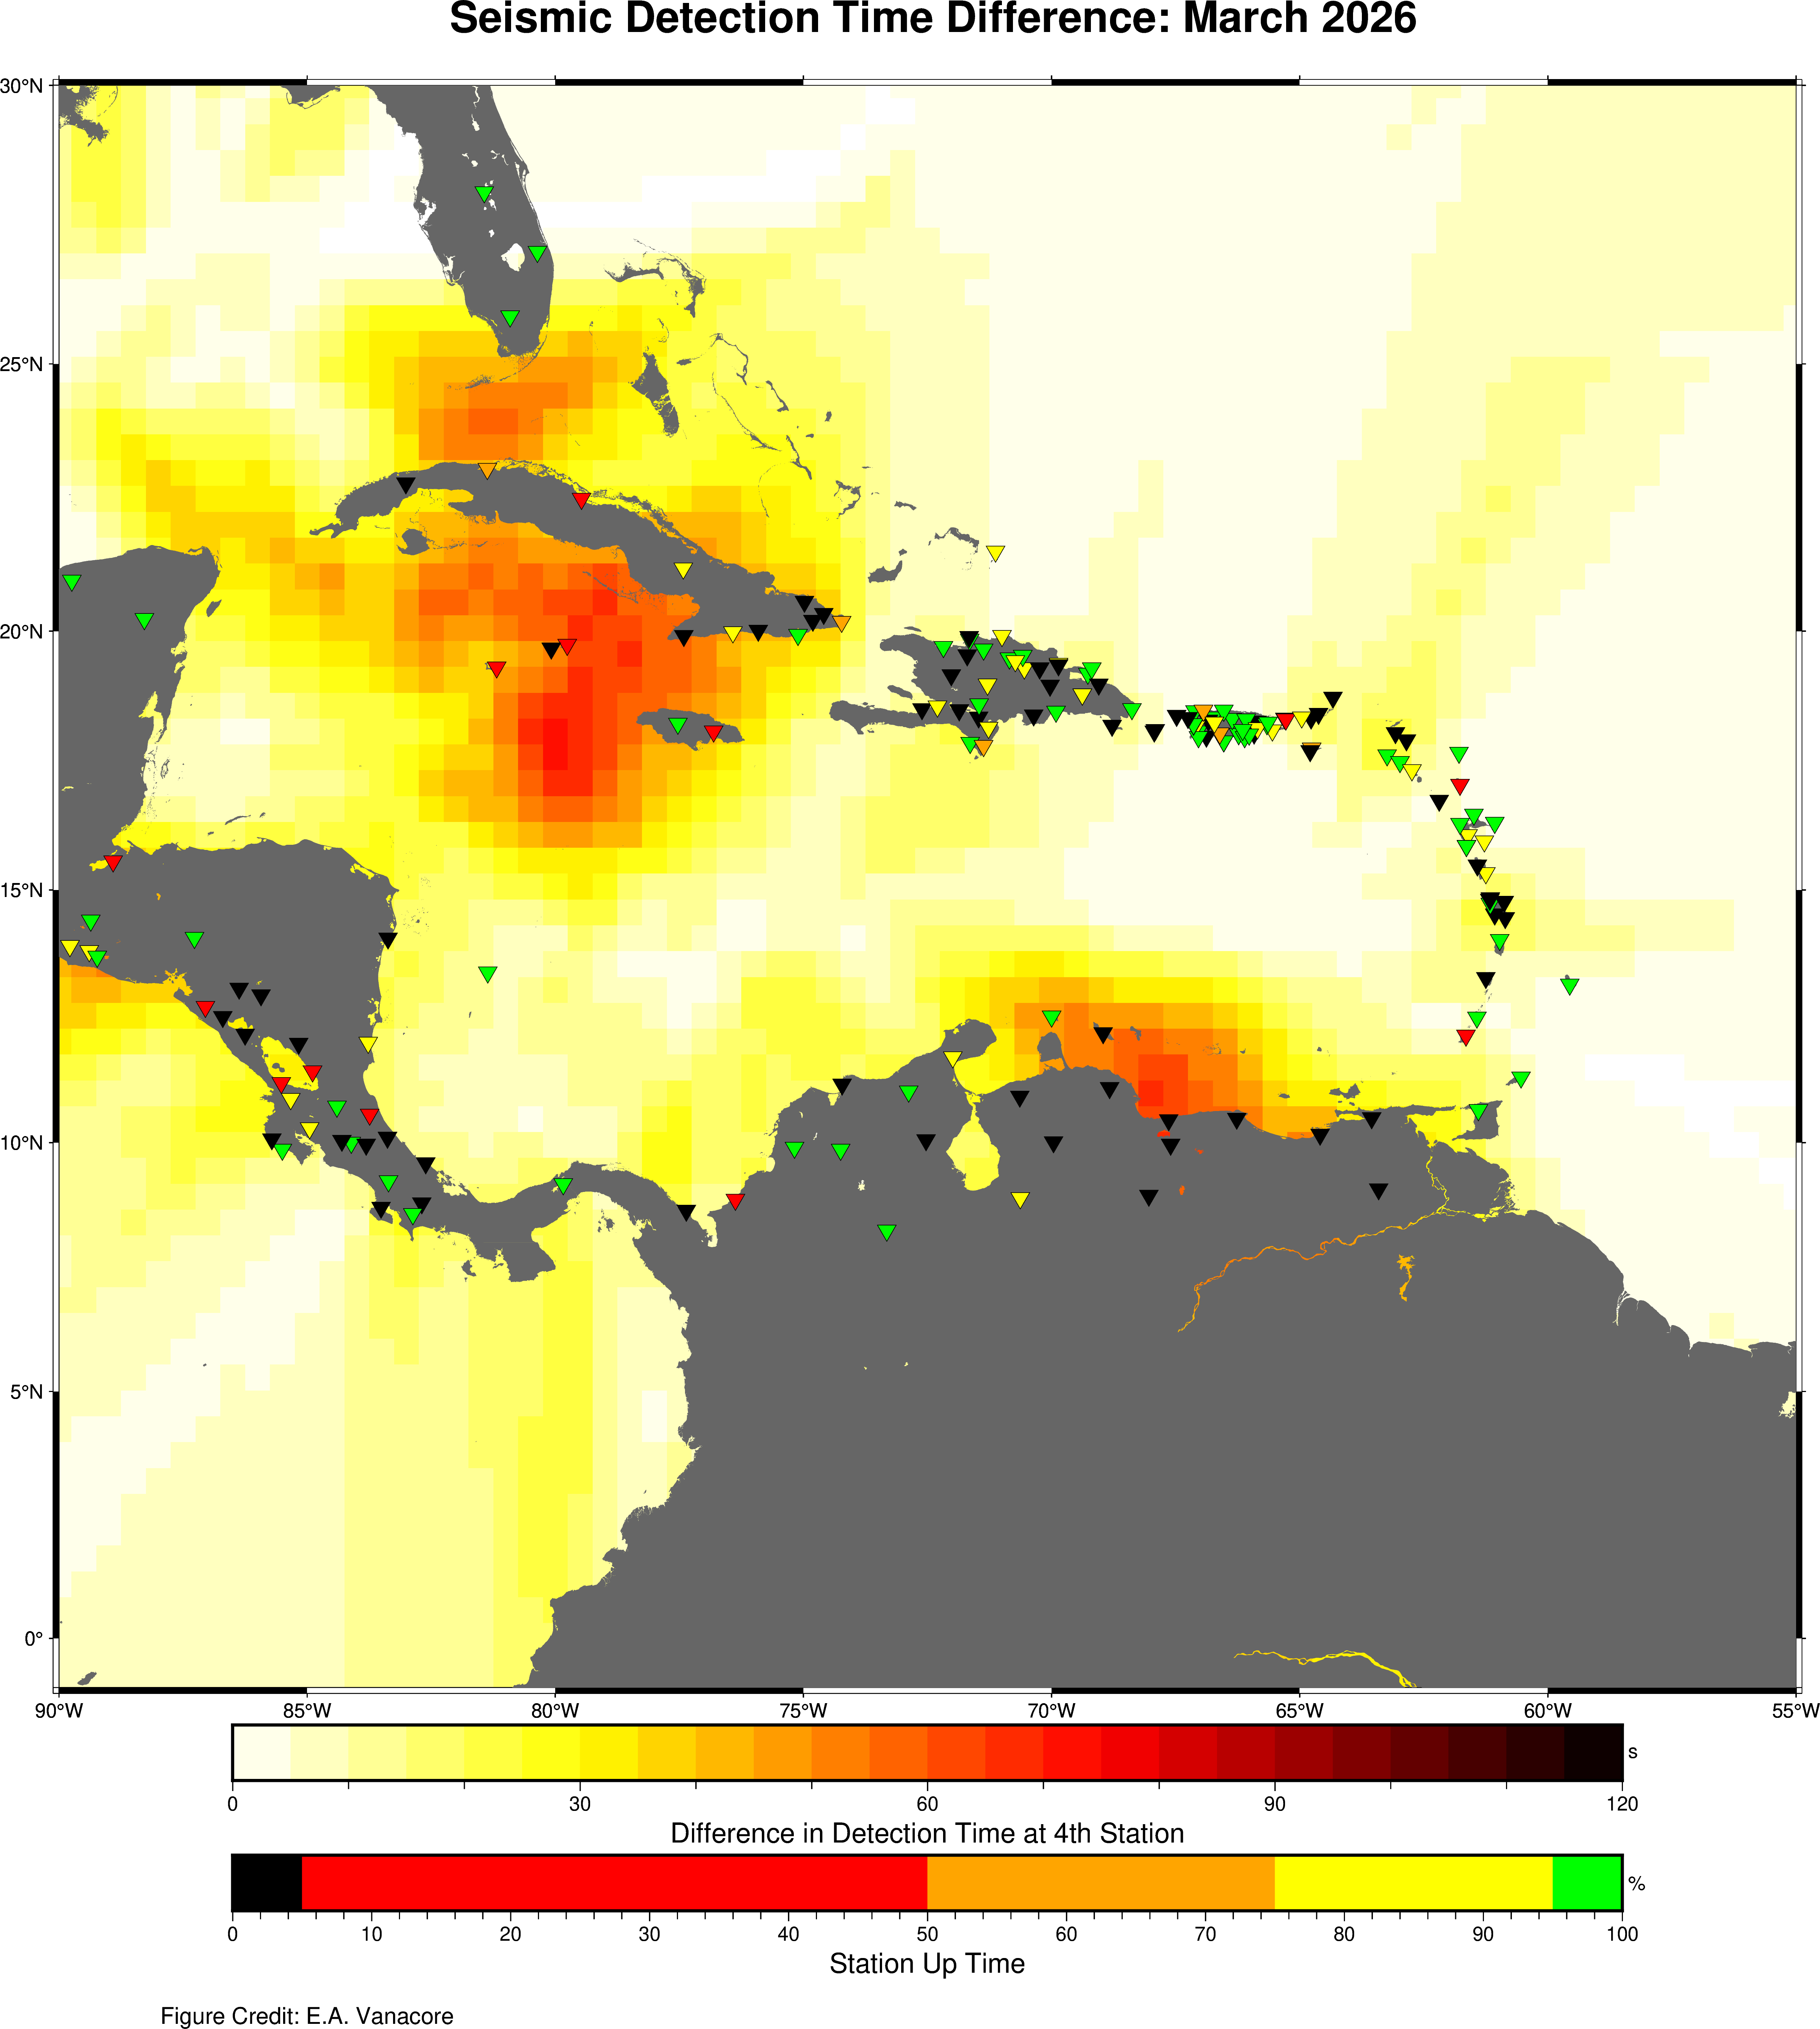
Detection Time Maps: Seismic
-60s
-60s

Slide 7
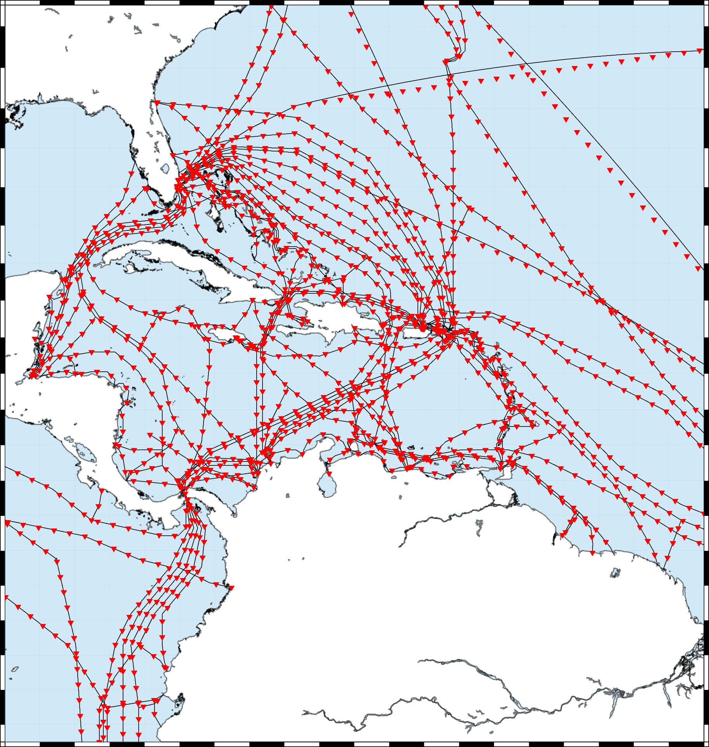
Smart Cables
Engagement with SMART JTF Caribe-EWS participant in Regional Coordination Group 1st Goal raise awareness and support beyond the tsunami community

Slide 8
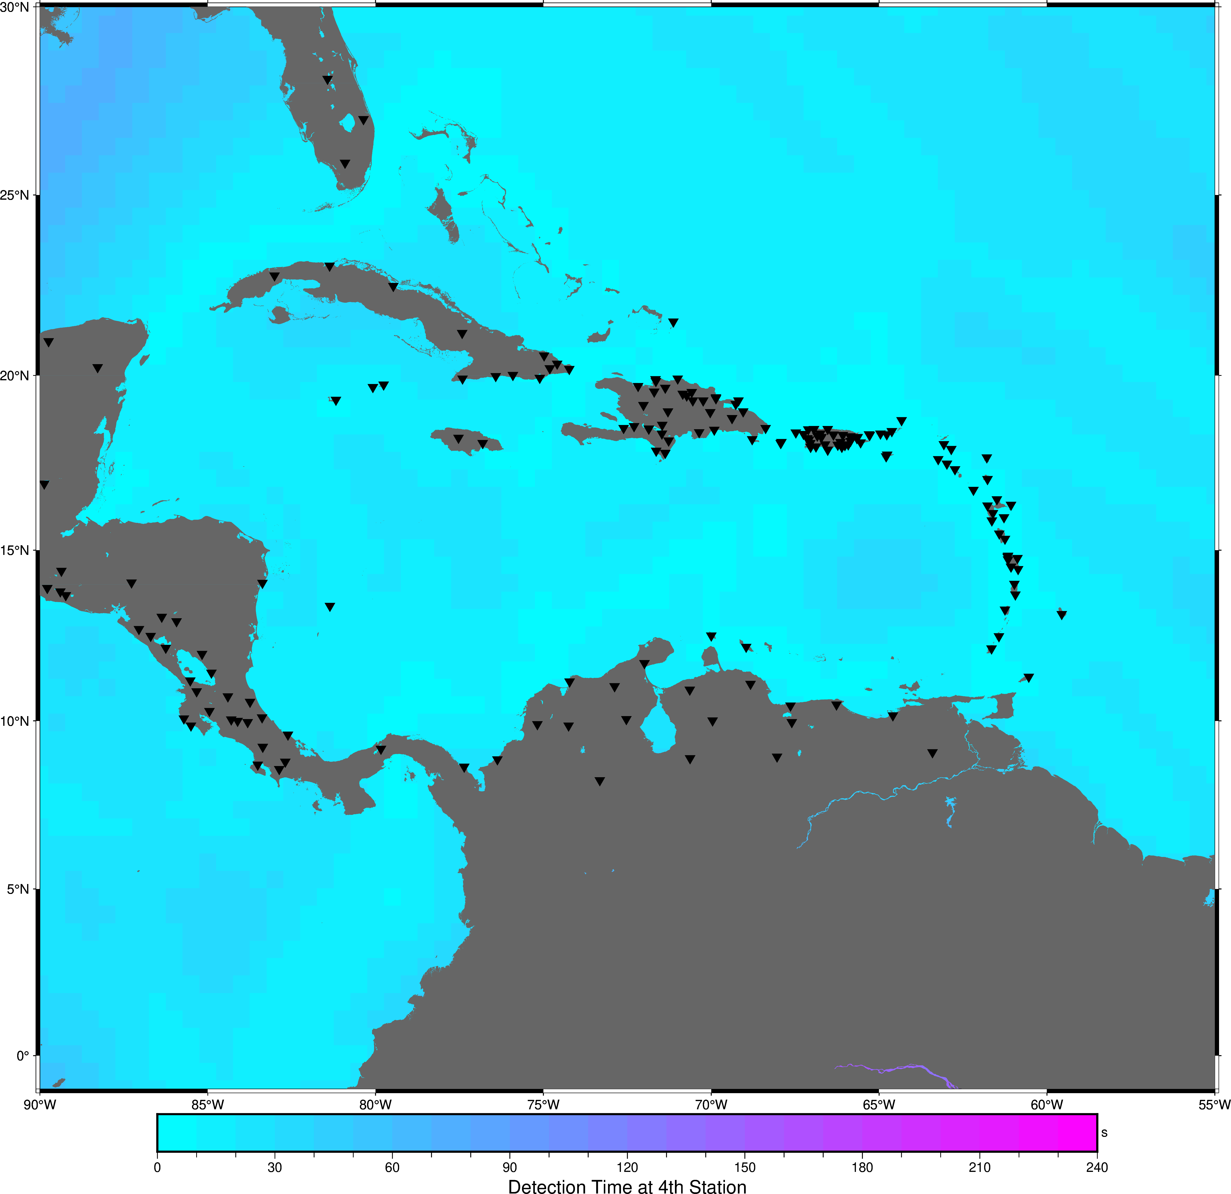
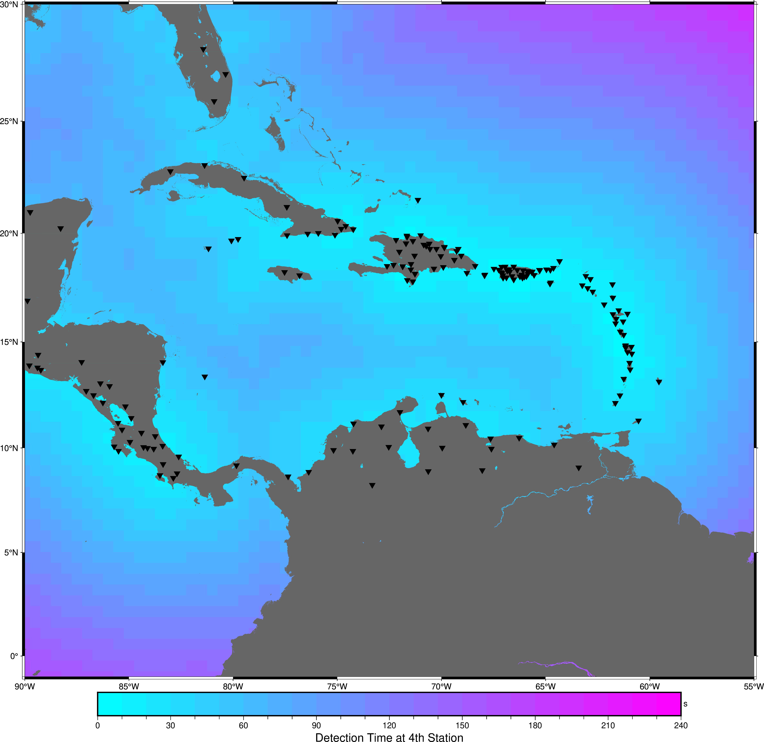
Smart Cables
If All Cables Were Smart
All Seismic: Best Case Current

Slide 9
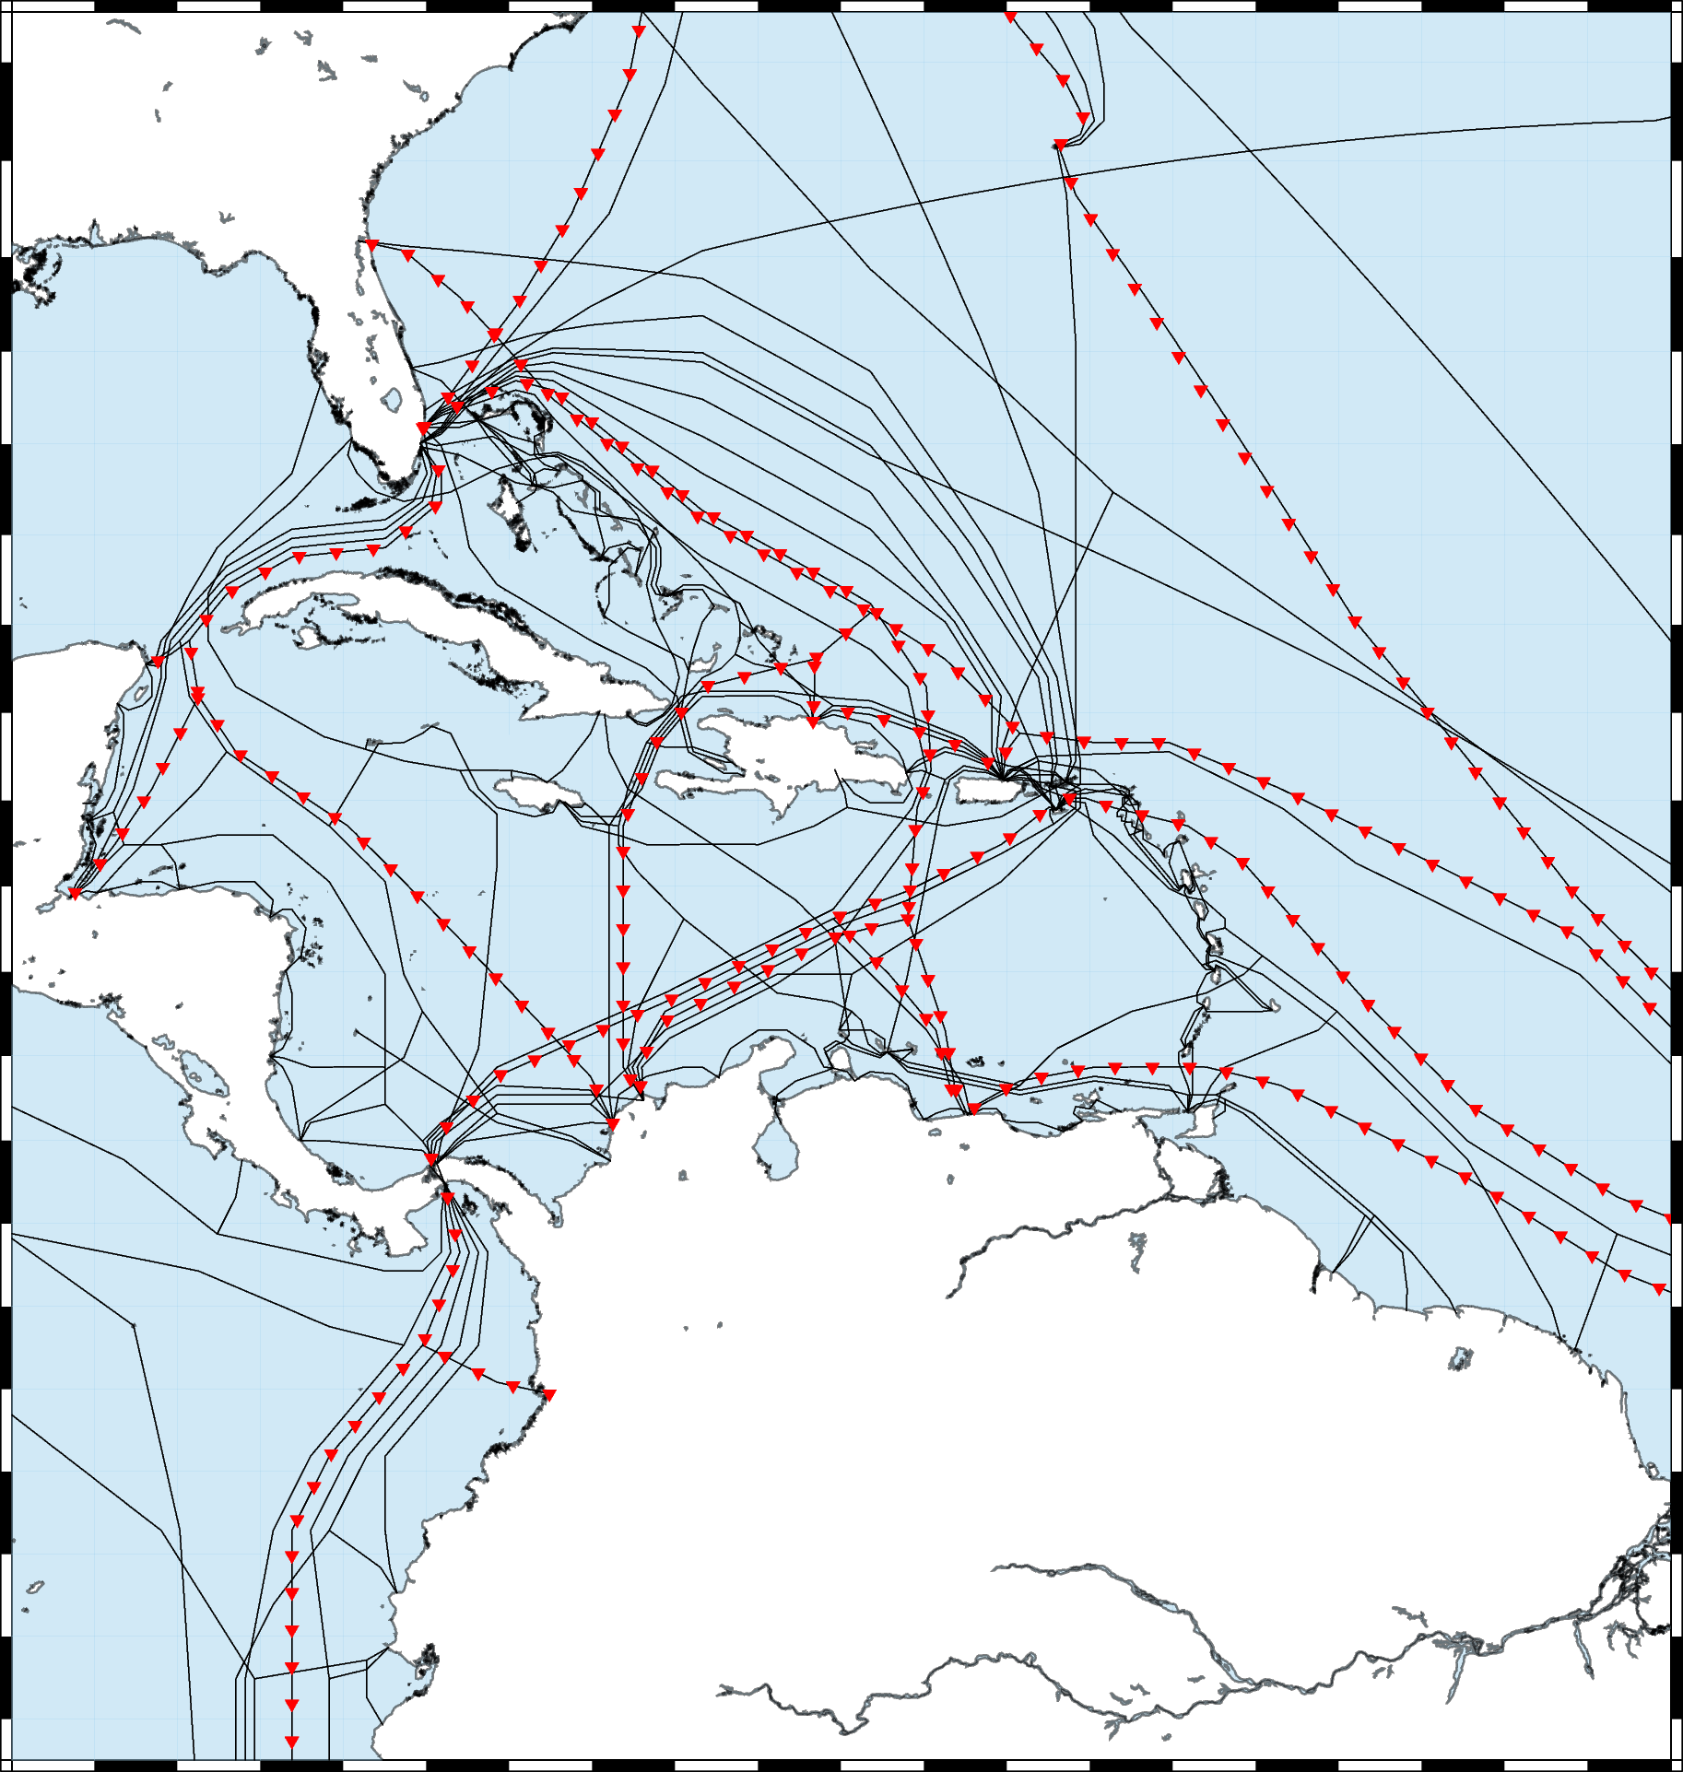
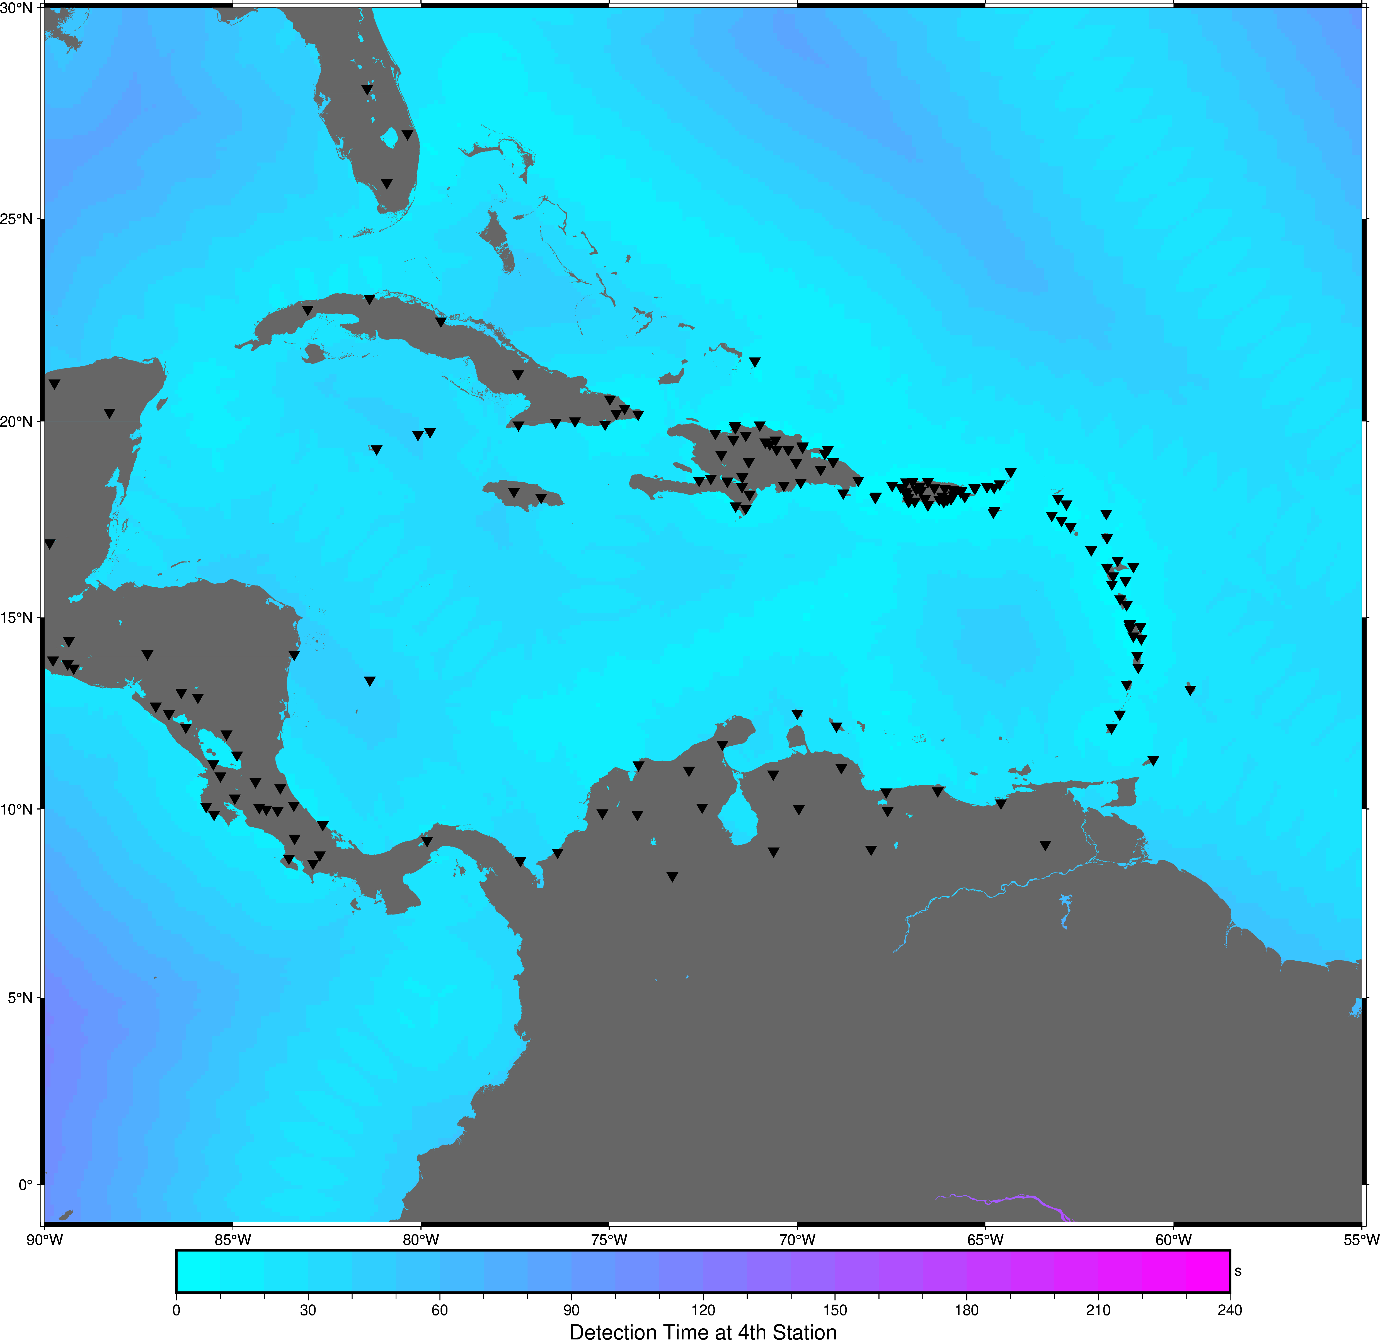
An Example with Less Cables

Slide 10

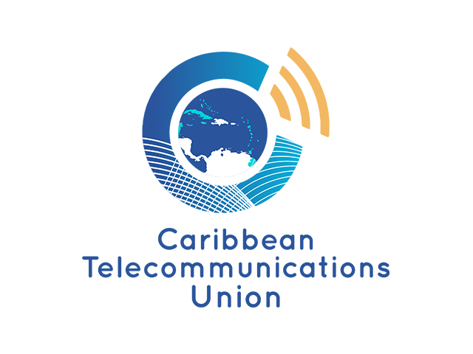
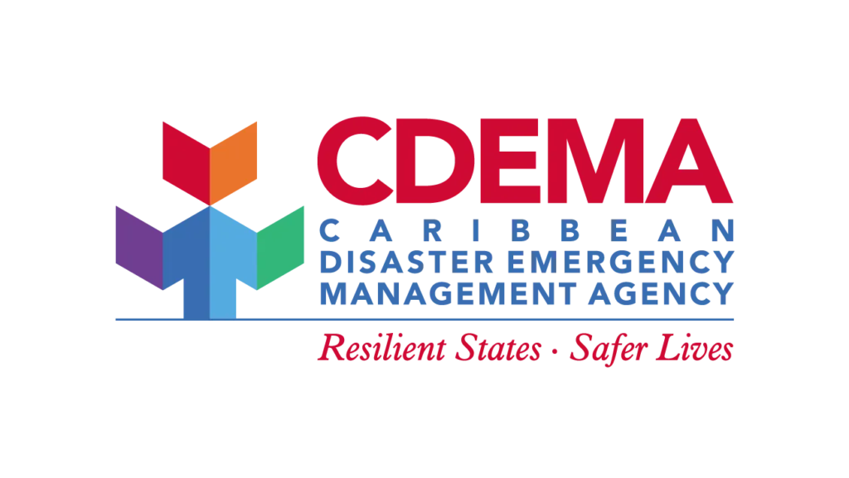

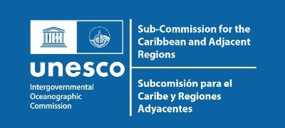

SMART Webinar: Save the Date
1st Targeted webinar: May 21

Slide 11
Draft Recommendations for ICG/CARIBE EWS XIX
Notes and appreciates the member States role of network operators in the region for the installation, maintenance, and data transmission from seismic, sea level and GNSS stations in the region
Appreciates the NOAA ITIC-CAR, PTWC and Earthscope for improving the automated processing and continued reporting on the status of seismic and sea level stations;

Slide 12
Draft Recommendations for ICG/CARIBE EWS XIX
Notes that a high percentage of the stations in the CARIBE-EWS sea level network are currently non-operational and therefore can delay the proper assessment of tsunami events and the issuance of timely and accurate tsunami alerts;
Urges Member States and operators of sea level stations contributing to CARIBE EWS to maintain their sea-level stations in an operational status and regularly review and update the status of its stations, in the IOC Sea Level Monitoring Facility, and inform ITIC-CAR and Secretariat on plans for repair;

Slide 13
Draft Recommendations for ICG/CARIBE EWS XIX
Appreciates the work of the UN Ocean Decade on smart cables and efforts to quantify the impact of SMART cables on regional detection of tsunamigenic events and;
Recognizing that SMART cable technology potentially impact ocean observations beyond tsunami hazard;
Recommends Caribe-EWS participation in a Caribbean working group including stakeholders from other ocean observatories and interests to specifically address the implementation of such technology in the Caribe-EWS and formalize relationships between the Caribe-EWS and the ITU/WMO/UNESCO-IOC Joint Task Force (JTF) on SMART Cables.
Further Encourages Member States to incorporate SMART capability into new subsea telecom cable projects.

Slide 14
Draft Recommendations for ICG/CARIBE EWS XIX
Recognizing and Appreciating the success of the English Language sea level training in Barbados and;
Appreciating the efforts of the NOAA, IHO, NOC, and the secretariat to secure support for an English sea level training and;
Appreciating the efforts of English sea level training organizing committee and regional partners in the planning and organization of such a training.
Recommends that WG2 organize a Spanish language sea level station workshop with the support of NOAA, IHO, IMO, and the secretariat in 2027.

