Slide 1

WMO Report
ICG/CARIBE-EWS XIX)
Rodney Martínez
WMO Representative for North America, Central America, and the Caribbean
6 November 2025

Slide 2
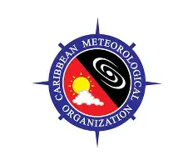
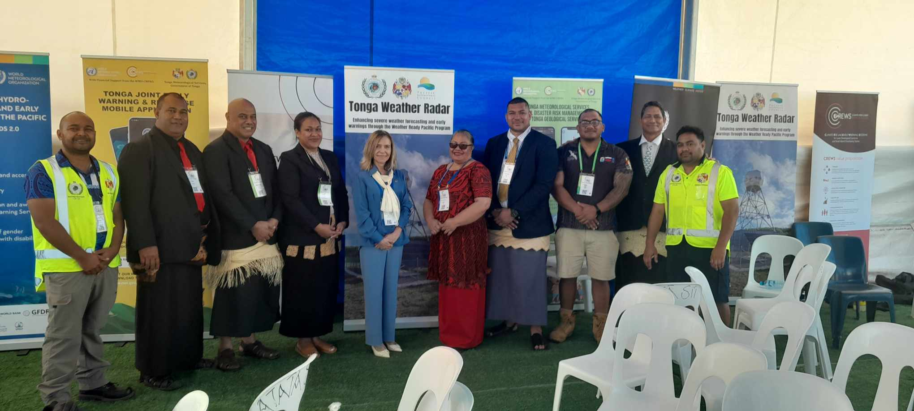

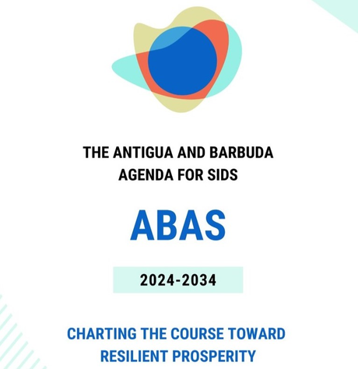

WMO ↔ Caribbean Met. Org. (CMO)
WMO collaborates closely with CMO to strengthen forecasting capacity, observation systems, and early warning services across the Caribbean.
WMO RA IV Hurricane Committee
WMO ↔ Weather Ready Pacific
Weather Ready Pacific is a regional investment programme to strengthen meteorological services and resilience across Pacific Island countries.
Developed with the support of WMO, SPREP, and the Australian Bureau of Meteorology.
Supporting Regional Agendas Through Global Coordination
ABAS (Antigua & Barbuda agenda for SIDS) and related initiatives
These connect with WMO through:
Early Warnings for All initiative
CREWS (Climate Risk and Early Warning Systems)
SOFF (Systematic Observations Financing Facility)
WMO supports and amplifies national and regional priorities rather than creating parallel agendas.
We engage where these priorities align with WMO’s core mandate
WMO ↔ Economic and Social Commission for Asia and the Pacific (ESCAP)
WMO works jointly with ESCAP to run intergovernmental platforms such as the ESCAP/WMO Typhoon Committee.
These mechanisms coordinate meteorological, hydrological, and disaster risk reduction activities.

Slide 3
Regional Association IV
Regional Association V
Barbados
Caribbean Institute for Meteorology and Hydrology (CIMH)
Indonesia
- Agency for Meteorology, Climatology and Geophysics (BMKG), recognized in 2012.
- Center for Competency Development on Water Resources, Human Settlements and Strategic Infrastructure (CWRSCD)
These centers cover meteorology education at BSc, MSc, and PhD levels, BIP-M and BIP-MT programmes, hydrology technician training, aeronautical meteorology, and specialized short courses.
These training activities included BIP-M and BIP-MT programmes, hydrology training, postgraduate education in meteorology, as well as specialized short- and medium-term professional courses.
Costa Rica
-Instituto MeteorológicoNacional (IMN)
-University of Costa Rica (UCR), recognized in 1968
Philippines
- Philippine Atmospheric, Geophysical and Astronomical Services Administration
- University of the Philippines (UP), recognized in 1984
Fiji
Currently under consideration as a candidate RTC
Regions | Participants | Courses
RA IV | 1,646 | 67
RA V | 11,650 | 211

Slide 4
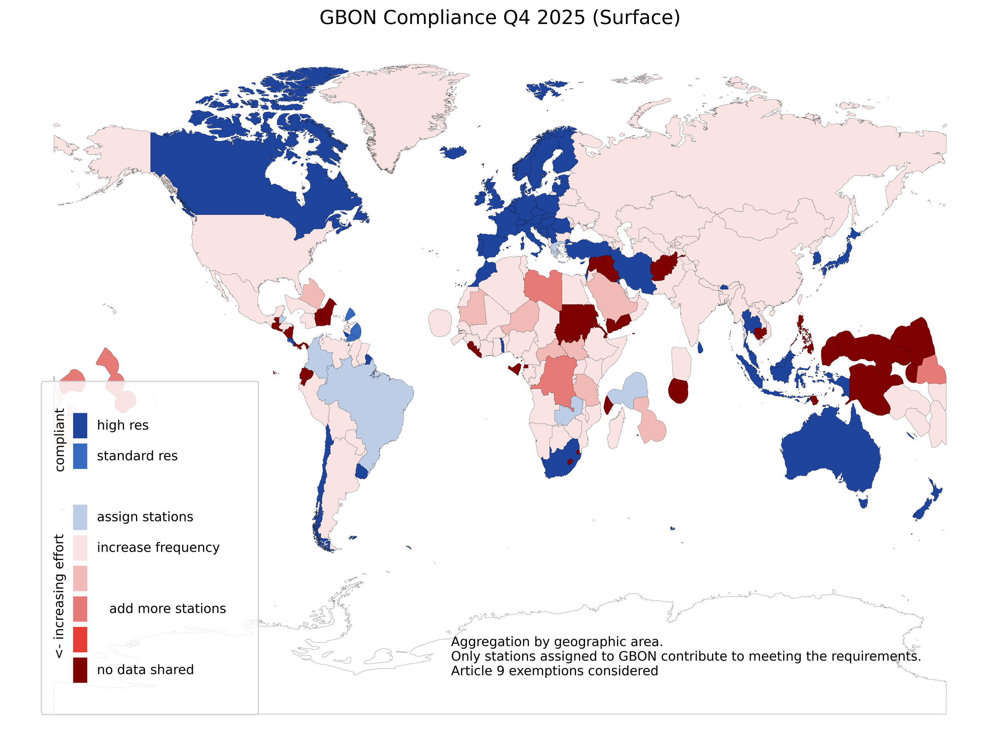
Global Basic Observing Network

Slide 5
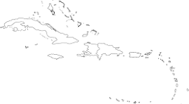
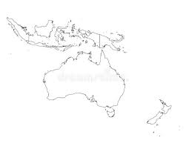
WMO Projects │ Overview
WMO Portfolio│Global
Active Projects Caribbean (RA IV)
CHF 7.4 M
national, regional & global projects implemented by WMO
65
Active Projects
Incl.
Technical Assistance Services
Active Projects Pacific (RA V)
CHF 130 M
Project Volume
implemented by WMO
(March 2026)
CHF 12.5 M
national, regional & global projects implemented by WMO
Notes:
CREWS Scale Up Inclusive Early Warning and Action in the Pacific (SIEWAP) Project

Slide 6

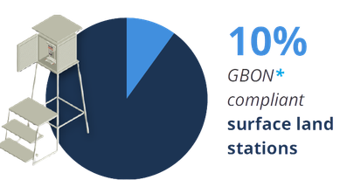
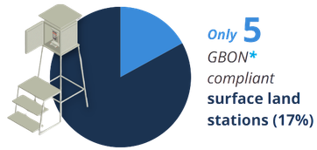


17%
GBON
compliant
surface land
stations
10%
GBON
compliant
surface land
stations
Readiness ongoing: Dominica, Granada, Saint Lucia, St. Vincent and the Grenadines, Trinidad & Tobago
Readiness ongoing; Vanuatu
Readiness completed: Bahamas, Barbados, Jamaica, St. Kitts and Nevis
Readiness completed: Fiji, Marshall Islands, Micronesia, Palau, Papua New Guinea, Tonga, Tuvalu.
USD 9.3 M
Caribbean
Pacific
Investment approved: Cuba, Guyana. Investment ongoing: Belize
USD 7 M
USD 31.8 M
Investment pipeline: Antigua and Barbuda, Dominican Republic, Haiti, Surinam
Investment ongoing; Kiribati, Nauru, Samoa, Solomon Islands
16 countries - 11 completed
12 countries - 11 completed
69%
92%

Slide 7

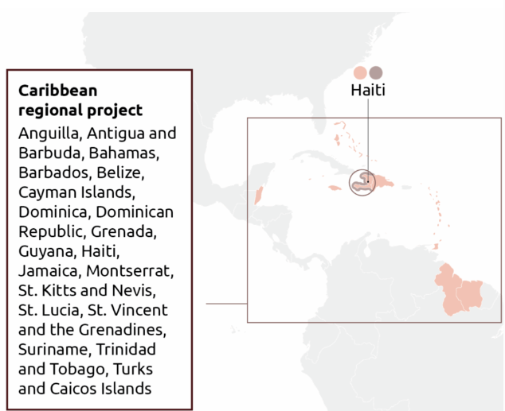
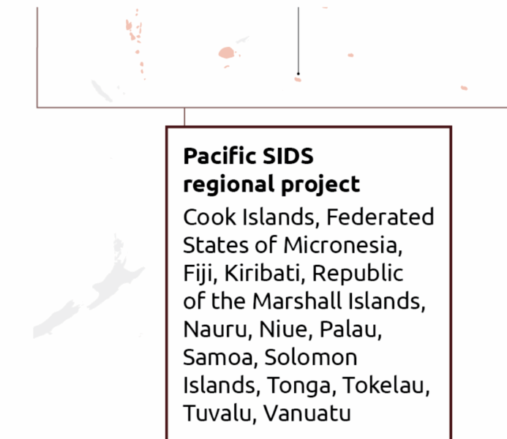
CREWS ensures that early warnings lead to action — mobilizing preparedness, enabling anticipatory humanitarian response, and saving lives. It puts people at the centre.
36
75
134
projects (multi-year country and regional projects, accelerated support window, and global projects)
LDCs and SIDS supported
million USD received or pledged (as of 31 Mar 2024)

Slide 8
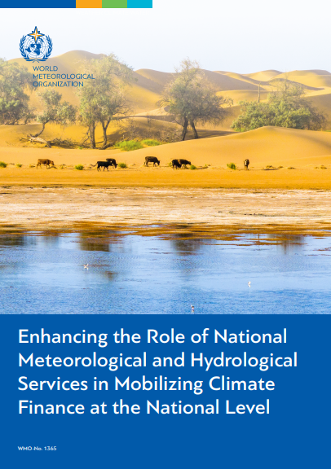
Mobilizing Resources: WMO as a Catalyst
WMO
WMO Commons: shared systems, standards, data
Access to global climate and development funds
WMO enables countries to unlock financing
NMHSs
and
Partners
Initiatives/
Programs
Governments

Slide 9
The WMO Commons: Protecting the Global Systems Every Country Depends On
What it is • Global pooled financing partnership led by WMO • Mobilises and aligns resources to strengthen WMO leadership and demand responsiveness of the global public backbone of weather, climate and water intelligence • Secures trusted data and services as a global public good
What it does • Sustains observing system interoperability, data exchange and prediction capabilities • Safeguards international coordination, standards and policies • Enables global early warning and climate services coverage • Ensures equity and global system coherence
Turning global cooperation into national impact
Why it matters for Members • Supports Members by strengthening the global systems they rely on • Turns fragmented investments into a coherent architecture • Turns global cooperation into national impact
Development & resilience impact • De-risks and helps ensure sustainability of climate and development investments • Enables climate-informed decisions across sectors • Aligns with Paris Agreement, SDGs, Sendai Framework and EW4All

Slide 10

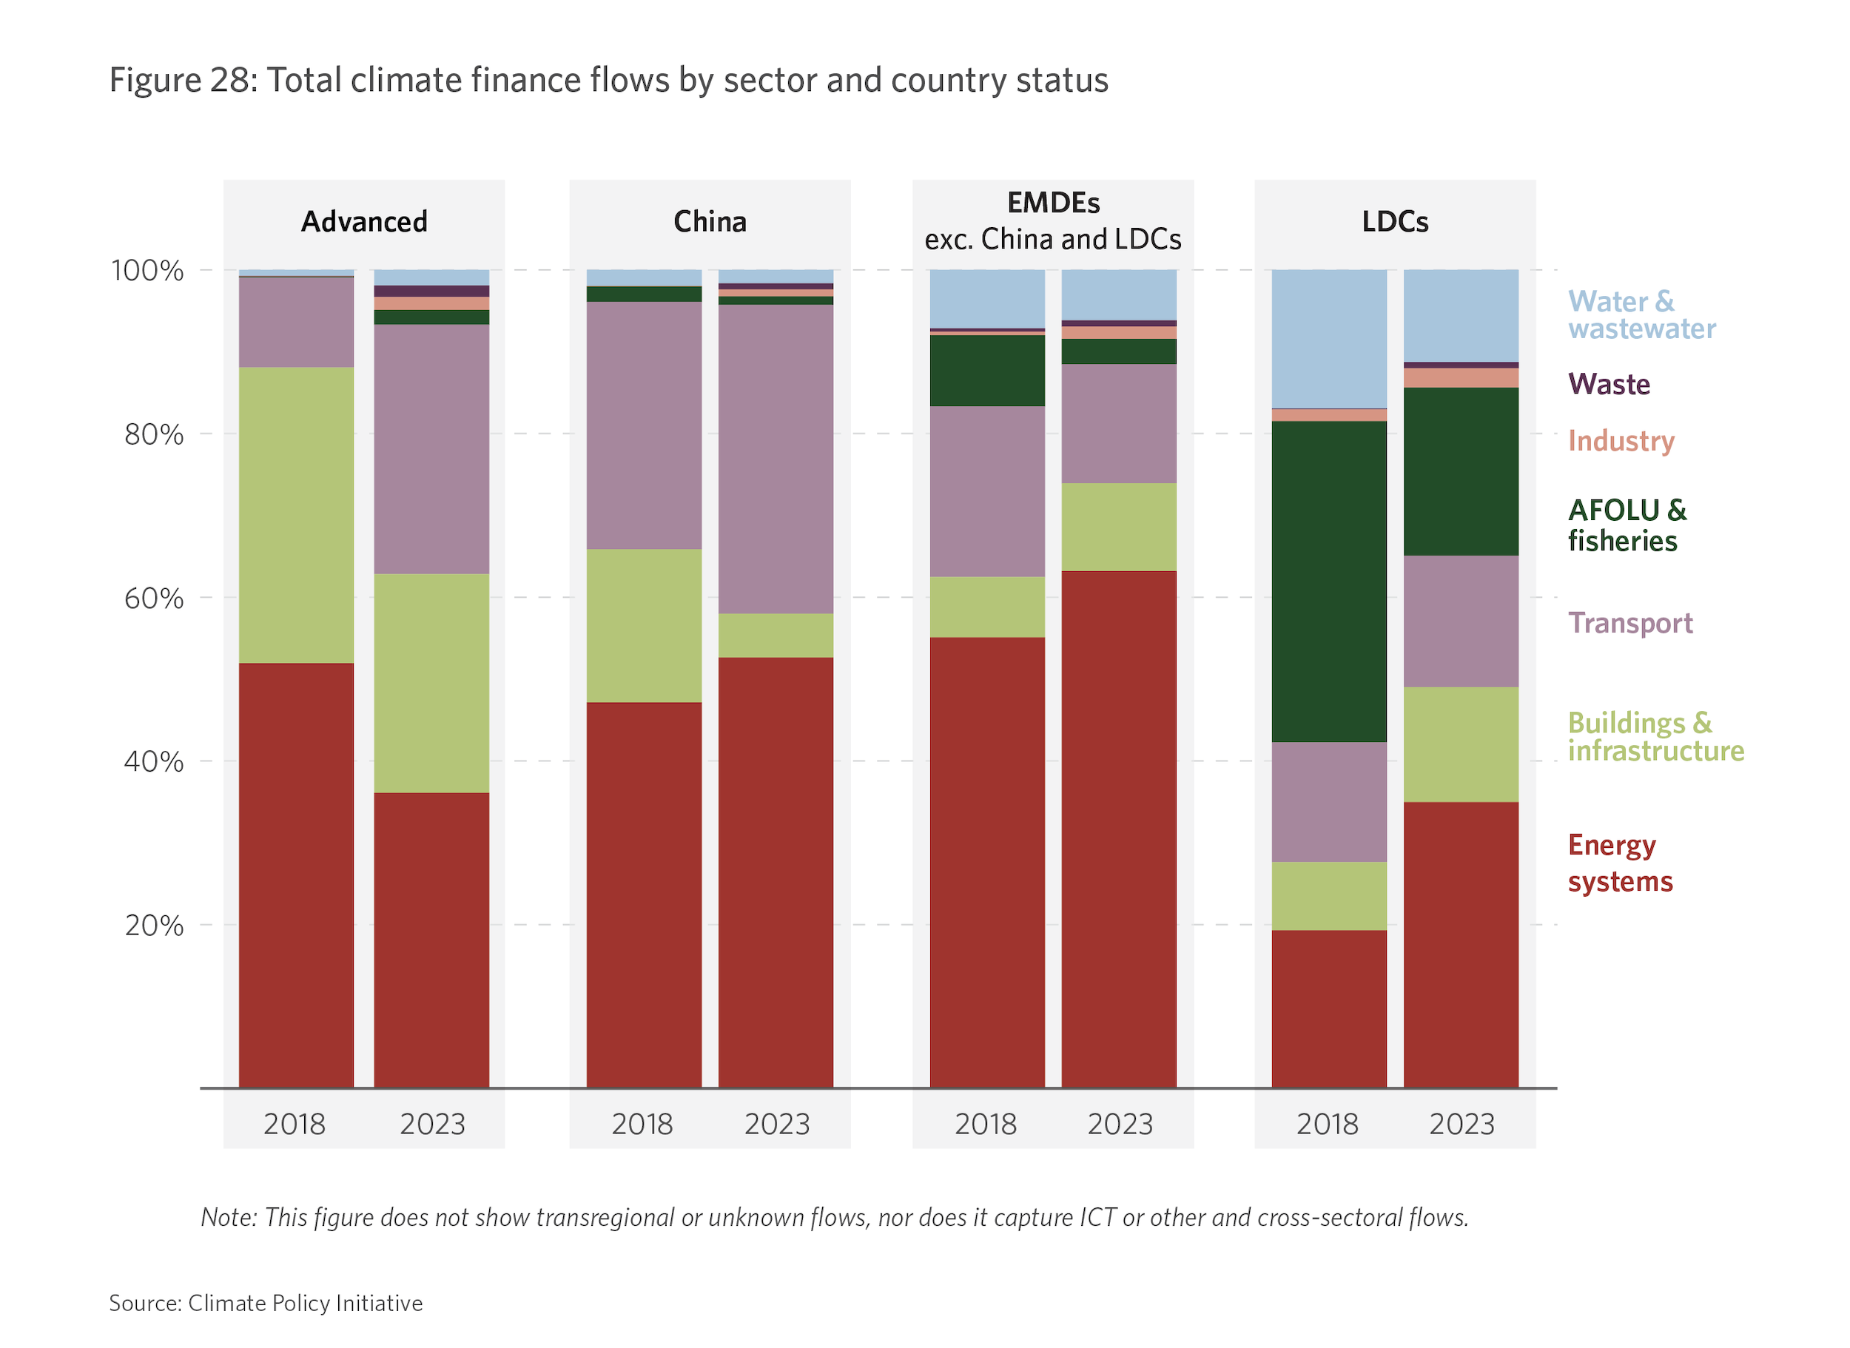
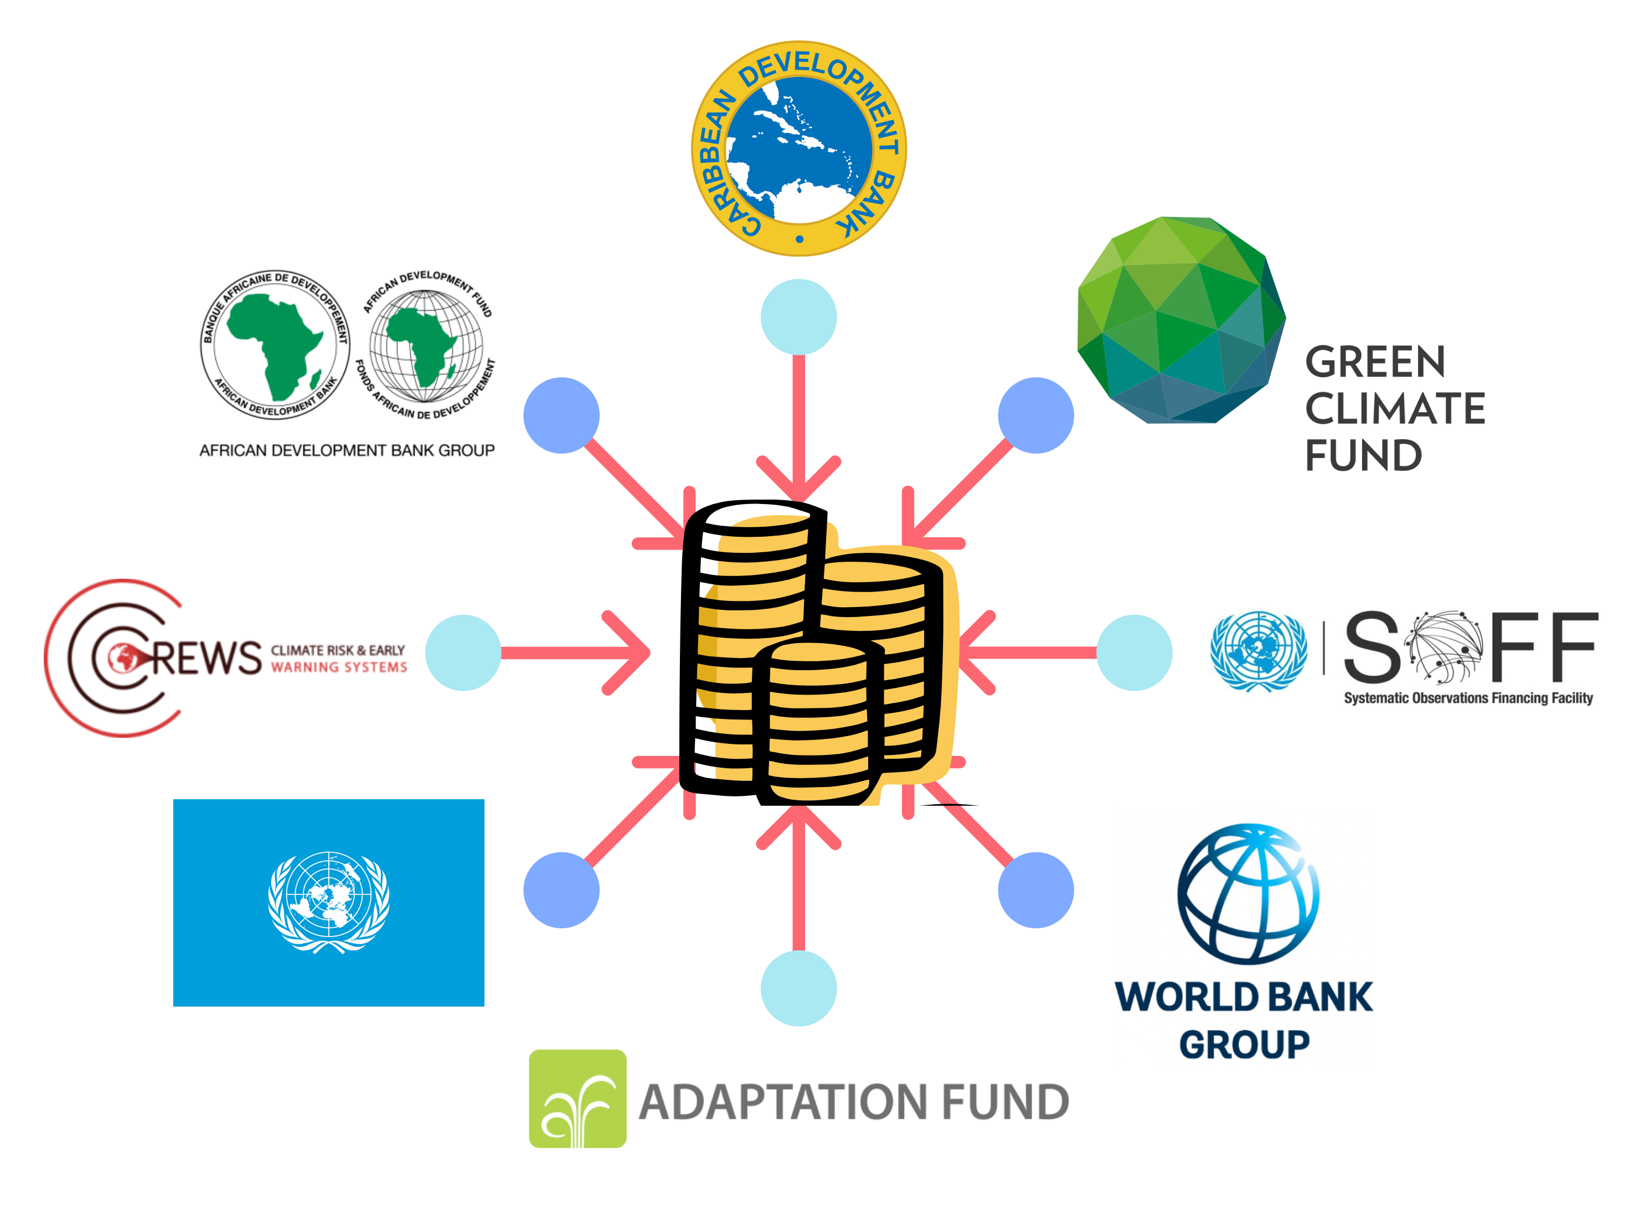

Global Funding Opportunities & How WMO Facilitates Access
A rapidly expanding opportunity
• Climate finance is scaling up with new collective goal of USD 300B/year by 2035 • Adaptation, early warnings, climate services and observations prioritized investment areas • Requires credible science, strong institutions, bankable proposals
NMHSs at the centre of access
• Provide authoritative climate data for: – NDCs & NAPs – Risk-informed investments – Results tracking & reporting • Empowering NMHSs unlocks finance for Members
From climate science → finance → implementation
Where funding comes from
• Multilateral climate funds (e.g. GCF, AF) • MDBs & regional development banks • Early warning mechanisms (CREWS)
Enable LDCs and SIDS to generate and sustain observations from (SOFF)
Bilateral donors & UN partners
How WMO operationalises support
• Engaging in global climate finance dialogues • Publication of Guidance note Enhancing the Role of NMHSs in mobilising Climate Finance • Structured support at: – Global | Regional | National levels • Trainings, proposal co-development, NDA engagement • Self-paced learning module in development

Slide 11
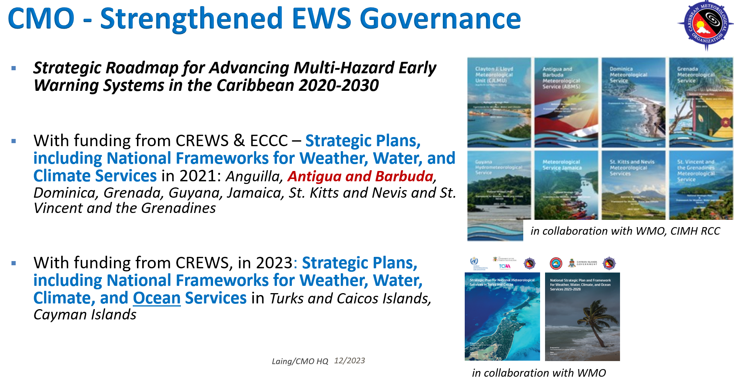

Slide 12
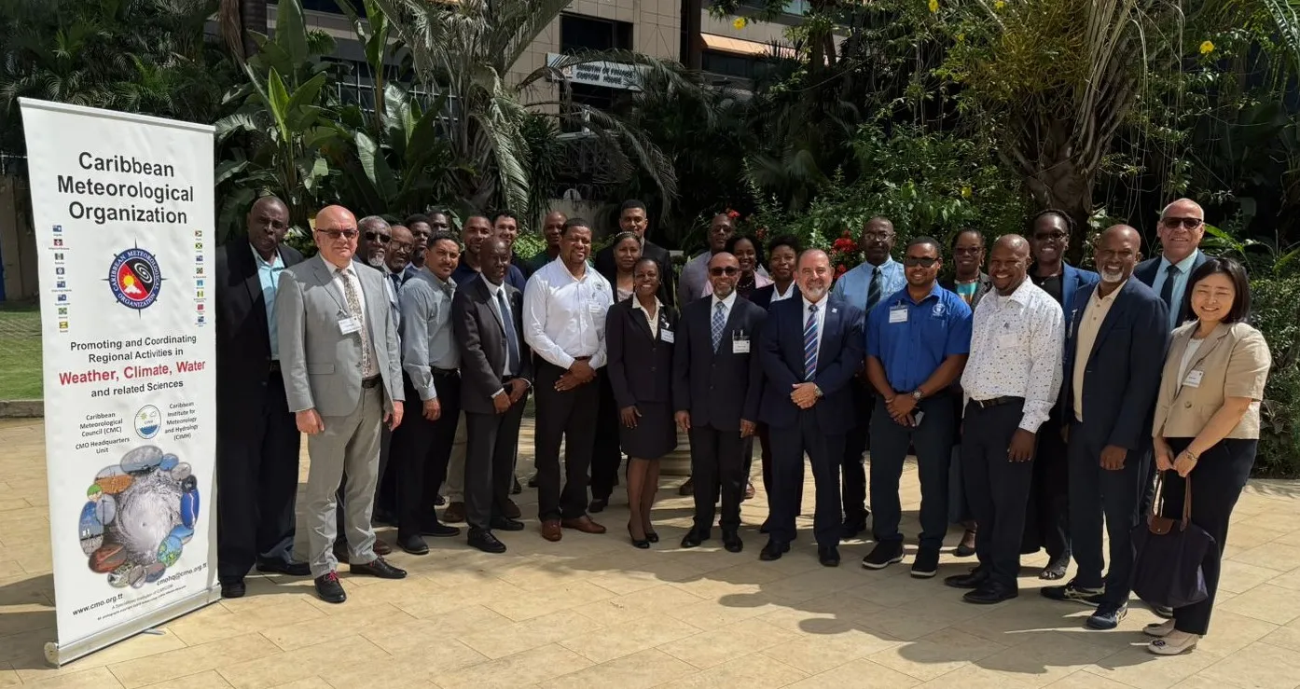
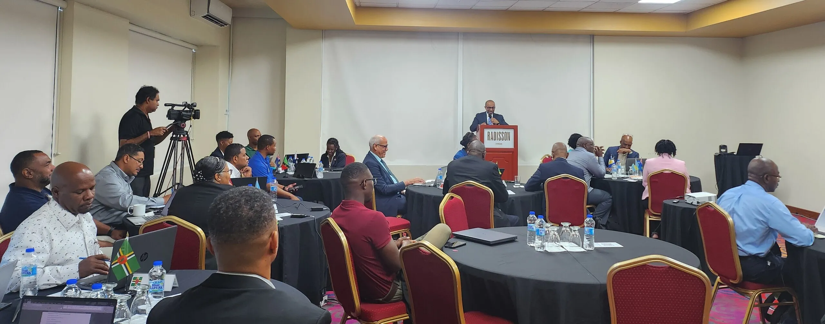
Leadership and Management Course Introduced for Caribbean Members
More than 30 participants including: Permanent Representatives, Hydrological Advisors, and Senior Managers from Caribbean countries.
Port of Spain, Trinidad and Tobago,
December 2025

Slide 13
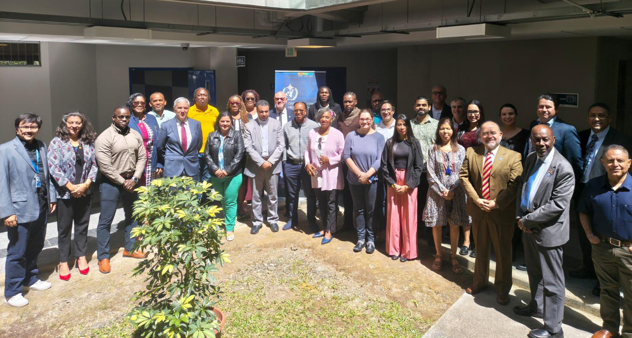
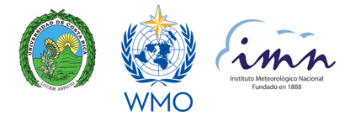
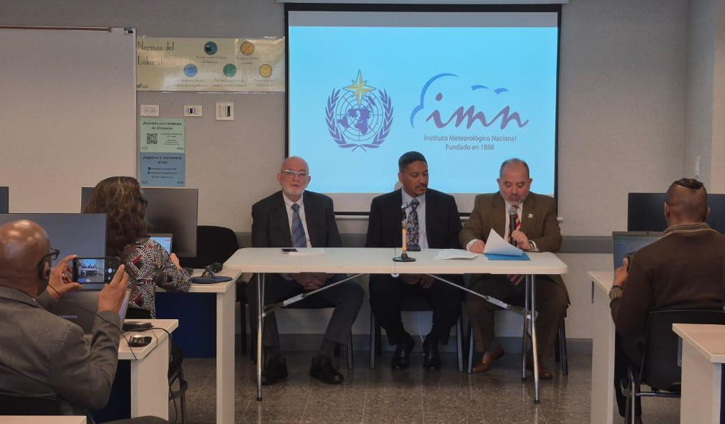
WMO RA IV Training Workshop on Regional WIGOS Centres (RWC) functions and tools
San José, Costa Rica
9-11 February 2026

Slide 14
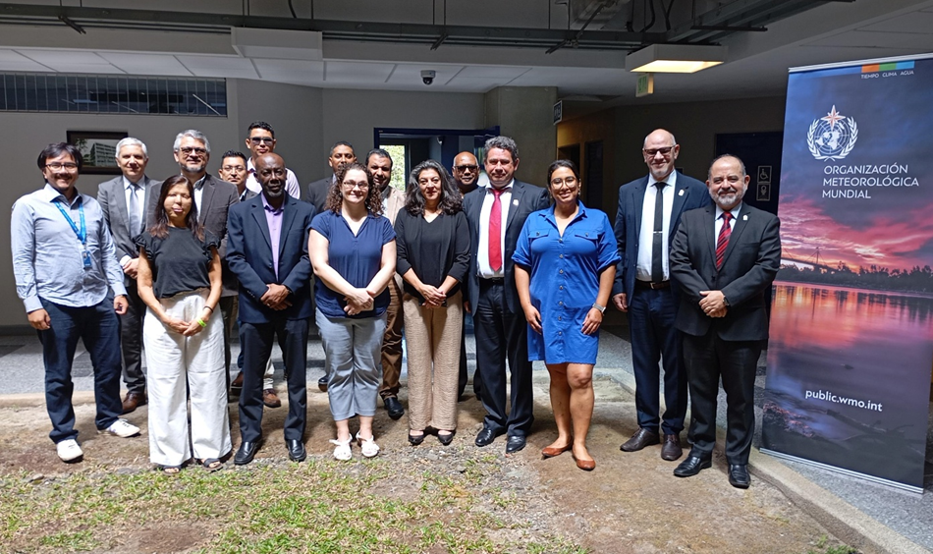
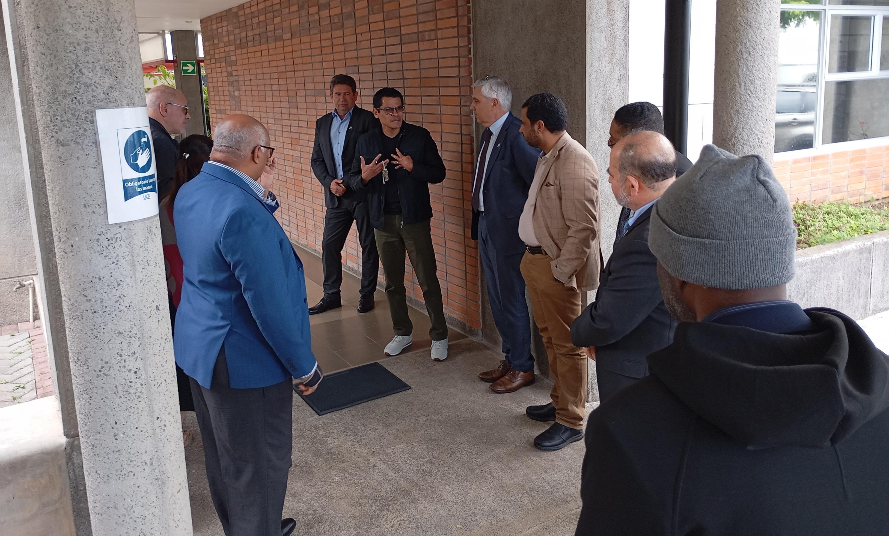
WMO Regional Workshop on RBON design for RA IV
San José, Costa Rica
12-14 February 2026

Slide 15
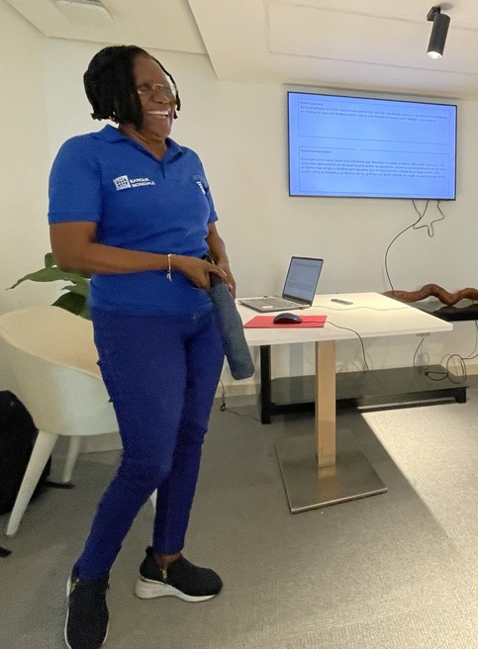
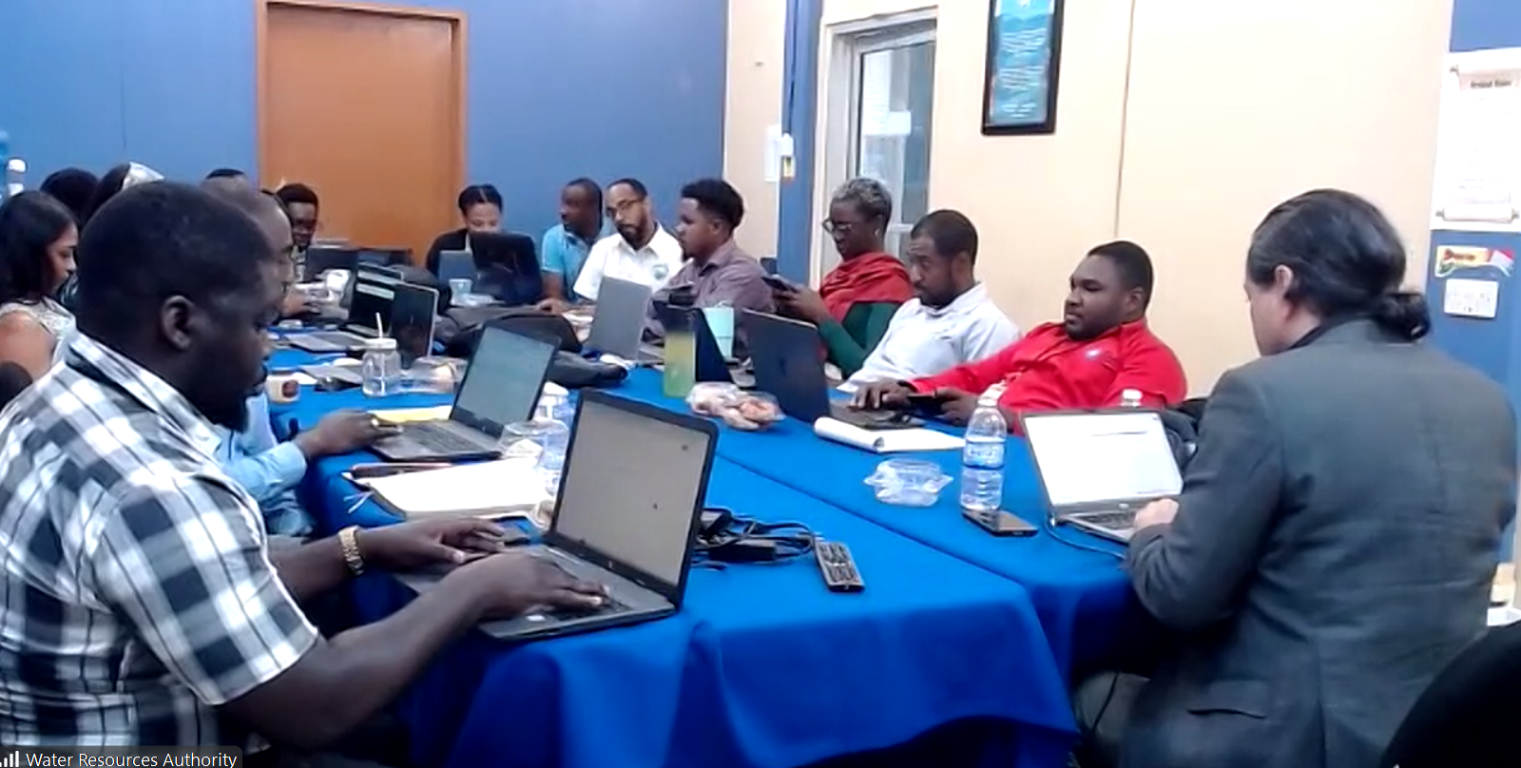
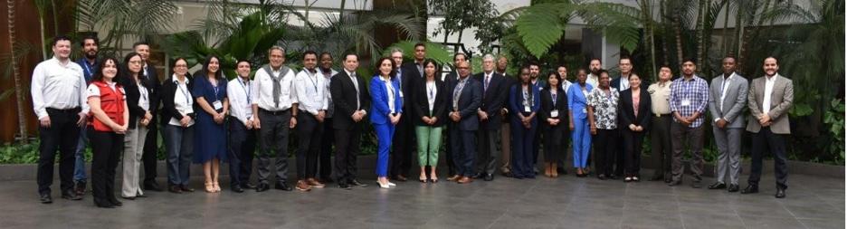
Hydrological activities – SIDS
Hydrological Status and Outlooks Systems in the Caribbean
Follows the HydroSOS Caribbean Implementation Plan, endorsed in Cg-19
Supports capacity development on data management and exchange through WIS/WHOS
Provides global products for hydrological status assessments (such as GEOGLOWS)
Provides participating countries with tools to quantify and visualize streamflow and groundwater, and support decision-making
Financed through CREWS, WMO, and key partners like UKCEH
Early Warning Systems for Floods - SIDS
National Capabilities Assessment were performed for selected countries in the Caribbean, South West Indian Ocean and the Pacific
Flash and urban flood prediction capabilities are to be enhanced during 2026
Directly supports implementation of EW4All in the regions
HydroSOS Workshop in Jamaica, Feb 2026
GEOGLOWS Workshop for
Haiti and Cuba, Dec 2025
EWS-F Planning Meeting for Antigua and Barbuda, Barbados, Guatemala, and Haiti, Jun 2024

Slide 16
RA-IV CENTERS
Regional Training Centers (RTC)
RA-VI CENTERS
Barbados
Indonesia
Caribbean Institute for Meteorology and Hydrology (CIMH)
- Agency for Meteorology, Climatology and Geophysics (BMKG), recognized in 2012.
- Center for Competency Development on Water Resources, Human Settlements and Strategic Infrastructure (CWRSCD)
Costa Rica
-Instituto MeteorológicoNacional (IMN)
-University of Costa Rica (UCR), recognized in 1968
Philippines
- Philippine Atmospheric, Geophysical and Astronomical Services Administration (PAGASA)
- University of the Philippines (UP), recognized in 1984
These centers cover meteorology education at BSc, MSc, and PhD levels, BIP-M and BIP-MT programmes, hydrology technician training, aeronautical meteorology, and specialized short courses.
Fiji
Regions | Participants | Courses
RA IV | 1,646 | 67
RA VI | 11,650 | 211
Currently under consideration as a candidate RTC
These training activities included BIP-M and BIP-MT programmes, hydrology training, postgraduate education in meteorology, as well as specialized short- and medium-term professional courses.

Slide 17
Caribbean │ Upcoming Project Activities
Planned in March - May 2026
Regional: Impact Based Forecasting
Workshop
Belize: Socio-Economic Benefit Analysis
High Level Launch
Major WMO Initiatives
EU ClimSA
CREWS funded
Caribbean 2.0
Haiti
Accelerated Support Window Belize & Cuba
Haiti: National Strategic Plan 2026 to 2028
Launch
Regional: HydroSOS + WHOS /MCH + rating curves & ground water
Trainings
Notes:
9-13 March

Slide 18

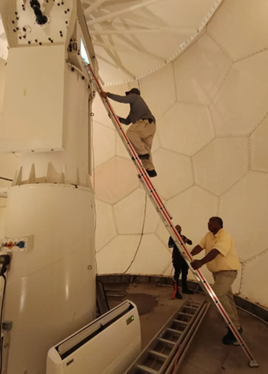
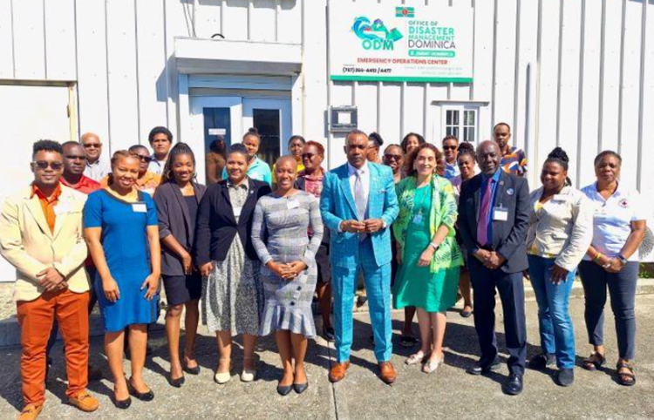

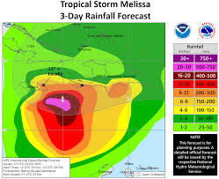
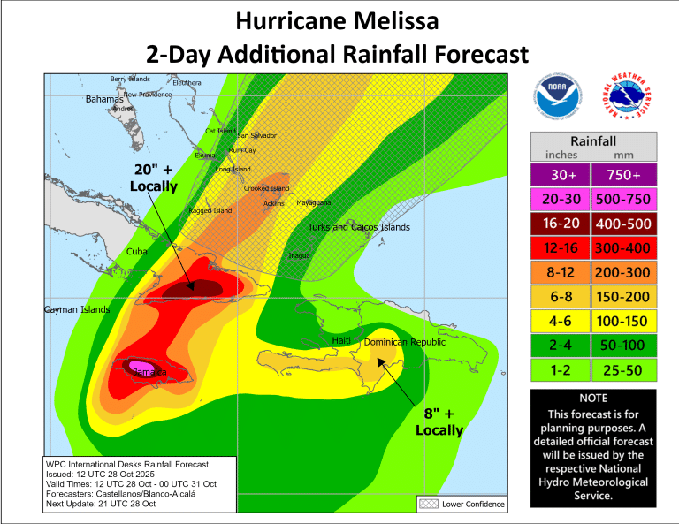
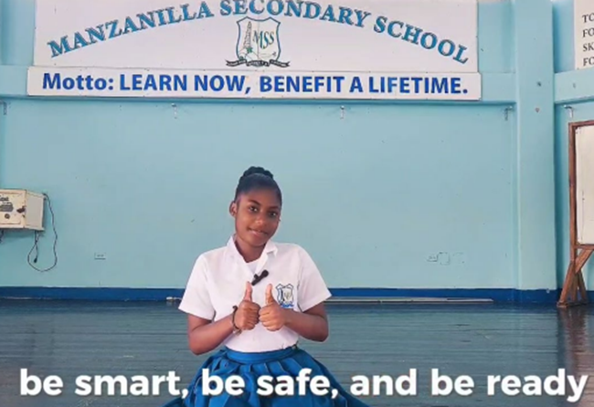
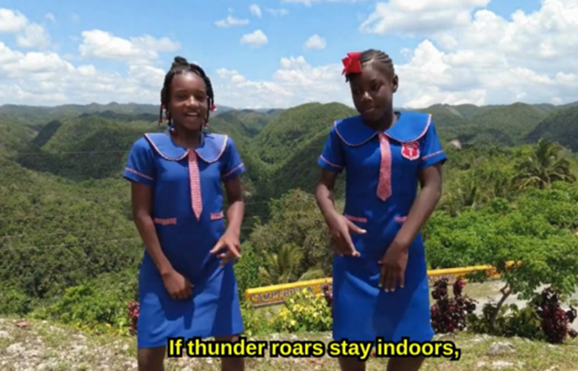
Strengthening Science, Observations & Climate Services
In October 2025, under CREWS Caribbean 2.0, when Belize’s national radar failed at the peak of hurricane season, WMO acted immediately to deploy urgent technical training - safeguarding the country’s early warning capacity when it was needed most.
Science for Informed Decision-Making
Provides robust, policy-relevant evidence
Identifies emerging risks and compounding hazards
Integrates physical sea-level science with social vulnerability analysis
Supports early action before impacts become irreversible
Closing Observation Gaps
Persistent data gaps in vulnerable SIDS limit risk quantification
Need sustained ocean observing system
Strengthen meteorological networks and impact data systems
Improve access to satellite and reanalysis products
From Forecasting to Protection
Impact-based forecasting enables anticipatory action
Multi-hazard Early Warning Systems reduce exposure and loss
Investments in preparedness and communication protect rights to life, health and security
In 2025, by agreeing to expand SWFP–Caribbean to full regional domain coverage, Members significantly strengthened coordinated, IBF and ensured more consistent early warnings across the Caribbean.
Under CREWS Caribbean 2.0, three CAP workshops in Dominica, Saint Lucia, and Grenada contributed to > 1,100 CAP warnings issued in 2025 across Caribbean, strengthening operational early warning delivery.
Caribbean Lightning Safety Awareness Contest, June 2025
Launched by CMO with WMO, this regional initiative empowered school-aged children to raise awareness on lightning safety and first aid - turning youth creativity into life-saving knowledge for Caribbean communities.

Slide 19
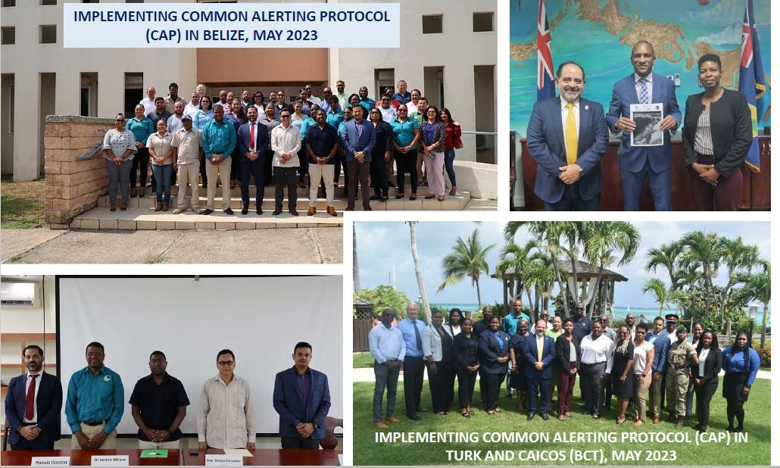
Implementation and operationalization of the Common Alerting Protocol (CAP) in the Caribbean
Two (2) Workshop on Implementing CAP held in Belize & Turks & Caicos Islands
Collaborative effort:
National Meteorological Services
CMO Headquarters Unit
World Meteorological Organization
Funded by:
Climate Risk & Early Warning Systems (CREWS)
Notes:
In terms of action item # 2 , members to implement and operational the common alert protocol which is now a recommended standard by the WMO, I ca report that during the intersessional period, 2 Members, Belize and Turks and Caicos islands implemented workshops on implementing cap in their jurisdictions. These will be elaborated on by the Project officer when he reports on project but just to say the these were collaborative errforts.

Slide 20
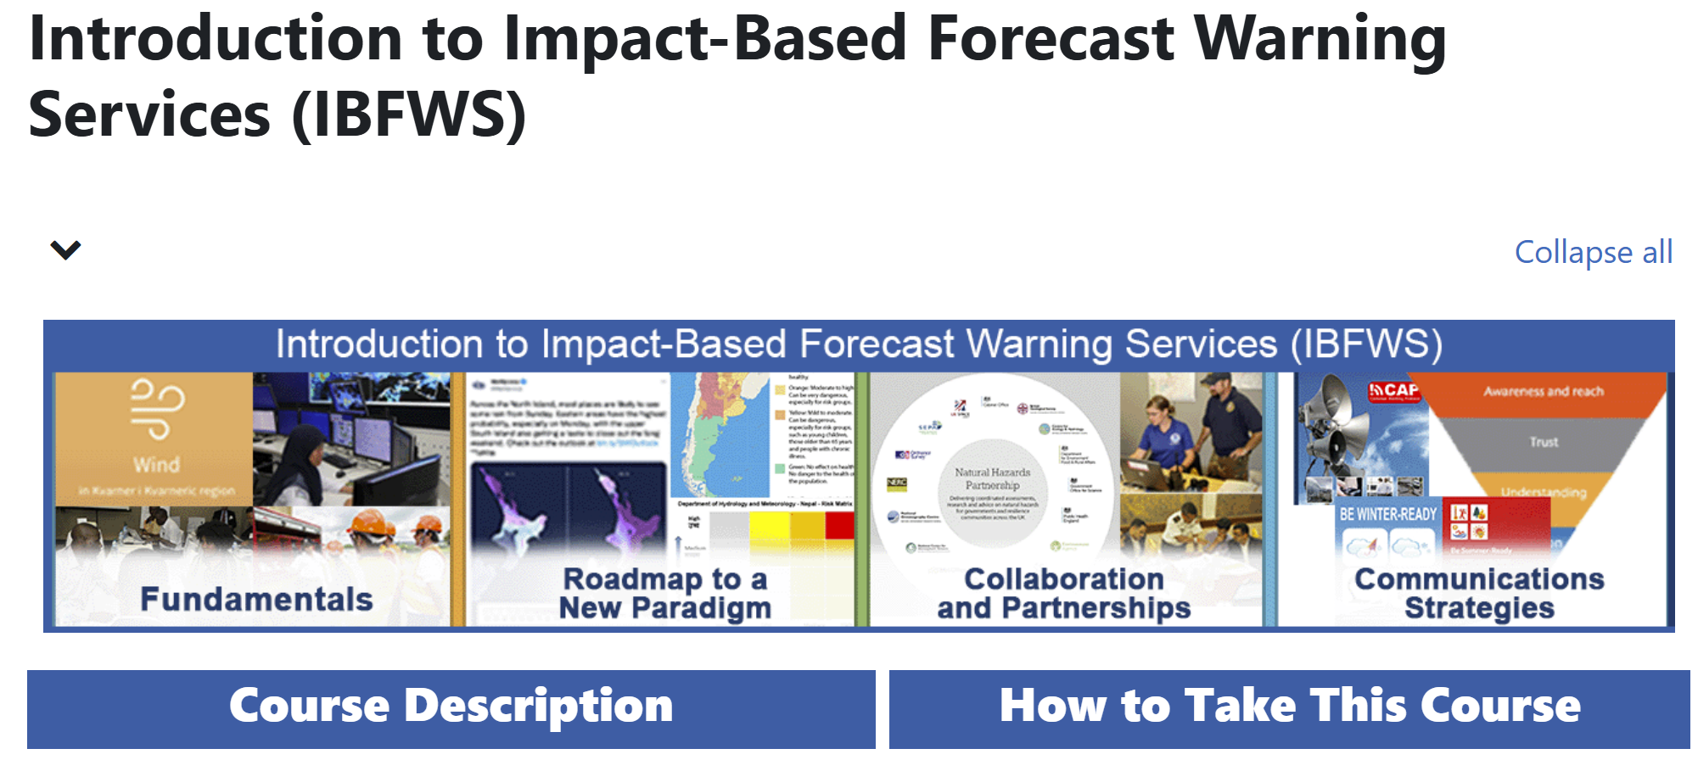
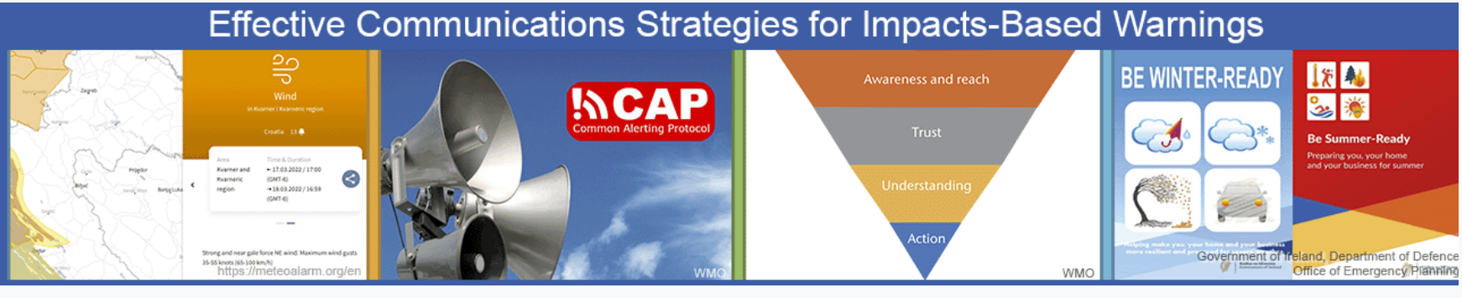
Strengthening Service Capacity Including Marine and Ocean Services
Roadmap for EW4All supports production of IBFWS:
WMO will provide Members with IBFWS training workshops,
Expand IBFWS eCourse for priority hazards,
Widen warning dissemination tools by implementing CAP
Integrate e-learning IBF courses and CAP editor tool in WIS 2.0 Box
WMO IBFWS eCourse
https://etrp.wmo.int/course/view.php?id=253
Notes:
The WMO EW4All road map also supports production of IBFWS, and WMO will provide Members with IBFWS training workshops and expand the ecourss for priority hazards by integrating the eCourse and CAP editor tool in the WIS 2.0Box. In fact during the work shop the plan is to introduce IBF as well.

Slide 21
CAP Implementation in Central America and the Caribbean
‍🏫 CAP Trainings (2024–2025)
📊 CAP Implementation Status – RA IV
Dominican Republic & Panama (Spanish)
– Webinar series (4 sessions) | April–May 2024 – CAP implemented: Dominican Republic (Sept 2024), Panama (Jan 2025)
🌴 Caribbean Countries (English) – Webinar series (2 sessions) | May 2024
🌎 Regional Workshop – Latin America & Caribbean (Spanish) – CAP & Impact-Based Forecast and Warning Services (IBFWS). Held in Chile | 9–13 December 2024
Dominica, Saint Lucia, Grenada – National Workshops (2 days each) | 27 Jan – 4 Feb 2025
Status | # of Countries | %
✅ Operational / Compliant | 14 | 54%
🔧 Testing / Development | 9 | 35%
⏳ Not Started | 3 | 11%
WMO is supporting Members in advancing CAP compliance through various capacity development options, including South-South cooperation among NMHSs, as well as collaboration with regional institutions such as CIMH and CMO. Support is provided through webinars, regional events and targeted national training workshops

Slide 22
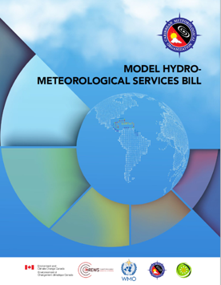
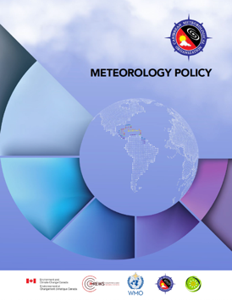
Strengthening EWS Governance
Model Hydro-Meteorological Bill and Meteorology Policy
Endorsed by CMO Members (2021)
Adapted to draft national legislation
2021-2022: Anguilla, Antigua and Barbuda, Belize, Grenada, Jamaica, Saint Lucia, St Kitts & Nevis, St Vincent & the Grenadines
2023: Barbados
In collaboration with WMO, OECS
Funded by CREWS & ECCC

Slide 23
Thank you! ¡Gracias! Merci !

