Slide 1

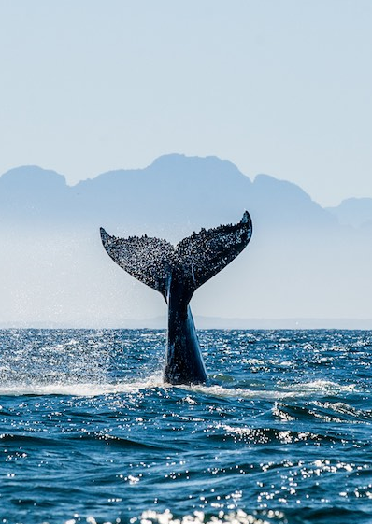
Regular Budget Outlook
Maintaining 42C/5 Regular Budget Staff of 34.5 posts
- 11% implies:
Reductions to the non-staff (activities) budget ranging from 28% to 42% depending on scenario
Staff/non-staff ratio: 72/28 in the worst-case scenario
- 22% implies:
Reductions to the non-staff (activities) ranging from 58% to 68% depending on scenario
Staff/non-staff ratio: 82/18 in the worst-case scenario
,
Notes:
Biodiv, coastal resilience, SOE, multiple ocean stressors,
Obs, data, CD, financing

Slide 2
42 C/5 – TSR budget $916,395
 |  | CARIBE-EWS (ON+AB) | IOTWMS (RB+AK) | NEAMTWS (DCS) | PTWS (ON + JK) | TOWS (BA)
Promote integrated and sustained warning systems-3210313011 | $ 329,389.00 | $65,878 | $65,878 | $65,878 | $65,878 | $65,878
Tsunami-Ready - Educating communities at risk -3210313021 | $ 128,850.00 | $0 | $42,950 | $42,950 | $0 | $42,950
Tsunami-Ready Caribbean - 3210313031 | $ 86,808 | $86,808
Tsunami-Ready - Pacific - 3210313041 | $ 90,434 |  |  |  | $90,435
Building capacities for assessment-3210313051 | $ 163,814 | $40,954 |  | $40,954 | $40,954 | $40,952
Building capacities for assessment Indian Ocean-3210313061 | $ 117,100 |  | $117,100
 | $ 916,395.00

Slide 3
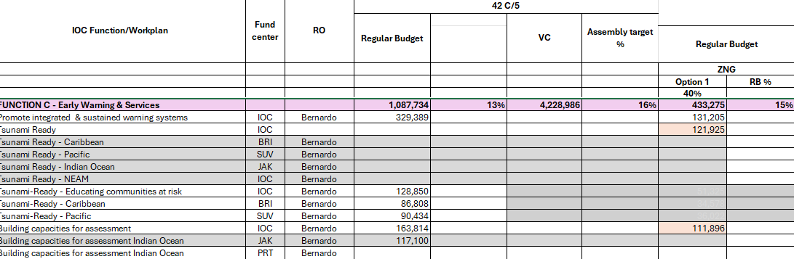
43 C/5 – TSR budget $486,951 (February 2026)

Slide 4
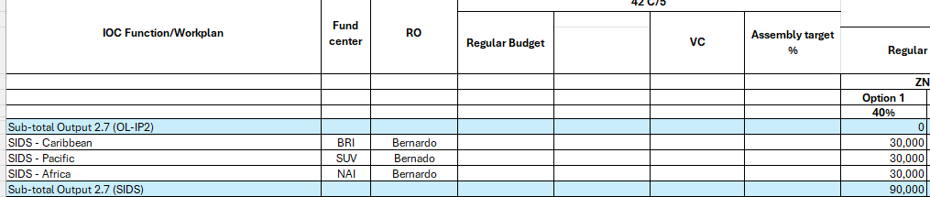
43 C/5 – TSR budget $486,951+90,000+250,000= $826,951
Tsunami Ready Caribbean (decentralized CTG 60K USD)
Tsunami Ready Pacific (decentralized to API 70K USD)
Tsunami Ready Indian Ocean (decentralized to JAK 60K USD)
Tsunami Ready Africa (decentralized to NAI 60K USD)
TARGETS number of TR communities
2026: 150+8 (Africa 5+3, SIDS 18+5)
2027: 200+9(Africa 7+4, SIDS 21+5)
Baseline | 100 Member States’ communities (Africa 5, SIDS 15)

