Slide 1


IOCARIBE Marine Spatial Planning Activities Update
Alejandro Rojas A, Consultant
Marine Spatial Planning in the Caribbean Region
Alejandro rojas

Slide 2
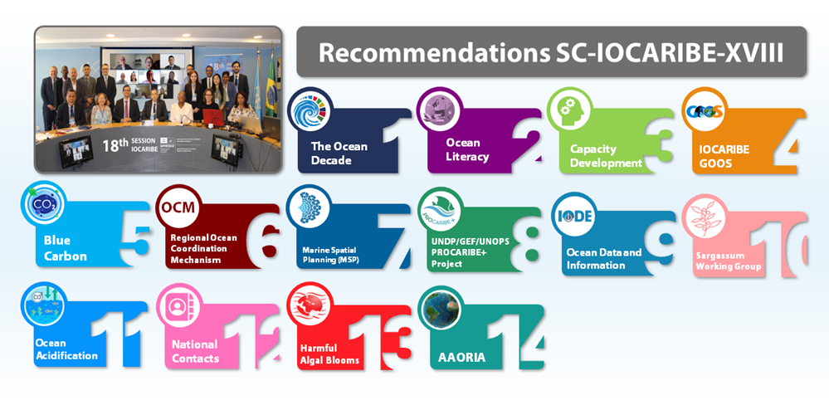
BIENNIAL WORK PLAN

Slide 3

Marine Spatial Planning
Id. | Activities
7.1 | Seek training opportunities for MSP processes in Member States, including the application of global toolboxes
7.2 | Facilitate training for the implementation of economic valuation studies in support of MSP processes.
7.3 (A33) | Enhanced application of best practices, tools and approaches for ecosystem-based management.
7.4 (A33) | Enhanced observations and data for increased scientific understanding of the ocean dimension in climate change.
7.5 (AR33) | Enhanced evidence base on the societal and economic return on investment in ocean science and ocean science infrastructure.
7.6 (AR33) | Enhanced application of fit for purpose knowledge-based sustainable ocean planning and management tools.

Slide 4
UNDP/GEF/UNOPS PROCARIBE+ project
UN to UN Transfer Agreement Signature 13 February 2025. (2025-2028)
“Protecting and Restoring the Ocean’s natural Capital, building Resilience and supporting region-wide Investments for sustainable Blue socio-Economic development” (PROCARIBE+) 5-year project (2023-2028):
Scaling up actions on marine spatial planning, marine conservation, blue carbon and strengthening regional ocean governance.

Slide 5
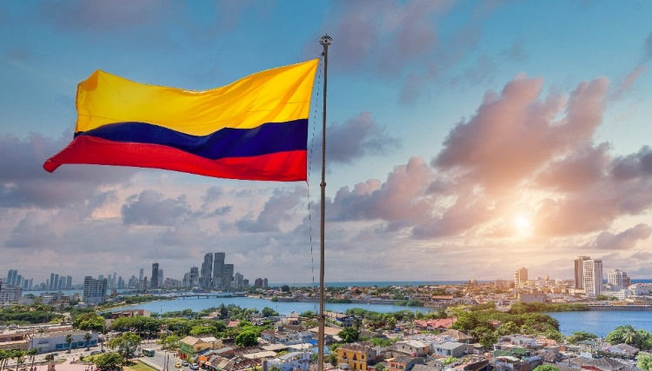
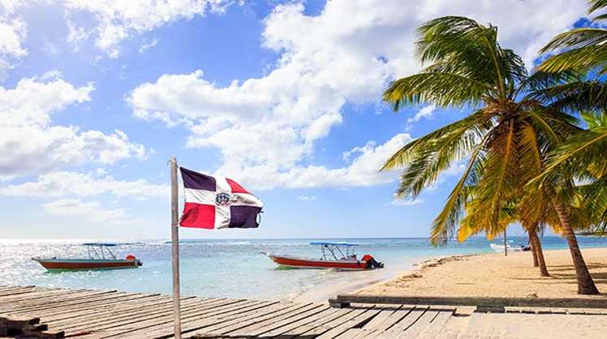
Colombia
National MSP Processes
UNESCO signed an Implementing Partnership Agreement (IPA) with INVEMAR.
UNESCO will be contracting a consultant to implement inception phase activities in the Dominican Republic
UNESCO will contract an expert entity to develop the MSP in Dominican Republic
Dominican Republic
Cartagena Bay and adjacent areas (~274 km²)
Coarse-scale for EEZ (min. 150,000 km²)
Finer-scale, “high-priority” area (min. 400 km²)

Slide 6




Capacity Development (Trainings)
Regional Advocacy
on MSP
One in person training and one virtual session on MSP (Biodiversity & Climate Change, May 2026; and Data, Oct 2026 tbd).
Exchange visits between MSP sites supported by the Procaribe+ Project.
Promote further increase in MSP efforts in the region (target of 10% of the CLME under MSP).

Slide 7
Marine Spatial Planning
Task Team
Recommendation SC-IOCARIBE-XVIII.3
IOCARIBE established a Task Team on Marine Spatial Planning as part of IOCARIBE’s Working Group on Capacity Development
To support regional capacity development activities
  MSP Task Team will review efforts and develop capacity-building GAP analysis and workplans for robust MSP progress.​
  Expand MSP to other IOCARIBE Member States.

Slide 8
Advocay on MSP – Key meetings
2nd Latin American and Caribbean (LAC) Marine Spatial Planning (MSP) Forum and Workshop from 18-21 February 2025 in Panama City, Panama.
The Eighteenth Intergovernmental Session of the Sub-Commission for the Caribbean and Adjacent regions (SC-IOCARIBE-XVIII) and Technical Science Meeting, 22-25 April 2025 in Brasilia, Brazil.
MSPglobal Online Conference - 2.0 Closing & 3.0 Kick-off (4 September, 2025).
78th annual meeting of the Gulf and Caribbean Fisheries Institute (78GCFI), 27-31 October, 2025.
Missions to Barbados and Trinidad and Tobago (1-5 Dec 2025, scale up MSP synergies with key regional parterns).

Slide 9
MSP Newly Published guides
Complementary Guides UNESCO-IOC & European Commission:
Biodiversity inclusive MSP (w/UNEP; reviewed by CBD Secretariat & OBIS)
Climate-smart MSP (reviewed by UNFCCC and IOC/OSS)
2. Data Toolboxes: How to develop a Spatial Data Infrastructure for MSP (w/IODE)
How to integrate ocean observation into MSP (w/GOOS & OBIS)
3. Engaging Offshore Wind Sector (w/UNGC)
Sector overview
Good practices

Slide 10
Future activities
Rapid Assessment Methodology (RAM) workshops with Colombia and Dominican Republic to develop detailed workplan and budget.
Online call to develop MSP in Dominican Republic (June 2026).
4th Procaribe+ Project Executive Group Meeting (15-17 April 2026, Panama City, Panama).
Second meeting of the MSP-TT (11 May 2026, Santa Marta, Colombia).
Regional Capacity Building trainings on Biodiversity and Climate Smart Inclusive MSP (12-13 May 2026, Santa Marta, Colombia).
Nineteenth Intergovernmental Session of IOCARIBE (SC-IOCARIBE-IXX, 28 Sep – 2 Oct 2026, location: Guatemana City, Guatemala).

Slide 11
Thank you
Muchas Gracias
Merci Beaucoup
a.rojas-aldana@unesco.org

