Slide 1
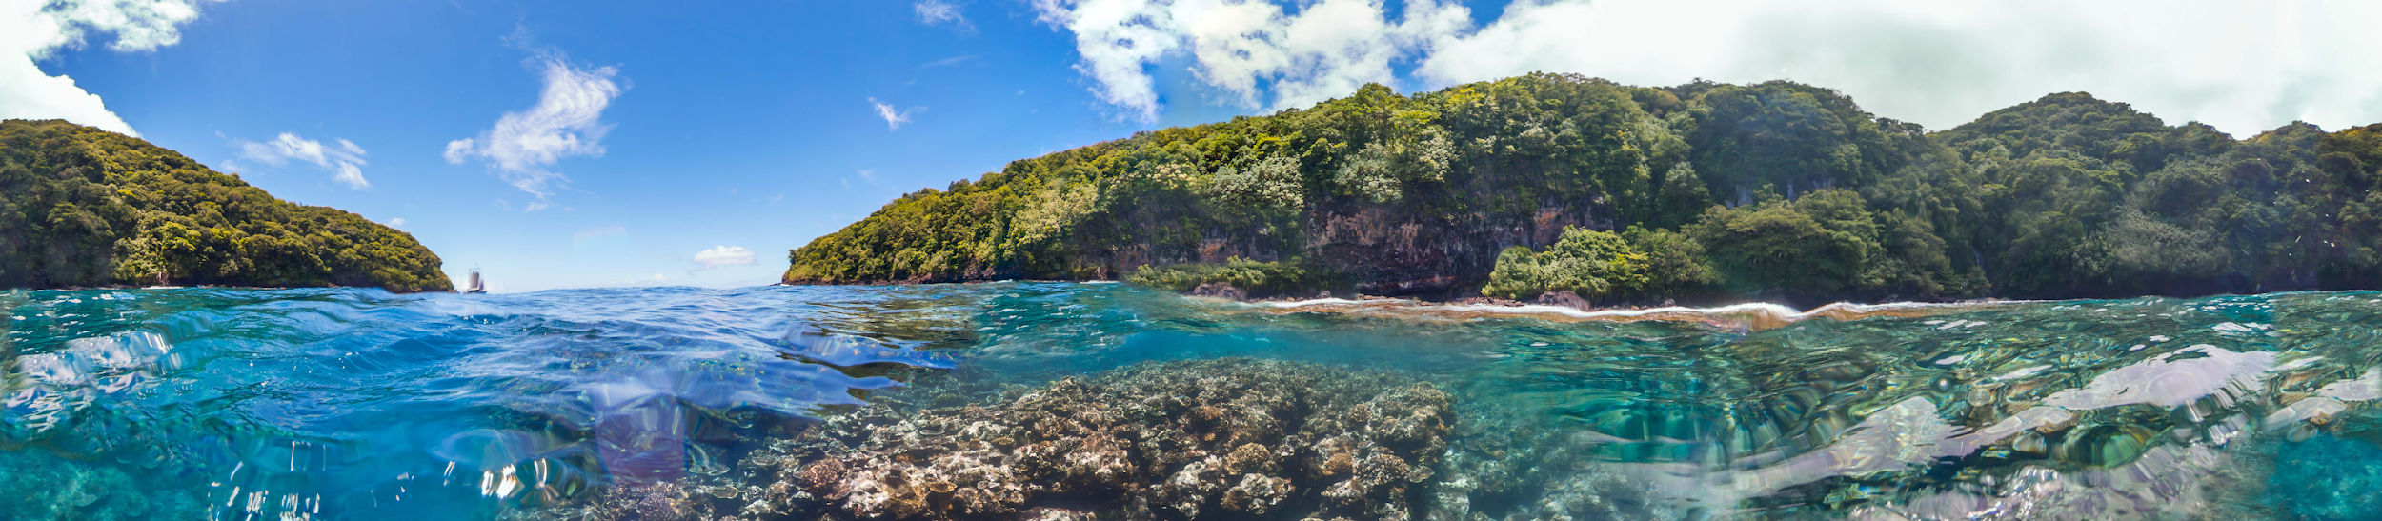



State of the (Ocean Data) Union
Adam Leadbetter
a.leadbetter@unesco.org
Lead Manager
Decade Coordination Office for Ocean Data Sharing
Intergovernmental Oceanographic Commission of UNESCO
EMODnet Open Conference 2025
25th November 2025 Breakout Session #2: EMODnet Technical Services –
Current Status & Future Developments

Slide 2
2

Slide 3
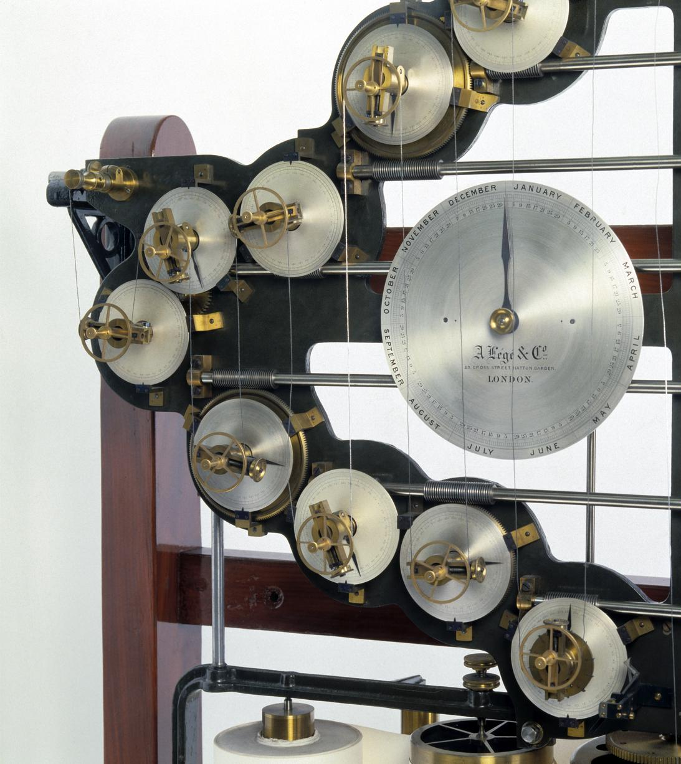
2018 – Where were we?
3
“Data is the new oil”
Valuable, raw resource
Rare / Scarce?
Needs extracting, refining, processing
Focus on data discovery
Metadata
Search Engine Optimisation
Rich snippets
Schema.org
Google Dataset Search
Data services / better data aggregation was the promise of the future
Image Credit: CC-By 4.0
Science Museum Group
Collection

Slide 4

4
Image Credit: Kurt Arrigo / Ocean Image Bank

Slide 5
2025 – What’s changed in the wider data landscape
5
 | Then | Now
Top 5 Companies By market capitalisation Source Motley Fool (fool.com) | Microsoft Apple Amazon Alphabet (Google) Berkshire Hathaway | Nvidia Microsoft Apple Alphabet Amazon
Cloud storage cost per Tb Enterprise costs Source: Google search, US Bureau of Labor Statistics | ~20USD per month ~26USD adjusted for inflation | ~15USD per month >40% cost reduction, accounting for inflation
Web search paradigm | Recommendation engine metadata aggregator | “Answer” engine data aggregator
Next generation World Wide Web models | Semantic Web | Agentic Web
Google Trends Source: trends.google.com. Categories: Computers & Electronics; Internet & Telecom | Mobile devices | Mobile devices
Ocean Data Hot Topics Source: Analysis of IMDIS 2018 and IODC 2025 conference abstracts | Build the infrastructure, catalogues and standards for consistent data access | Operate, compute, apply over large scale data systems

Slide 6
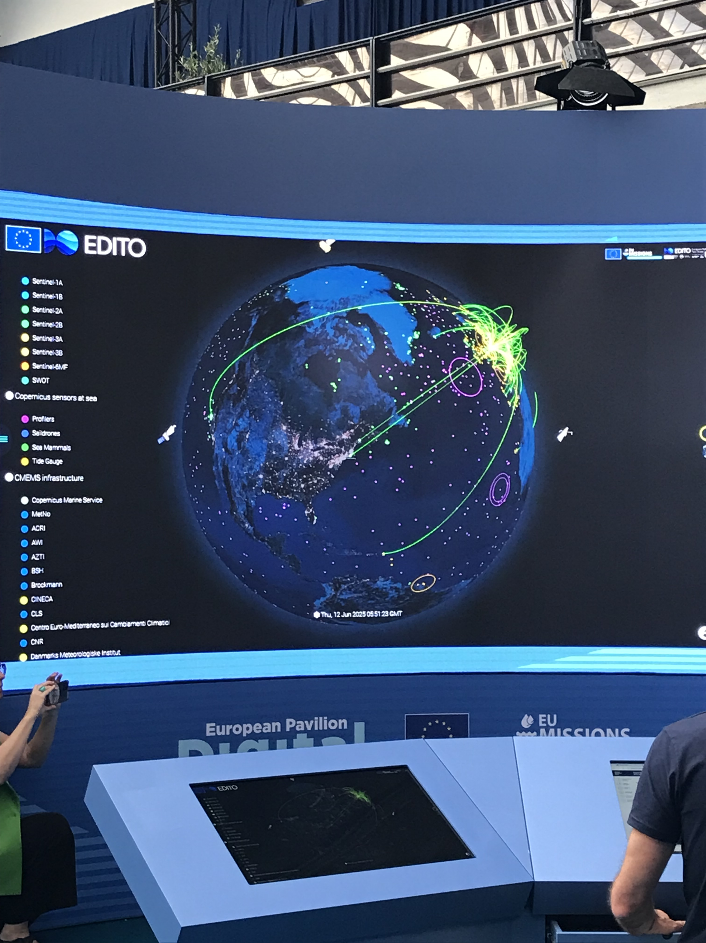
2025 – Where are we?
6
IODE’s Ocean Data Information System
Metadata for 59 nodes as of 13th November 2025
Based on Search Engine Optimisation technology
Limited dialogue with the search engine teams
Data exchange is missing (Essential Ocean Variables, Sustainable Development Goals…)
Data aggregation in Europe (and beyond)*
European Digital Twin of the Ocean data lake – fully open
BlueCloud data lake – somewhat closed
Erddap and Copernicus Marine Data Store & Model Context Protocol
Global ocean data supply
At risk from geopolitical pressure turning off the flow of new data
*But: the world’s biggest data aggregators are now Alphabet, Anthropic, OpenAI…
Image Credit: Adam Leadbetter

Slide 7

UN Ocean Decade – Vision 2030
7
Comprehensive, adaptive, dynamic digital representation of the ocean to enhance decision making
Global ocean data discovery and access service
Global ocean forecasting structure
Global digital atlas of the ocean
Marine knowledge exchange mechanism
Capacity development & training

Slide 8

2030 – Where might we be heading?
8
Image Credit: © Sunset Boulevard / Corbis
Data is product (content)
Trusted data provider
Key role for IOC / IODE globally and EMODnet regionally
Responsible enrichment
Provenance
We don’t have enough now to easily identify Essential Ocean Variables to GOOS specifications
What shouldn’t agents do with the data?
Preparation
Purpose, standards, guidance, practices
Badging / Certification
Private sector
From ocean data creators to ocean data suppliers
Ocean data users

Slide 9
State of the (Ocean Data) Union
Adam Leadbetter
a.leadbetter@unesco.org
Lead Manager
Decade Coordination Office for Ocean Data Sharing
Intergovernmental Oceanographic Commission of UNESCO
EMODnet Open Conference 2025
25th November 2025 Breakout Session #2: EMODnet Technical Services –
Current Status & Future Developments

