Slide 1


ICG/CARIBE EWS, Steering Committee 23 February 2026
Working Group 1: Risk Knowledge – progress report
Chair: Frédéric Dondin (France)
Vice-Chair: O’leary Fernando González Matos (Cuba)
Recommendations to WG1, last ICG CARIBE EWS meeting, May 2025 :
Conduct a literature review study on real-time detection of submarine landslides
Consider organizing an Expert meeting on Seismic and Non-seismic Probabilistic Tsunami Hazard Assessment (PTHA)
in the Caribbean and its adjacent regions
Nominate a vice-chair for WG1

Slide 2
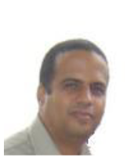
Recommendations last ICG CARIBE EWS meeting, May 2025 :
WG1 vice-chair nominee is : Dr O’Leary Fernando González MATOS.
He is assistant professor and currently a Postdoctoral researcher in Seismology at the Montagne Pelé volcano and seismological observatory (IPGP, France)
Phone numbers: +53 52163030, +53 55160767, and +53 22642521 Email: oleary@cenais.cu, olearyfgm@gmail.com
Further information provided with the attached CV

