Slide 1
Joint IQuOD/GTSPP/SOOP/XBT Science Meeting
SOOPIP Review
Justine Parks - Scripps Institution of Oceanography
Tamaryn Morris - South African Environmental Observation Network
Co-Chairs
Ship Of Opportunity Programme
Implementation Panel

Slide 2
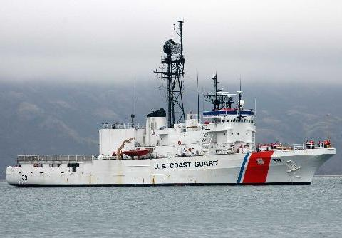
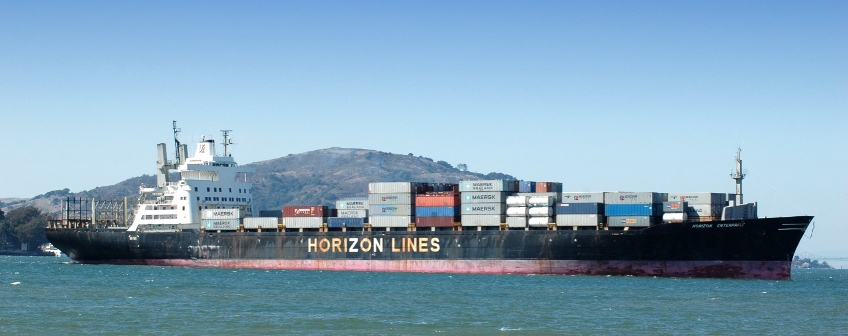
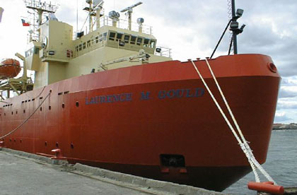
Function of SOOPIP
The Ship-of-Opportunity Implementation Panel (SOOPIP) coordinates the installation and deployment of instrumentation from Ships of Opportunity that travel in fixed transects, and in particular coordinates the implementation of regional and basin-wide instrumentation that measure [upper ocean] physical, chemical and biological parameters, such as XBTs, TSGs, pCO2 and CPR.
To ensure consistent collection of time-series data on all transects, a network of participating ships is maintained.
Network recognition and experience with large shipping organizations
Create and maintain goodwill with those participants
Logistical experience getting personnel and equipment to the ship
Create and maintain Best Practices for work on those ships

Slide 3
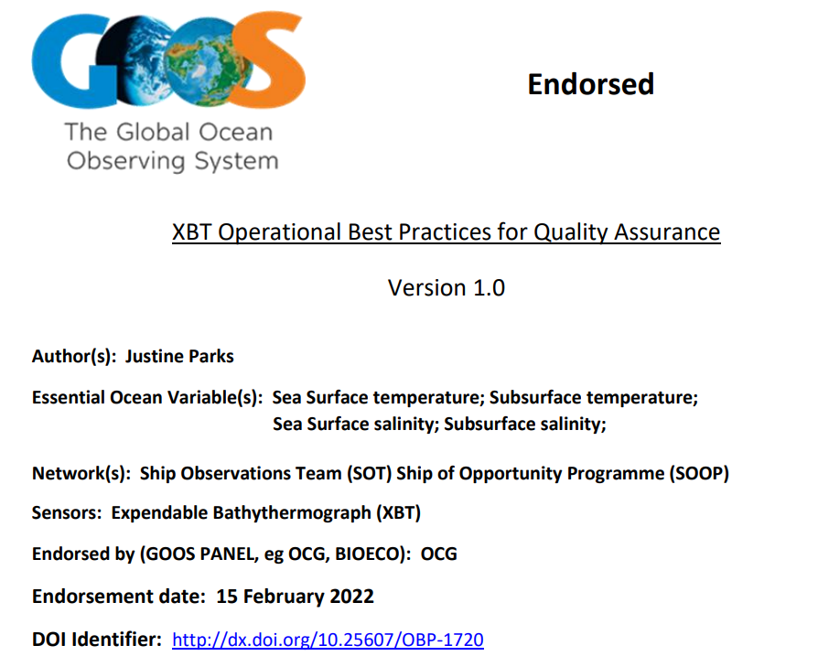


Best Practices
Vessel Recruiting - Parks, Justine, Hanstein, Craig, Kramp, Martin, Strom, Kerry, Cabrié, Joel, Rodriguez, Julian J. and de Villiers, Mardené C. Vessel Recruiting Best Practices v 1.2Publisher: WMO-IOC, Ship Observations Team, Geneva, Switzerland: (2024) https://doi.org/10.25607/OBP-2029
Delayed Mode XBT Quality Control – Cowley, Rebecca; Krummel, Lisa. Australian XBT Quality Control Cookbook Version 2.0. Hobart, Tasmania, Australia: CSIRO; 2022. https://doi.org/10.25919/3tm5-zn80
Automated QC – Simon Good, Bill Mills, Tim Boyer, Francis Bringas, Guilherme Castelão, Rebecca Cowley, Gustavo Goni, Viktor Gouretski, Catia M. Domingues. Benchmarking of Automatic Quality Control Checks for Ocean Temperature Profiles and Recommendations for Optimal Sets. Front. Mar. Sci., 15 February 2023 Sec. Ocean Observation, Volume 9 - 2022 https://doi.org/10.3389/fmars.2022.1075510

Slide 4
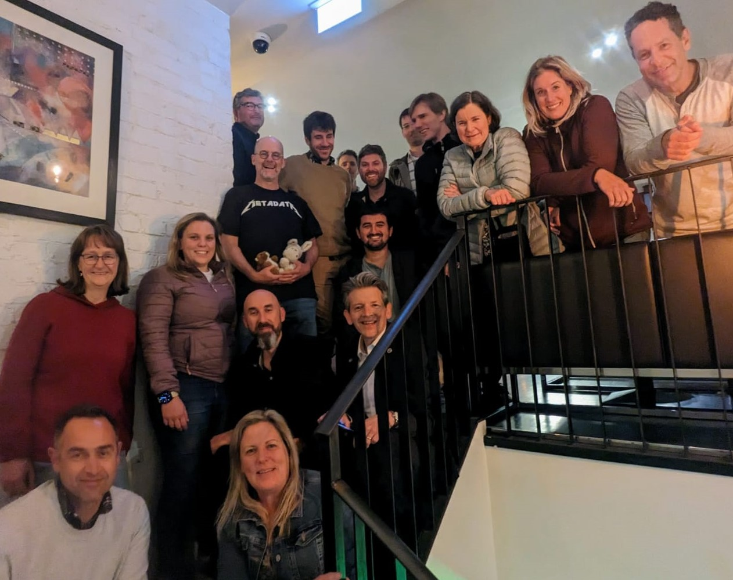
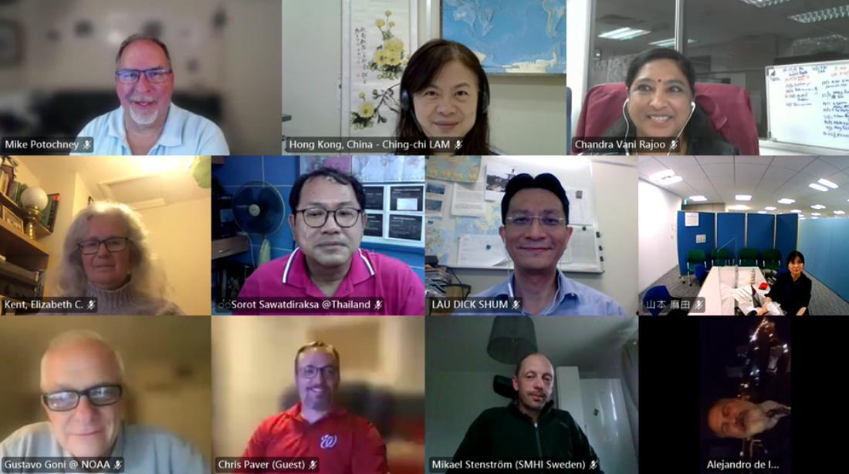
Some SOOPIP SOT-12 Action Items
Appoint (additional) SOOP members for metadata and KPI TTs with the aim to set up and maintain missing items in the OceanOPS environment.
Continue the development and maintenance of a flexible XBT data management system that meets all the community requirements for data dissemination and applications.
Continue the work with the TSG, pCO2, Ferrybox, CTD and CPR communities in operational and data management efforts.
Members to keep the OceanOPS database updated, including ship, station, contact and program metadata.
As identified in the WMO data policy, members are urged to share data in real-time using the recommended data formats.
Recommendations
For XCTD BUFR submissions, use new T/S data templates for submitting data to the GTS to include descriptors for the instrument type: new TM315006
Request a letter from IOC that can be used by SOOP recruiters/organizers
as a template to satisfy indemnification.
Request a member from the Ferrybox community to join the TT-Metadata. (Is Metadata TT subsumed by OCG Data TT?)
Update the SOOP website

Slide 5
SOOP Website
WMO domain from 2016 references JCOMM with links to unrelated jcomm cash relief business entity
https://community.wmo.int/en/ship-opportunity-programme
OceanOps old leads to all broken content
https://www.ocean-ops.org/sot/soop/
“Official” website in the OceanOps domain, static with outdated metrics https://www.ocean-ops.org/sot/programmes.html#SOOP
* How can SOOP initiate this work by OceanOPS?

Slide 6
Data Distribution in BUFR Format
For BUFR submissions, use new T/S data templates for submitting data to the GTS to include descriptors for the instrument type:
XBT: For XBT temperature profiles use only template TM315004.
XCTD: For XCTD temperature and salinity profiles use only template TM315006, approved in 2024 and requires the latest version of BUFR tables.
XBT Data is submitted to the GTS by some groups in both BUFR and FM 63 X Ext. BATHY simultaneously to maximize the use of the data.
This causes problems with apparent profile quantities and data duplication in data centers
Should we move to a full transition to GTS XBT data submission in BUFR only?
Which users and data centers or projects are not ready to ingest BUFR?
* Use the WMO Operational Newsletter 10 and METNO11 messages through the GTS notification system to notify the GTS data users about changes and updates to the data distributions: https://community.wmo.int/en/news/operational-newsletter

Slide 7
Format for Data Distribution & Sharing
Currently data providers use different data formats (ASCII, netCDF, other binary formats) to transfer and distribute XBT data though their project websites, or to data users. There are clear benefits to working towards the development and implementation of a standard format for XBT data that providers can use for all data distribution purposes:
Facilitates submissions by providers to different data repositories.
Facilitates data repositories to ingest and archive data from different providers.
Users can use the same software to read XBT data from all providers.
Facilitates data distribution and discovery
It will facilitate adoption of WIS 2.0 planned for full adoption by 2030.
Propose development of a netCDF file format and contribution to the WMO manual on Codes
Easy to read and write, most data providers are familiar with netCDF files.
There is work already completed in this direction of creating standard format netCDF files including variable names, attributes, and metadata.
Finalize that effort and recommend a wider implementation.
* WMO Expert Team on Data Standards (Kevin O’Brien, lead of the TT-CFNetCDF)

Slide 8
XBT Data Quality Control
Propose, in cooperation with IQuOD and GTSPP, the creation and implementation of a standard auto QC methodology for XBT data (real-time only) to be used by all data providers before submitting data into the GTS. Include specific QC tests, documentation, and software to data.
Benefits:
Standard QC flags with the same meaning regardless of the data provider.
Users will know how QC flags were determined.
Increase in data use and applications.
Could allow a better understanding of auto QC performance and facilitate further development.
Enhance interoperability and facilitate data processing for data centers or projects, such as IQUOD, WOD, GTSPP, etc
Simplifies maintenance.

Slide 9
Platform and Profile Metadata
OceanOps – SOOPIP promotes the input of platform metadata into OceanOPS.
SOOP Published Metadata Guidelines - updates from in 2017 needed?
SOOP-XBT Platform Metadata
SOOP-XBT Cruise Metadata
SOOP-XBT RT Deployment Metadata
SOOP-XBT DM Deployment Metadata
https://www.ocean-ops.org/sot/programmes.html#SOOP
Metadata definition - is sometimes inconsistent for different databases (WOD, GTSPP, etc). Is it possible to map the metadata in different databases?
Metadata QC -Work and discussions of data QC should include metadata QC.

Slide 10
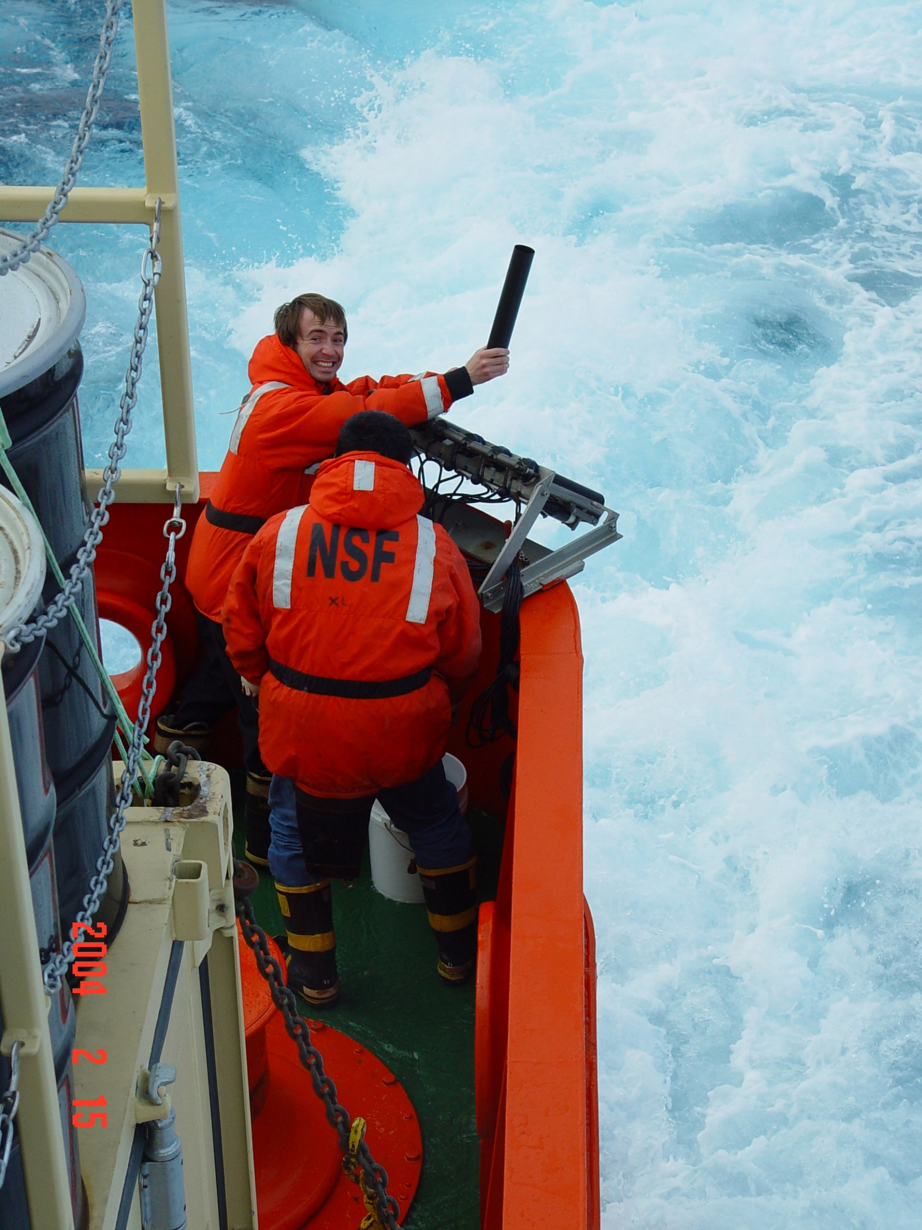
Future of SOOP
OceanOPS reorganization and implementation of SLAs
SOOP was XBT on commercial ships on fixed transect, now it is upper ocean on commercial ships, but not all upper ocean on commercial ships. Who belongs in SOOP, or even SOT?
FishSOOP, FVON, SOCONET/CO2, Ferrybox, etc
How are networks categorized by IOC/WMO?
From the GOOS/OCG website, the way networks are
categorized and who belongs in them is not clear,
especially as emerging networks are added or in
consideration.
by platform
by EOV
by methodology Does it matter (SLAs)?

Slide 11
OceanOPS SLAs
Outline of OceanOPS Baseline Service Levels for ALL Networks
https://docs.google.com/document/d/1kYmr_IqtYU4zC8pKWSlMrx-Ucld77Kq5ZxIiNA9ZHGE/edit?tab=t.0
Responsibilities of OceanOPS and the Networks
Description of Baseline Services
Proposed Future services:
API Metadata Input
API ODIS integration
EOV performance tracking
Proposed future developments for standard and advanced services
https://docs.google.com/document/d/1mczZ3eVQRtbSQksJxn5X9dZCqeaCMm2VbMlM8LmhqIo/edit?tab=t.0

Slide 12
OCEANOPS BASELINE SERVICE LEVEL AGREEMENT
The Baseline Services are largely automated, with minimal manual input and will be available to all OCG endorsed networks, irrespective of any funding to OceanOPS provided through the networks.
SERVICE LEVEL | DESCRIPTION | BENEFIT
Baseline Network Monitoring/Web | Routine monitoring products that are generated automatically by OceanOPS (e.g. status maps for varying criteria, KPIs). Updated maps, statistics and indicators (see Annex 2) on Network performance are automated and will be provided by OceanOPS to each network on a monthly basis. | This service provides visibility of networks on the OceanOPS integrated website, allows maps and statistics to be embedded into external websites and automatically updated, and tracking of performance of networks (see annex). Enables the network and GOOS OCG to regularly assess status and progress in an harmonized way, fostering transparency and engagement.
 | Access to a suite of integrated web-based tools, including a search engine, list/edit/import/export platforms, metadata, statistics for national reports, programmes and contacts management. Tools are available for users to extract information on the network’s implementation status. | The available tools (e.g. interactive maps) can be used for national, regional, or institutional monitoring, with potential for further development. This will allow networks to assess the status of their network, plot basic information, extract maps etc. beyond the automated quarterly updates.
GOOS Reporting | Visibility of the networks (including Members, Institutions, and Operators) in GOOS Reports such as the annual GOOS Report Card and various others of IOC/UNESCO and WMO (e.g. State of the Ocean Report, WMO Bulletin, GCOS reports). | This allows networks to demonstrate to stakeholders that they are part of the GOOS infrastructure, provide international recognition, visibility, and accounting of contributors, successes, and challenges. This is critical for the network's sustainability and securing future funding.
Baseline Platforms Metadata Management | Web based dashboard for management of platform metadata (e.g. unique identifiers, program/country, model etc.) through the dashboard/GUI. | Platform metadata serves as the foundation for most of OceanOPS services, including monitoring and performance analysis. Without accurate metadata, no accounting is possible, and platforms will not appear on maps, in statistics or bulletins. Operators, networks, OceanOPS, etc., rely on this metadata to plan, track the implementation, and assess instrumentation performance. By using the dashboard to plan, implement and monitor their operations, platform operators use the GUI within their workflows.
 | OceanOPS provides standard platform metadata format including network-specific reference tables and controlled vocabulary.
 | Metadata must be made available by the network operators update as agreed and, as far as possible, enabled for routine M2M submission or harvesting.
Baseline Data Monitoring | Monitoring of data flow on identified global nodes (e.g. Web/GDAC, GTS/WIS 2.0) as designated by GOOS/OCG. Data are monitored periodically (real-time where possible) without specific reporting on performance or actions taken for problem resolution. | Provides an activity status for the platforms using a traffic light system, e.g. data are flowing recently, not since a certain date, or never. This aids in optimising the data availability to users by identifying the platforms that are not delivering data. This allows for problem resolution (errors of identifiers or headers in data transmissions, guidance for redeployment of platforms, etc.) and alignment between data and metadata records.
API Metadata Output | API for M2M extraction of metadata from OceanOPS in various formats, incl. CSV, JSON, XML (WIGOS). | Distributes harmonised, quality-controlled metadata to any user and enables refined extractions based on various criteria. Metadata delivered include operator inputs, enriched by OceanOPS relational database, controlled vocabulary, and connections to global data nodes (e.g. to provide a status tag).
API WIGOS/OSCAR Integration | OceanOPS API to be WIGOS-compliant XML and include routine metadata submission to WIGOS/OSCAR. | In OSCAR, all observing systems are integrated from WMO Members and recognized entities like OceanOPS. OceanOPS holds a unique position and authority to submit integrated and quality-controlled metadata from GOOS systems to OSCAR. This metadata submission is crucial for data exchanges on the WMO Information System. It allows for the analysis of quality, coverage, and timeliness through the WIGOS GBON and Data Quality Monitoring System, providing high-level visibility on gaps for WMO Members to address. Network operators do not need to develop this capacity locally.

Slide 13

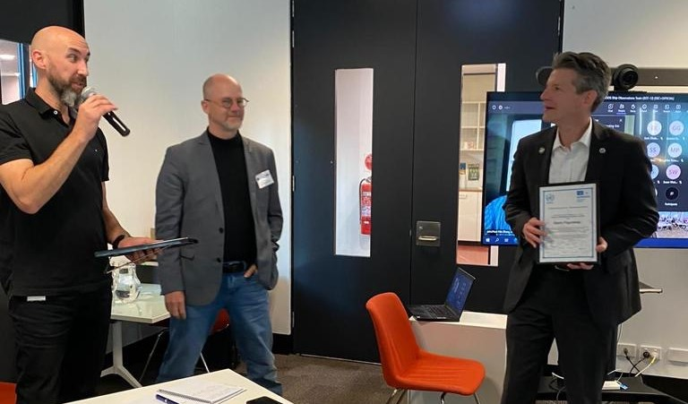
Target Action Items for SOT-13
Thirteenth session of the Ship Observation Team (01-04 April 2025) hosted by Ifremer Plouzané (Brest), France (Hybrid)
Registration and all informational forms completed and returned before 31 January 2025
Check the list of national focal points for Ship Observation Team programmes and notify required changes to the Secretariat https://www.ocean-ops.org/board?t=sot
Event Website https://goosocean.org/event/4588
This meeting will help fill in the bullet points for this slide

