Slide 1

GOOS Co-Design Programme’s
Tropical Cyclone Exemplar
Co-Designing Ocean Observing Systems for Improving the Understanding
and Forecasting of Tropical Cyclones
Scott Glenn, Distinguished Professor, Rutgers University, USA
Cheyenne Stienbarger, Program Manager, NOAA, USA
Sixteenth Observations Coordination Group Meeting (OCG-16)
7-10 April 2025, IFREMER, Brest, France

Slide 2
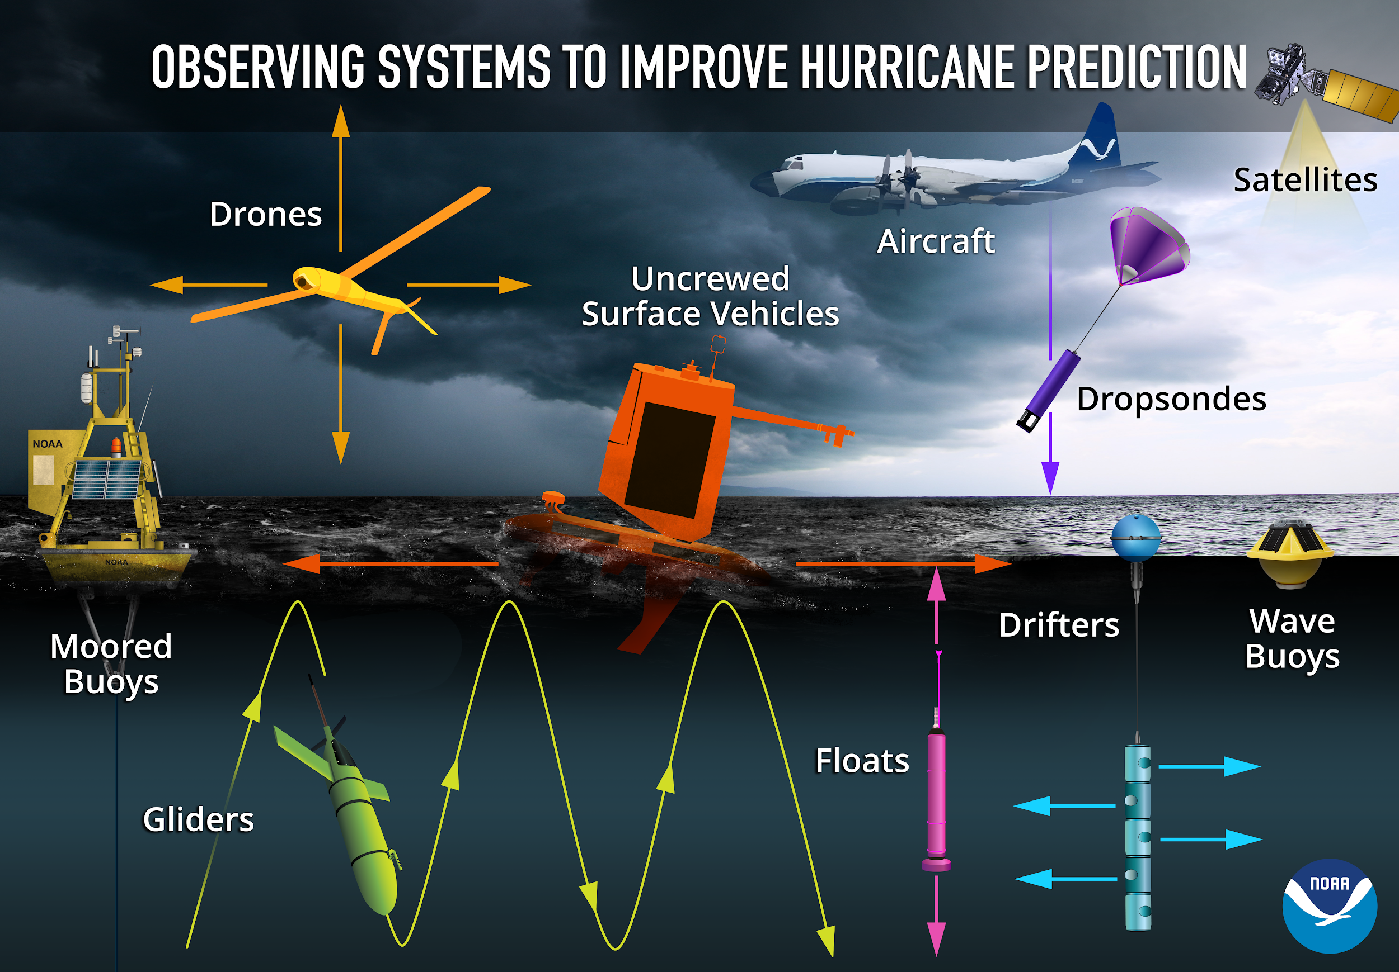

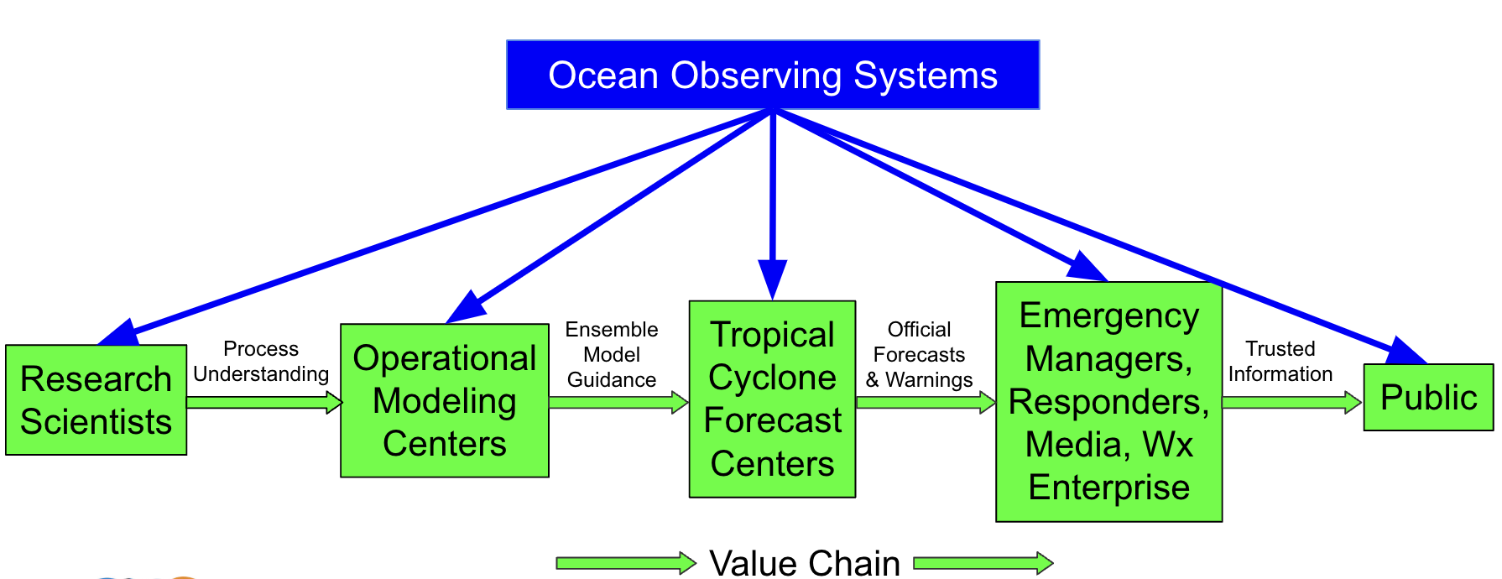
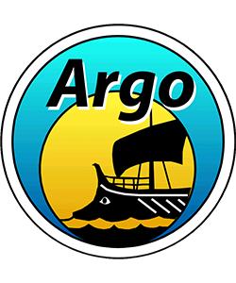

Tropical Cyclone Exemplar Co-Design Starting Point:
Numerous technologies demonstrated to improve hurricane forecasts
Co-Design
Process
Requirements
Co-Design Requirements Result:
“There is a dearth of subsurface profile data”
- NOAA Environmental Modeling Center (EMC)
GOOS/WIGOS
Observations Coordination Group
TC Exemplar Approach: Leverage global networks (OCG) & regional capacity (GRAs) to facilitate profile data collection (e.g. TAC Region Pilot Study)
FVON
Fishing Vessel Observing Network
Leveraging two GOOS Mature Networks since 2018
Adding an Emerging Network in 2025
Notes:
SG

Slide 3
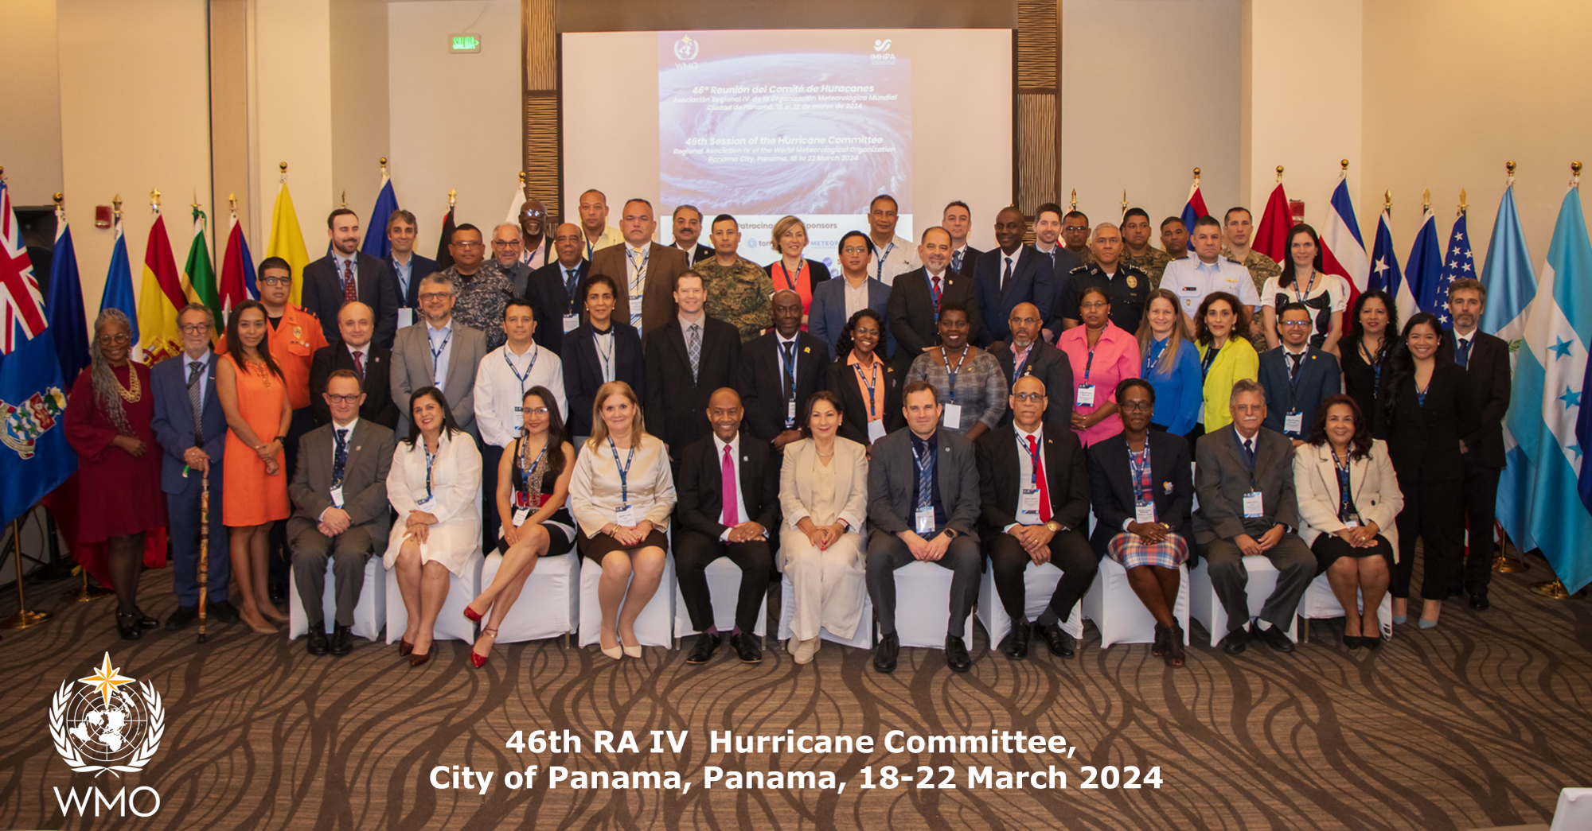
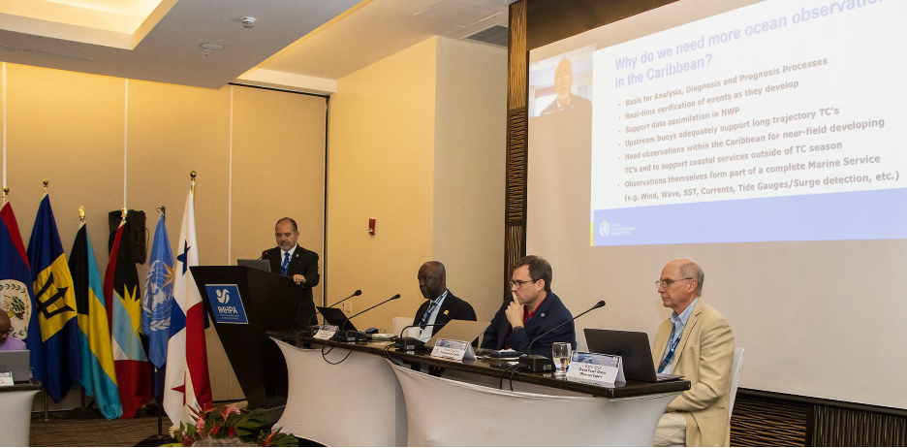
TC Exemplar: WMO Engagement
WMO Region IV Hurricane Committee
WMO RA IV Hurricane Committee
  March 2024 - Panama - 1st Ocean Panel
  Caribbean is undersampled for TCs
  Expand beyond Marine Scientific Research permissions for uncrewed systems
  Demonstration projects for capacity building
WMO Impact of Observing Systems
  May 2024 - Sweden - TC Exemplar/TAC
WMO RA V Cyclone Committee -
  July 2024 - Australia - TC Exemplar/TAC
WMO TECO (Technical Conf for Observations)
  Sept 2024 - Austria - Yucatan HF Radar
WMO RA II RBON
  February 2025 – Hong Kong - TC Hazard
WMO RA IV Hurricane Committee
  April 2025 – El Salvador - 2nd Ocean Panel
WMO Region IV Ocean Panel
Notes:
SG

Slide 4
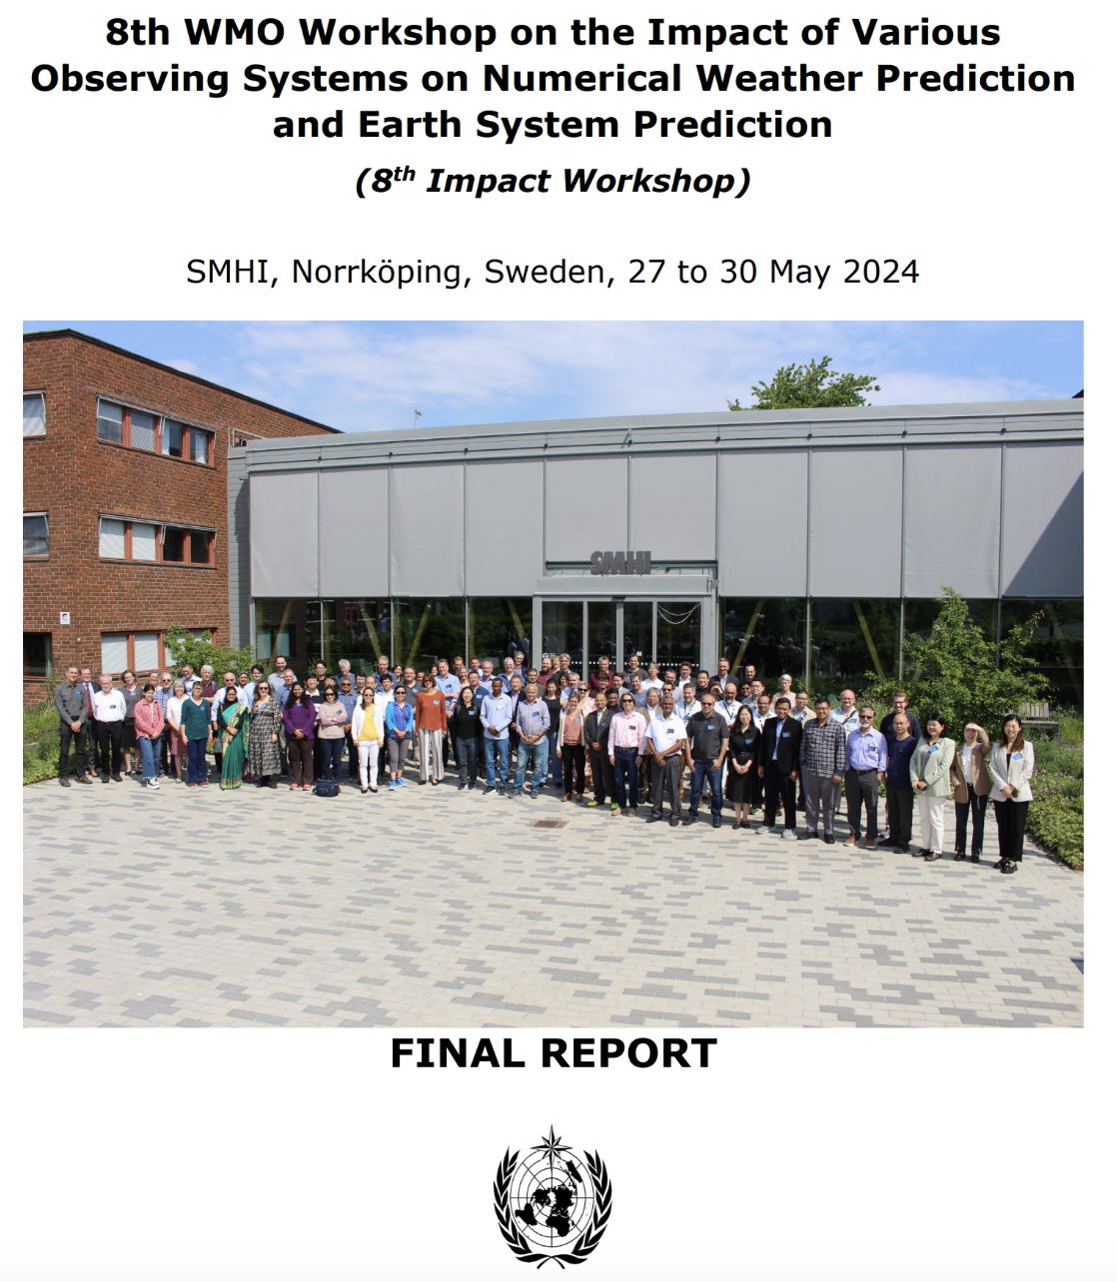
WMO 2024 Workshop: Impact of Observing Systems
3.1. Recommendations for WMO Members and Observing Network Operators
3.1.4. To sustain routine observations of the ocean temperature and salinity profiles (for example, Argo, gliders).
3.3. Recommendations for the scientific community
3.3.6. To continue the development of coupled ESP systems and, where possible, to develop and promulgated common metrics of skill for such systems, in collaboration with the operational NWP centres.
3.4. Recommendations for WMO and other International Organizations
3.4.1. Intergovernmental Oceanographic Commission (IOC), WMO and relevant coordination entities to work together to expand ocean profiling observing systems and secure sustainable funding for them.
Workshop Report Link
Both OSEs and OSSEs have shown that assimilation of satellite-derived altimetry and temperature data is essential for constraining the intermediate/mesoscale variability, while the simulation of ocean heat and freshwater contents is better constrained by Argo data (O3.3) (page 14).

Slide 5

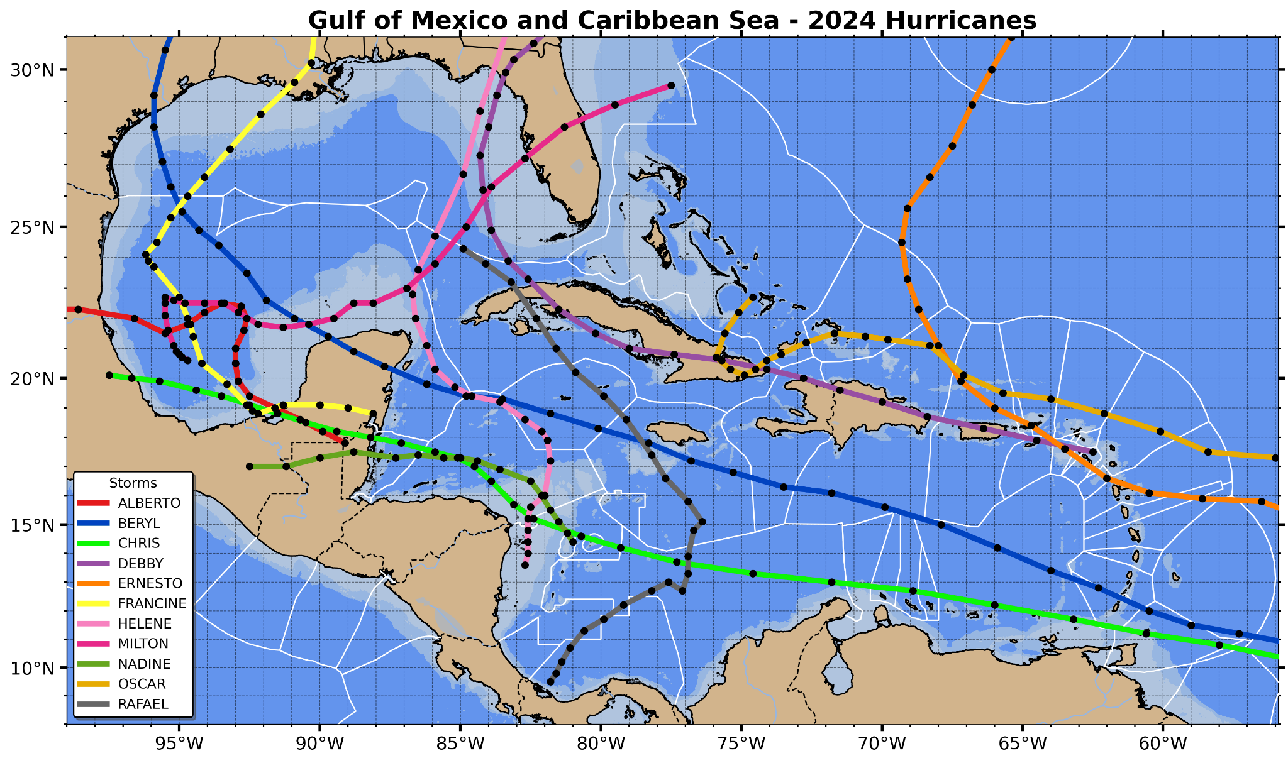
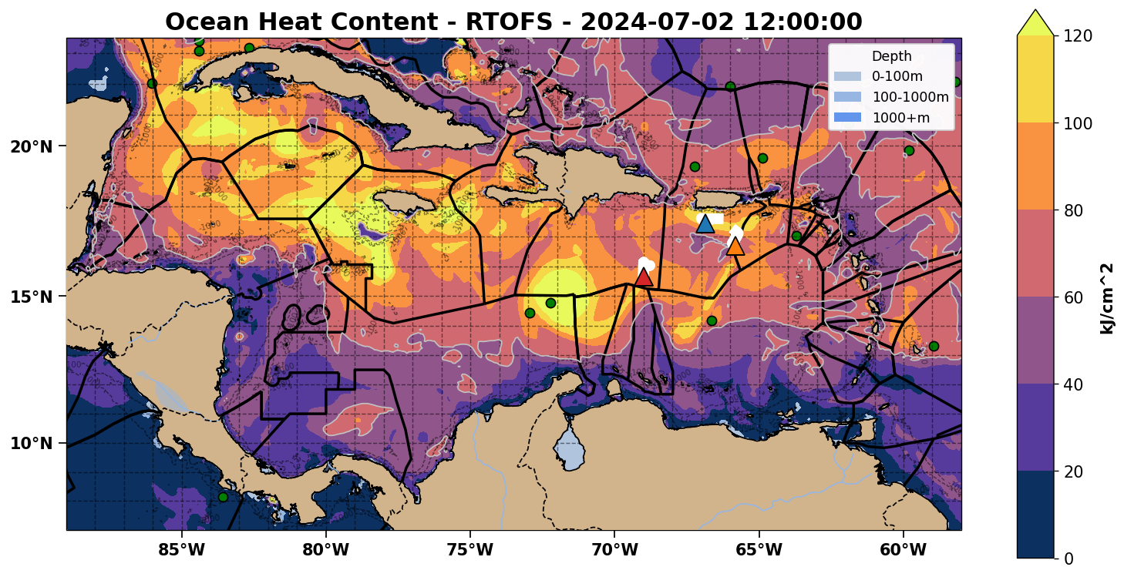
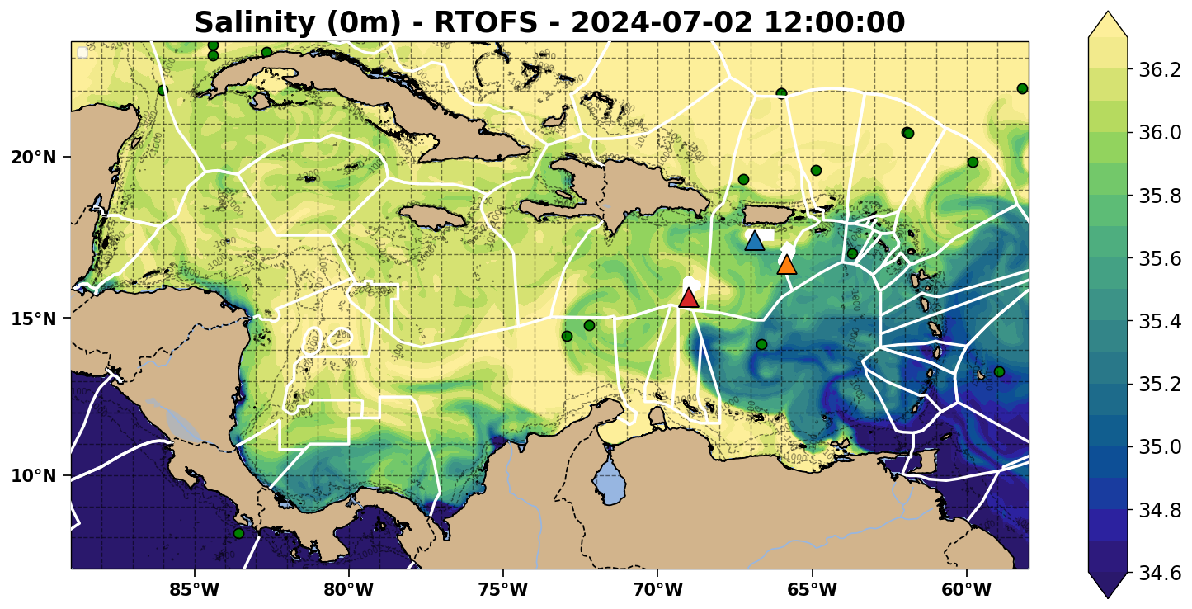
2024 Hurricane Tracks
Essential Ocean Features Affecting Hurricane Intensity
Ocean Heat Content
Low Surface Salinity for Barrier Layers
Hurricane Tracks & Essential Ocean Features cover the full Caribbean!

Slide 6
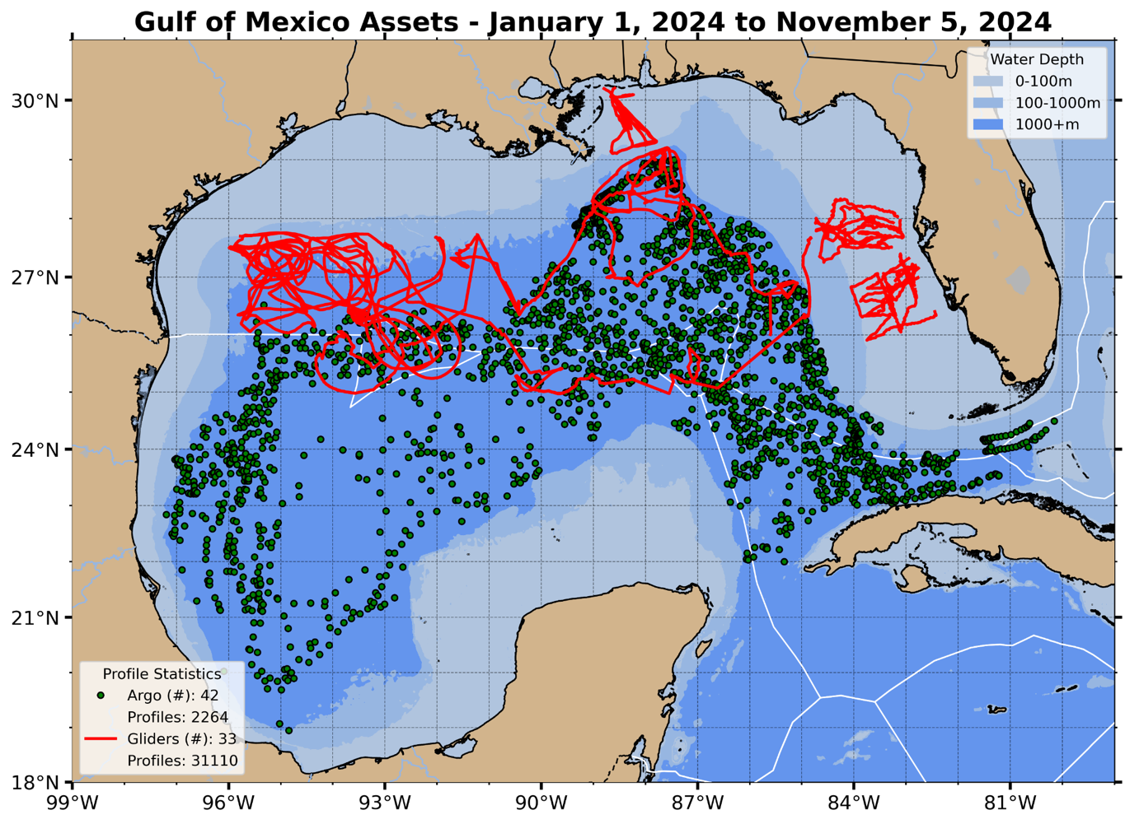
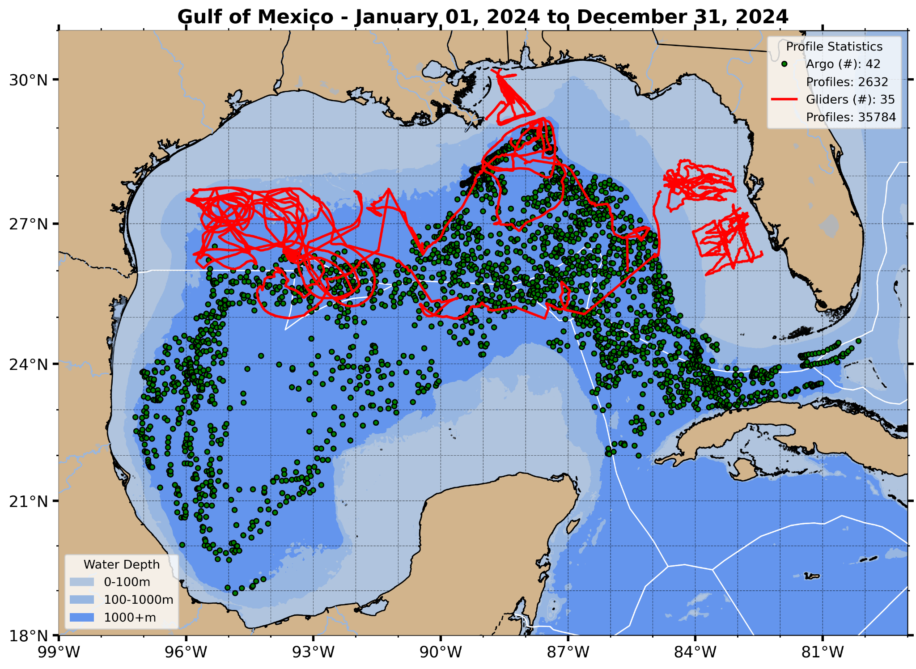
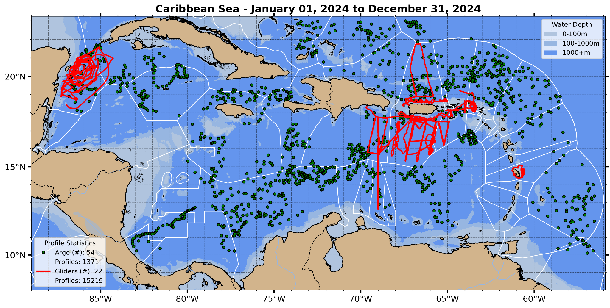
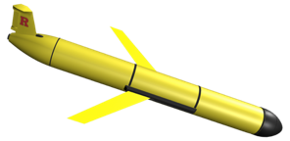
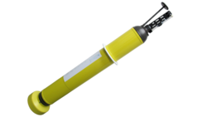
Profile Data Available for Assimilation
2024 | Gulf of Mexico | Caribbean Sea
Surface Area | 1.55M km² | 2.75M km²
Argo Profiles | 2,632 | 1,371
Glider Profiles | 35,784 | 15,219
Argo Glider

Slide 7

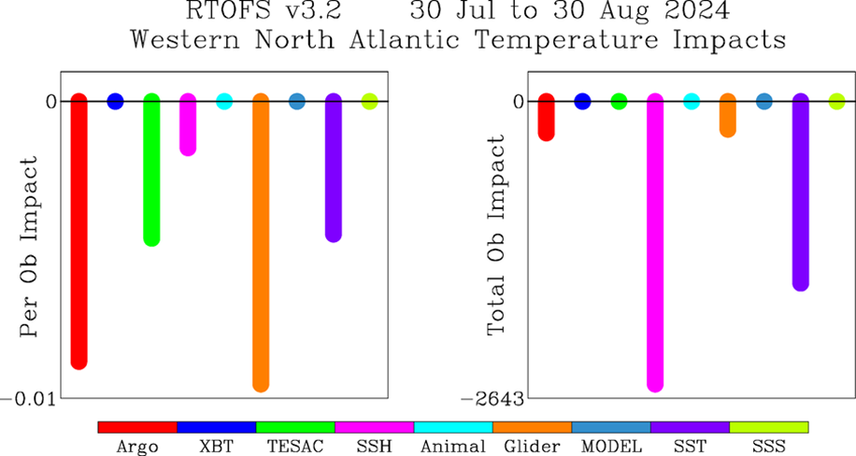
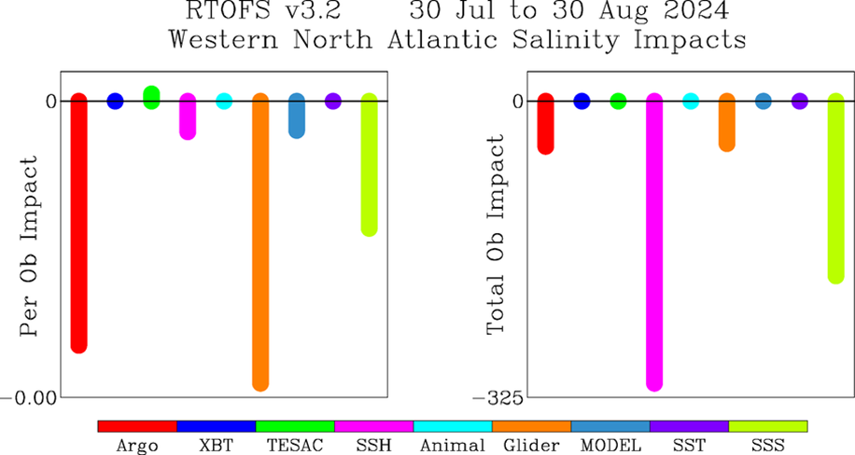
RTOFS Adjoint Model - Profile Assimilation Impacts
Temperature
Salinity
Per Ob
Total
Per Ob
Total
On a per observation basis (blue boxes), T&S profiles from Argo and Gliders outperformed all other data observing systems, including Satellite Altimetry (SSH).
This supports the idea that prioritizing T&S profiles could improve RTOFS performance the most.
Impacts Slide from NOAA Environmental Modeling Center (EMC)

Slide 8
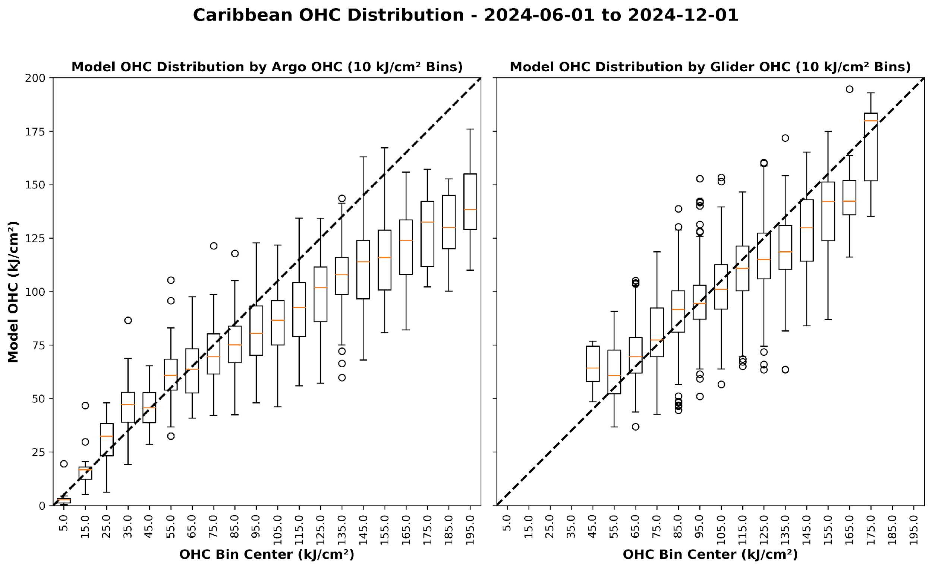
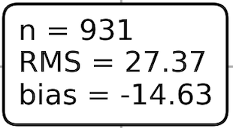
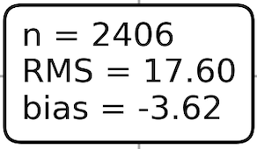


Argo & Glider OHC comparison to operational RTOFS model
Before each Profile is Assimilated in daily model runs
Argo sampling is typically 1 profile every 10 days;
Glider samping is typically multiple profiles per day
RTOFS
Cold Bias
Argo
Glider

Slide 9
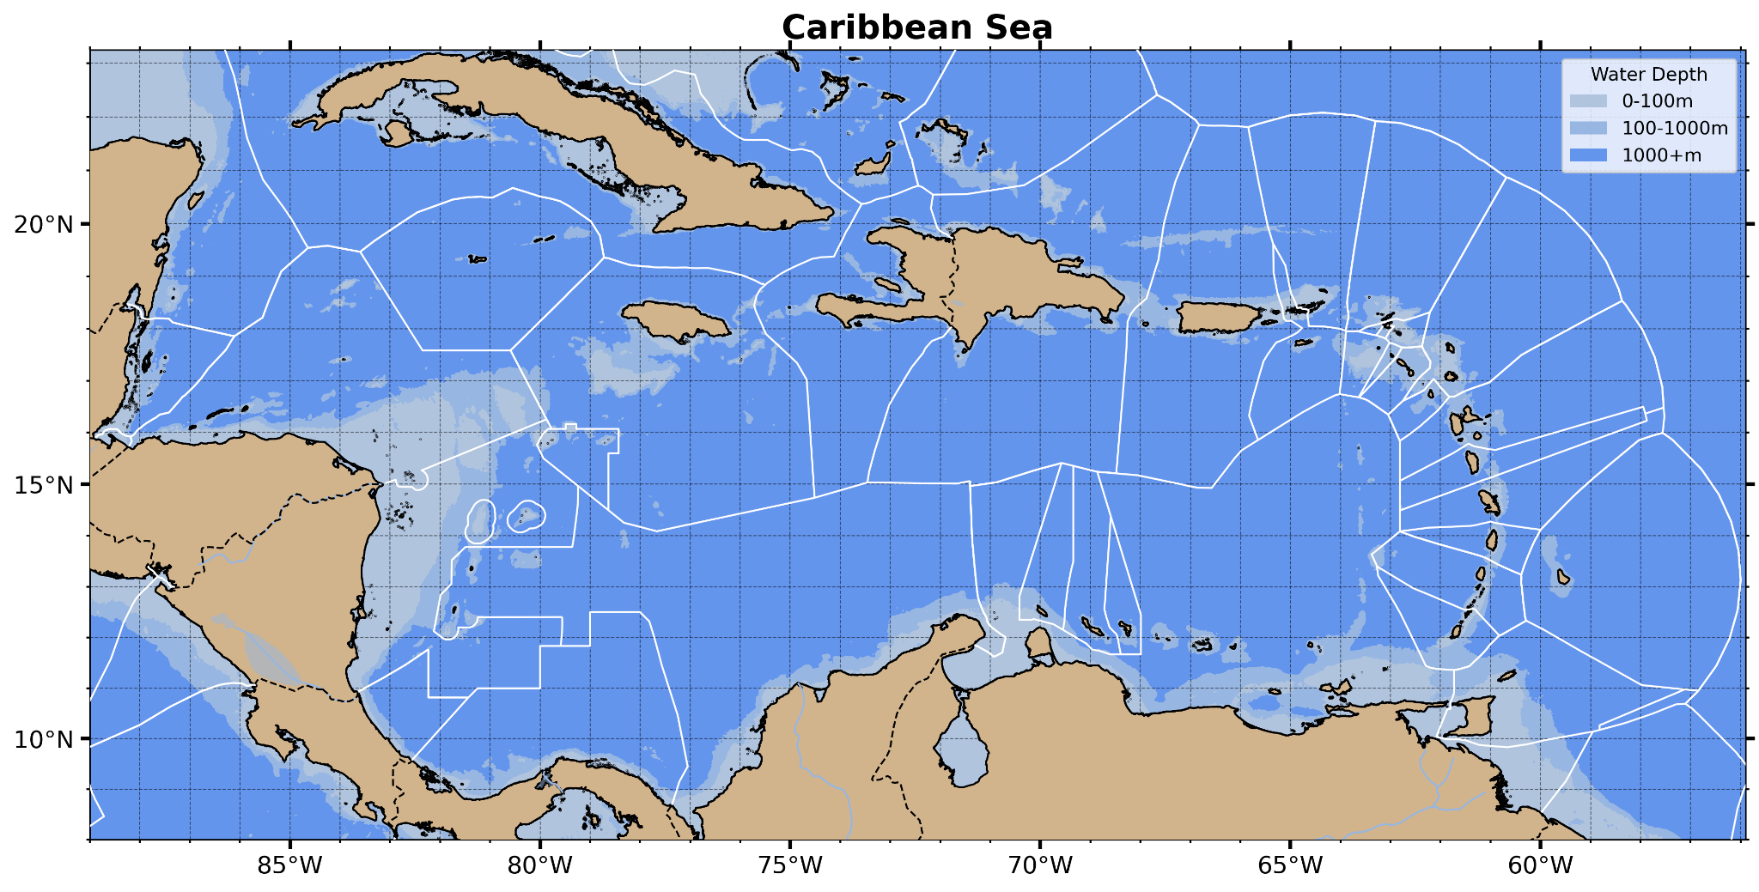
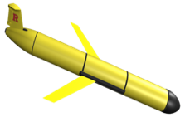
2025 Planned Caribbean Profile Observations
OceanGliders + Argo + Fishing Vessel Observation Network (FVON) provide real-time profile data for assimilation by hurricane forecast models
North Atlantic Inflow - PR-USVI-BVI
(US Hurricane Gliders)
Throughflow -
DR to Curacao
(2024 Vetlesen to US NSF)
Throughflow - Nicaraguan Bank (US NSF)
Yucatan Outflow -
Mexico
(US NAS/ Mexico)
South Atlantic Inflow - Barbados to Guyana (2025 Vetlesen)

Slide 10
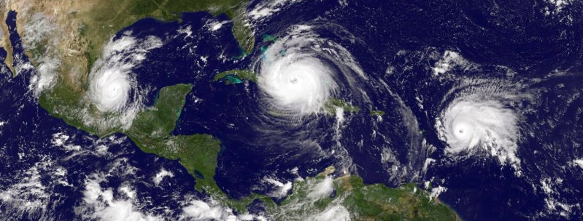
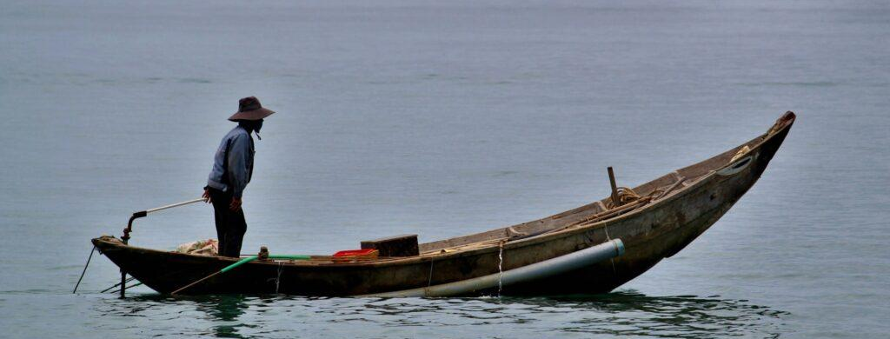
Next Steps & Resources Required
WSJ
FVON
Next steps for Caribbean:
Deliver on 2025 Hurricane Season sampling plans
Facilitate transition of FVON to mature status
Expand EEZ permissions
Continue building connections between IOCARIBE-GOOS & WMO RA-IV
Initiate RBON Process in RA-IV
Need GOOS and OCG advocacy and support for:
Argo: Increase dedicated Caribbean/storm sampling without endangering Argo’s climate mission
OceanGliders: Build the Caribbean fleet & enhance regional operator capacity
FVON: Grow local participation, monitor data flow & impact
Network Crosscut: Support for WIS 2.0 integration

Slide 11
RBON Ocean Observing Requirements - Technologies
Existing GBON Requirements
1 Sea Surface Temperature (SST) observation every hour on a 500 km resolution grid or better – Ocean Surface Buoys
Tropical Pacific Observing System (TPOS) Requirement
1 Temperature & Salinity (T&S) profile every 5 days in each 3x3 degree grid cell (~333 km resolution or better) – Argo
Candidate Recommendations for RA II RBON
Threshold – Match TPOS T&S Profile requirement in deepwater portions of RA II Marginal Seas - Argo
Breakthrough – Extend T&S profile sampling to boundary currents and coastal waters – shorter space and time scales - Gliders
Goal – Essential Ocean Features sampled with >1 T&S profile every day to match typical global ocean model assimilation cycles – Argo + Gliders

Slide 12

Key messages/Recommendations to HC-47
Key Messages:
Caribbean is undersampled; profile data is especially sparse
Operational ocean model is biased cold and fresh; Assimilation of daily profile data is especially good at improving the ocean component of coupled hurricane forecast models
2024 Glider demonstration projects (Yucatan, DR to Curacao, Martinique) used the cumbersome Marine Scientific Research (MSR) permission process to demonstrate value to both research and operations
Inspired by 2024 successes, 2025 hurricane season is an opportunity to demonstrate the value of even broader Caribbean-wide participation and three GOOS networks (OceanGliders + Argo + FVON)
Caribbean is process rich: process and data rich regions are a magnet for early career scientists
Recommendations:
Accelerate the transition from Marine Scientific Research permissions to regional agreements for operational monitoring across national jurisdictions (e.g. CARICOM; Mexico-Cuba).
Together expand foundation support for demonstration projects that establish new Glider-ports and new Glider operational areas
Leverage existing excess capacity & experience (e.g., U.S. & Mexico) to demonstrate success while building the Caribbean Glider Fleet and training local Glider operators
Provide RA IV Hurricane Committee endorsements to entities seeking funding for improved ocean observing

Slide 13
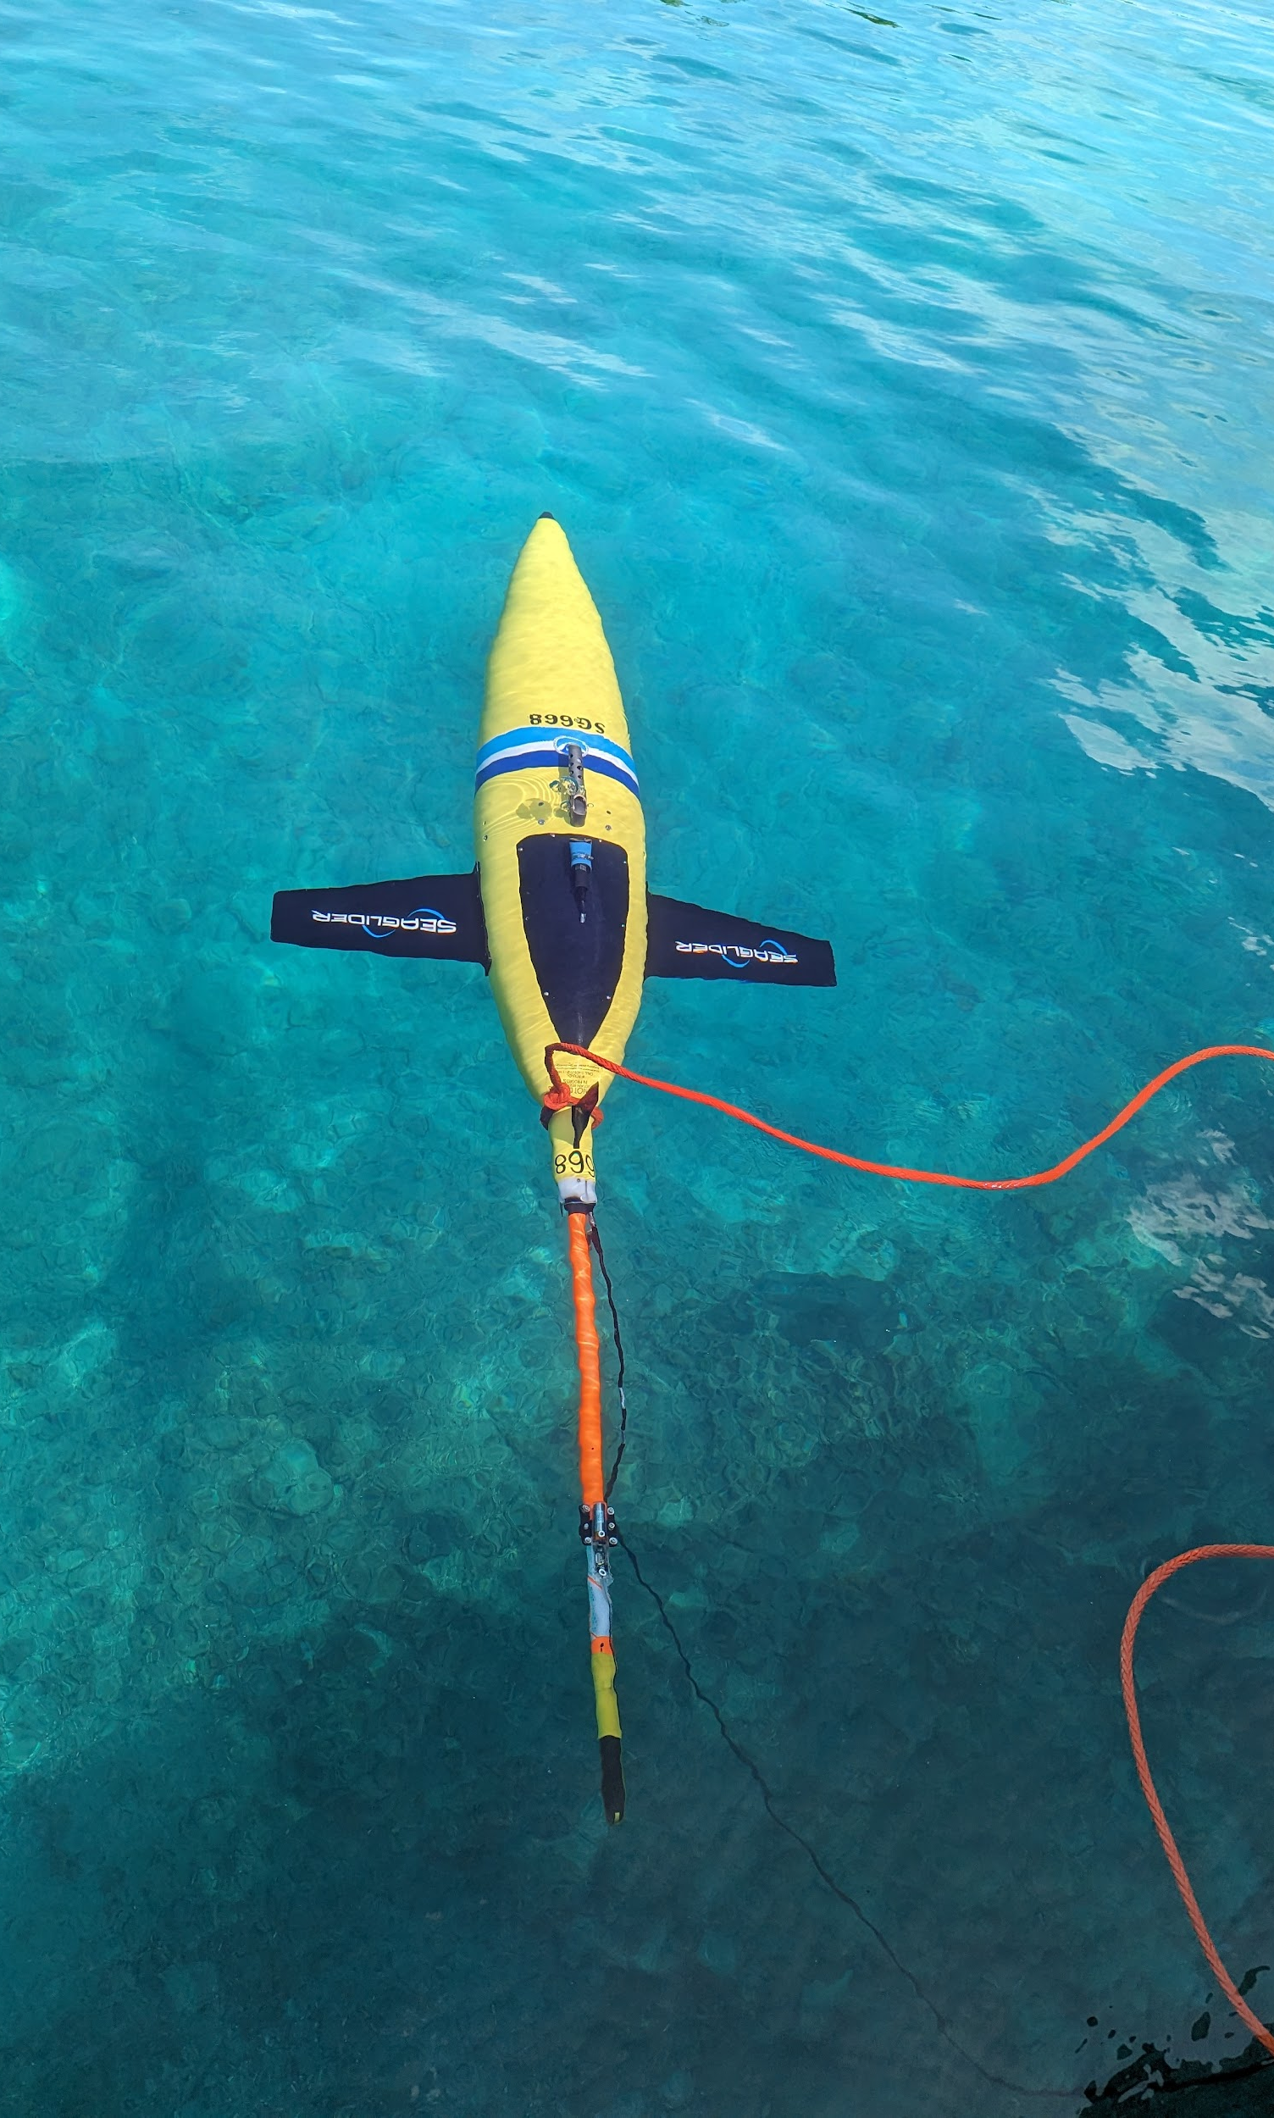
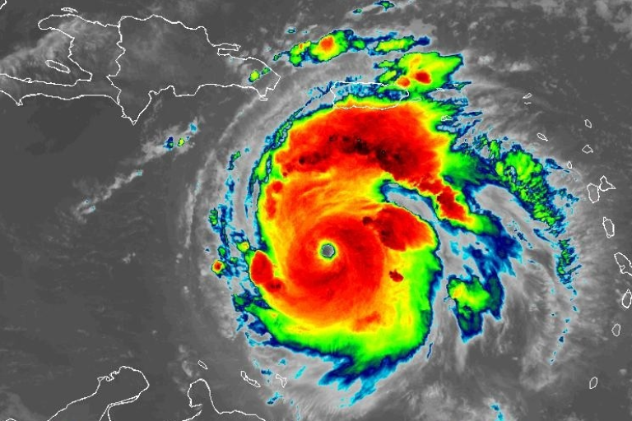
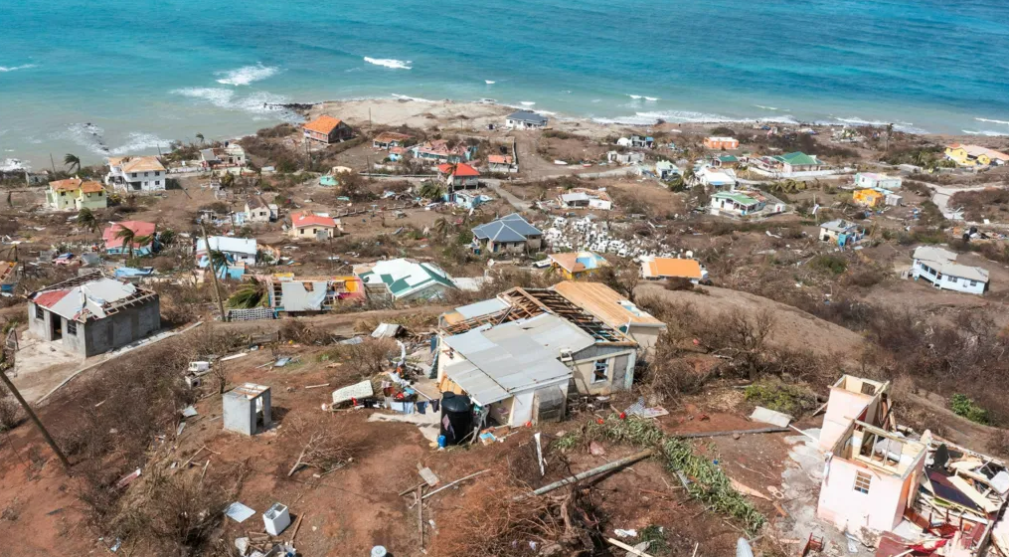
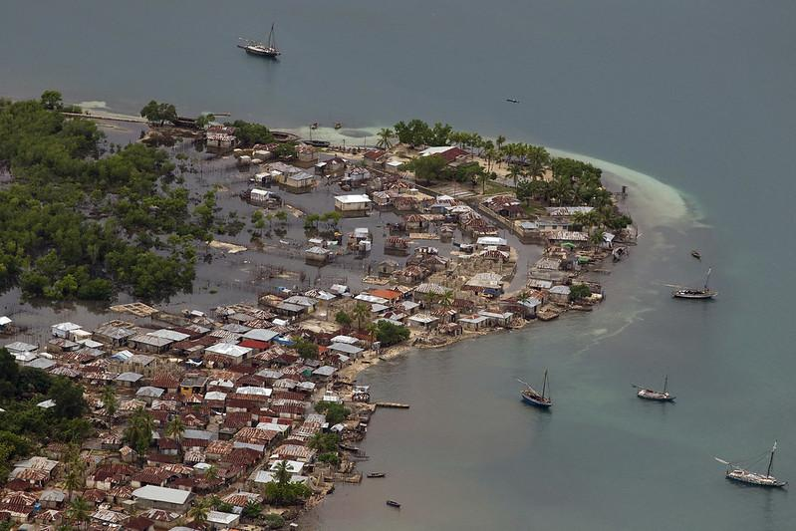
THANK YOU
NOAA
NOAA
BBC
goosocean.org
Logan Abassi / UN Photo

Slide 14
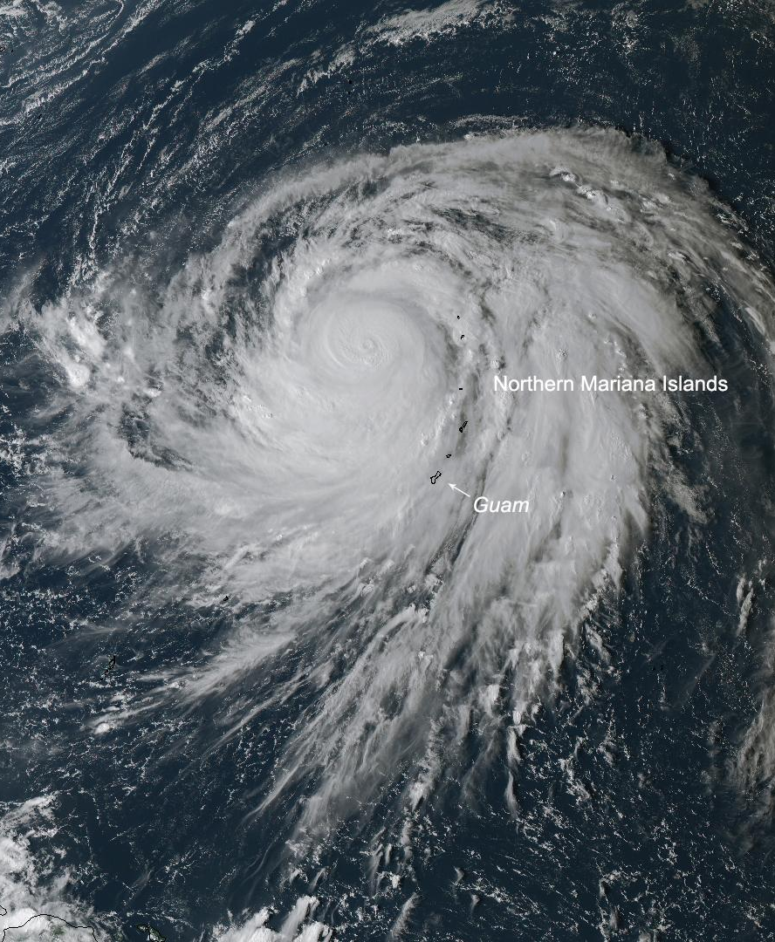
SUPPLEMENTAL
NOAA
goosocean.org

