Slide 1



Improving data-driven reconstructions of ocean dynamics: from operational to scientific applications Bruno Buongiorno Nardelli
Institute of Marine Sciences
CNR-ISMAR
motivation and rationale
strategy and ongoing projects
discussion points

Slide 2
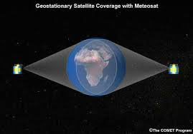

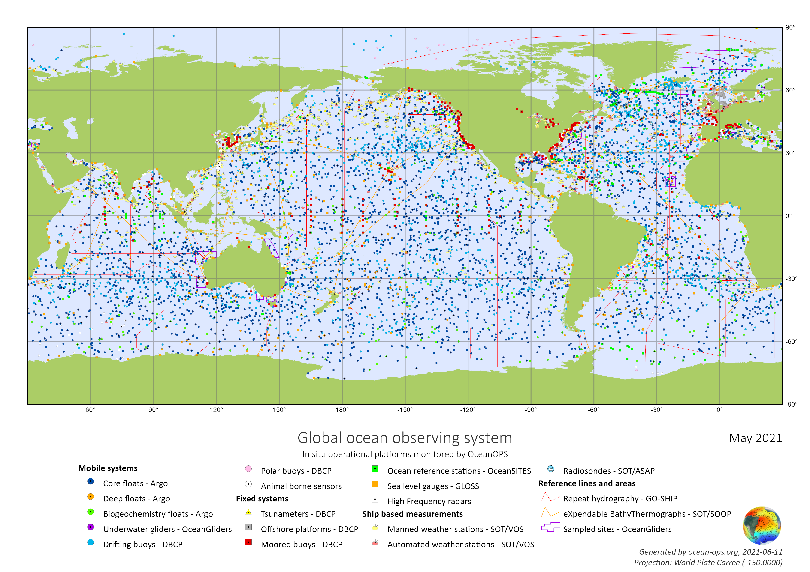
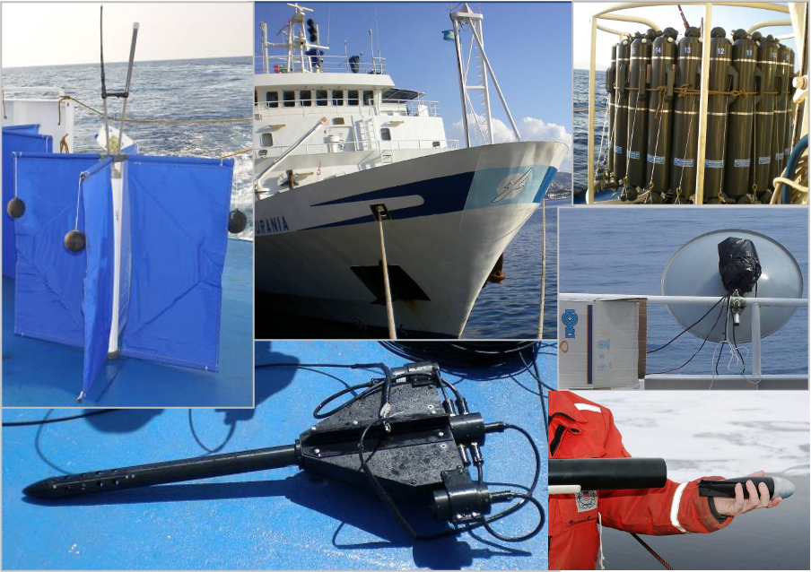

No instrumental measurement taken in isolation is capable of observing and fully describing the ocean state
(at all dynamically relevant scales)
LIMITS
Spatial/temporal coverage (e.g. moored instruments/gliders)
Spatial/temporal sampling (e.g. Argo/CTD)
Representativeness of the measurement (e.g. satellite data)
Impossibility of direct measurements (e.g. vertical velocities)
The “ocean state estimation” problem

Slide 3

CMEMS-Sea Surface Temperature-TAC
CMEMS-Multi-OBservation-TAC
2D data interpolation
ESA-Upper Ocean Dynamics
3D structure reconstruction
Strategy and ongoing projects
ESA-World Ocean Circulation
diagnostic/downscaling models development
ESA-4DMED
future observing system design
ESA-Harmony/ESA-CIMR
PNRR-ITINERIS
scientific data analysis
PNRR-CNHPC Spoke 4
H2020 AtlantECO

Slide 4
"Classical" reconstruction from observations
● Tuned to minimize differences with respect to independent observations
● Limited number of/approximated state variables
● Mostly empirical/statistical methodologies with poor to no physically-driven constraints
● Generally requires a priori knowledge of statistical properties of variables/errors
Ocean state simulation through numerical models
● Physically consistent ocean state evolution at selected scale
● Low resolution/sub-grid physics parameterized
● Affected by numerical errors
● Requires knowledge of initial state
● Requires knowledge of forcings
● Difficult to get predictions close to observations
Observed data assimilation in numerical models
● Optimal estimate based on probabilistic approach
● Not rigorously tractable due to huge number of variables and nonlinear processes characterizing the ocean state
● Does not improve model physics/parameterizations
● Requires a priori knowledge of statistical properties of errors
The “ocean state estimation” problem
Model output assimilation in data-driven reconstruction
● Learns (inverse) mapping from numerical model output to simulated observing system data
● "Gray-box" models, but can include physically-based constraints
● Requires dedicated Observing System Simulation Experiments
● Limited number of state variables
● surrogate model driven/limited by numerical model physics
Direct data-driven modelling
● Learns (inverse) mapping from high accuracy/resolution observations to low-resolution/partial data
● "Gray-box" models, but can be used to learn or impose physically-based constraints
● Limited number of state variables
● potential to exploit new satellite missions (SWOT, Harmony)

Slide 5
"Classical" reconstruction from observations
● Tuned to minimize differences with respect to independent observations
● Limited number of/approximated state variables
● Mostly empirical/statistical methodologies with poor to no physically-driven constraints
● Generally requires a priori knowledge of statistical properties of variables/errors
Ocean state simulation through numerical models
● Physically consistent ocean state evolution at selected scale
● Low resolution/sub-grid physics parameterized
● Affected by numerical errors
● Requires knowledge of initial state
● Requires knowledge of forcings
● Difficult to get predictions close to observations
Observed data assimilation in numerical models
● Optimal estimate based on probabilistic approach
● Not rigorously tractable due to huge number of variables and nonlinear processes characterizing the ocean state
● Does not improve model physics/parameterizations
● Requires a priori knowledge of statistical properties of errors
The “ocean state estimation” problem
Model output assimilation in data-driven reconstruction
● Learns (inverse) mapping from numerical model output to simulated observing system data
● "Gray-box" models, but can include physically-based constraints
● Requires dedicated Observing System Simulation Experiments
● Limited number of state variables
● surrogate model driven/limited by numerical model physics
Direct data-driven modelling
● Learns (inverse) mapping from high accuracy/resolution observations to low-resolution/partial data
● "Gray-box" models, but can be used to learn or impose physically-based constraints
● Limited number of state variables
● potential to exploit new satellite missions (SWOT, Harmony)

Slide 6
"Classical" reconstruction from observations
● Tuned to minimize differences with respect to independent observations
● Limited number of/approximated state variables
● Mostly empirical/statistical methodologies with poor to no physically-driven constraints
● Generally requires a priori knowledge of statistical properties of variables/errors
Ocean state simulation through numerical models
● Physically consistent ocean state evolution at selected scale
● Low resolution/sub-grid physics parameterized
● Affected by numerical errors
● Requires knowledge of initial state
● Requires knowledge of forcings
● Difficult to get predictions close to observations
Observed data assimilation in numerical models
● Optimal estimate based on probabilistic approach
● Not rigorously tractable due to huge number of variables and nonlinear processes characterizing the ocean state
● Does not improve model physics/parameterizations
● Requires a priori knowledge of statistical properties of errors
The “ocean state estimation” problem
Model output assimilation in data-driven reconstruction
● Learns (inverse) mapping from numerical model output to simulated observing system data
● "Gray-box" models, but can include physically-based constraints
● Requires dedicated Observing System Simulation Experiments
● Limited number of state variables
● surrogate model driven/limited by numerical model physics
Direct data-driven modelling
● Learns (inverse) mapping from high accuracy/resolution observations to low-resolution/partial data
● "Gray-box" models, but can be used to learn or impose physically-based constraints
● Limited number of state variables
● potential to exploit new satellite missions (SWOT, Harmony)

Slide 7
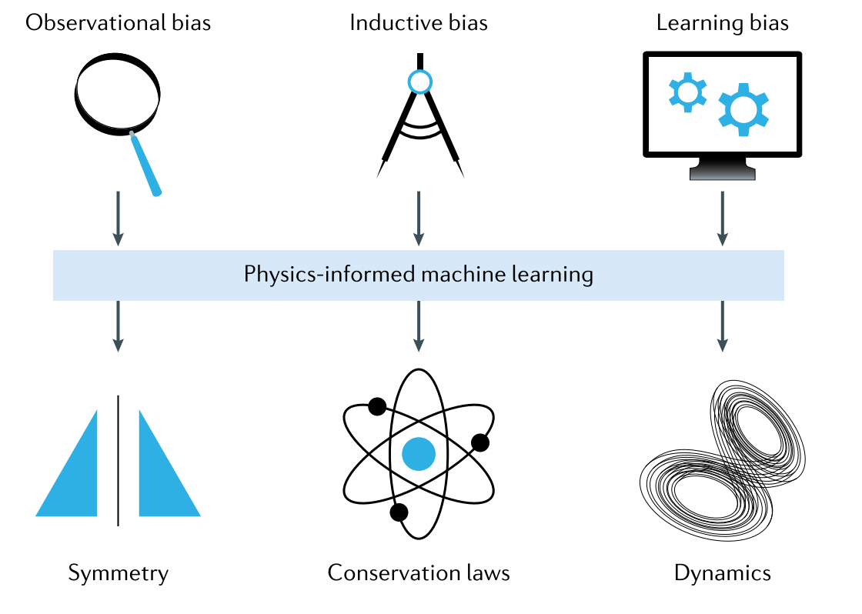
Physically-informed machine learning approach
→designed to introduce appropriate observational, inductive or learning biases in the models in order to obtain physically consistent solutions
Observational biases originate from the choise data that inherently reflects the underlying physics (very soft constraints)
Inductive biases refer to pre-existing assumptions that can be integrated within the architecture of a machine learning model
(hard constraints, usually difficult to implement except for simple properties)
Learning biases are introduced by appropriate choice of loss functions, constraints, and inference algorithms enforcing the training process to converge towards solutions that adhere to known physical laws
(soft constraint, efficient implementations)
The “ocean state estimation” problem
Karniadakis, G. E., I. G. Kevrekidis, L. Lu, P. Perdikaris, S. Wang, and L. Yang, 2021: Physics-informed machine learning. Nat. Rev. Phys., 3, 422–440, https://doi.org/10.1038/s42254-021-00314-5.

Slide 8



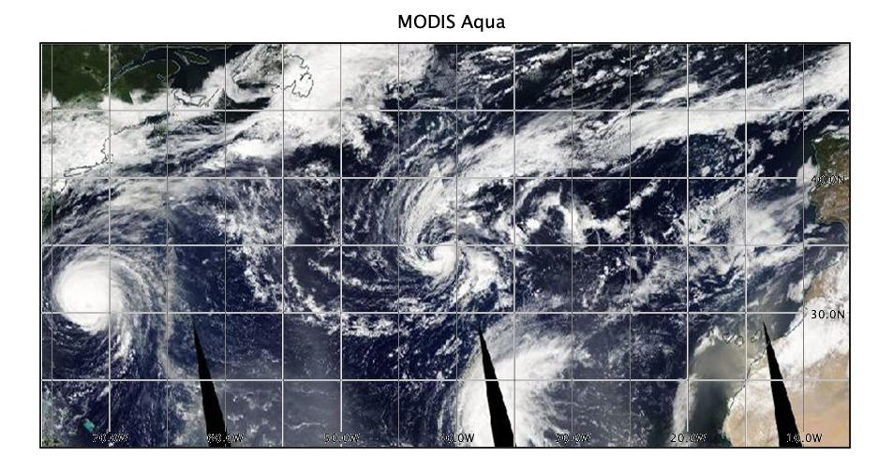
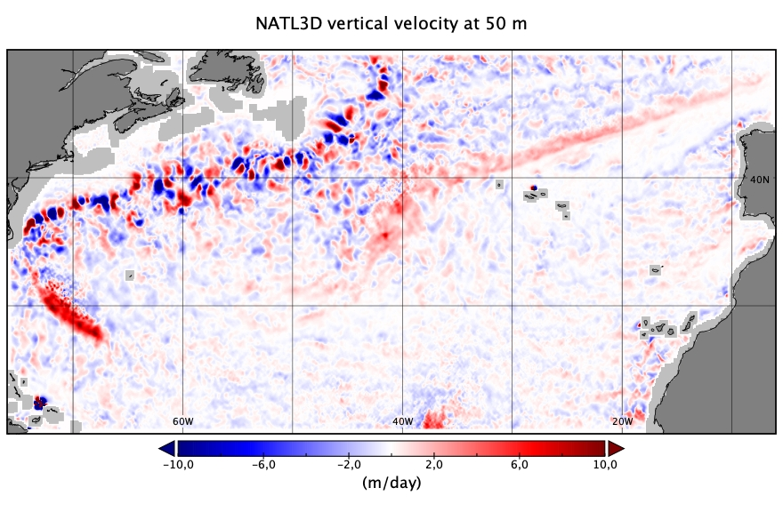

Reconstruction of 3D Quasi-Geostrophic Currents from combined satellite-in situ data
B. Buongiorno Nardelli, S. Asdar, D. Ciani, M. Sammartino

Slide 9
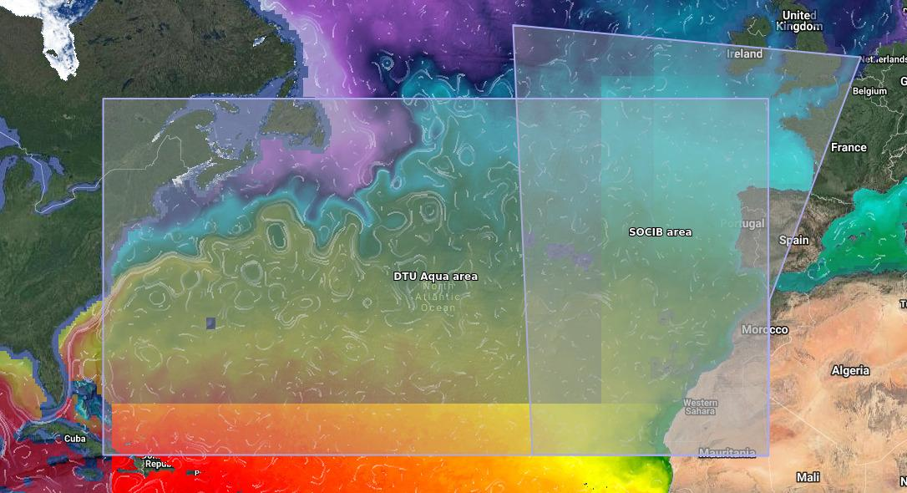
Context
Theme 2 WOC-NATL3D
Improve our knowledge of the 3D transport and environmental conditions and that are known to potentially affect key biological and ecological processes in the upper ocean
Develop new products to explore of the potential impact of long term oceanic variability on the population dynamics of different fish species.
→New product tested by intermediate users active in fishery advisory bodies (e.g. ICCAT, ICES) working groups and projects to achieve maximum impact in support of sustainable fishery.
The main interest is to:
investigate the role of frontal meanders and eddies in the and dispersal of larvae of selected species (keeping in mind the possibility of diel vertical migrations from the surface down to few hundreds meters)
assess the vertical exchanges at the base of the euphotic layer and their potential impact on primary productivity
SOCIB | Diego Alvarez | Spain | http://www.socib.eu/
DTU Aqua | Patrizio Mariani | Denmark | https://www.aqua.dtu.dk/english

Slide 10
Methods & Data
WOC-NATL3D product development and processing steps
TARGET
2010-2019 daily 3D (0-1500 m) quasi-geostrophic ocean currents (u,v,w), at 1/10°x1/10°, North Atlantic Ocean (20°N-50°N, 76°W-6°W)
Three steps:
Collect/develop high resolution surface data
Sea Surface Temperature (SST)
Sea Surface Salinity (SSS)
Absolute Dynamic Topography (ADT)
2. Retrieve ocean 3D hydrographic structure from combined surface data and in situ vertical profiles
Feed-Forward Neural Network (FFNN)
Bi-directional Long Short-Term Memory Network (Bi-LSTM)
Long Short-Term Memory Network (LSTM)
LSTM plus 1-Dimensional Convolutional Layer (LSTM+Conv1D)
3. Solve diabatic Quasi-Geostrophic Omega equation including surface forcings
adapt Copernicus Marine Service OMEGA3D processing chain to NATL3D domain/resolution
improve forcings

Slide 11
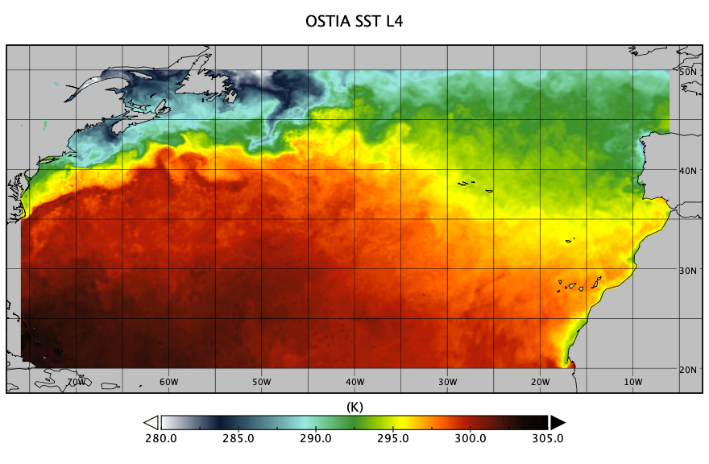
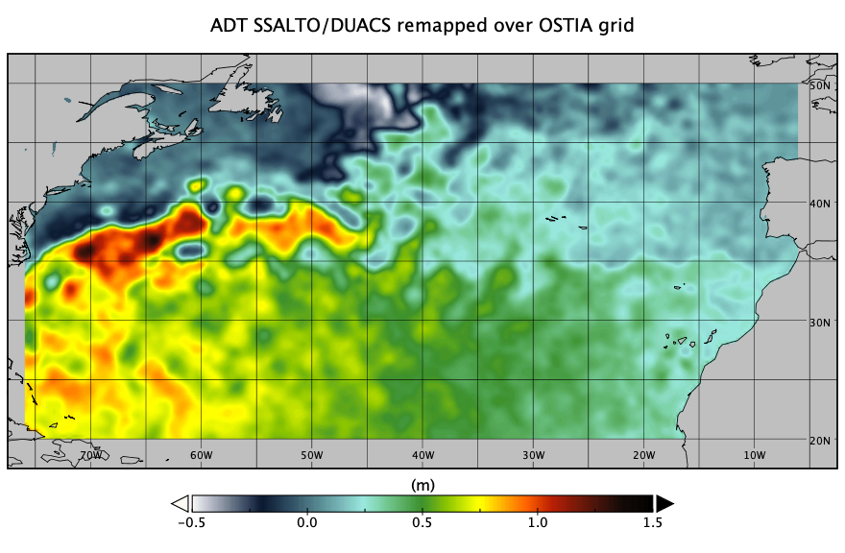
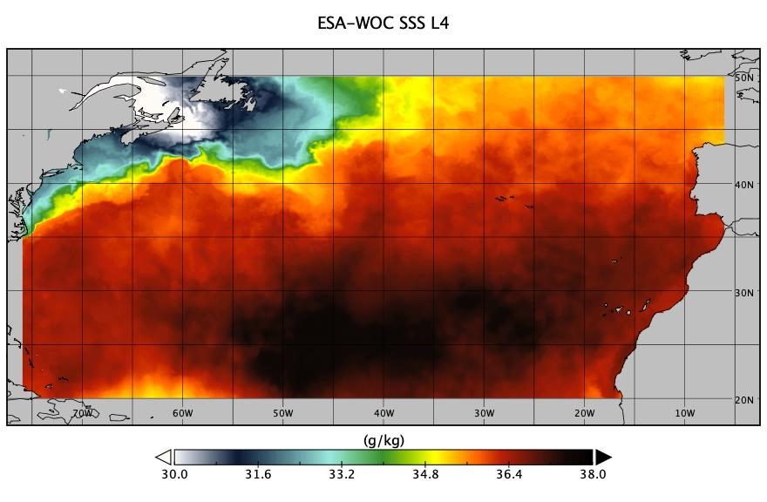
Methods & Data
WOC-NATL3D input high resolution surface data
Sea Surface Temperature (SST) → OSTIA (UK Metoffice)
ESA-WOC Sea Surface Salinity (SSS) →new ESA-WOC daily product at 1/10°
Absolute Dynamic Topography (ADT) →new ESA-WOC product: NATL2D

Slide 12
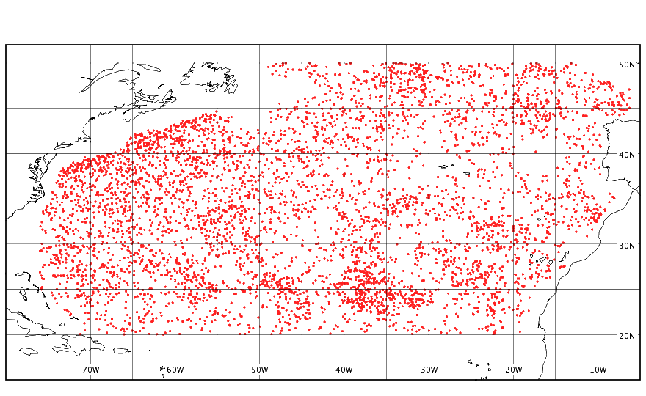
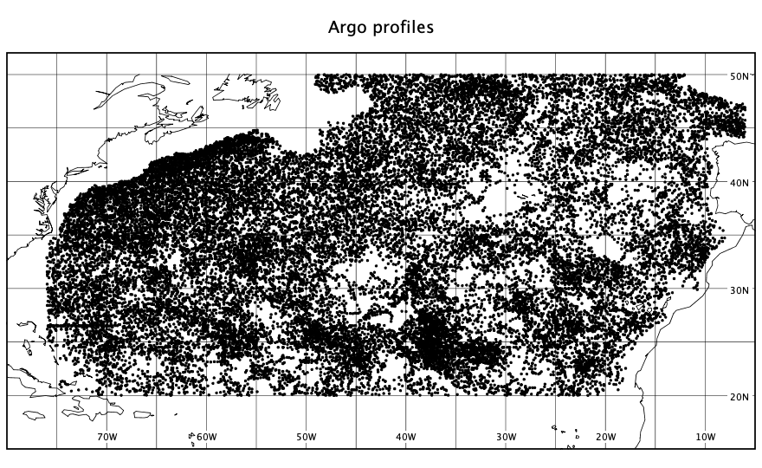
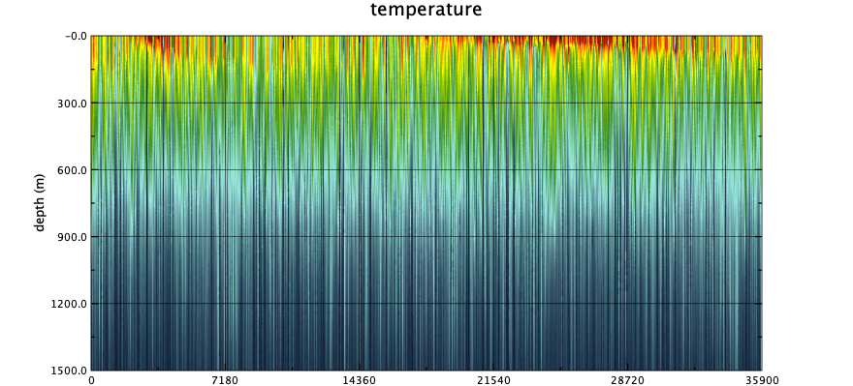
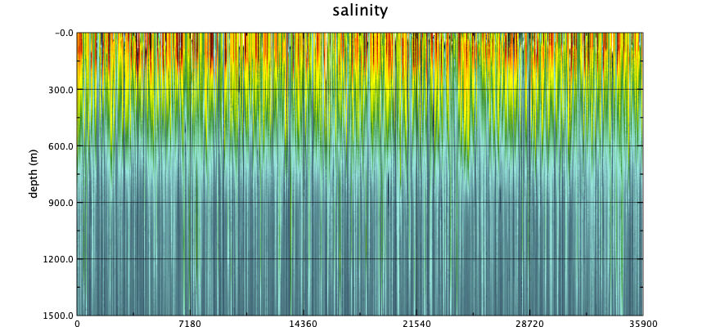
Methods & Data
WOC-NATL3D input in situ vertical profiles
CMEMS CORA 5.2 quality controlled temperature and salinity from CTD and Argo profiles (Szekely et al., 2019)
WORLD OCEAN ATLAS 13 monthly objectively analyzed (1°x1° grid) climatological fields of in situ temperature, salinity
test data
training dataset
test dataset (independent from training)

Slide 13
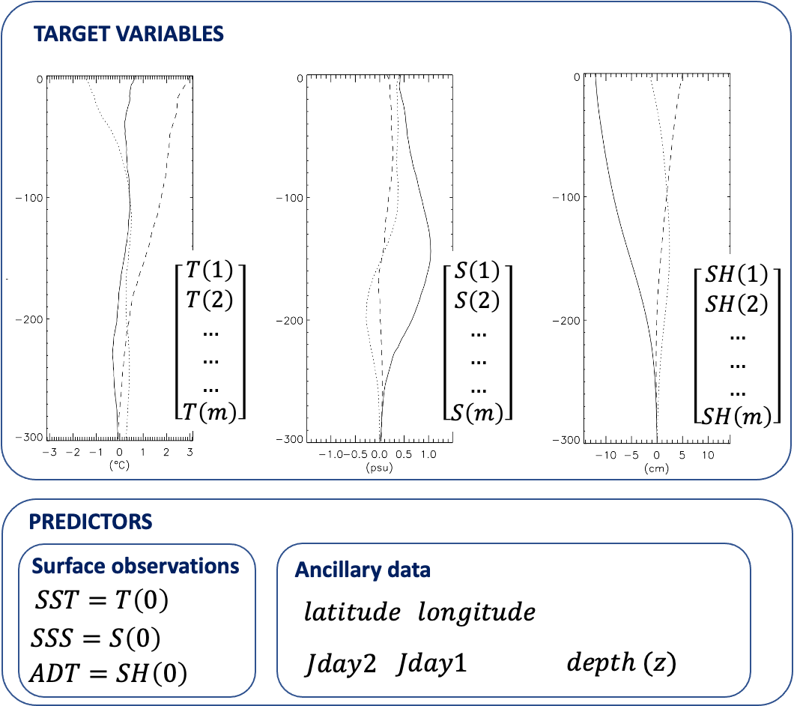
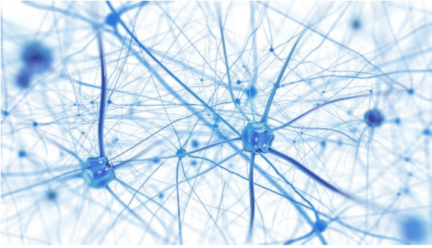
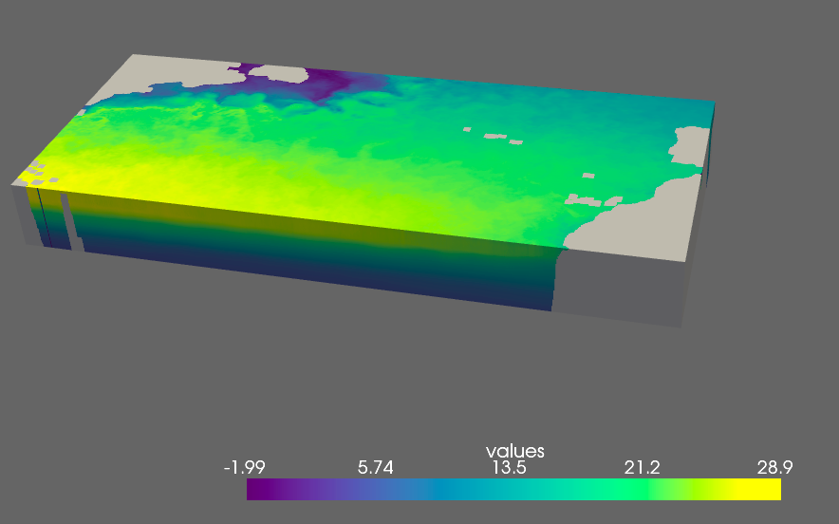


Methods & Data
Neural network model to estimate vertical profiles and associated errors
$$y=ℳ\left(x\right)=f(h\left(…\left(x\right)\right) →Neural Network$$
$$y$$
$$x$$

Slide 14
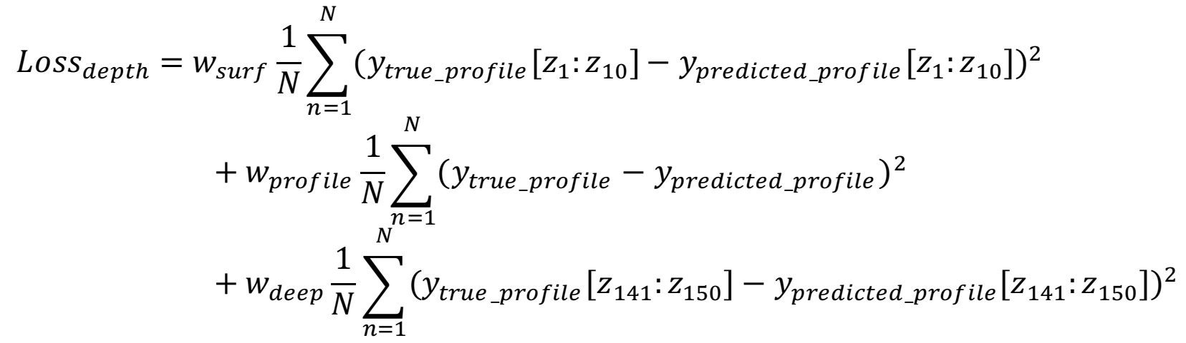
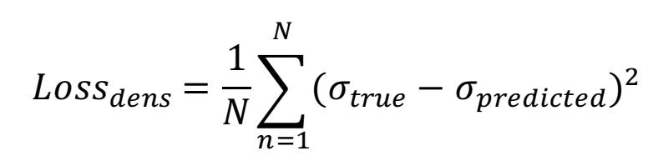
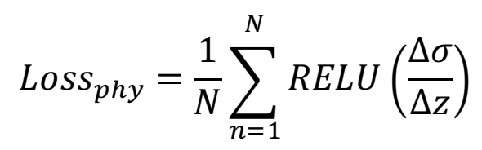
Methods & Data
Neural network model to estimate vertical profiles and associated errors
$$y=ℳ\left(x\right)=f(h\left(…\left(x\right)\right) →Neural Network$$
Physically-informed DNN
1.
2.
enforcing consitency between density estimated from predicted T/S (through the equation of state) and true density profiles
3.
constraining the profile to be statically stable by penalizing the predictions that contain density inversions

Slide 15
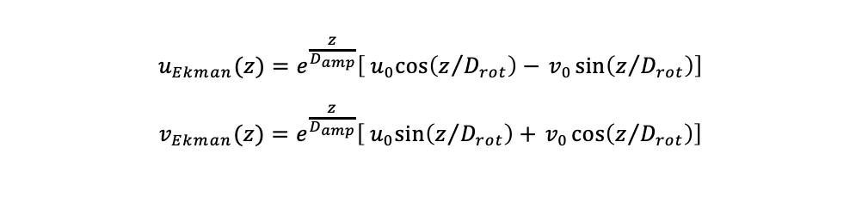


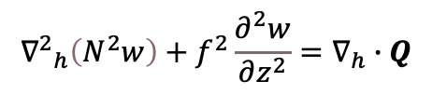

Methods & Data
From 3D tracers and geostrophic currents to full 3D dynamics: Omega Equation
Q-vector formulation of the quasi-geostrophic Omega equation solved to get the vertical velocity fields
$${{∇^{2}}_{h}\left(N^{2}w\right)+f}^{2}\frac{∂^{2}w}{∂z^{2}}=∇_{h}∙Q$$
$$Q=2Q_{twg}+Q_{th}+Q_{dm}$$
kinematic deformation
$$Q_{twg}=\frac{g}{ρ_{0}}\left(\frac{∂u_{g}}{∂x}\frac{∂ρ}{∂x}+\frac{∂v_{g}}{∂x}\frac{∂ρ}{∂y},\frac{∂u_{g}}{∂y}\frac{∂ρ}{∂x}+\frac{∂v_{g}}{∂y}\frac{∂ρ}{∂y}\right)$$
turbulent momentum
$$Q_{dm_WOC}=\frac{f}{ρ_{0}}\left(\frac{∂^{2}}{∂z^{2}}\left[{ρK}_{m}\left(\frac{∂v_{g}}{∂z}+\frac{∂v_{Ekman}}{∂z}\right)\right],−\frac{∂^{2}}{∂z^{2}}\left[ρK_{m}\left(\frac{∂u_{g}}{∂z}+\frac{∂u_{Ekman}}{∂z}\right)\right]\right)$$
→combination of empirical estimates and KPP for tracers non-local effective gradient, γ_{ρ}, and viscosity/diffusivity, K_{x}.
turbulent buoyancy
$$Q_{th}={−\frac{g}{ρ_{0}}∇}_{h}\left(\frac{∂}{∂z}\left[K_{ρ}\left(\frac{∂ρ}{∂z}−γ_{ρ}\right)\right]\right)=∇_{h}\left(\frac{∂}{∂z}\left[K_{ρ}\left(N^{2}+\frac{g}{ρ_{0}}γ_{ρ}\right)\right]\right)$$
$$u_{Ekman}(z)=e^{\frac{z}{D_{amp}}}\left[{ u}_{0}\cos\left(z/{D_{rot}}\right)−{ v}_{0}\sin\left(z/{D_{rot}}\right)\right]$$
$$v_{Ekman}(z)=e^{\frac{z}{D_{amp}}}\left[{ u}_{0}\sin\left(z/{D_{rot}}\right)+{ v}_{0}\cos\left(z/{D_{rot}}\right)\right]$$
background Ekman velocity approximated through an analytical fit to CMEMS Ekman empirical reconstruction (MULTIOBS_GLO_PHY_REP_015_004)
viscosity in the Ekman layer constrained by analytical profile (defined as in Nagai et al., 2006) estimated empirically (i.e.limited by local Ekman amplitude decay scale)
$$K_{m}\left(z\right)=K_{max}\left[1+tanh\left(\frac{z−D_{amp}}{δ}\right)\right]$$
$$K_{max}=\frac{fD_{amp}^{2}}{2}$$

Slide 16


Adaptive Deep Residual networks to super-resolve sea surface observations from ocean model dynamics: application to the Mediterranean Sea
B. Buongiorno Nardelli, D.Ciani, D. Cavaliere, E. Charles, C. Fanelli

Slide 17
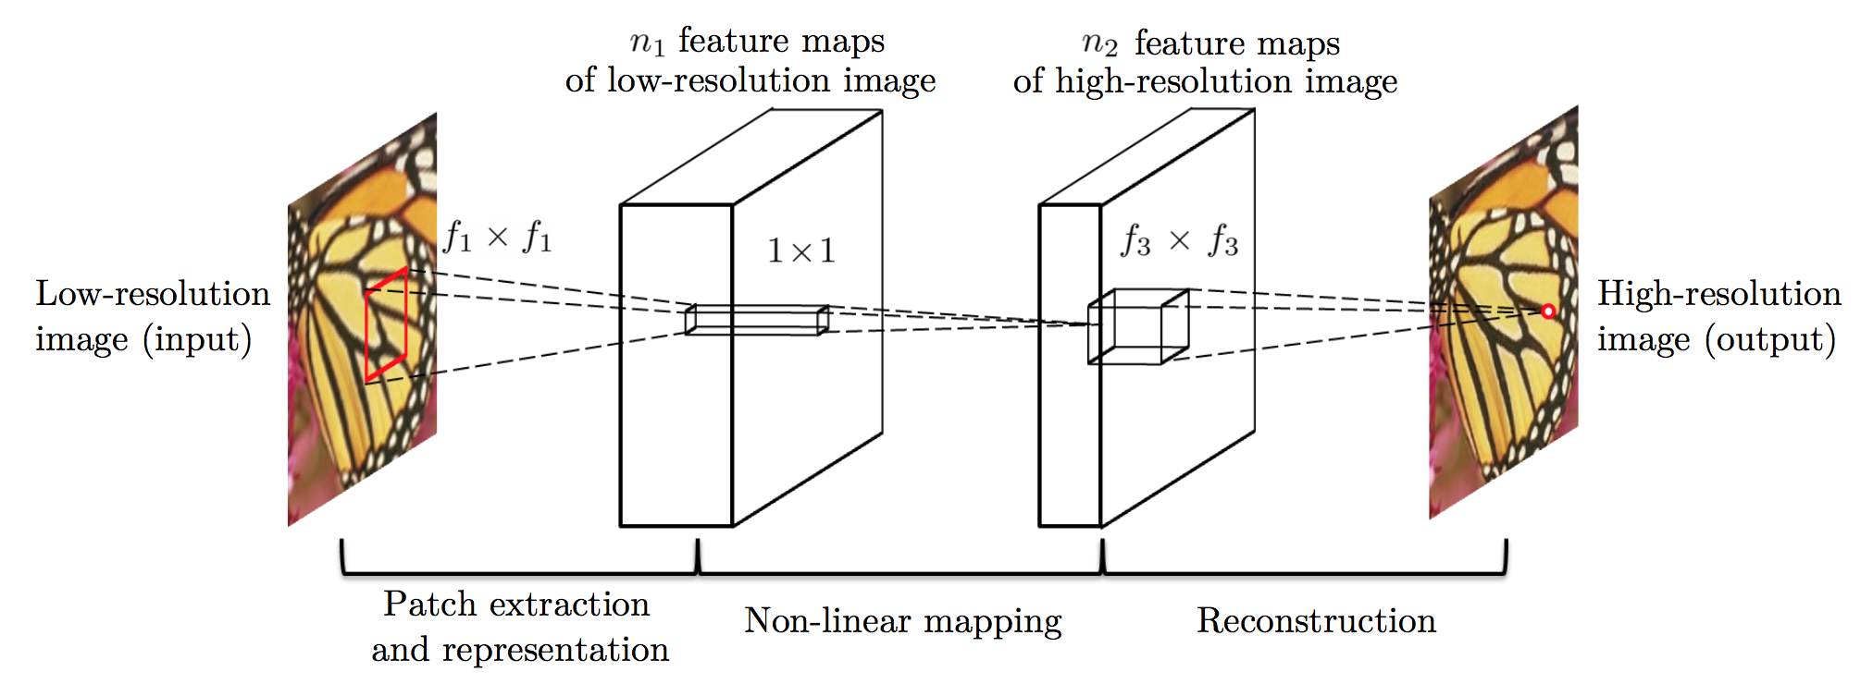
﻿Single image super-resolution learns an end-to-end mapping between low resolution and corresponding high-resolution images. The mapping is modelled as a deep Convolutional Neural Network.
SR-CNN was designed to improve details in blurred photographs
Super-Resolution CNN
Source : Dong et al., 2016, https://arxiv.org/abs/1501.00092
How can we apply super-resolution to surface ocean dynamics?
Model output assimilation in data-driven reconstruction
● Learns (inverse) mapping from numerical model output to simulated observing system data
● "Gray-box" models, but can include physically-based constraints
● Requires dedicated Observing System Simulation Experiments
● Limited number of state variables
● surrogate model driven/limited by numerical model physics
Direct data-driven super-resolution
● Learns (inverse) mapping from (future) high resolution observations to low-resolution data
● "Gray-box" models, but can be used to learn physically-based constraints
● Limited number of state variables
● need to wait for accurately filtered SWOT data, Harmony(2030)

Slide 18
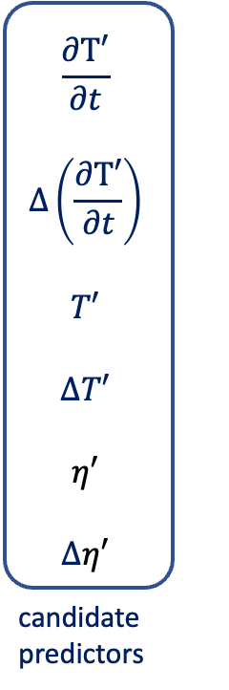
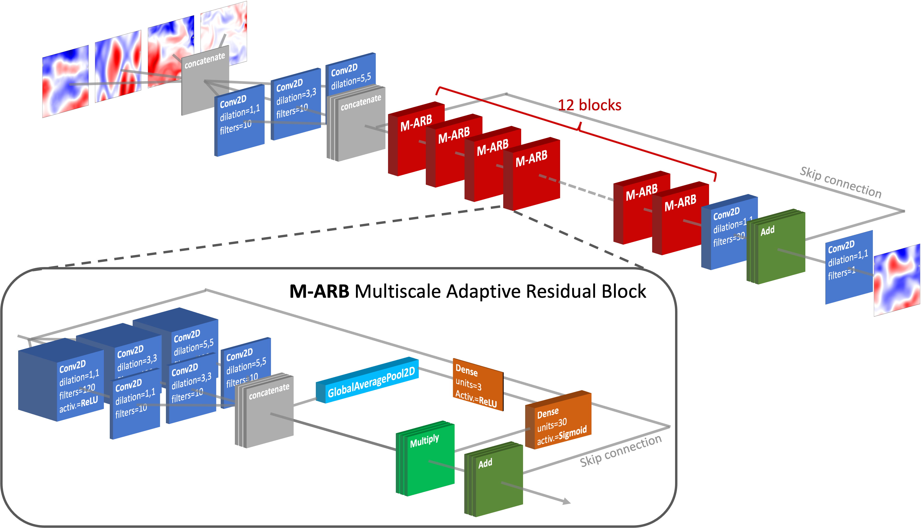
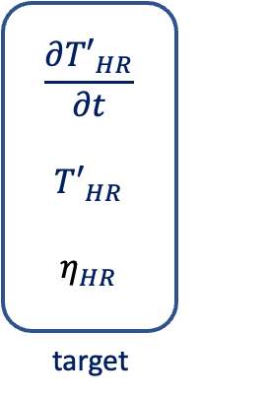
﻿Single image super-resolution learns an end-to-end mapping between low resolution and corresponding high-resolution images. The mapping is modelled as a deep Convolutional Neural Network.
Super-Resolution CNN
Model output assimilation in data-driven reconstruction
● Learns (inverse) mapping from numerical model output to simulated observing system data
● "Gray-box" models, but can include physically-based constraints
● Requires dedicated Observing System Simulation Experiments
● Limited number of state variables
● surrogate model driven/limited by numerical model physics
Direct data-driven super-resolution
● Learns (inverse) mapping from (future) high resolution observations to low-resolution data
● "Gray-box" models, but can be used to learn physically-based constraints
● Limited number of state variables
● need to wait for accurately filtered SWOT data, Harmony(2030)

Slide 19
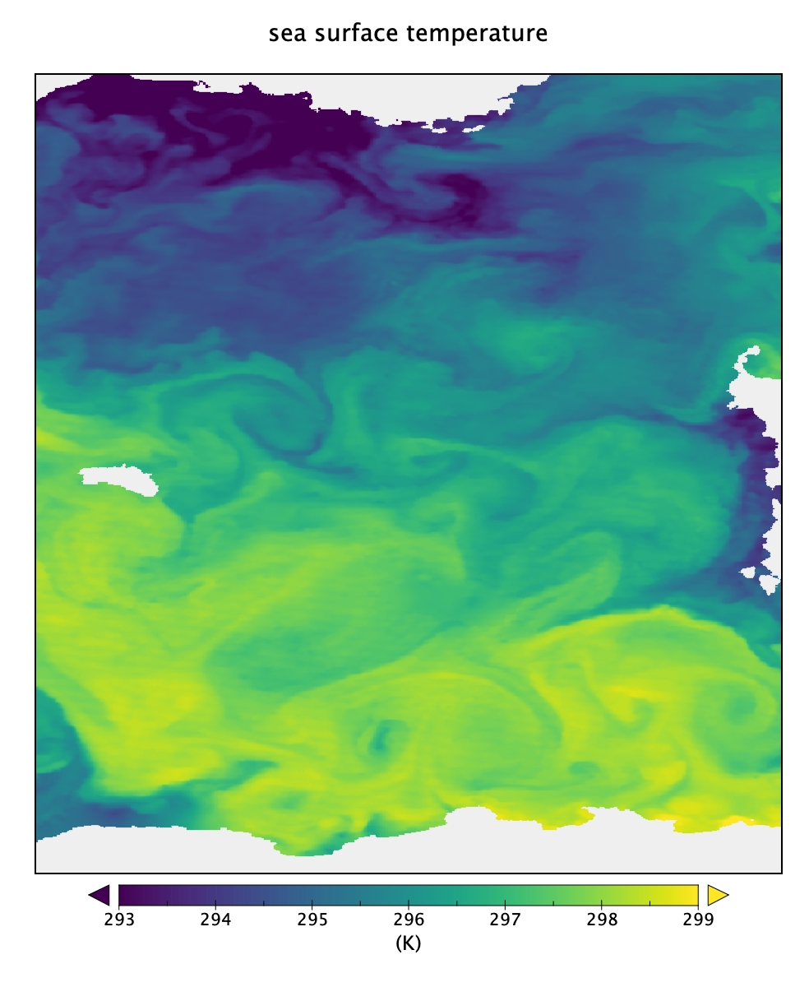
Artificial Intelligence for Ocean Dynamics
Satellite Sea Surface Temperature images contain a lot of dynamical information at high spatial and temporal resolution

Slide 20
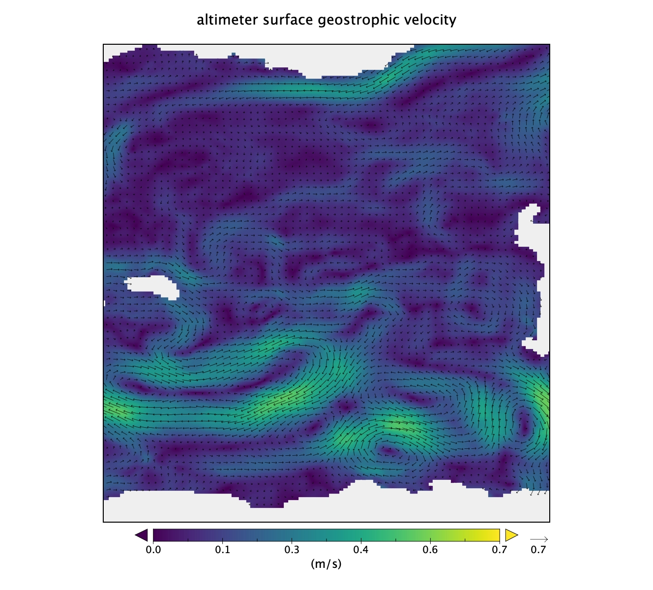
Artificial Intelligence for Ocean Dynamics
Satellite Sea Surface Temperature images contain a lot of dynamical information at high spatial and temporal resolution
Currents derived from satellite altimetry miss several dynamical features due to poor sampling

Slide 21
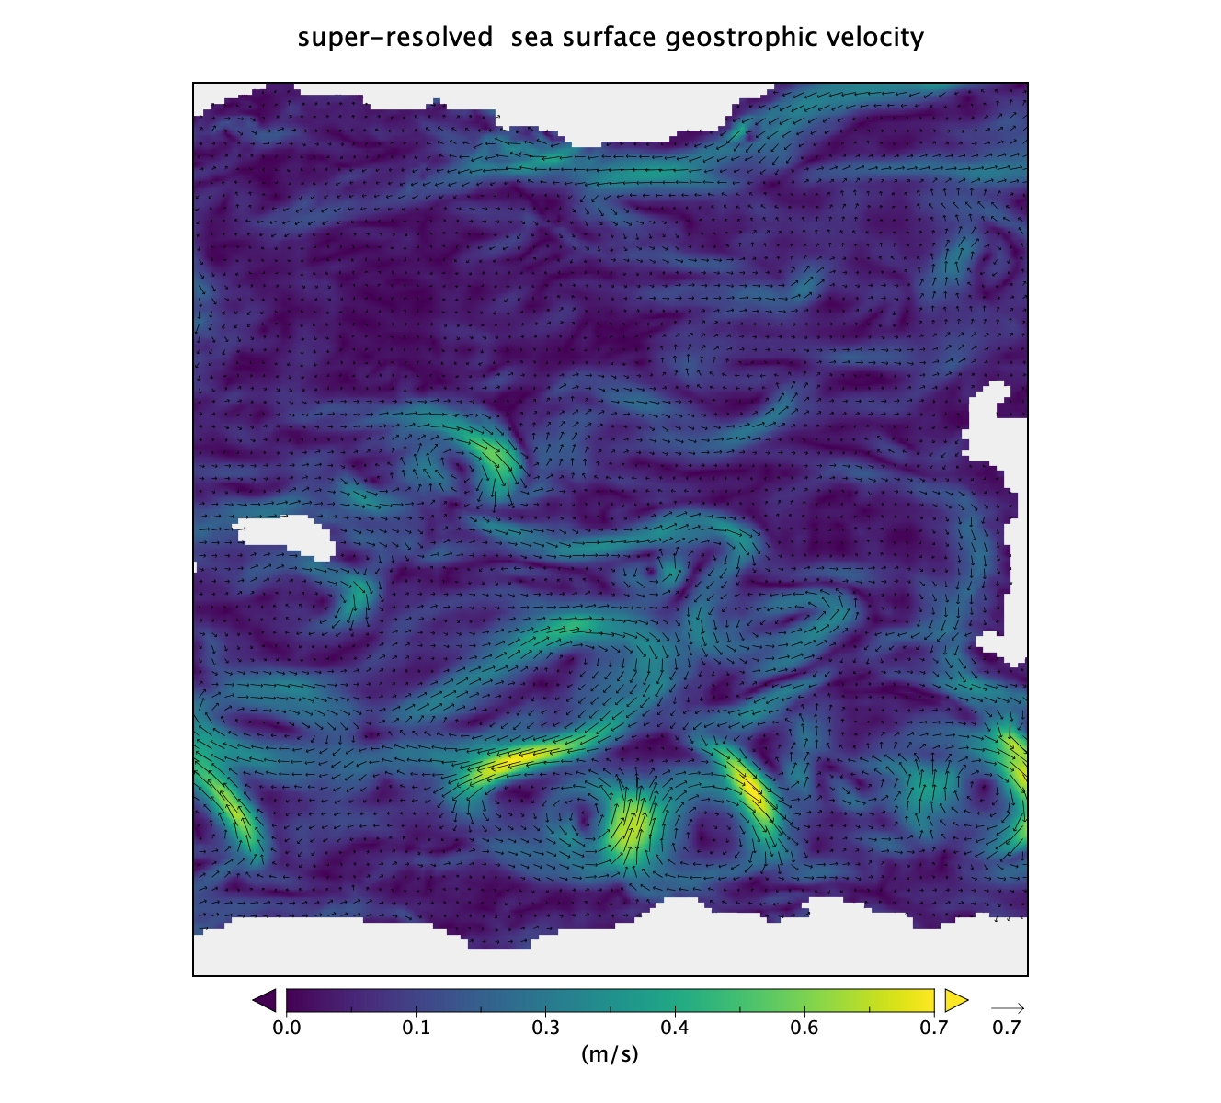
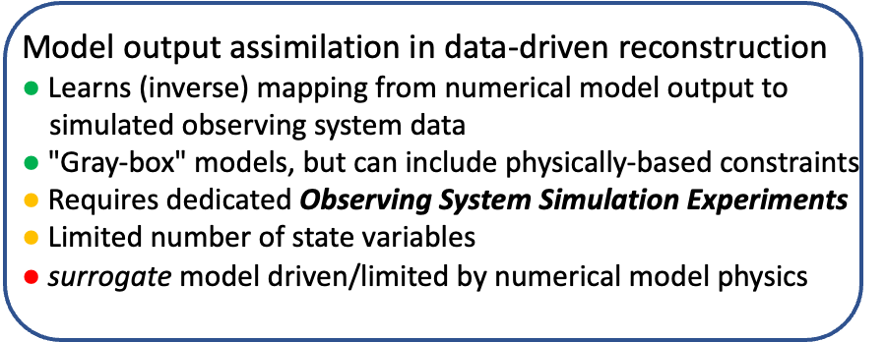
Artificial Intelligence for Ocean Dynamics
Satellite Sea Surface Temperature images contain a lot of dynamical information at high spatial and temporal resolution
Currents derived from satellite altimetry miss several dynamical features due to poor sampling
The Loss function includes one term imposing physical constraints based on temperature advection equation

Slide 22
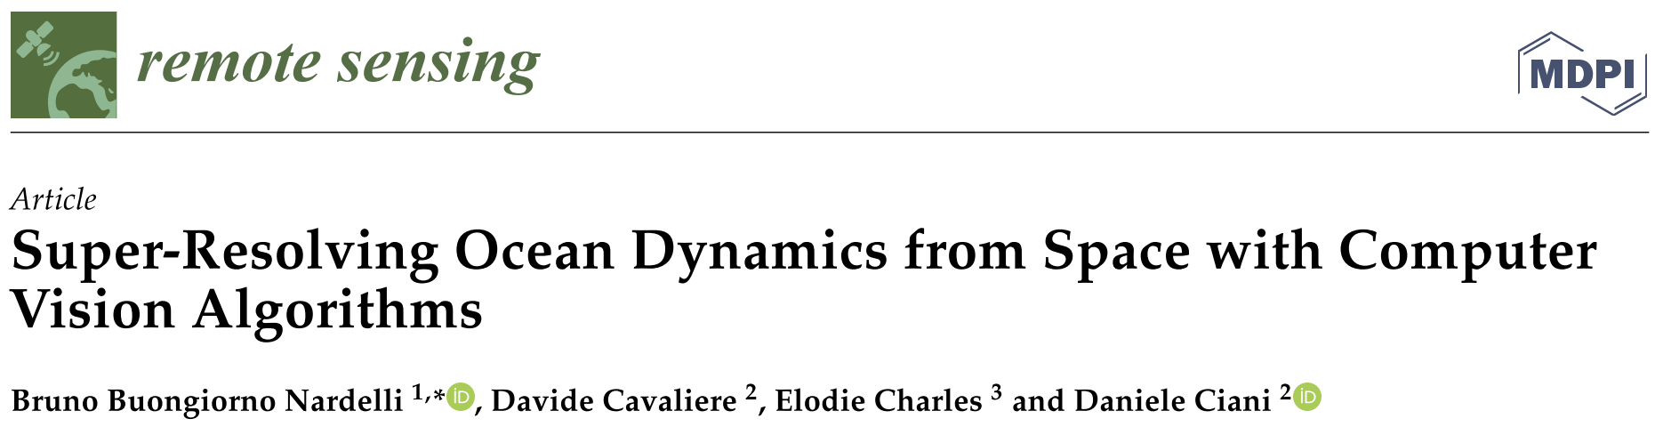
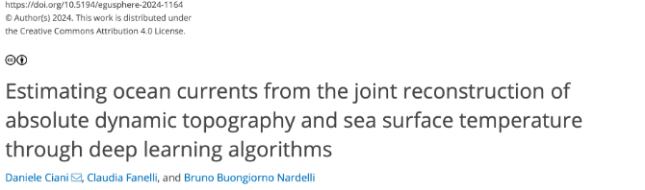
Artificial Intelligence for Ocean Dynamics
Satellite Sea Surface Temperature images contain a lot of dynamical information at high spatial and temporal resolution
Currents derived from satellite altimetry miss several dynamical features due to poor sampling

Slide 23
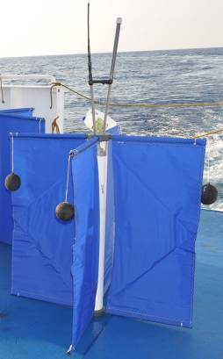
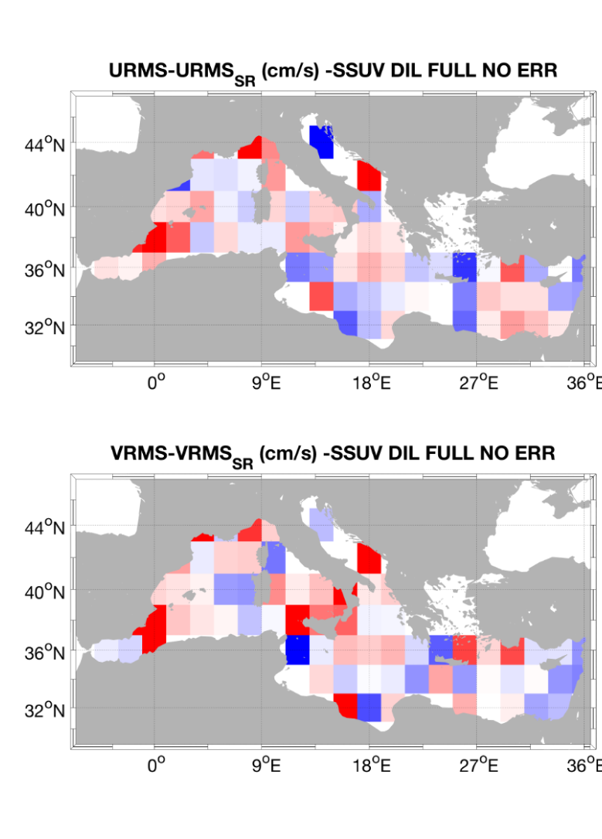
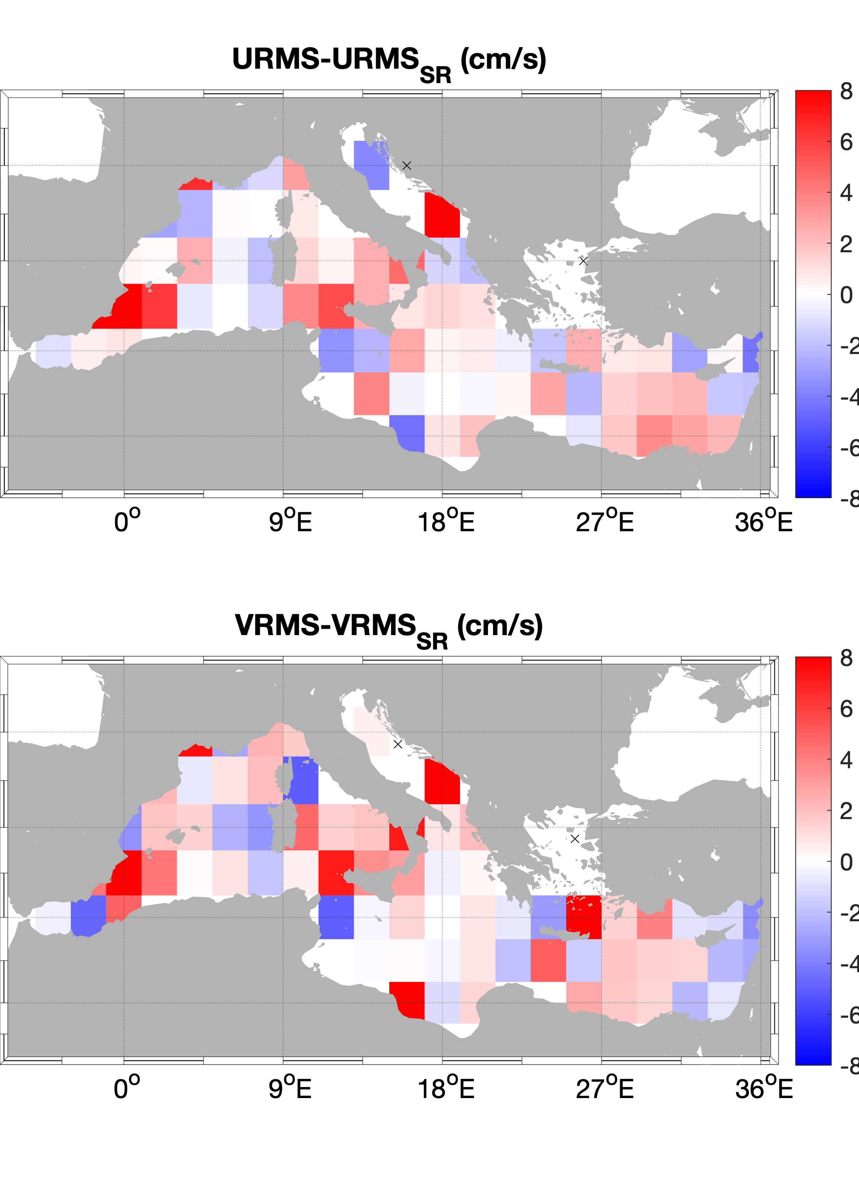
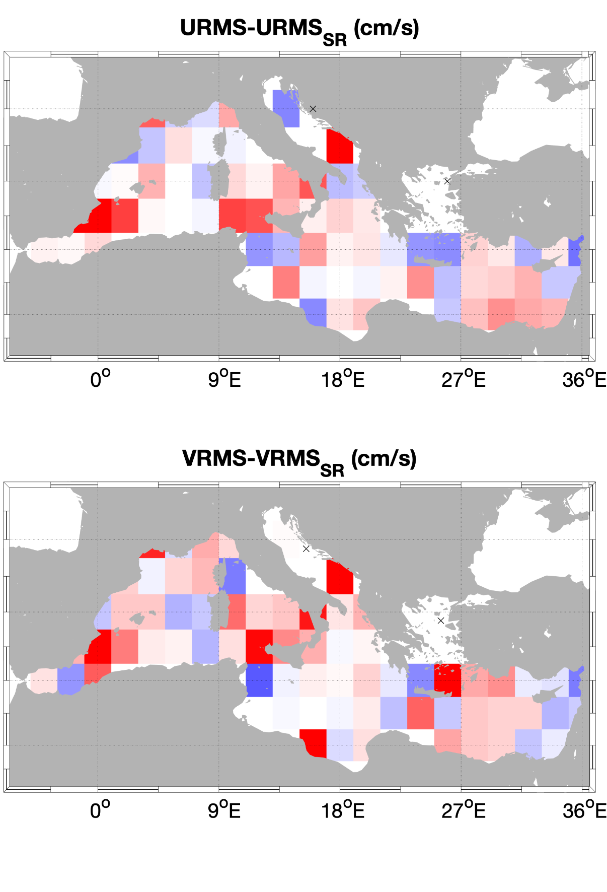

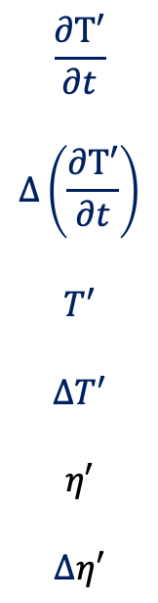
observation-based reconstruction assessment vs measured surface currents
physically-informed dilated Adaptive Deep Residual Network for joint ADT and SST Super-Resolution (PI-dADR-SR)
Performance with respect to standard altimeter L4 data along drifter trajectories
(matchups over 2008-2019 period)
$$\frac{∂T′}{∂t}$$
$$∆\left(\frac{∂T′}{∂t}\right)$$
$$T′$$
$$∆T′$$
$$η′$$
$$∆η′$$
$$\frac{∂{T′}_{HR}}{∂t}$$
$${T′}_{HR}$$
$$η_{HR}$$
Last OSSE
target
candidate predictors
BBN et al. 2022
Full predictors/target
Physically-Informed

Slide 24
observation-based reconstruction assessment vs measured surface currents
physically-informed dilated Adaptive Deep Residual Network for joint ADT and SST Super-Resolution (PI-dADR-SR)
Performance with respect to standard altimeter L4 data along drifter trajectories
(matchups over 2008-2019 period)
$$\frac{∂T′}{∂t}$$
$$∆\left(\frac{∂T′}{∂t}\right)$$
$$T′$$
$$∆T′$$
$$η′$$
$$∆η′$$
$$\frac{∂{T′}_{HR}}{∂t}$$
$${T′}_{HR}$$
$$η_{HR}$$
Last OSSE
target
RMS ALTI/RMS SR (cm/s) zonal | RMS ALTI/RMS SR (cm/s) meridional
12.34 /11.90 | 12.81 / 11.86
RMS ALTI/RMS SR (cm/s) zonal | RMS ALTI/RMS SR (cm/s) meridional
12.34 /12.15 | 12.81 / 12.00
candidate predictors
Ciani, D., Fanelli, C., and Buongiorno Nardelli, B. DOI:/10.5194/egusphere-2024-1164, 2024.
BBN et al. 2022
Full predictors/target
Physically-Informed

Slide 25
Data-driven approaches for the retrieval of ocean dynamics from combined observations
Several possibilities to exploit recent advances in data-science and new sensors, a lot of work to build robust approaches:
→methods learning from OGCM simulations do learn/emulate model physics (but they also learn model errors)
→physically-informed ML, more scientifically sound but often less accurate predictions
→possibilities to exploit new satellite sensors (e.g. SWOT)
Several requirements/limits related to data:
→ sufficient amount of data needed for robust training
→ consistent quality of data needed (e.g. in situ data QC, satellite data filtering, consistent processing/filtering of drifter data)
A relatively "young community":
→still too few experiments/tests, need to explore many more neural network architectures
→still relying on limited computing resources (generally leading to sub-optimal amount of data being used for learning)
Discussion points/perspectives

