Slide 1
OceanOPS Report
Martin Kramp & OceanOPS team
mkramp@ocean-ops.org

Slide 2
OceanOPS: WMO/IOC Centre for GOOS Monitoring and Implementation Support
Established in the 90s as JCOMMOPS (with Joint WMO/IOC Technical Commission, JCOMM)
7 WMO or IOC staff members; IT manager position to be filled shortly; TCs reduced from 3 to 2
Office hosted by Ifremer in Brest (France) since 2014; former host CLS in Toulouse
IT system migration completed in 2024; robust new system within Ifremer architecture
Mostly WMO/IOC extrabudgetary funding from Members, and EU projects
Allocate unique IDs (WMO/WIGOS-IDs, SOT-IDs, Cruise-IDs), support ICES ship codes
Collect and process metadata from GOOS/OCG networks, provide data QC relay/feedback
Provide monthly maps and stats, explore synergies between networks
Monitoring of EEZs per IOC resolution for Argo
Feed marine metadata into WMO-WIGOS-OSCAR; link to WDQMS, GBON
Service Level Agreements (SLA) underway – What are SOOP priorities?

Slide 3
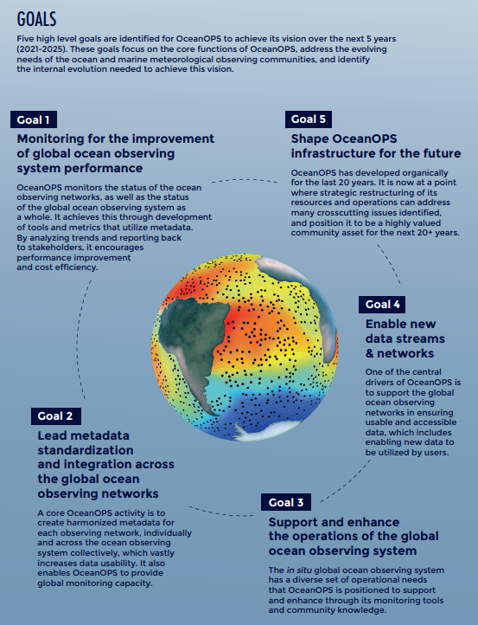
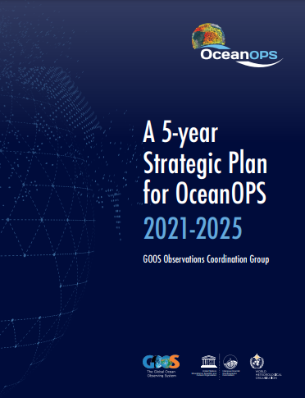
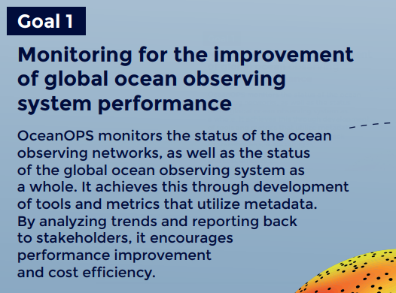
OceanOPS Strategic Plan 2021-2025

Slide 4
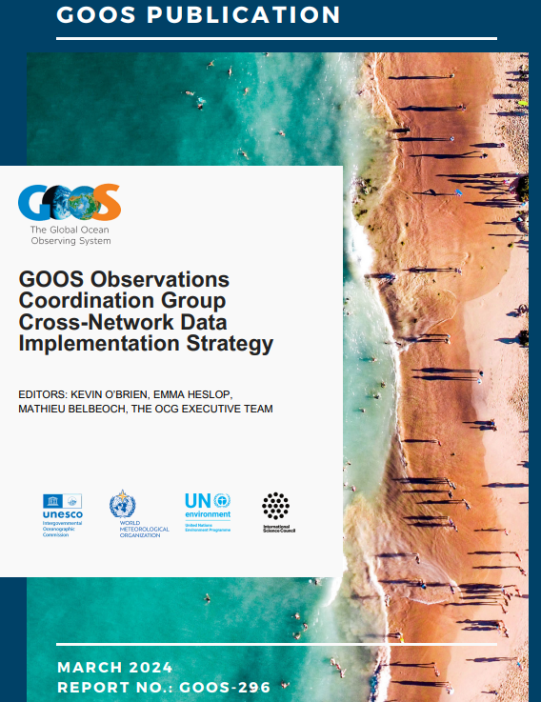
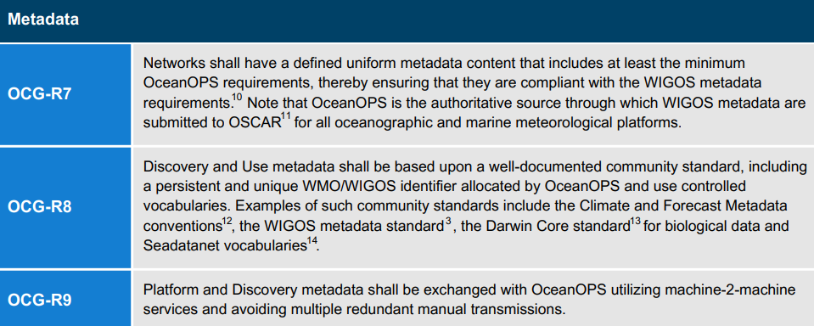

Slide 5
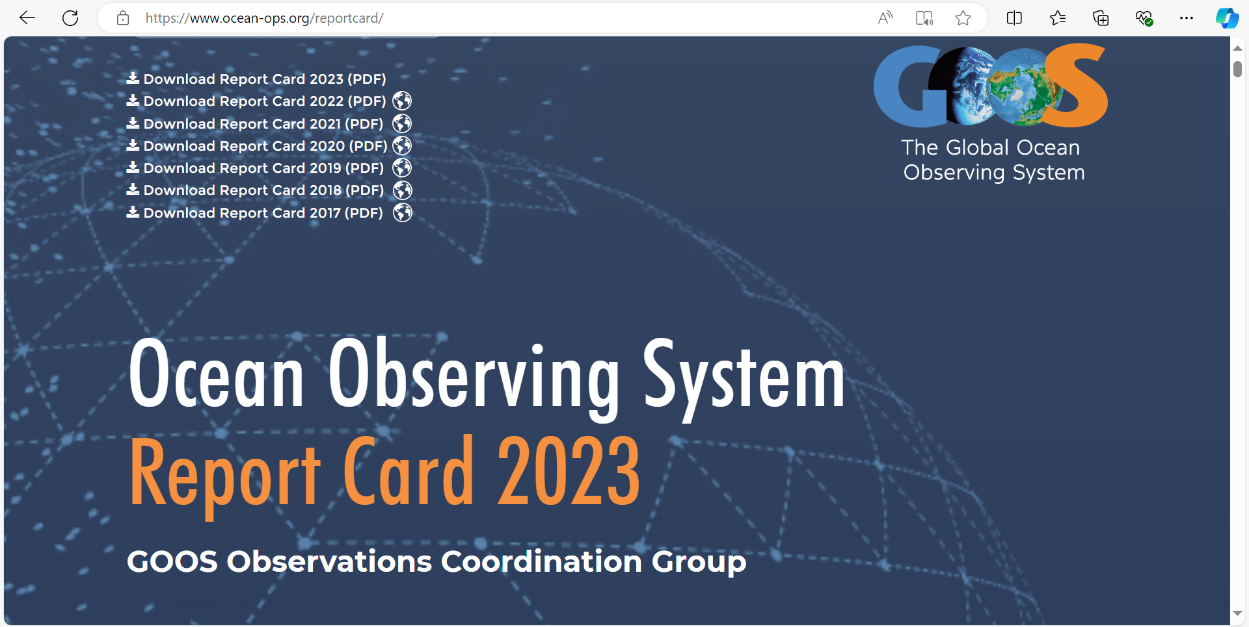
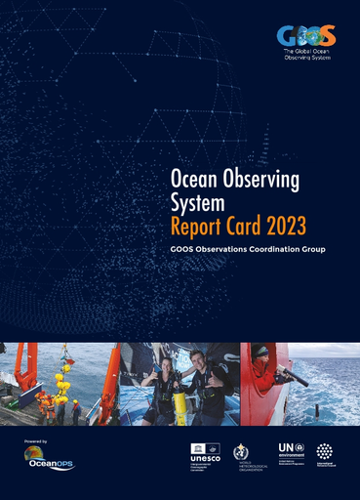

Slide 6
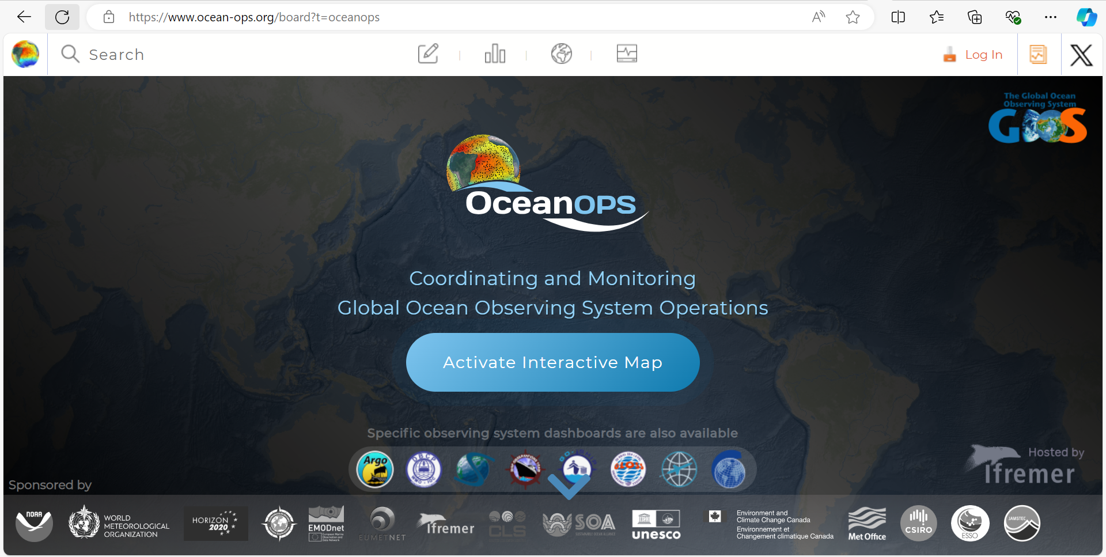

Slide 7
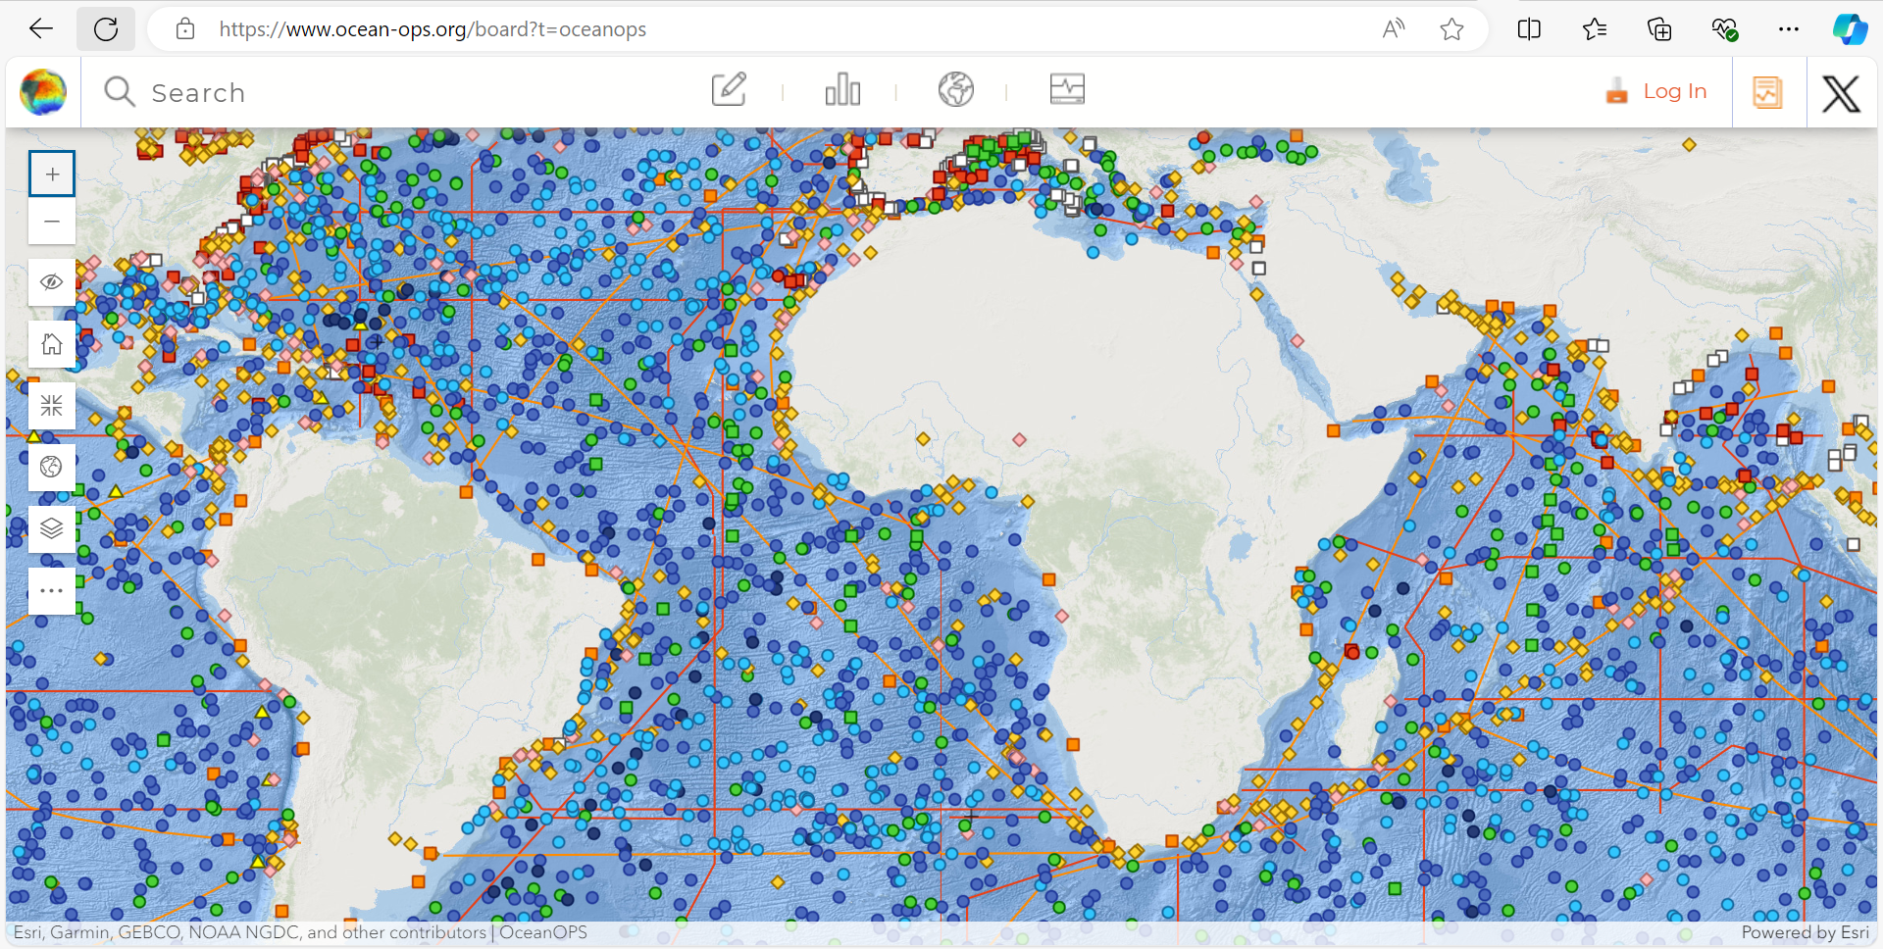

Slide 8
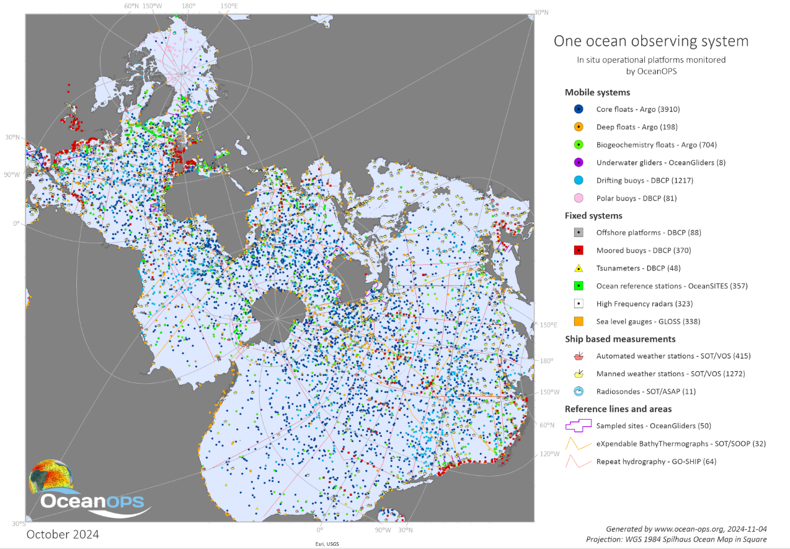

Slide 9
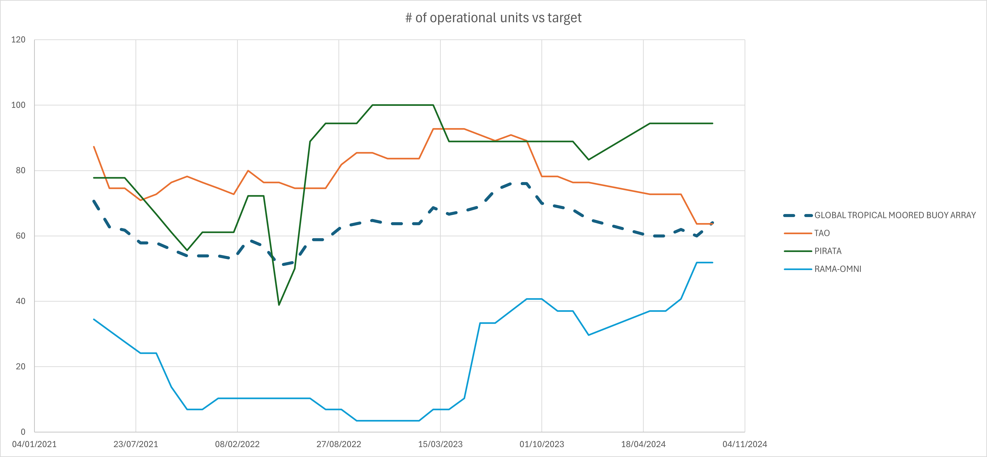
Global Tropical Moored Buoy Array: Performance per Array in % / Global Performance in %

Slide 10
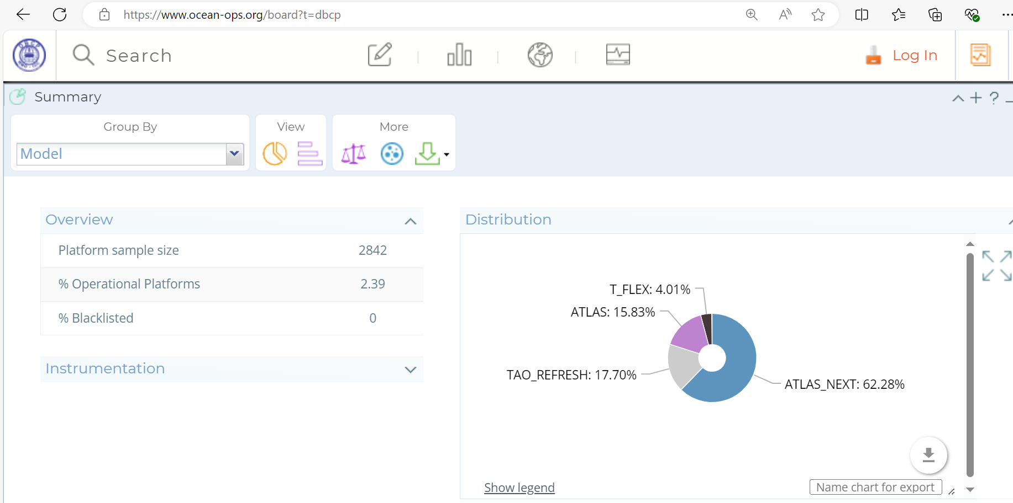
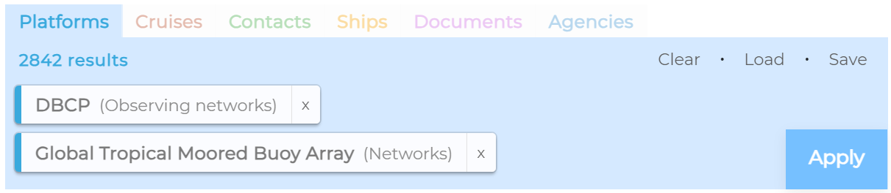
Sample:OceanOPS - 5200321_038

Slide 11
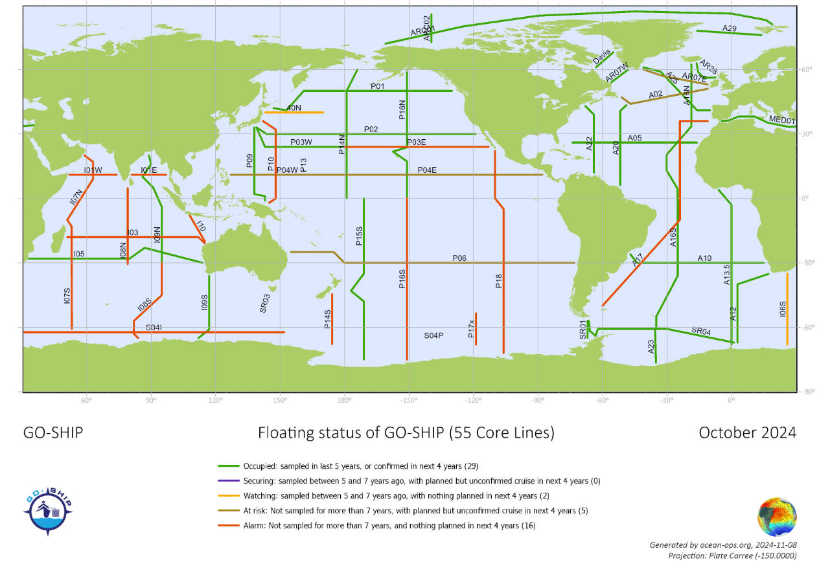

Slide 12
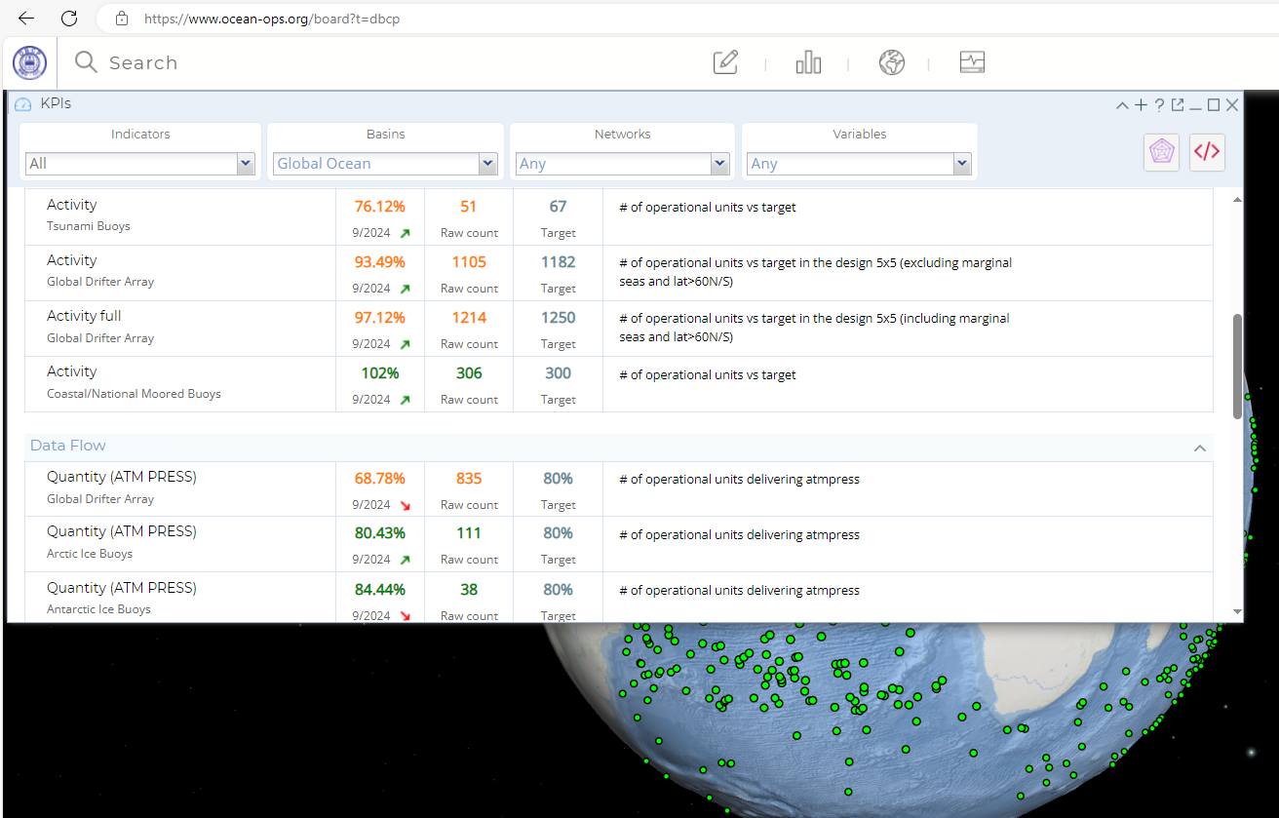

Slide 13
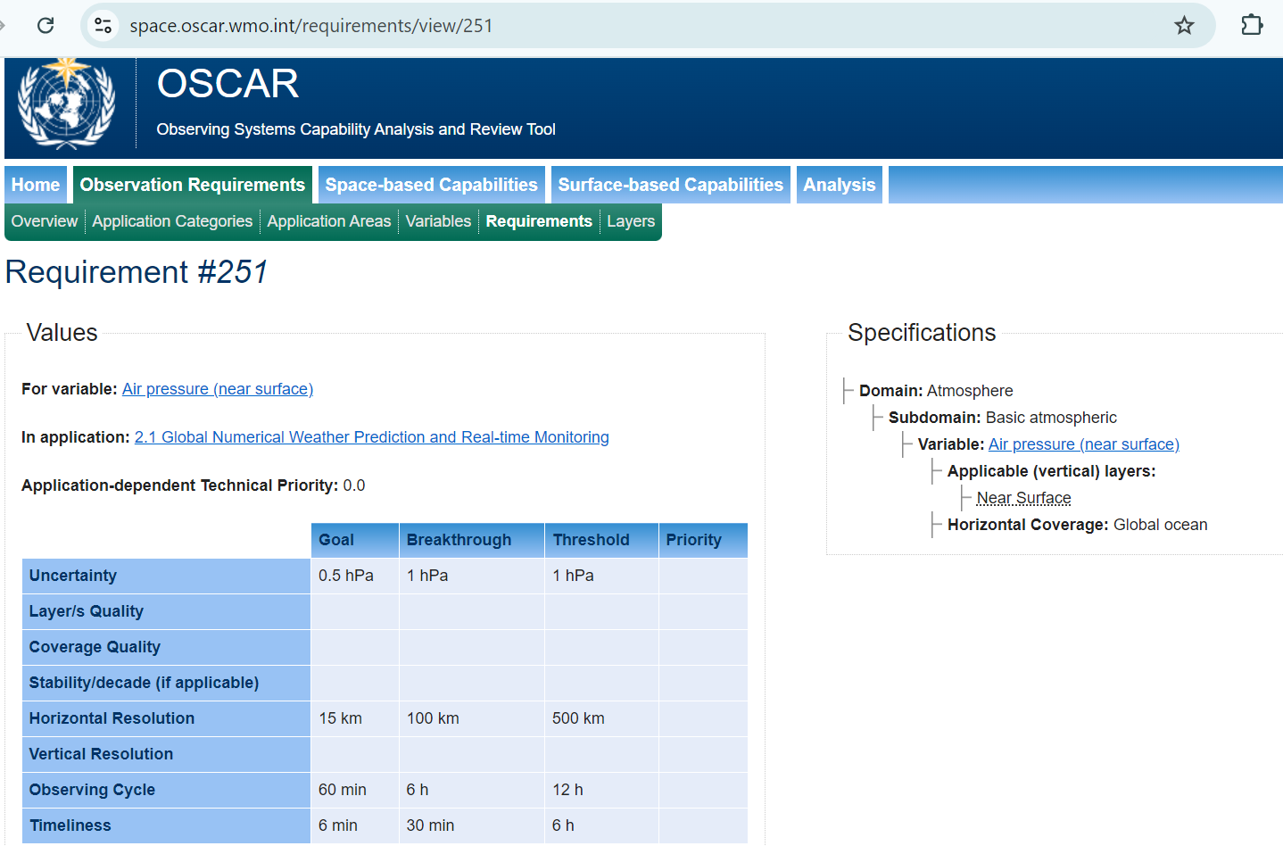

Slide 14
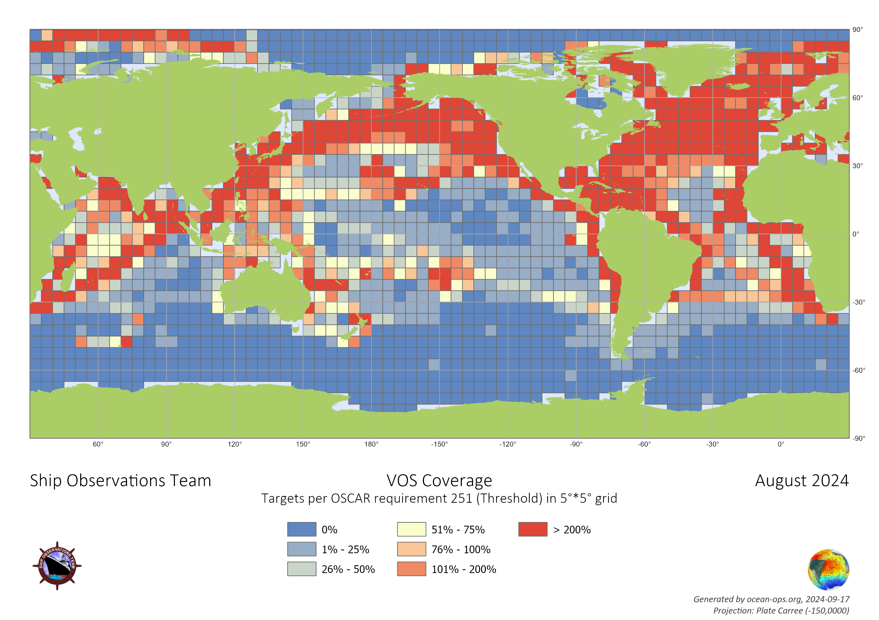
VOS vs
OSCAR 251
Cross-network
Analysis/KPI?

Slide 15
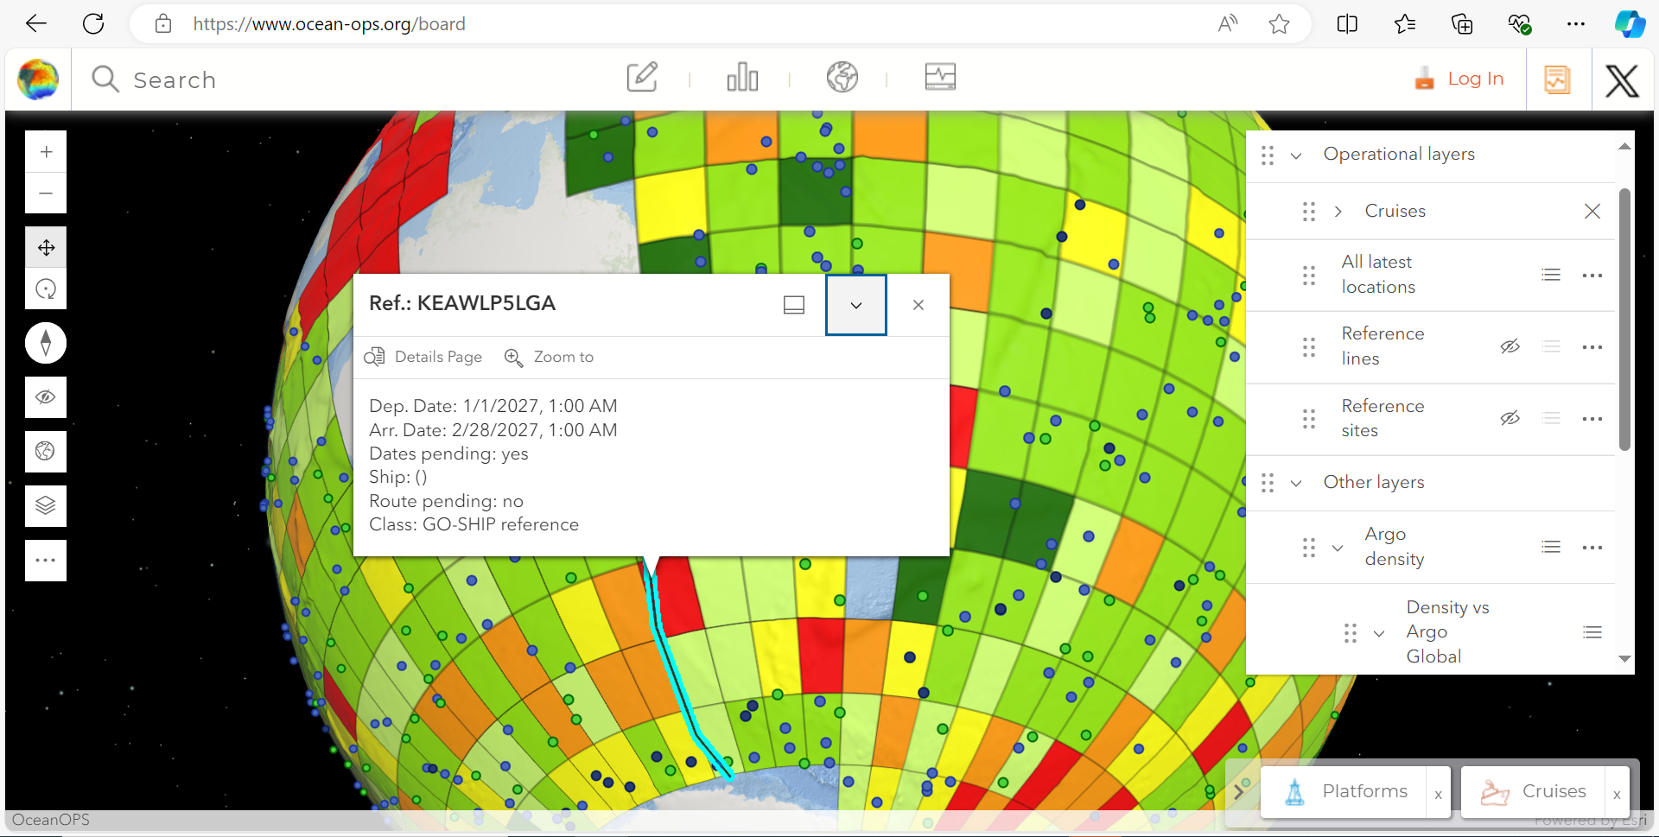

Slide 16
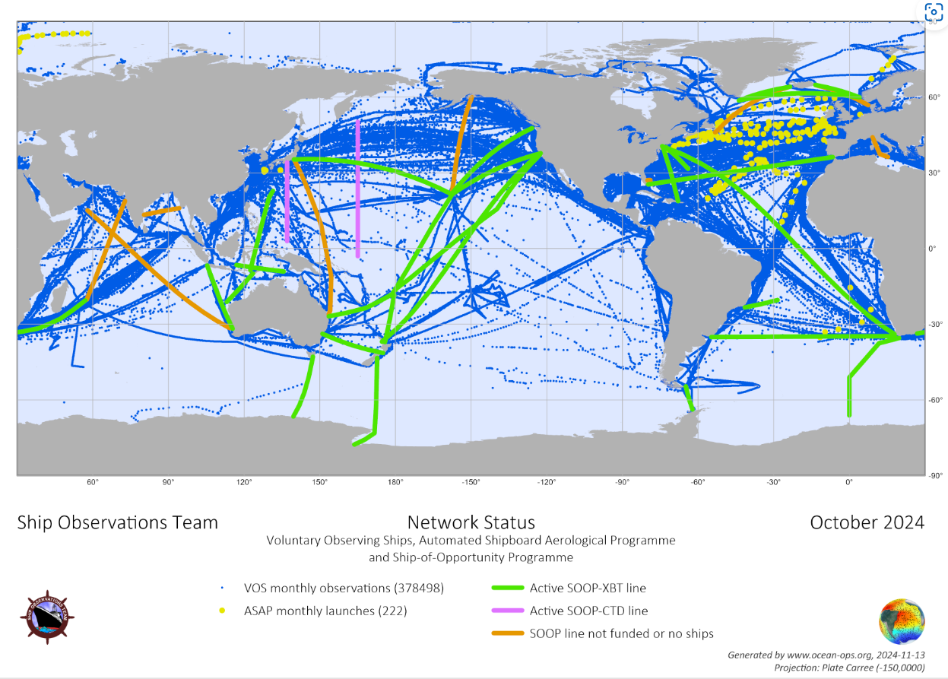

Slide 17
Take home messages
Cruise ID: Important new PID for tracking of cruises along full lifetime, including planning phase
Availability of metadata in OceanOPS of growing importance (GBON)
Ships, Stations, Sensors, Cruises: Follow GOOS/OCG Strategy!
Training in OceanOPS Tools required; API upgrade coming; ODIS feed
Definition of SOOP-SLA required
Targets for SOOP/XBT network: Adjustment needed?
Tracing (meta-) data: Get full picture from new sources (Coriolis, WIS2)
SOT 13: 31 March to 4 April 2025 in Brest!

Slide 18
Video / Questions?

