Slide 1

GOSUD - GTSPP - IQuOD
Improve Collaboration and Data Management Practices
IQuOD workshop 12/11/2024

Slide 2
Who am I
At Ifremer since 2006
Marine Data Manager
Copernicus Marine Service - Global Product / Service Manager / co-Technical Coordinator
GOSUD co-chair
Coriolis (w. Thierry Carval & Christine Coatanoan (QC))

Slide 3
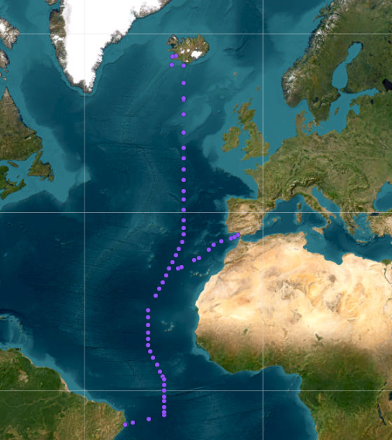
IODE & GOOS
IODE programs such as GTSPP, IQuOD, GOSUD are supporting GOOS OGC Networks for data management
Long term archive of data (SOOP-XBT, SOOP-TSG)
GO-SHIP
Bottles & CTD => CCHDO is the GDAC
ADCP => University of Hawaii (UH Currents Group) + SeaDataNet
TSG => GOSUD
SOOP-XBT : GTSPP
SOOP-TSG : GOSUD
Example for hydrographic cruise
www.gosud.org
(callsign: WTEC)
Ship RONALD H. BROWN

Slide 4
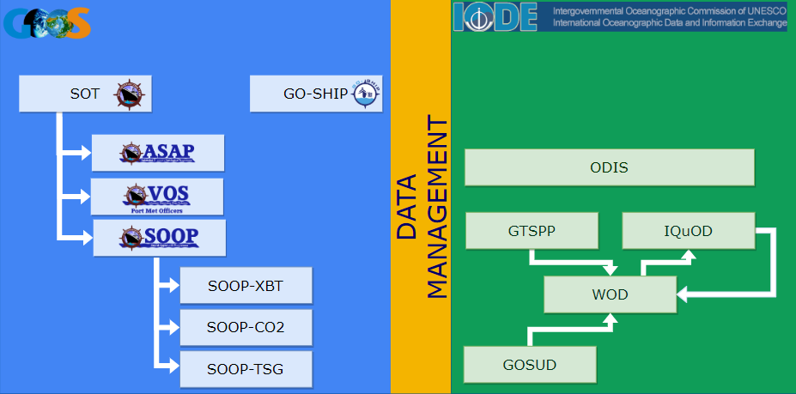
Quaterly
Quaterly
Quaterly
Monthly

Slide 5
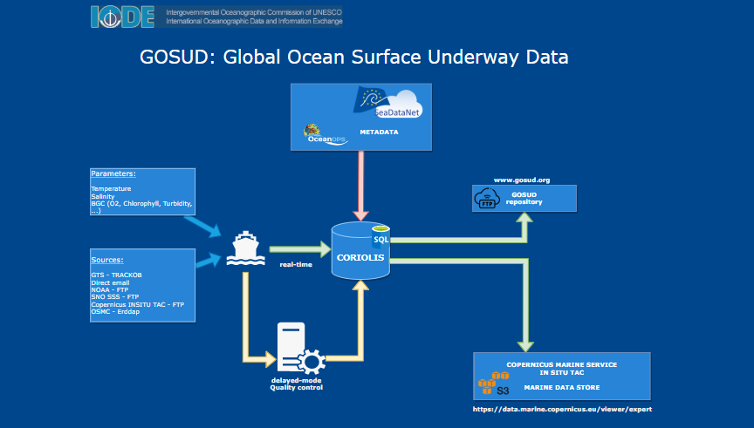

Slide 6
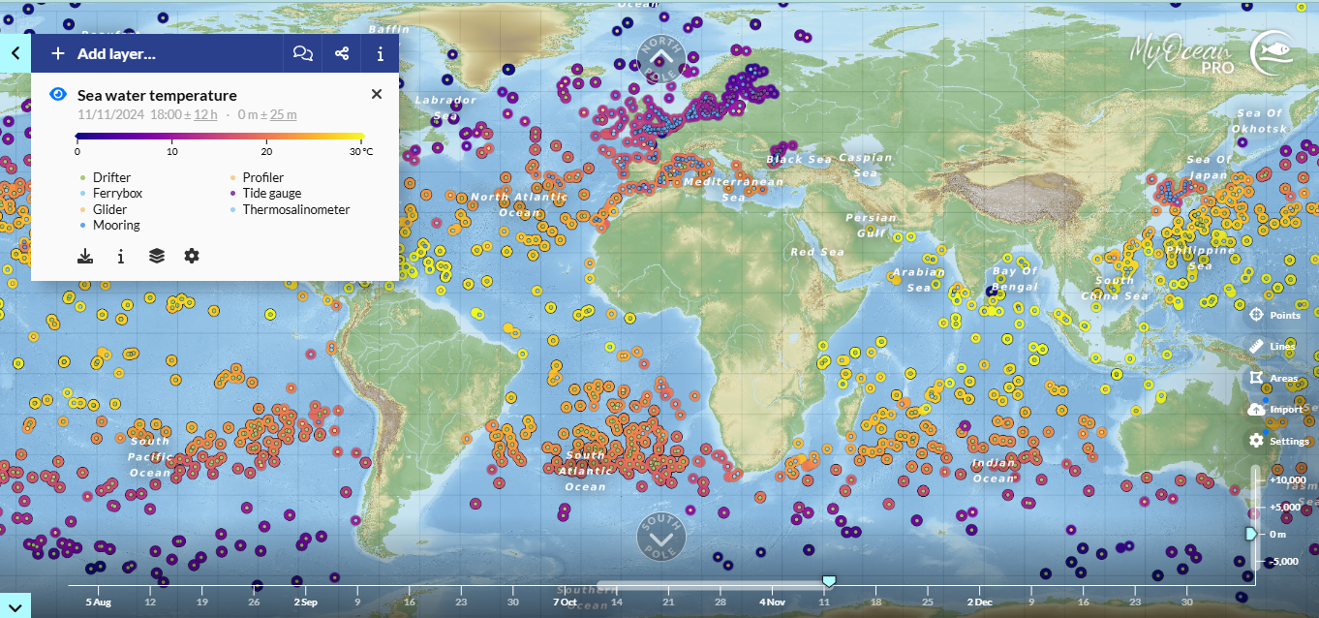
Sea water temperature in Copernicus Marine In SItu

Slide 7
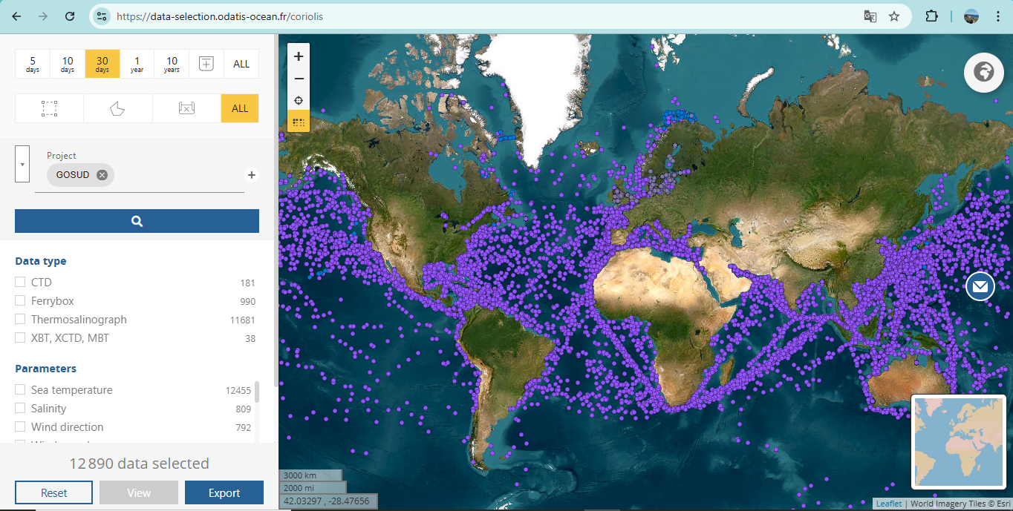
Project GOSUD in Coriolis

Slide 8
TSG GOSUD
GOSUD pilot project in 2003
MERSEA project in 2004 => MyOCEAN => Copernicus Marine Service
Revisit Term of reference in GOSUD in 2022 and become a program activity
Copernicus2 Phase 2 2025-2028
IODE provides international recognition and long term visibility
Being GDAC for Argo, GOSUD, OceanSites, DBCP is a strength to lead Copernicus Marine In Situ TAC

Slide 9
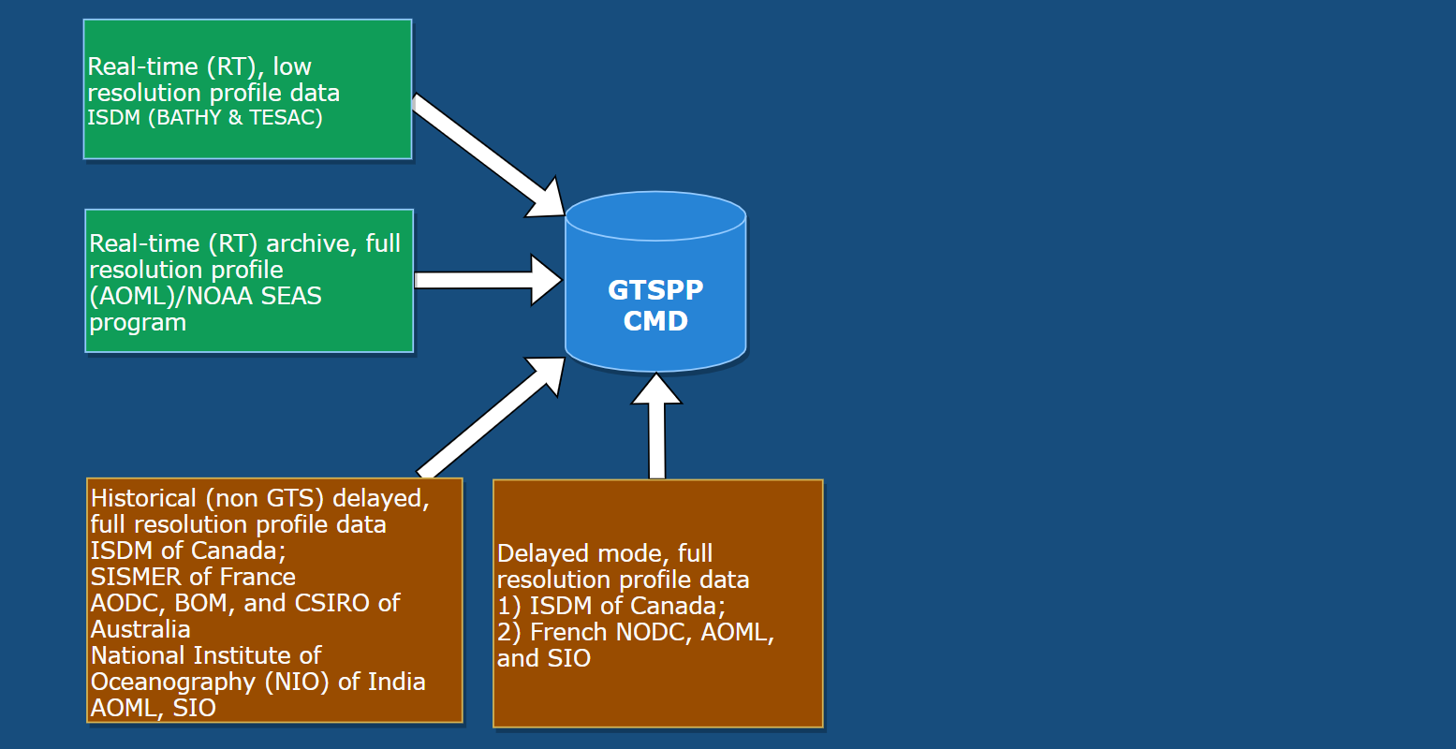
How metadata is managed ?
Is it possible to rely on the same metadata flow ?
OceanOPS (for platforms)
ICES (for ship information)
SEADATANET (for parameters)
Only temperature & salinity ?
BUFR ? SOT-ID ?

Slide 10
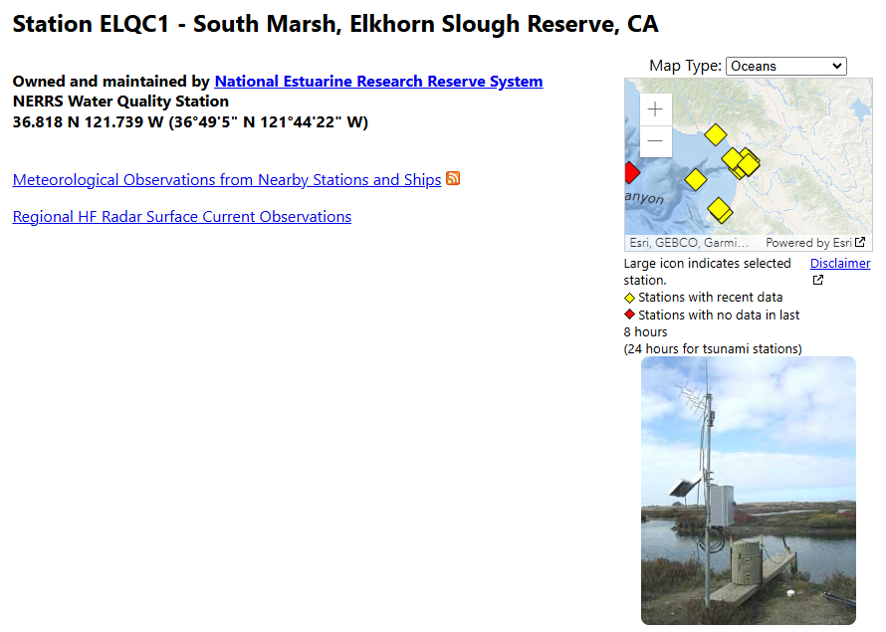
Too many profiles circulates on TESAC
Example of fixed stations transmitting data in TESAC
This situation will continue until NOAA will switch to BUFR.

Slide 11
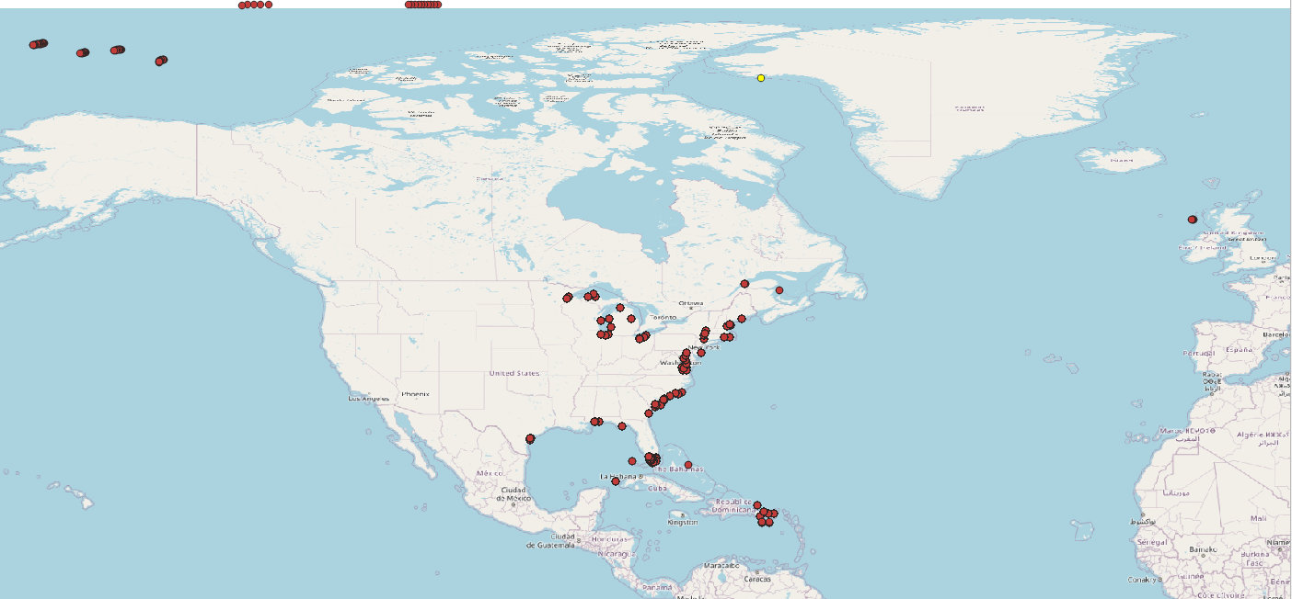
Example of files in GTSPP
Profiling floats
realtime/atlantic/2024/10
73163 “profiles”
Only one platform is a real CTD or XBT profile
Fixed buoys

Slide 12
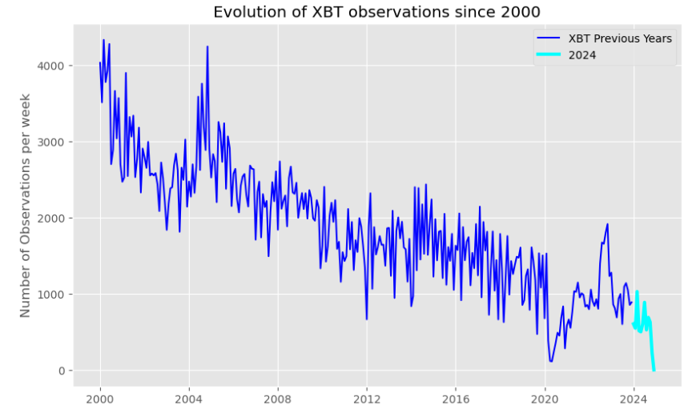
Evolution of XBT since 2000 in Coriolis: is it a real decrease or a switch to BUFR ?
XBT in 2023: 11,177
In WOD : 11,135

Slide 13
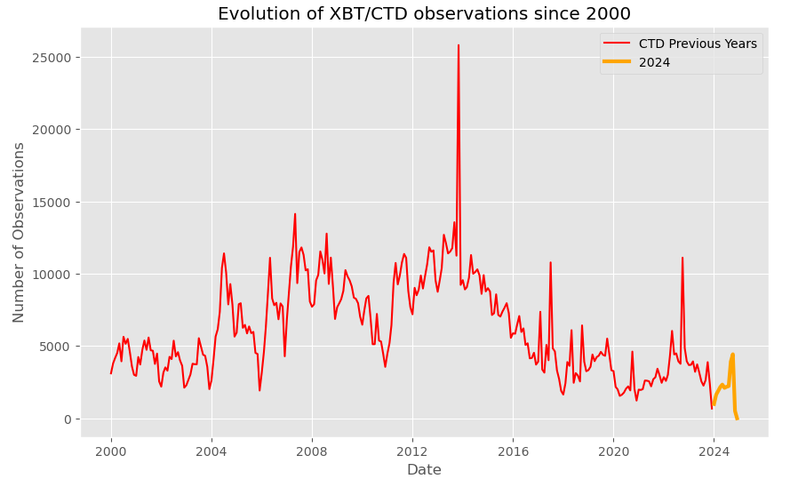
Evolution of CTD in Coriolis (number of casts per week)
CTD in 2023: 17,738
In WOD : 10,138

Slide 14
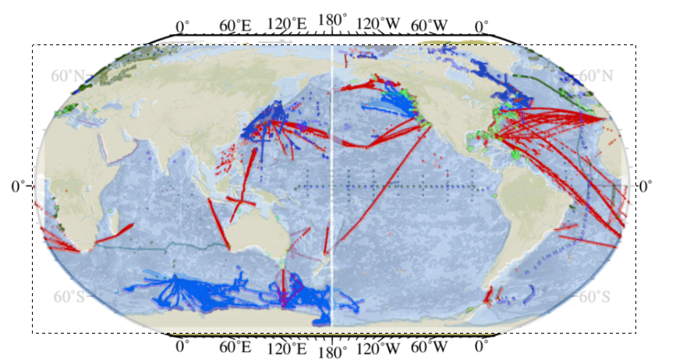
WOD and Coriolis quick check in 2023

Slide 15
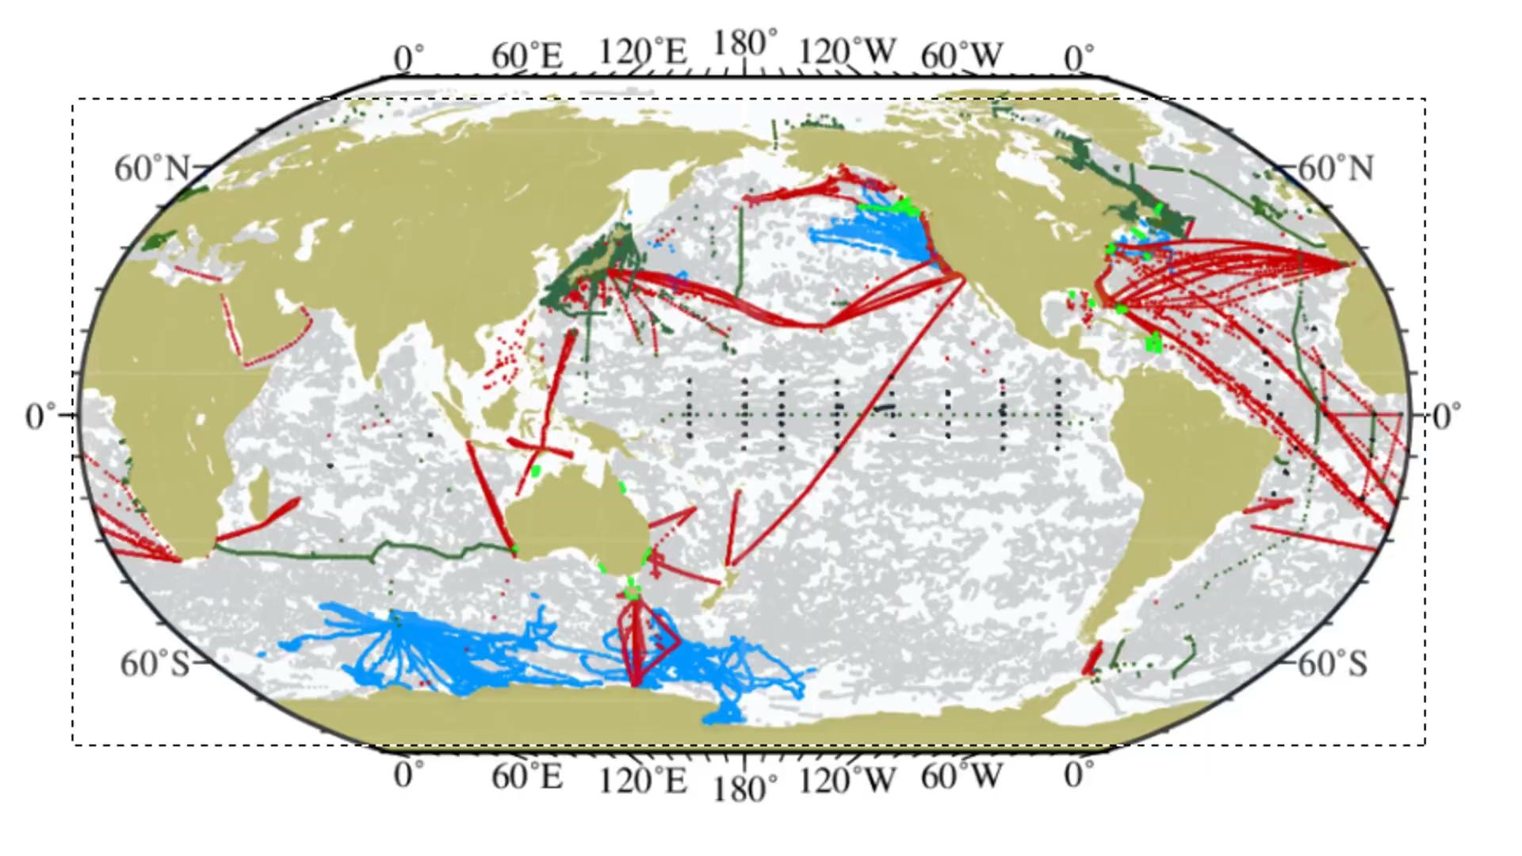

Slide 16
How to maintain these programs ?
Difficulties for GOSUD to maintain the group active
Only remote meetings since 2019
Importance to check / compare our databases, KPI, cross-check what we are doing
Comparaison with DBCP where the GDAC are part of the annual meetings
Can we integrate annual SOT meetings to present our activities, number of profiles CTD / XBT collected each year ?
Define TT-Data Management on behalf SOT-SOOP ?
Should WOD or ODIS try to maintain GOSUD & GTSPP groups active by organising meeting regularly?

Slide 17
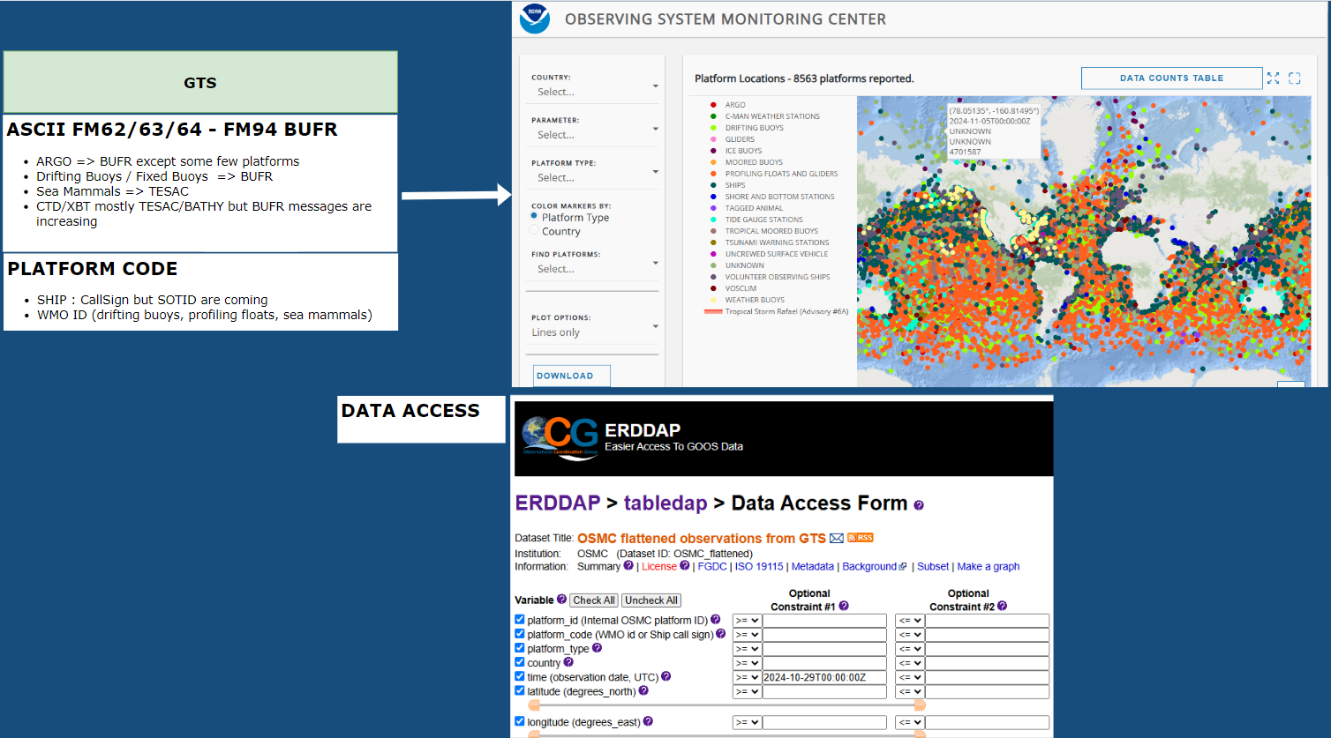

Slide 18
Switching to OSMC erddap ?
MEDS (Canada) (TRACKOB/TESAC/BATHY)
METEO FRANCE ((TRACKOB/TESAC/BATHY) + BUFR 315010 (waves)
OSMC erddap
TRACKOB/TESAC/BATHY + BUFR
BUFR 315011
BUFR 3 15 004 (XBT)
3 15 006 (XCTD)
3 15 007 (CTD)
are missing
CORIOLIS

Slide 19
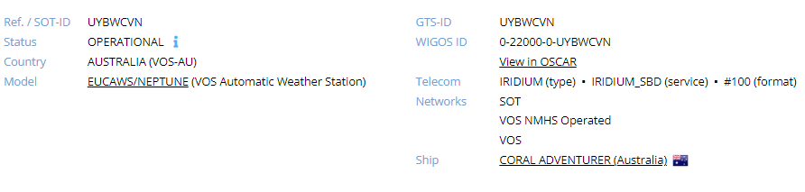
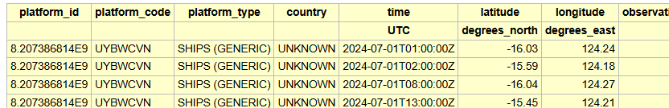
Some questions / issues
Arrival of WIS 2.0
BUFR message => we are missing XBT/CTD/SUV (3 15 004, 315 006, 3 15 007, 3 15 011)
SOT-ID : Example CORAL ADVENTURER is sending TSG data using SOTID
QC and IA : Question to IQuOD is there some progress towards this

Slide 20
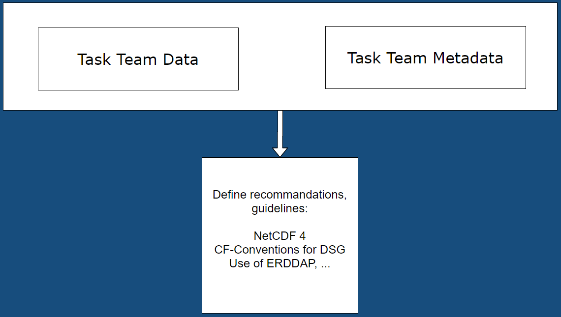
Moving in the same direction
NetCDF3 => NetCDF4 classic => NetCDF4 (Ex: https://www.ncei.noaa.gov/data/oceans/ncei/formats/netcdf/v2.0/index.html )
GTSPP => NetCDF3 - GOSUD => NetCDF4
CF conventions (current 1.11) and Discrete Sampling Geometries
GTSPP is using 1.6
GOSUD is using 1.6
Parquet - DuckDB - S3
Common github to share code ?

Slide 21
Link to ODIS
ODIS is the parent activity of program such as GOSUD, GTSPP, IQuOD
How to jointly be connected to ODIS ?
GOSUD, GTSPP, IQuOD
Definition of a provisional schedule to integrate in ODIS
We have to meet together not to duplicate the same workload

