Slide 1
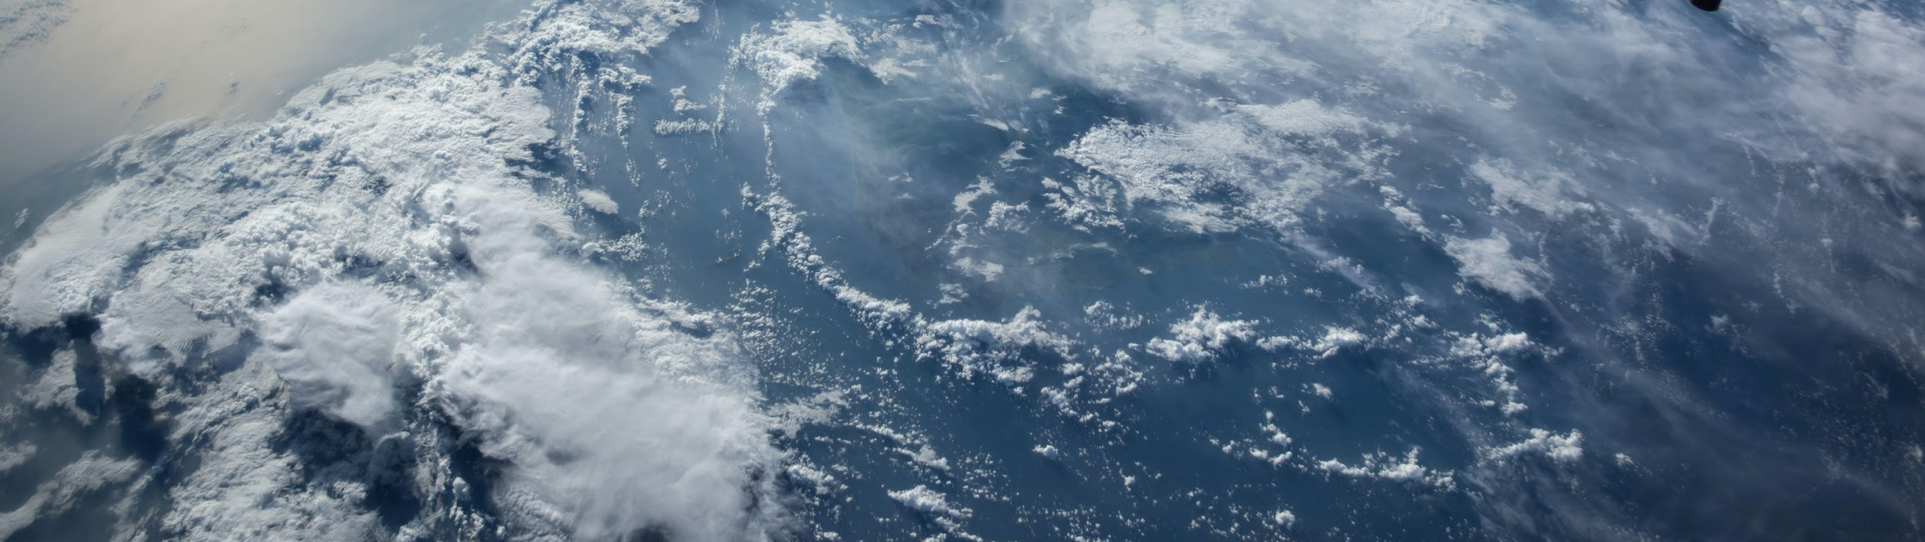
QC for historical salinity data and an investigation of potential Argo salinity bias
Zhetao Tan, Yingfan Sun, Lijing Cheng, Viktor Gouretski, Zhankun Wang, James Regan, Annie Wong, Tim Boyer, Yuying Pan, Huifeng Yuan, Bin Zhang et al.
IAP/CAS & NOAA/NCEI

Slide 2
Outlines
Part-1: Salinity automatic quality control (QC)
Part-2: Salinity instrumental bias correction
Notes:
Due to the time limitation, I will skip the background and go ahead to the method and result part. The first part is about the salinity QC

Slide 3
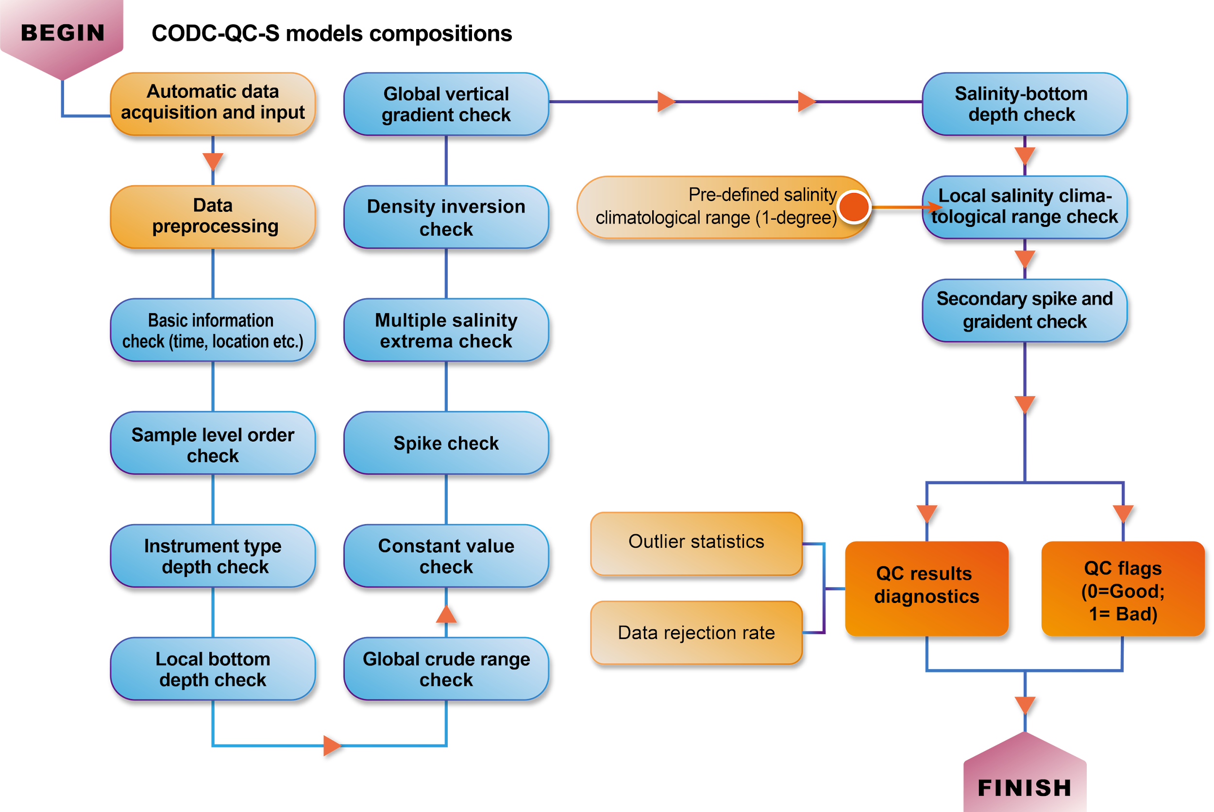
CODC-QC-S for salinity data
13 QC modules
Key advantages:
Chinese Academy of Sciences (CAS)
Ocean Data Center (CODC)
Local salinity climatological ranges
Accounting for the salinity anisotropic feature of the local salinity distribution
Accounting for topographic barriers separating different water mass properties
Vary with time to account for ocean salinity changes, reducing the possibility of erroneous excluding true extreme events
Notes:
Some of you may know that our team had been developed a QC for temperature two years ago, namely as CODC-QC. Built upon that effort, now we developed a similar QC system for salinity.
This is a climatological range based quality control, it includes 13 QC checks such as spike check, density inverison check, constant value check, local salinity climatological range check balababal. Here, I would like to highlight the local salinity climatological range check, because this check we think is the most powerful checks to detect the outliers as much as possible.
In details, the predefined climatological range has been account for the ....

Slide 4
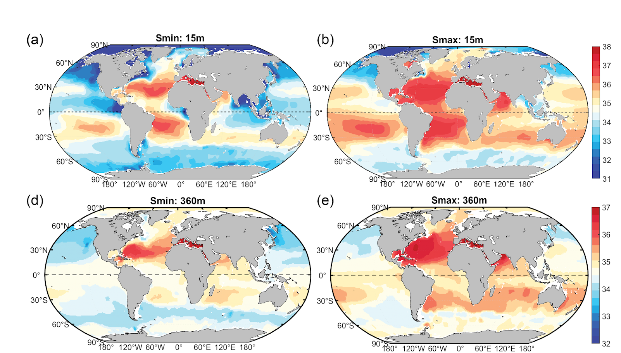
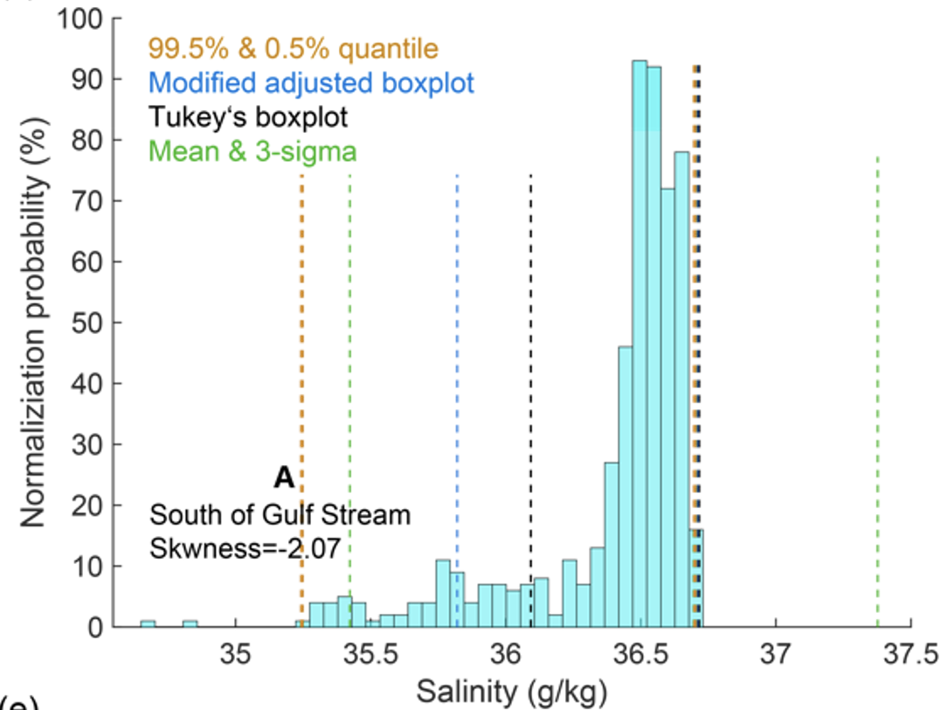
Salinity climatological range (1-degree, monthly)
Mean & 3-sigma
Modified adjusted boxplot
(Adil and Irshad. 2015)
99% quantile
Smin
Smax
No specific distribution laws are assumed
99% quantile are used (left: 99.5%; right:0.5%)
Compared with other threshold decisions
These data are likely to be ‘good data’ than bad data as they have undergo crude QC checks
Notes:
As for the threshold decisions of the climatological range, we know that there are many methods to determine, some are subjective, and some are objective. For example, the mean with 3 standard deviation, the boxplot, the modified adjusted boxplot, the 99% quantile etc. As we found that in most of regions, the data disctribution law are skewed, or even highly skewed. We compare the above three different methods, and based on the assumption that these highlgh skewd data are likely to be good data than bad data, we found that 99% quantile could fits well this case. So after carfully evulation, as well as benchmark evluation, we decided to use the 99% quantile to cut-off the local salinity climatological range in each 1-degree box.

Slide 5
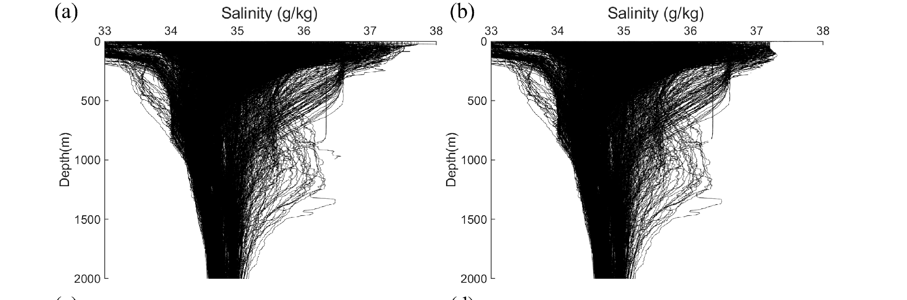
Performance Evaluations
Benchmark dataset -- WOCE one-time salinity profiles undergo carefully expert QC
True negative rate
CODC-QC: 98.02%
Benchmark good data
After CODC-QC-S
CODC-QC-S can effectively minimize the risk of mistakenly flagged good data
Notes:
As for the performance evaluation, so far, only WOCE onetime benchmark dataset could be used in salinity QC evaluation. We found that the true negative rate of the CODC-QC is about 98%, which means that nearly all the benchmark good data are retained. This show that, .....

Slide 6
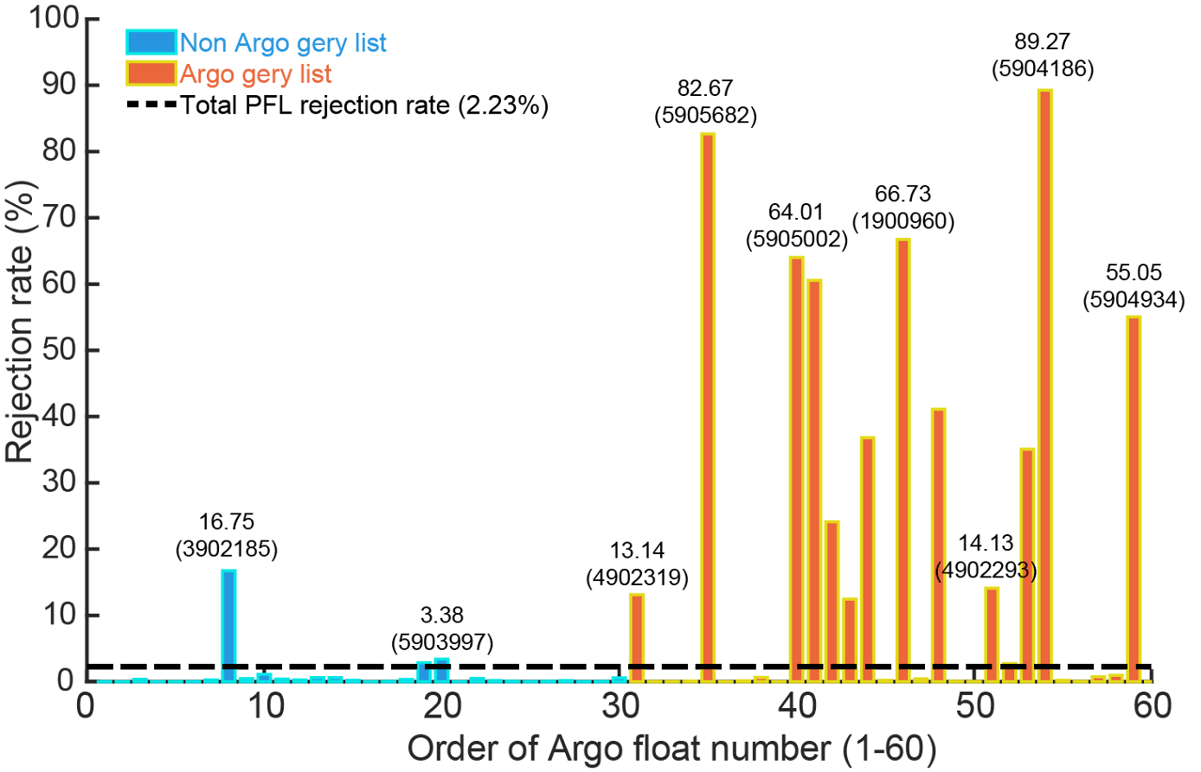

Performance Evaluations
Argo data
Floats in the non-grey list v.s. Float in the grey-list
The rejected data are pointed to some specific ‘malfunction’floats/cruises
Notes:
As for detect the outliers, we used argo data to check its performance. As we know that more outliers exists in the Argo grey list float (in orange colors) than the non-grey list float marked in blue colors. So we randomly selected many floats from these two groups and perform the QC and then calculate the rejection rate. And we found that the higher rejection rate are many pointed to the orange one, in which means that The rejected data are pointed to some specific ‘malfunction’floats/cruises

Slide 7
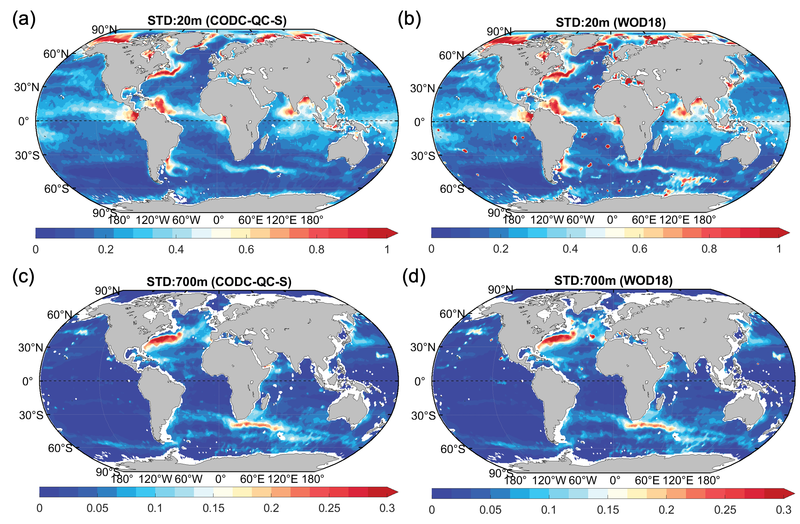
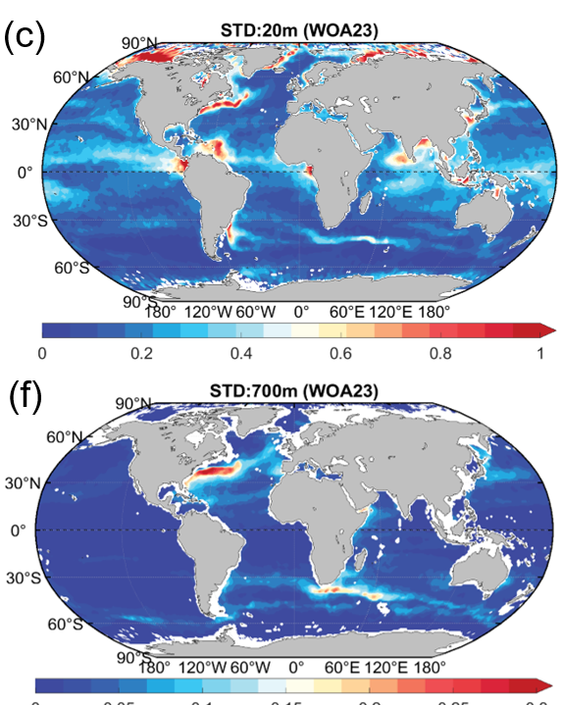
Performance Evaluations
‘All years’ climatology
WOA23 (Regan et al., 2024)
[after manual QC]
CODC-QC-S
WOD-QC (Salinity_WODflags≠0)
10m
700m
Notes:
We also use all the WOD data to check the performance. This figure are the ‘all years’ climatology with all the same QC passed data in different three flags, one is after CODC-QC, one is after WOD-QC, and one is World ocean atlas 2023. You can see that most of the unrealistic spikes and red bloods are disappeared in CODC-QC-S, and this fileld are really similar with the WOA23 which have undergo manual QC. But anyhow, a more comprehensive comparison is needed in the future.

Slide 8
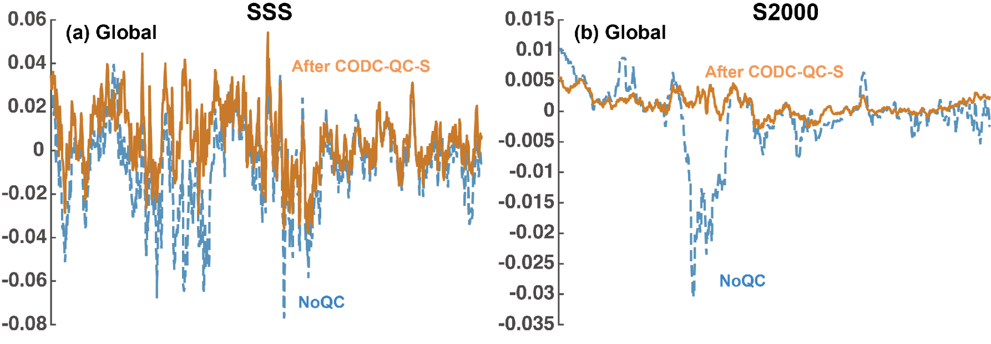
The potentiel impact of QC on the global salinity change
The variation of salinity change (STD) is reduced: 25% for SSS, 75% for S2000
The impact on long-term trend estimation
Mapping methods follows Cheng et al., 2020
Notes:
We also check the potential impact of QC on the global salinity change, from the surface to the 2000 meters dept. You can find the variation is significantly reduced after the CODC-QC. And also it will also impact the long-term trend estimation. But how much are the impact are? Which regions are more significant impact by QC? These also are the future works should be answer.

Slide 9
Outlines
Part-1: Salinity quality control
Part-2: Salinity instrumental bias correction
Notes:
Now, we go to the second part, the salinity instrumental bias correction.

Slide 10
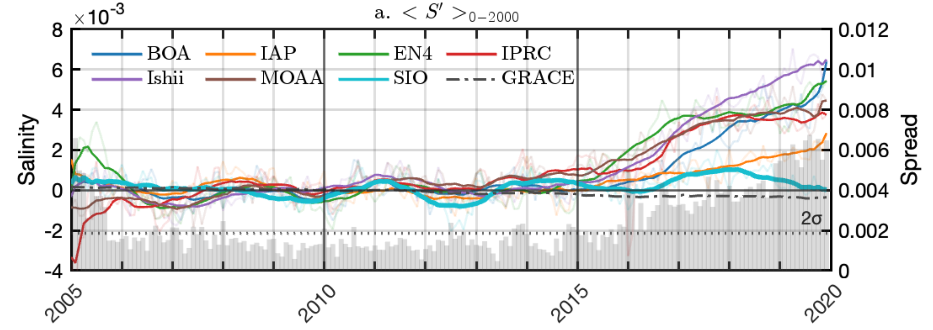
What we want to answer?
Detect the potential offset/bias: compare Argo with collocated CTD data, to examine the potential systematic Argo salinity offset, if any, and then investigate how salinity offset changes with time, depth, etc.
If Argo salinity data does have non-neglectable offsets, try to give an appropriate bias correction?
Salinity drift: 2016-onward; Why?
Global 0-2000m salinity time series (GRACE in dashed black)
Liu et al. 2024 JGR-oceans
Notes:
As many studies argues before that there might be a salinity drift after 2015, so we first compare Argo data with collocated CTD data to examine the potential systematic Argo salinity offset, if any, and then investigate how salinity offset changes with time, depth, latitude, service time etc Then, If Argo salinity data does have non-neglectable offsets, try to give an appropriate bias correction?

Slide 11
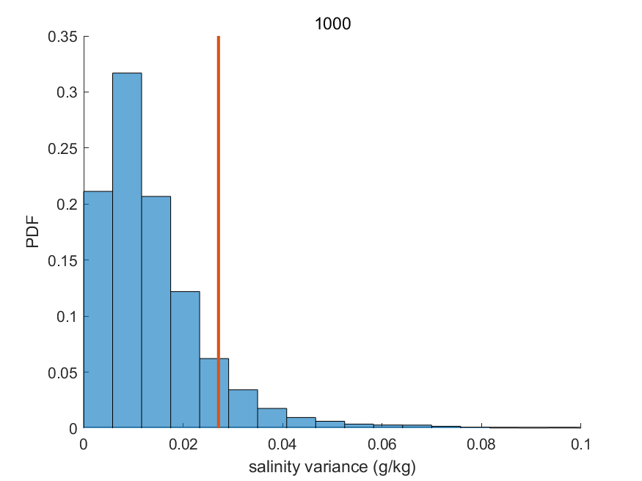
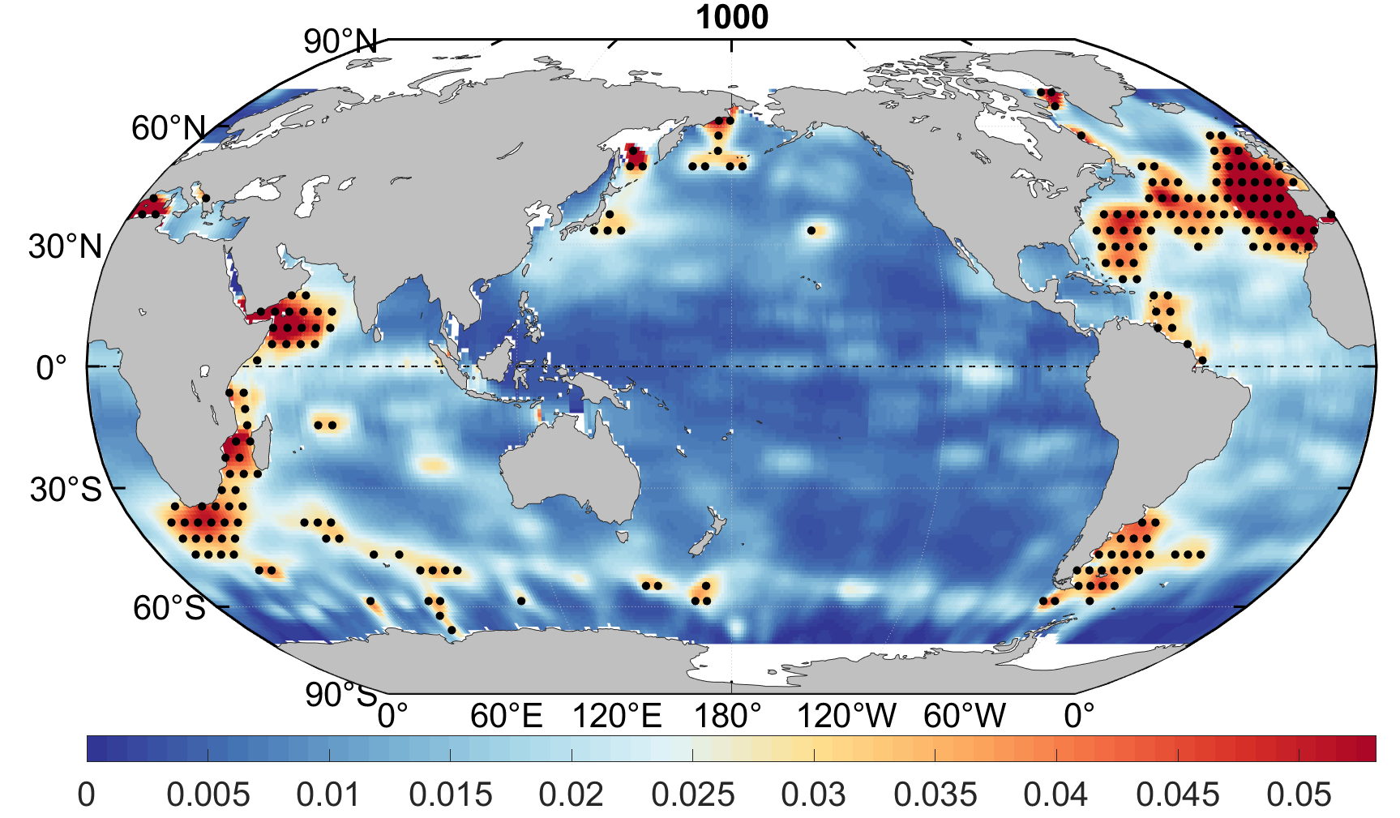
Methodologies
Focused on the Argo delayed-mode data in 2005-2023 (downloaded from WOD)
Collocated pairs (Argo & CTD): 30days & 100km
Only considered regions with small salinity variance (defined by the standard deviation of all observation in a box)
Salinity offset : S_offset = S_Argo - S_CTD; (mean & median)
Mean + 1*STD
salinity variance
threshold = mean of variance + 1* standard deviation of variance
*salinity data in the dotted regions will not be included
Notes:
We focus on the argo delay-mode data, and match the collocated pairs in 100km within one month. In addition, we didn’t considered the regions with high salinity variance regions such as the boundary courrents and high eddies regions. For example, in this figure, the data in the dotted regions will not be included. This is defined by the the standard deviation of all observation in a box. The cut-off threshold for the regions selected is defined by the mean of variance and standard devaition of variance.
Finally, we calculated the salinity offset by the difference between argo and CTD.

Slide 12
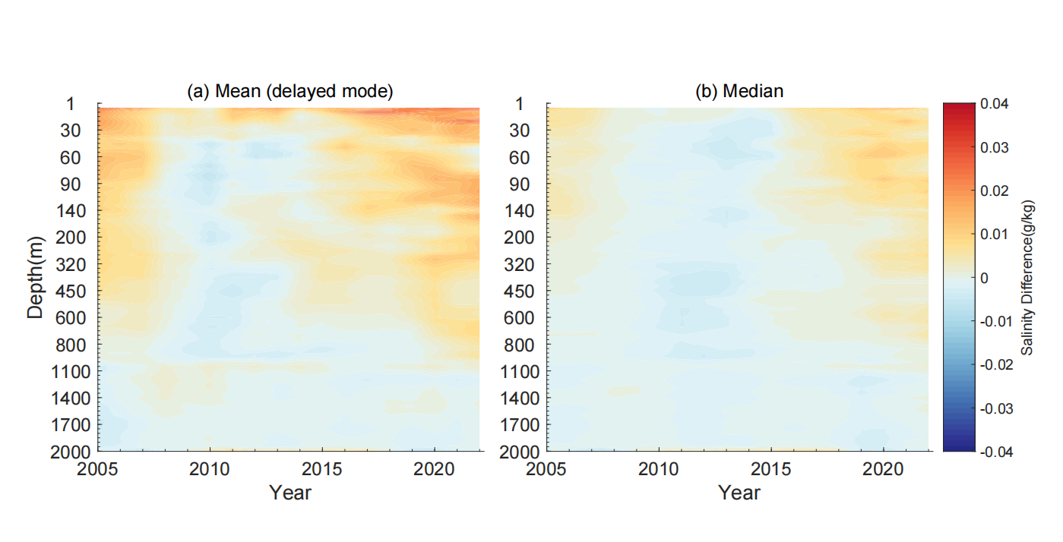
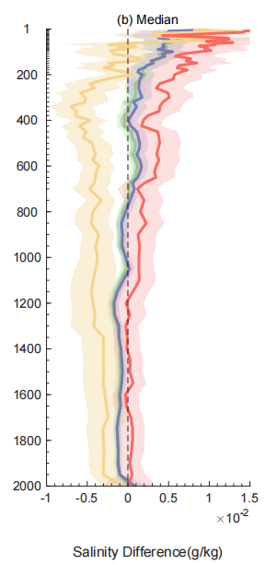
Results -- S_offset(depth)
For delay-mode Argo data
2015-2023 median offset
Blue: delayed-mode data
0.001~0.002 g/kg
[200-800m]
2015
800m
A positive offset
[depth-dependent?]
0-800m
Notes:
This is the median offset as a functino of depth and year, we can found that it is indeed after 105 and in the upper 800m, a positive offset can be observed. And it looks like a depth-dependent bias. In the right figure, the depth bias is decreasing with depth in the upper800, but it is still positive, the mangnitude is about 0.001~0.002 from 200-800m

Slide 13
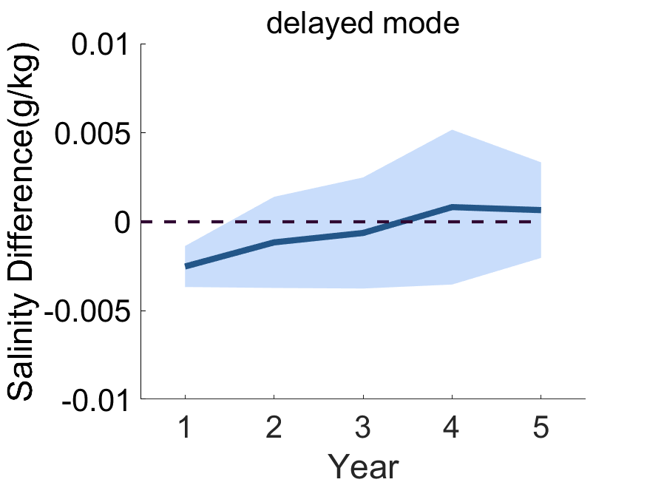
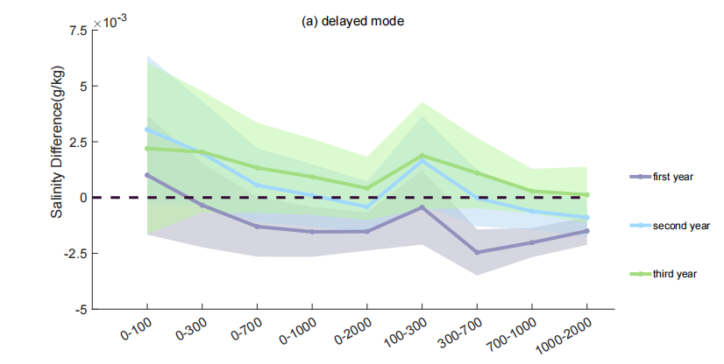
Results -- S_offset(float, service time)
Argo sensor float service time (lifetime): generally within three years (Wong et al., 2020)
Bias: Increasing positive biases with increasing lifetime
Potential pure salinity bias?
Lifetime: Second & three years (~0.002)
Notes:
Here, we would like to provide another perspective in our IAP group. As argo float life time is generally within three years, we also found that the offset is increased with increasing lifetime. You can also found that in different depth interval, the offset in second and three years is always positive.
So it means that if argo does have a salinity bias, the lifetime might be a reason for the potential pure salinity bias.

Slide 14
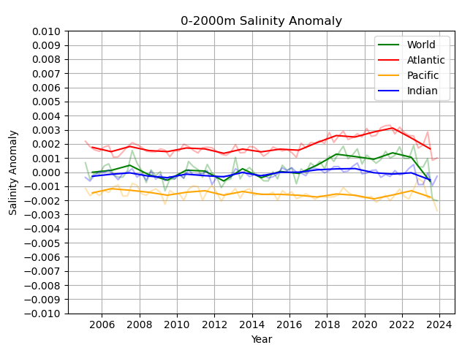
NOAA/NCEI’s results – global average
Delayed Mode Adjusted Salinity Data
The increase in global salinity is also evident in the delayed-mode adjusted salinity data (~0.001) from 2016- 2022.
Global average
Notes:
This is the results from NOAA’s team, lead by Jeam Regon. First, we can found that there is indeed a salinity drift after 2016. The mangutide is indeed about ~0.001.
The dark lines are the annual averages in each plot. The lighter lines are the seasonal values. The global average salinity consists of the Atlantic, Pacific, and Indian Ocean basins.

Slide 15
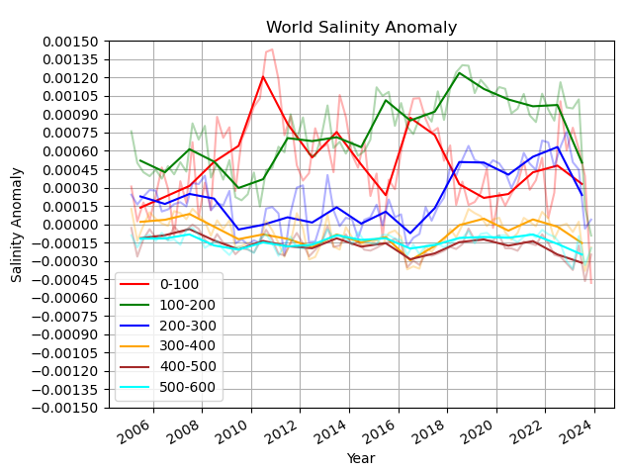
NOAA/NCEI’s results – global average
Delayed Mode Adjusted Salinity Data
The increase we see in global salinity is primarily a result of increases from 2016 to 2018 in the 100-500m layer.
Is this salinity increase we see from 2016 to 2018 between 100 and 500m a residual salinity bias not yet accounted for?
Notes:
Then, the salinity drift are indeed depth dependent, which it is primarily due to the increase from 2016-2018 in the upper 100-500 layers.
We decompose the salinity changes between 0-2000m into different depth intervals (volume adjusted to the full 0-2000m volume). The increase post-2016 appears to occur primarily in the 100-500m depth range (left plot), with freshening in the upper 100m. We see very little change, if any, at depths greater than 600m (right plot).

Slide 16
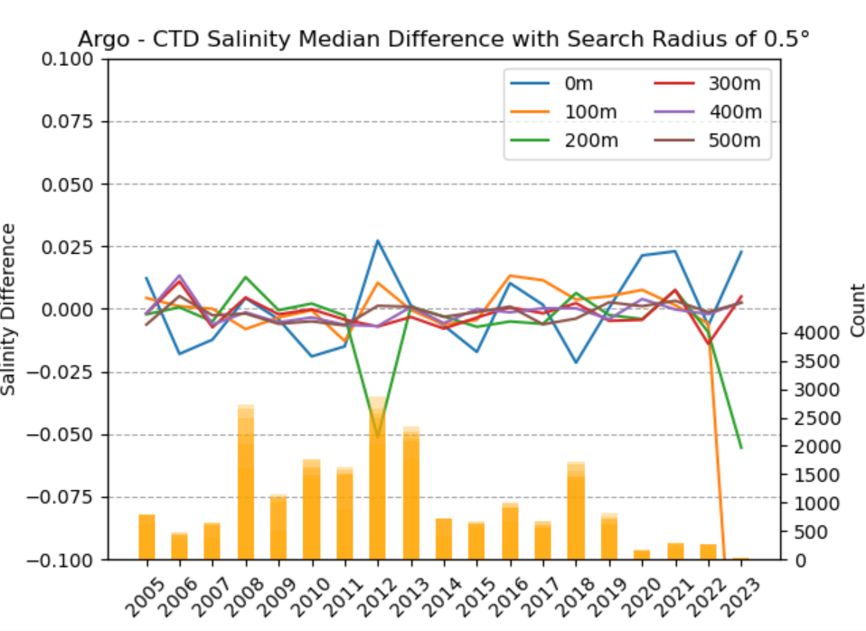
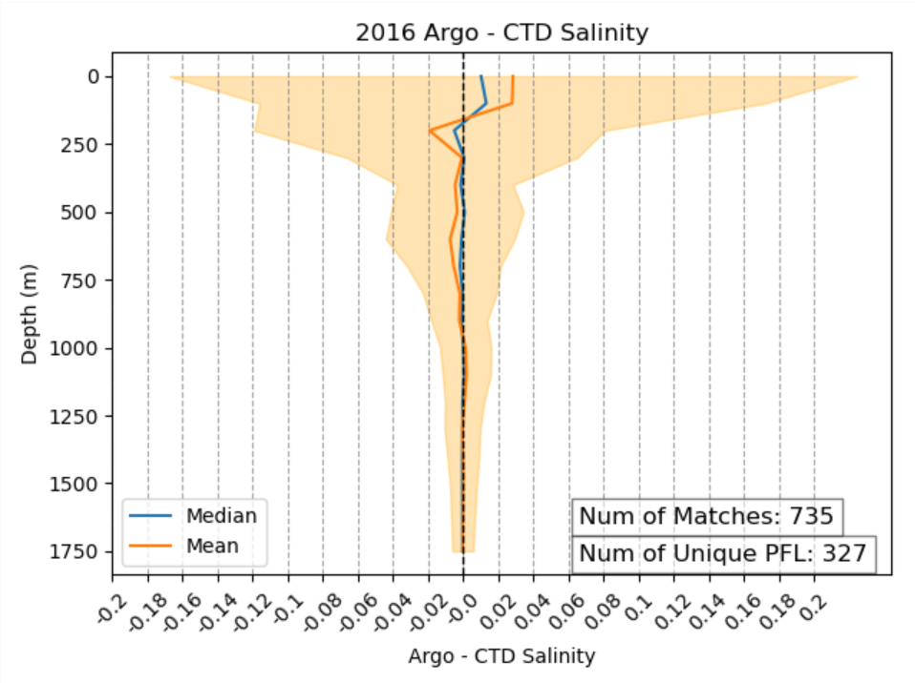
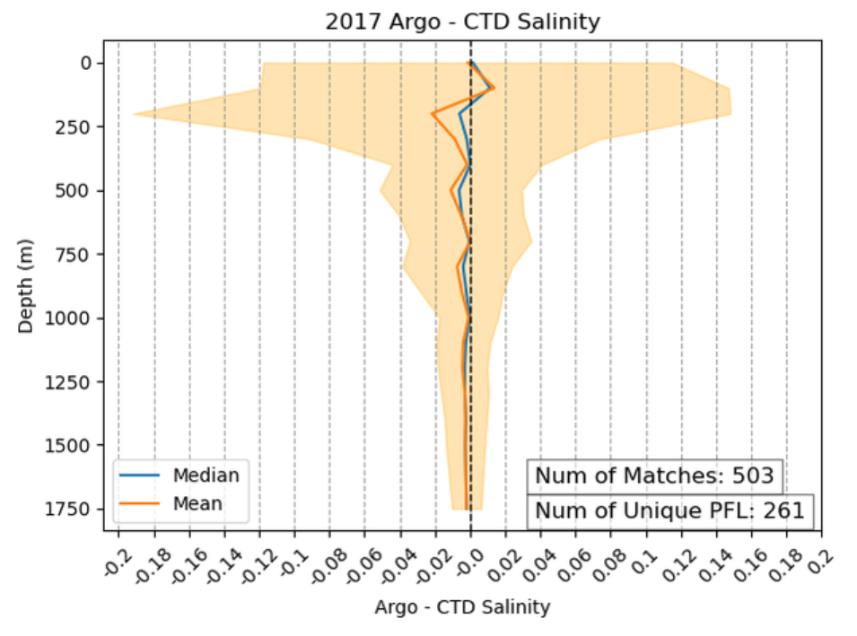
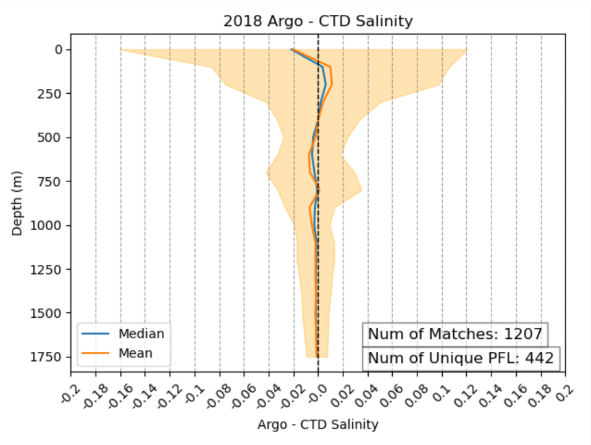
NOAA/NCEI’s results – S_offset(depth)
Argo-CTD Matchup Criteria:
Delayed-Mode Argo Salinity
CTD (GO-SHIP only cruises) Salinity
Profiles within 30 days of each other
Distance less than or equal to 0.5° lat/lon
No evidence of a significant salty bias remaining in the Delayed-Mode Argo salinity profiles after comparing to CTD. Does not explain the salinity increase between 2016 and 2018.
2016
2017
2018
Notes:
However, after compared the collocated CTD, there are no evidence of a residual salinity bias in the delayed-mode Argo data, and thus they told me that they think the salinity increase, at least between 0-2000m and where Argo can capture the signal, is real. The reasons of the increase salinity might be due to other possible reasons such as freshwater redistribution, freshwater accumulation in Argo-free zones regions where no Argo are observed, terrestrial storage, and so on.
It should also be noted that the standard deviation (+/- 1 standard deviation is shaded orange) of the differences is quite large in the upper couple of hundred meters illustrating increased variability when compared to deeper depths.

Slide 17
Summary
 | NCEI | IAP
Methods | GO-SHIP CTD | WOD CTD
 | Delayed mode Argo with Argo-QC flags & WOD-QC flags | Delayed-mode Argo with CODC-QC-S flag
 | 30 days, 0.5° lat/lon | 30 days, 1° lat/lon
 | 1 year mean | 3 year mean
 | Checked different layers | Remove regions with large variability (>0.025)
Salinity offset | Small negative (2016-2018), with an order of -0.001~-0.004 (visual check) | Negative before ~2018, positive afterward, with an order of -0.004~0.003
Significance | Standard Deviation (not significant) | 2 Standard Error (Significant)
Interpretation/ assumption | Salinity increase is real and associated with Argo sampling | Salinity increase is not real, and it is an Argo bias
Small salinity change, but a big impact on sea level: 0.001 salinity change is equal to ~1.8 mm sea level rise
Mapping/sampling does matter; different datasets used different mapping methods and the resultant spread is ~0.006 for global mean 0-2000m salinity
The approach shows the smallest salinity increase is SIO (Argo only) and IAP (All data), which does not support that Argo-sampling matters a lot (but maybe it is just by chance and mapping uncertainty is large)
IAP
SIO
Global 0-2000m salinity time series (GRACE in dashed black)
Liu et al. 2024 JGR-oceans

Slide 18
Summary and possible challenges for part-1: QC
Summary:
A new automated QC procedure (namely as CODC-QC-S)
The salinity climatological thresholds are flow-, topographical-, depth-dependent, time-varying, and do not rely on predefined distribution patterns
evaluated the performance of the CODC-QC-S
The potentiel impact of QC on global salinity change: reduce the variability and impact the trend
Challenges:
Needs more benchmark datasets for evaluation: only WOCE + Argo benchmark dataset were used
Intercompare different salinity QC scheme and Identify the best practices method: to have a more comprehensive comparison between WOD-QC, GTSPP-QC, CODC-QC-S? (a potential task team?)
Incorporate into IQuOD initiative: producing the first version of database with quality flags for salinity profiles?
Notes:
I can lead the second point
Yes, someone needs the funding request...

Slide 19
Summary and possible challenges for Part-2: Argo bias
Does Argo salinity delayed-mode data have a positive offset/bias after 2015?
IAP : seems to have; NOAA/NCEI : no significant offset
IAP: Seems to be dependent on sensor float lifetime
We are also checking the robustness by using the Argo data download from the GDAC (Yingfan)
Potential depth bias?
Cooperate with NOAA/NCEI team (Jim et al.)
Physical reasons of the salinity offset?
Should communicate & collaborate with Argo community

Slide 20
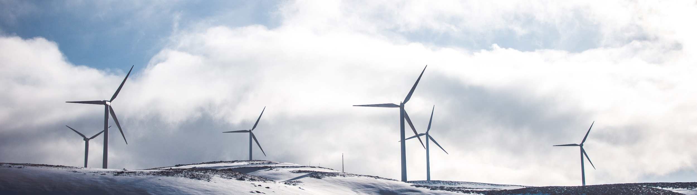
Comments welcome!
Zhetao Tan, Yingfan Sun, Lijing Cheng, Viktor Gouretski, Zhankun Wang, James Regan, Annie Wong, Tim Boyer, Yuying Pan, Huifeng Yuan, Bin Zhang et al.
Institute of Atmospheric Physics, Chinese Academy of Sciences (IAP/CAS)
NOAA/NCEI

Slide 21
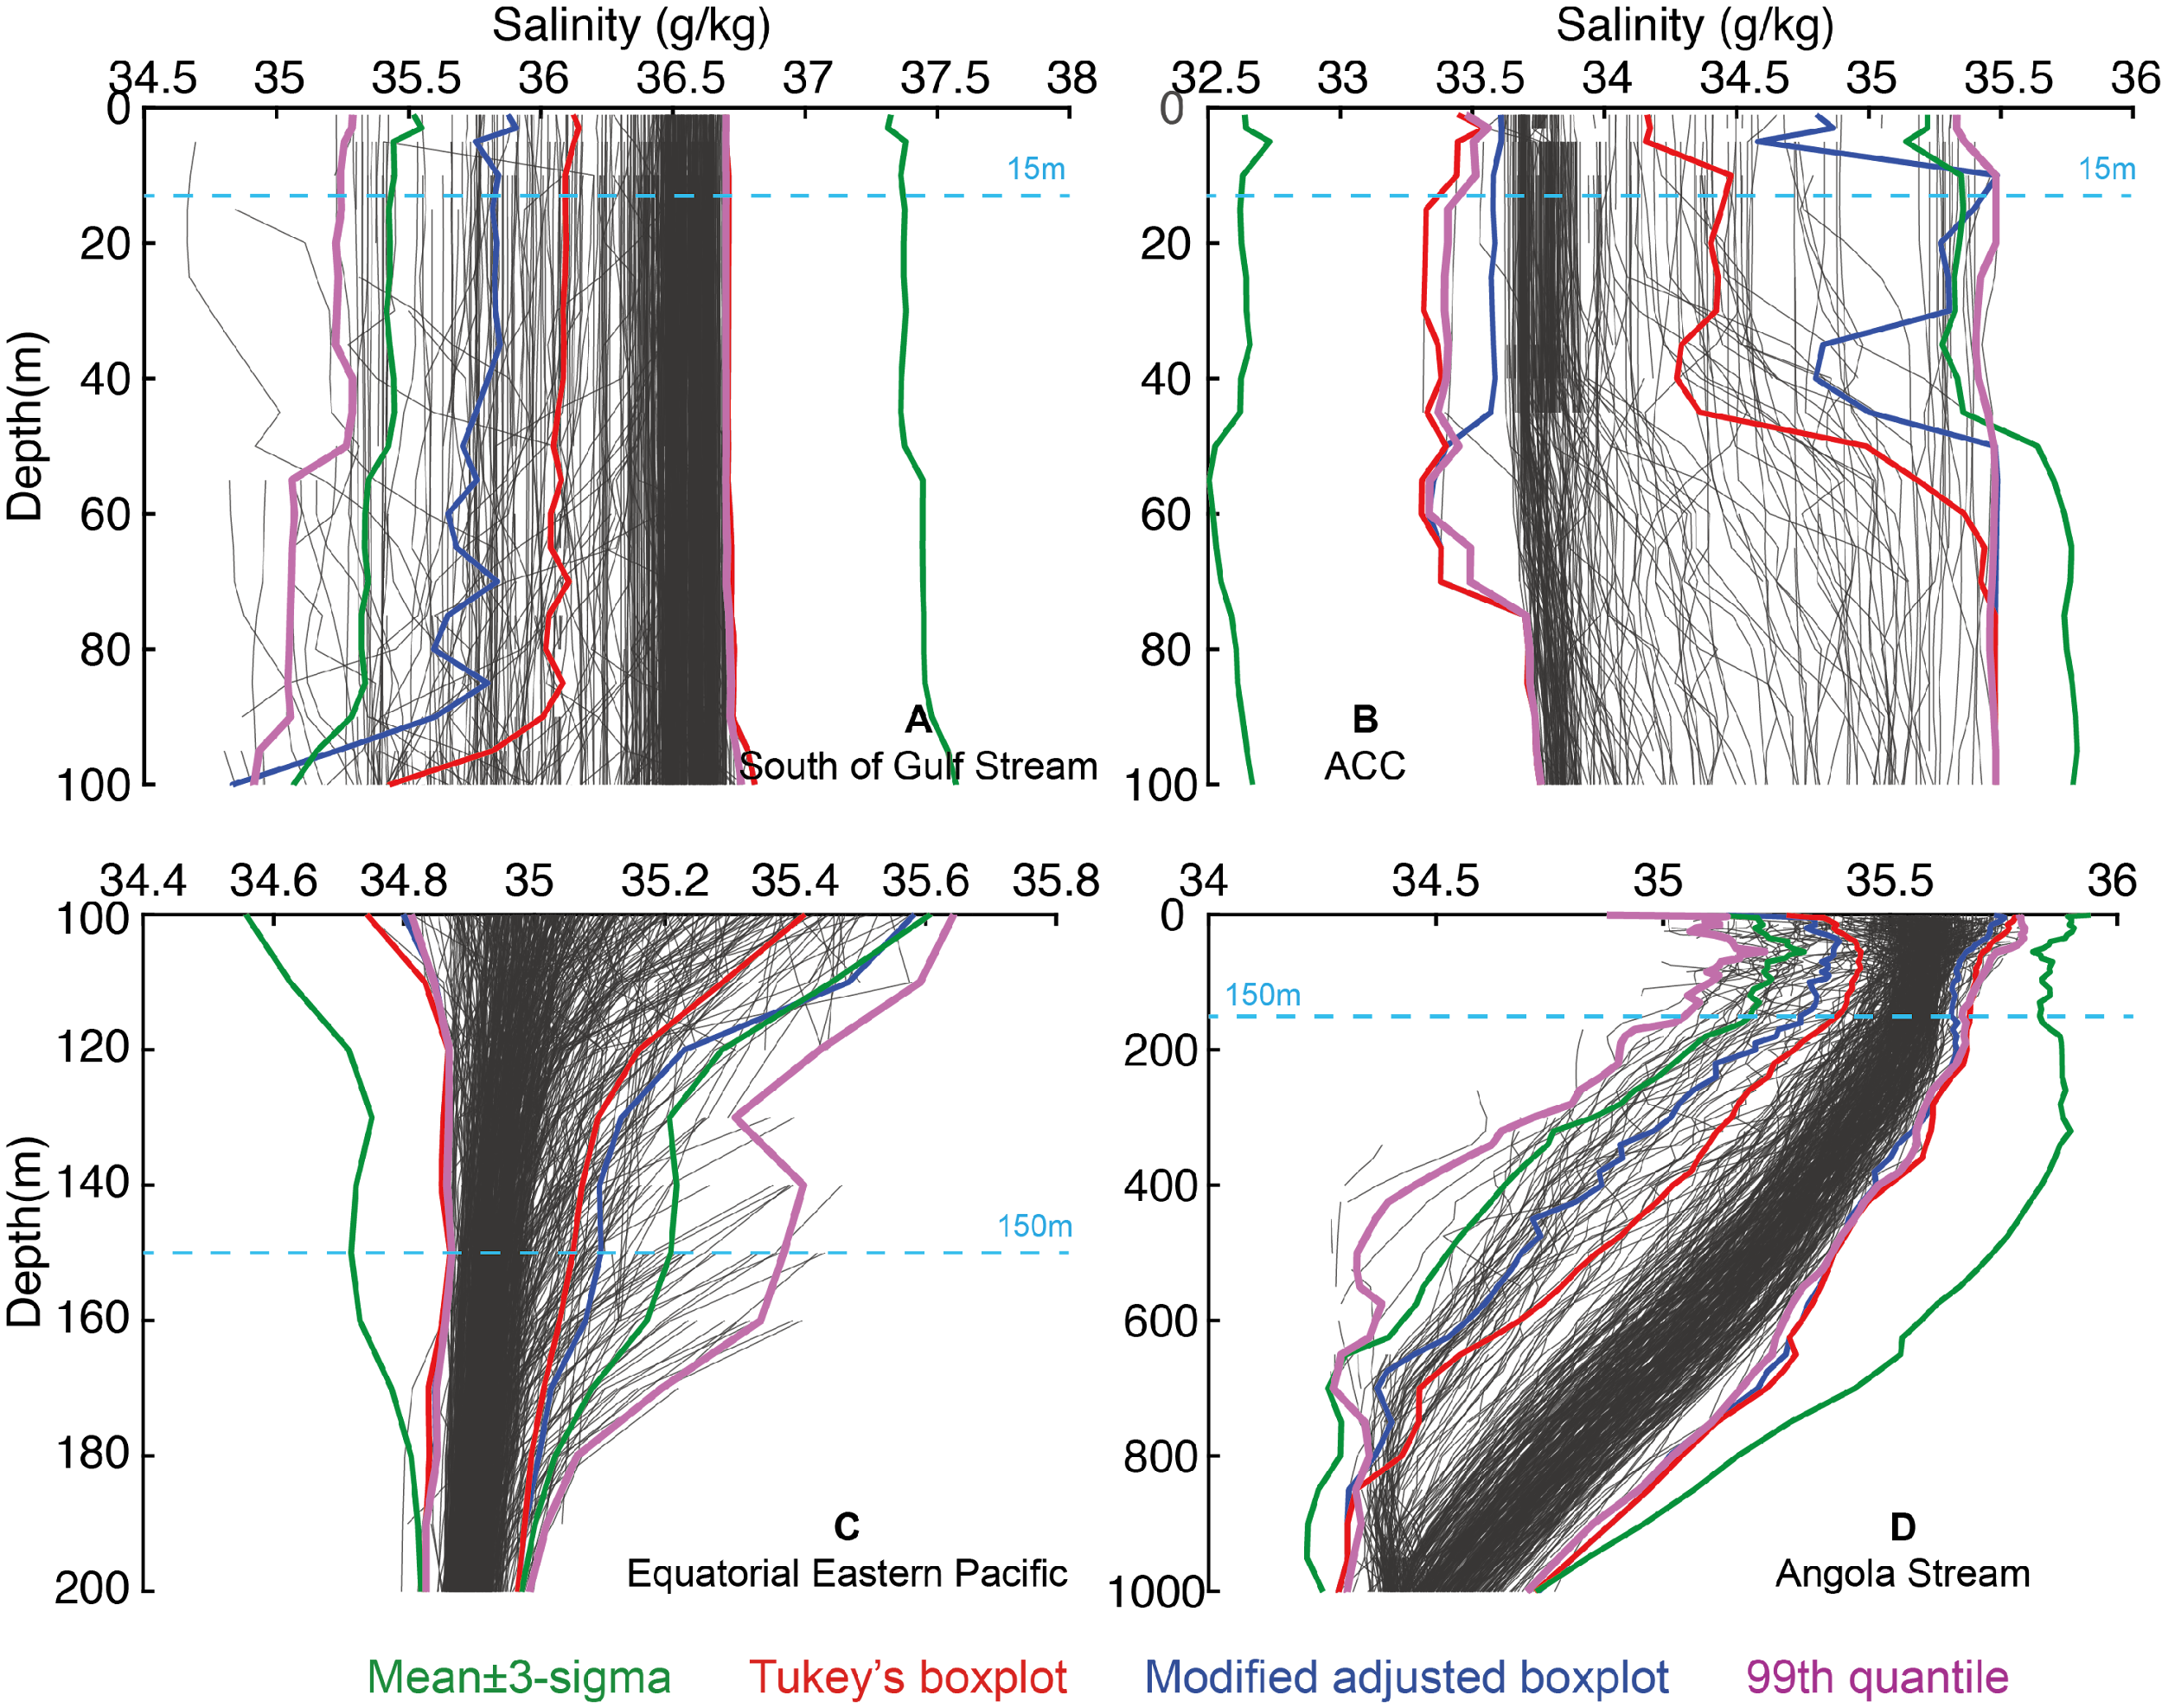
Local salinity climatological threshold decisions
The profiles are ‘best-looking‘ profiles
Notes:
各有好处，说明还可以
基于这几个例子，他们也有什么问题，我们也有问题，比如说。。。

Slide 22
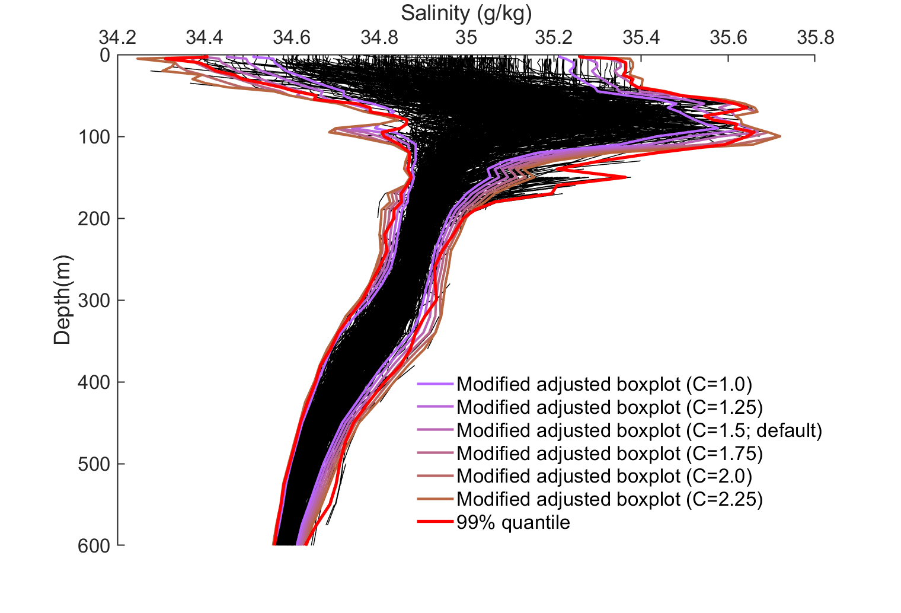
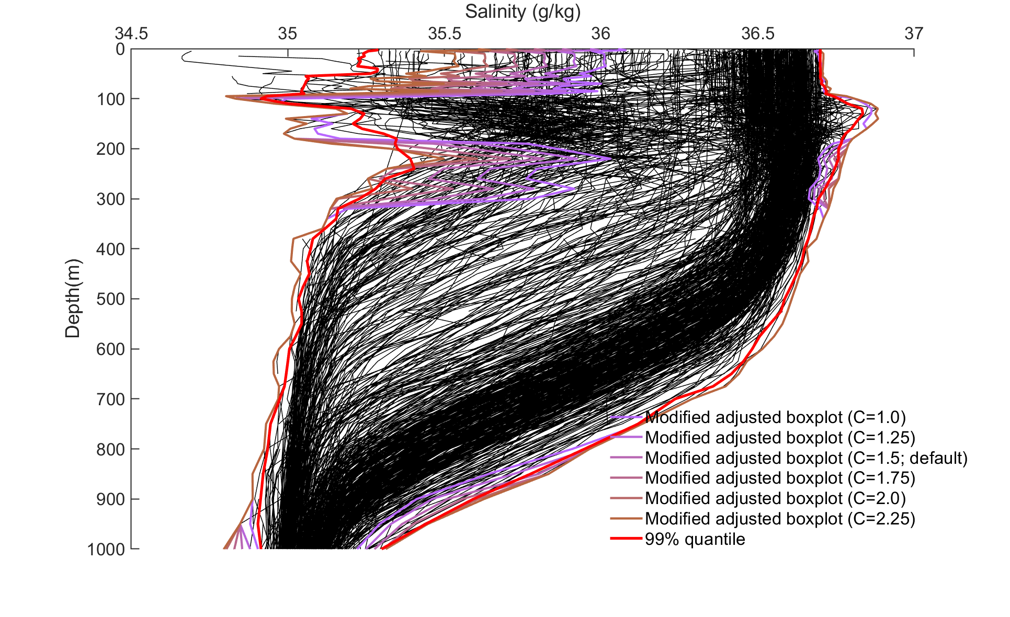
The C is increasing from 1.0 to 2.25, with 0.25 step.
Also, I attached the 99% quantile I used in the manuscript
There are some climatology ‘spikes’ for the threshold profiles.
However, for the 99% quantile, seems more reasonable with depth
In some cases, the threshold defined by the modified adjusted boxplot can also mistakenly flags some data point in the ‘best-looking’ profiles. This cases are not sensitive with the coefficient choices.

Slide 23
Discussion points
Intercompare different salinity QC scheme and Identify the best practices method: to have a more comprehensive comparison between WOD-QC, GTSPP-QC, CODC-QC-S?
Compare internal parameter settings of different QC schemes
Compare the QCout and QCpassed data of different QC schemes
Benchmark evaluation (TPR, FPR, TNR etc.); Water mass analysis (T-S diagram);
Profiles checks: climatology fields, climatology profiles etc.
Global and regional salinity changes (salinity contrast) comparisons:
Time series, trend, seasonal cycle, inter-annual variability, decadal (multi-decadal) variability etc.
Uncertainty of salinity changes due to QC

Slide 24
Discussion points
Some possible scientific questions :
（1）Global hydrological cycle estimation: QCpassed or QCout data makes the cycle more stronger/weaker?
（2）climate model simulation (historical run): initial field and assimilation field 🡪 compare the model results with the independent observations
（3）Density or stratification estimation: bring back the QCout data will get better results?
（4）Geostrophic flow comparison: estimate by salinity and temperature, and compared with independently observed currents rates (e.g., ADCP data)
（5）Sound velocity comparasion: estimate the velocity profiles by salinity, then compare with the acoustic observation data (such as acoustic Doppler current profilers)
（6）altimetric data?

Slide 25
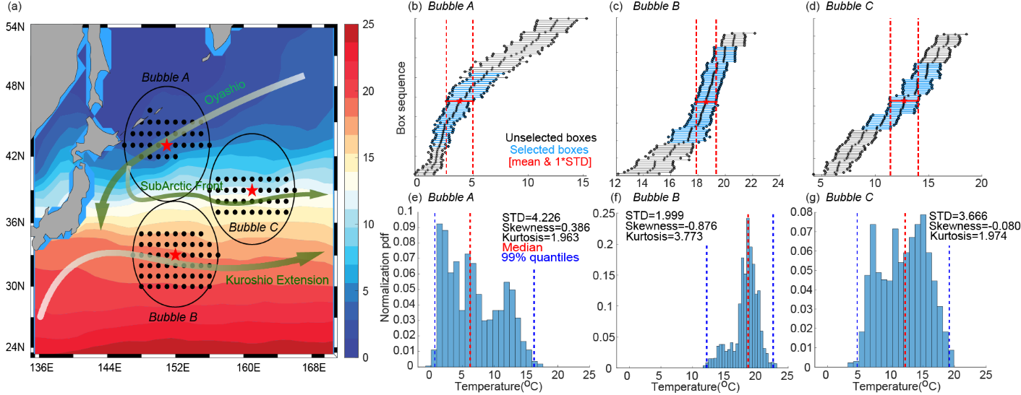
Methods: Climatological range determination
The anisotropic feature of water mass is accounted
Water mass selection
Flow dependency (zonal dependency)
January climatology field
Notes:
In addition, these threshold is flow dependent. We consider the anisotropic feature of the water mass.
For example, the data in bubble A is within the cold Oyashio current, which the water is much more colder than the south. So we retain only the cooler data in those nearby boxes. And that is so-called the zonal dependency or the flow dependency
with water mass characteristics similar to those of the central box, so that the boxes from the northern half of the bubble are selected and then used the data in these boxes to make the statistics.

Slide 26
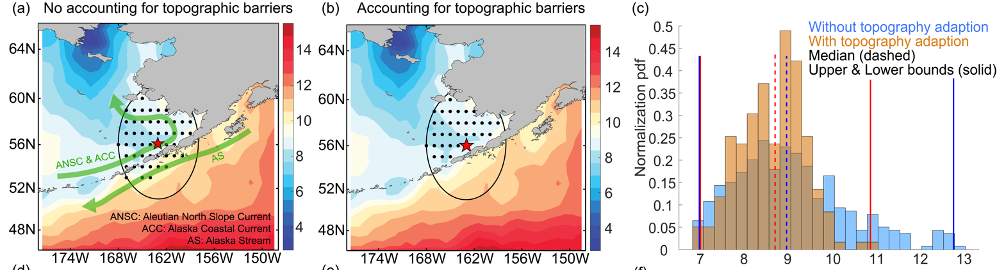
Methods: Climatological range determination
The topography barriers adjustment of water mass is accounted
Surface, January
Example: The Alaska Peninsula
‘Similar water mass’ are both observed in the north and south, but meets the topography barriers
Notes:
we also consider the topography barriers adjustment of the climatological range.
For example, the figure on the left show the surface currents around the Alaska peninsula. After the flow dependency water mass selection, some boxes within the bubble will cross the topography. But in fact, these are two different currents. Therefore, as shown in the middle figure, we retain only those profiles for which no topographic barrier between the central boxes exists by using the land mask data and bottom depth data.
We then link a connection between the location of a selected profile in the bubble range and the location of the bubble central box, and if the connection meets the topographic barrier, this profile will not be included in the statistical process (by checking the location of each profile one by one

Slide 27
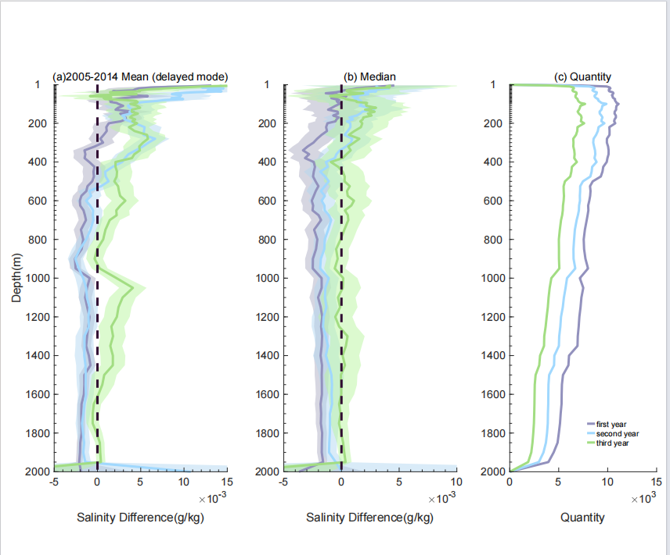
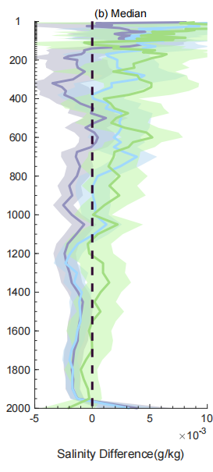
Results -- S_offset(float, service time)
Potential pure salinity bias of service time as a function of depth
2005-2014
2015-2023
The third year
The third year
The second year
The second year
The first year
The first year
Can be observed in both two periods (before & after 2015)
The bias of second year and third year are positive in 2015-2023, while it is negative in 2005-2014

Slide 28
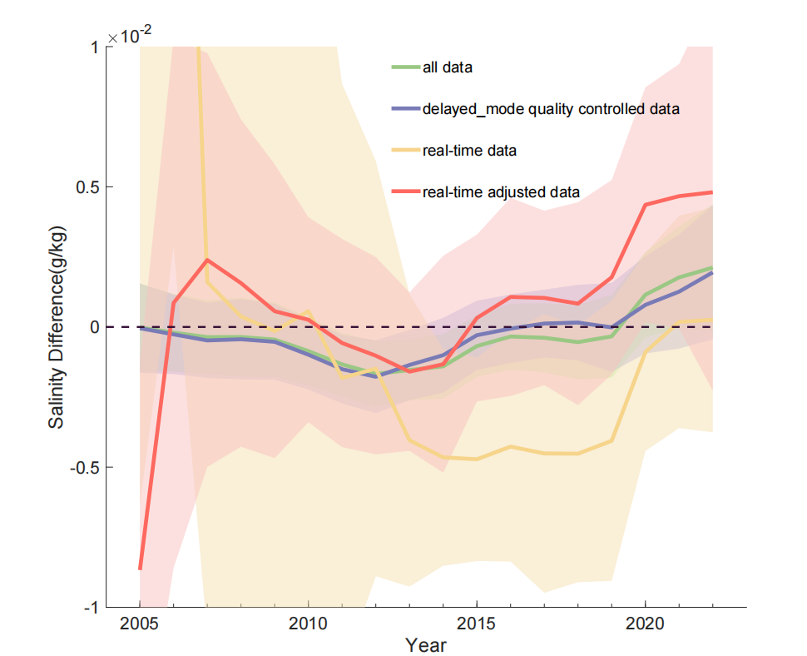
Results
Mean & 2*STE
Median (S_Argo - S_CTD)

Slide 29
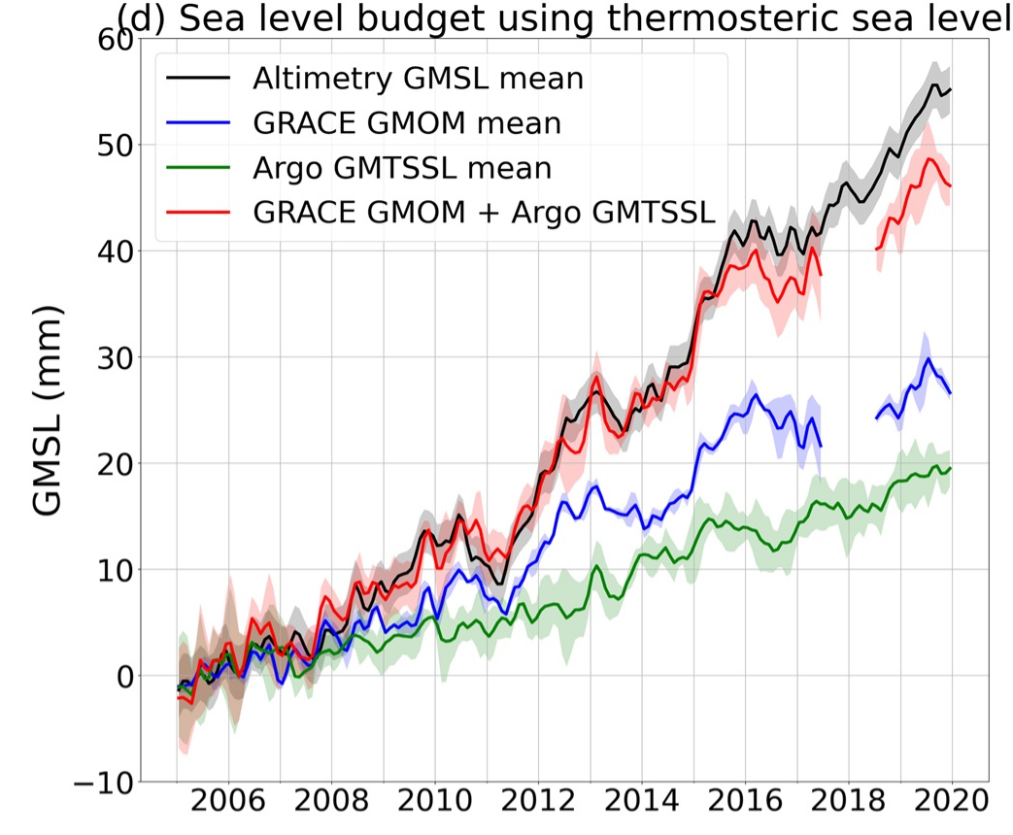
Background
Sea level budget is not closed
Global salinity is observed to be rising
Potential salinity drift after 2015
......
Does Argo delayed mode data still have some offsets?
Barnoud, A., Pfeffer, J., Guérou, A., Frery, M.-L., Siméon, M., Cazenave, A., et al. (2021)
to get a better understanding of salinity change , water circulation and sea level budget

Slide 30
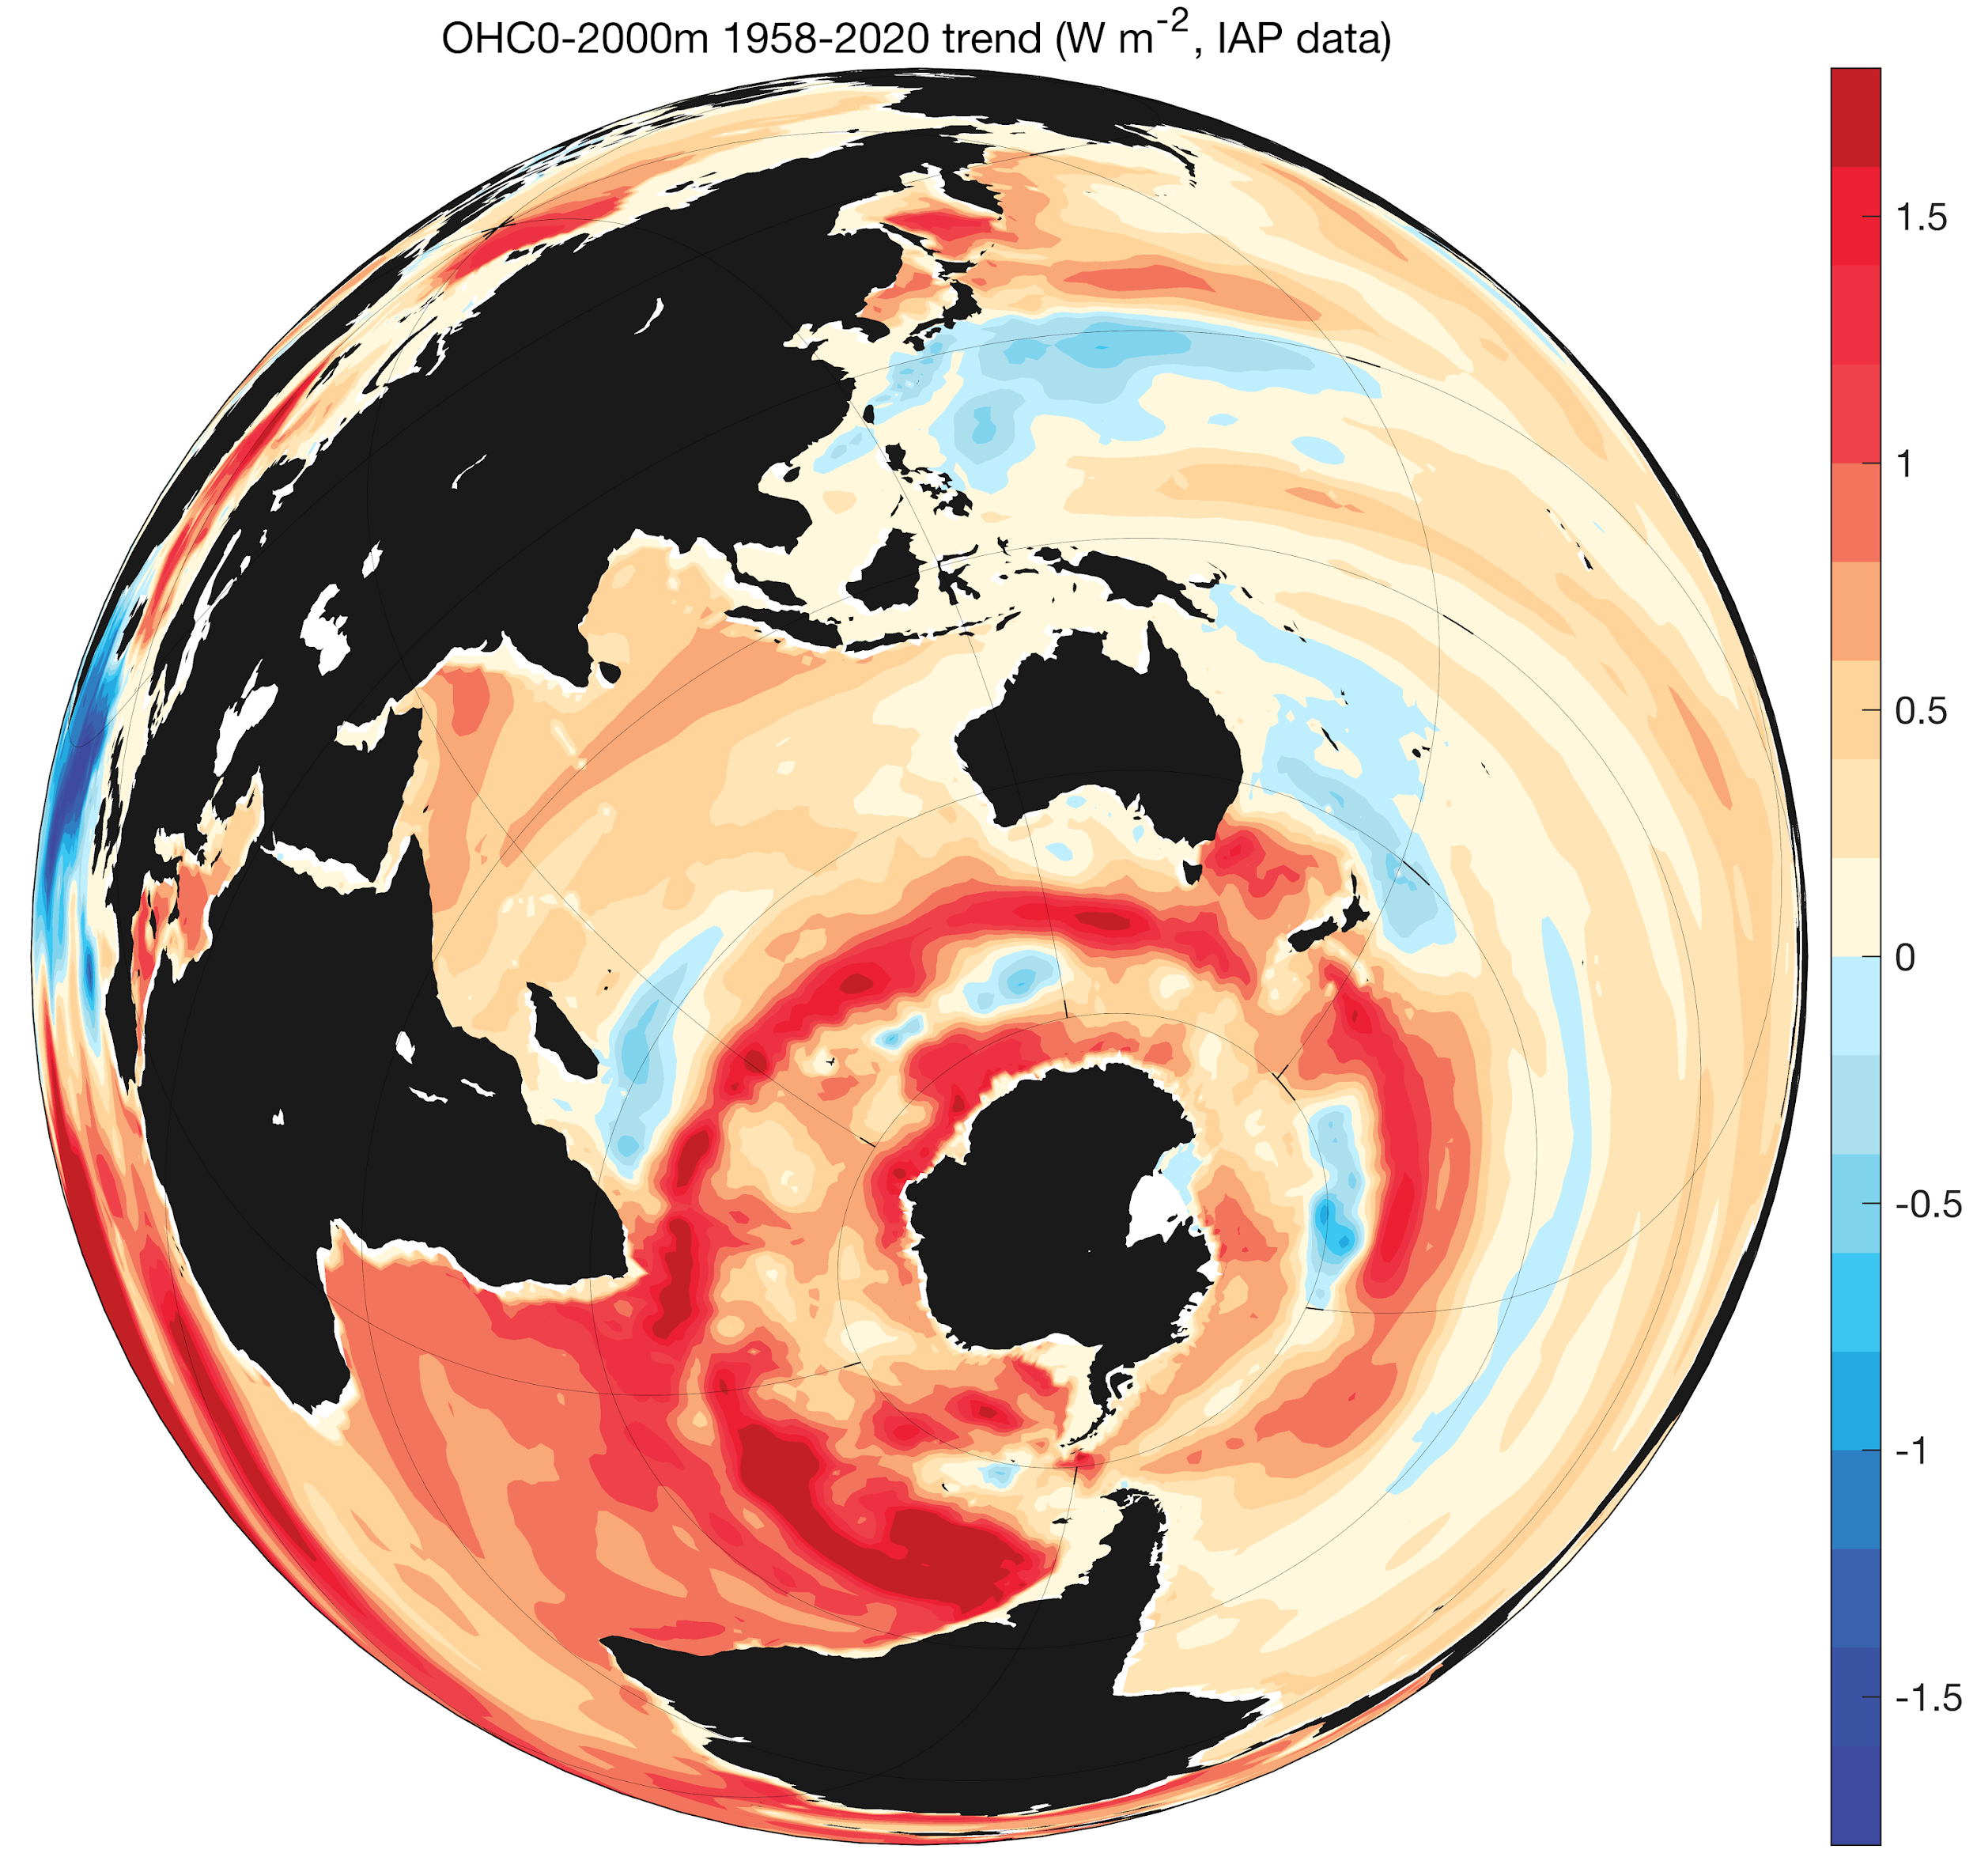
全球海洋科学数据集（L1）数据详情（格点化数据）
温度格点产品：1°、0.5° 分辨率
盐度格点产品：1°、0.5° 、0.25°分辨率
溶解氧格点产品：1°分辨率
层结格点产品： 1°分辨率
热含量格点产品：1°分辨率
比容海平面： 1°分辨率
地转流： 1°分辨率
公开网址：www.ocean.iap.ac.cn/
1960-2020海洋上层2000米热含量变化趋势

Slide 31
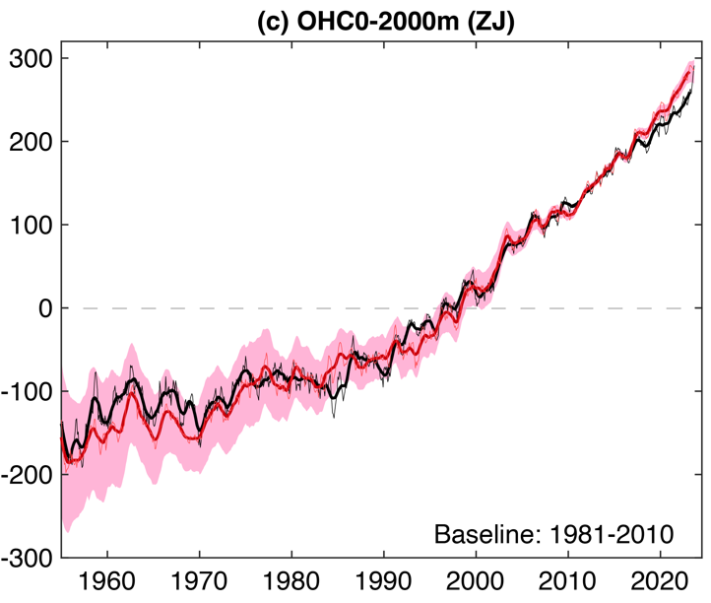

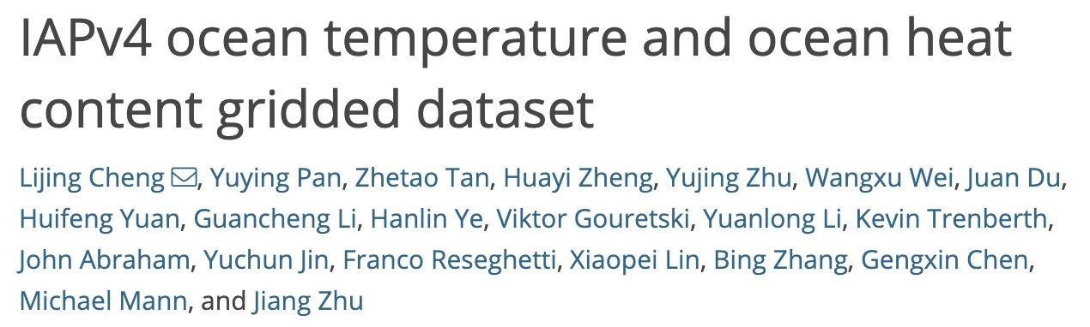
全球海洋科学数据集（L1）数据详情（格点化数据）
Data quality-control
XBT bias
correction
MBT/XBT bias
correction
Bottle bias
correction
Cheng et al. 2024 ESSD
https://doi.org/10.5194/essd-2024-42
Mapping improvement
90% CI
(instrumental error and sampling error)

Slide 32
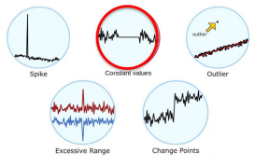
Background of Salinity QC
(1) > 10 million ocean salinity profiles (1940-onward):
Different collection methods
Different resolution
Different accuracy
(2) Several QC systems has been developed (WOD-QC, ICDC-QC, GTSPP-QC, Argo DMQC, EN4-QC, etc.), but the quality of the salinity profile data is highly heterogeneous.
(3) Large performance difference among different AutoQC (at least for temperature; Good et al., 2022)
Mistakenly flag too many good data (High FPR)
detect small amount of bad data (Low TPR)
Needs time-cost human/expert verification after AutoQC (e.g., WOD-QC)
Notes:
a consistent dataset is necessary and thus calls for the development of an effective quality control algorithms

Slide 33
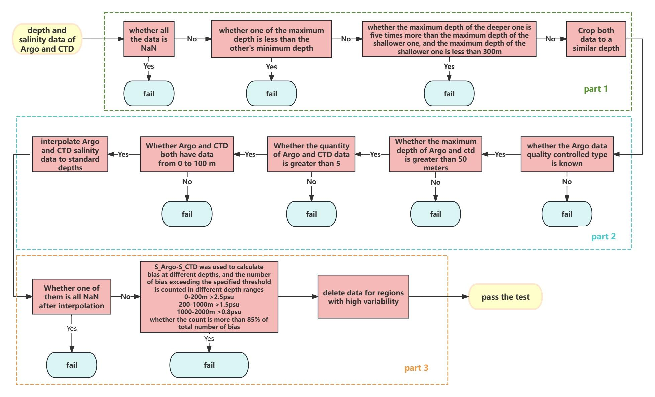
Appendix: match the collocated CTD & Argo

Slide 34
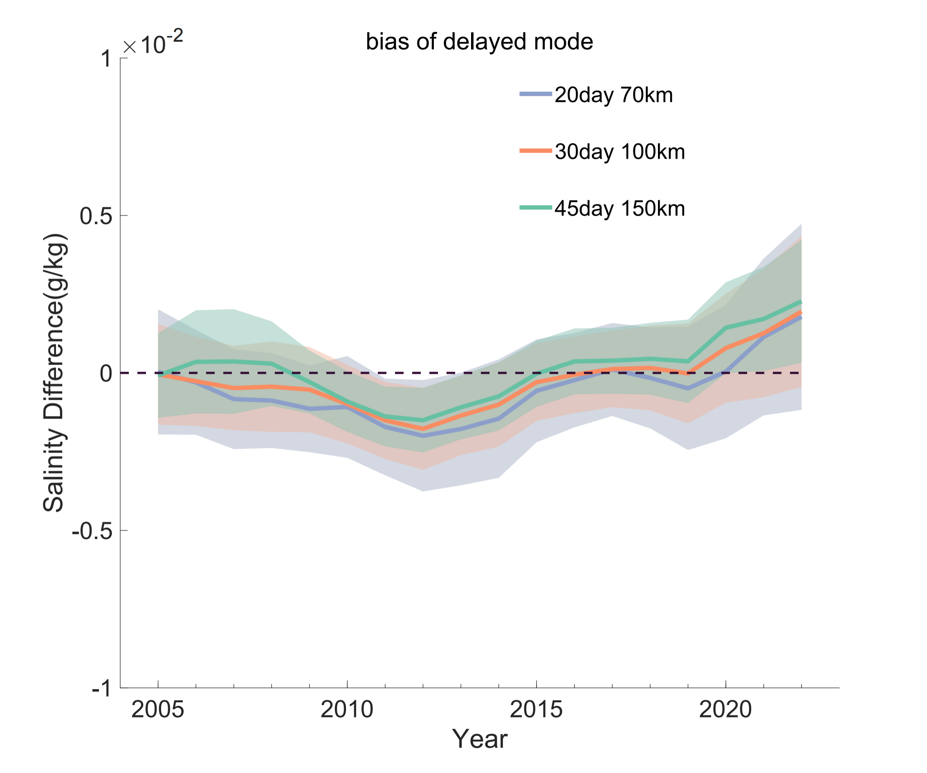
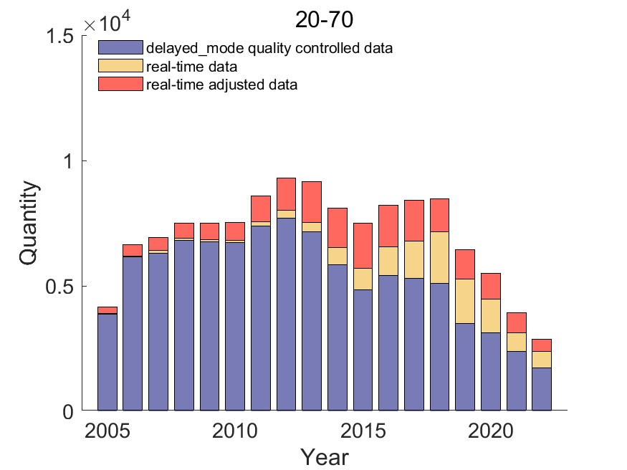
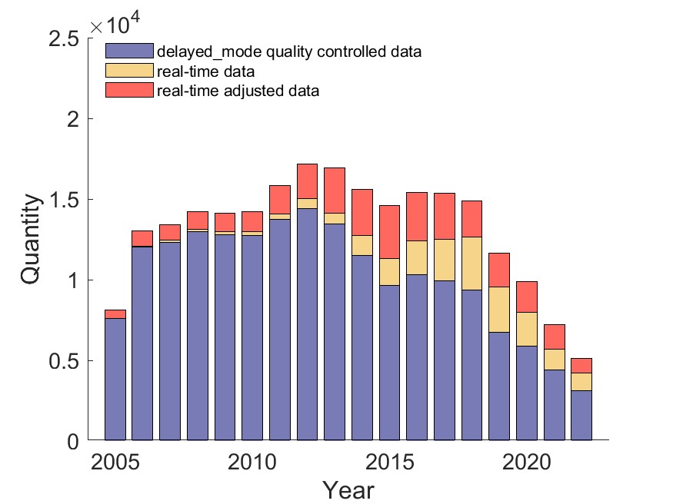
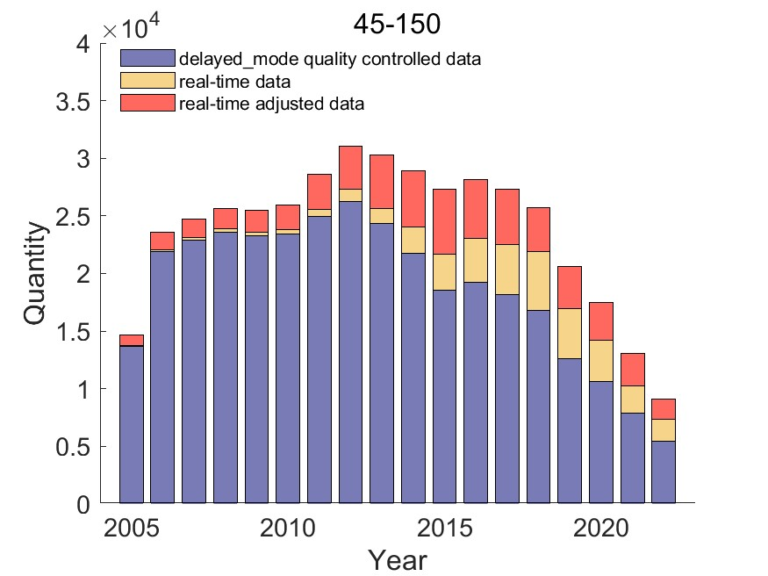
Appendix
Have been checked the robustness with 20days & 70km and 45days & 150km
Sensitivity test:
Similar results for three different matching methods
20days & 70km
30days & 100km
45 days & 150km

Slide 35
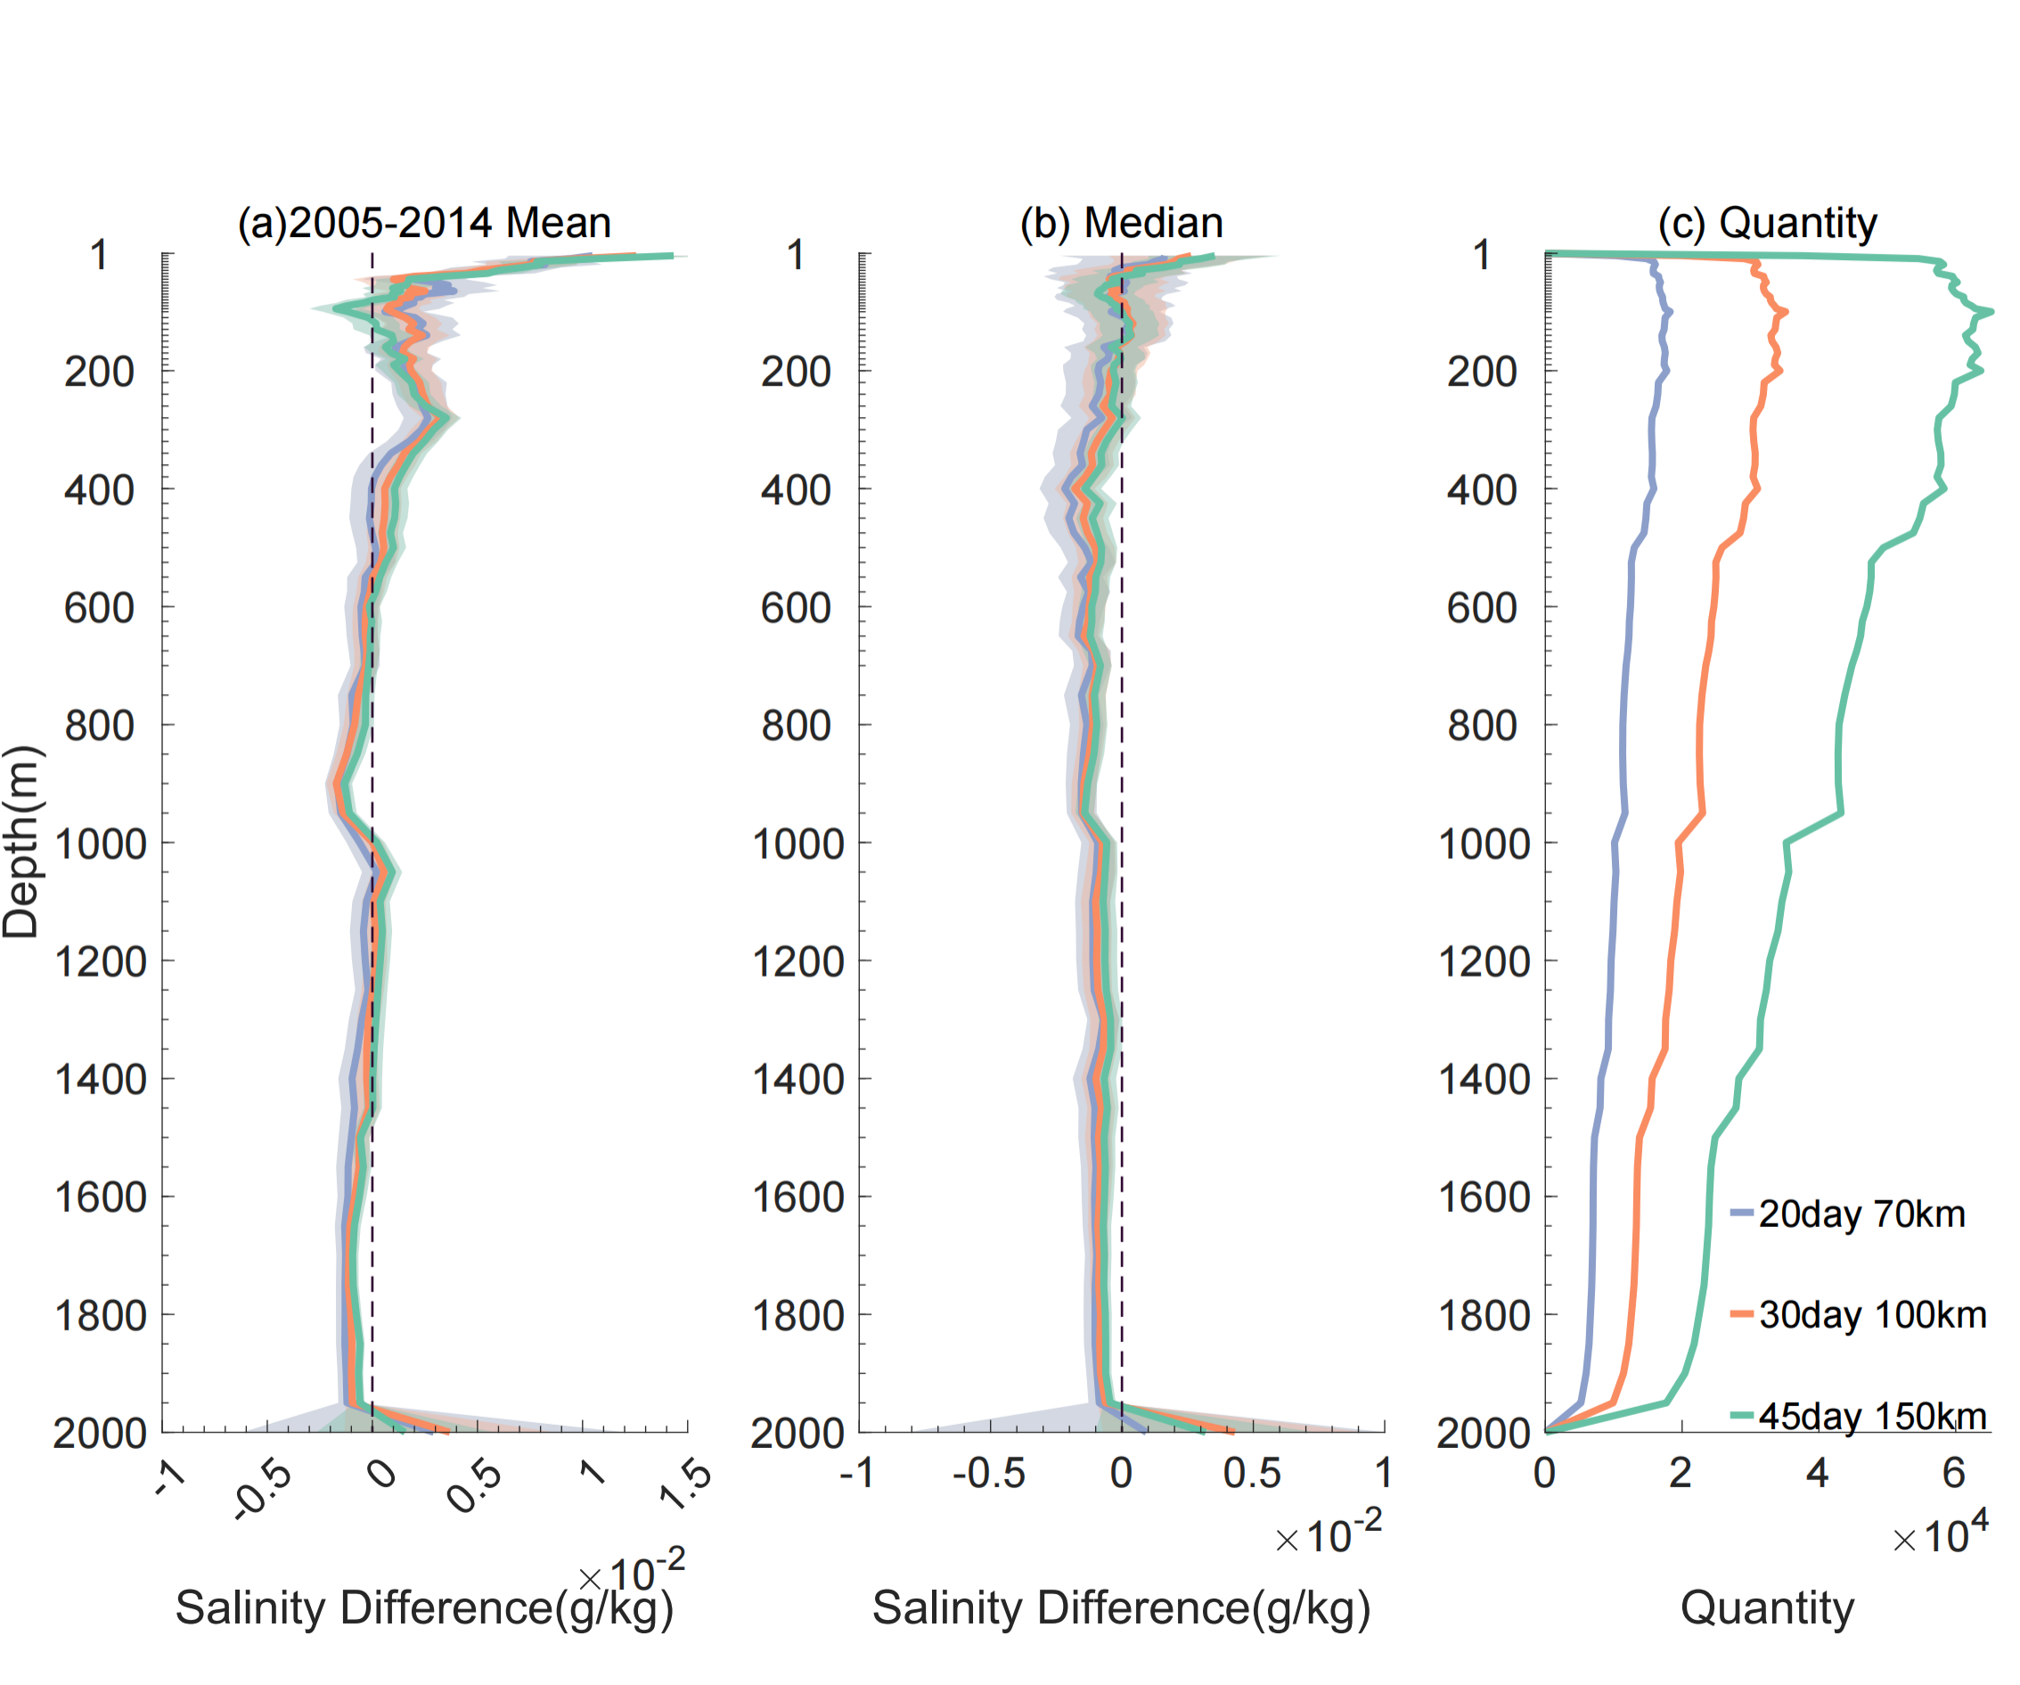
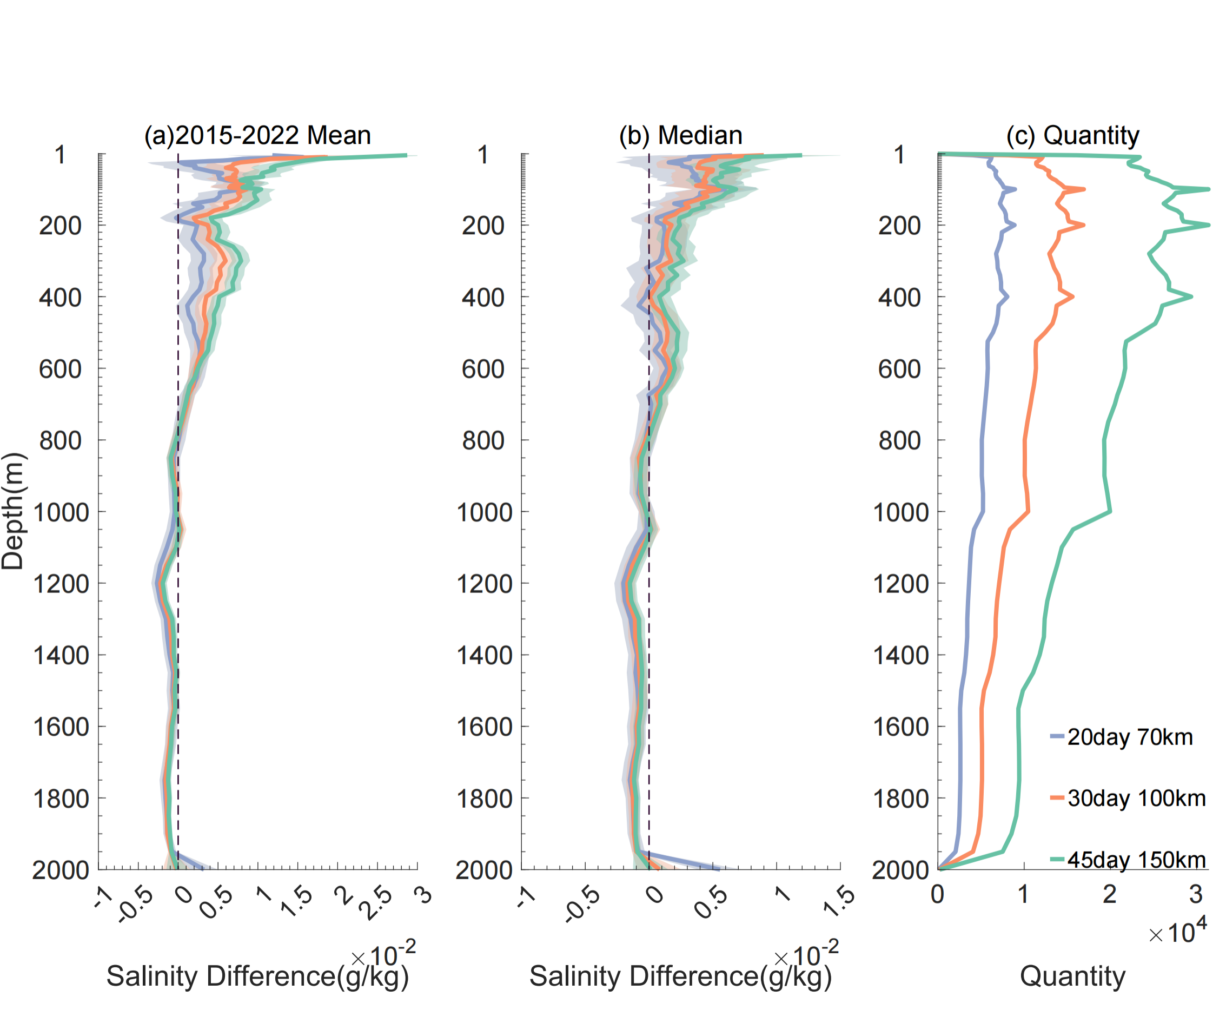
Appendix
Sensitivity test: the results are similar between three methods (both before and after 2015)

Slide 36
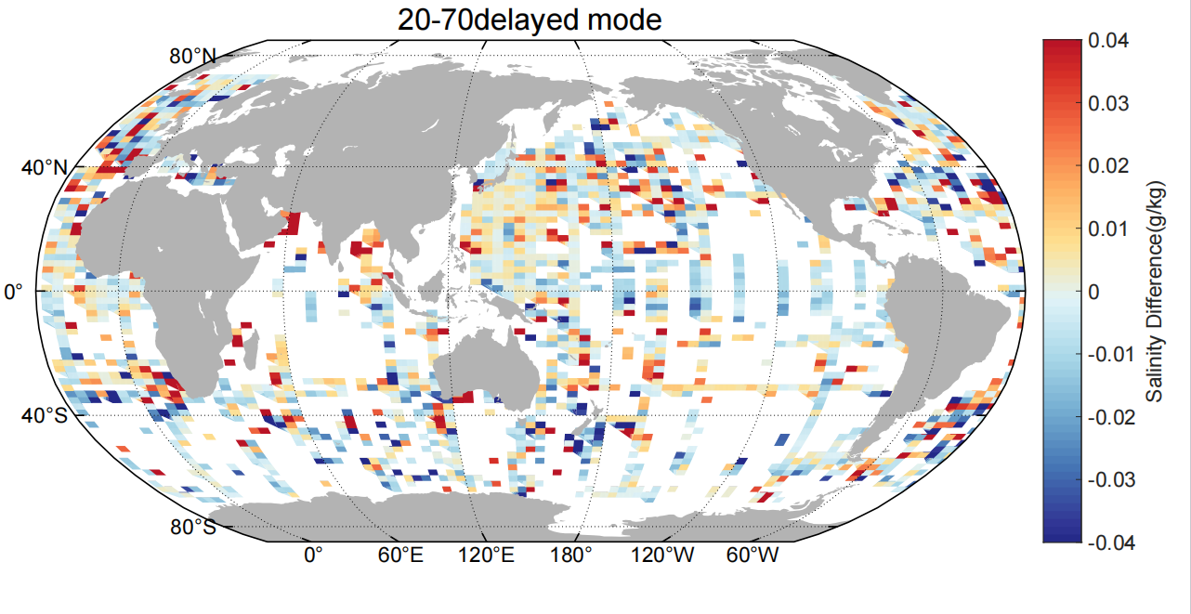
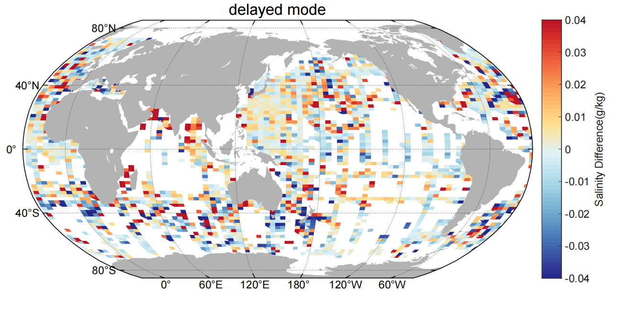
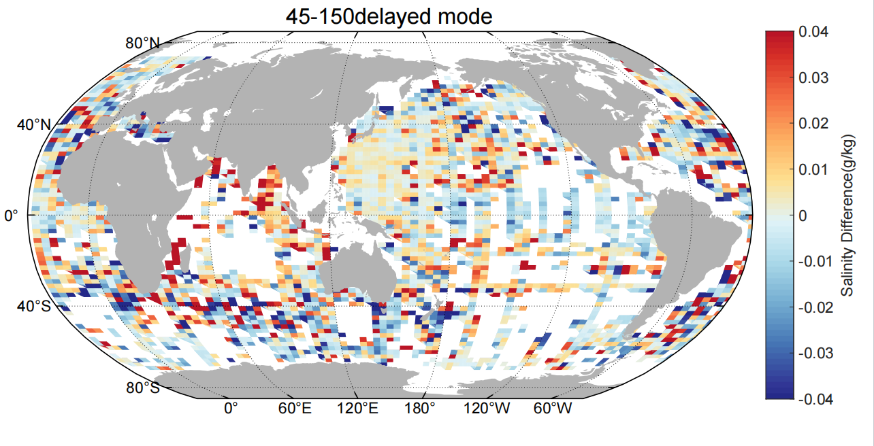
Appendix
Similar results of spatial distribution of salinity bias between these three methods
70km 20day
100km 30day
150km 45day

Slide 37
Appendix: illustration of potential depth bias
CTD
Argo
CTD
Argo
dS/dZ > 0
S_offset > 0
dS/dZ > 0
S_offset < 0
dS/dZ < 0
S_offset > 0
dS/dZ < 0
S_offset > 0
(a) Argo with pure salinity offset
(b) Argo with depth salinity offset

Slide 38
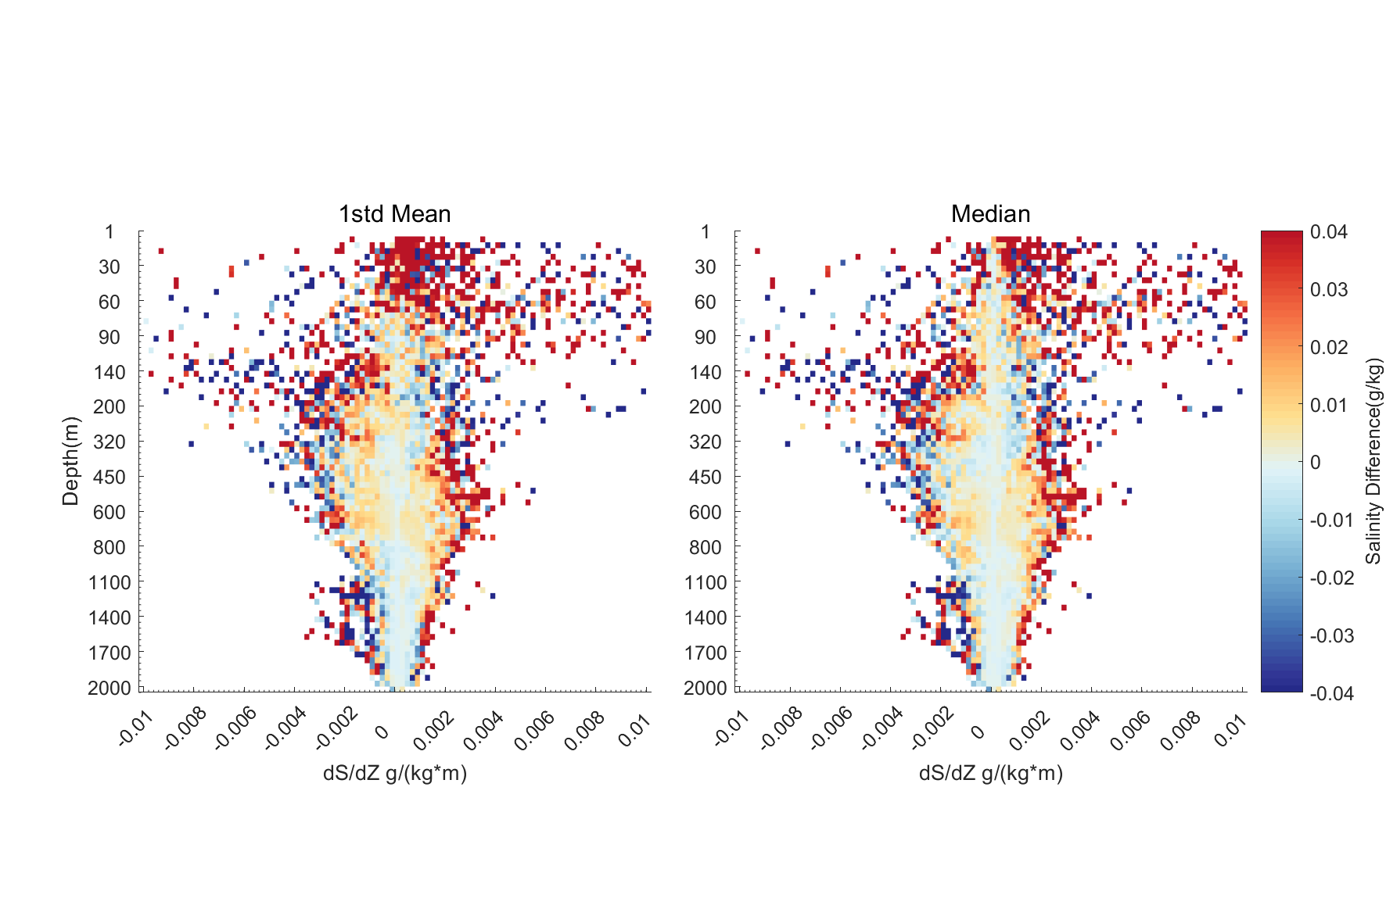
*salinity data in the dotted regions will not be included
Potential depth bias?
We are now narrowing the cut-off threshold of the variance of the salinity

Slide 39
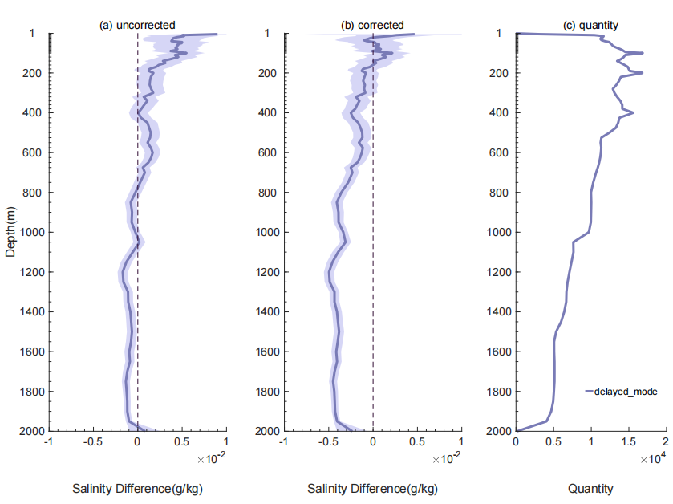
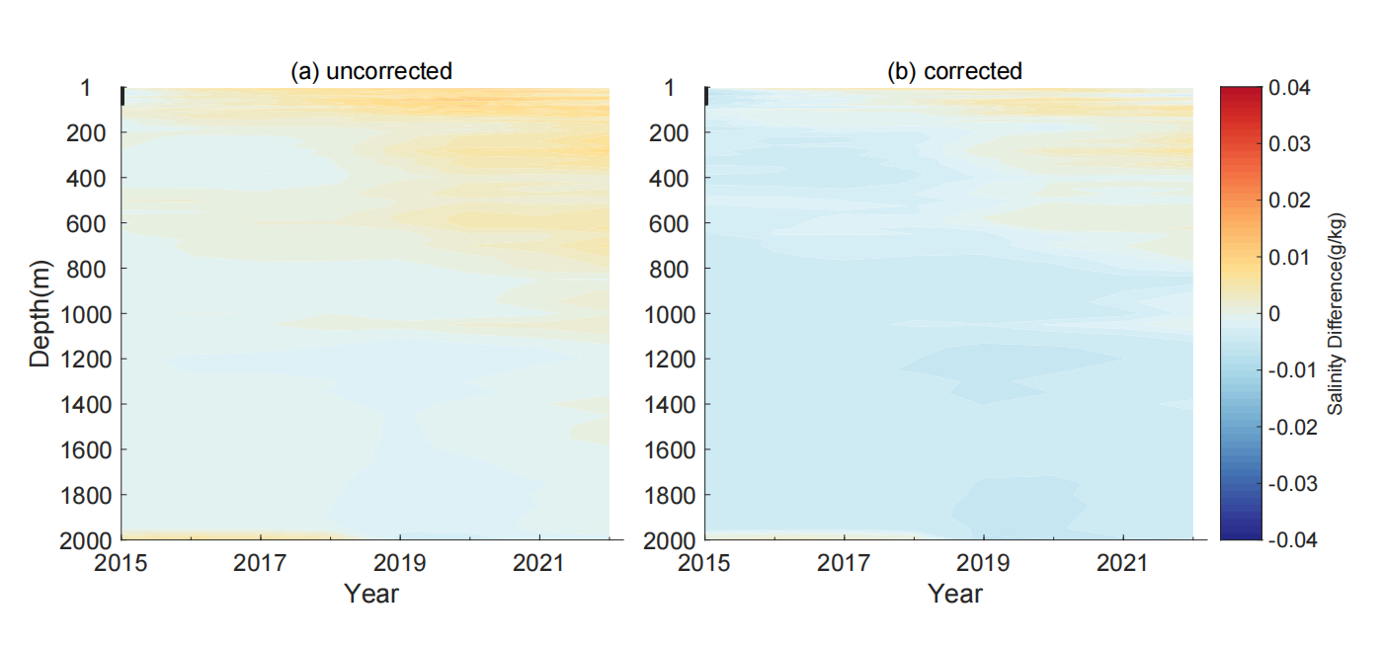
Appendix
* offset=ds/dz*1.1528+0.0030466
after depth correction, the residual offsets turn to be negative
potential pure salinity offset

