Slide 1

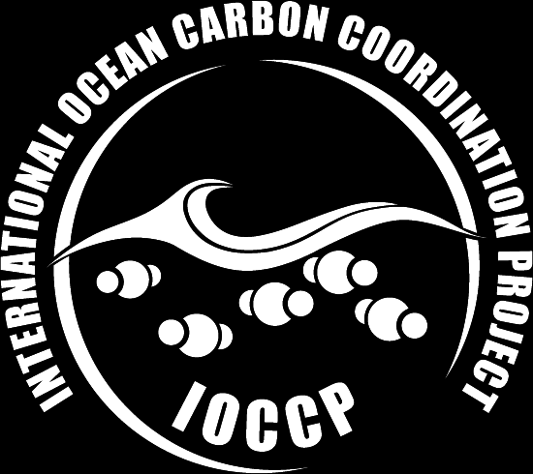

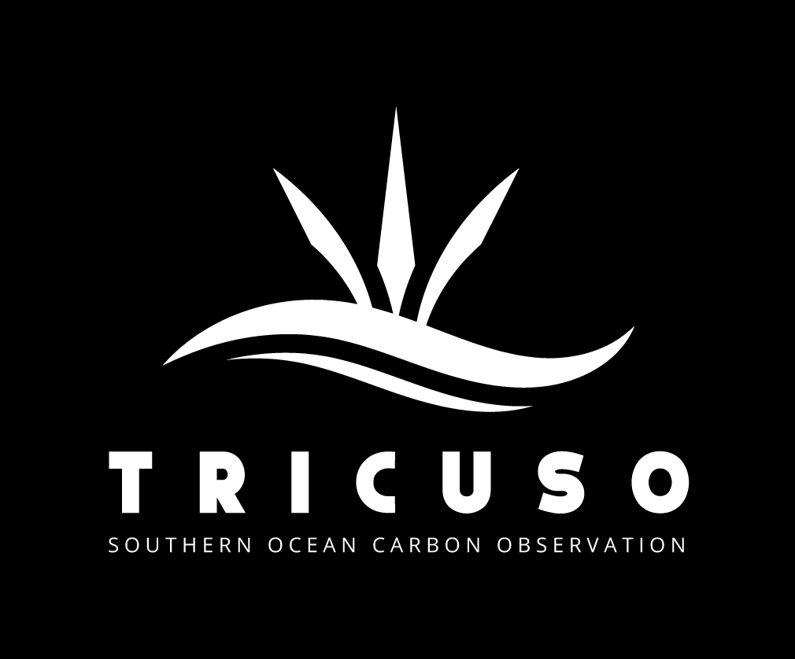





Formalizing, tracking and coordination of
Maciej Telszewski (SOCONET Network Coordinator, IOCCP, Poland)
Institute of Oceanology of Polish Academy of Sciences, ul. Powstańców Warszawy 55, 81-712 Sopot, Poland
Phone: +48 58 731 16 10 / Fax: +48 58 551 21 30, www.ioccp.org

Slide 2

Immediate Actions (2024-2025):
Formal integration of SOCONET into the GOOS Observations Coordination Group
SOCONET Interim Steering Committee and ToRs leading to selection and approval of SC
  Developing dedicated funding for SOCONET coordination at IOCCP and technical coordination at OceanOPS
  SOCONET website live AND manned in Q2-Q3 2025
  Stocktake of SOCONET assets and operators
Draft Tier 1 requirements approved by SC
Draft Tier 2 requirements approved by SC
Discussions with SOOP-CO2 and agreement on division of tasks/assets and competences.
Pilot on platform tracking through OceanOPS - NOAA assets
IOCCP includes a Nitrous Oxide Expert on its SSG to help integrate N₂O observations with SOCONET activities.
Initial Objectives (1-5 years):
Near-real-time platform tracking and development of metrics on data quality/quantity
  SLA with OceanOPS for services based on NOAA and TRICUSO funding
Develop SOCONET Implementation Plan, including network mission, targets, and design.
Develop and support capacity building focused on elevating quality and entraining additional platforms into the network
Provide coordination to the community on new platforms, instruments, sensors, and protocols
  e.g., N₂O and CH₄

Slide 3

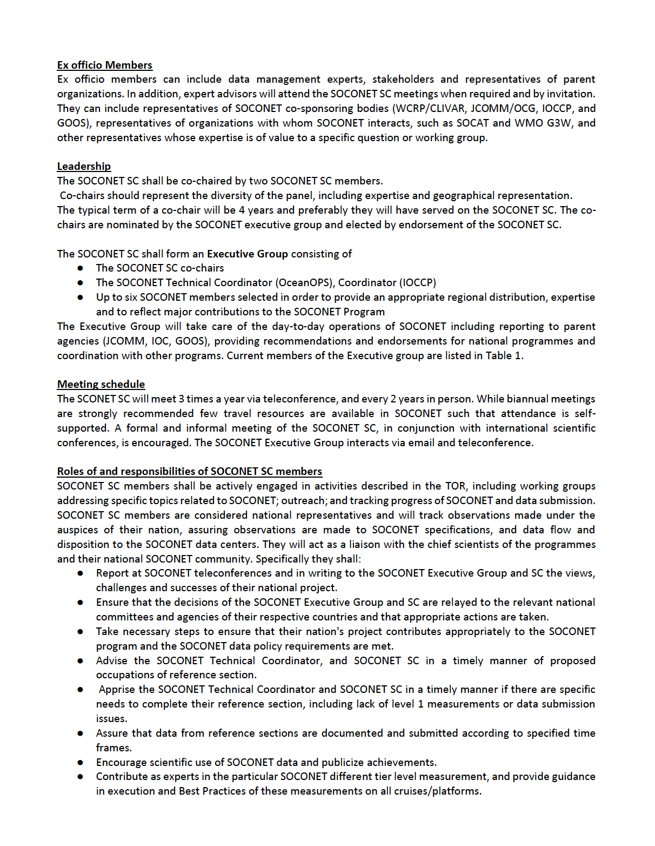
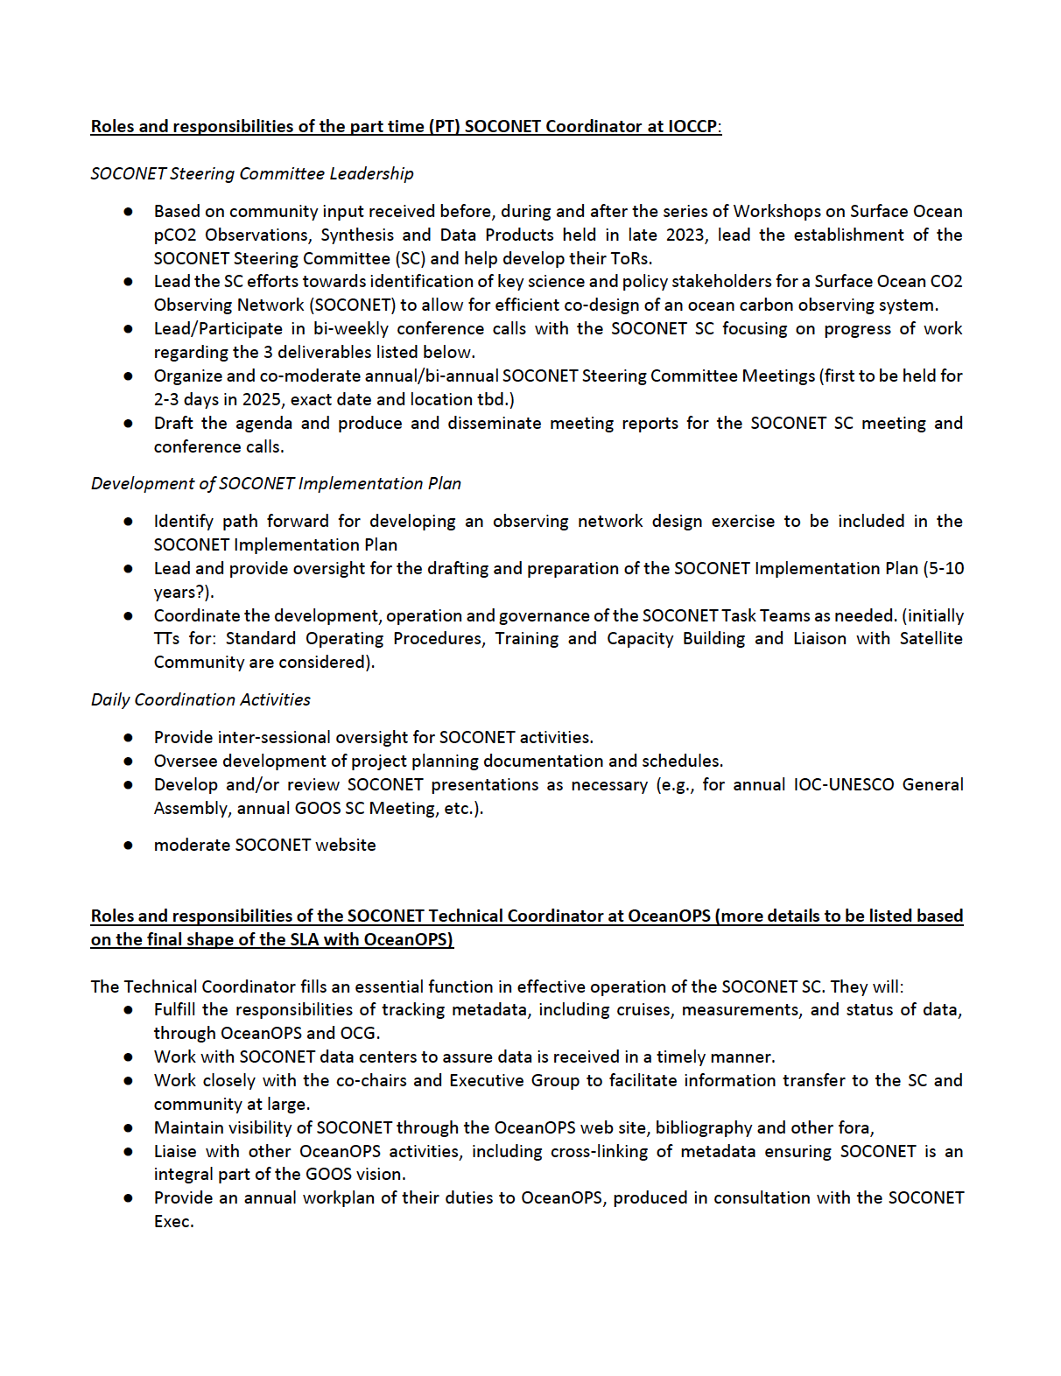
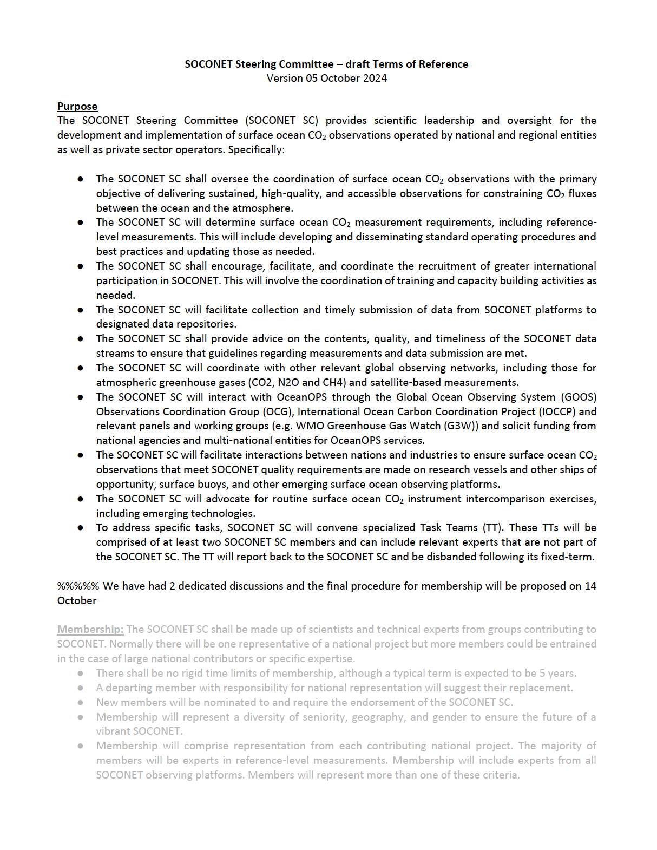
SOCONET Interim Steering Committee
and Terms of Reference
SOCONET interim Steering Committee
Adrienne Sutton, IOCCP, NOAA-PMEL, USA
Richard Sanders, IOCCP, ICOS-OTC, NORCE, Norway
Bronte Tilbrook, CSIRO, Australia
Dorothee Bakker, SOCAT, UEA, UK
Rik Wanninkhof, NOAA-AOML, USA
Shin-Ichiro Nakaoka, NIES, Japan
Tobias Steinhoff, ICOS-OTC, NORCE, Norway
Kathy Tedesco, NOAA-GOMO PM, USA
Thanos Gkritzalis, ICOS-OTC, VLIZ, Belgium
Kevin O’Brien, OCG Data, UW, USA
SOCONET Coordinator
Maciej Telszewski, IOCCP, IO PAN, Poland
SOCONET Technical Coordinator
  TBD soon, currently: Martin Kramp, OceanOPS, France

Slide 4


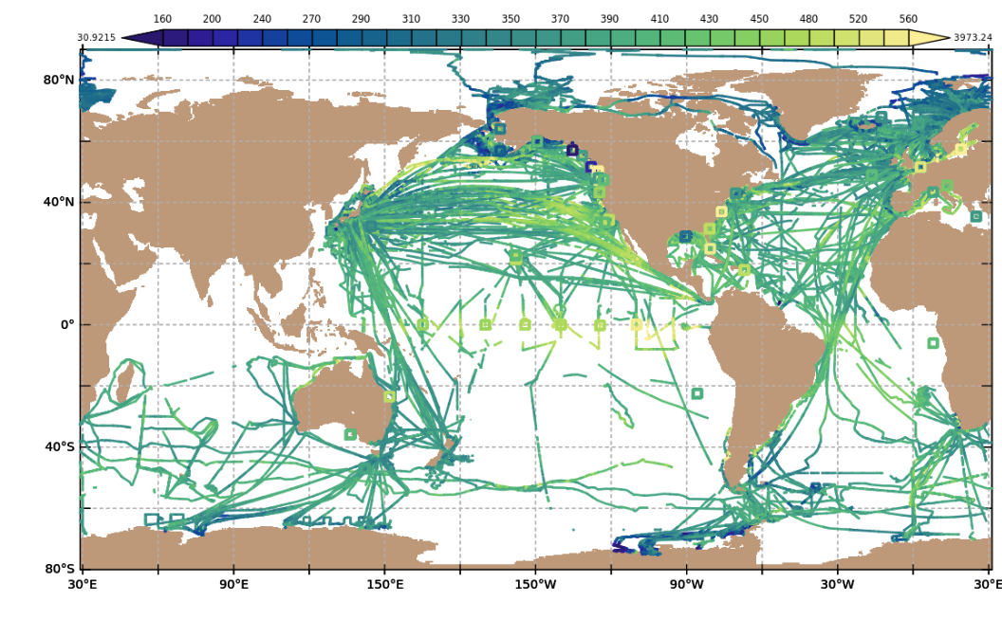
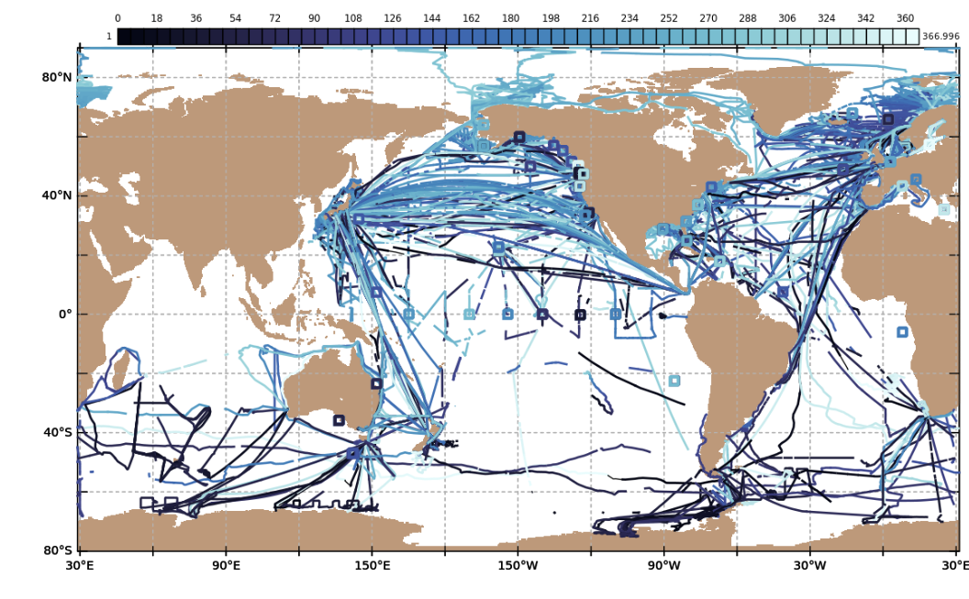
SOCONET
Inventory of Ocean CO₂ Observations
116 platforms with recurring surface ocean CO₂ measurements (from 2019 to 2023 in SOCATv2024 & new platforms)
Ships (59), moorings (55), uncrewed surface vehicles (2)
Surface ocean fCO₂ (µatm)
Day of year

Slide 5
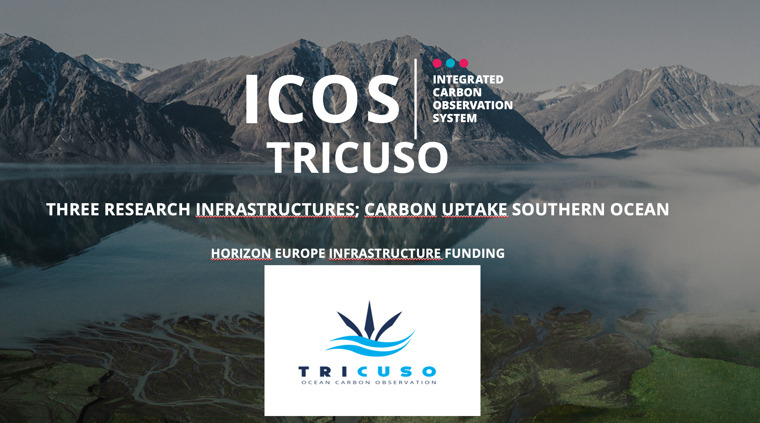
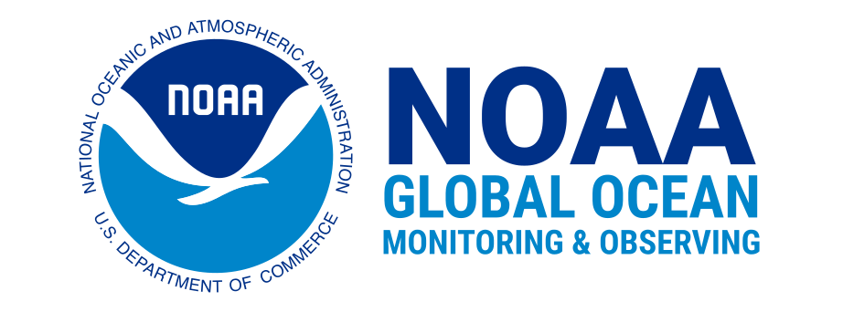
Funding for SOCONET Coordination at IOCCP and SOCONET Technical Coordination at OceanOPS
SOCONET interim Steering Committee members:
Richard Sanders, IOCCP, ICOS-OTC, NORCE, Norway
Kathy Tedesco, NOAA-GOMO PM, USA
4 years (January 2025 – December 2028) part-time support for SOCONET at IOCCP and OceanOPS

Slide 6
WP6: Role of RIs in the G3W and the wider GOOS landscape
Task 6.2: Building an International Governance Structure for surface ocean pCO2 observations.
Lead: IOPAN [12 PM], WMO [36 PM], UEA [6 PM]

Slide 7
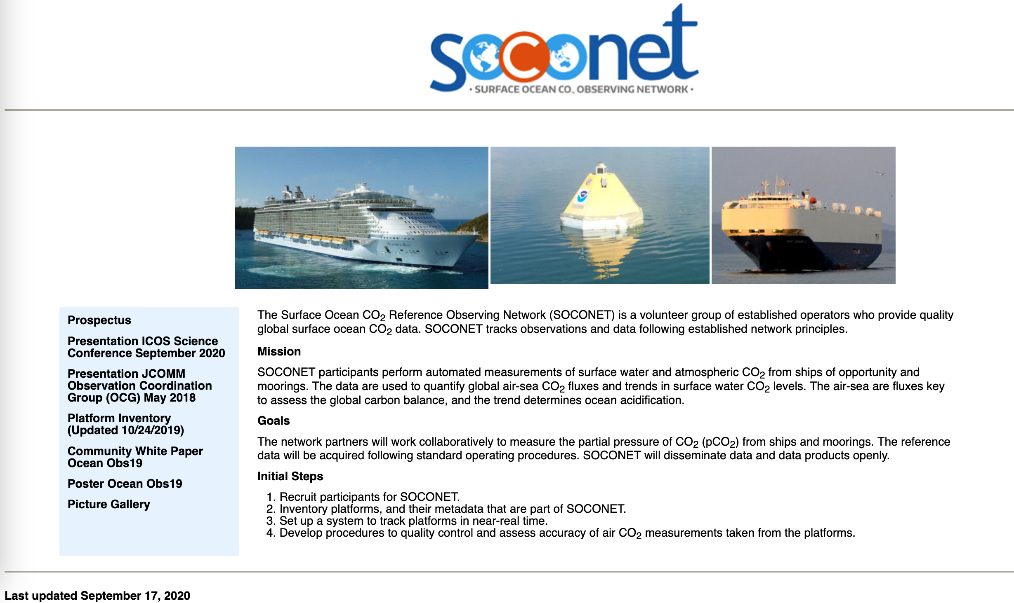
SOCONET website MAINTAINED at IOCCP planned for Q2-Q3 2025

Slide 8
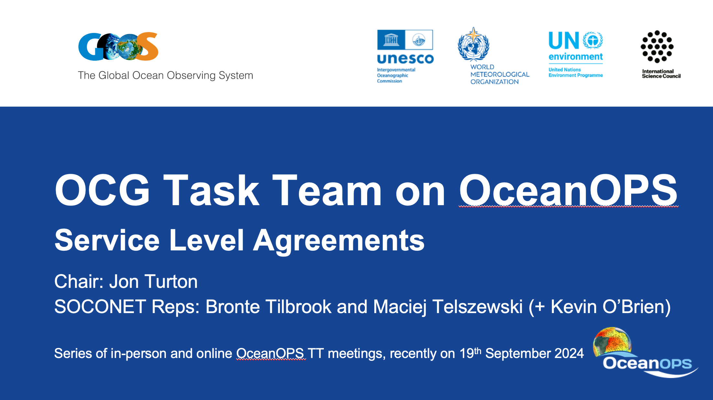
Near-real-time platform tracking
Service Level Agreement with OceanOPS

Slide 9
SOCONET alignment with OCG observing network attributes
OCG Network Attributes | SOCONET alignment
Global in scale | Global coverage with ships, moorings, uncrewed surface vehicles (USVs)
Observes one or more EOVs/ECVs | Inorganic Carbon
Observations are sustained | Back to 1990
Community of Practice | Build off Workshops on Surface Ocean pCO₂ Observations, incl creating a Steering Committee
Maintains network missions/targets | To be included in SOCONET Implementation Plan
Delivers data that are free, open and available in timely manner | Continued submission through the established SOCAT data system and NODCs
Ensures metadata quality and delivery | Metadata are delivered to SOCAT and NODCs, and will be augmented, if needed, for OceanOPS metadata requirements
Develops Standards and Best Practices | Standards and best practices will be collated and updated in SOCONET Implementation Plan
Undertakes capacity development | Some currently, but more needed to elevate quality and provide assistance to under-resourced groups to entrain additional platforms into the network
Environmental stewardship | Sustained observations from SOCONET are a key for stewardship of marine resources and assessing impacts of ocean acidification, autonomous platforms offer lower carbon footprint

Slide 10
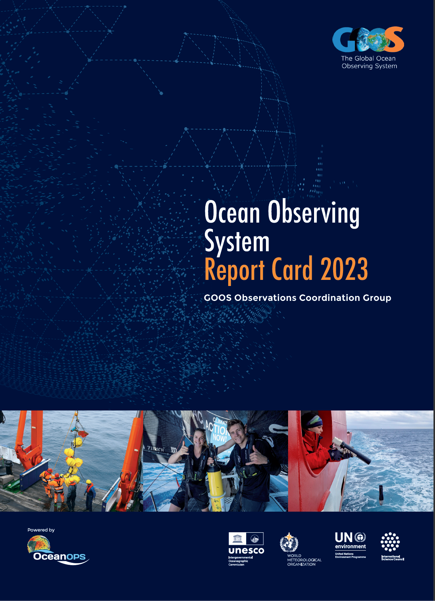
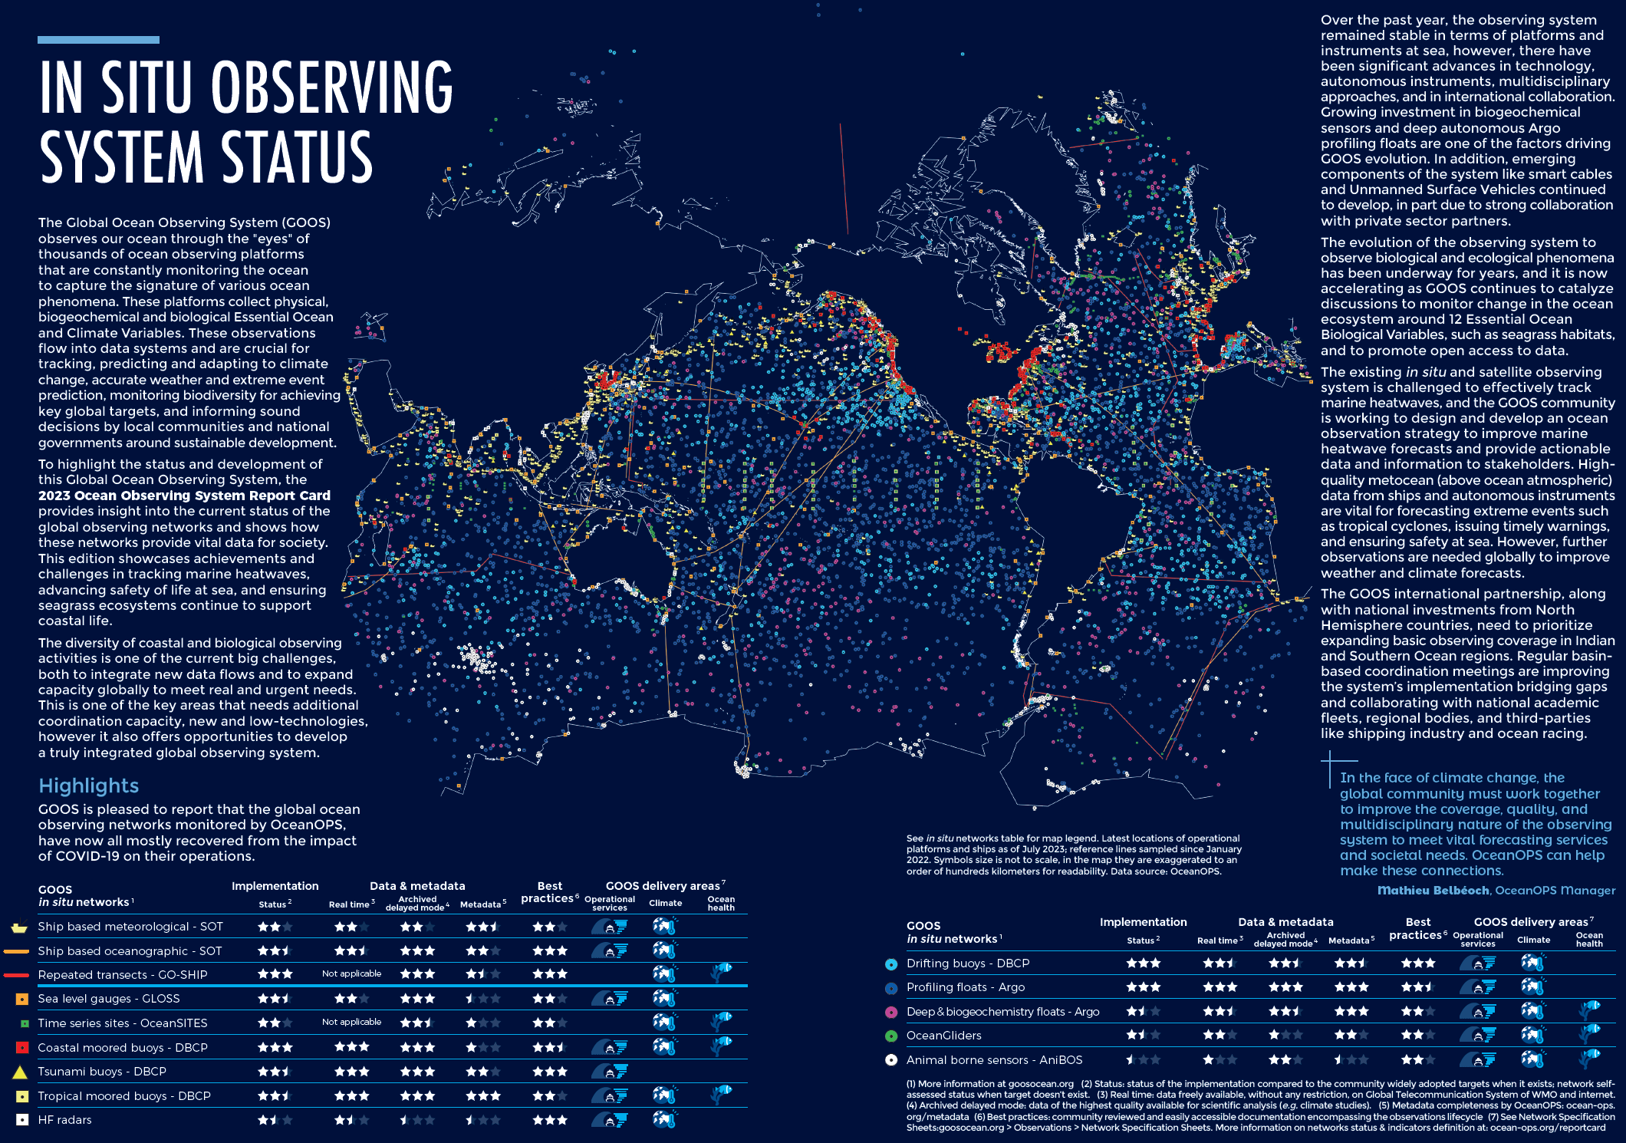
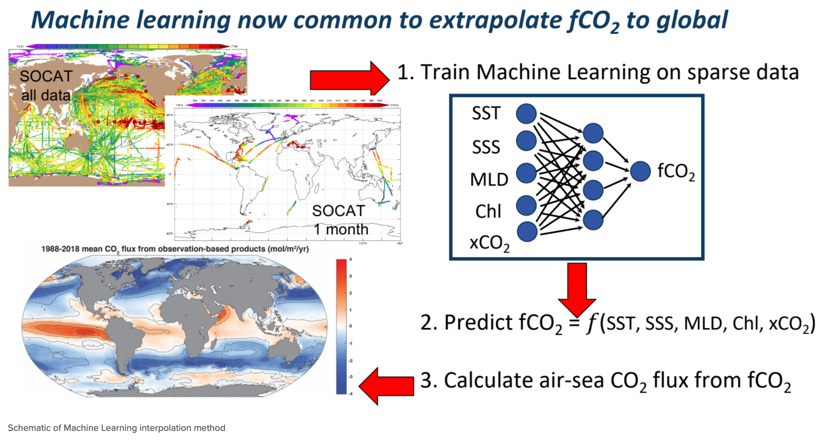
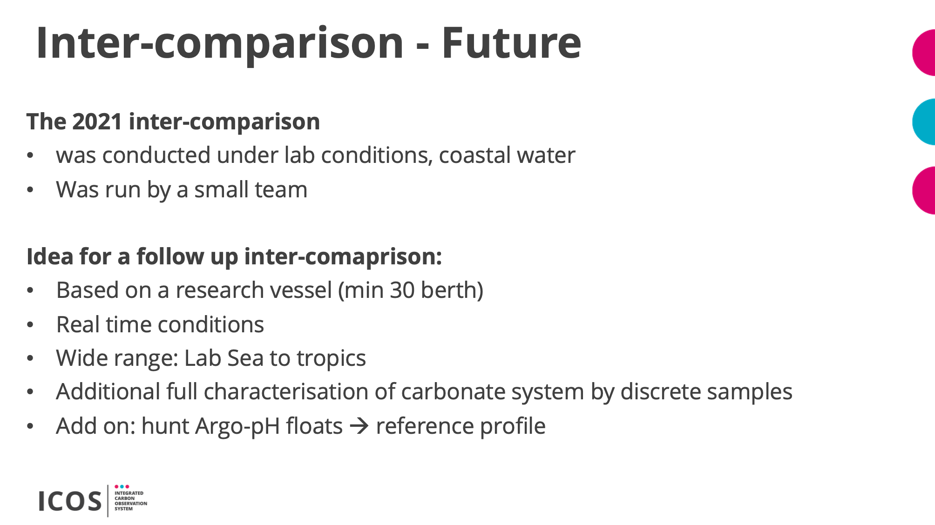
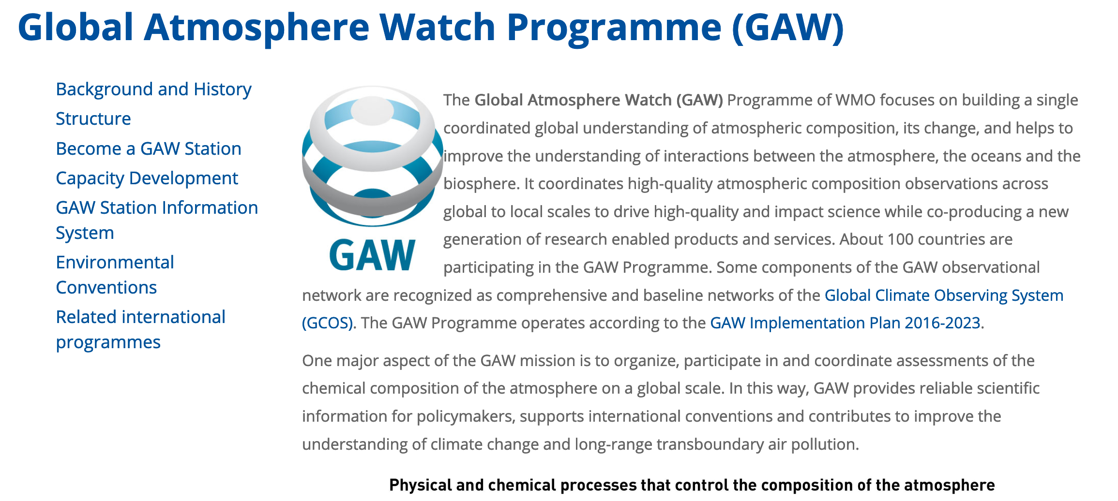
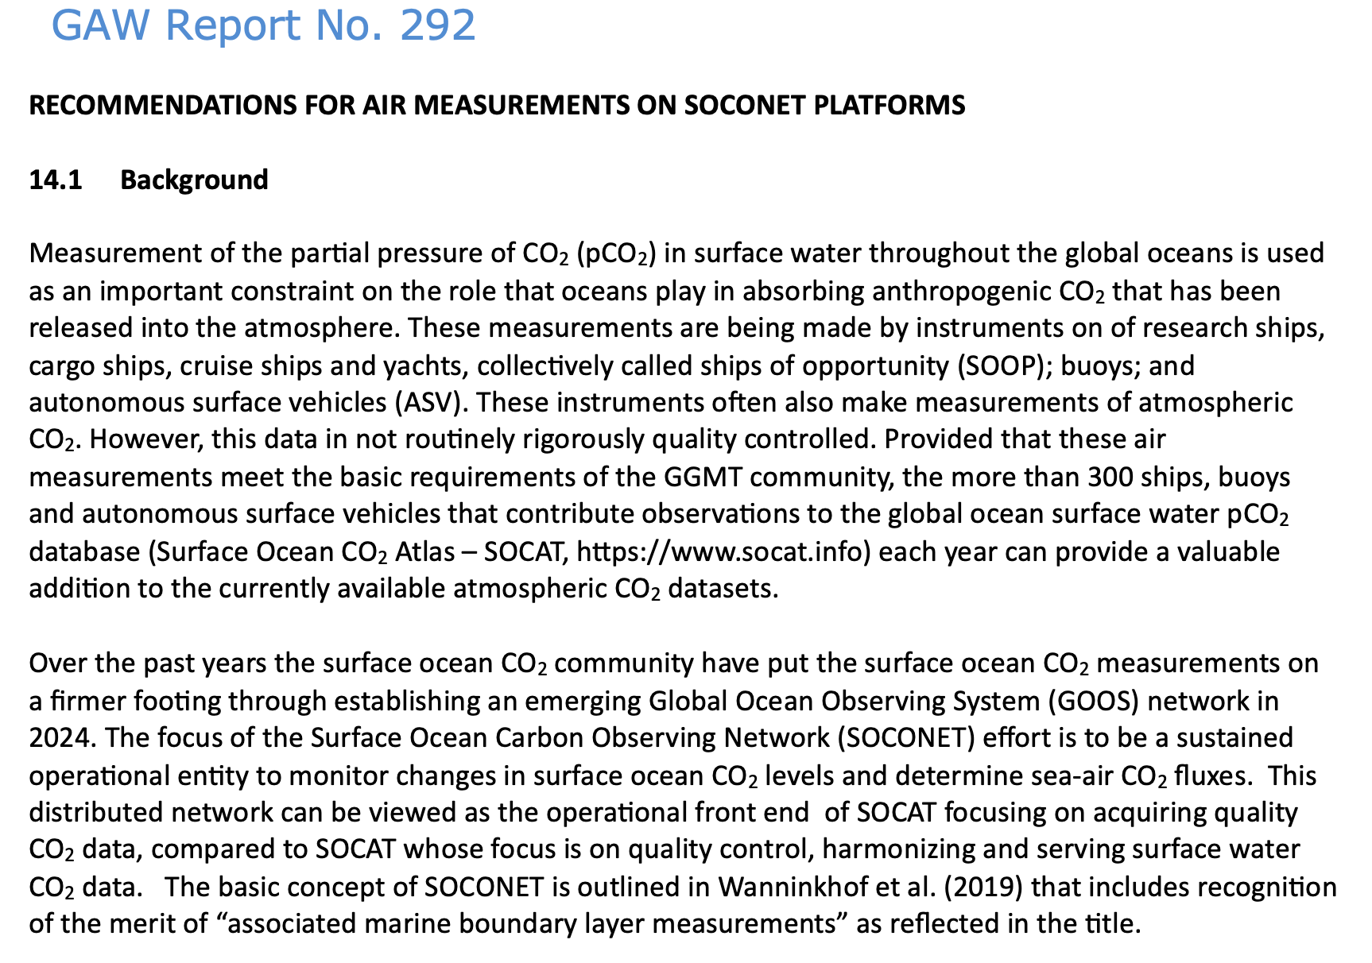
SOCONET Implementation Plan
    Stocktake and gap analysis of existing SOP’s and identification of specific SOP’s to be developed
    Development of feasible targets and metrics.
    Augmentation of metadata formats, standards and pathways to include OceanOPS requirements
    Plan for observing system design activities.
    Plan for intercomparison exercise including at sea.
    Incorporation of atmospheric observations.
    Readiness-level assessment of N₂O observing capacity

Slide 11

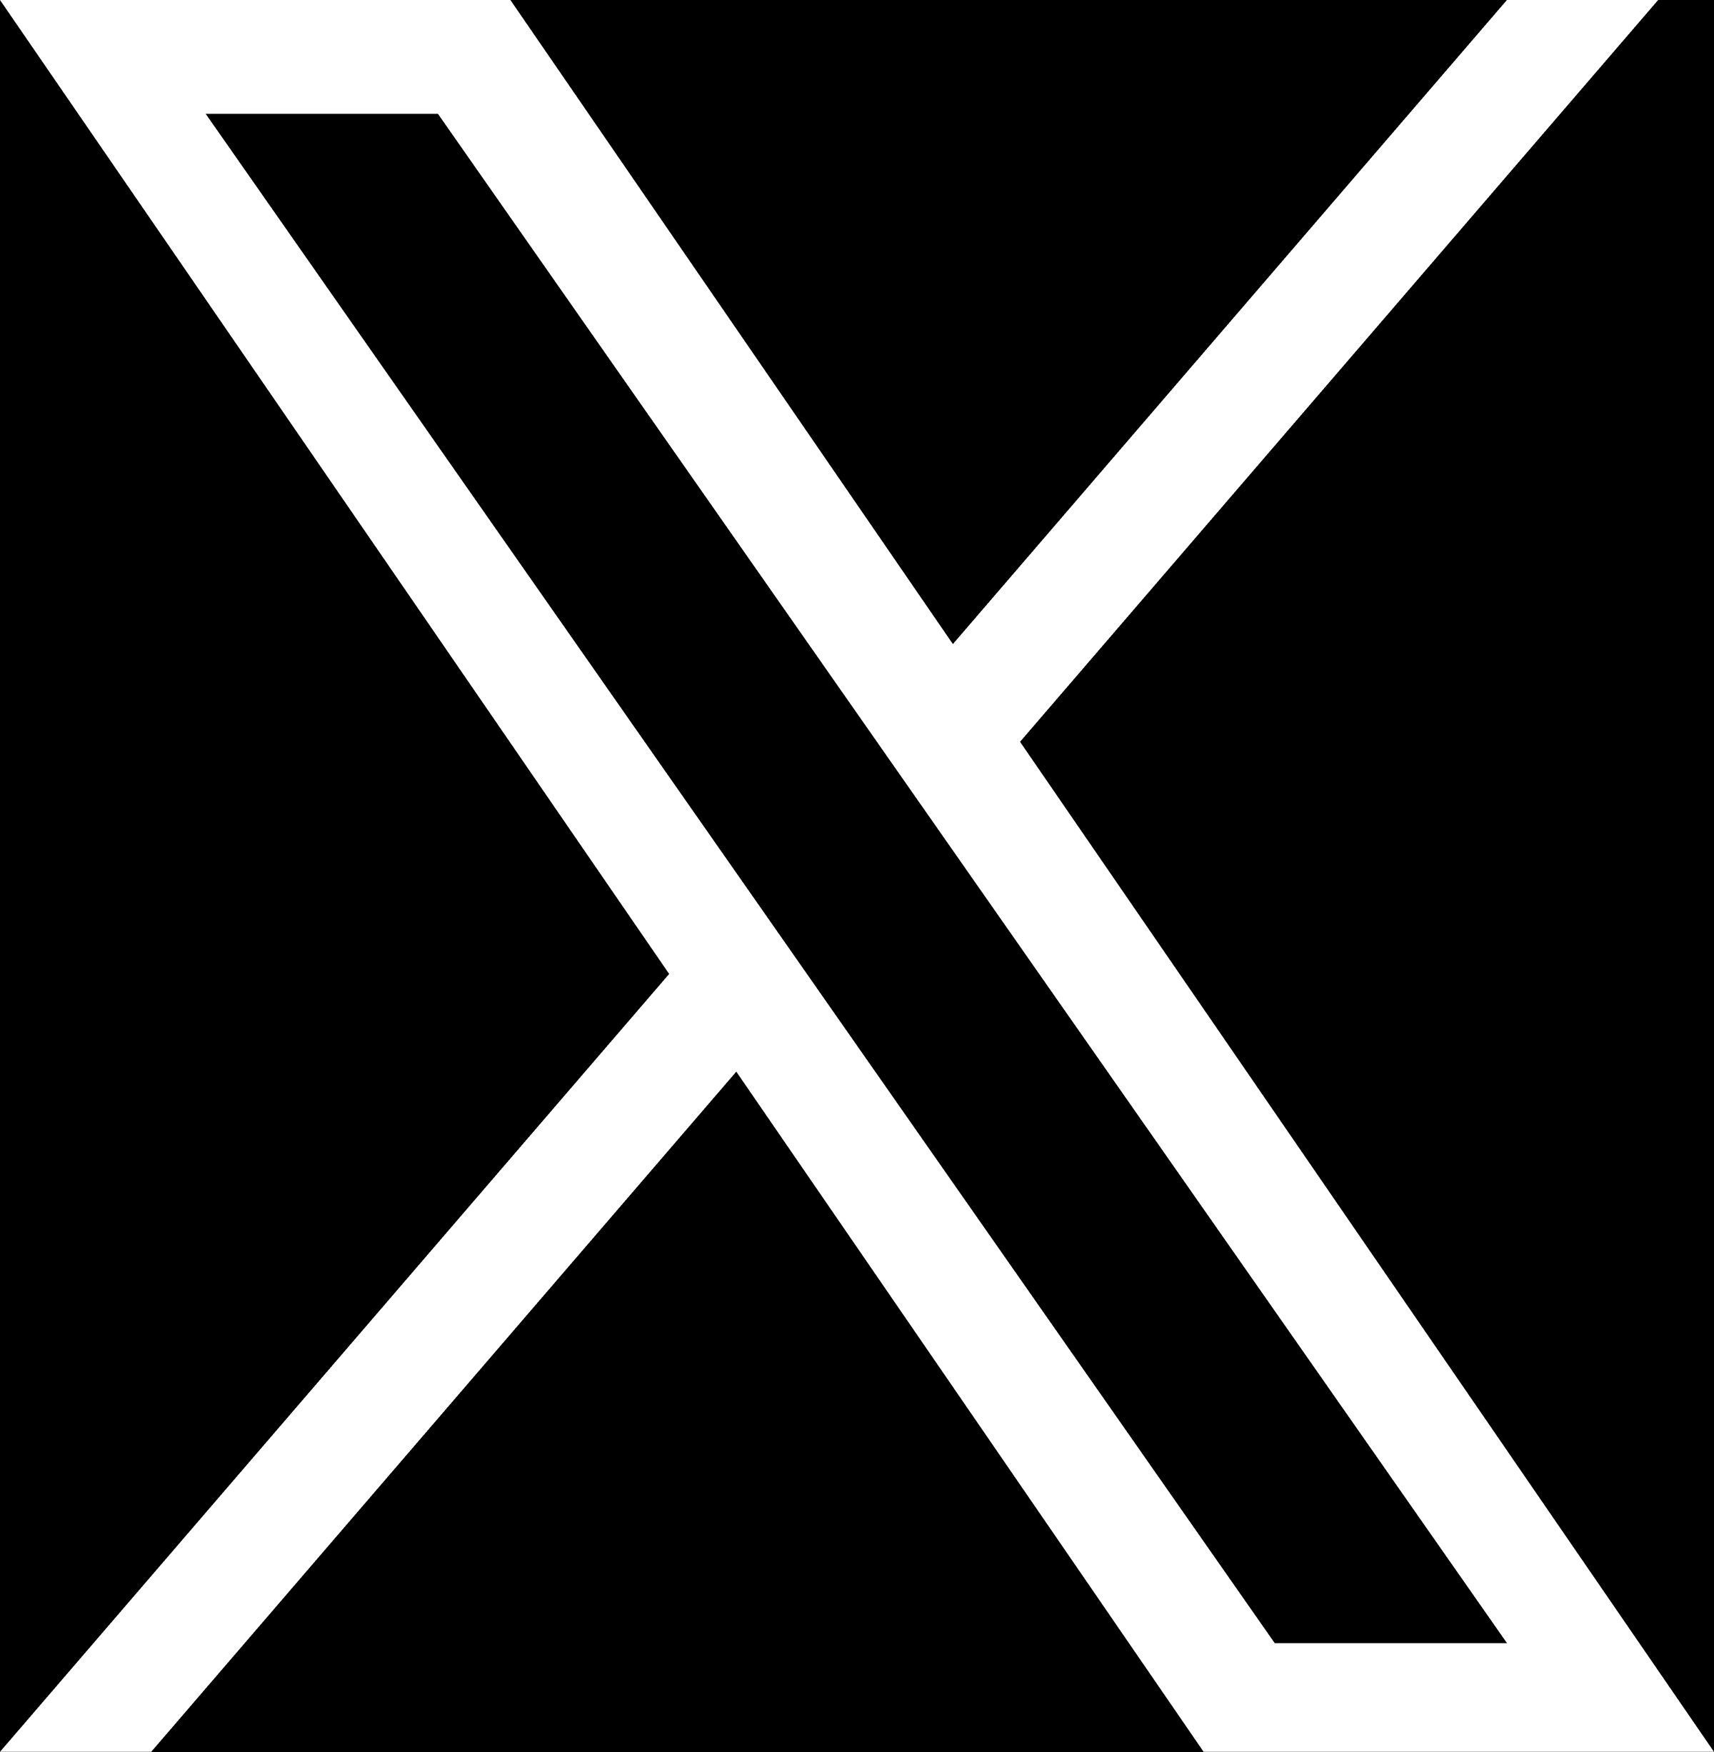
A communication and coordination service for marine biogeochemistry
www.ioccp.org @ioccp_org
Thank You!
Institute of Oceanology of Polish Academy of Sciences, ul. Powstańców Warszawy 55, 81-712 Sopot, Poland
Phone: +48 58 731 16 10 / Fax: +48 58 551 21 30, www.ioccp.org

