Slide 1
Session 6: SMART Cable Emerging Network
Bruce Howe, Chair, ITU/WMO/UNESCO-IOC Joint Task Force SMART Cables
Sixteenth Observations Coordination Group Meeting (OCG-16)
7-10 April 2025, IFREMER, Brest, France.

Slide 2
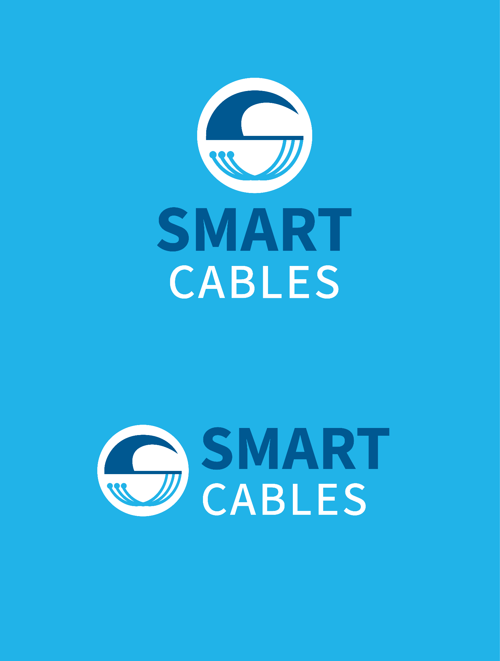


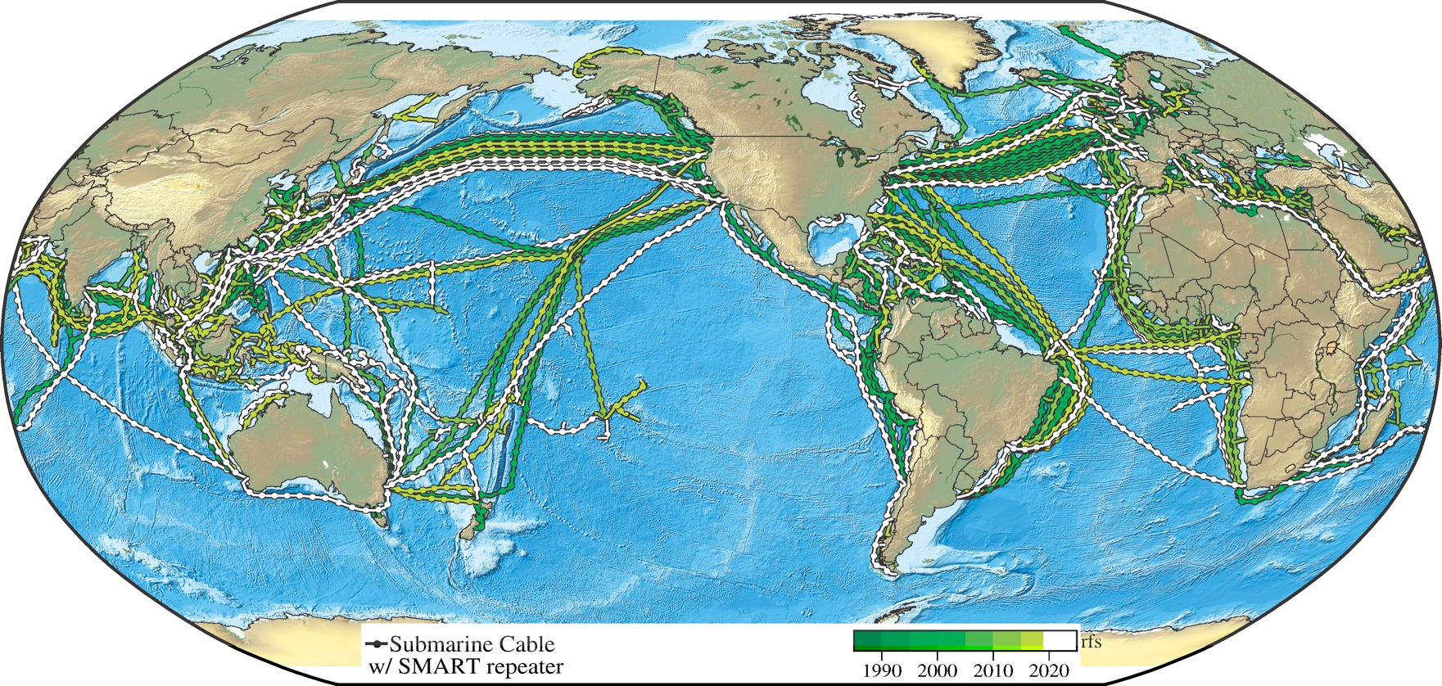


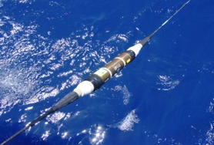

Climate Change and Disaster Risk Reduction
Global Array for Climate, Oceans, Sea Level, Earthquakes, Tsunamis
1st order addition to Ocean-Earth observing system
A sustained planetary sensor, power, Internet network
Share submarine cable infrastructure
Telecom + science
⬇ €$
NO Interference
Emerging
Network
1.4+ GM
~20,000 repeaters
20 year refresh
Every ~100 km
InSEA Wet Demo 2023
SMART Atlantic CAM and Tamtam V-NC
Funded, install 2026
Know the environment protect the network
Bottom temperature, pressure,
seismic motion

Slide 3
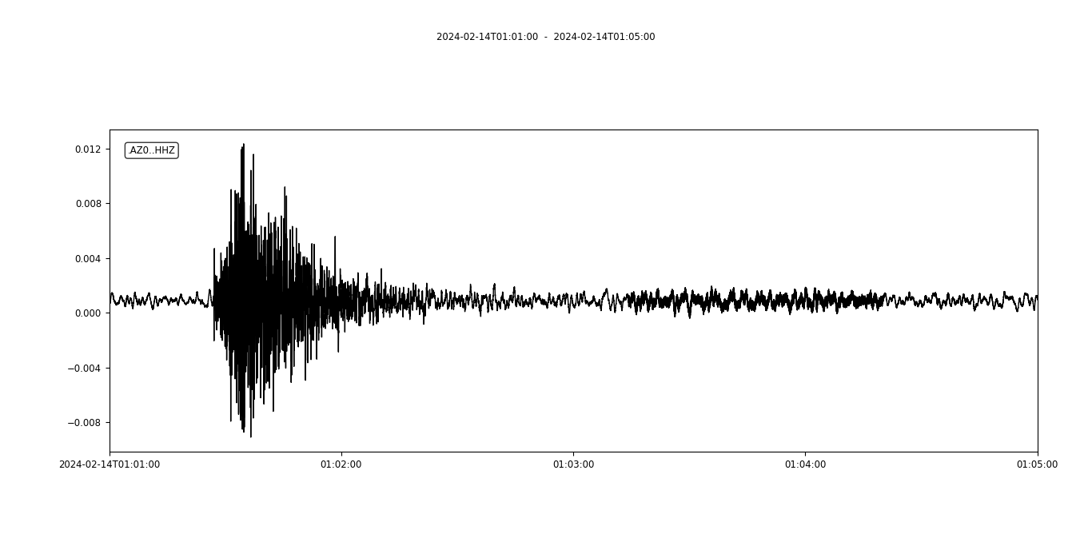
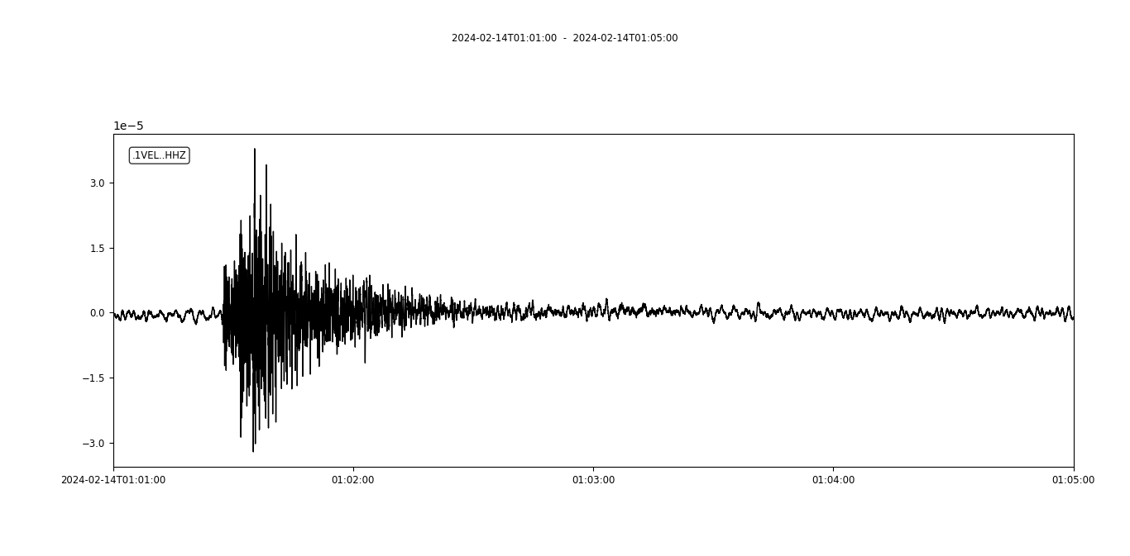
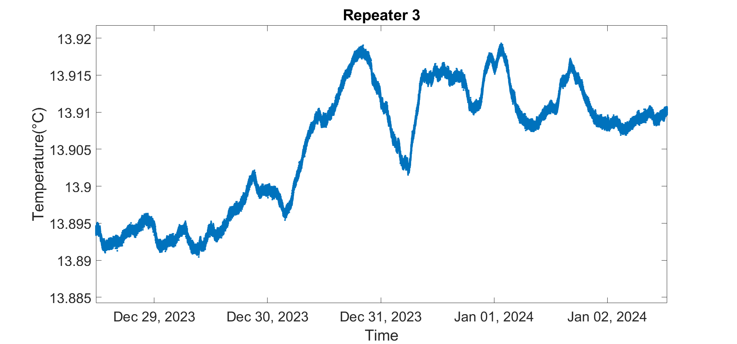
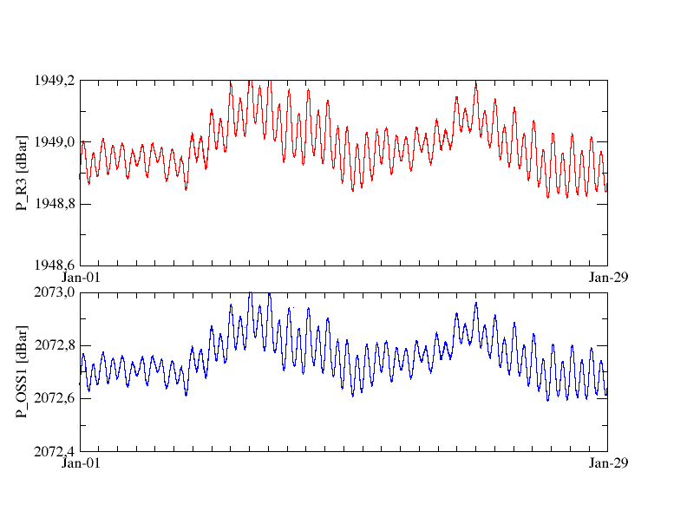
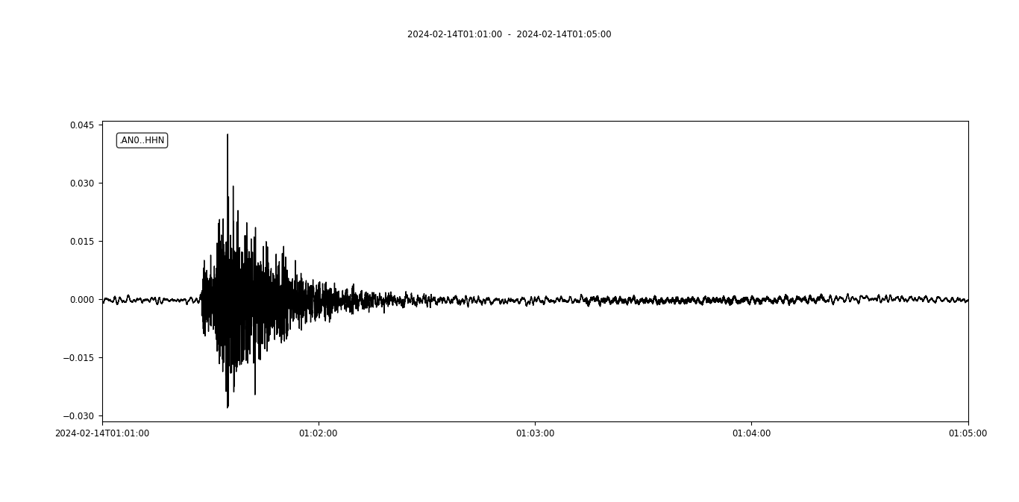

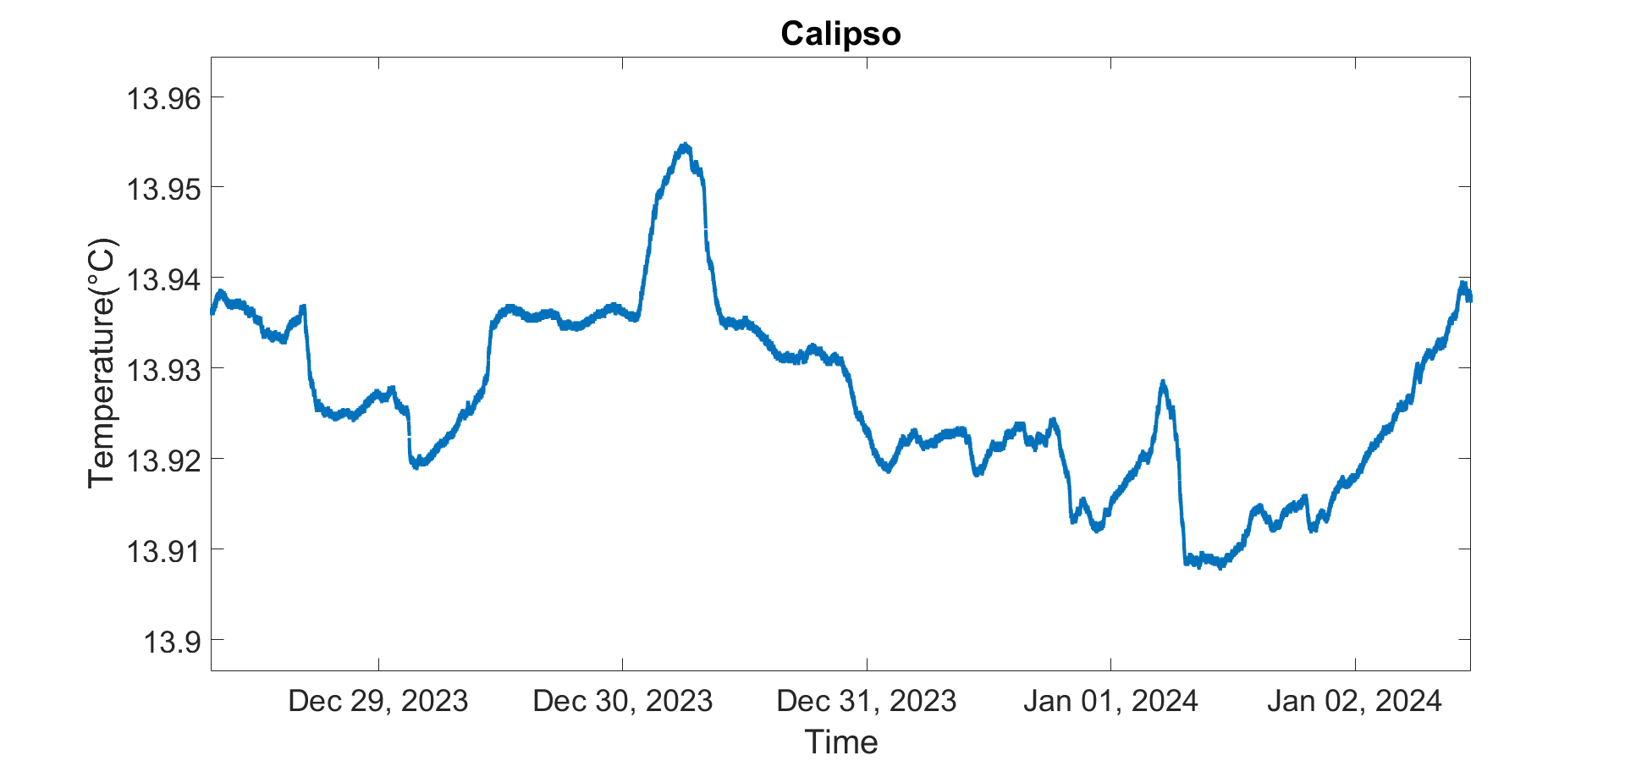
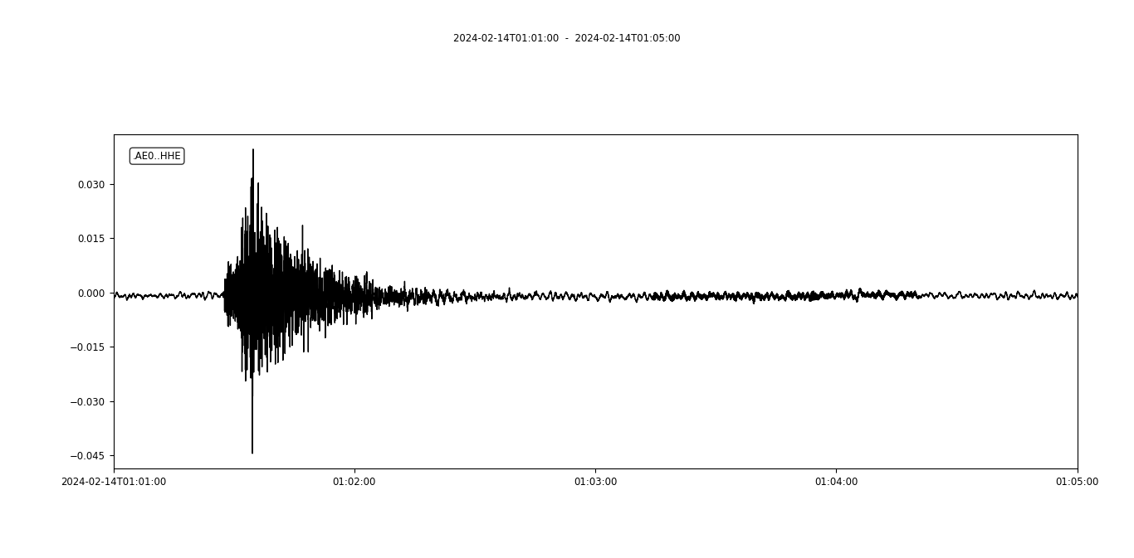
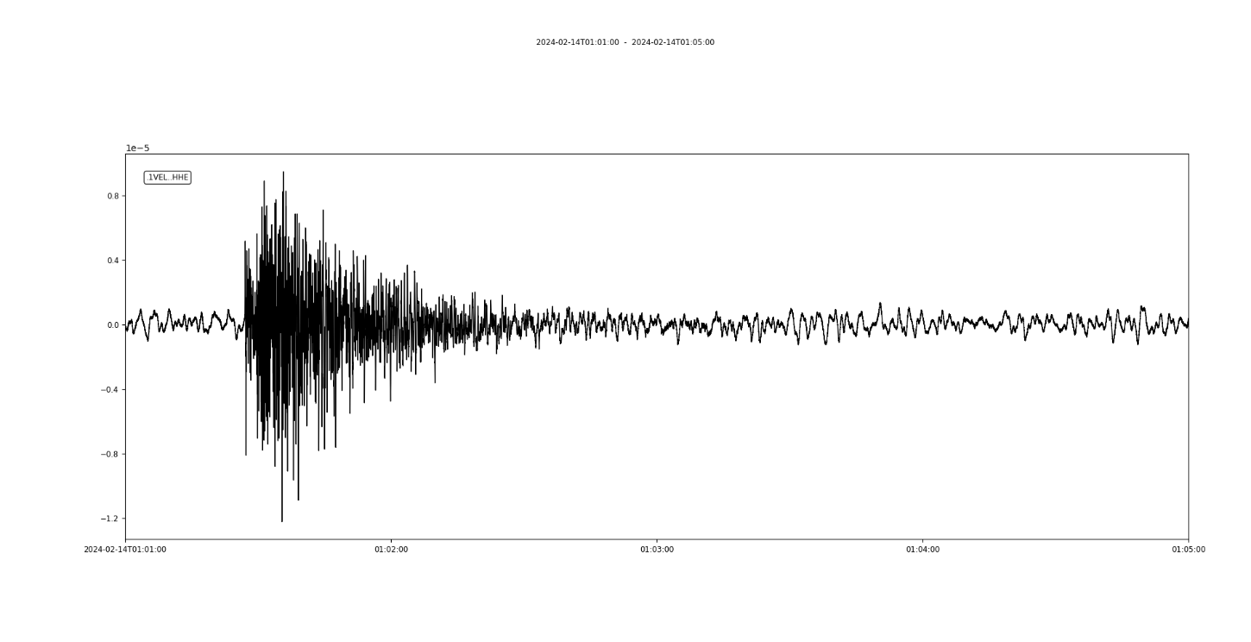
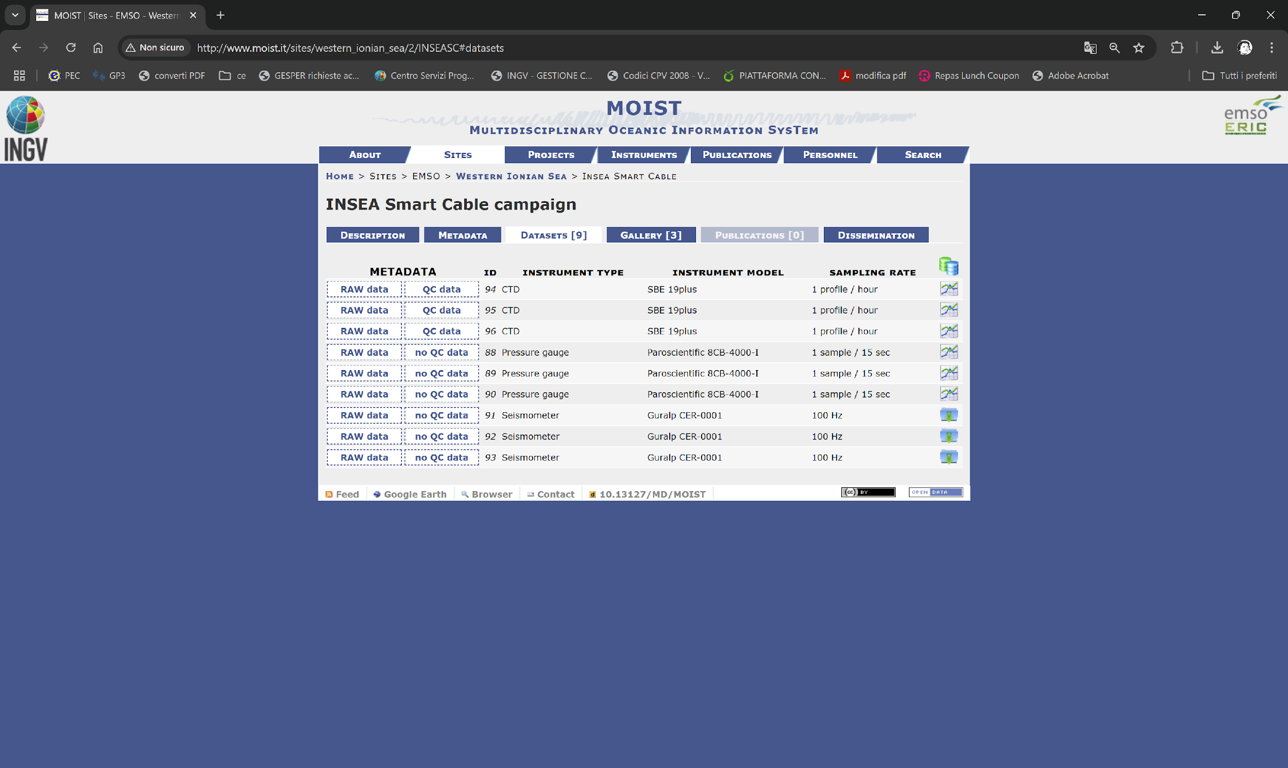
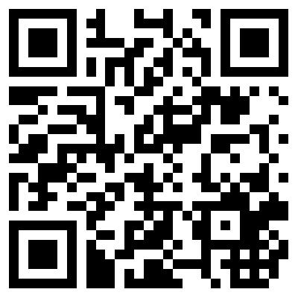
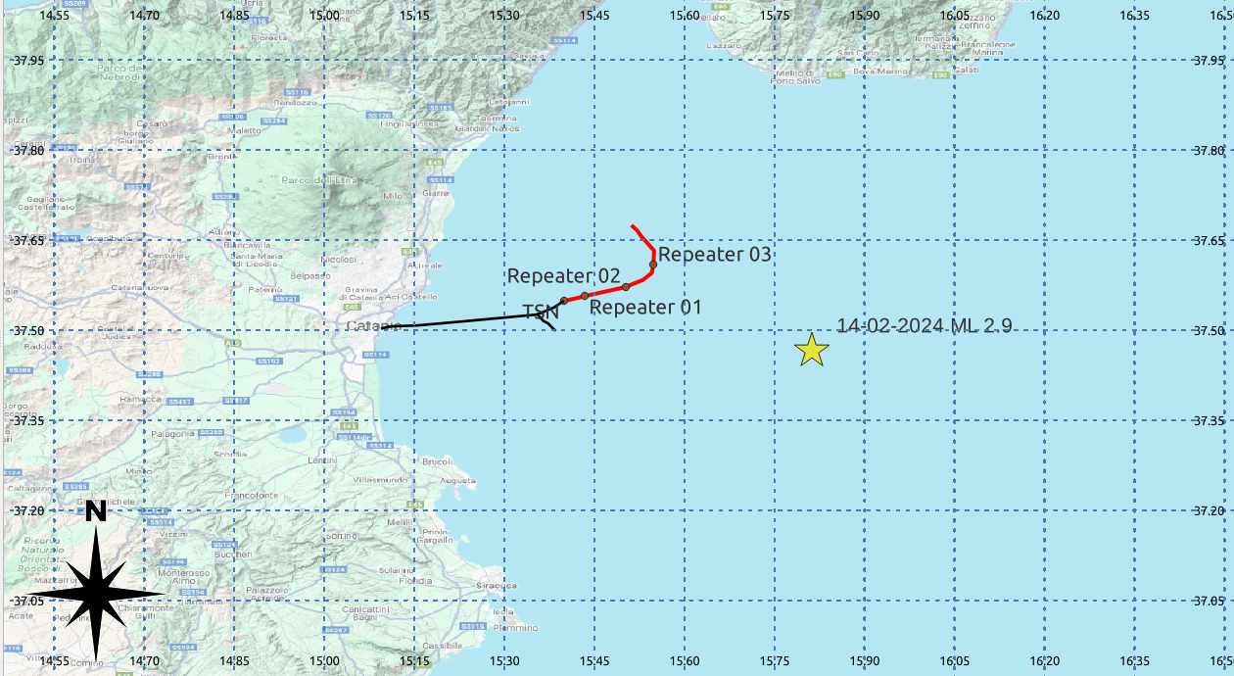
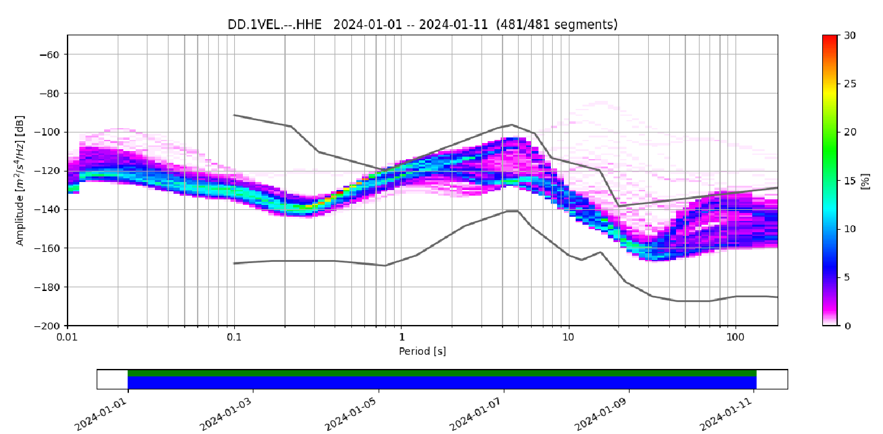


RAW pressure data 1-1-2024🡪29-1-2024
InSEA wet demo SMART cable
temperature data 29-12-2023🡪2-1-2024
pressure data 1-1-2024🡪29-1-2024
CALIPSO observatory seismometer
SMART cable seismometer
REPEATER 3
3-7 Hz filter
CALIPSO
LOCAL EVENT ML 2.9 Ionian Sea
31 km depth
14-02-2024 01:01:17
INGV
EMSO ERIC
SMART cable PSD
http://www.moist.it/sites/western_ionian_sea/2/INSEASC

Slide 4


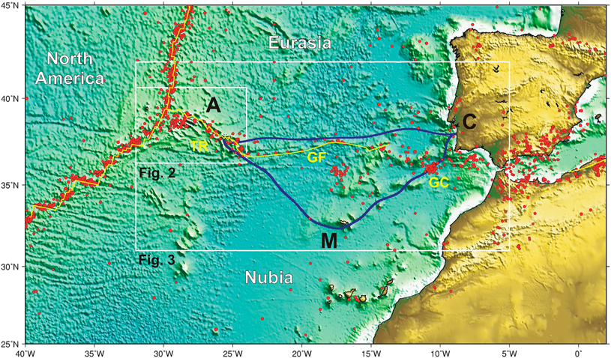

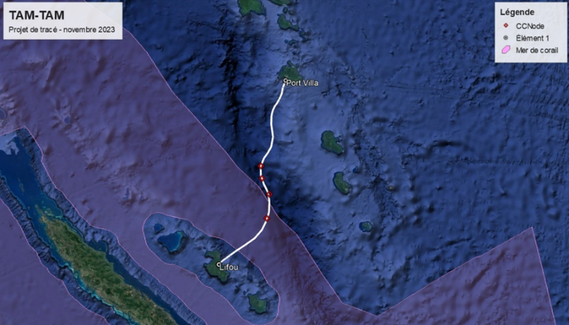


Funded SMART Cable Systems
Atlantic CAM SMART System
TAMTAM SMART Cable System
Contracts
signed
ASN
RFS 2026
Lisbon
Azores
Madeira
IPMA
Ifremer + VMGD
3700 km, ~20 SMART modules
Gov’t €154M. EU support €56M
SMART 15% ➔ €22M ~ €2/citizen/25 y
~= 2 Tsunami buoys, 25 year (unreliable,
no seismic, not real time)
450 km long, 4 SMART modules
France funding SMART (telecom: AFD, ADB)
25+ year life, reliable, low lifetime cost
Leverage $5B/y industry, 175 y
Optical Fiber Sensing in both

Slide 5
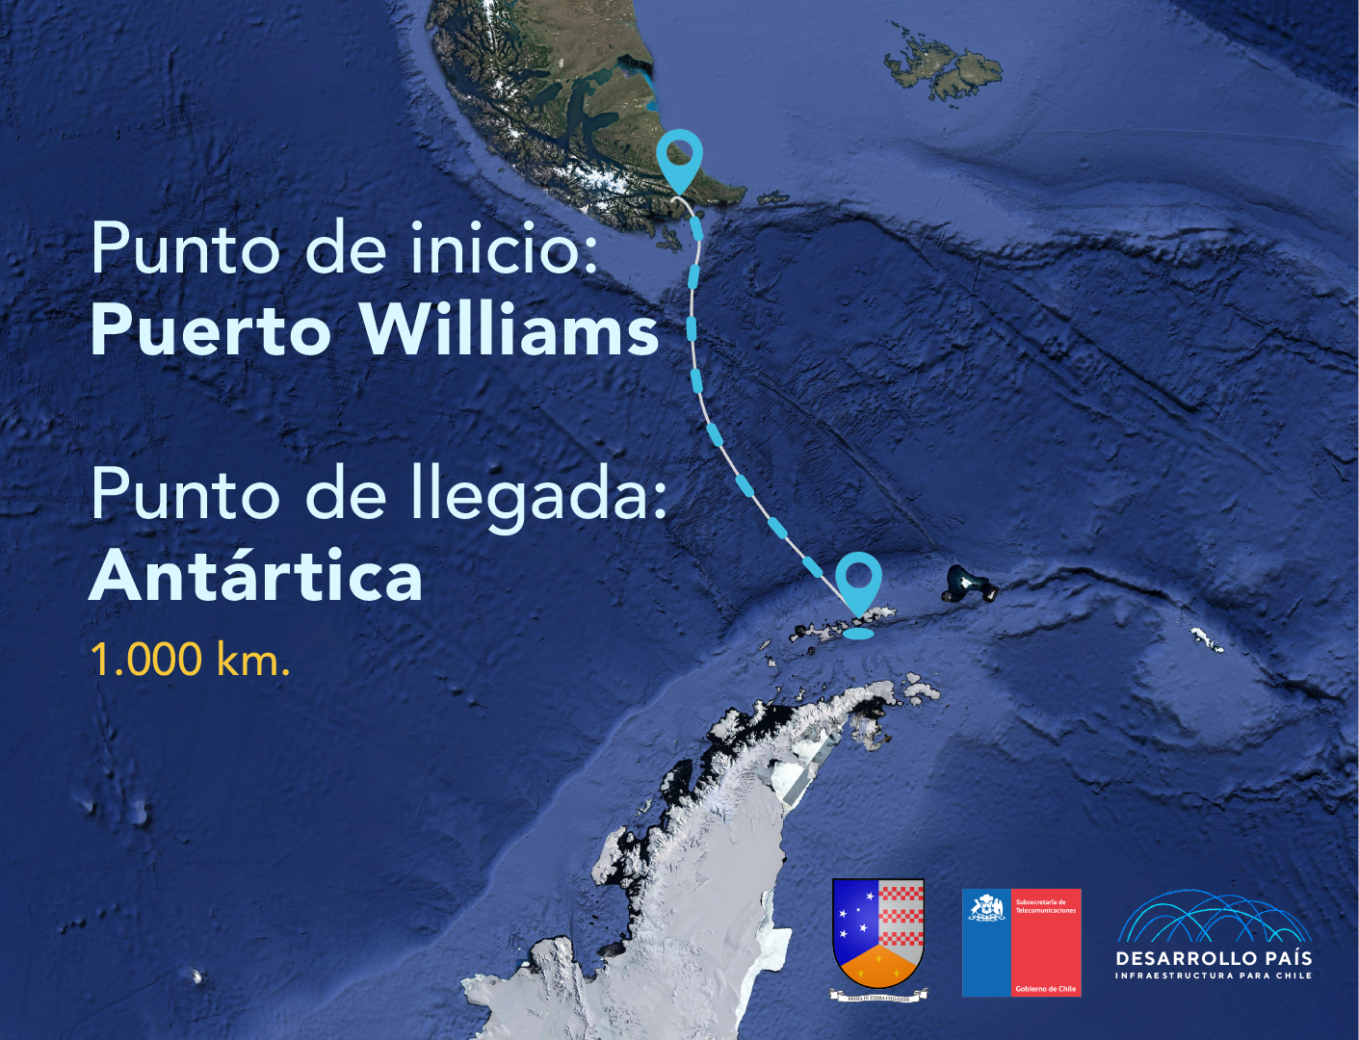
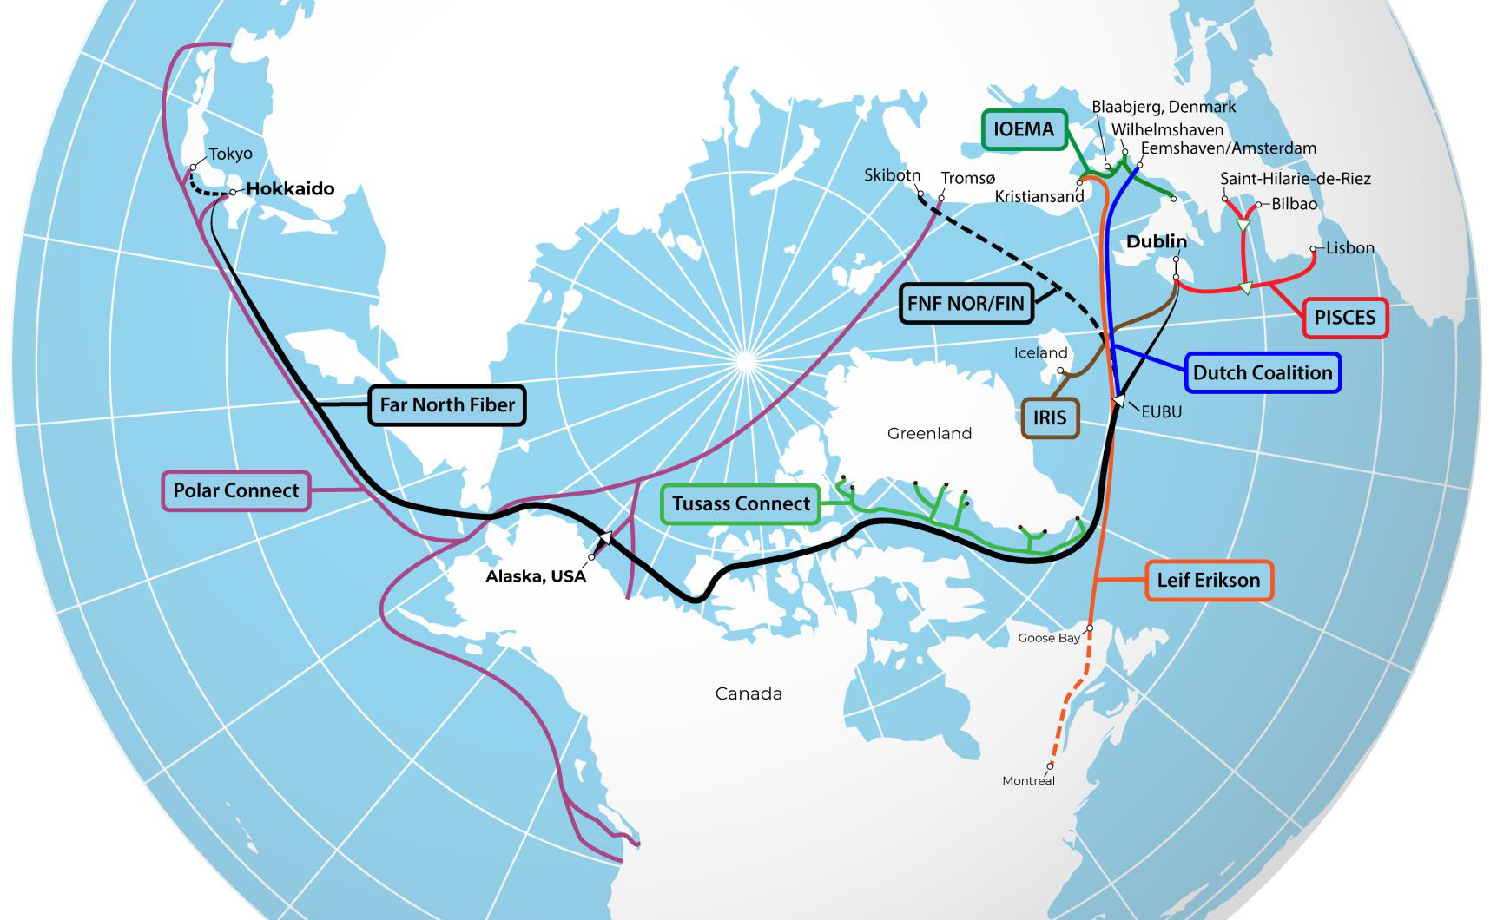
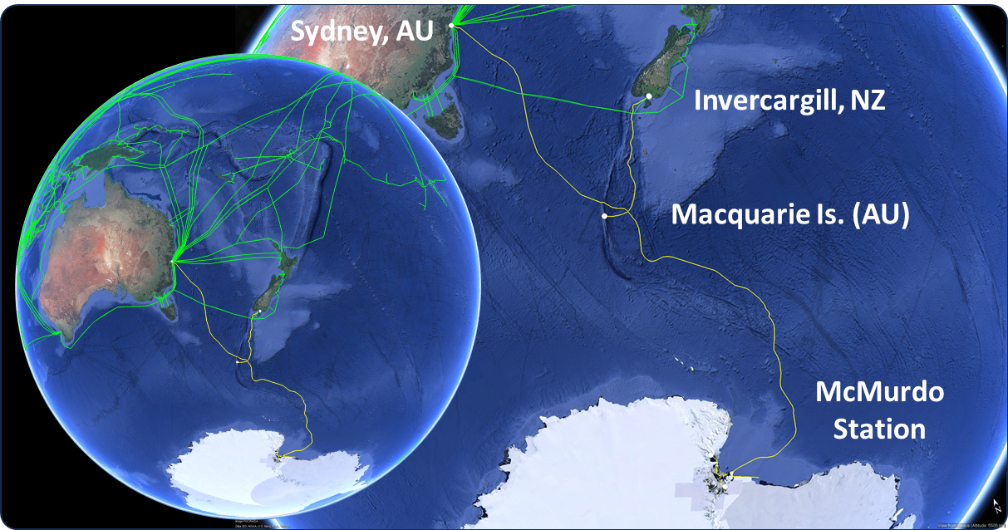
Polar and North Atlantic
Polar Connect, Far North Fiber, Tussas, PISCES, IRIS, IOMEA, +
Antarctica Chile
Drake Passage
AUS/NZ Antarctica
NSF McMurdo
Notes:
We do this with the SMART contribution. The Repeaters of the cable systems will have Sensors that will measure ocean bottom temperature, pressure, and seismic acceleration.
Sensors can be mounted in or connected to the repeaters of a telecom cable for power and communications, approximately every 70 km.
Considering a Telecom system lifetime is 25 years with minimal maintenance, adding these sensors can transform the “deaf, dumb, and blind” cables
to environmentally aware systems and thereby improve their integrity and resilience.
Alcatel Submarine Networks, the largest supplier of submarine telecom systems, is very publically committed to supplying SMART capability in the 2025 timeframe as part of its “Climate Change Solution” – a good example of the Blue Economy in action.

Slide 6
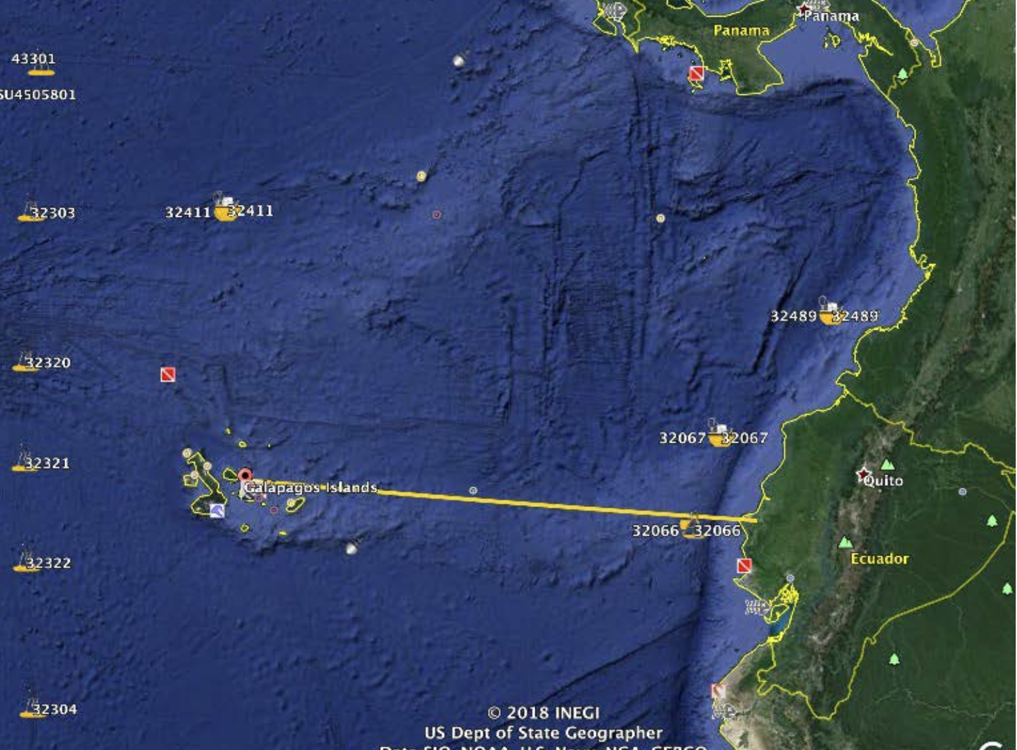
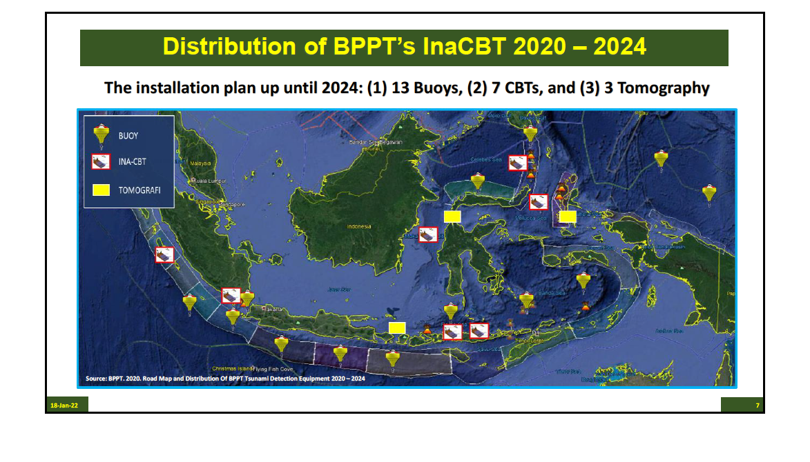
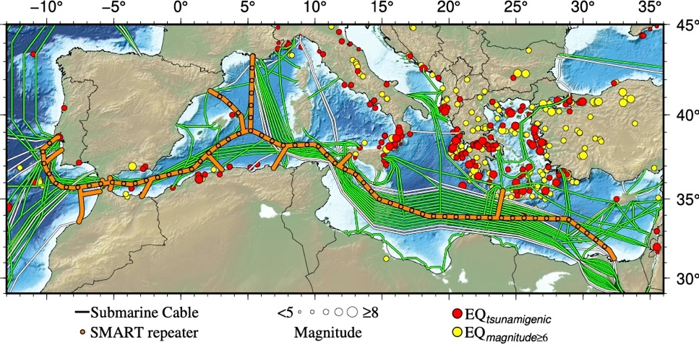
Pacific, Mediterranean, Indian Oceans
Galapagos
NZ - Chathams
Indonesia
50 km, 2 module test system installed off Labuan Bajo
Medusa
MISTS
BARRACUDA

Slide 7
Attributes status – SMART Cables Network
1. | Global in scale | Grow from regional to global
2. | Observes one or more EOVs | temperature, pressure, ocean sound, will be adding more …
3. | Observations are sustained | Cable systems have 25-year life – stability, good inertia; tech toward “future proofing”
4. | Community of Practice | ITU/WMO/UNESCO-IOC Joint Task Force, + evolving GOOS OCG SMART Cables Network
5. | Maintains network mission and targets | In process of establishing means to track progress
6. | Delivers data that are free, open, and available in a timely manner | In progress, definition to come with first systems
7. | Ensures metadata quality and delivery | Process just starting
8. | Develops and follows Standards and Best Practices | Will be developed by first systems
9. | Undertakes capacity development and technology transfer | Starting, e. g., National University of Vanuatu
10. | Environmental stewardship awareness | Rely primarily on cable system suppliers

Slide 8
Assessment of progress and gaps
3 systems
220 million euro raised
EC DG-Connect support significant
Includes Moore 7M, SAFAtor 30M
8 or so prospective systems
ITU – SMAR, Secretariat, Recommendation, Resolutions
Coordination across IOC (GOOS, Tsunami, …)
Coordination between ITU, WMO, UNESCO-IOC
Need an operational network entity to federate individual cable systems
Data policies and management (through OceanOPS, WIS2.0)

Slide 9
OCG next steps
Assist with establishing emerging network, federating entity, documents, etc (review spec sheet; work with appropriate entities (e.g., OceanOPS, OCG Data, JTF Data, WIS2.0, EMSO, INGV, IPMA, Ifremer, VMGD) to develop the data procedures, frameworks, metadata – in prep for the 2026 deployments.
Facilitate identification of critical infrastructure funds from other sources
Request IOC, WMO, ITU, to address legal aspects of SMART, integrate along with other similar for other networks (JCB, … areas under national jurisdiction, areas beyond, GBON, …)

Slide 10
Resource required - new
More resources toward OSSEs, modeling, digital twins
Funding for cable systems – of course! ”our responsibility, but help
Plan for continuation of IOC – JTF liaison position

Slide 11
Recommendations and Next Steps
Not just for SMART:
Use IOC circular letters to member states to raise awareness and request assistance (and ITU and WMO) – contact all ministries, including non-ocean (all focal points)
Encourage global system engineering a la Framework of Ocean Observing – integrate across networks – includes OSSEs, digital twins f(t), etc.
Explore subsea and seafloor critical infrastructure opportunities (“cable resilience”), and Maritime Domain Awareness needs (fully manage EZZs, new technology)

Slide 12
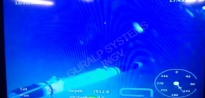

Thank you
SMART Cables
INGV InSEA SMART Wet Demonstration deployed December 2023
goosocean.org

