Slide 1
EOV Based Monitoring Tools
A. Zinkann, T. Latter
OCG-16 Session, 07 - 11 April 2025
Ifremer, Brest, France

Slide 2
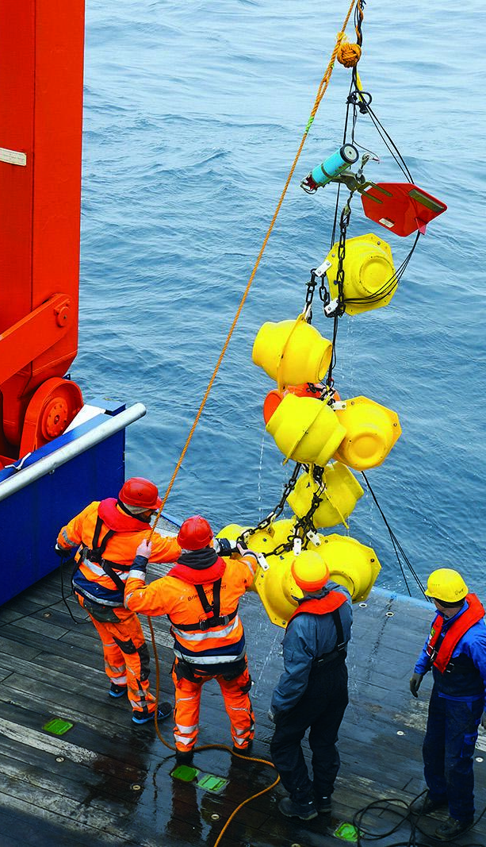
Background
After the restructuring of OceanOPS it has been agreed that Service Level Agreements (SLAs) to provide a framework for structuring OceanOPS services and identify priorities.
During planning meetings, with the SLA Task Team and Network leads, Networks made requests for additional services to be developed.
GOAL:
Align this tool with WMO WDQMS
Deep dive into one area for future development
Outline network requests, needs, scope
Notes:
Ann

Slide 3
Future Developments
SERVICE LEVEL | DESCRIPTION | BENEFIT
API WIGOS/OSCAR Integration | OceanOPS API to be WIGOS-compliant XML and include routine metadata submission to WIGOS/OSCAR. | In OSCAR, all observing systems are integrated from WMO Members and recognized entities like OceanOPS. OceanOPS holds a unique position and authority to submit integrated and quality-controlled metadata from GOOS systems to OSCAR. This metadata submission is crucial for data exchanges on the WMO Information System. It allows for the analysis of quality, coverage, and timeliness through the WIGOS GBON and Data Quality Monitoring System, providing high-level visibility on gaps for WMO Members to address. Network operators do not need to develop this capacity locally.
API Metadata Input | API for M2M submission of metadata to OceanOPS, including format checking and security measures. | The ID allocation API provides the foundational basis and once fully developed, all networks will be able to benefit in a manner similar to the API Metadata Output. Operators can make partial or bulk updates through the API, receive a log in return for potential errors, and this securely through an authorization.
API ODIS integration | Routine platform metadata submission to ODIS, a digital ecosystem coordinated by IODE/IOC where a global community of organizations share and exchange their (meta)data to better understand and steward the ocean. | Enhances interoperability by enabling users to discover metadata from this key repository, extending beyond the GOOS domain. This connection is not yet established but will be implemented as a simple harvesting process from ODIS to the OceanOPS API.
EOV based monitoring tools | Development of cross-networks variable oriented metrics (time, space, depth, quality). | Tracks the performance of the system as a whole to respond to specific applications. Provides a gap analysis capability at the variable level (vs application) to promote networks contributions and complementary nature. Fuel WMO RRR gap analysis and Codesign requirements.
Notes:
Ann

Slide 4
Future Developments
SERVICE LEVEL | DESCRIPTION | BENEFIT
API WIGOS/OSCAR Integration | OceanOPS API to be WIGOS-compliant XML and include routine metadata submission to WIGOS/OSCAR. | In OSCAR, all observing systems are integrated from WMO Members and recognized entities like OceanOPS. OceanOPS holds a unique position and authority to submit integrated and quality-controlled metadata from GOOS systems to OSCAR. This metadata submission is crucial for data exchanges on the WMO Information System. It allows for the analysis of quality, coverage, and timeliness through the WIGOS GBON and Data Quality Monitoring System, providing high-level visibility on gaps for WMO Members to address. Network operators do not need to develop this capacity locally.
API Metadata Input | API for M2M submission of metadata to OceanOPS, including format checking and security measures. | The ID allocation API provides the foundational basis and once fully developed, all networks will be able to benefit in a manner similar to the API Metadata Output. Operators can make partial or bulk updates through the API, receive a log in return for potential errors, and this securely through an authorization.
API ODIS integration | Routine platform metadata submission to ODIS, a digital ecosystem coordinated by IODE/IOC where a global community of organizations share and exchange their (meta)data to better understand and steward the ocean. | Enhances interoperability by enabling users to discover metadata from this key repository, extending beyond the GOOS domain. This connection is not yet established but will be implemented as a simple harvesting process from ODIS to the OceanOPS API.
EOV based monitoring tools | Development of cross-networks variable oriented metrics (time, space, depth, quality). | Tracks the performance of the system as a whole to respond to specific applications. Provides a gap analysis capability at the variable level (vs application) to promote networks contributions and complementary nature. Fuel WMO RRR gap analysis and Codesign requirements.
Notes:
Ann

Slide 5
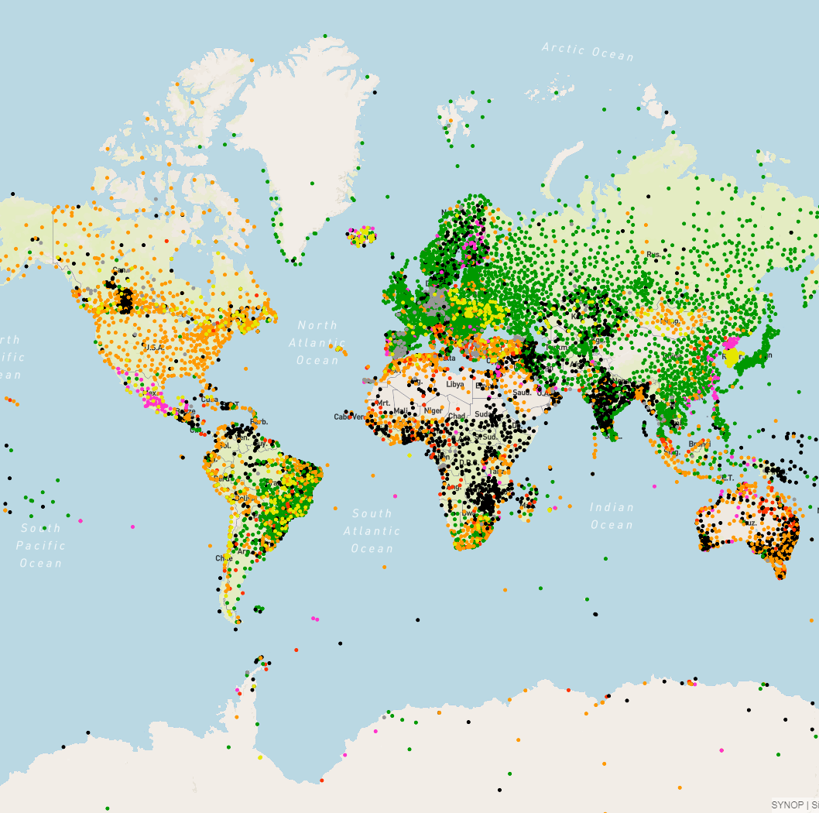

WDQMS
WIGOS Data Quality Monitoring System

Slide 6
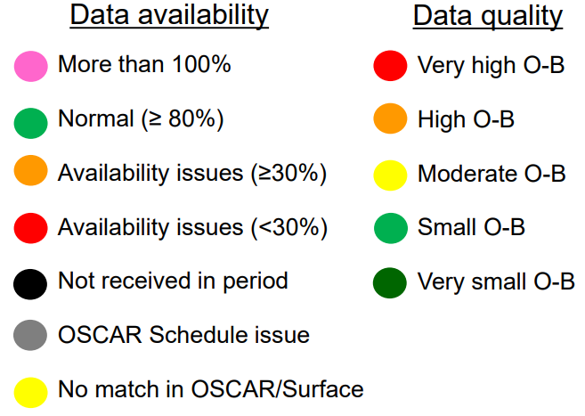
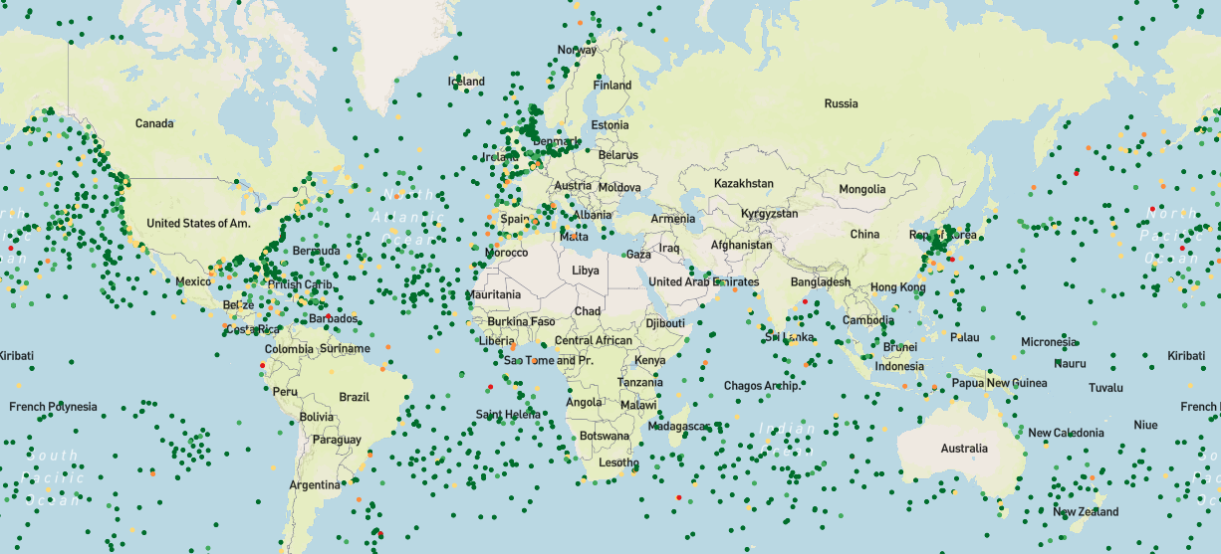
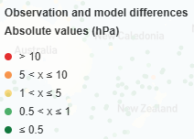
WDQMS
A web based tool for near-real time monitoring the availability and quality of observations exchanged internationally
Provide daily monitoring reports on availability / quality / completeness
WIGOS monitoring and evaluation function - releases performance reports
Webtool displays maps of monitoring outputs to evaluate performance
https://wdqms.wmo.int
Notes:
Ann

Slide 7
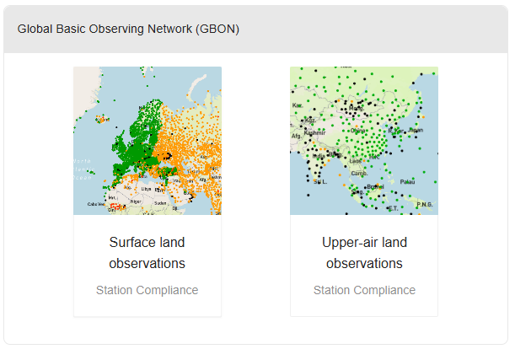
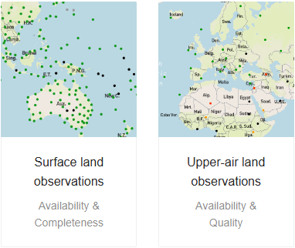
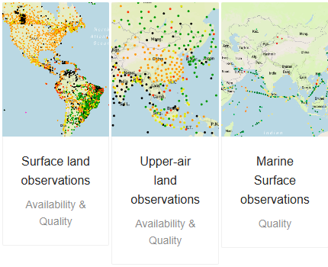
Tiers of Services
A web based tool for near-real time monitoring the availability and quality of observations exchanged internationally
Global Basic Observing Network (GBON)
Monitoring of the GCOS Networks
Near real-time NWP monitoring of the GOS networks
Notes:
Ann

Slide 8
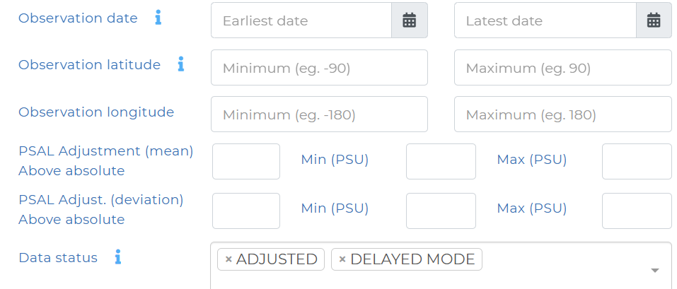
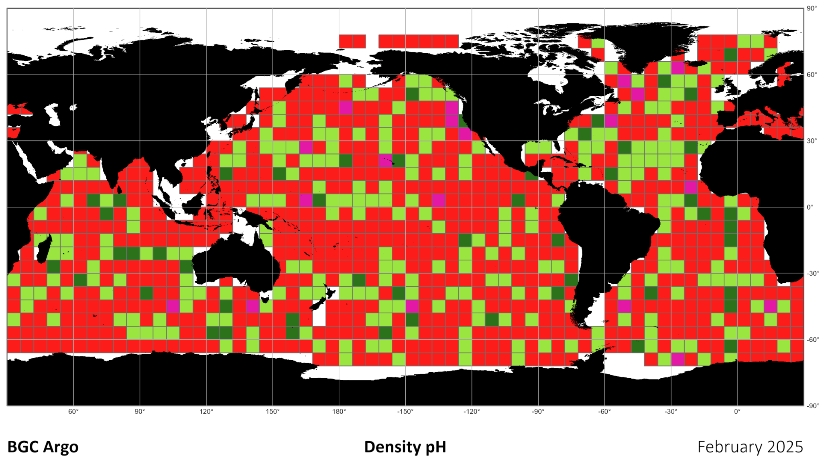
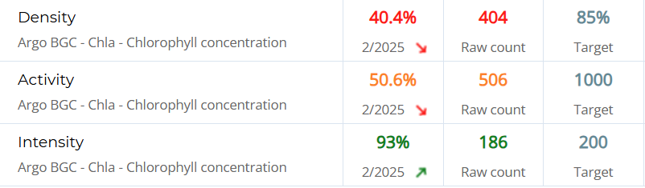
Existing IT
Connected to GTS and global data nodes when available (RT/DM). Limited integration of observation data for some networks
Precalculated density/coverage KPIs for Argo by region and EOV
Observation harvesting allows for platform status updates and data coverage available to users
Static visualizations and maps for Argo
Existing frontend Charting and Map Tools that can be adapted and enhanced for EOVs
Advanced search of observations and platforms by data fields (spatio-temporal, variable, data status etc)

Slide 9

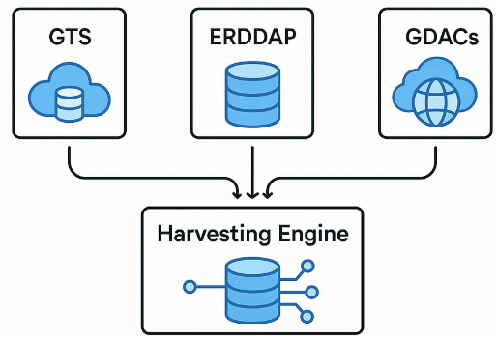
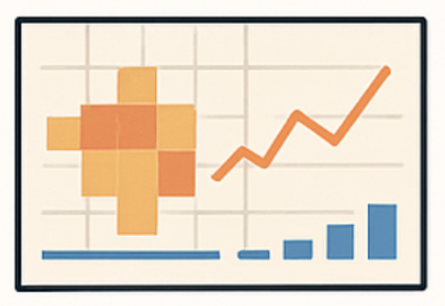
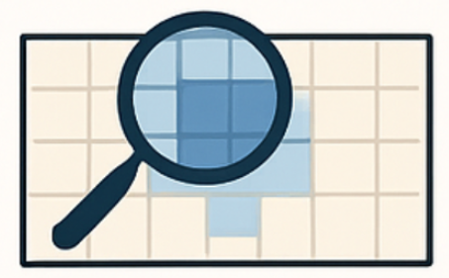
IT Backend: Building the EOV Data Engine
  Expand Harvesting
Expand the Observation harvesting pipelines by improving OceanOPS and Ifremer/Coriolis integration with smooth data access of large data sets, and by connecting to diverse global OCG data nodes (GDACs).
  Big Data Storage
Build scalable storage and processing systems to handle high volumes of observation data across space and time. Complexity: Large volumes of data, spatial binning, time slicing, performance optimizations.
  Optimize Queries
Develop powerful query services that allow users to search by geographic zone, date range, and EOV. These services must return aggregated insights fast, even on large datasets.

Slide 10
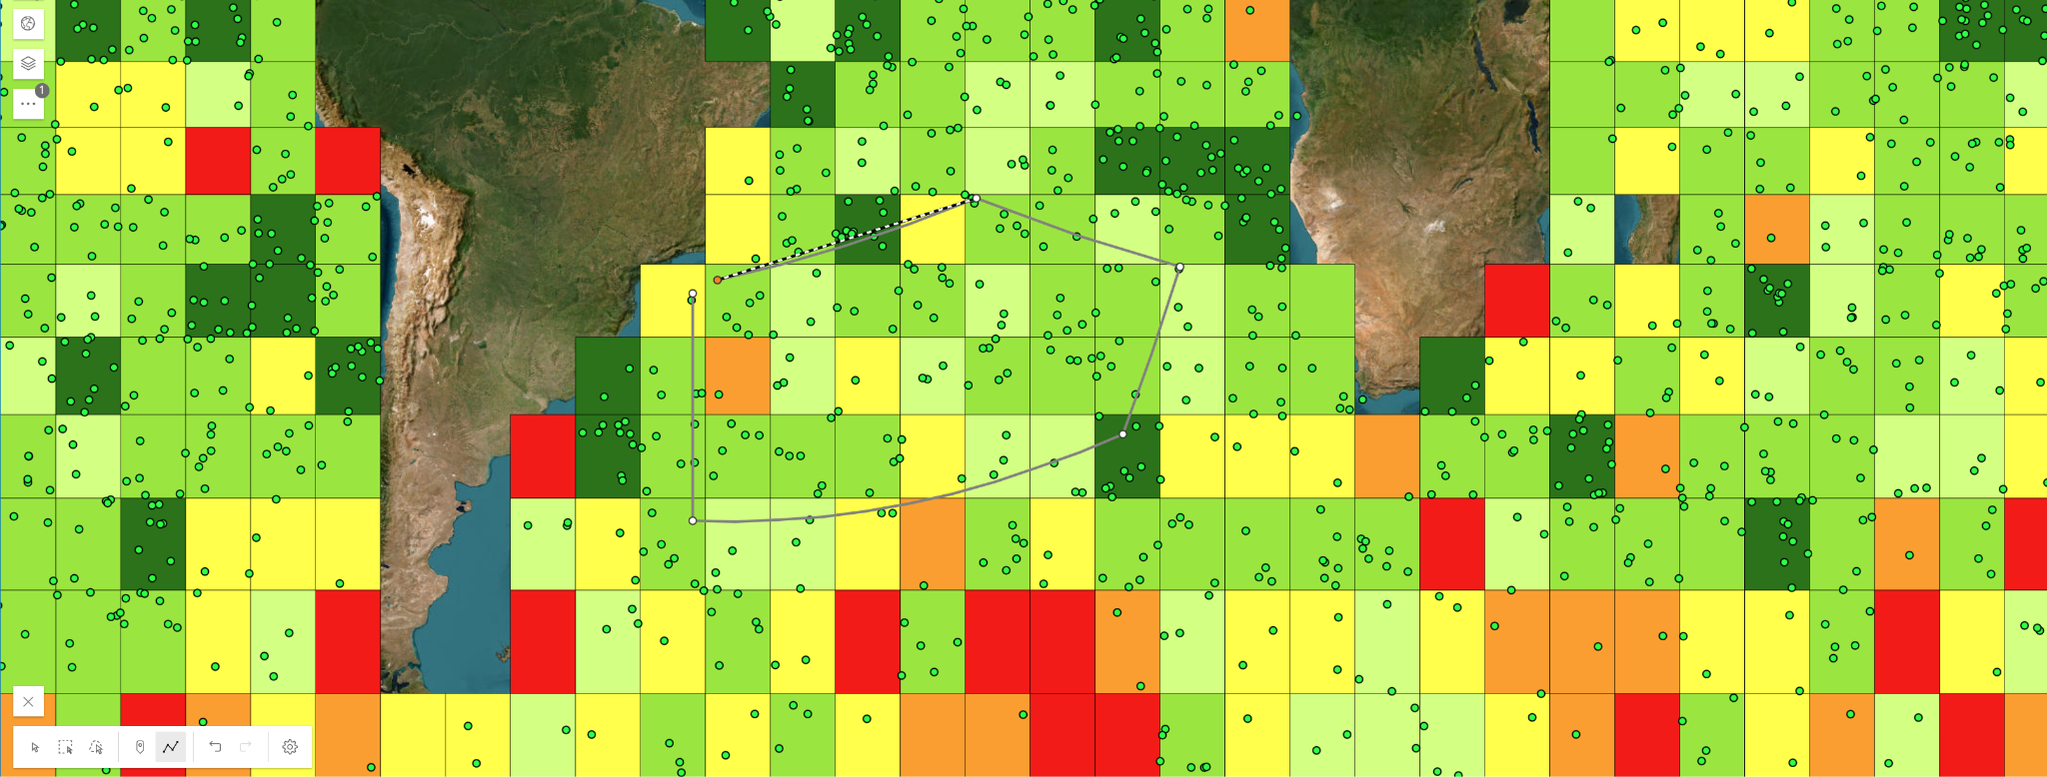
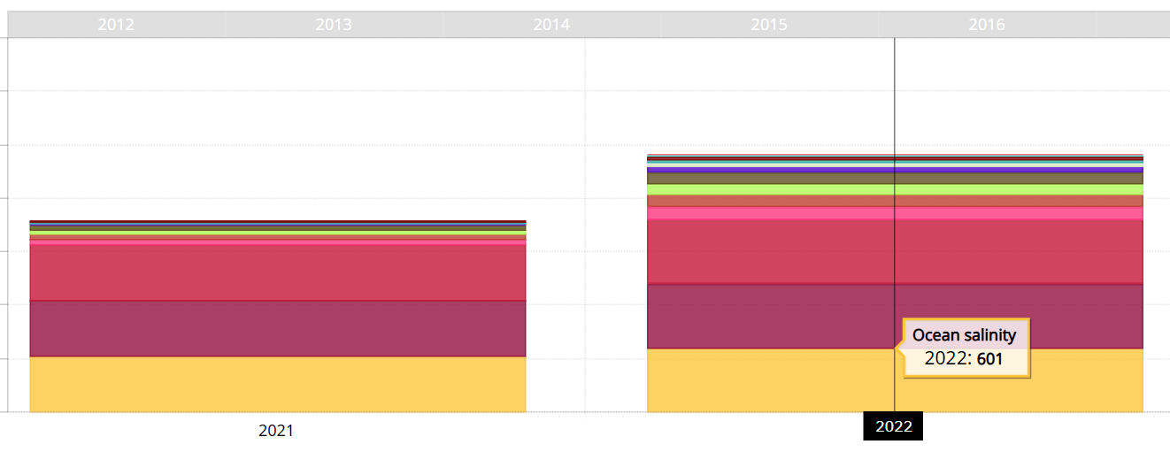
IT Frontend
  Interactive zone selection / EOV filters
Draw/select zones, choose time range, EOVs, etc.
Spatial overlays showing coverage density, observation gaps, frequency.
Complexity: Real-time map rendering, tiling strategies, legends, multi-resolution views.
  Dynamic KPIs and timeline charts
Show measurement count, density, trends over time per EOV.
Complexity: Aggregating data on-the-fly or from cache, synchronizing filters and views.

Slide 11
Vision: EOV Monitoring & Discovery
GOAL
Allow users to search, display and analyse measurements filtered by multiple parameters: Latitude, Longitude, Depth, Time, EOV, Grid Size, Platform (eg. 1x1, 6x6, ..), and possibly Quality.
STEPS
Technical specifications for backend and frontend developments
Implement OCG data strategy, connect OCG data nodes
Implement backend handling of big data storage
Codesign with the community the user interfaces
Develop the GOOS Gap Analysis Application components
→ Estimated at 2 years work for an IT developer who would act as a data broker, help networks set up data nodes and work in close cooperation with OCG and Ifremer architecture.

Slide 12
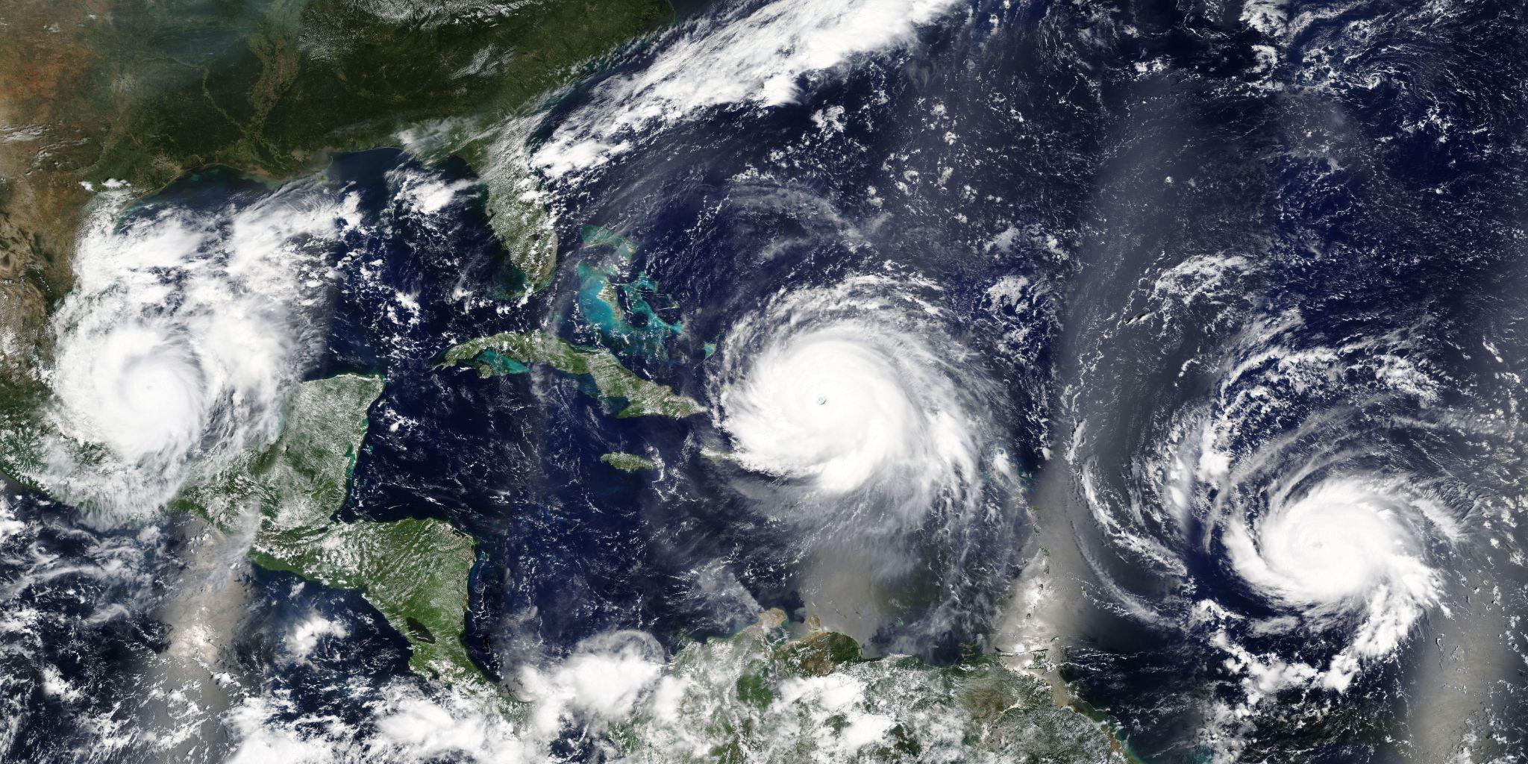
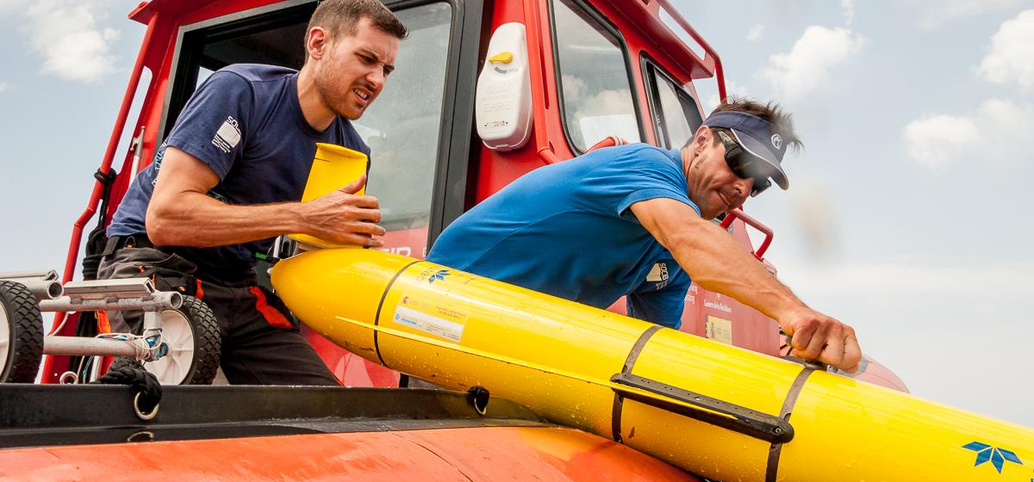
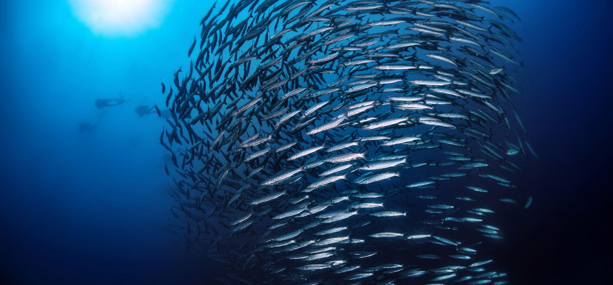
Specific Questions
  IMPACT
What is the envisioned impact of this service ?
What is the primary use and audience?
  TOOL
What specific applications or visualizations are looking for (e.g., Maps) ?
  PARAMETERS
Are there parameters beyond - Latitude, Longitude, Depth, Time, EOV, Grid Size, Platform - that are missing?

Slide 13
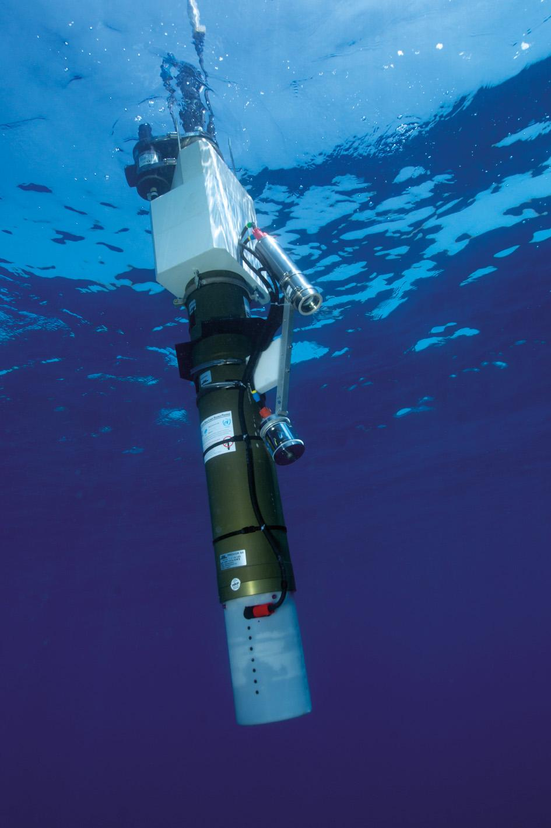
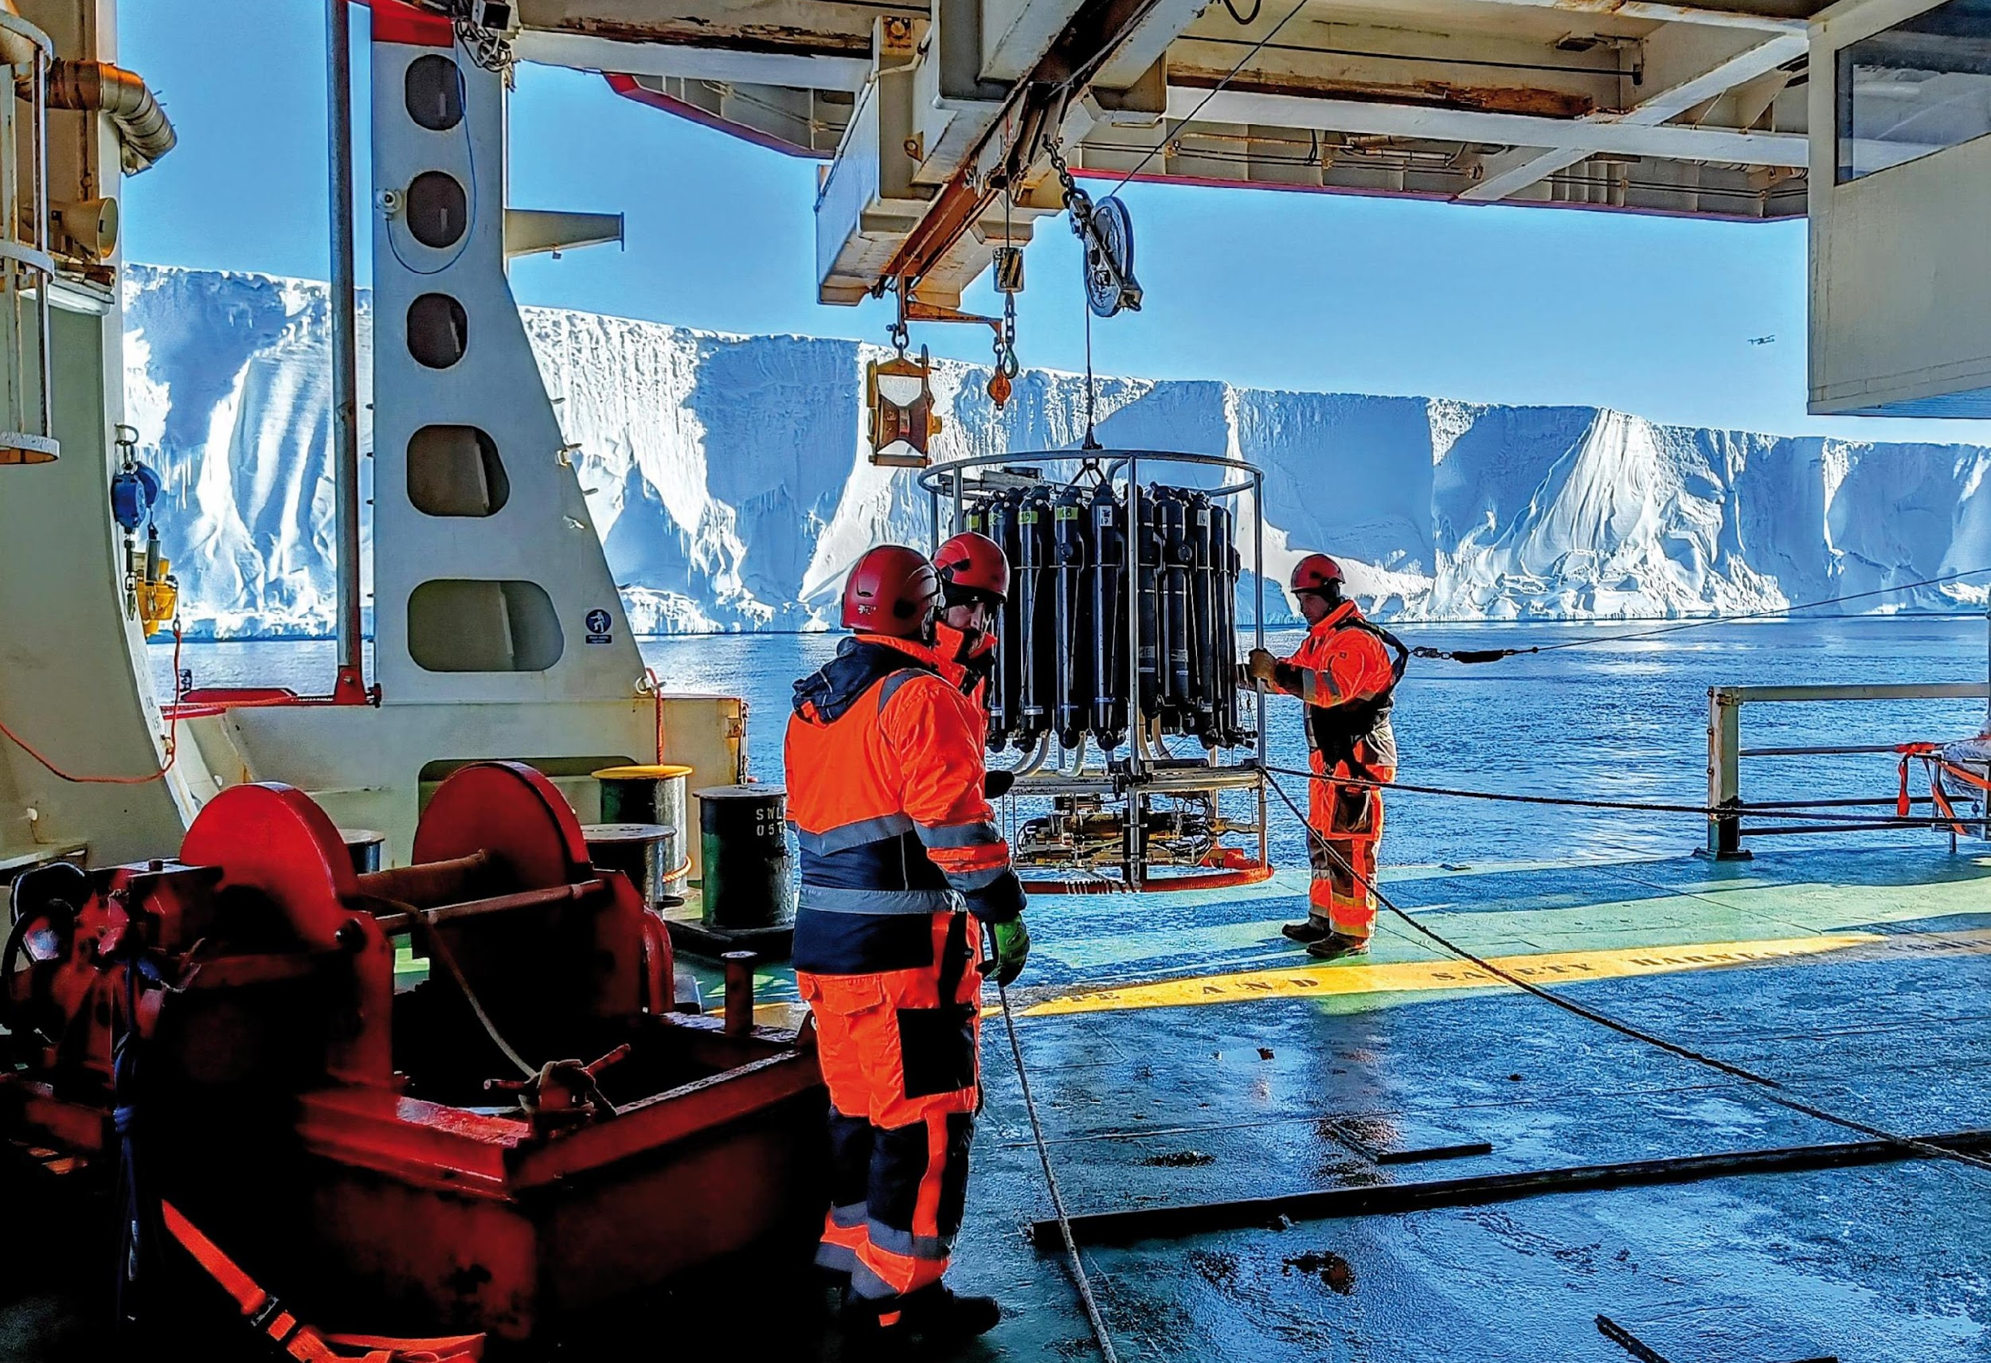
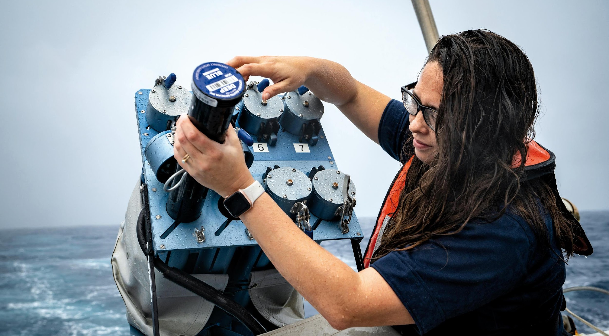
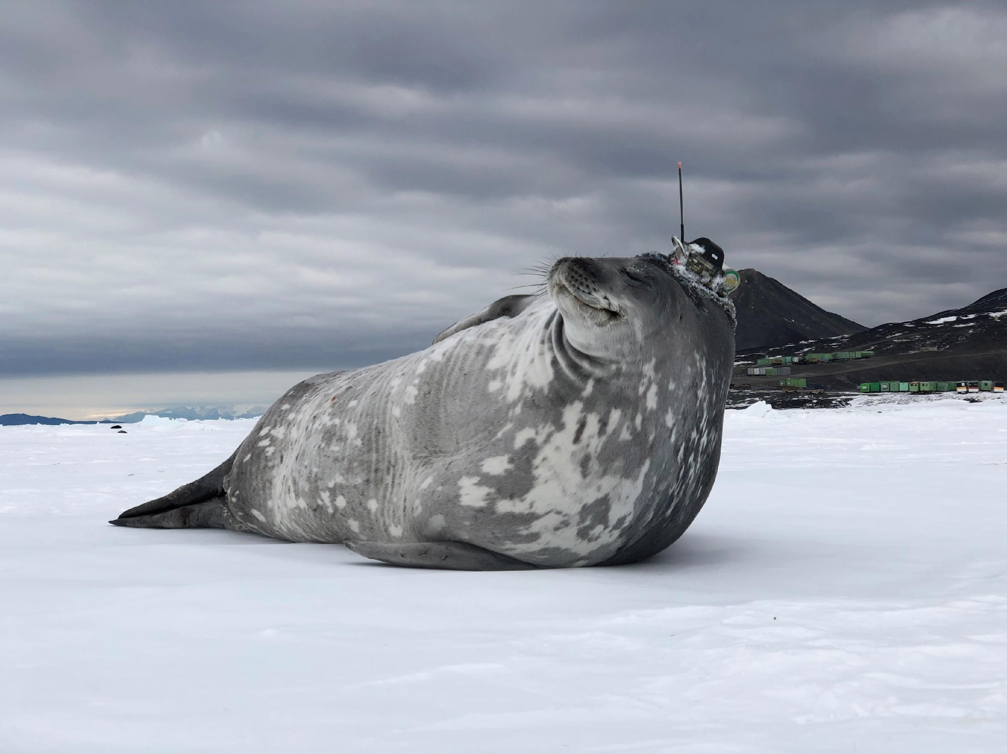
Thank you
goosocean.org
ocean-ops.org

