Slide 1
Session 9: OceanOPS Budget
Mathieu Belbéoch, Emanuela Rusciano - OceanOPS
Sixteenth Observations Coordination Group Meeting (OCG-16)
7-10 April 2025, IFREMER, Brest, France.

Slide 2
Executive summary
Financial trends & Budget growth
2025 Income: increase in national contributions (EU, USA) & EU projects (TRICUSO, AMRIT).
2025 Expenditure: higher core staff costs (IT manager reestablished) but reduced IT dev expenses.
2026 Forecast: Core staff secured at WMO; budget stabilized; inflation adjustments included.
Staffing & key Changes
2025: staff growth from project funding & in-kind support.
2025: Pilot position unfunded beyond Sept., in-kind staff (France/Polytechnique - 3 years)
2026: project-funded full-time staff (IT developer, Network Expert)
Comm/Admin role shifting to WMO.
Strategic challenges & recommendations
Network support adjustments under new SLAs.
BGC-Argo Pilot ends unless new funds secured.
Reduce dependance on limited national funding and encourage multinational support for sustainability.
NOAA contract ends mid-2027 - negotiation needed in 2026.
Risk management: one year of core staff salary secured.

Slide 3
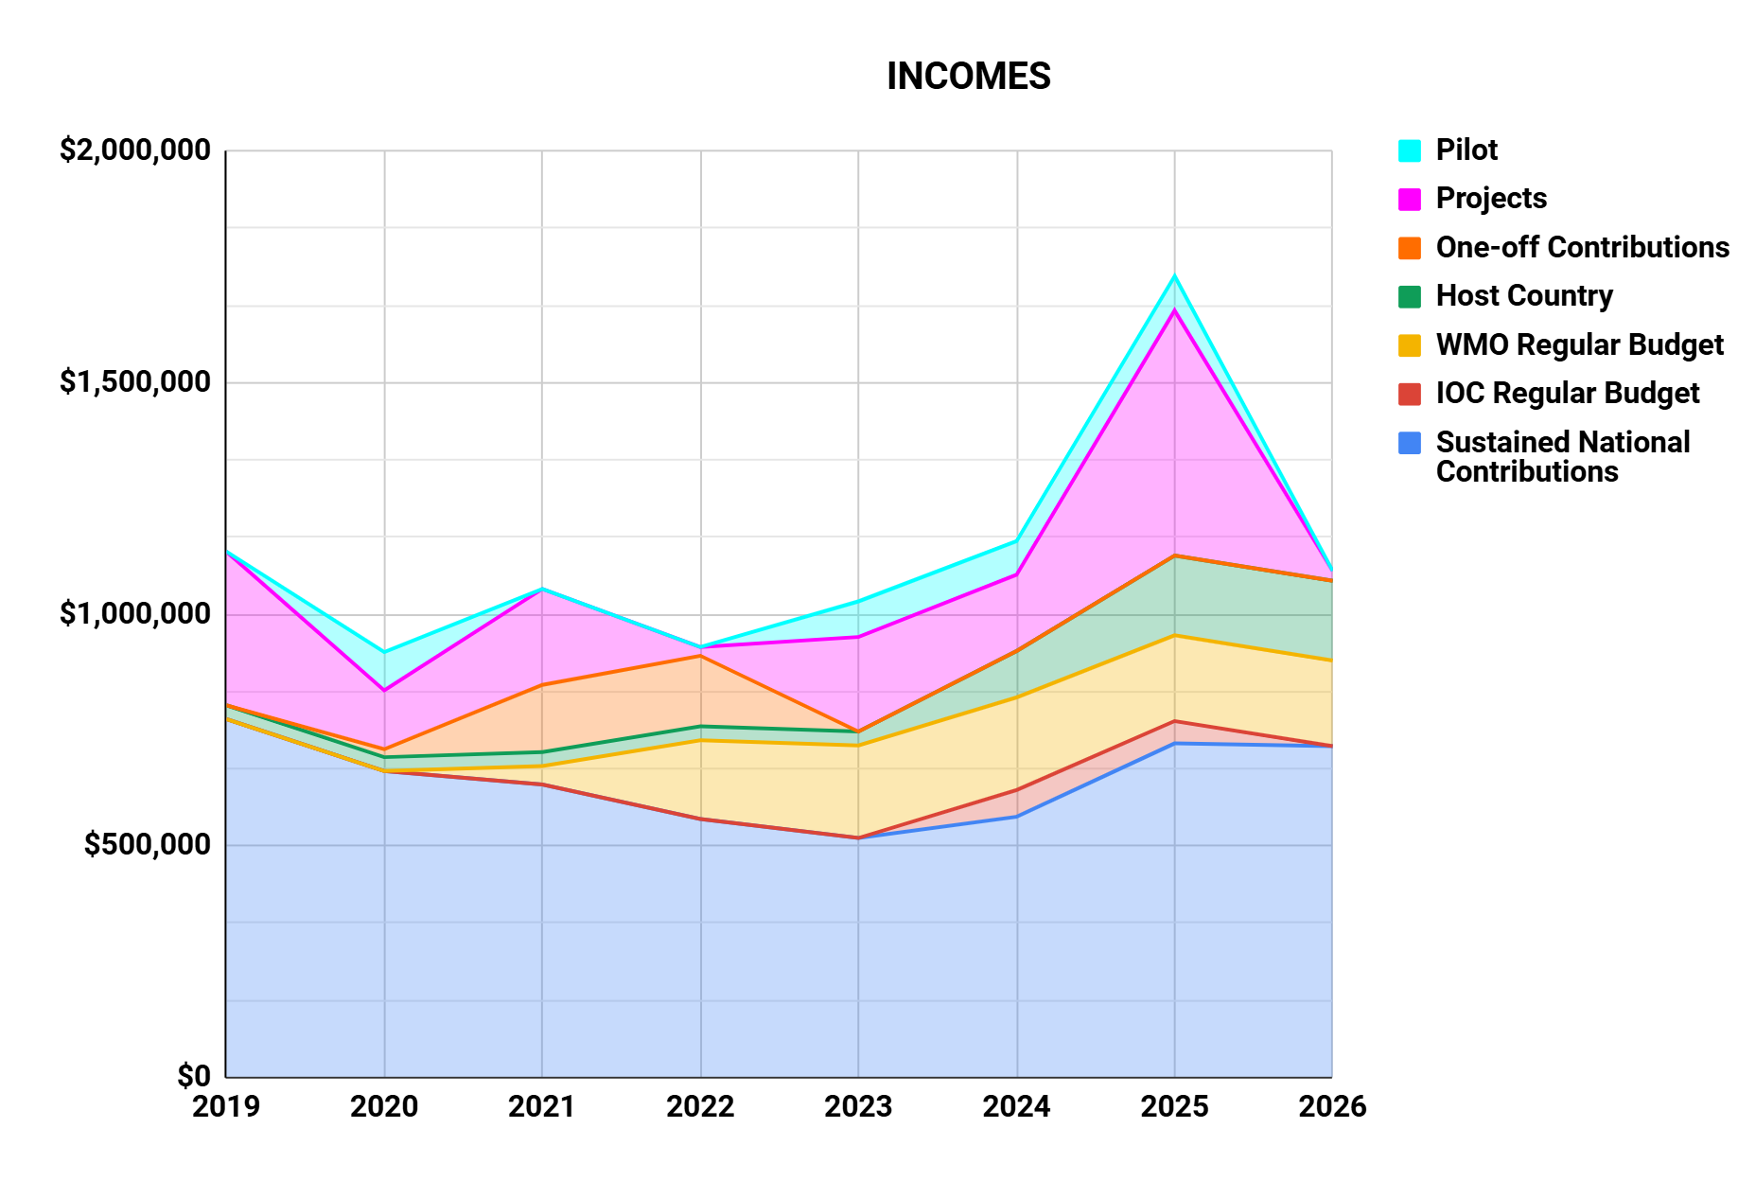
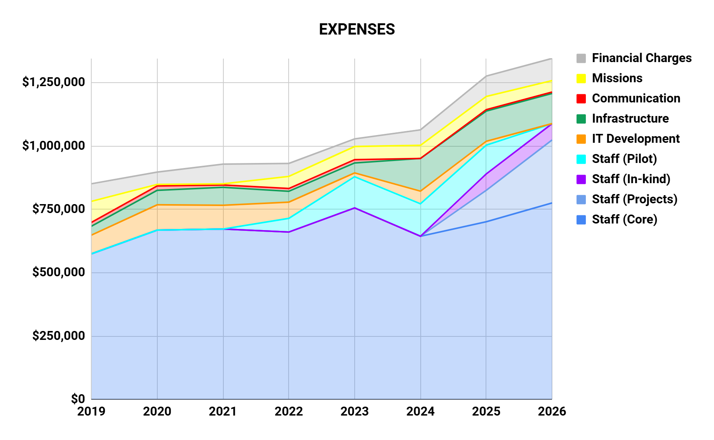
Financial trends
INCOMES:
Light increase in sustained national contributions in 2025 driven by new EMODnet support (for 2 years) and NOAA.
Growth in host country funding, including infrastructure support and an in-kind network expert.
Increased EU projects funding, notably through TRICUSO & AMRIT.
No secured funding yet to support the Pilot position
EXPENSES:
Staff growth through reestablishment of the IT manager position, projects and in-kind contributions from host country.
Reduced IT dev expenses, as tasks will be covered by the IT manager and the AMRIT-funded IT position.

Slide 4
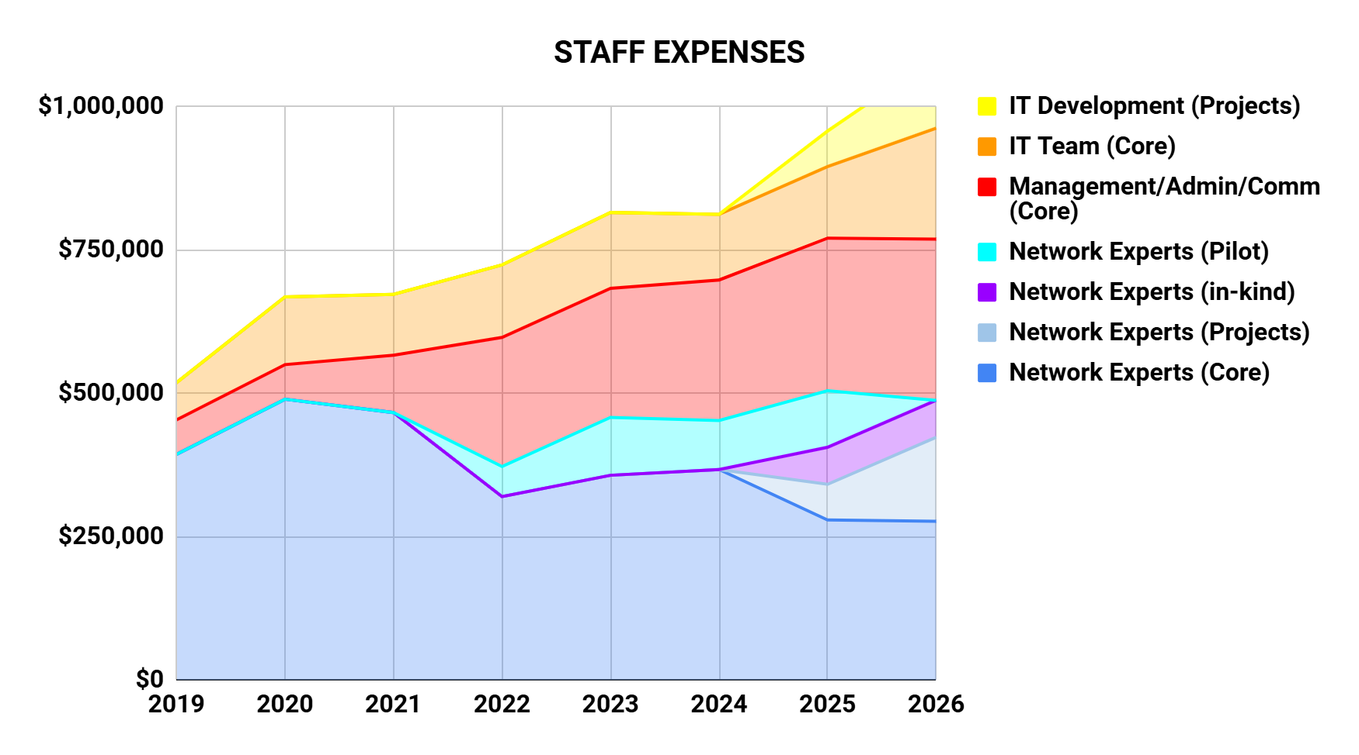
Trends summary - staff
2024 restructuring:
  Network Expert expenses (core) decreased
  IT team (core) increased
Staff growth in 2025 will primarily rely on project funds and in-kind support from host country.
Core staff costs aligned with stable contributions
project funding strictly allocated to project-related activities
Pilot staff expense phasing out by lack of funding.

Slide 5
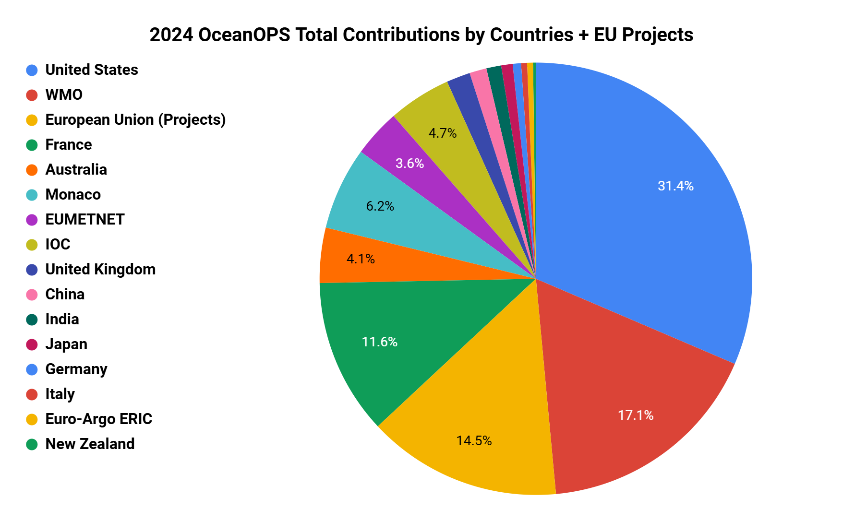
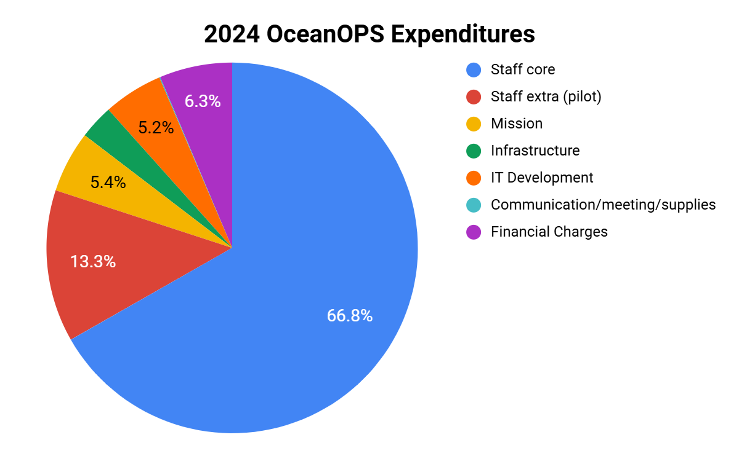
2024 Financial Overview
Increased incomes: 1,150 M$ vs 1 M$ in 2023
Increased overall budget: 1.5 M$ (including carry forward)
Stable expenditures: 1M$ (decrease in core staff cost compensated by increase in IT dev to ensure IT system migration, and financial charges)
Positive balance at year end: ~500 K$

Slide 6
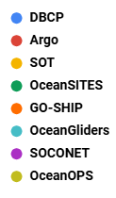
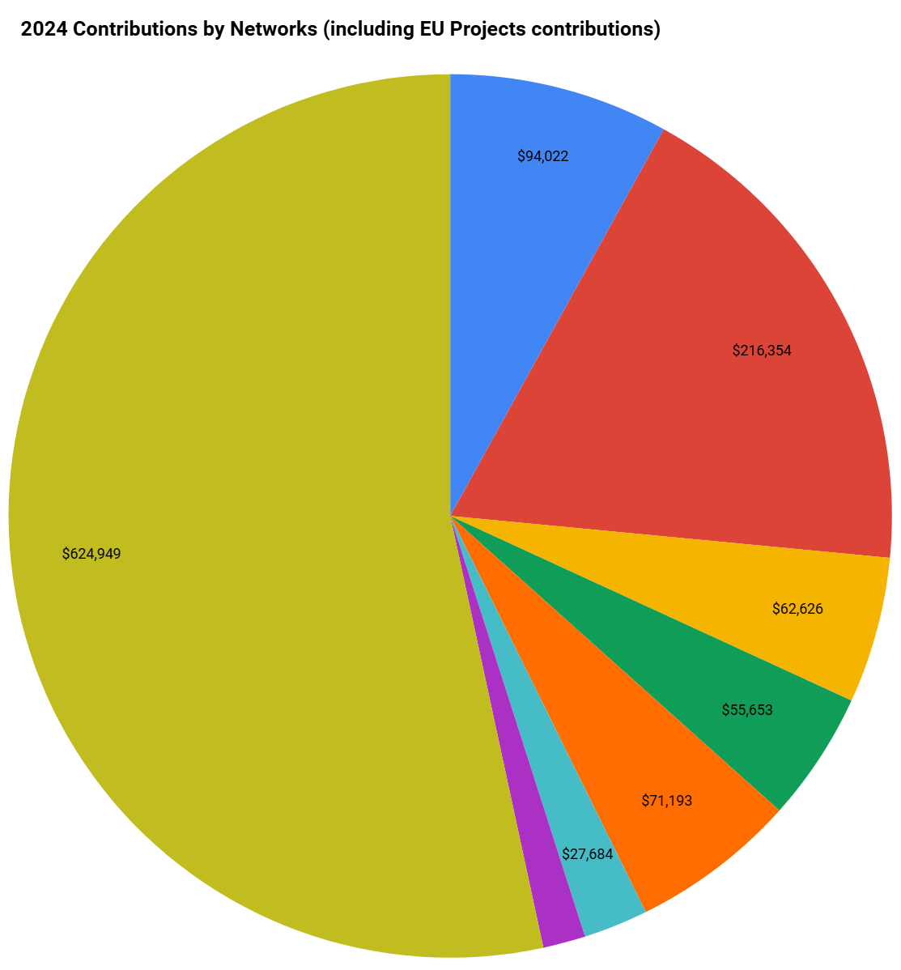
2024 Highlights
    Host/France investment in OceanOPS (I.S. & infrastructure): 100 K$
    IOC investment: 57 K$
    WMO continued investment: 200 K$
    NOAA increased contribution (support BGC-Argo & SOCONET)
    Stable regular national contributions: 560k$
Continuous significant support from EU Projects: AMRIT (125K$), EuroGOSHIP (30 K$), GROOM (10 k$)
Networks | Contributions received in 2024 calendar year
DBCP | US, TRUSTED Project, Australia, EUMETNET, India, New Zealand - BSH & Canada contrib. received late 2023
Argo | US, Monaco, Australia, France, UK, China, Japan, India, Italy, Germany, EuroArgo
SOT | US, EUMETNET
OceanSITES | US, Australia, France
GO-SHIP | US, EuroGOSHIP Project
OceanGliders | US, GROOM Project
SOCONET | US
OceanOPS | US, WMO, AMRIT Project, Monaco, IOC, France
Remarks & Recommendations:
We encourage diversification of funding sources for networks (OceanGliders, GO-SHIP, OceanSITES, and SOT), which have relied on support from only 1-3 countries for many years.

Slide 7
2025 Interim Budget
  Expected overall budget: 2 MCHF (increase) || Expected expenses: 1.1 MCHF (increase)
Highlights: budget unified & stabilized at WMO (monitoring in CHF)
Budget growth drivers:
New contribution: EMODnet - 90 KCHF (2024 & 2025)
EU Project support: AMRIT - 128 KCHF (Year 2), TRICUSO - 309 KCHF (80% of total funding)
Increased NOAA support for BGC-Argo & SOCONET, plus a slight increase for staff costs.
Increased host country support (infrastructure and in-kind staff budgeted 150 KCHF)
Staffing and key changes:
BGC-Argo/Med. Pilot position ends in 30/08 unless additional funds are secured.
IT developer funded Jan-June (acting as IT Manager)
New hires (July 2024 onward): IT manager, IT Dev. (AMRIT), Network Expert (TRICUSO).
Comm/Admin position at IOC closing mid-year – open at WMO with light changes
France/Polytechnique provided in-kind support for OceanGliders coordination (0.75 FTE).
Remarks:
End-of-year balance (due to unspent EU projects) will secure 3-year contracts for IT web dev & SOCONET TC.
Core staff salaries secured in 2026 and buffer against potential delayed contributions.

Slide 8
2026 Anticipated Budget
  Expected overall budget: 1.9 MCHF (almost stable) || Expected expenses: 1.2 MCHF$ (increase)
Highlights:
All core staff secured at WMO with a simplified budget management process
Expecting Financial Advisor support provided by WMO/WIGOS
Travel budget maintained at 2024-25 levels.
IT development on projects
Staff costs at a peak with full year (core, projects).
1 year of salary reserve for core staff –3% inflation considered in projections.
Remarks & Recommendations:
SLAs in place for all Networks – Marketing plan assembled (UN, EU, G7...)
New contract with NOAA to be negotiated for future funding.

Slide 9
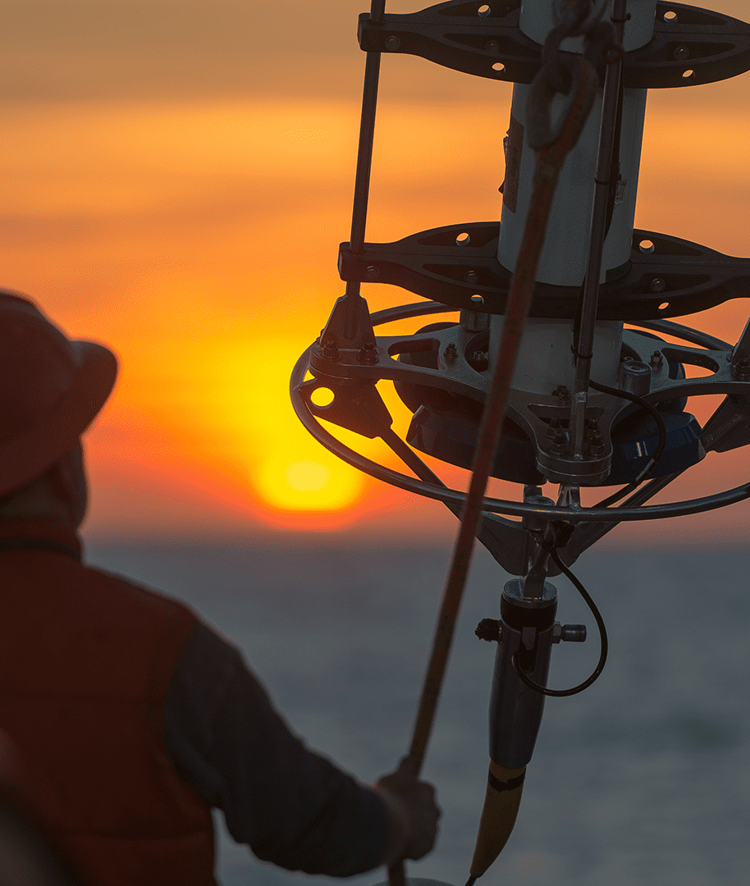
Remaining Challenges
In 2024 OceanOPS guided by its Management Board took major restructuring steps to address budget & staffing precarity, laying a foundation for long-term stability.
2025 will be marked by key progress:
Unified budget at WMO & signature of SLAs with networks.
Core staff stabilized ensuring operational continuity.
Host country agreement finalized, strengthening financial stability & strategic collaboration
Start of a new (reasonable) growth period thanks to 2 major EU projects
Challenges ahead:
Keep reducing dependency on one Member (single point of failure)
Market the consolidated SLA ambition
Continue invest in EU projects proposal

Slide 10
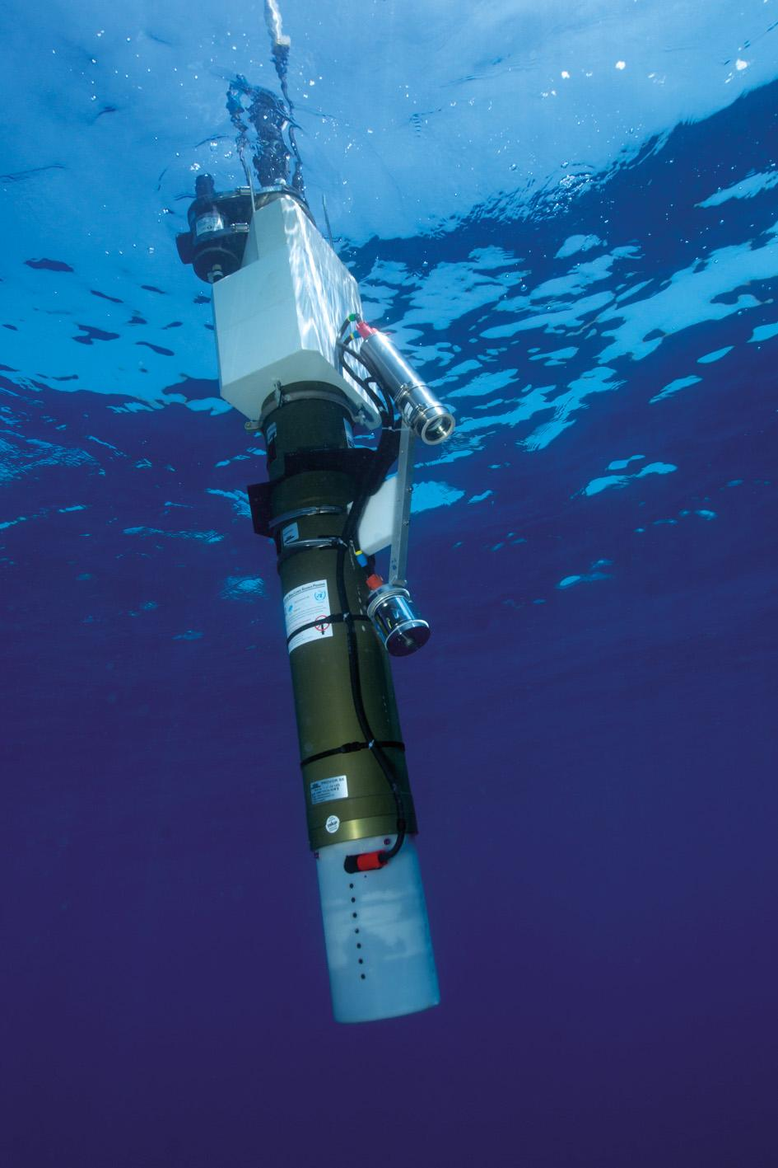
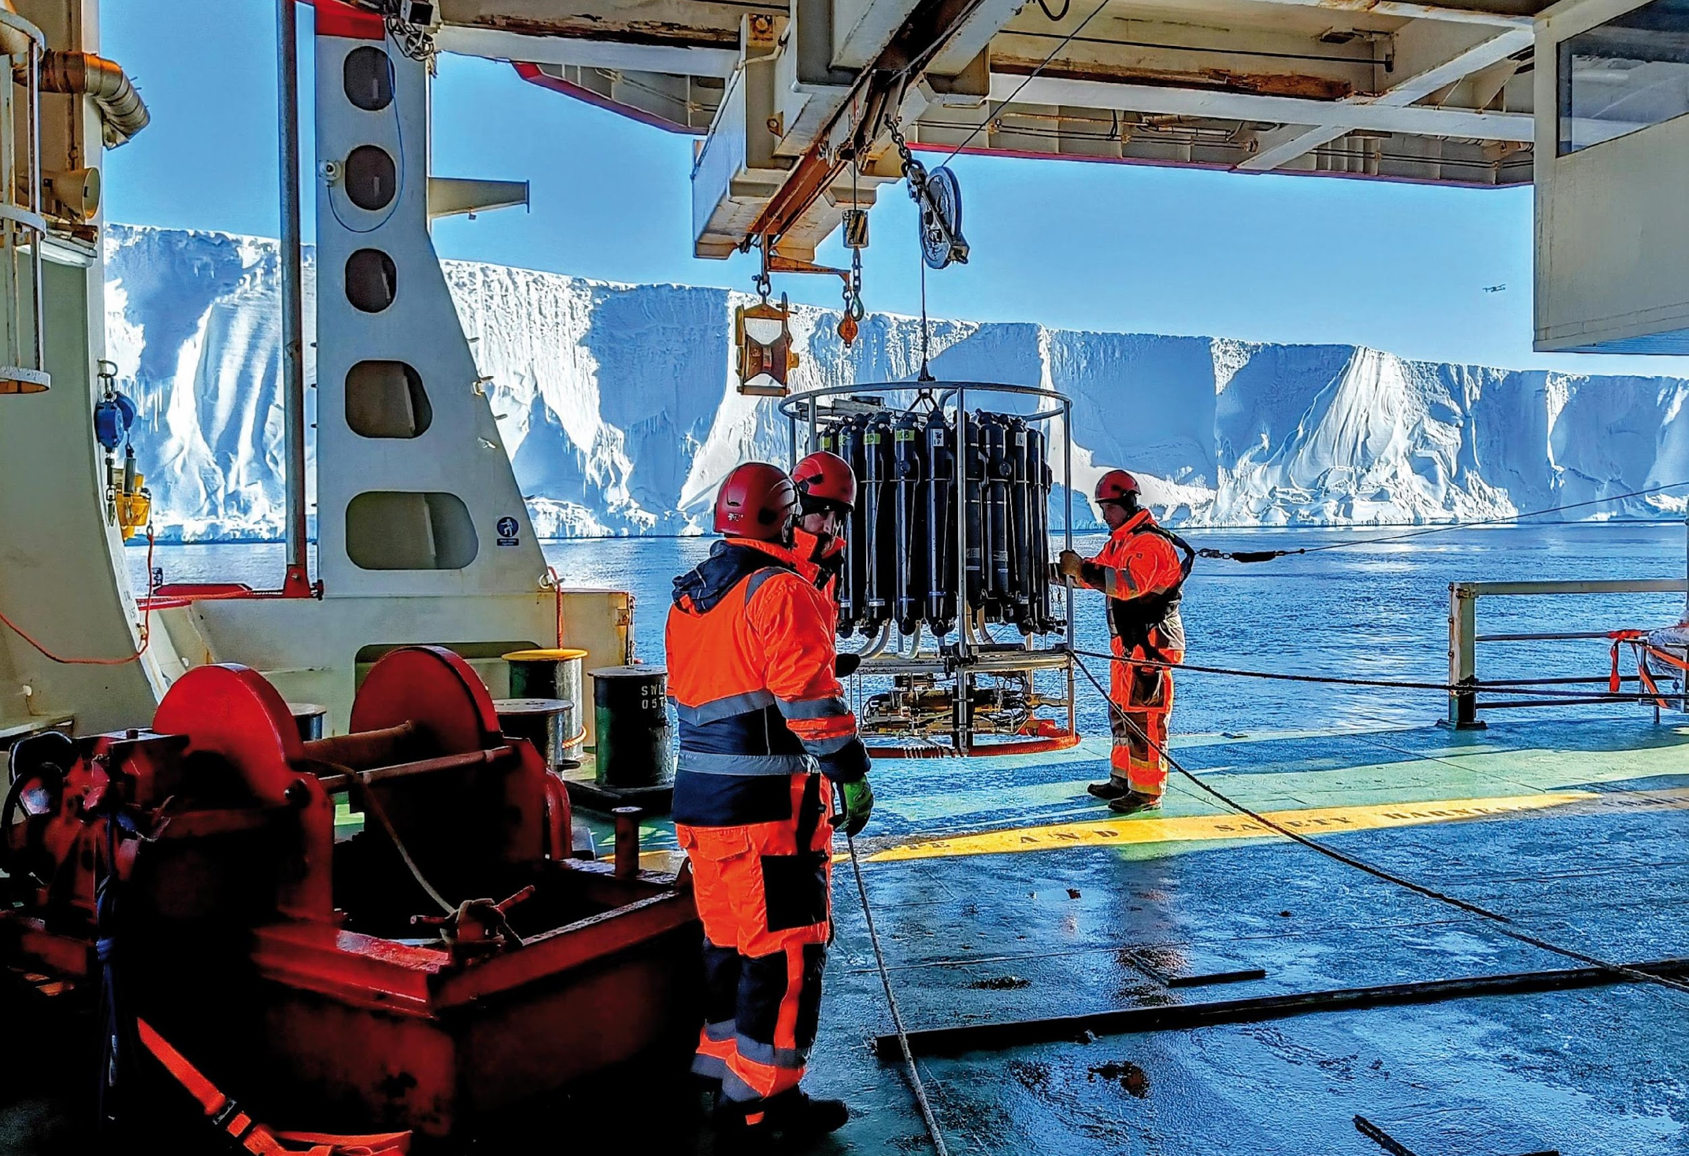
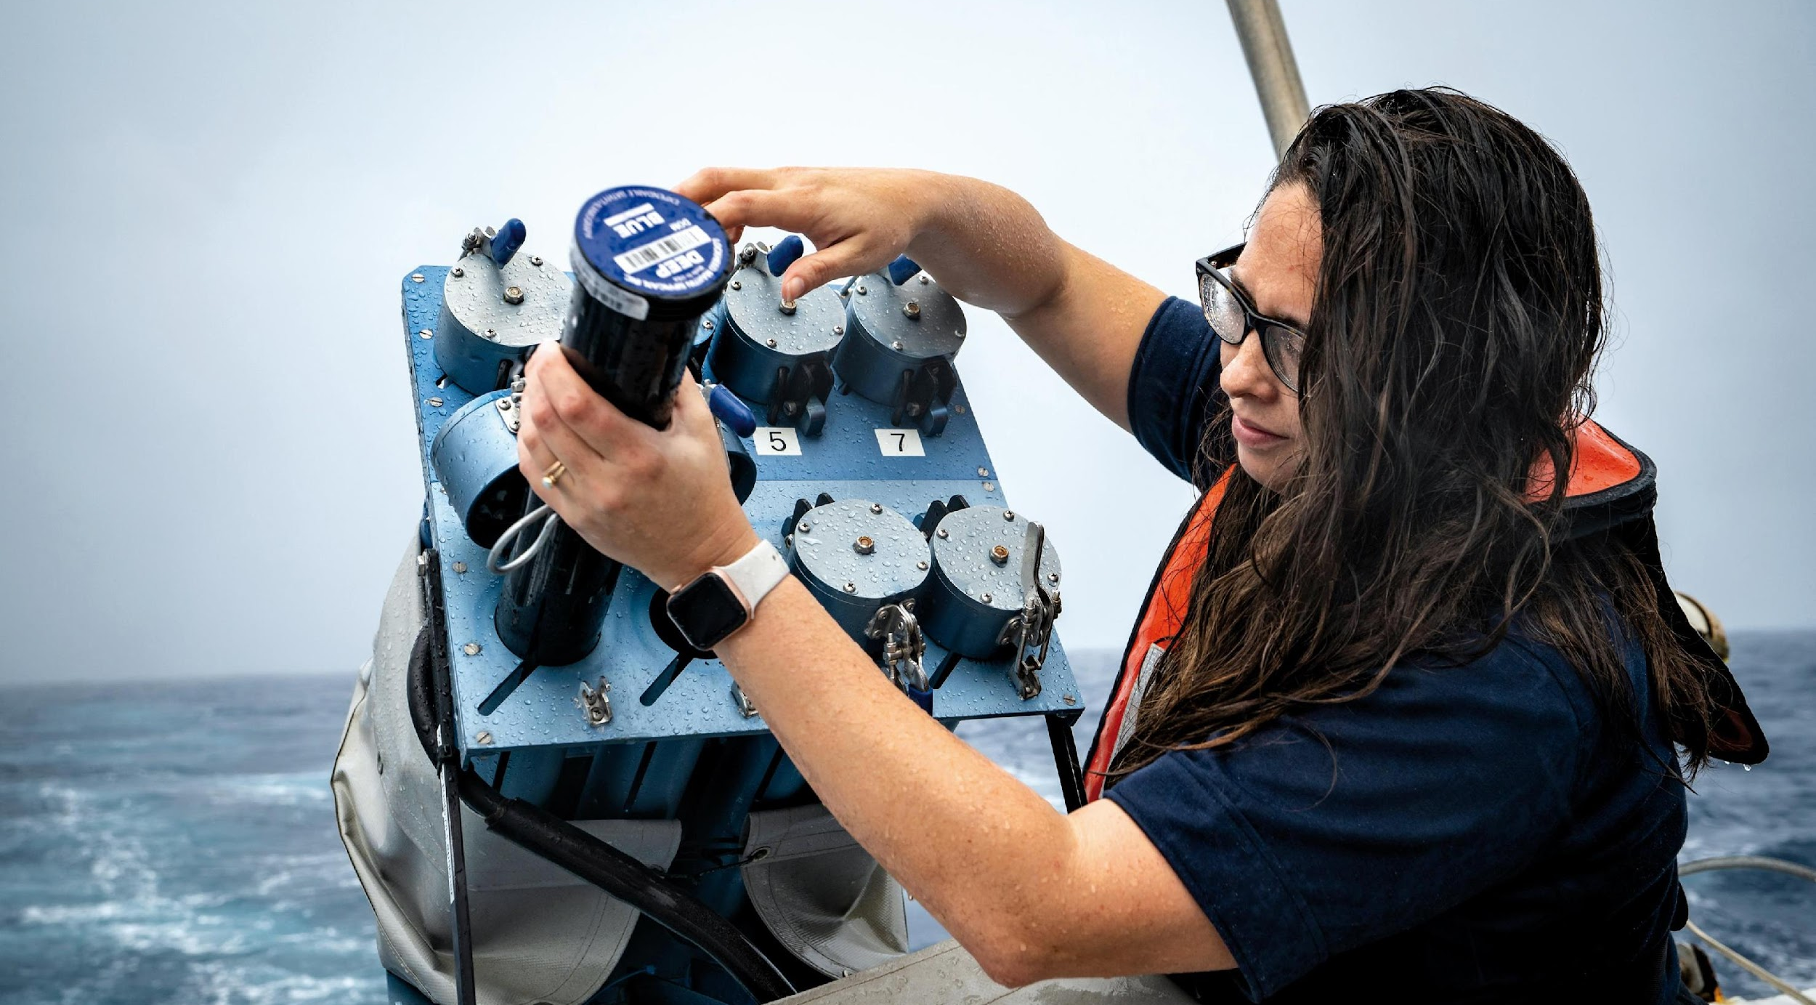
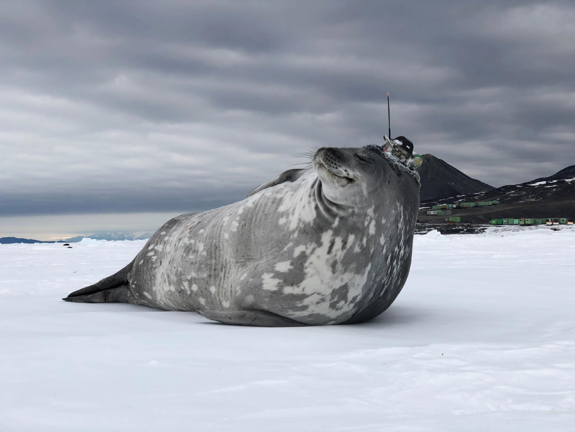
Thank you
goosocean.org

