Slide 1
WMO WIS2 and Ocean updates
Tom Kralidis
Senior Geospatial Architect
Meteorological Service of Canada
tom.kralidis@ec.gc.ca
@tomkralidis
Chair, WMO Expert Team on Metadata Standards
Architect, WIS2 Architecture and Implementation
Technical Lead, WIS2 in a box
2025-04-08

Slide 2



WIS Architecture
Discovers data from
Subscribes to
Global Services
Receives notifications of new data from
Downloads data from
Downloads data from
Receives notifications of new data
Subscribes to
WIS2 node

Slide 3


WIS2
Nodes
WIS2 Components: WIS2 Nodes
Data users
Each WMO Member shall implement at least one WIS2 Node to share data in WIS2
Publishes real-time notifications about data
A WIS2 Node replaces the GTS Message Switching System
Publishes Core and Recommended data
Advertises what data is available (discovery metadata)
Data and metadata are shared using a WIS2 Node
A WIS2 Node shares data via an HTTPS service and sends notifications to MQTT subscribers
WIS2 Node
WIS2 Node
WIS2 Node

Slide 4





Global Services
WIS2 Components: Global Services
Data users
Global Monitoring
Discovers datasets
Subscribes to topics
Downloads core data
Global Discovery Catalogue
Global Broker
Global Cache
Downloads recommended data
Downloads recommended data
Downloads recommended data
  Provides an API to discover datasets and services
  Sends notifications of new data to be downloaded from Global Caches or WIS2 nodes
Provides users HTTP download of core data cached from WIS2 nodes
WIS2 node
WIS2 node
WIS2 node
Scale to highly-available, global data sharing

Slide 5

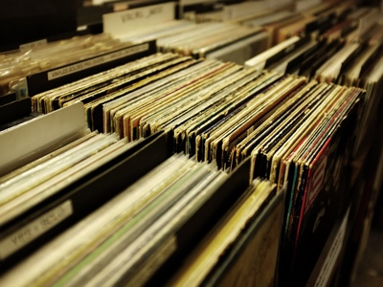
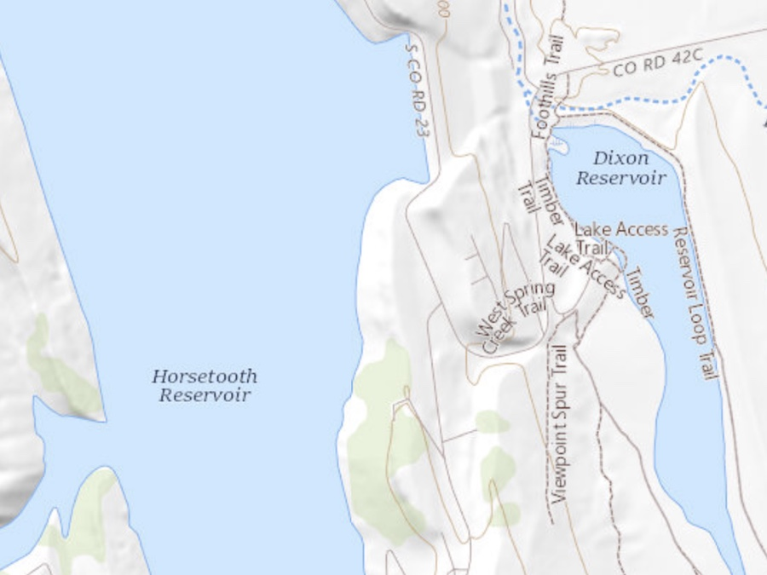
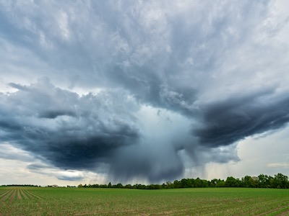
OGC Standards Implementation
Replay API
  OGC API – Features
Data Access
  OGC API - EDR, Features, etc. (recommended)
Pub/Sub (pending)
  OGC API – Pub/Sub
Discovery Metadata encoding
  OGC API – Records – Core (Record)
  GeoJSON
Notification Metadata encoding
  GeoJSON
Global Discovery Catalogue API
  OGC API - Records
OGC Modular Specification (ModSpec) development adoption
  Core + extension
  Requirements, recommendations, permissions
Notes:
OGC-API pub/sub discussion paper is partly rooted in WIS2

Slide 6

WIS2 progress: Pilot Phase complete
Pilot Phase
Pre-operational
2030
2033
Operational
Pre-oper Global Brokers
2025
Pilot Global Brokers
Global Brokers operation
90% of Members migrated to WIS 2.0
Stop transition infrastructure and GTS transmission
Pilot Global Discovery Catalogue
Pre-oper Global Caches
Global Caches operation
Pilot Global Caches
2023
2022
2024
Technical Regulations
Pre-oper Global Discovery Catalogue
Global Discovery Catalogue operation
WIS 2.0
Guidelines
NCs
DCPCs
Q1
Q2
Q3
Q1
Q2
Q3
Q1
Q2
Q3
WIS2 box release 1.0
Transition Infrastructure
WIS2 Monitoring
NCs & DCPCs
NCs & DCPCs
Workshops and training
INFCOM-2
EC 75
Cg-19
EC-76
EC 77
WIS 2.0 Tech- Reg approved
Guidelines for WIS 2.0
implementation published
INFCOM-3
EC 78
technical guidance in the Guide to WIS
Report on WIS2 progress
NCs/DCPCs may stop WIS1 functions if migrated to WIS2
GISCs contributing to Global Services may stop WIS1

Slide 7

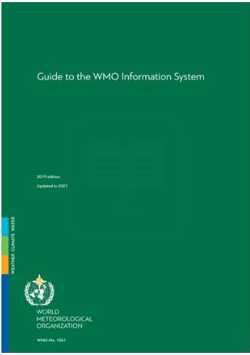

WIS2 regulatory material
June 2023 Cg-19
Manual on
WIS
April 2024 INFCOM-3
Guide to
WIS
Volume I
WIS 1.0
Volume I
WIS 1.0
Transition from WIS/GTS
to WIS2
Manual on
WIS
Guide to
WIS
1
2
3
4
5
6
Manual on
WIS
Guide to
WIS
Volume II
WIS 2.0
doc 8.3(2) TRANSITION FROM WIS 1.0 AND GTS TO WIS 2.0, INCLUDING CAPACITY DEVELOPMENT
Volume II
WIS 2.0
Manual on WIS Volume II WMO Information System 2.0
All documents have been endorsed by INFCOM 3 (April 2024)
doc 8.3(1) AMENDMENTS TO THE MANUAL ON THE WMO INFORMATION SYSTEM
doc 8.3(3) UPDATE OF THE GUIDE TO THE WMO INFORMATION SYSTEM
 | 7

Slide 8


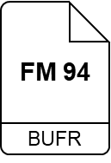






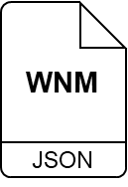
Publishing data
For WIS2 I see that my collection of real-time observation data is called a ‘Dataset’¹
But I still don’t know anything about your Dataset!
Following instructions in the WIS2 Guide², I establish a WIS2 Node to share my Dataset
files in BUFR, GRIB2, NetCDF, GeoJSON, XML, etc.
HTTPS
00110001
00110000
» »
interactive API
OGC API
WIS2 Notification Messages
MQTTS
¹ Guide to WIS (WMO No. 1061), Vol II, §1.1.4 Why are datasets so important [draft]
nl-knmi-nmc
² Guide to WIS (WMO No. 1061), Vol II, §1.3.1 How to get started [draft]

Slide 9



Publishing metadata
Ahh, good point! The next section in the WIS2 Guide³ says that I need to provide ‘discovery metadata’⁴ about my Dataset
Description of the Dataset
Identifier
Title
Description
Keywords
Geometry (extent)
Time (extent)
HTTPS
That’s great. I can find the description of your Dataset …
Who to contact
OGC API
Publisher contact
How to access
Data access (files)
Data access (API)
Data access (notifications)
MQTTS
Conditions of use
Data policy
Rights
License
nl-knmi-nmc
How to attribute
search engines
Citation
WCMP2
«publish»
Global
Discovery
Catalogue
«index»
³ Guide to WIS (WMO No. 1061), Vol II, §1.3.2 How to provide discovery metadata to WIS2 [draft]
JSON
⁴ Manual on WIS (WMO No. 1060), Vol II, Appendix F: WMO Core Metadata Profile 2 [draft]

Slide 10
WMO Core Metadata Profile 2.0 (WCMP2)
The new standard for WIS Metadata
Description of the Dataset
WCMP2 is an extension of the International Standard OGC API - Records
Discovery metadata describes a given dataset or collection
Aligning with the WIS 2.0 Principles, discovery metadata will be published to the Global Discovery Catalogue
Identifier
Title
Description
Keywords
Geometry (extent)
Time (extent)
Who to contact
Publisher contact
How to access
Data access (files)
Data access (API)
Data access (notifications)
search engines
WCMP2
«publish»
Global
Discovery
Catalogue
«index»
JSON
Conditions of use
Data policy
Rights
License
Guide to WIS (WMO No. 1061), Vol II, §1.3.2 How to provide discovery metadata to WIS2 [draft]
How to attribute
Citation
Manual on WIS (WMO No. 1060), Vol II, Appendix F: WMO Core Metadata Profile 2 [draft]

Slide 11
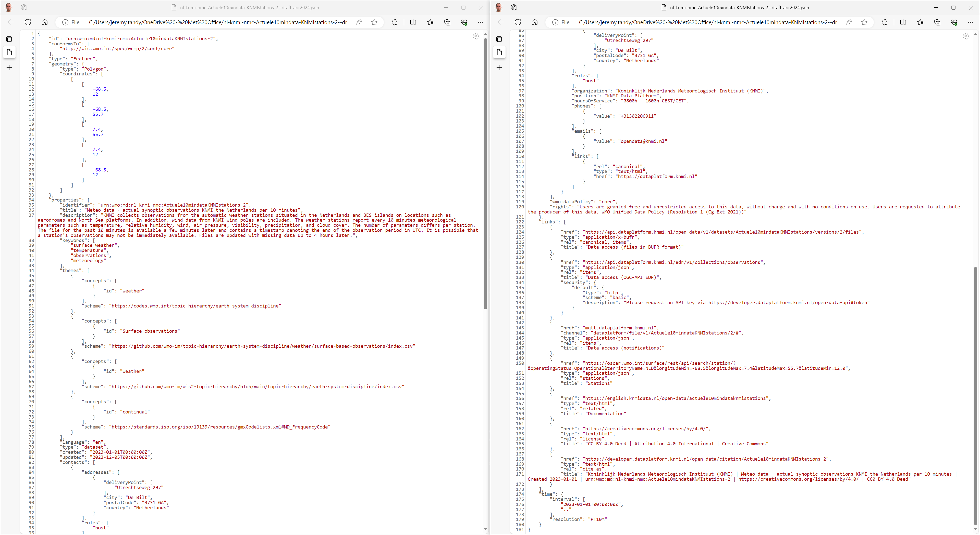
--------------------------------------
--------------------------------------
Geometry (extent)
Publisher contact (cont.)
Identifier
Data policy
Title
Rights
Description
Data access (files)
Keywords
Data access (API) with security info
Data access (notifications)
Additional info (OSCAR/Surface)
Additional info (Developer docs)
License
Publisher contact
Citation
Example: KNMI dataset (draft)
Time (extent) and update frequency

Slide 12



Topic Hierarchy and Notification Message
Publisher 1
Publisher 2
Publisher 3
Lagrangian Drifter Laboratory
WIS2 Topic Hierarchy – “Backbone” of the notification architecture where the messages will be available
WIS2 Notification Message – Format of the Notification Messages
Message Broker
Publish
Publish
Publish
Topic 1
Topic 2
surface-based-observations/buoy
Topic 3
Subscribe
Subscribe
Subscribe
User 1
User 2
User 3
Ocean users
Notification Message

Slide 13

Finding and downloading data from WIS2: full workflow
WIS2
Global Broker
Subscribe
WIS2 Global Discovery Catalogue
Find
Data
Consumer
Download
WIS2
Global Cache

Slide 14
WIS2 FOSS Implementations
  BUFR tools
    csv2bufr
    synop2bufr
  pywcmp: github.com/wmo-im/pywcmp
    Validator
    KPI quality assessment
    Topic hierarchy validation
  wis2box: docs.wis2box.wis.wmo.int
    WIS2 Node reference implementation
    Discovery Metadata UI (which will be built for standalone reuse)
  pywiscat: github.com/wmo-im/pywiscat
    WIS catalogue client tool
  pywis-pubsub: github.com/wmo-im/pywis-pubsub
    Publish/Subscribe tool
  pywis-topics: github.com/wmo-im/pywis-topics
    Validate / browse WIS2 Topic Hierarchy
  WIS2-Global-Broker-Redundancy: github.com/golfvert/WIS2-GlobalBroker-Redundancy
    GB implementation
  wis2-gb: github.com/wmo-im/wis2-gb
    GB implementation
  wis2-gdc: github.com/wmo-im/wis2-gdc
    GDC implementation
  wis2-gc: github.com/wmo-im/wis2-gc
    GC implementation
  pyoscar: github.com/wmo-cop/pyoscar
    OSCAR/Surface client
Every WIS2 component has a FOSS reference implementation
github.com/wmo-im/wis2pilot/wiki/Resources - software-options

Slide 15
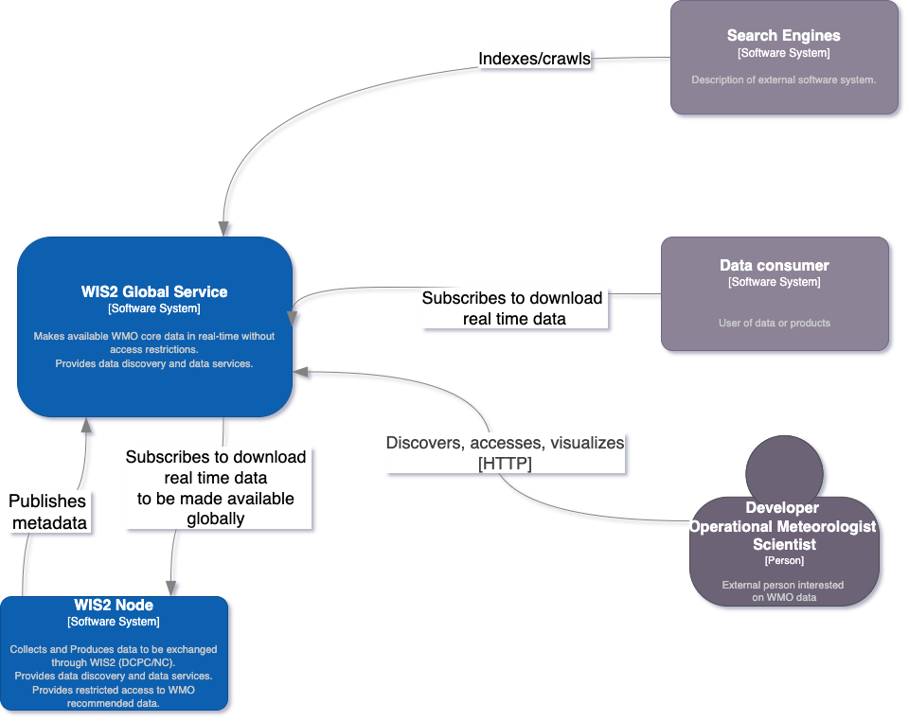
wis2box: the WIS2 Node Reference Implementation
WIS2 in a box is a reference implementation of a WIS2 Node
  MQTT
  HTTP
Free and Open Source
Publishing facility/capability compliant to WIS 2.0 Architecture
  Provides data transformation
  Can integrate with existing data management systems
  OGC APIs out of the box
docs.wis2box.wis.wmo.int
MQTT
HTTP

Slide 16
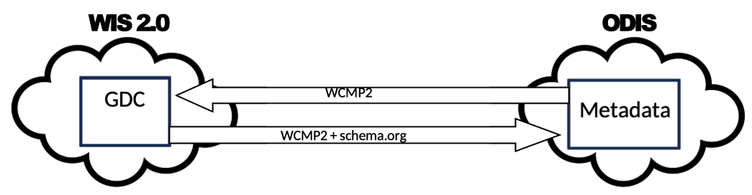
WIS 2.0 Interoperability with ODIS
OceanInfoHub
System to system
interoperability
schema.org

Slide 17
ERDDAP / ODIS / WIS2 Considerations
Extending ERDDAP with WIS2 support
  MQTT broker/service
wis2box Component reuse
ODIS
Metadata
Federation
ERDDAP
+
WIS2 enhancements
WIS2
Data

Slide 18
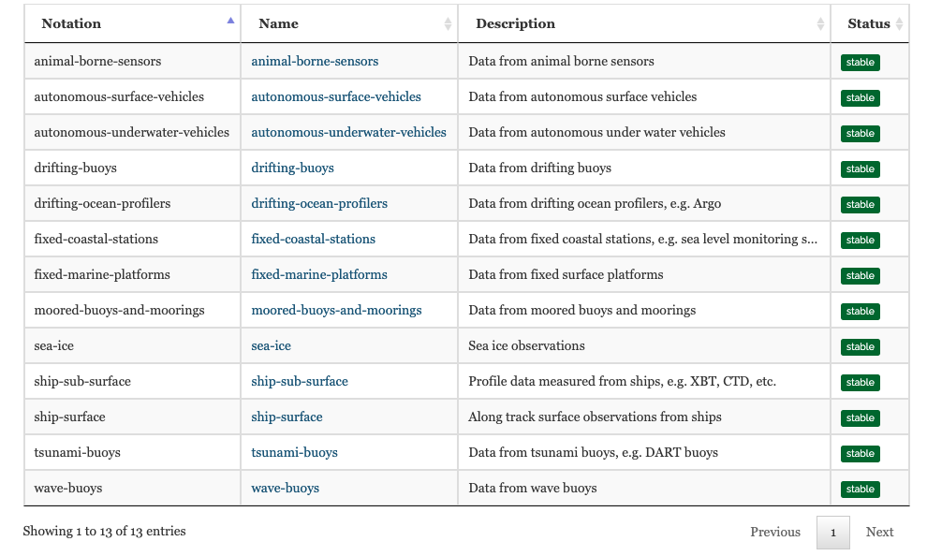
Ocean updates
  WIS2 GDC: 26 records
    Observations (moored buoys)
    NWP (Ice Ocean Prediction)
  WIS2 Topics
    New topics for ocean
    added in 2024
    Surface based observations
    Experimental topic
  In progress
    Marine meteorological warnings, forecasts and sea ice services
    WMO No 558, provision 1.2
    github.com/wmo-im/wis2-topic-hierarchy/issues/208
codes.wmo.int/wis/topic-hierarchy/earth-system-discipline/ocean/_surface-based-observations

Slide 19
Architecture of participation considerations
Migration: less GTS, more WIS2!
Data flow: networks publishing through their NMHS
  BODC -> UKMO
  DFO -> ECCC
Argo programme and data publication
  Needs coordination / management to reduce duplication of publishing
  Identifying QA/QC processing level (data quality/lineage)
Attribution and licensing
  Attribution needs to be consistent throughout the data/metadata publication lifecycle
    WCMP2 attribution/contacts/citation
  Licensing needs to be discussed by JCB

Slide 20
Bridging WIS 2.0 and ODIS?
Status:
Informal collaboration between WIS and ODIS teams following IODC 2 / IODE 27
ODIS now referenced in the Guide to the WMO Information System
Next steps:
Formalize work through Joint WMO/IOC Collaborative Board (JCB) technical working group for data management, in particular ToR 1:
  Propose actions for enhanced interoperability for an integrated observing and data system, improving data sharing between the WMO Information System (WIS) and the IOC/IODE Ocean Data and Information System (ODIS).
    Review and propose updates to the topic hierarchy for ocean data.
    Establish pilot project(s) from the ocean community to act as DCPCs within the WIS 2.0.
    Propose a mechanism for mirroring between ODIS and WIS catalogues and seamless integration of the respective systems.
The full draft ToR for this new working group are included in the IODE-28 action paper (paragraph 253)
The ToR will be presented to the next JCB meeting (24th March 2025)

Slide 21

Thank you
Merci
Gracias
شكرا
谢谢

