Slide 1
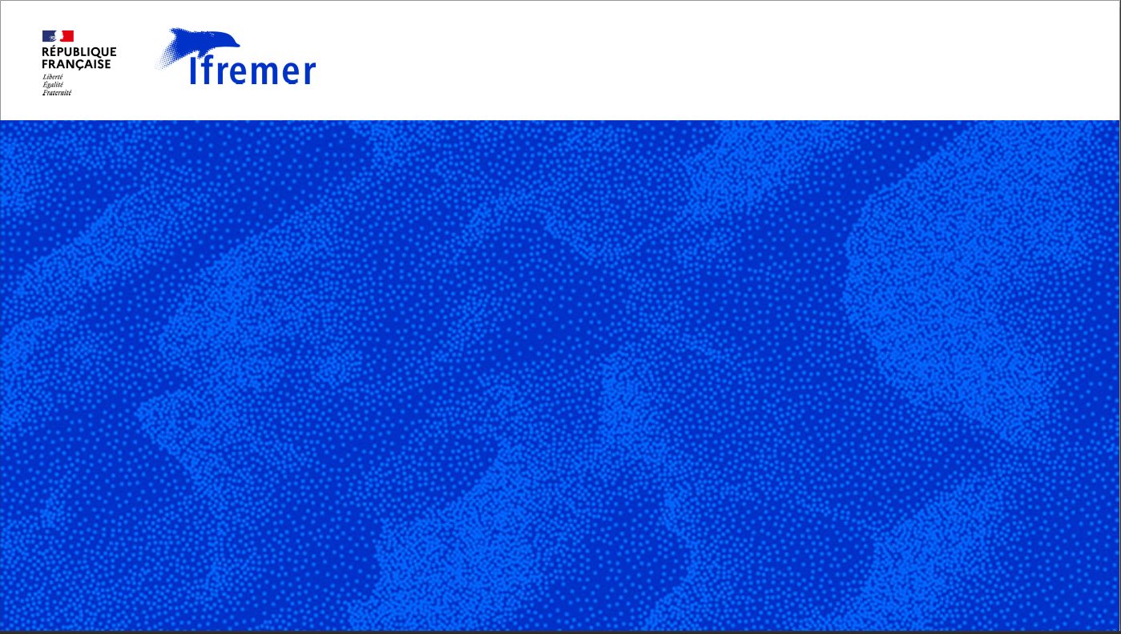
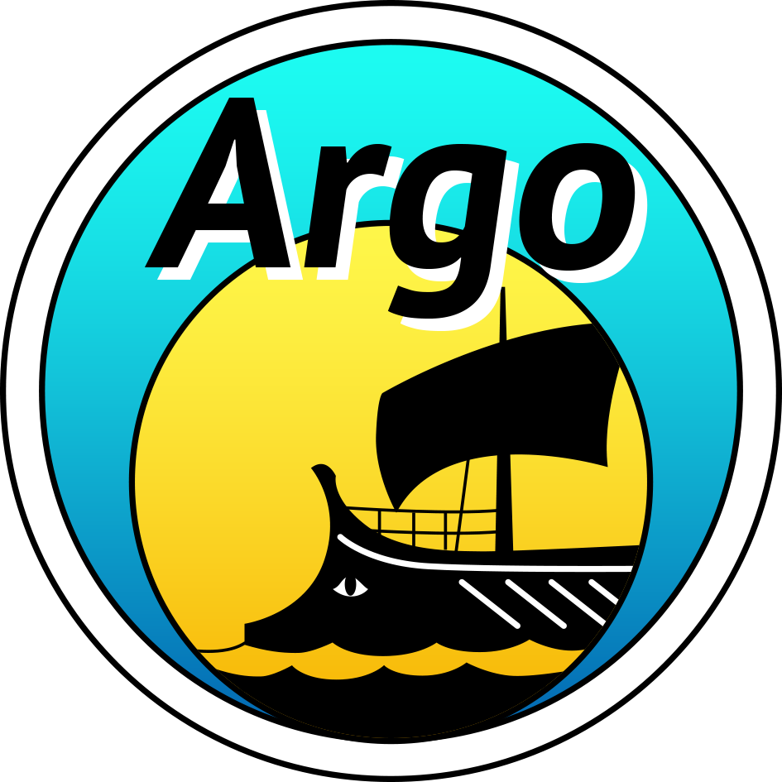
Argo WIS2 node
Léo Bruvry-Lagadec
OCG-13 - Brest, April 2025

Slide 2
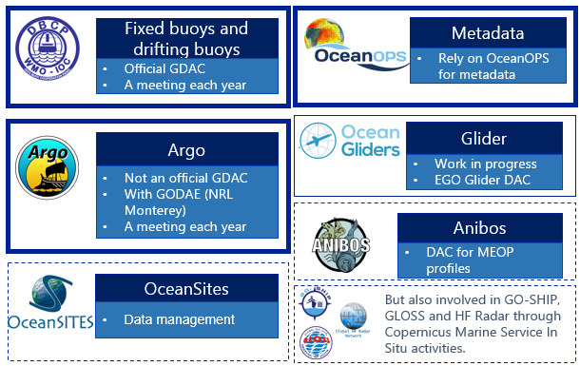

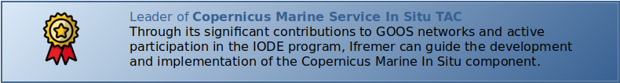
Data networks

Slide 3



Argo & EuroGOOS WIS2 node - Status
Argo has requested Ifremer to establish a WIS2 node.
Applying
We (Ifremer) formally preparing a DCPC (Data Collection or Production Centre) application to the WMO.
Implement
The Ifremer WIS2 node for Argo has been successfully prototyped and is now ready to be integrated.
Launch Timeline
Expected transmission approval before summer

Slide 4
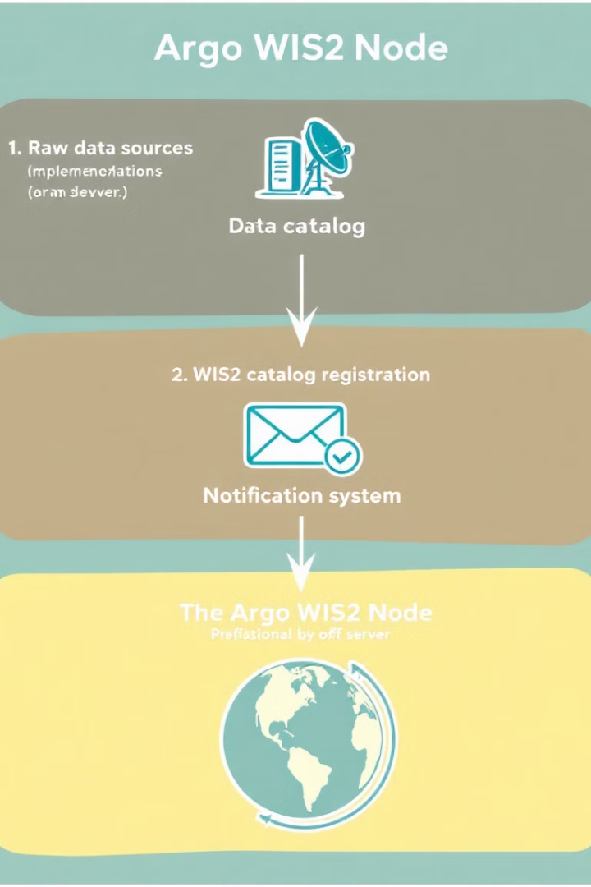
Argo WIS2 node – Implementation approach
GDAC’s HTTPS server
2 Dataset on WIS2 Catalog Registration
NetCDF profiles
BUFR messages accessible online
BUFR for modeling community
NetCDF for scientific research
Notification System
BUFR: profiles <10 days old
NetCDF: all new profiles (real-time or delayed-mode).

Slide 5












Node implementation - Solution Design
Standards-Based
Widely-used tools
OGC, W3C, OpenAPI, CloudEvents, STAC
Mosquitto MQTT broker, Airflow scheduler
Open Source
Keep it simple
GitHub managed, cloud-ready implementation
Implementation as simple as possible
  Demo project on Github : https://github.com/ifremer/wis2-data-processing-chain

Slide 6
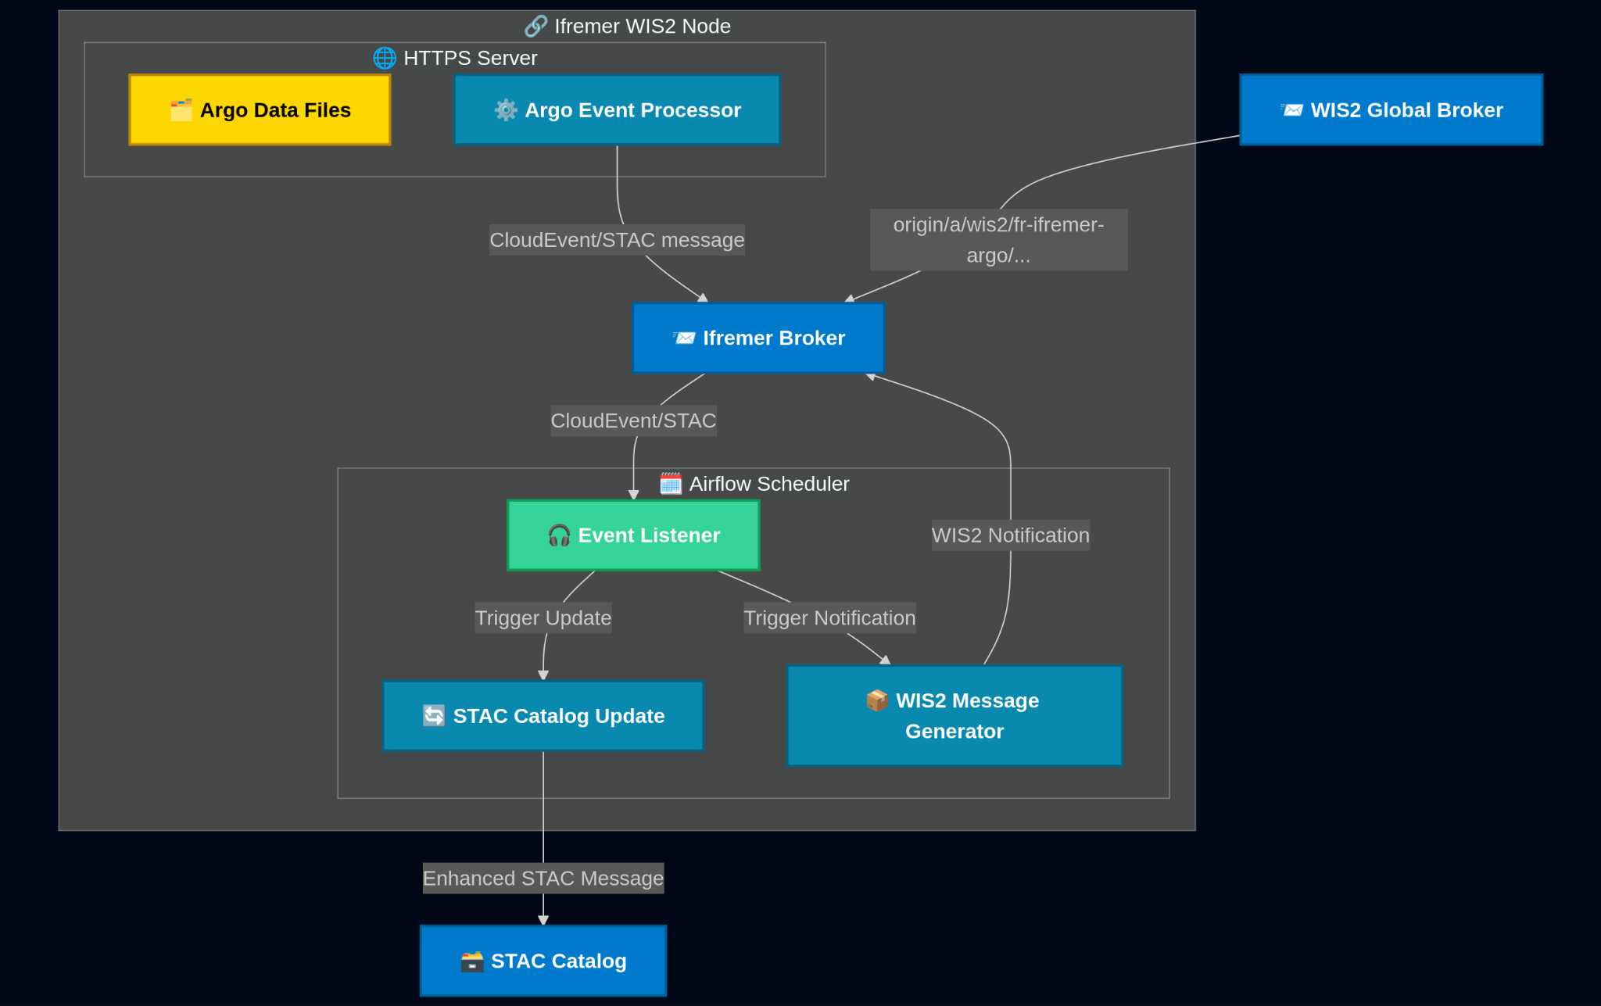
Node implementation - Architecture

Slide 7
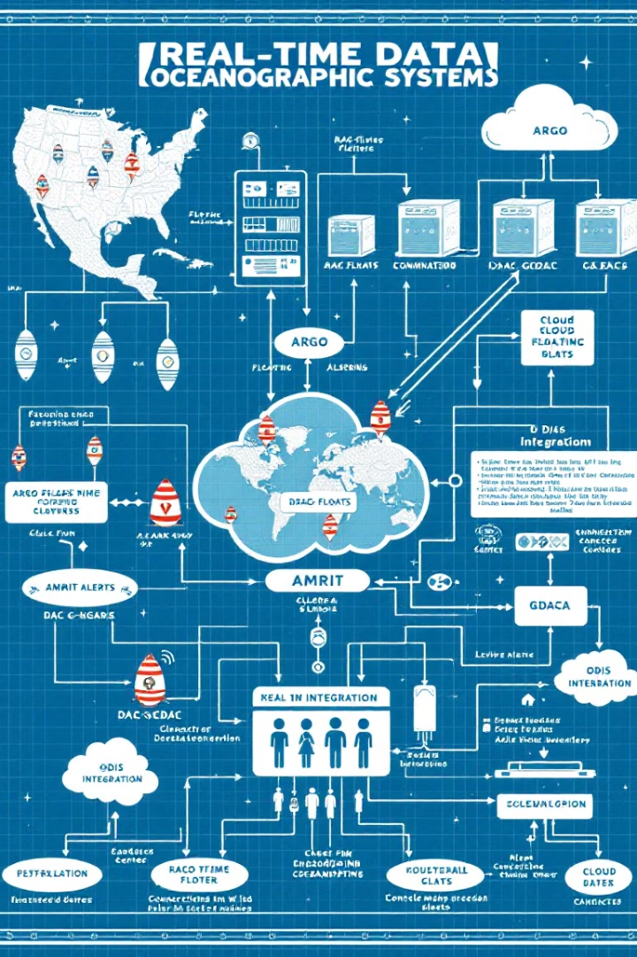
What’s Next?
4+
Potential Applications
Expanding beyond Argo to other systems
3
Key Infrastructure Projects
AMRIT alerts, cloud DAC-GDAC, ODIS integration
25
Years of Legacy
Replacing FTP-based transfers with modern solutions
100%
Open Standards
Ensuring maximum interoperability

