Slide 1
Session 7: Data strategy and its implementation
Kevin O’Brien, OCG Vice-chair for Data, University of Washington/CICOES
Sixteenth Observations Coordination Group Meeting (OCG-16)
7-10 April 2025, IFREMER, Brest, France.

Slide 2
Agenda
7.1 OCG Data Implementation Plan and Data Task Team update - Kevin
7.2 IOC Data Architecture concept and Initial Work – Emma
Discussion
Coffee Break
7.3 WMO and WIS 2 updates
Argo WIS 2 pilot project - Léo Bruvry-Lagadec
ERDDAP as a WIS 2 node - Kevin
Marine Climage Data System (MCDS) Update - David Berry
Discussion
WIS2 progress in ocean domain – Tom Kralidis

Slide 3
Background
From OCG 15 (May 2024)
Create new OCG Data Task Team that will report on progress at OCG 16
  Goal: Enable the OCG Data Implementation Strategy
    Minimum metadata for WIGOS ID
    Improving metadata flows into OceanOPS
    Federated data/metadata end points

Slide 4
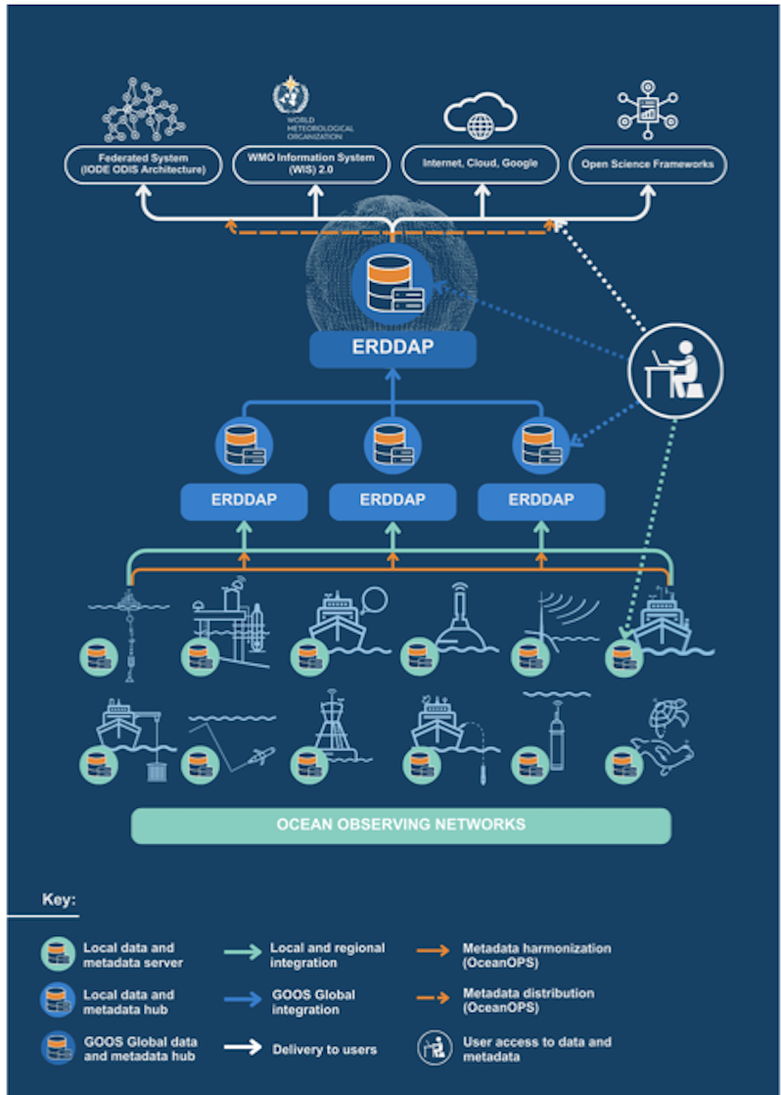

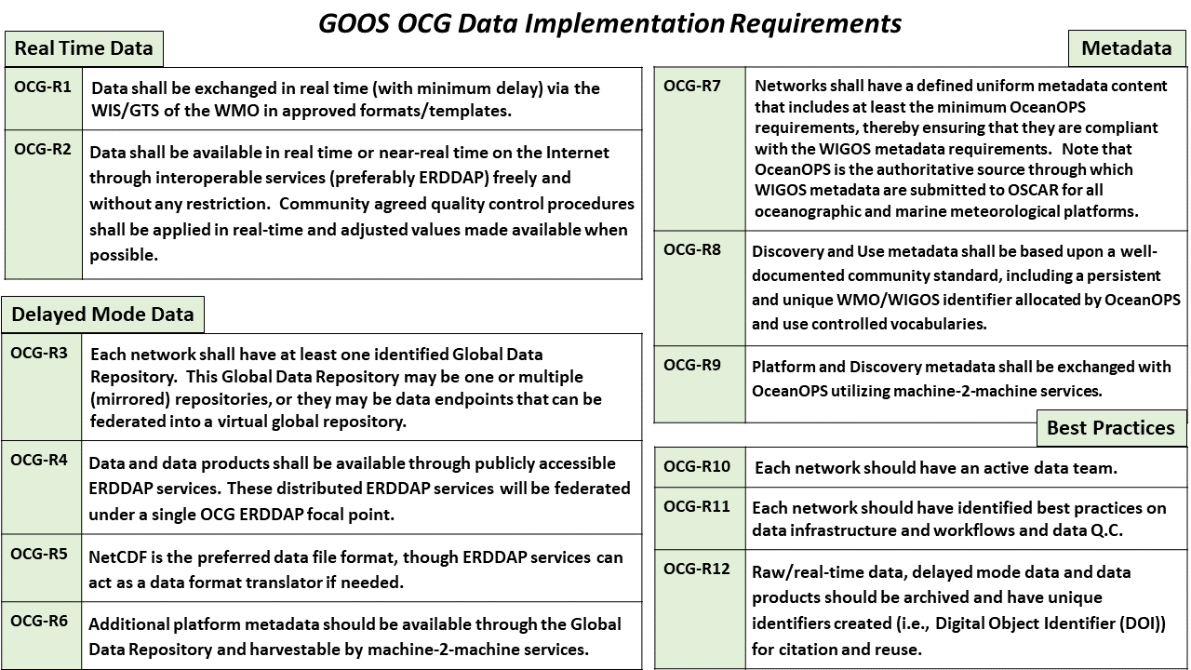
OCG Cross-Network Data Implementation Strategy
This Implementation Plan is an effort to define specific and actionable ways OCG network/programs can move towards FAIR compliance
Improve (meta)data discovery, exchange, accessibility and usability for all stakeholders
Improve access to distributed (meta)data endpoints through federated, uniform data services

Slide 5
Data Implementation Plan & Data Task Team updates
Develop metadata flow between observing network data systems, OceanOPS, and external stakeholders (WMO, IODE, etc)
Improve m2m metadata exchange with OceanOPS and other stakeholders (WMO, IODE ODIS)
Expand integration of ERDDAP data services across OCG networks
Objectives
Activities
Four meetings (Nov, Dec 2025; Jan, Mar 2026)
Members
~43 people consisting of network data TT members and other relevant community members – open to all!

Slide 6

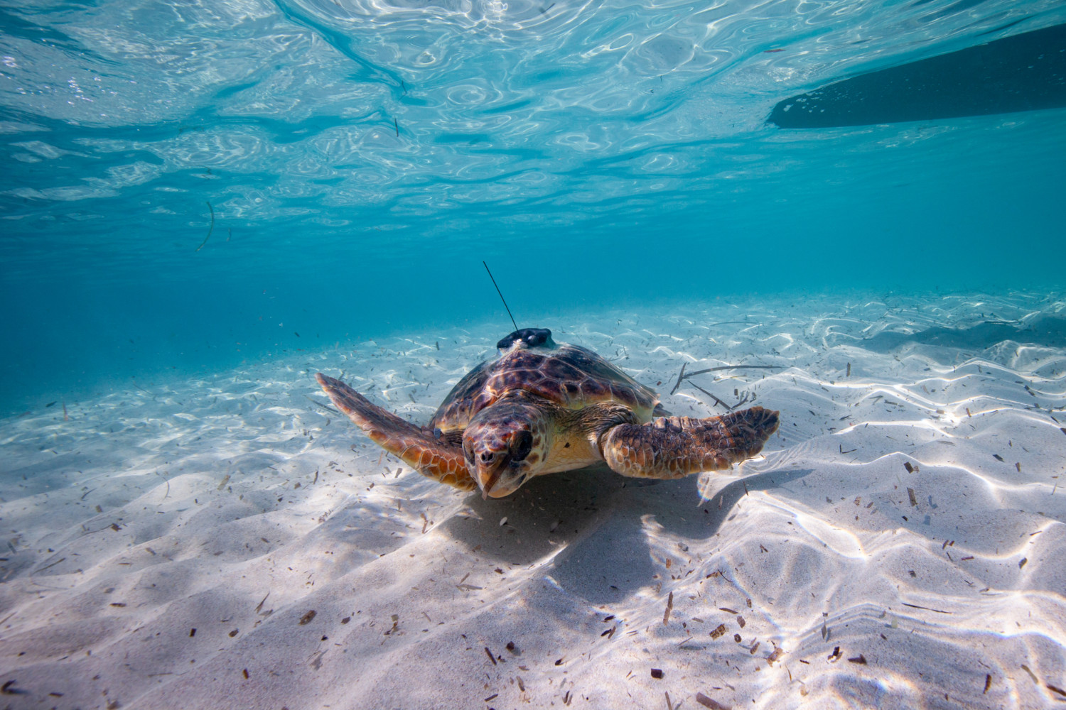
OceanOPS Metadata “Passport”
Passport metadata
Mandatory Computed Nice to have
(*) Reference table
[ … ]array
Identification
WIGOS ID
Platform description (*)
[EOV/ECV] (*)
image
Hardware Platform model (*) Manufacturer (*)
Serial number [Telecommunication]
[Sensors] (*) Model Manufacturer (*)
[Sub Variables] (*)
Serial number
Sensor height (if applicable)
Start date
End date
Providers (*) (if applicable)
Affiliation Program (*) Country (*)
Organization (lead) (*)
[GOOS Observing Network] (*) [Observatories] (*) (if applicable) [Tags] (*)
Data
[Data Assembly Centre] (*) [Global Data Node] (*) [data identifier]
Status
Status (*)
Latest observation date
Latest observation latitude Latest observation longitude
Update
Passport Delivery Date
Latest Update Date
Operations Deployment date Deployment latitude Deployment longitude
Deployment ship (*) (if applicable)
Deployment cruise (*)
Ending date Ending latitude Ending longitude Ending cause (*) Recovery ship (*) Recovery cruise (*)
Defining the minimum metadata required for a WIGOS ID

Slide 7
Data Implementation Plan & Data Task Team updates
OCG Cross-Network Data Survey
A series of ~12 questions to:
Finalize the required minimum metadata needed at OceanOPS to register a WIGOS ID
Understand how networks are exchanging metadata with OceanOPS
Identify Network data end points (urls) where data is made available

Slide 8
Finalize the required minimum metadata needed at OceanOPS to register a WIGOS ID
Minimum metadata elements
Mostly broad agreement on the elements presented
There are network specific needs that need to be considered
  HF Radar – Type of data being produced (Ideal or measured)
  GLOSS – Add Tide Gauge Benchmark (TGB)
OCG Data TT will work with individual networks to address network specific concerns
What receives the WIGOS-ID?
Most networks have a target for the ID
Some will need discussion
  GO-SHIP: would like further clarification. Rosette?
  GLOSS – A single Tide Gauge site may have several stations

Slide 9
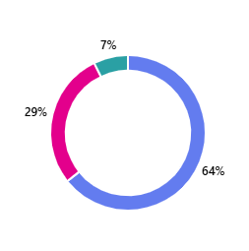
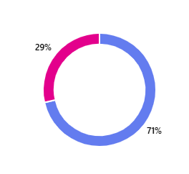
Does Network have existing metadata pathways to OceanOPS?
Yes
No
Don’t Know
Question was perhaps not clear enough. Responses ranged from:
Email CSV files
ERDDAP server (4)
Metadata in file name
NERC Vocabulary Server
NetCDF files (2)
Some left answer blank
Suggestions for Improvement
Several suggestion for API – could either mean push or harvest (ERDDAP is preferred)
Pull directly from GDAC
Create separate metadata file for harvest
Controlled vocabularies
Does Network utilize controlled vocabularies?
Broad adoption of Climate and Forecast (CF), Attribute Conventions for Dataset Discovery (ACDD)
Several references to NERC Vocabulary Server (NVS)

Slide 10
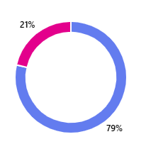
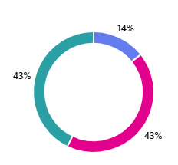
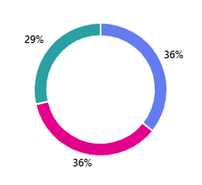
GDACS for NRT and Delayed mode data
Will need to follow up on this with networks during data TT meetings
Most RT data is on GTS
  Some networks also have NRT endpoints, but most networks pointed to data centers
Similar for delayed mode – will follow up with individual networks to determine URLs (some were provided)
  3 networks have no GDAC at his point
Yes
ERDDAP and Dissemination
No
Don’t Know
11 of 14 respondents use ERDDAP in some context
9 of 14 respondents need help with ERDDAP, or don’t know
Only 2 of 14 respondents have some other API
Wis 2; Schema.org

Slide 11
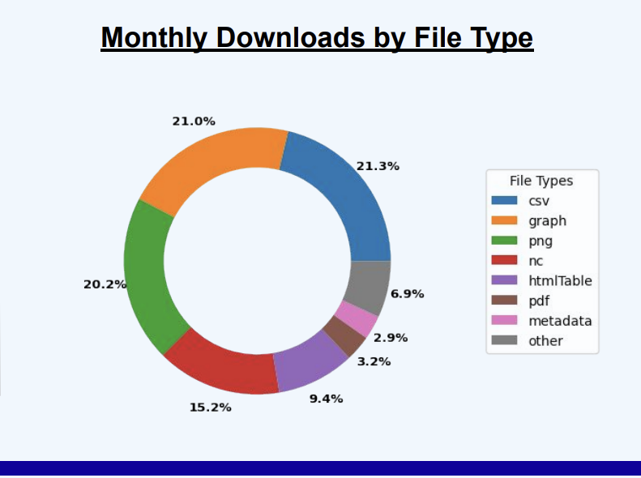
ERDDAP as an interoperability layer

Slide 12
Data Implementation Plan Status
Data Task Team meetings, survey, etc. have taken quite a bit of time
Progress on m2m metadata exchange
  Anibos deployments since Dec 2019 in ERDDAP and harvested at OceanOPS
  Developed python program to crawl and harvest US IOOS Glider DAC ERDDAP for ingestion into OceanOPS
    Striving to make this as generic as possible for ERDDAP installations
    Need to work with Magali, Thomas and Victor to ingest into OceanOPS

Slide 13
Data Implementation Plan: Challenges
Time, people, resources
Full understanding of network delayed mode data flows, end points, services, formats, etc
Some networks are complex
  OceanSITES platforms are not all at a GDAC, so harvesting is difficult
  VOS delayed-mode GDAC going through format changes
Identifying appropriate data licenses
Ensuring Provenance of data collected by networks
Should we be focusing on data rescue/preservation issues?

