Slide 1
Session 4: Requirements implementation
Biogeochemistry Panel
Maciej Telszewski, GOOS Biogeochemistry Panel
Sixteenth Observations Coordination Group Meeting (OCG-16)
7-10 April 2025, IFREMER, Brest, France.

Slide 2

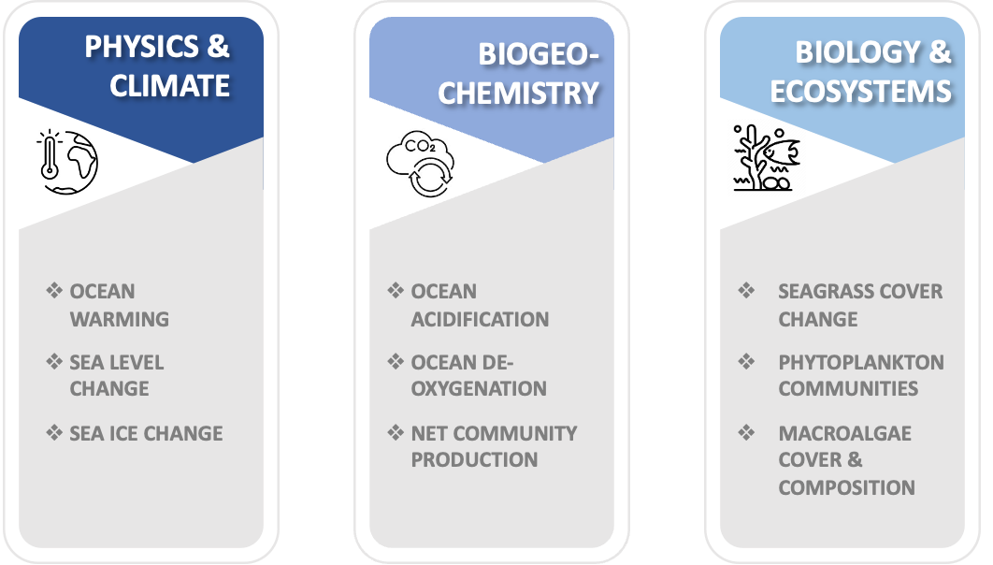
Global Ocean Indicators: Marking Pathways at the Science-Policy Nexus
von Schuckmann et al., 2025
to be submitted to Journal of Marine Policy
Ocean indicators are crucial for translating ocean science and data into practical metrics, guidance, and tools informing on the state and health of the ocean that can be directly applied by policymakers, practitioners, and the public
Despite their critical importance, ocean indicators trail behind those for continental areas, limiting effective monitoring and policy integration
Developing reliable, comparable, and regularly updated ocean indicators, backed by a unified international framework, is essential for delivering coherent, actionable insights that can guide global goals and protect the ocean's future
This paper establishes a scientific foundation for ocean indicators through international and multidisciplinary collaboration, presenting defined criteria and a set of pilot indicators for the ocean’s physical, biogeochemical, biodiversity, and ecosystem aspects
The proposed framework offers a solid foundation for generating indicators that not only track the ocean state, but also provide outputs for application in informing policy and decision-making.
The 9 pilot indicators as proposed by GOOS for three environmental dimensions: physics & climate, biogeochemistry, biology and ecosystems

Slide 3

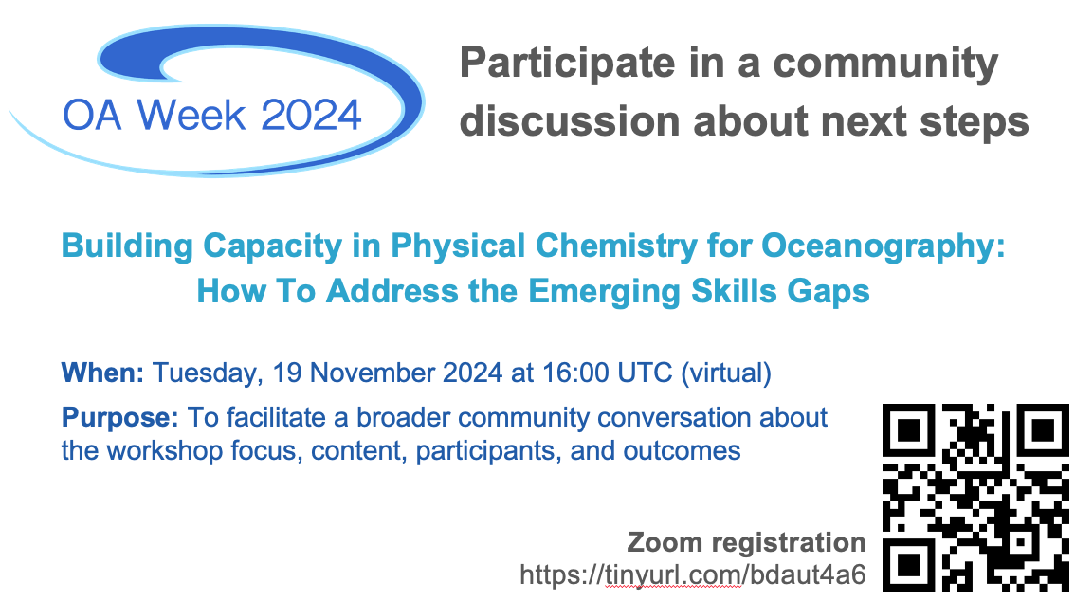






Emerging skills gaps in the physical chemistry of natural waters
Multi-year ongoing collaboration of SCOR WG & NERC/NSF project focused on chemical speciation modeling in aquatic environments (ocean carbonate system, trace metals)
Limited expertise in lab-based physical chemistry
limited understanding of fundamental chemistry of speciation calculations
Finding collaborators
Inter-relationships among the four carbonate chemistry variables: Limited understanding of the equilibria and equilibrium constants involved
Poor understanding of calibration of pH and inter-conversion between scales: Affects measurements and development of self consistent global datasets
Chemistry of mCDR: Alterations of seawater physical chemistry caused by composition change become problematic.
Integration of treatment of chemical speciation across a range of natural waters: Not possible without a fundamental understanding of chemistry involved.
Read the full report at marchemspec.org
Joint Committee
on the Properties
of Seawater

Slide 4
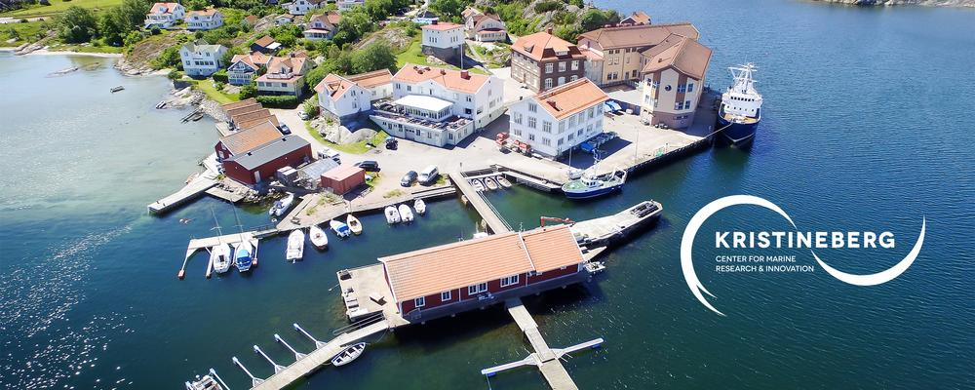
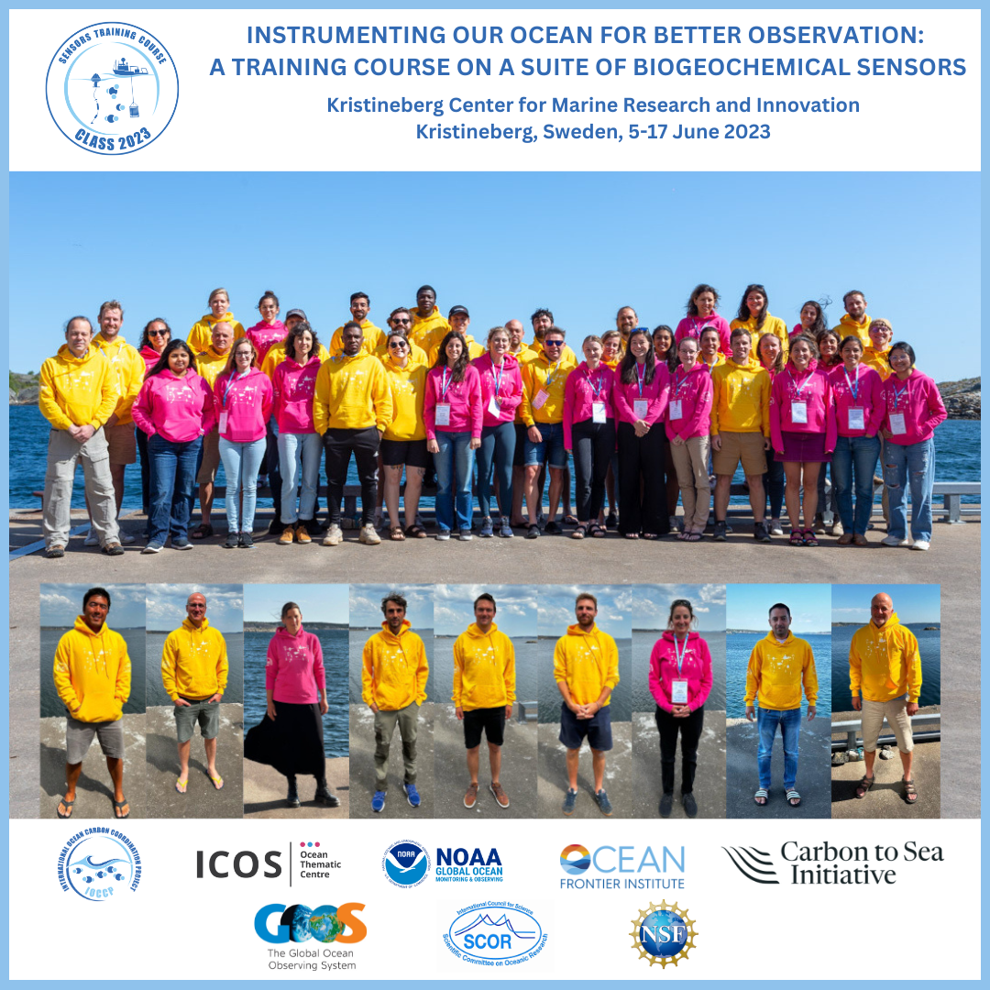
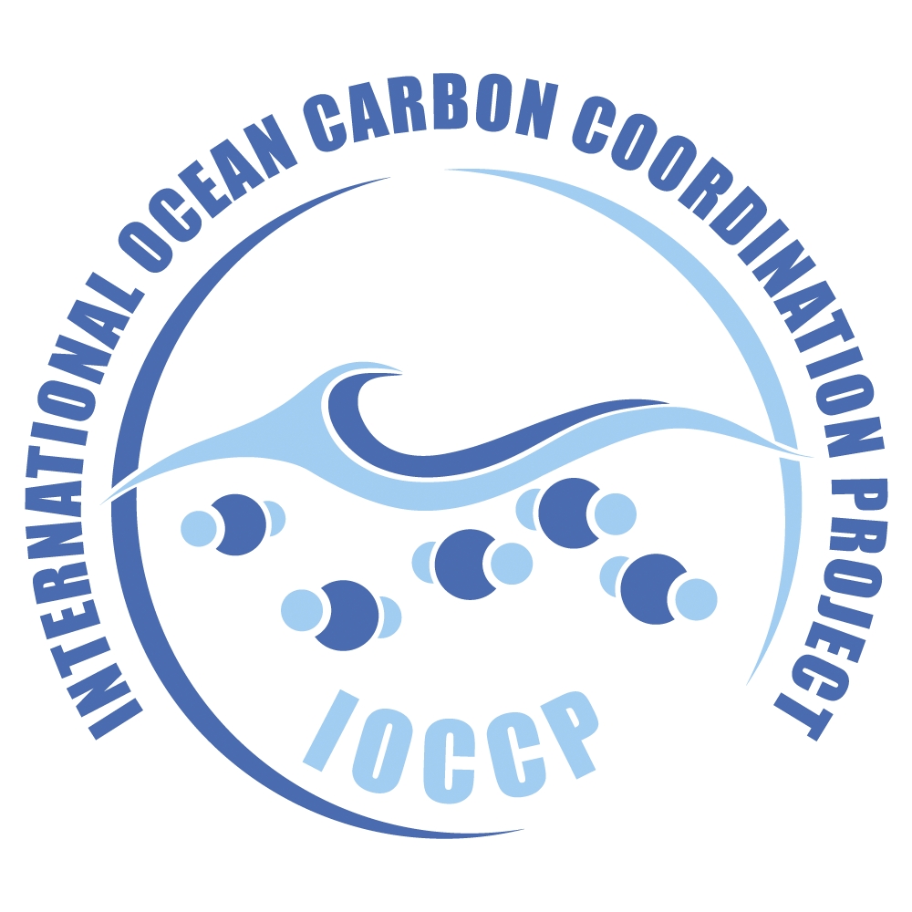


4th IOCCP Biogeochemical Sensor Summer School, 14-28th June 2026
Center for Marine Research and Innovation, UGOT, Kristineberg, Sweden
Early thoughts on logistics for the 2026 edition:
Early fundraising(!)
Part-time project manager to facilitate course organization
Catalogue of relevant video instructions
Optimize the candidate selection process to maximize impact
Optimize application process and timing: visa issues, institutional permits to attend the course
Avoid overlap with other CP activities!
Focus on one-to-one interactions and small group activities

Slide 5
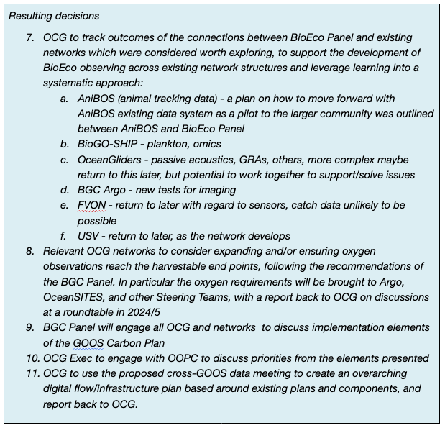
OCG-15 decisions
Key activities regarding the GOOS Carbon Plan in the next 12-24 months
Continue engagement with WMO around the Global Greenhouse Gas Watch (G3W) and its Implementation Plan;
Formalize structures and strategies for SOCONET to create a robust and resilient GOOS network bringing together ocean CO₂ observing efforts;
Develop a clear pathway to securing a robust, resilient and scalable SOCAT data management system for the long term;
IOCCP includes a Nitrous Oxide Expert on its SSG to help integrate N₂O observations with carbon activities across the value chain
Plan for global ocean observing system design across relevant observing networks as well as across observing-modelling interface

Slide 6
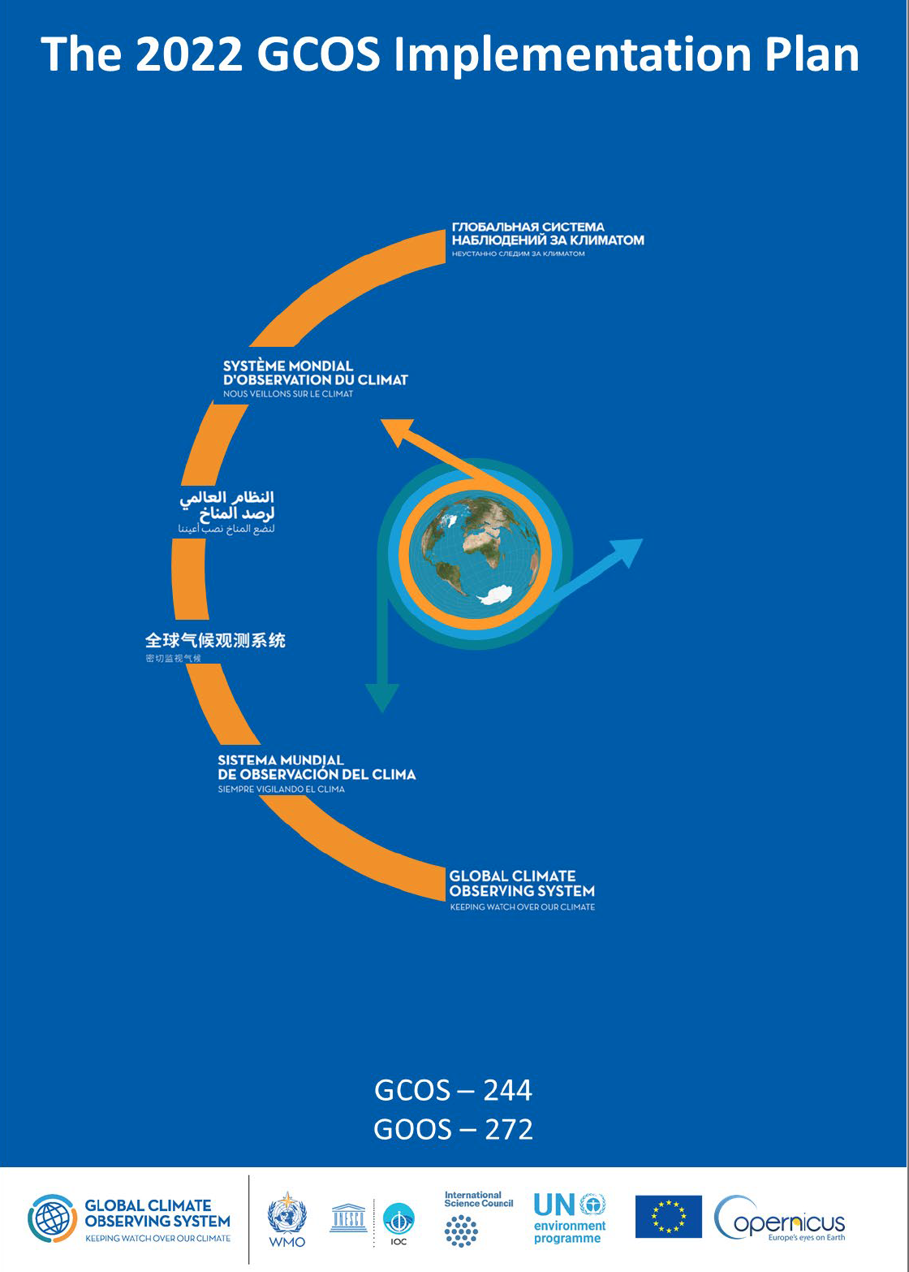
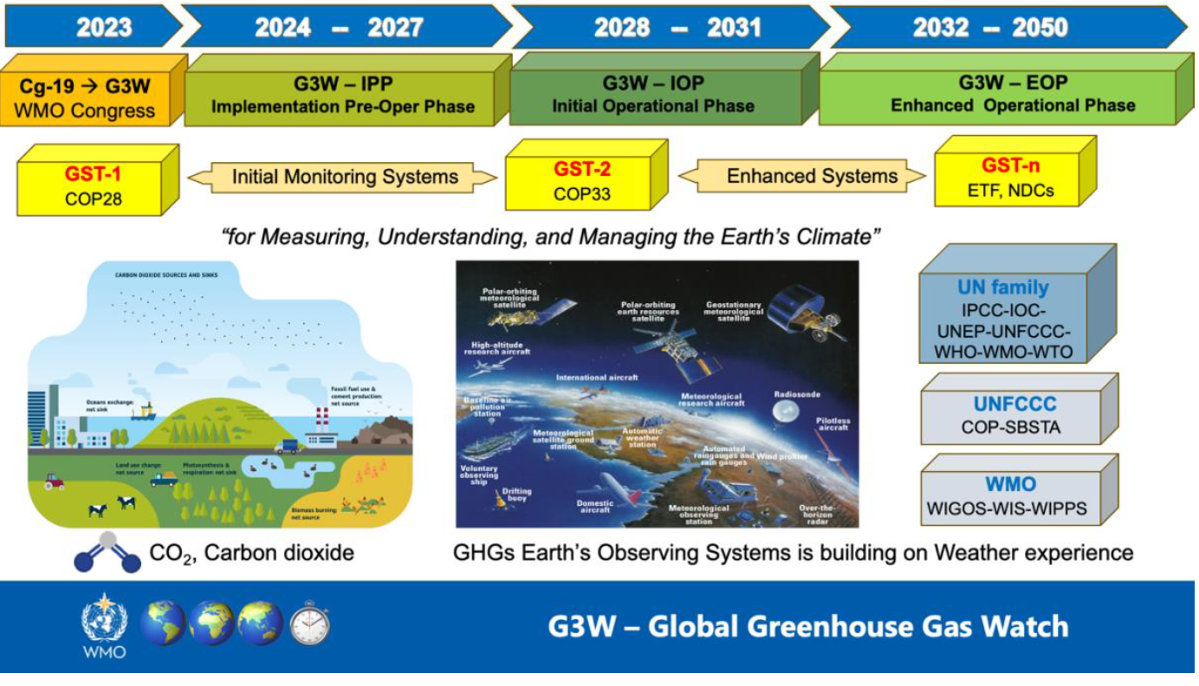
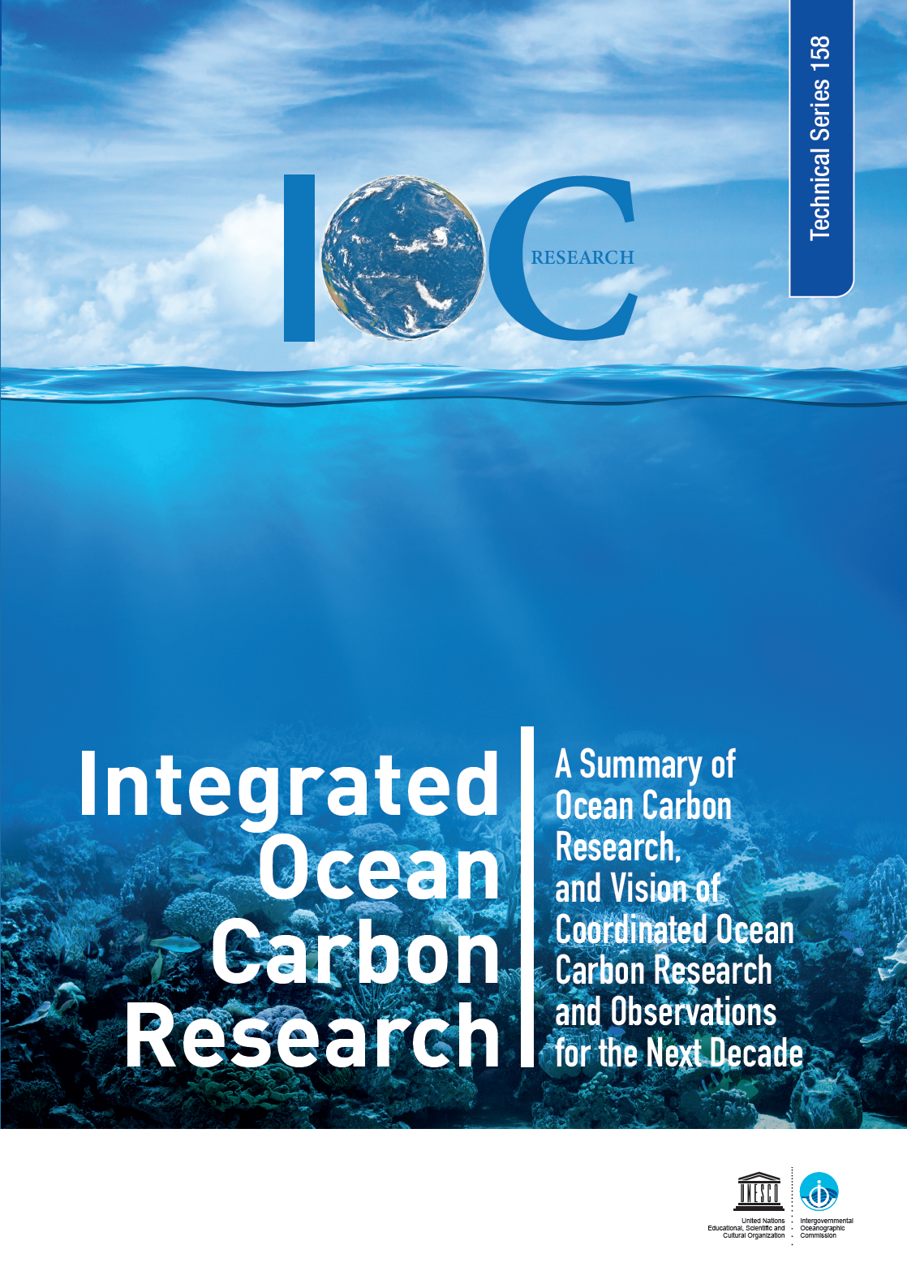
GOOS is designated as the implementing body of ocean carbon actions in WMO and IOC plans
Actions fall within three focal areas:
COORDINATION OF OCEAN GHG NETWORKS
ONGOING CORE GOOS RESPONSIBILITIES
OCEAN CARBON NETWORK DESIGN DEVELOPMENT

Slide 7
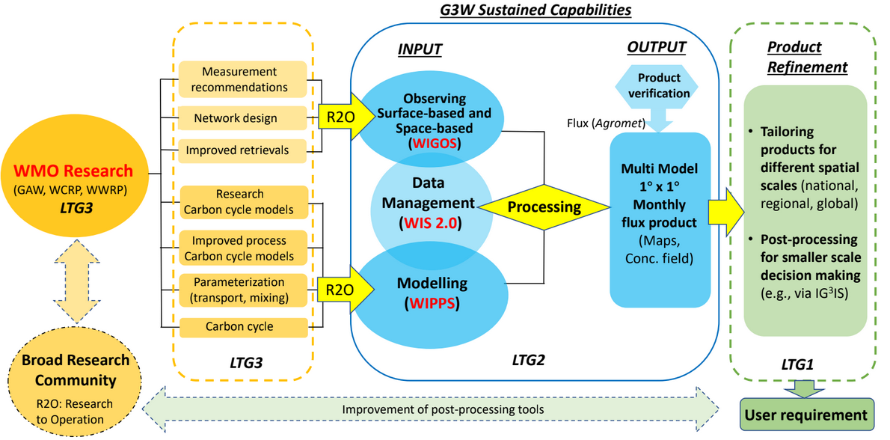
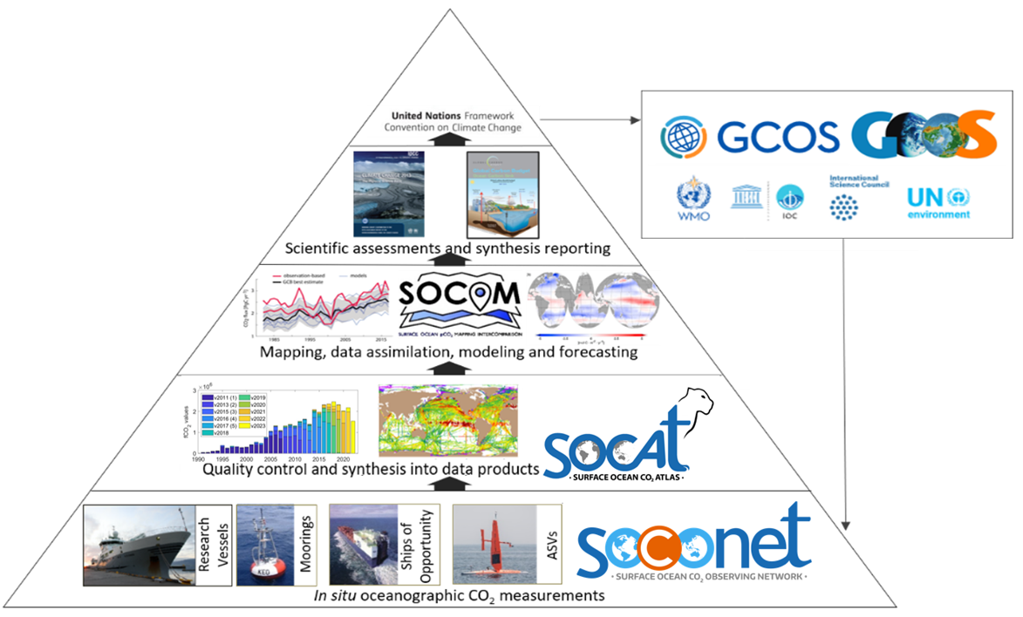
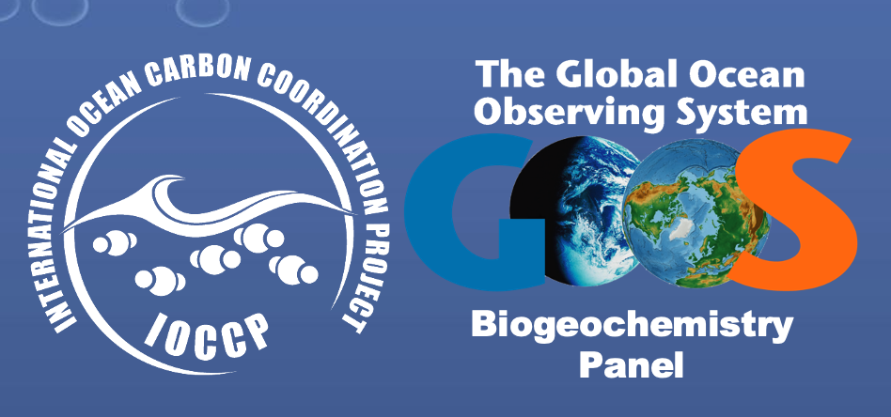
The ocean component of G3W

Slide 8
Summary and timeline of GOOS actions in G3W IP
Actions summarized | Lead GOOS elements | Status - timeline to complete | Focal area
Ocean GHG measurement inventory and standards | BGC Panel* | underway - 2027 | Ocean GHG networks
Formalize (and enhance) SOCONET | BGC Panel | completed (ongoing) | Ocean GHG networks
Identify and deliver routine ocean flux products | BGC Panel (OCG)* | underway - 2031 | Ocean GHG networks
Liaise with satellite community | BGC Panel* | not started - 2025 | Ocean GHG networks
Establish data management life cycle | OCG (ETOOFS)* | underway - 2031 | Core GOOS
WMO workshop to develop longer-term GHG activities | All GOOS to activate ocean participation | 2026 workshop | Network design
* Supported through GOOS participation on
G3W Task Teams:
Networks
Data
Modelling

Slide 9
Summary and timeline of GOOS actions in GCOS IP
Actions summarized | Lead GOOS elements | Status - timeline to complete | Focal area
Coordinate CO₂ and N₂O observations and products | BGC Panel | underway - ongoing | Ocean GHG networks
Identify gaps in ocean carbon observing system | BGC Panel (modelling community, networks) | underway - 2025/26 | Network design
ECV standards, guidance, best practices | GOOS Panels | underway - ongoing | Core GOOS
Ensure existence of data centres for ECVs | OCG | underway - ongoing | Core GOOS
Develop integrated operational GHG system | BGC Panel (OCG, ETOOFS)* | underway - 2031 | Ocean GHG networks

Slide 10
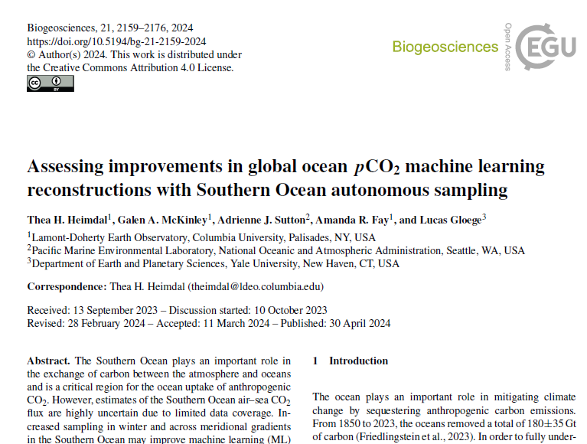
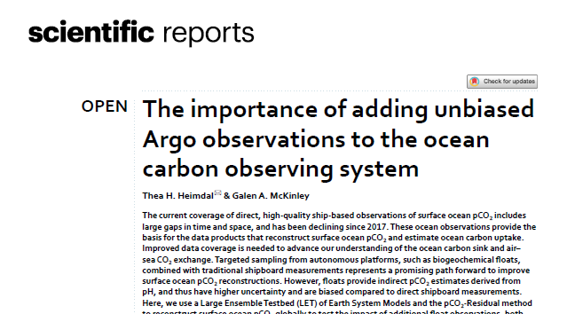

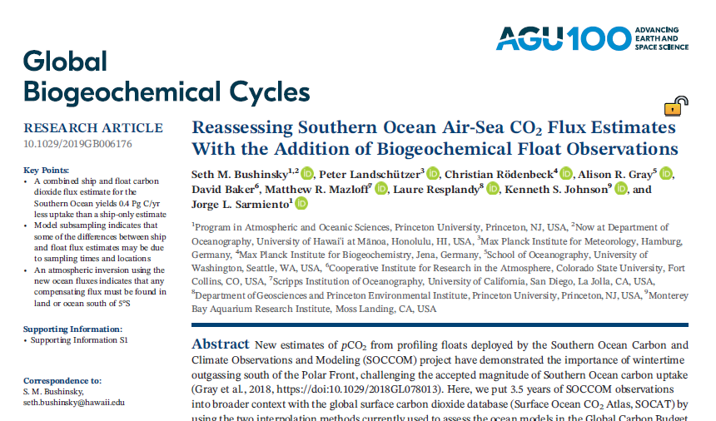
Ocean Carbon Network Design
Global ocean observing design prerequisites:
Research-oriented, cross-network strategy for GOOS networks w/ role in global ocean carbon observing
Enhance collaboration within modelling community and improve understanding between observationalists and modelers

Slide 11
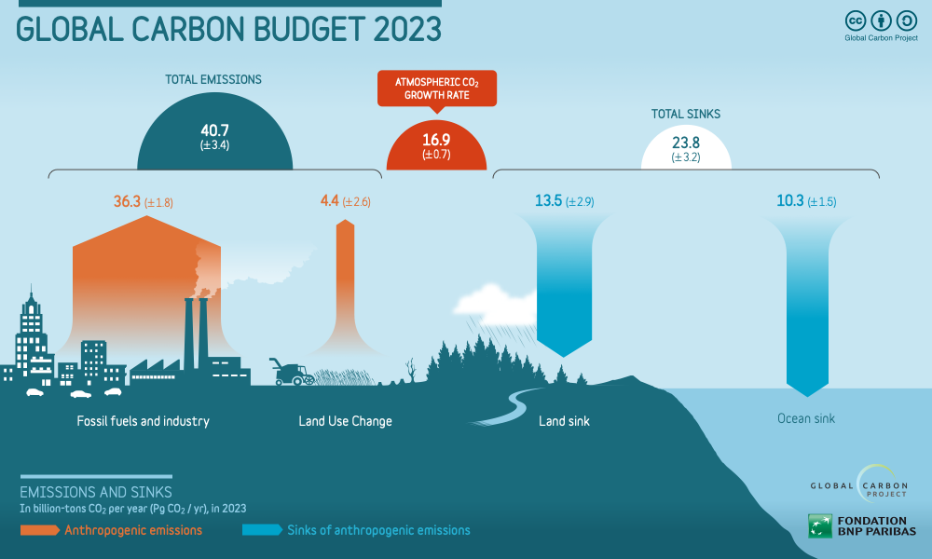
Global Ocean Carbon Observing System Design
Integrated global ocean carbon observing system design across networks
a summary of existing networks’ (primarily GO-SHIP, SOCONET, BGC-Argo) missions, implementation plans, and network designs
a clear cross-network strategy, describing the roles of each network and dependencies across networks, including satellite oceanography
integrate designs across networks, and identify priority network enhancements and technology development to fill gaps
Global ocean carbon observing system design based on close collaboration with colleagues in the modelling community focused on optimizing observing systems:
Discussions with several groups loosely affiliated under SOCOM umbrella are underway. Several ongoing project-based tasks focused on ocean carbon observing design will provide first results in 2025
A workshop attended by observing networks and relevant colleagues in the modelling community is planned for 2025
An outcome of this workshop will provide actionable recommendations

Slide 12
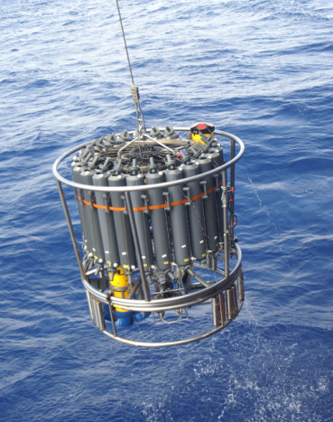
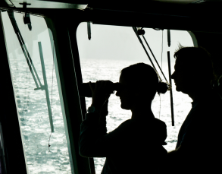

Thank you
goosocean.org
Dimitris Poursanidis / Ocean Image Bank
Giiulia Wood

