Slide 1
ICG PTWS XXXI
Agenda item 3.8.2:
WG2 Report
Bill Fry, WG2 Chair
8 April, 2025
Beijing, China

Slide 2
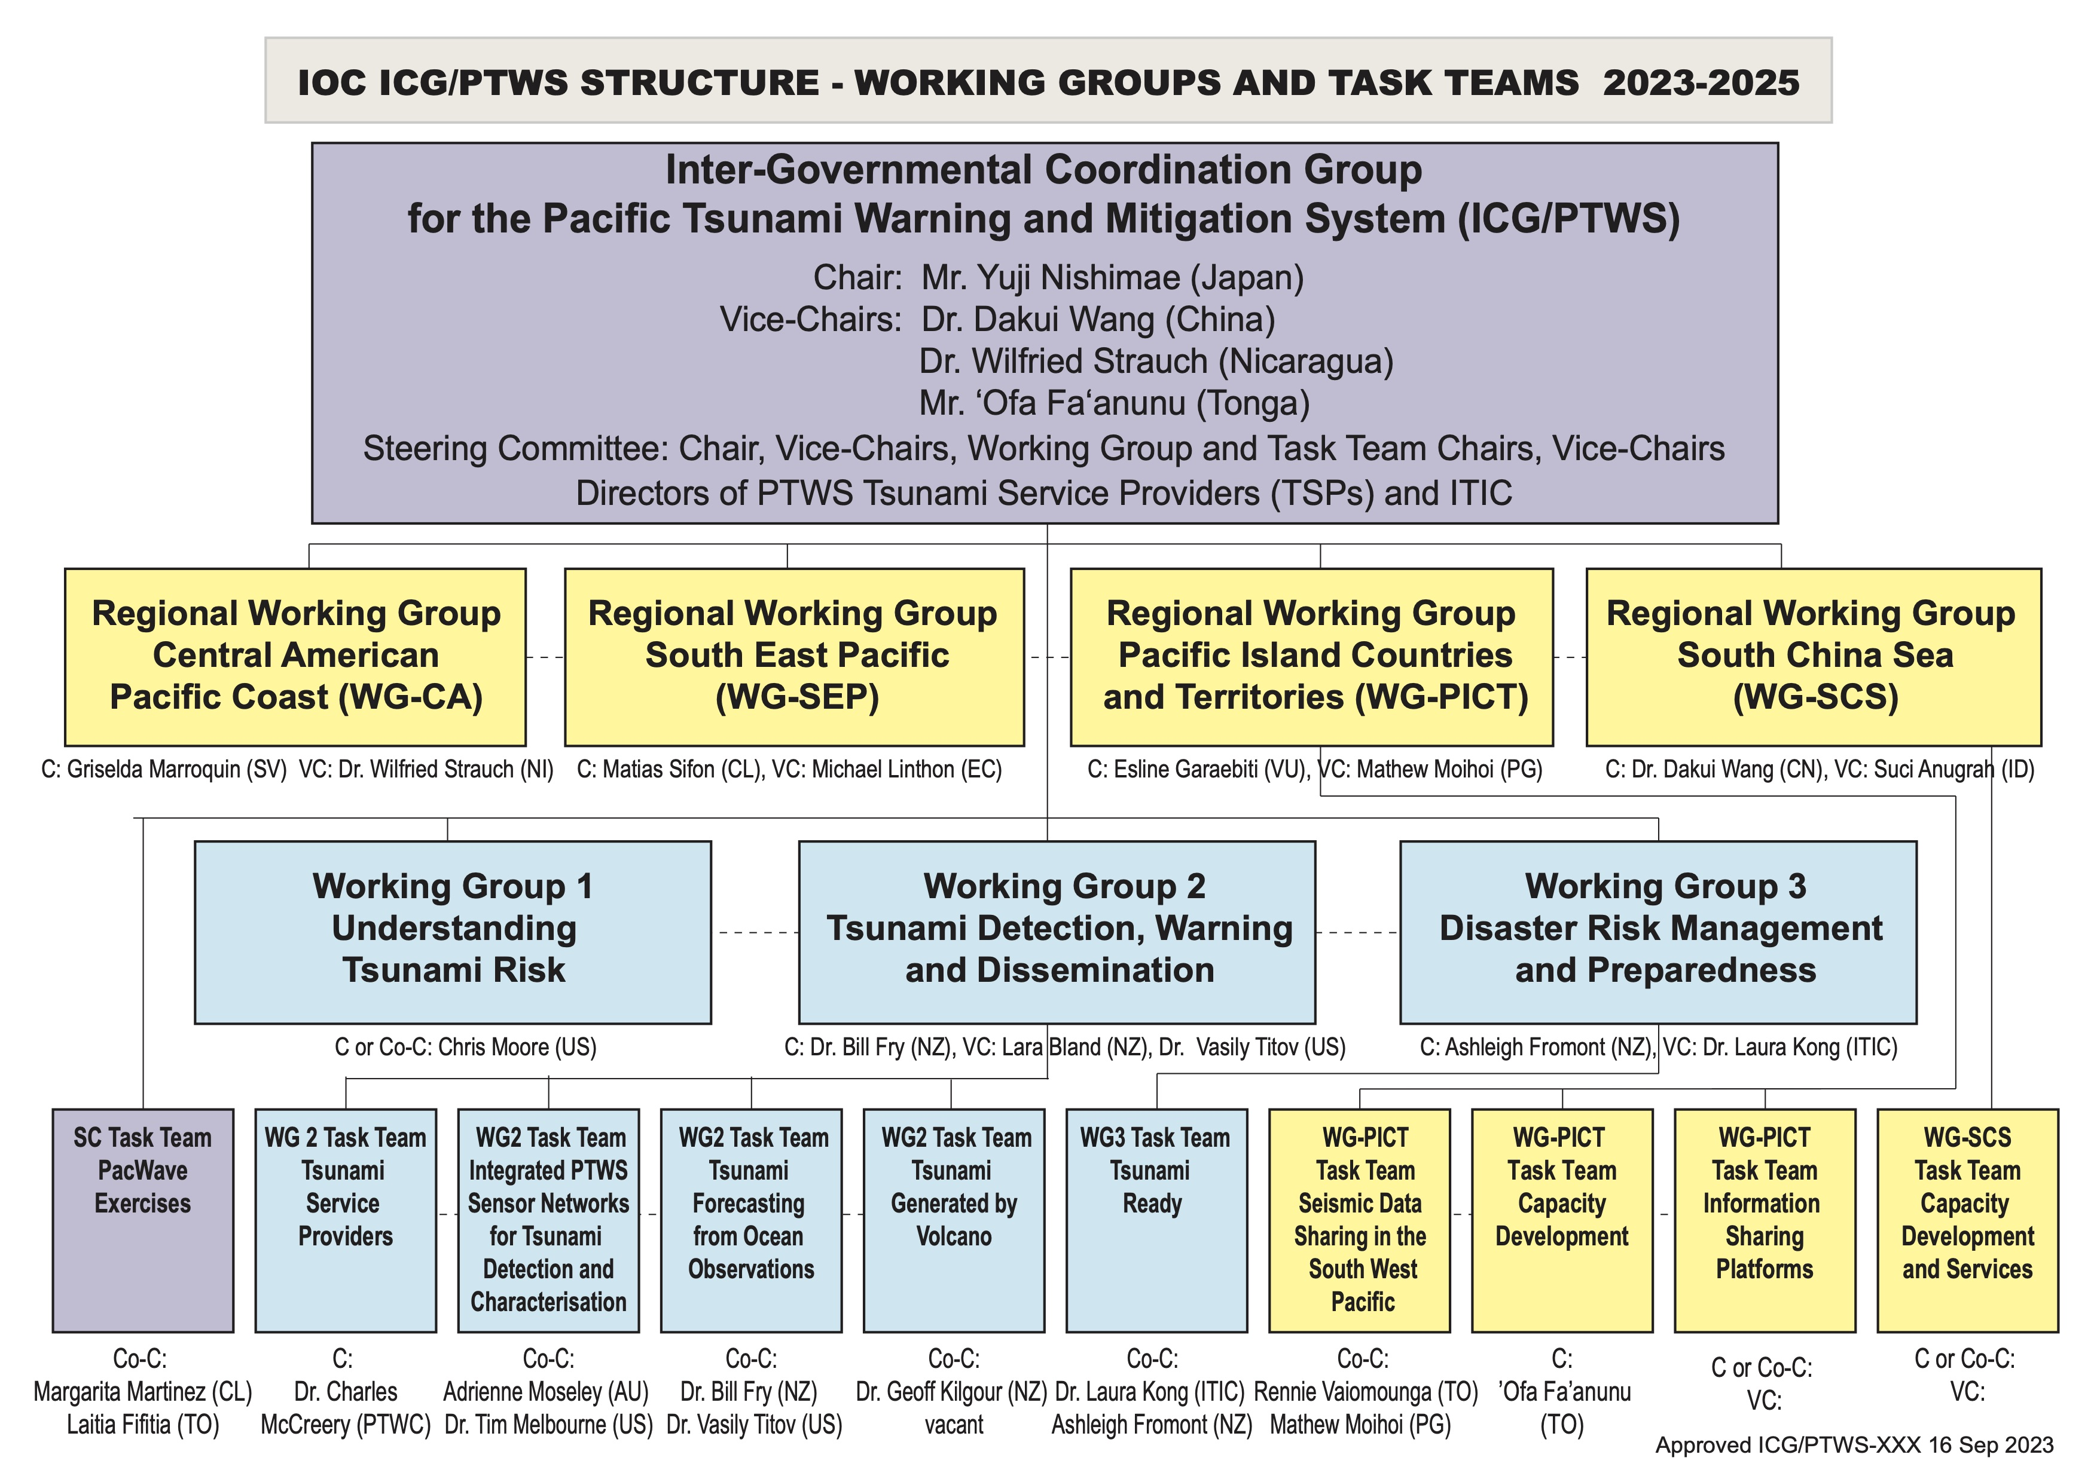

Slide 3
TT TSP (Chair Charles McCreery)
Treatment of events outside PTWS source zone: Agenda item 4.6
Maritime Products: Agenda item 4.7
Revision of TSP User’s Guides: Agenda item 4.8
Termination of Telefaxes
  IOC circular letter 3006
  Cessation of telefax transmission from TSP as of March 1, 2025

Slide 4
TT ISN (Co-Chairs Moseley and Melbourne
Agenda item: 4.5
ToR of TTFOO to represent merger with TTISN proposed
  Noting that the TT Integrated Sensor Network has completed the task contained within its terms of reference
  and Noting that further work on integrated sensor networks, beyond the original terms of reference is required
  and further Noting the alignment of TTISN with TTFOO,
  WG2 Recommend the closure of TTISN and an expansion of the terms of reference of TTFOO to incorporate continued focus on integrated sensor networks within the context of forecasting strategies highlighted by TTFOO

Slide 5
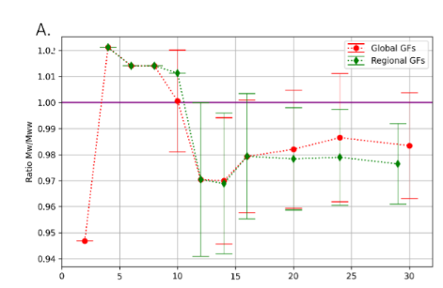
TT FOO (Co-Chairs Fry and Titov)
  French and New Zealand studies suggest that using regional Green’s Functions can improve time-dependent accuracy of Wphase results for tsunami forecasting in the SW Pacific and Japan.
  We find stable Mww within ~7 minutes
Figure from Luce Lacoua

Slide 6
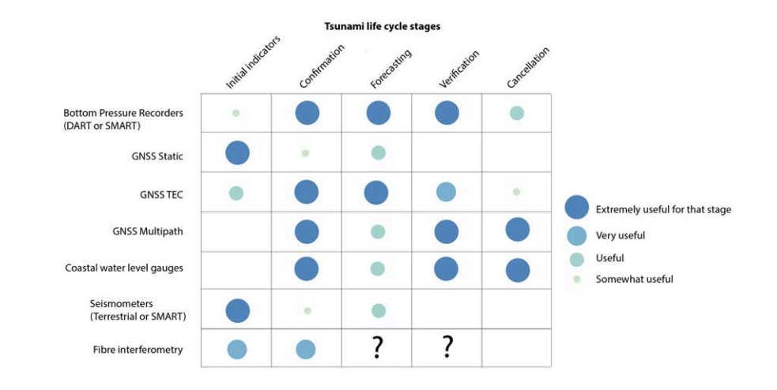
Justification for multi-data/multi-sensor

Slide 7
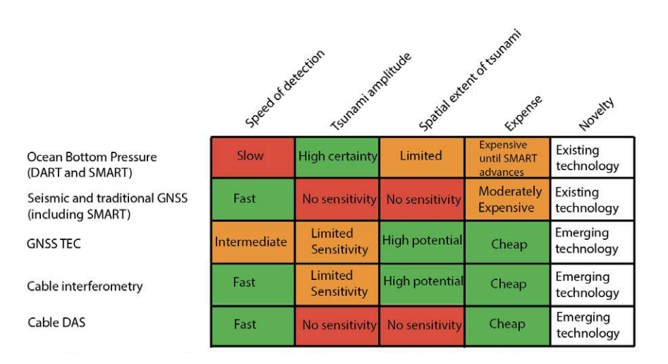
Justification for multi-data/multi-sensor

Slide 8
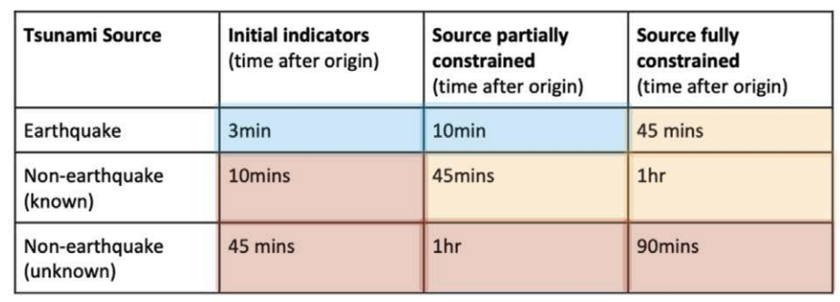
TT FOO: Assessment against ODIP targets
  3 classes of forecasting algorithms
    Indirect observations
    Hybrid
    Direct observations

Slide 9
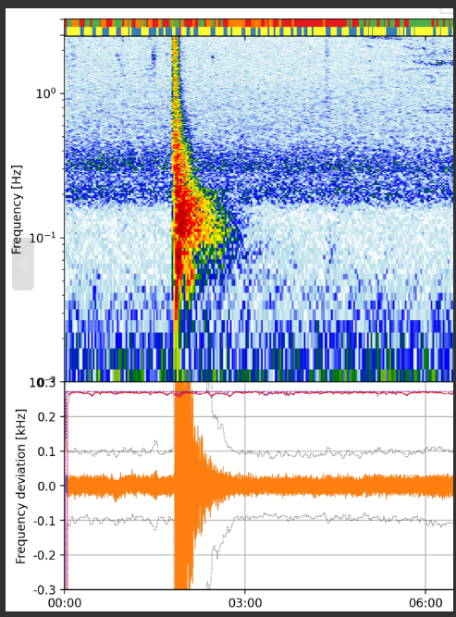
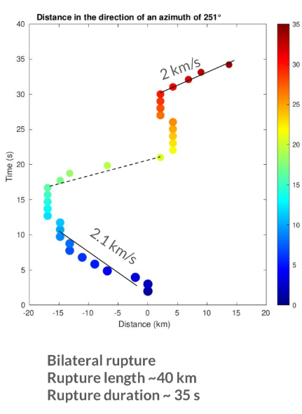
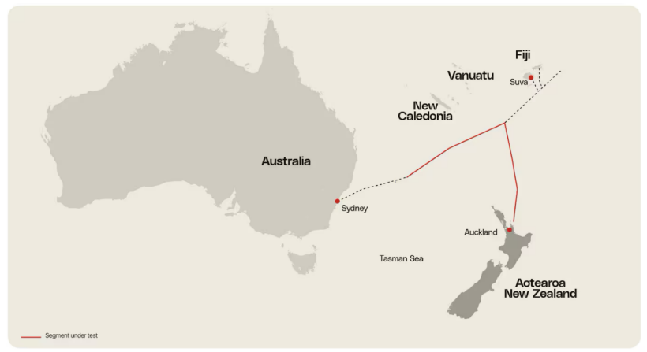
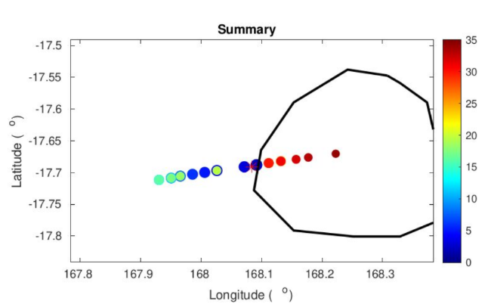
Cable observations
  SMART Cables (3.10.3)
  Laser interferometry
Collaboration with UK NPL
Figure from Amin Aghee-Naeni

Slide 10
TTFOO ToR update
This expert Task Team will establish and document a methodology to test the sensitivity of the PTWS sensing networks, integrating new and emerging techniques and technologies by:
1) Comparing and documenting existing strategies for source-independent tsunami early warning, and quantifying and documenting their operational usefulness. Efforts will include consideration of both existing and emerging ocean observation technologies and techniques.
2) Connecting with appropriate entities in the WMO and IOC Oceanographic communities to allow best-practice direct-observation-driven forecasting techniques to be assessed for their usefulness in tsunami forecasting from ocean observations.
3) Integrating emerging techniques and sensor technologies with the existing sensing network for the purpose of advancing tsunami warning service capability towards achieving UN ODTP goals.
4) Undertaking to establish direct collaboration between ICG/PTWS Member States and other expert groups (such as International GNSS Service (IGS)) for the purpose of collaborating on data sharing and research efforts that are adaptable to the tsunami warning systems and operations of the IOC- Tsunami Programme, and aligned to the 10-year Research, Development and Implementation Plan of the UN ODTP.
5) Aligning efforts with the Task Team for TSPs and NTWC operational needs, to ensure that the Task Team recommendations consider the current and potential operational feasibility of emergent technologies augmentation for TSPs and NTWCs.

Slide 11
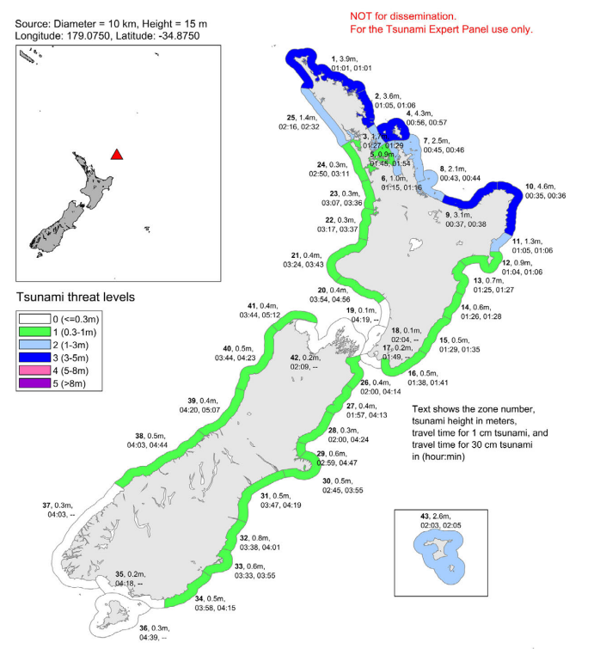
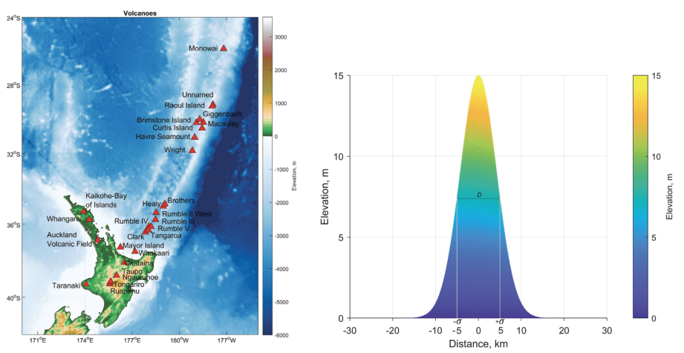
TT TGV (Co-chairs Sifon and Kilgour)
Considerations of Hazard and Forecasting
  Agenda item 4.11 JATWC introduction to Australian SoP for volcano tsunami response
  New Zealand creation of Threat Level Database for MCE TGV
Example only for explanation
Gusman and Wang, 2024

Slide 12
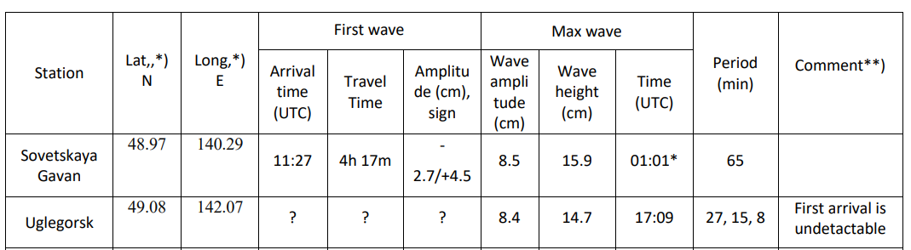
Standardisation of Event Reporting
Recognising the opportunities to improve tsunami DRR through the standardisation of member state reporting of tsunamigenic events
WG2 recommends the ICG-PTWS to request member states to adopt standard event reporting within their National Reports to the ICG.
WG2 commends the IUGG JTC for leading the effort to standardise event reporting.

Slide 13
WG2 Other Matters
WG2 commends advances in SMART Cable initiatives in the Pacific and will continue to work closely with the JTF for SMART Cables to utilize monitoring data from these efforts when they are available.
WG2 commends testing of laser interferometry on the Southern Cross NEXT fibre-optic cable in the southwest Pacific.
WG2 commends the Geodetic Tsunami Early Warning Systems Oceania (GaTEWS) initiative in the southwest and continues to follow their efforts.
WG2 commends Australia for continued support of instrumentation and data retrieval in the southwest Pacific, including installation and maintenance of seismic and geodetic infrastructure.

Slide 14
WG2 Other Matters
WG2 would like to recognise the strong and insightful leadership of the ICG PTWS Chair, Yuji Nishimae. Over the last 4 years, his technical guidance has provided significant benefits to WG2. His kindness and generosity are greatly appreciated. Thank you, Nishimae-san.

Slide 15
Thank you for your gracious attention

