Slide 1
Session 0: Introduction slides
Sixteenth Observations Coordination Group Meeting (OCG-16)
7-10 April 2025, IFREMER, Brest, France.

Slide 2

Housekeeping
Access for Ifremer visitors: 8:00 AM – 6:00 PM. Don’t forget your passport!
Meeting rooms: plenary & poster area “Salon de l”Océan”, 2 breakout rooms if needed for side conversations and small group discussions.
Limited power strips. Please do not stack power strips on top of each other.
Restrooms: located outside the plenary room and in front of the restaurant entrance.
Wi-Fi:
  Network: ifrcaptif
  Login: oceanops
  Password: 6pGC86fm
Coffee breaks: served between the meeting rooms, sponsored by ARMINES (Laurent Mortier).
Lunch: self-funded at 1:00 PM under the meeting room (€12.40). Payment by credit card preferred to speed up checkout.
Group dinner (Tuesday): self-funded at 7:30 PM at Le Vauban (downtown).
Pre-dinner activity: a short sightseeing hike to the lighthouse and Petit Minou beach.
  After the meeting, we will go together to the Ifremer entrance to take a private bus
to Petit Minou. After the hike, or swim, the bus will take us to the restaurant.

Slide 3
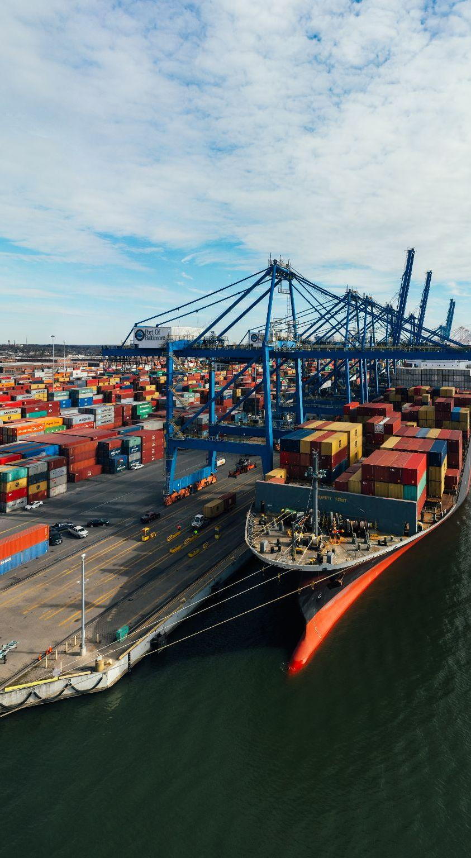
OCG-16 Etiquette
Keep your microphone muted unless you are speaking and try to use video.
For question or comment, please use the chat box or indicate by raising your hand in order to be called upon by the moderator.
Please be succinct in both your questions and answers.
The sessions will be recorded for the purpose of writing the report, and the recordings deleted afterwards.
Attendees who are joining as observers please edit their names and note OBS_ in front of their name.
Notes:
Ann

Slide 4
Meeting roles - quick resume
Chairs
  Engage in and guide the discussion
  Make sure questions are addressed
  Wrap up with outcomes and actions, summary of key points & seek consensus
  Keep agenda on track
OCG Members - networks and Exec - actively participate in the discussion & decisions
Observers and experts - participate in discussion as relevant
Rapporteurs indicated in detailed agenda
  Summary key discussion points (AI help), ensure decisions/recommendations noted
Online moderator - Louise will be the interface for online participants
PPTs - Emanuela will facilitate getting PPTs on screen
For help - erusciano@ocean-ops.org : Emanuela Rusciano / l.blezat@unesco.org : Louise Blezat

Slide 5
OCG-16 Objectives
Identify actions and major lines of work for OCG 2025-2027, with resource required
Agree OceanOPS Work Plan, SLA framework & planning for new strategy to 2030
Assess development of networks and emerging networks, identify key issues for 2025-2027
Develop the framework for assessing network maturity, health and risk, agree the OCG network/subnetwork list
Identify the data and metadata work towards the IOC Data Architecture and WIS2
Assist IOCARIBE in planning for a regional ocean observing system. Using the Caribbean as a test case to look at the connection between GOOS OCG networks and GOOS Regional Associations - addressing priorities

Slide 6
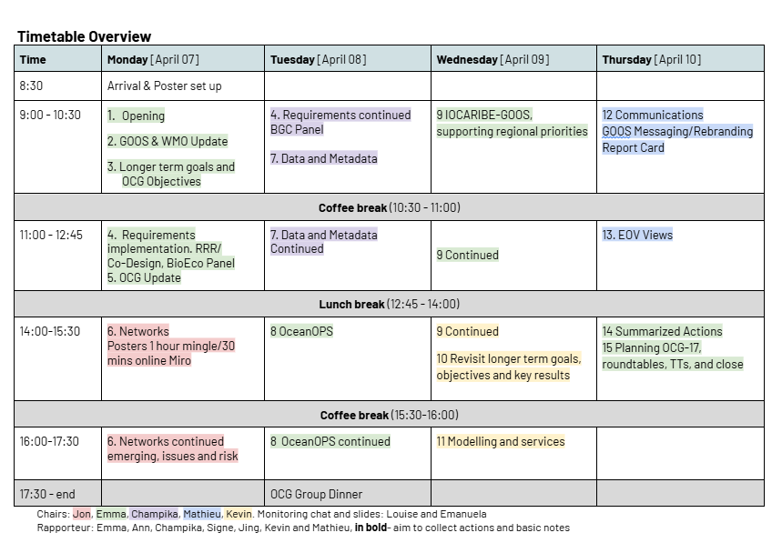
Detailed Agenda OCG-16
Link to the Agenda
Link to the Zoom

Slide 7
Miro Boards - brainstorming/online work
To save time please sign up to Miro - here
We will be using this afternoon - Session 6 networks session, Session OceanOPS and for the TT Metrics and Maturity Poster

Slide 8
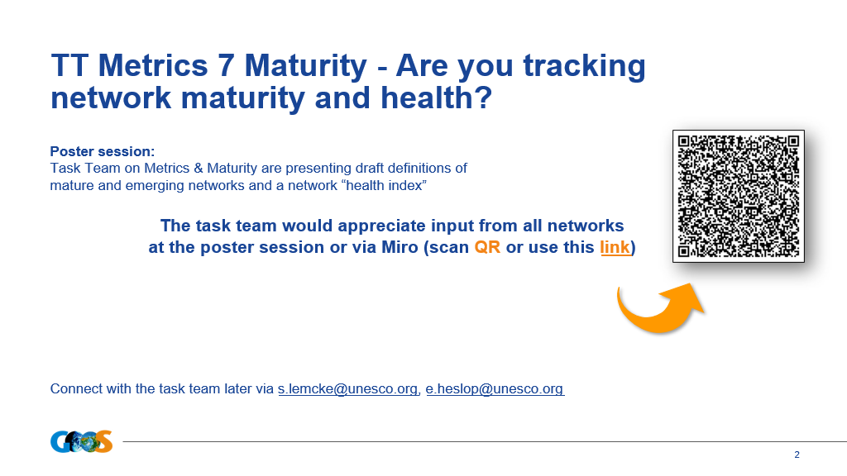

Slide 9
USV ‘emerging OCG network’ decision
Progress - background paper and presentation in session 6
Opportunity to ask questions and discuss -in sessions and across next 2 days
Take the decision on Wednesday (end of day) - all OCG members eligible to take part in the decision (OCG network lead and OCG exec) - with a ’any objections to endorsing USVs as an OCG emerging network’ approach, noting any recommendations

Slide 10
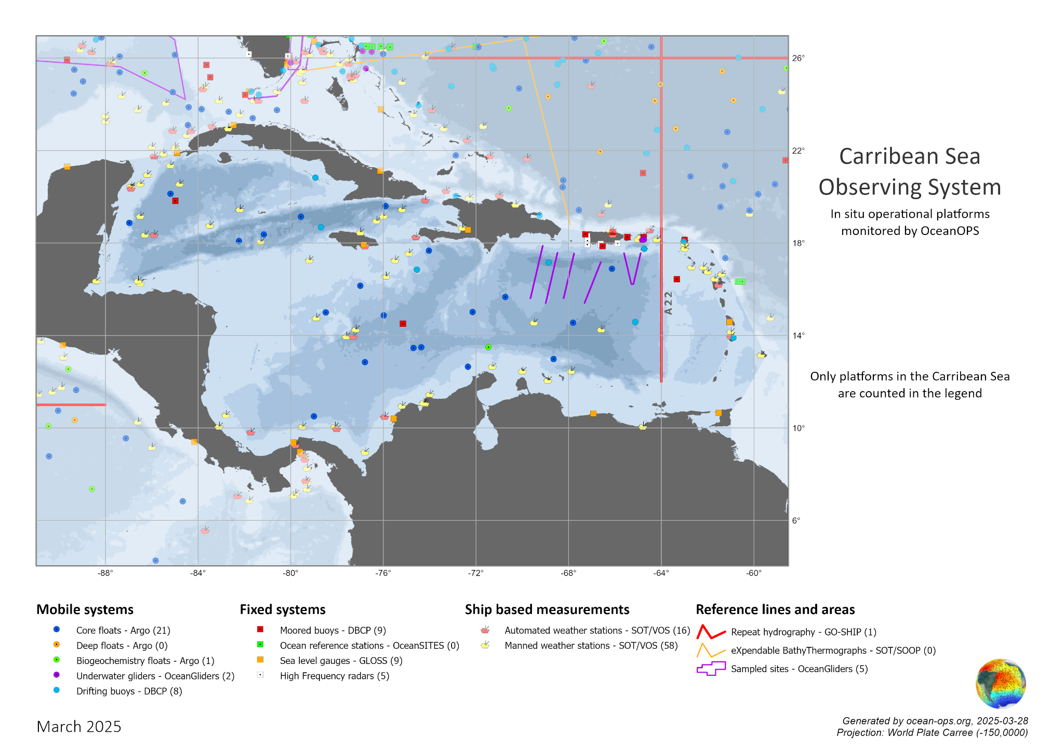
WORKSHOP - IOCARIBE-GOOS
Session 9 on Wednesday morning (Day 3)

Slide 11
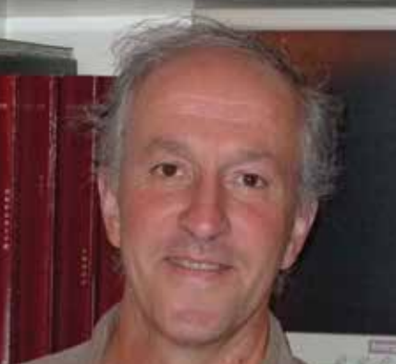
News OCG Co-Chair
Laurent Mortier - professor physical oceanography, gliders, and leading AMRIT and working with OceanOPS
Hopefully joining in about 2 months
Looking for co-chair - different geographic area
LAURENT MORTIER is Professor of
Physical Oceanography at ENSTA-ParisTech.
He has played a major role to develop
the French glider national facility and the
European coordination for gliders since
2003. He is now Principal Investigator of
the French Mediterranean Ocean Observing
System (MOOSE).

Slide 12
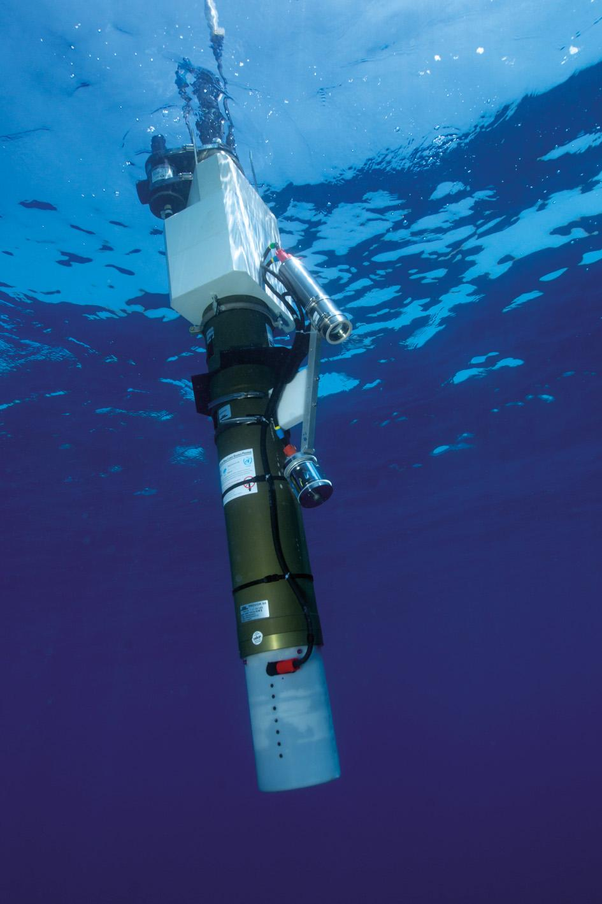
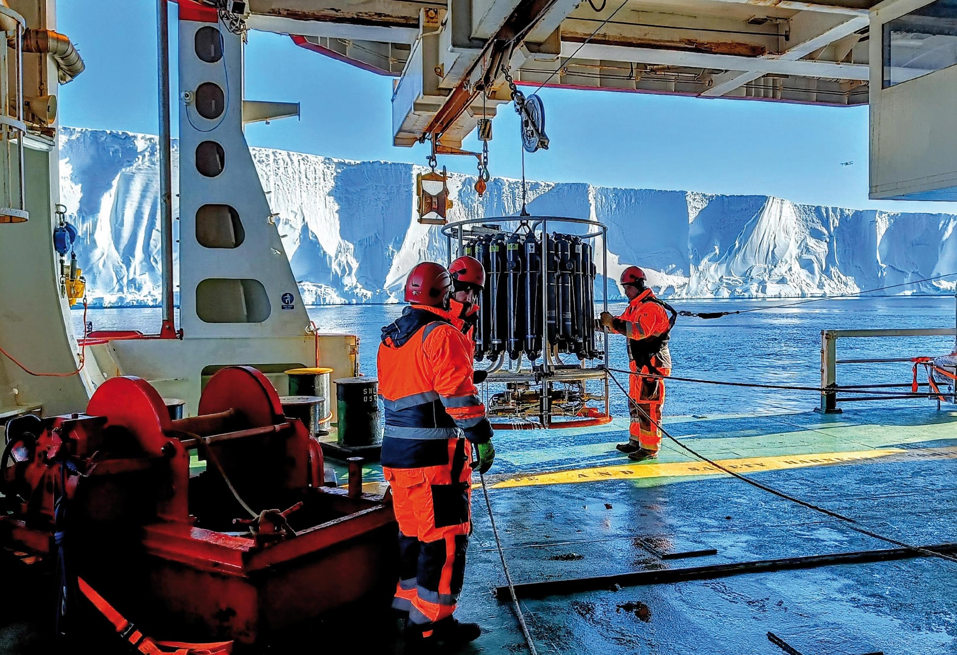
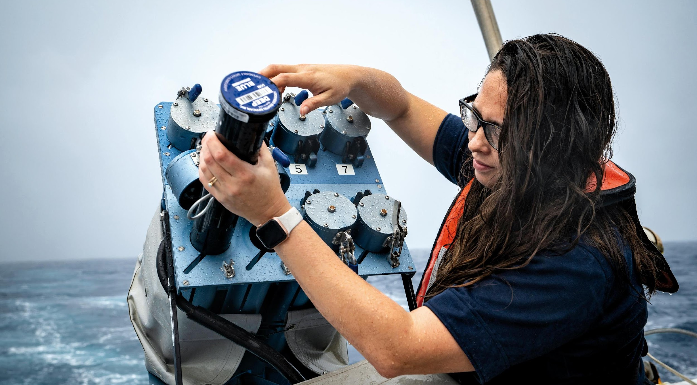
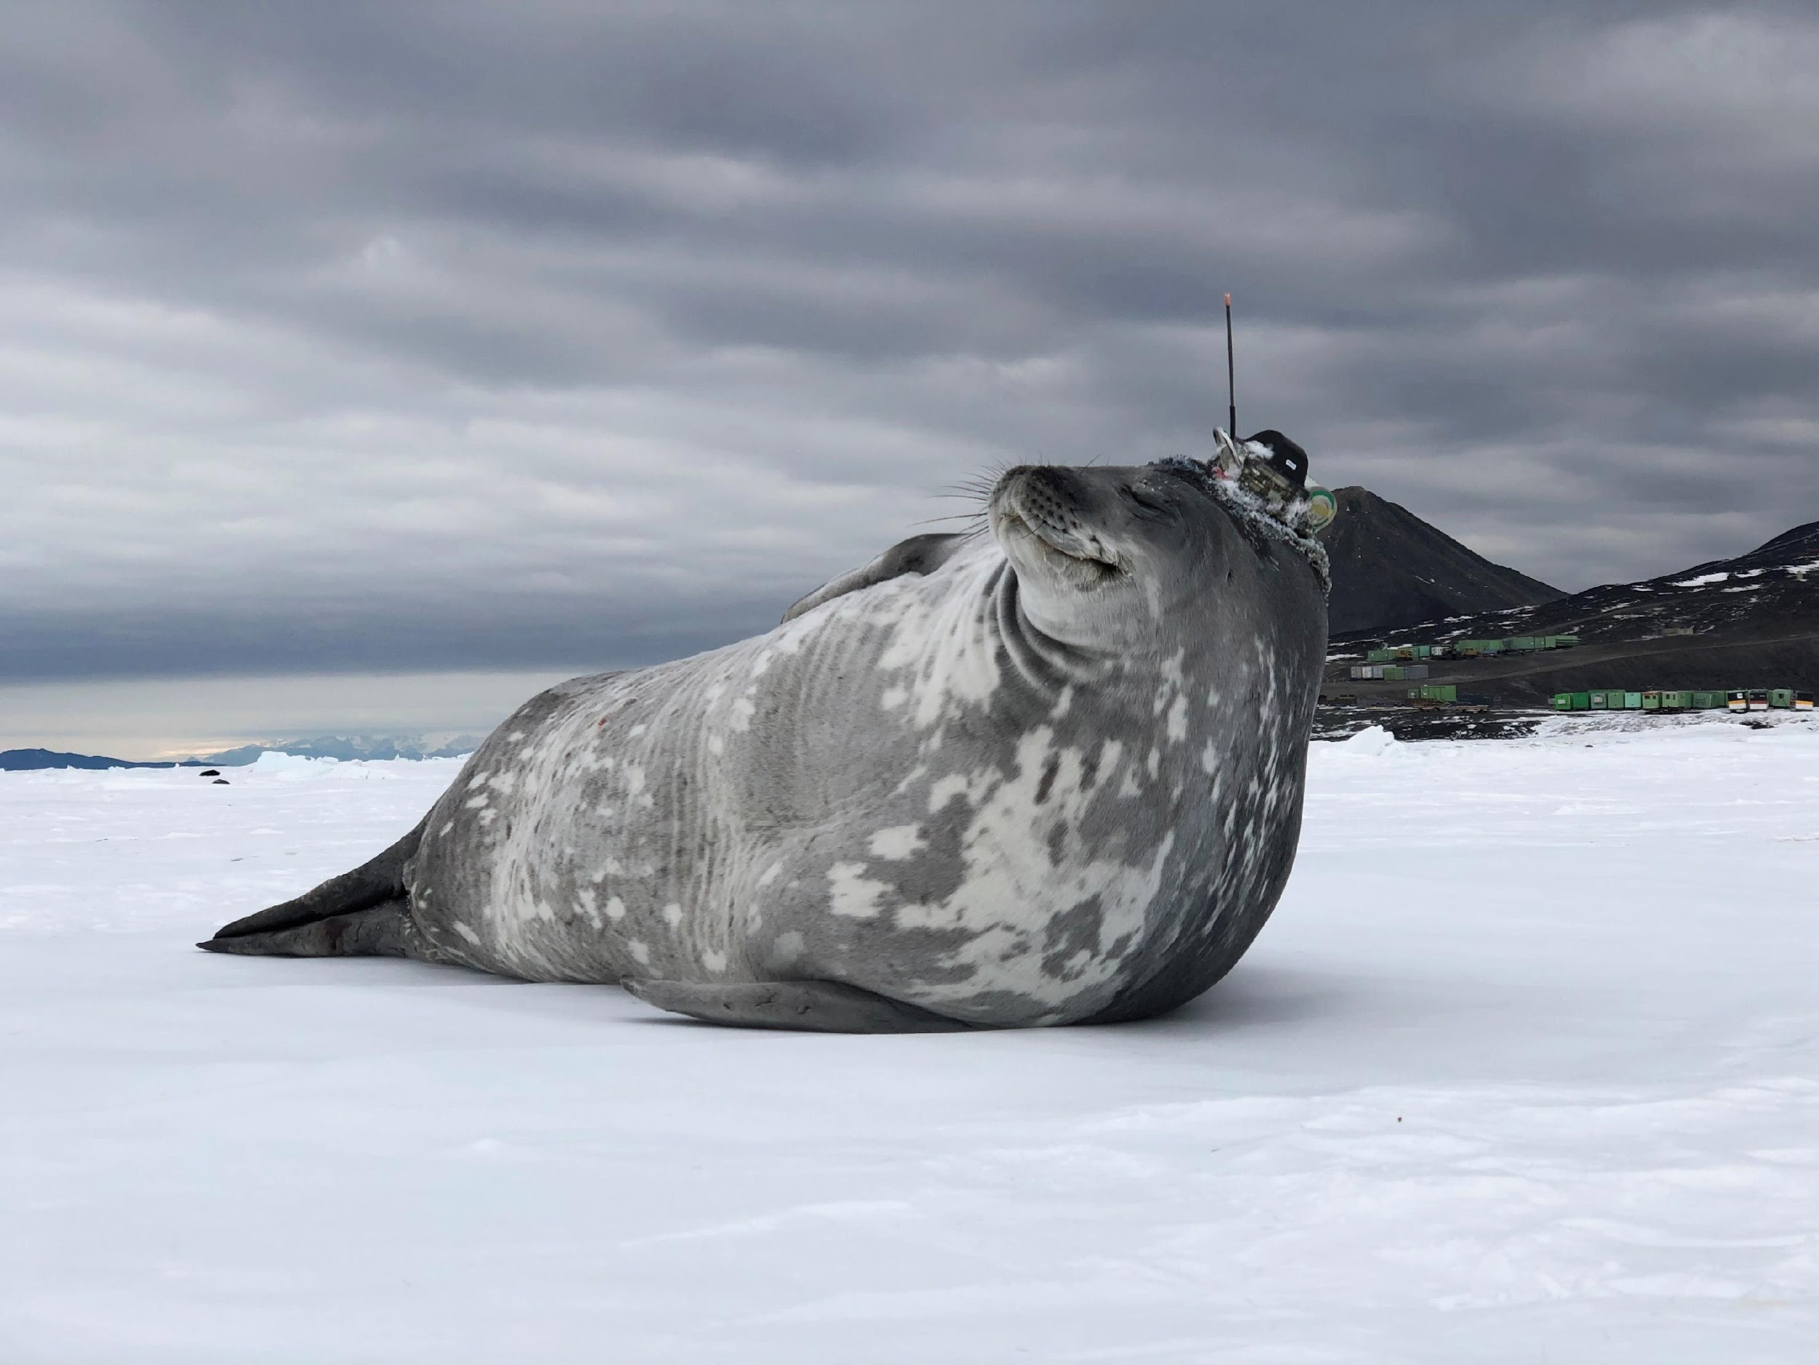
Thank you
goosocean.org

Slide 13
Miro Boards - brainstorming/online work
To save time please sign up to Miro - here
We will be using this afternoon:
  Session 6 Networks posters
    Brainstorming on the poster on Maturity and Metrics TT - here
    Brainstorming on the Network posters - here

Slide 14
Table on OCG Networks
GOOS (OCG) Networks - List and attributes: here

Slide 15
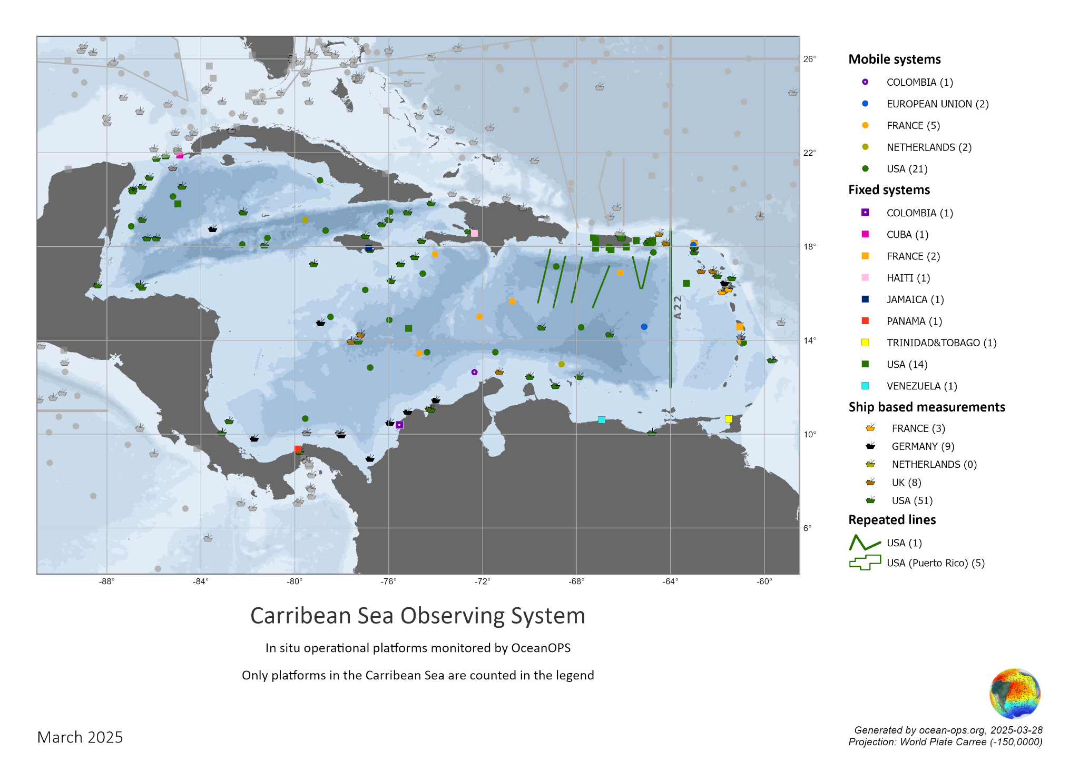
WORKSHOP - IOCARIBE-GOOS
Session 9 on Wednesday morning (Day 3)

