Slide 1
Session 3.1: Longer term goals and OCG Objectives
Emma Heslop, David Legler, Ann-Christine Zinkann
Sixteenth Observations Coordination Group Meeting (OCG-16)
7-10 April 2025, IFREMER, Brest, France.

Slide 2
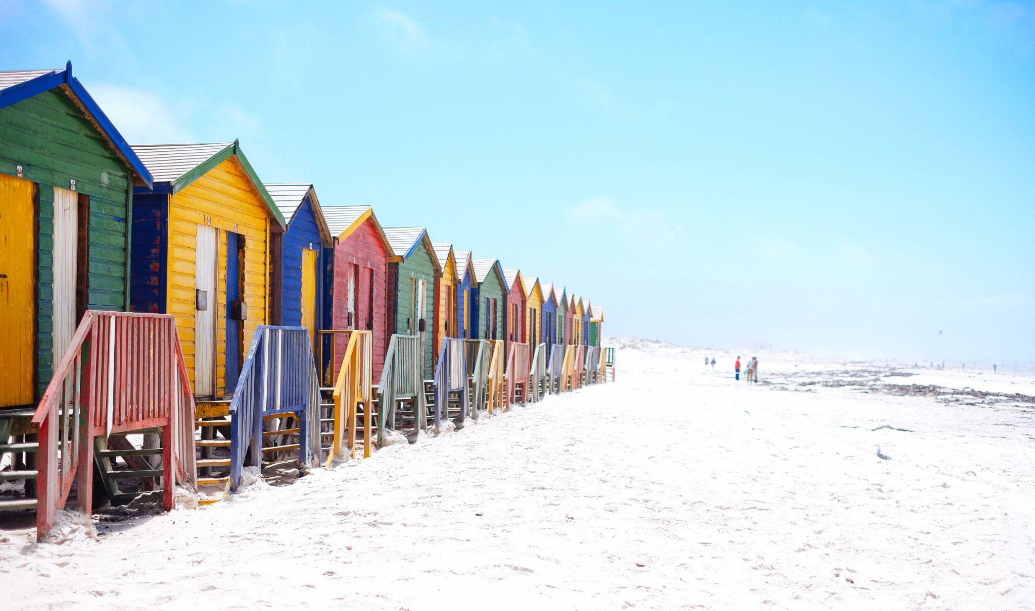
Background
Environment changes
Observing solutions of the future will be more integrated across platforms, providers, and communities (eg. co-design program activities, ocean carbon, marine ecology, etc)
AI and other technological changes
Private sector collaboration and / or supply
Digital environment
LINK FOR OCG TORs

Slide 3
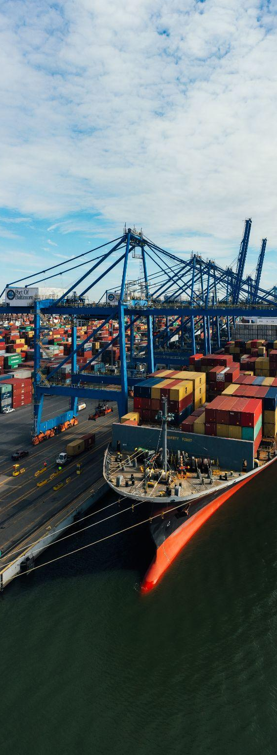
Background
Ideas from across the team - questions we could ask ourselves:
Is the EOV framework strong / visible enough in our activities?
What is OCG's role in identifying ocean observing priorities (e.g. for GBON)?
What is OCG role in working with modelers (e.g. should OCG help shape modeling feedback to networks on impacts, etc)?
How does GOOS support and encourage “operationalisation”?
How will AI influence the observing landscape?
What should OceanOPS be doing in 2035?
Should we be more directional in filling gaps/future gaps in observing?
Do networks change their target/design as new observing/modeling capabilities evolve?
How do we manage risk?
Does the digital future change our work today/how do we think of evolution or future proofing?
LINK FOR OCG TORs

Slide 4
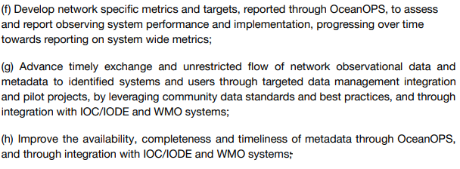
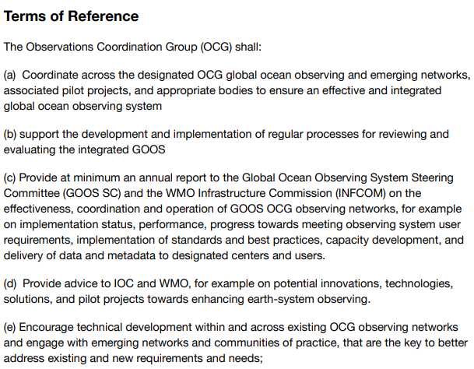
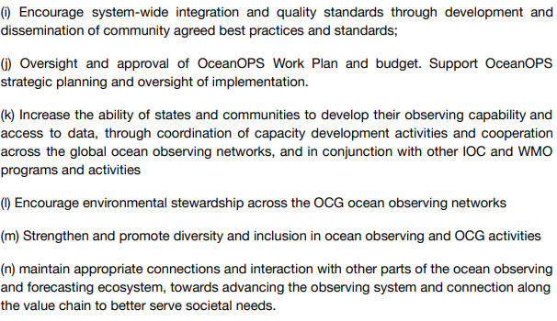
Terms of Reference - OCG
well developed | Needs improvement

Slide 5
Session 10 - revisit after discussions
1) Discussion on which of these are of highest interest to the networks?
2) Provide sense of initial actions; and
3) Do we need to consider our ToRs for the next years
TORs that need improvement

Slide 6
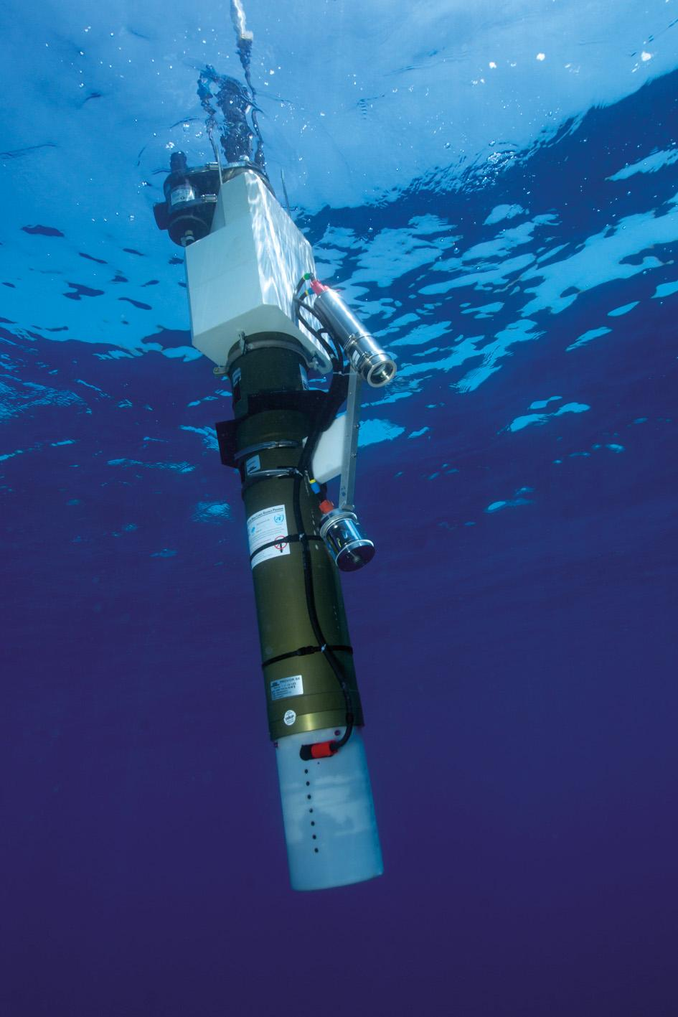
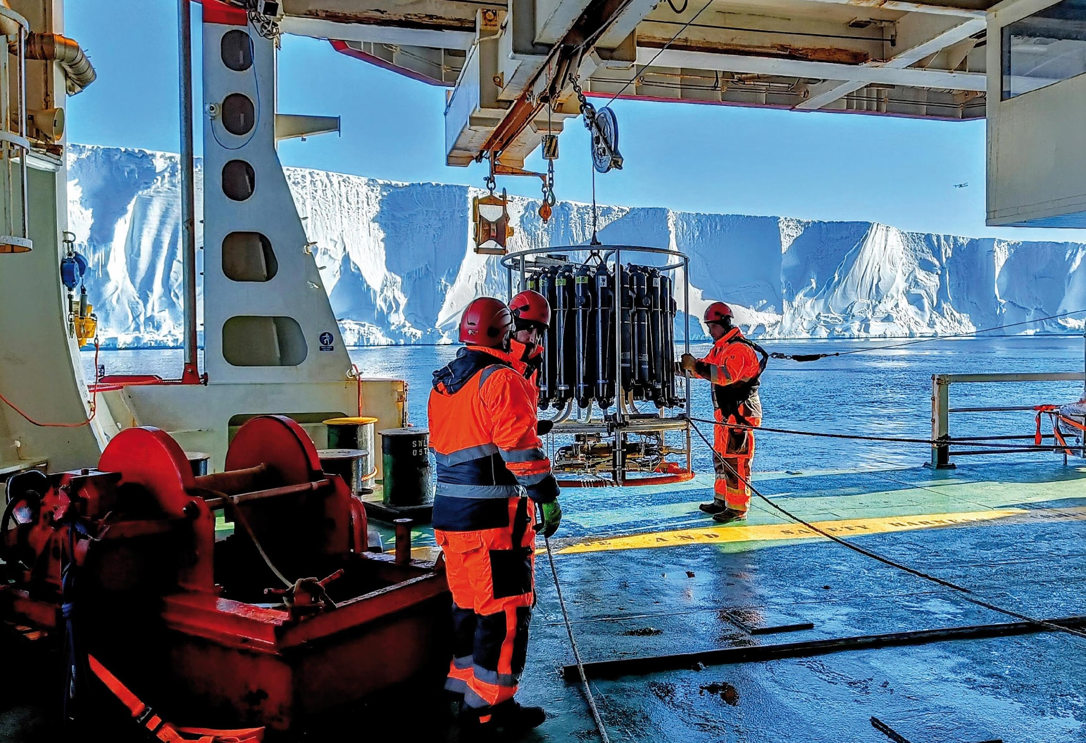
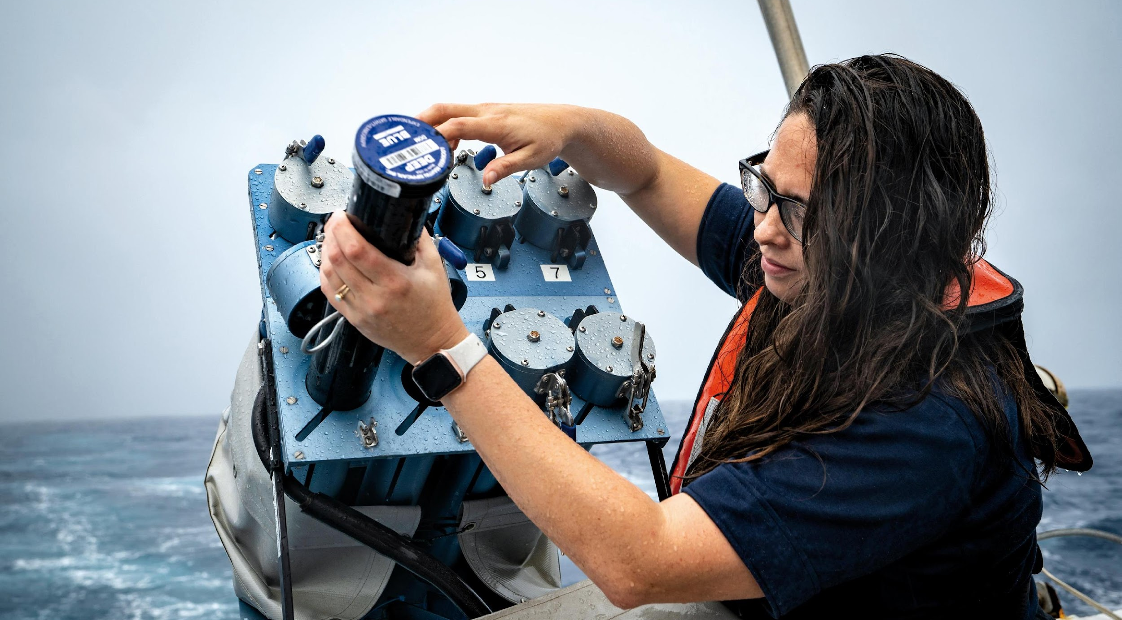
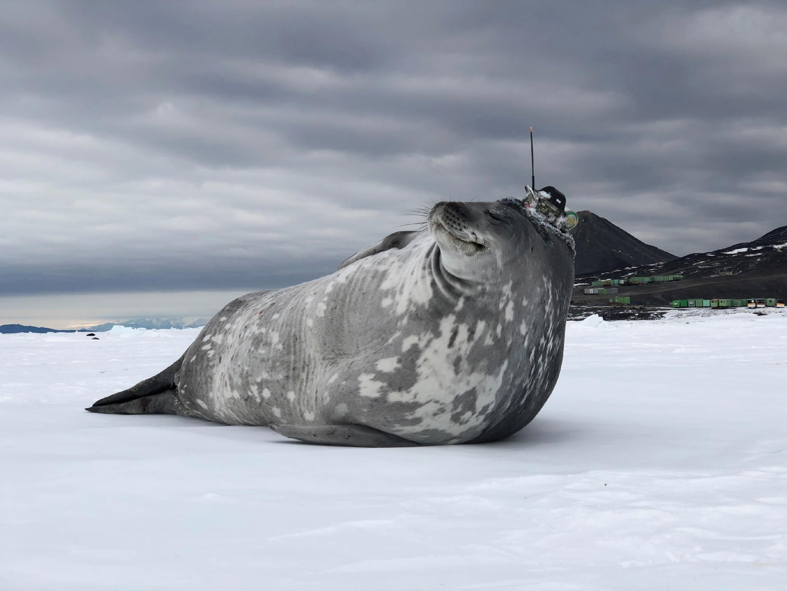
Thank you
goosocean.org

