Slide 1

WMO update for OCG
Albert Fischer
Director, WMO Integrated Global Observing System (WIGOS) Division, Infrastructure Department
Infrastructure = observations, data exchange and policy, prediction systems
16th Observations Coordination Group Meeting, 7 April 2025, Brest, France

Slide 2




Why WMO thinks anything matters: Weather, climate, water service delivery
space-based
Weather
Climate
Water
Related
Environmental
Services
Atmosphere
Hydrology
Cryosphere
Ocean
Terrestrial
Space weather
e.g., quality of air, water, soil;
space weather
Hydrological services
surface-based
Photos: Various authors, WMO Calendar Competition 2024, cc
Notes:
History of IMO, predecessor to WMO – was in the marine space
Core of WWW was for Weather and in atmosphere – observations, data exchange, and prediction systems
Work with IOC started in late 1990s with JCOMM’s first meeting in 2001.
2019 reform – Earth System Approach for infrastructure.

Slide 3
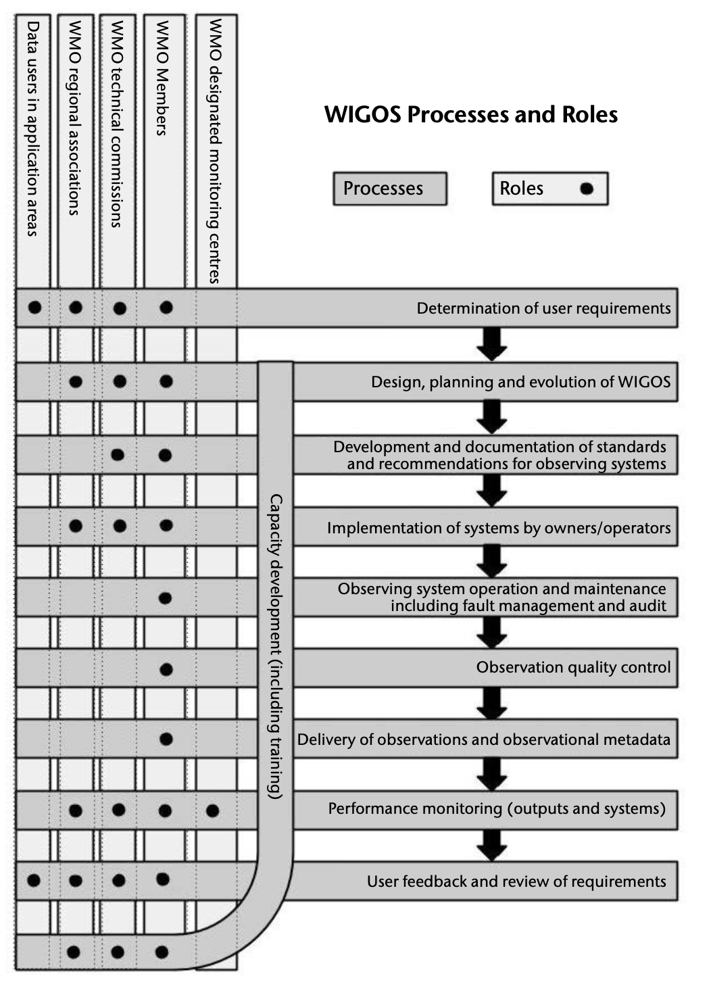

WMO’s USPs, WIGOS processes, Impacts workshops
WMO USPs
How can engaging WMO lift GOOS implementation?
Impact Workshops
4-year cycle
May 2024 edition enlarged focus beyond Numerical Weather Prediction (NWP) to Earth System prediction
operational service delivery focus
“shall” in Technical Regulations
Complementary WIGOS processes
Compliance tracking and linked financing through SOFF
Requirements
Design
Standards / best practice
Implementation
Quality
Delivery
Monitoring
Feedback/review
Capacity development

Slide 4
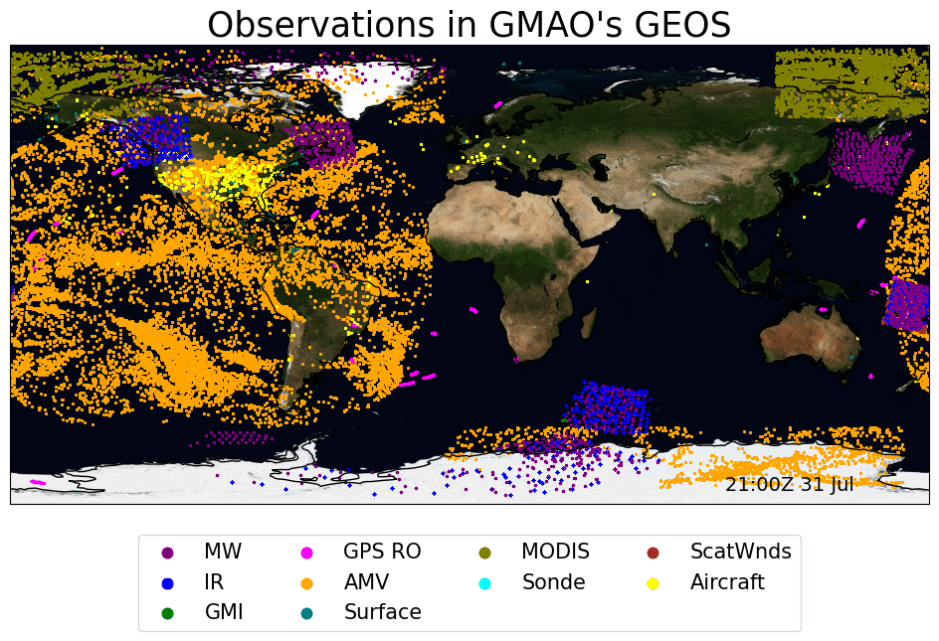
Snapshot of observations going into NWP 5-minute windows, large volume of satellite data
Big 5 for skill
Satellite data provide 70-80% of prediction skill
Passive microwave radiometers (sat)
Hyperspectral infrared sounders (sat)
Radio occultation sounders (sat)
Radiosondes (surface)
Aircraft-based sensors (surface)
NASA GMAO Erica McGrath-Spangler

Slide 5
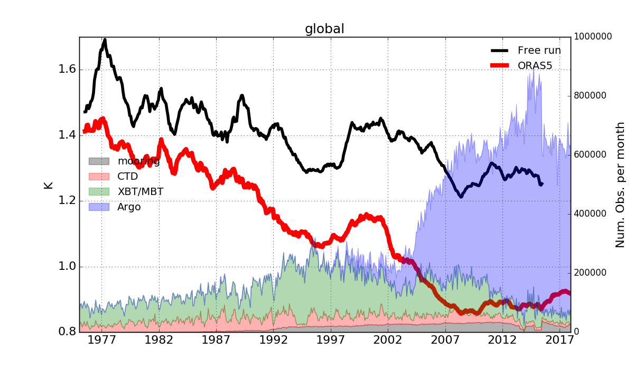

Impact of ocean obs on ECMWF operational system – ORAS5
Zuo et al., ECMWF, 2024
1. Ocean prediction skill largely from in situ data (65%)
Temperature RMSE: 0-1000m
~65% of the total RMSE reduction comes from assimilating in-situ data
Model free run
ORAS5
With DA
MRB: moored buoy
OSD: CTD sonde
XBT: Expendable bathythermograph
PFL: Argo float
Figure adapted from Zuo et al., 2019
Assimilation of ocean observations helps to constrain the ocean, therefore providing better estimation of the ocean initial condition for the coupled forecasting system

Slide 6
Impact of ocean obs on ECMWF operational system – SEAS5
Zuo et al., ECMWF, 2024
2. Ocean data are critical in monthly to seasonal prediction
ORAS5 provides ocean and sea-ice initial conditions for all ECMWF coupled forecasting systems since 2017, including ENS, HRES and SEAS5.
Johnson et al., 2019 GMD
Tietsche et al., 2020 Climate Dynamics
1997 2002 2006 2011 2017
Gain about 2 months in ENSO prediction
Without Ocean observations and DA, we would lose about 15 years of progress (from S1 to S5).

Slide 7
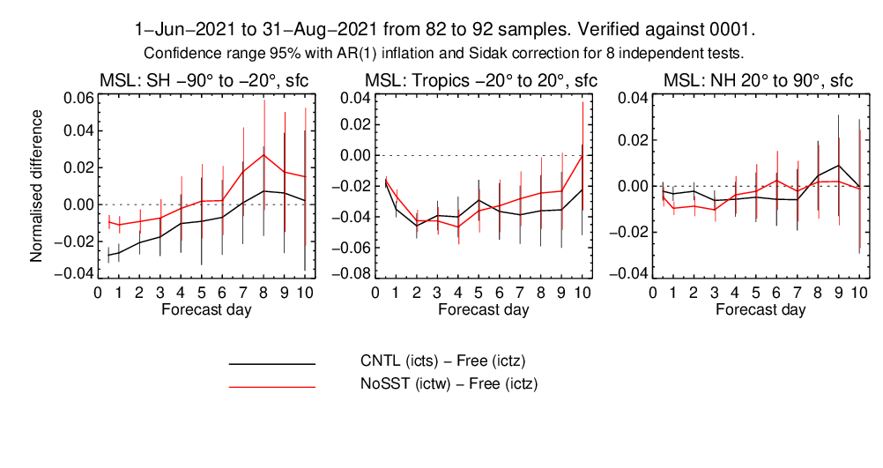
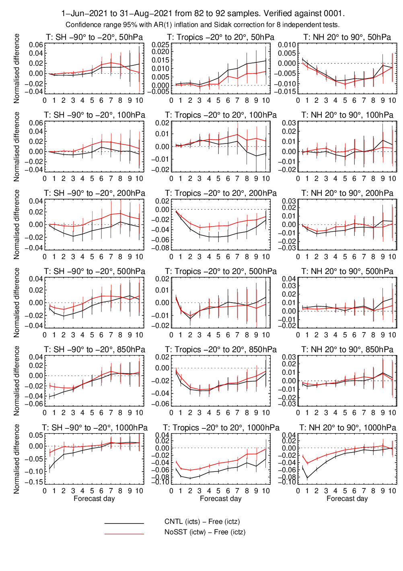
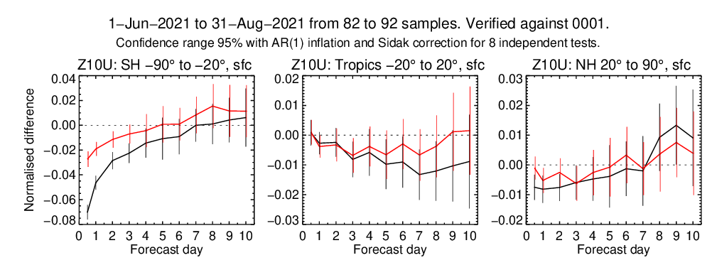
Zuo et al., ECMWF, 2024
3. Ocean subsurface data increase medium-range (3-10 day) weather forecast skill, particularly in the tropics
Assimilation of In-situ and altimeter observations has sizable impact (positive) on forecasting atmospheric variables in the medium-range
Impact from ocean observations lasts longer in the tropics
Changes in normalized RMS errors
Reference is Free run without data assimilation
+ in-situ, Alti and SST
+ in-situ and Alti
Temperature
(Lower troposphere and surface)
MSL
Zonal wind at 10m
Notes:
If we focus only on the lower troposphere and surface, we see a bit impact of assimilating SST (as expected) at early stages of the forecast. And the the impact last longer in the tropics (in fact, it gets amplied. (e.g. in 10m winds).
It is also curious to see that assimilating alti and insitu also help the forecast

Slide 8
Impacts of ocean observations for weather
All 10 of WMO’s Global Meteorological (prediction) Centres assimilate ocean surface and subsurface physical data
The majority of predictive skill in the ocean comes from in situ data, in contrast to the atmosphere
Ocean data are critical to monthly to seasonal prediction
In the latest tightly-coupled prediction systems, subsurface ocean data significantly improves atmospheric skill in the medium-range (3-10 days), particularly in the tropics
WMO’s NMHSs increasingly depend on ocean surface / subsurface data to deliver weather and climate services, but studies on the impact of in situ observations are rare
AI / ML techniques are very quickly changing how data are used in prediction

Slide 9
WIGOS 2040 Vision update
- An effort has been kick started (January 2025) to update the WMO Integrated Global Observing System (WIGOS) vision for the 2050 timeframe.
- A representative (but small-enough to be agile) core team was put together by WMO to this end, with the purpose of finalizing the product in 2026.
- The scope will include space- and surface-based components and will envision a global system to measure the Earth, and address WMO-relevant applications
- Many driving factors are expected to influence this vision including technology evolution, applications/users needs, the future landscape of observing systems providers including non-traditional systems and commercial providers, etc.
- This effort is expected to provide the community with a vision that will help coalesce efforts toward a cohesive, complementary global observing system.
- The vision, should be as well-informed and technically accurate as possible, and should inspire the community to design, evolve and deploy a complementary global observing system that addresses the needs of the future, and leverages the emerging opportunities

Slide 10
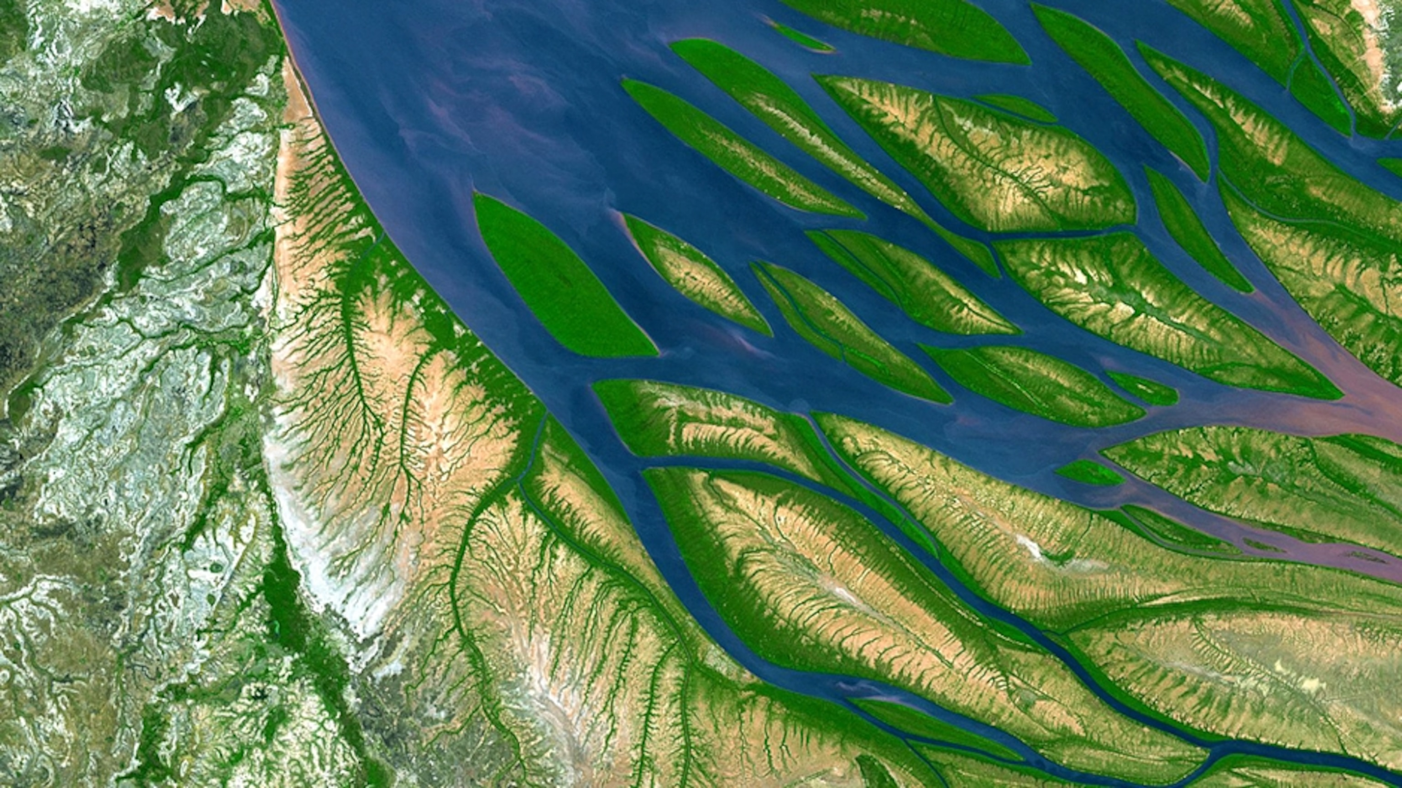
General Goal of the Vision
“The Vision for WIGOS in 2050 presents a likely scenario of how user requirements for observational data may evolve over the next 25 years, and an ambitious, but technically and economically feasible vision for an integrated observing system that will meet them. It provides high-level targets to guide the evolution of the WIGOS in the coming decades. It anticipates a fully developed and implemented WIGOS framework that supports all activities of WMO and its Members within the general areas of weather, climate and water.”
10

Slide 11
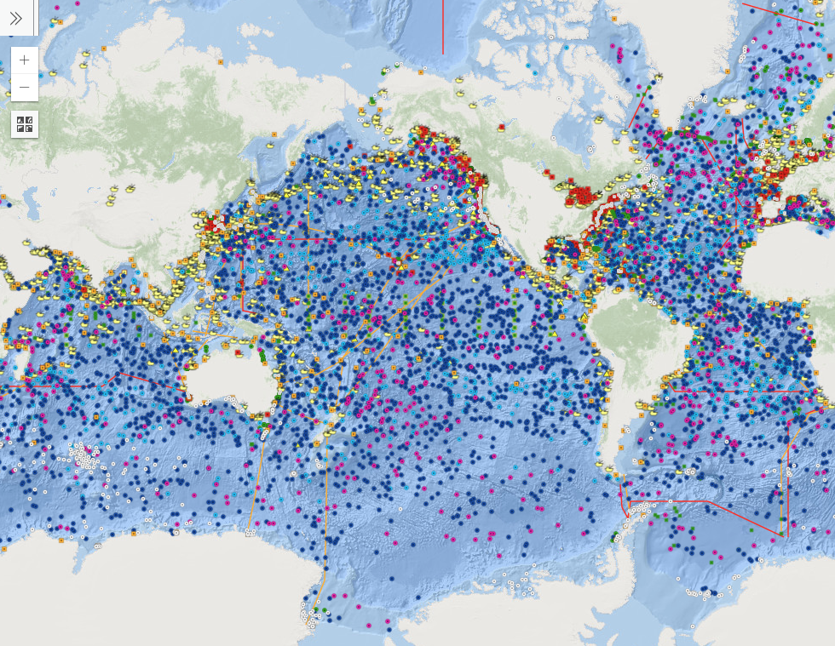
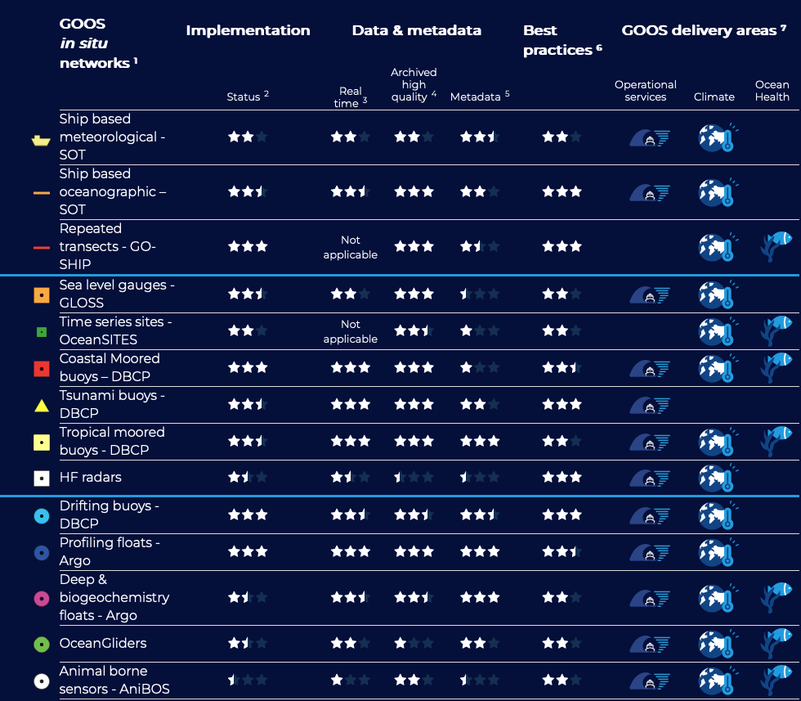
Joint WMO-IOC Collaborative Board Subgroup on Basic Observing Networks
Provide advice on the development, design, and implementation of the WMO/WIGOS Global Basic Observing Network (GBON) for the ocean domain as a part of the Global Ocean Observing System (GOOS), driven by WMO application areas in weather and climate,
Develop the concept of a complementary global ocean observing system basic network (GOOS basic network) that would further address IOC application areas (e.g., ocean health and sustainable management, ocean and coastal hazards), which together with the GBON would identify the key basic ocean observations needed for global public good for Member States, through GOOS, IOC and WMO and,
Provide advice on GBON ocean requirements, Technical Regulations, and guidance, relevant to national, coordinated regional, and global development of GBON in the ocean domain, as well its effective compliance monitoring;

Slide 12
OCG and WMO through GOOS
Avenues for advocacy of sustaining ocean observations
Work on the definition of the essential, basic observing networks for global public good
WIGOS 2040 Vision update
Impacts on weather and climate applications
OceanOPS support to networks
Metadata and data flows, including links to WIGOS (OSCAR/Surface) and WIS systems

