Slide 1

Session 2: GOOS Update
Emma Heslop, Programme Specialist GOOS, IOC/UNESCO
Joanna Post, GOOS Director, IOC/UNESCO
Sixteenth Observations Coordination Group Meeting (OCG-16)
7 - 11 April 2025, Ifremer, Brest, France

Slide 2
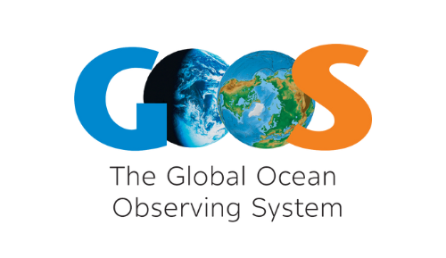
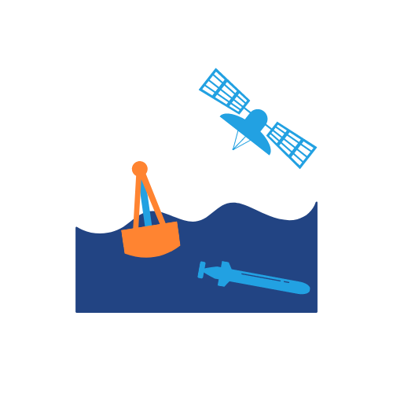










“Ocean Observation is a Societal Service”
Global Ocean Observing System
Ecosystem of providers Observation infrastructure
Beneficiaries of ocean information
Collaboration - Coordination - Integration - Advocacy
Ocean observing community Member States & other investors
Member States, research, decision makers, operational service delivery, users, investors
Notes:
GOOS:
Framework to ensure that observations meet global policy needs
Sets the specifications for essential ocean variables
Works on strengthening delivery through best practices, data and metadata standards,
Advocates for OO, ensuring governments and UN know what underpins their weather, ocean health, risk management, blue economy, reporting and decisions
Makes the partnerships to ensure ocean data is turned into actionable information

Slide 3
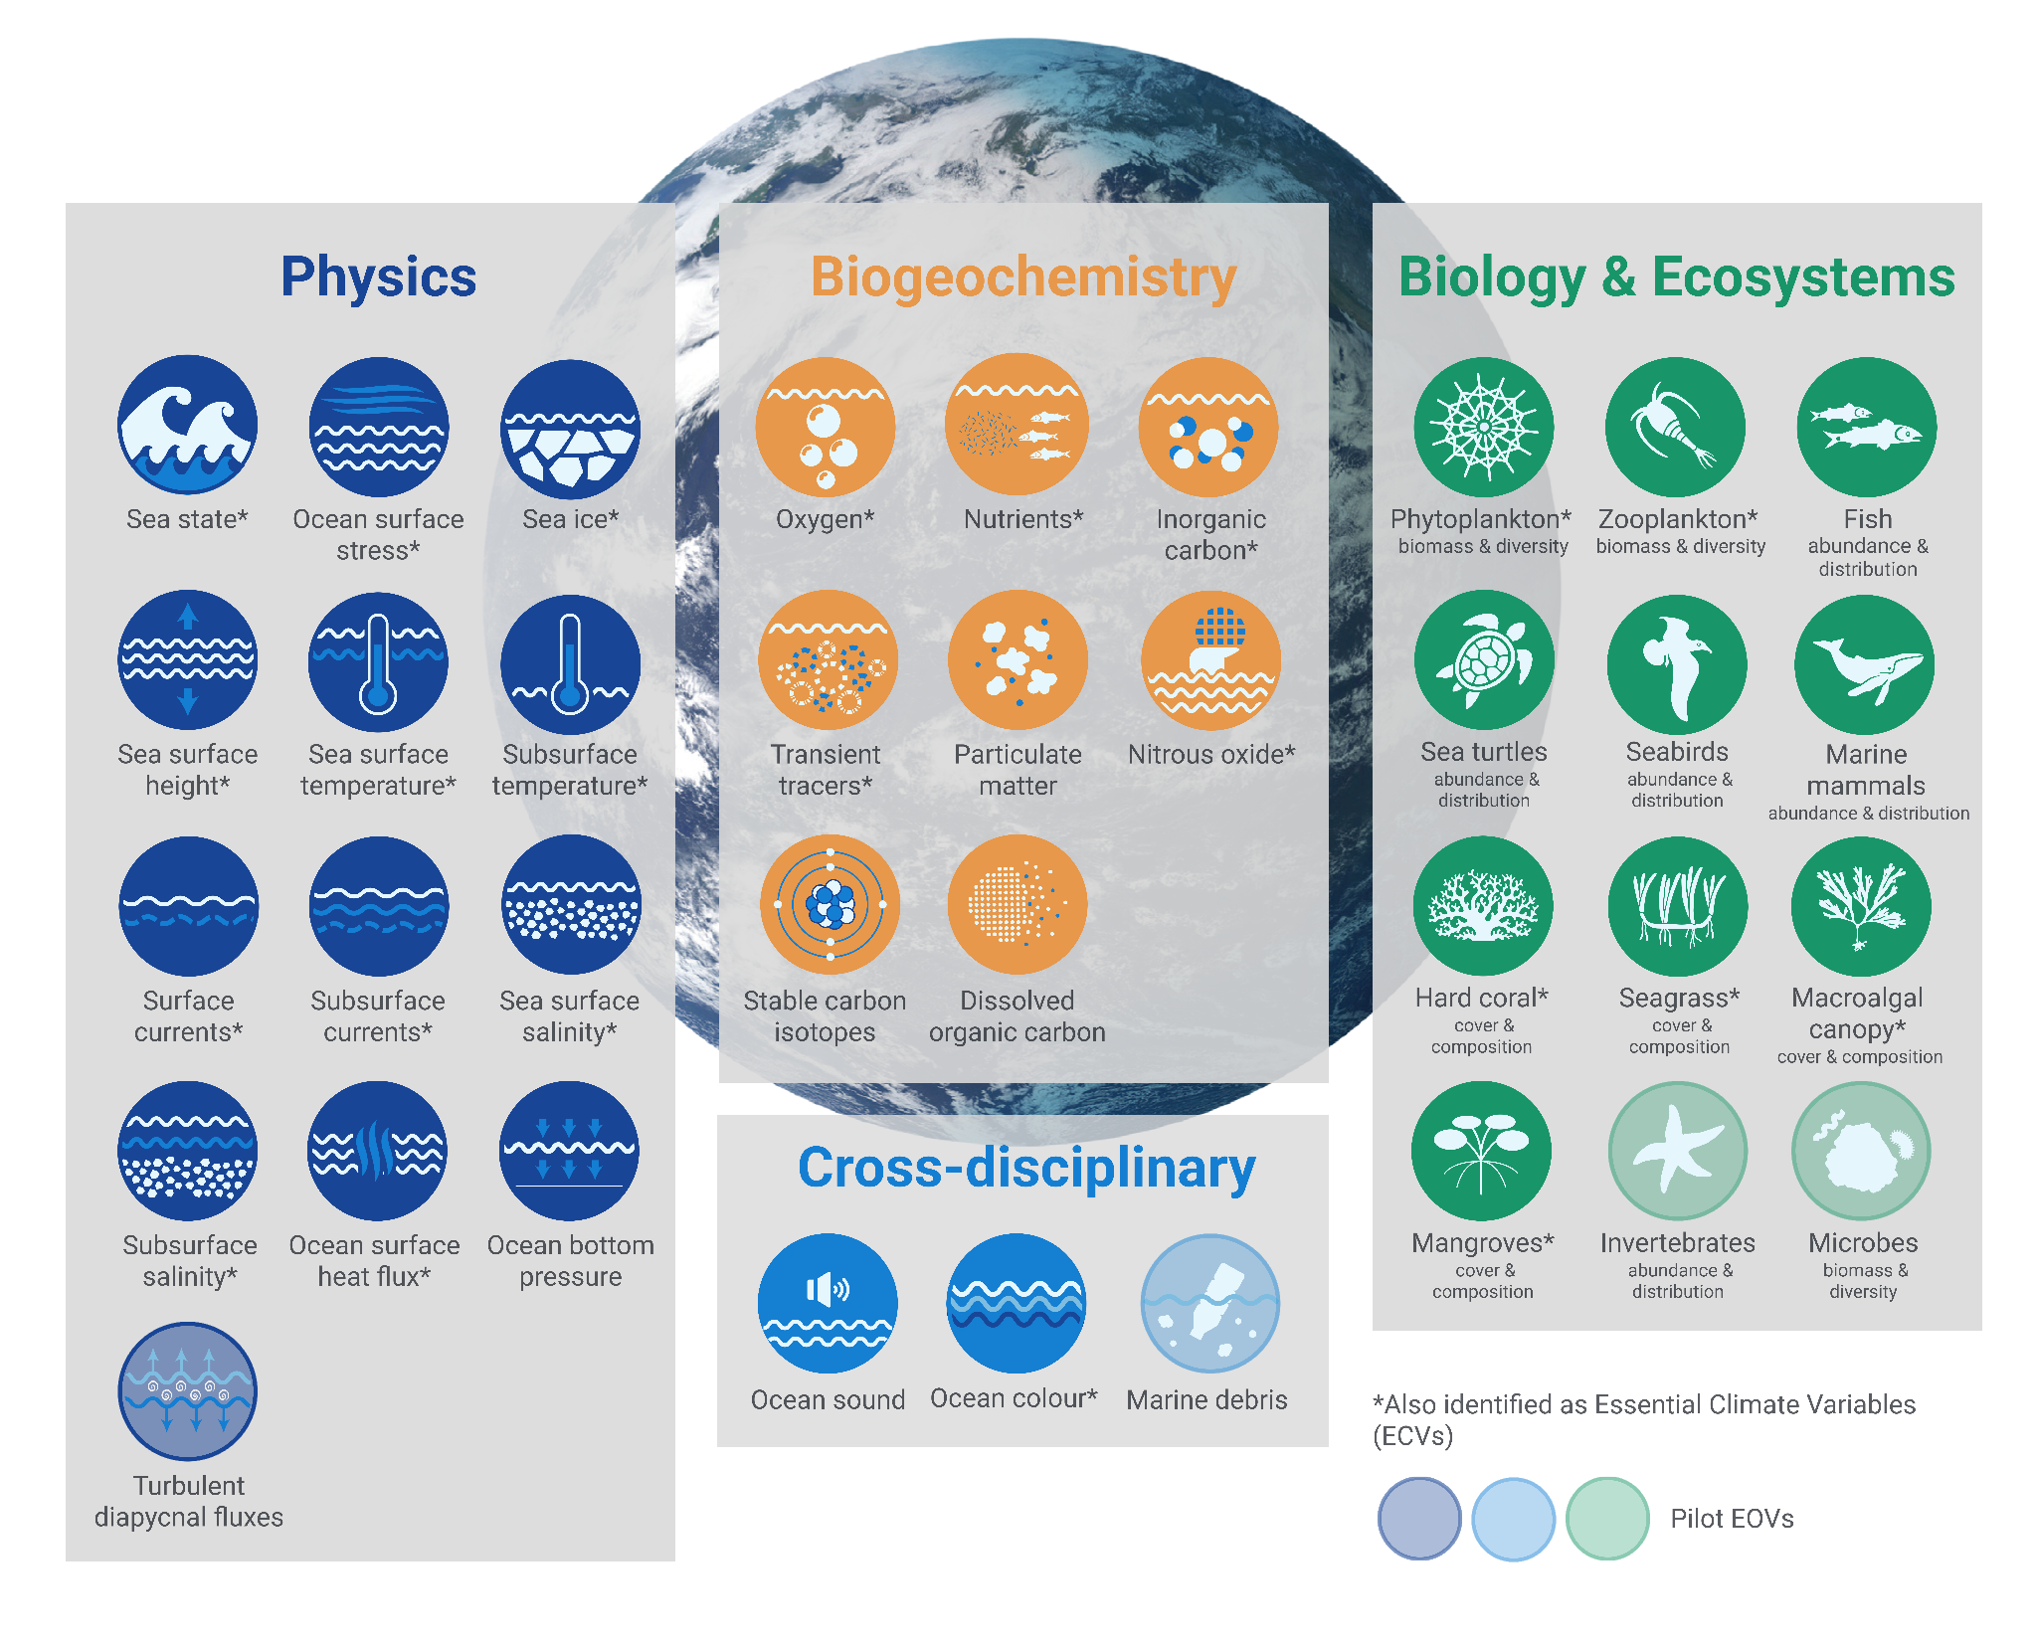
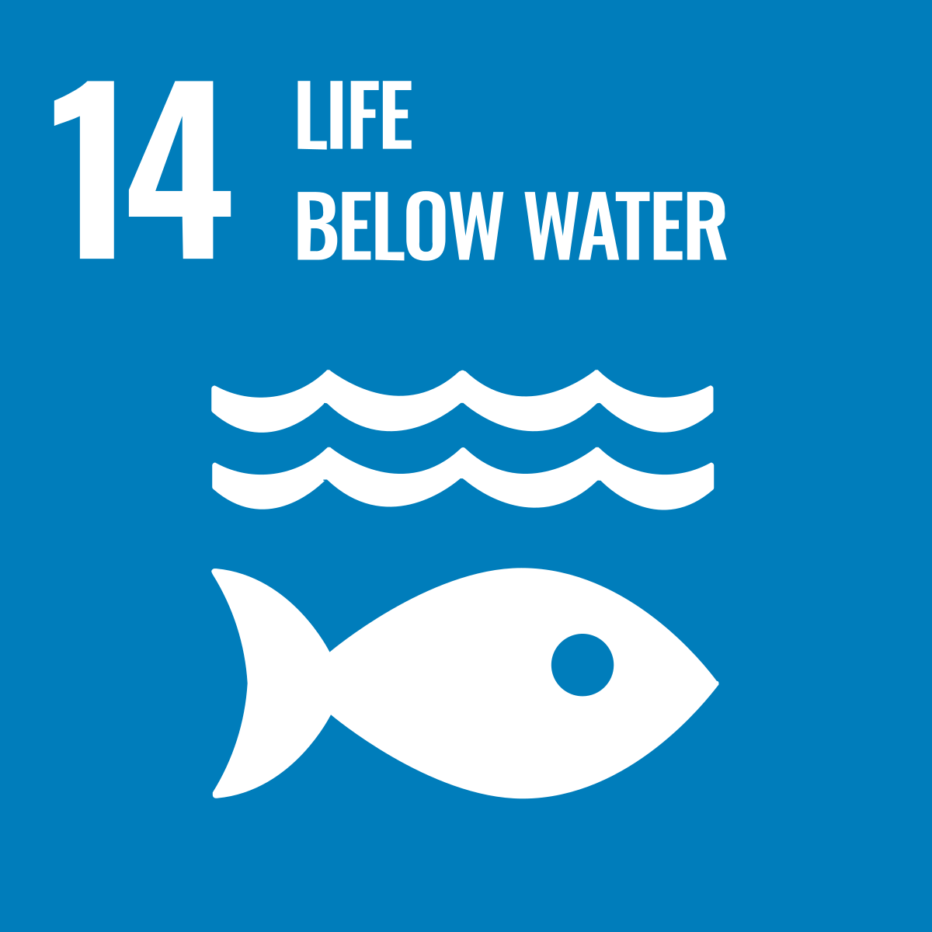
36 Essential Ocean Variables (EOVs)
Minimum set of ocean variables that are needed to assess ocean state & variability for important global ocean phenomena, and to provide data for applications that benefit society.
A key reference framework for ocean observing, data management, government, and industry.
Enable interoperability, harmonisation, and collaboration.
Notes:
GOOS has established a framework of Essential Ocean Variables - critical ocean measures that allow the efficient monitoring of the state and health of the ocean.
These physical, biogeochemica, biological and cross-disciplinary variables contribute to various international frameworks and conventions, such as the Sendai Framework for Disaster Risk Reduction, United Nations Framework Convention on Climate Change, Convention on Biological Diversity, etc.
Move beyond a focus on single platforms, programs or regions a connected & coordinated system.
Established critical ocean measures that allow efficient monitoring of the state and health of the ocean

Slide 4
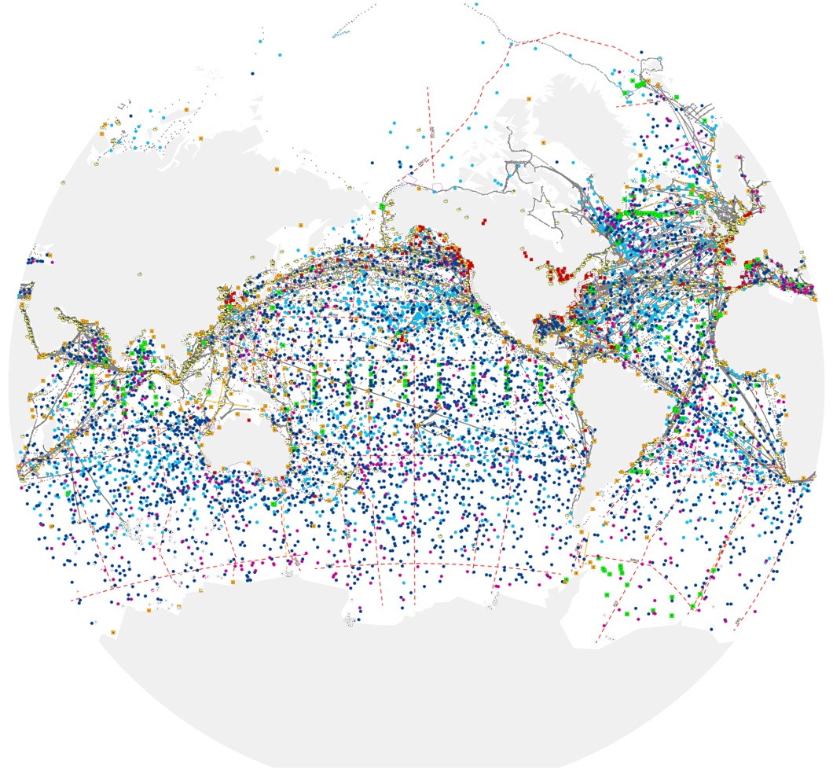
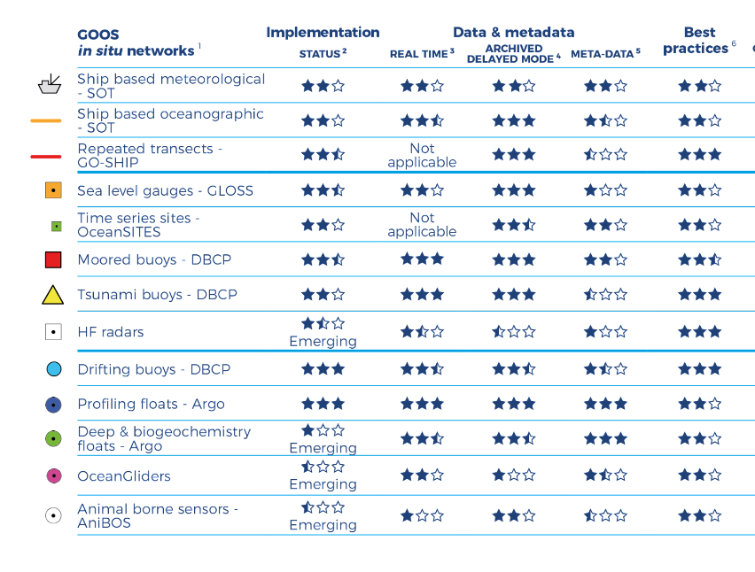
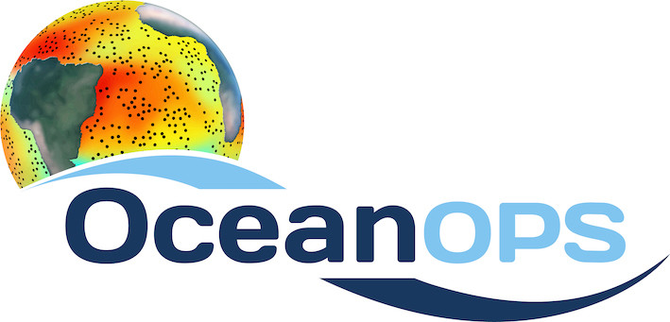

“The weather forecasting systems will run off the rails if they don’t have the surface pressure information over the ocean to constrain them” - Lars Peter Riishojgaard, Director of the Earth System Branch WMO
8th WMO workshop on the Impact of Various Observing Systems on Numerical Weather Prediction and Ocean Prediction, May 2024
Subsurface observations increase forecast skill 3-10 days, particularly in the tropics - Zuo et al ECMWF (2024)
Notes:
In the last 30 years, GOOS developed -
Mature networks drifting buoys, voluntary observing ships, tide gauges, Argo floats, and emerging networks; HF Radar, ocean gliders
Ocean Observing is big science

Slide 5
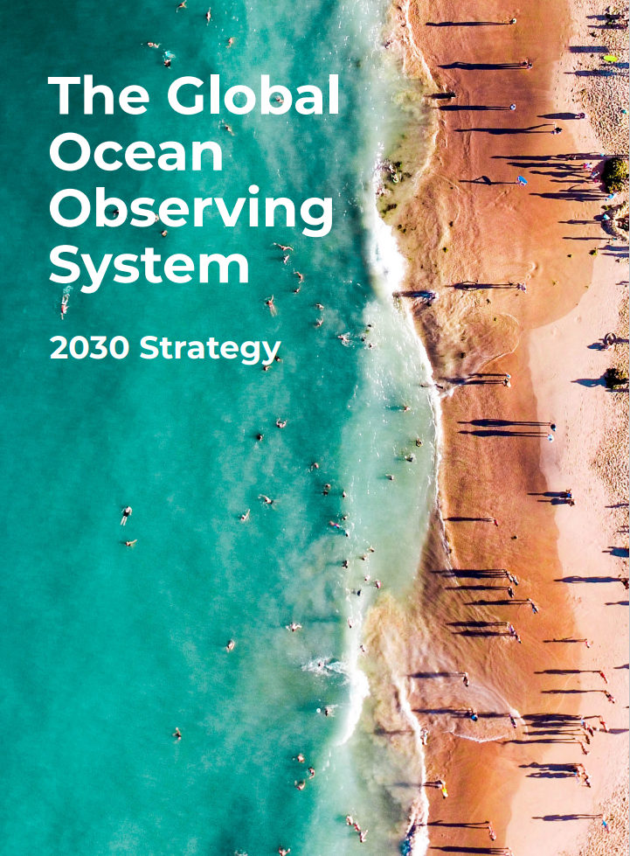
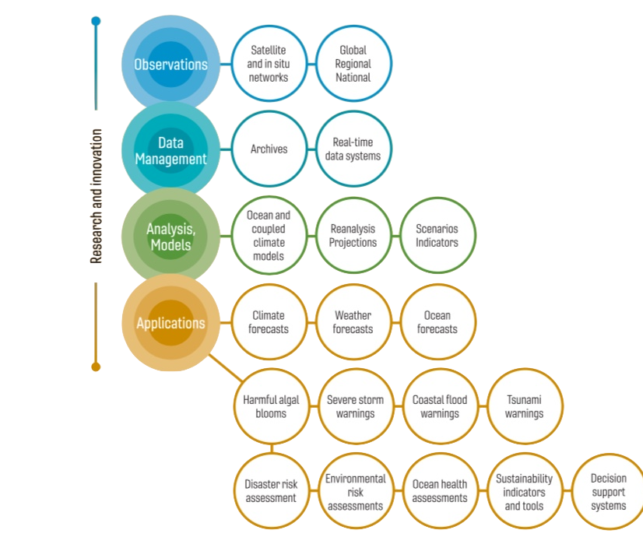
Sustained observations for a wide range of applications
Vision:
A truly global ocean observing system that delivers the essential information needed for our sustainable development, safety, wellbeing and prosperity
Partners
Notes:
Underpinning the strategy is the ocean observing value chain, and the need for the ocean observing system – satellite and in situ - to support a wide range of applications and for partnership along the value chain to ensure that the observations are fit for purpose.

Slide 6


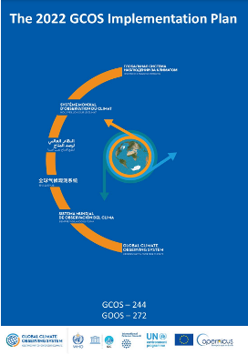
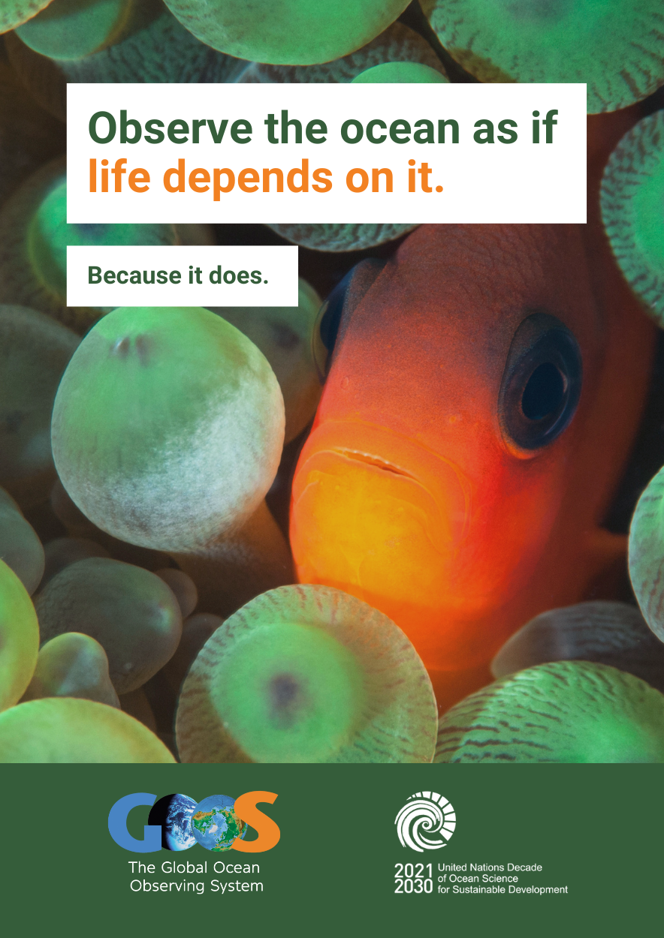

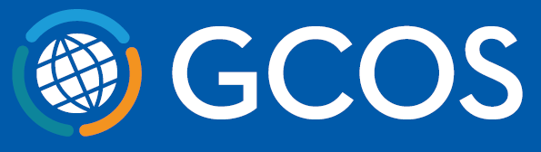



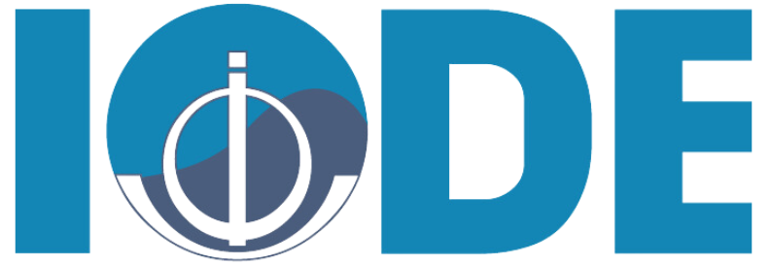

Advocacy within
United Nations
Implementing GOOS Communication Plan
Strengthened partnerships
CBD COP-16
COP-29
UNOC June 2025
Mailing list – GOOS Updates – articles, Report Card 2025
Communication toolkit
& GOOS brand update
Notes:
Implementing GOOS Communication Plan: Since August 2022, with a focus on both community and supporters/users, clear messaging and channels. Ocean Observing System Report Card is now fully cross GOOS.
Advocacy within UN: Increasing recognition of observing system and GOOS (e.g., Ocean Conference, COP27, COP28 and COP15, COP16).
Socio-economic valuation of ocean observations: A new approach in modelling their value in decision-making - It proposes an economic model, the Applied Policy Valuation of Ocean Observation (APVOO), to quantify the societal benefits of using EOVs for sustainable management.
Value chains in public marine data: A UK case study - 2021
Strengthened partnerships: WMO connection developed to the Rolling Review of Requirements, IODE and data, GCOS - ocean component of the GCOS Implementation Plan - work to strengthen with UNEP, GEO BON, MSP, and others.
Change: Building understanding need for ocean observing and GOOS - through consistent and clear messaging across communications and advocacy. We have adopted a professionally developed Communications Plan last August that channels and focuses our communications on both our observing community and on the supporters, users and funders (broader audience) on the observing system.

Slide 7
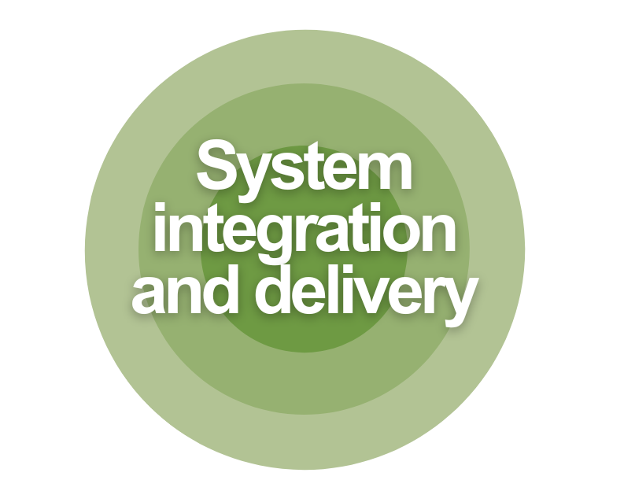

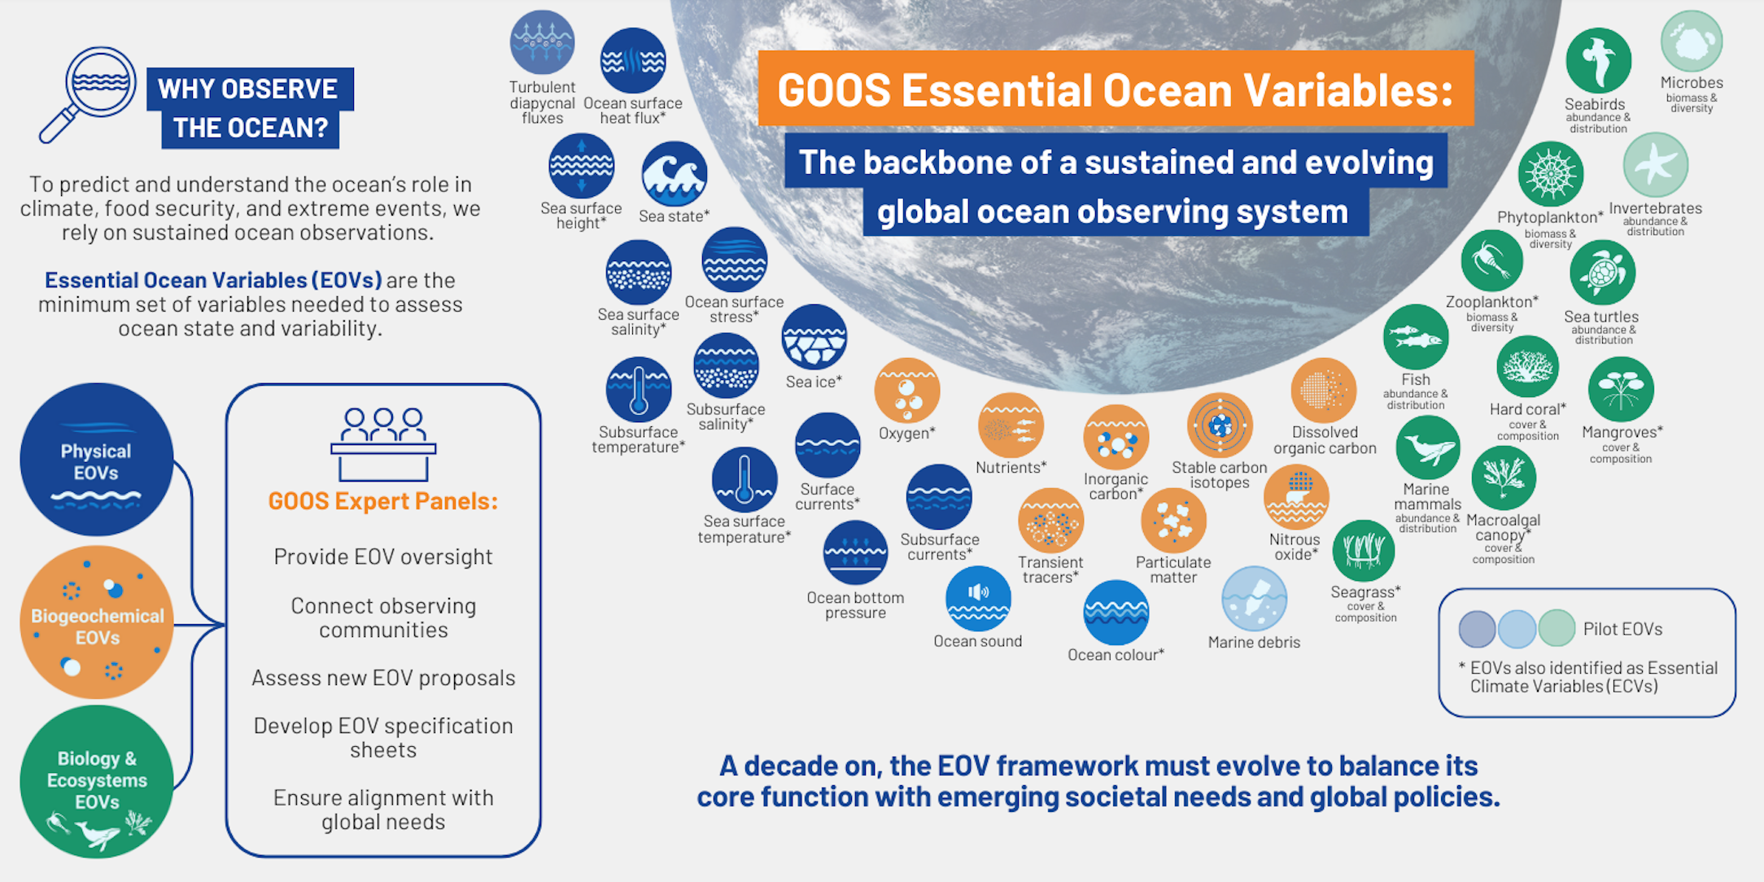
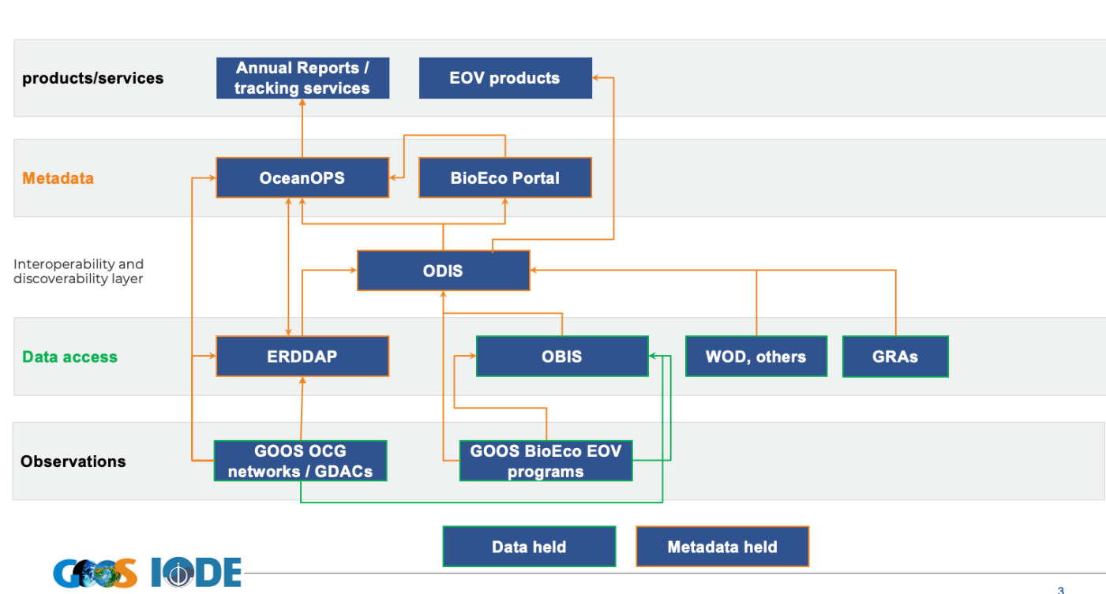
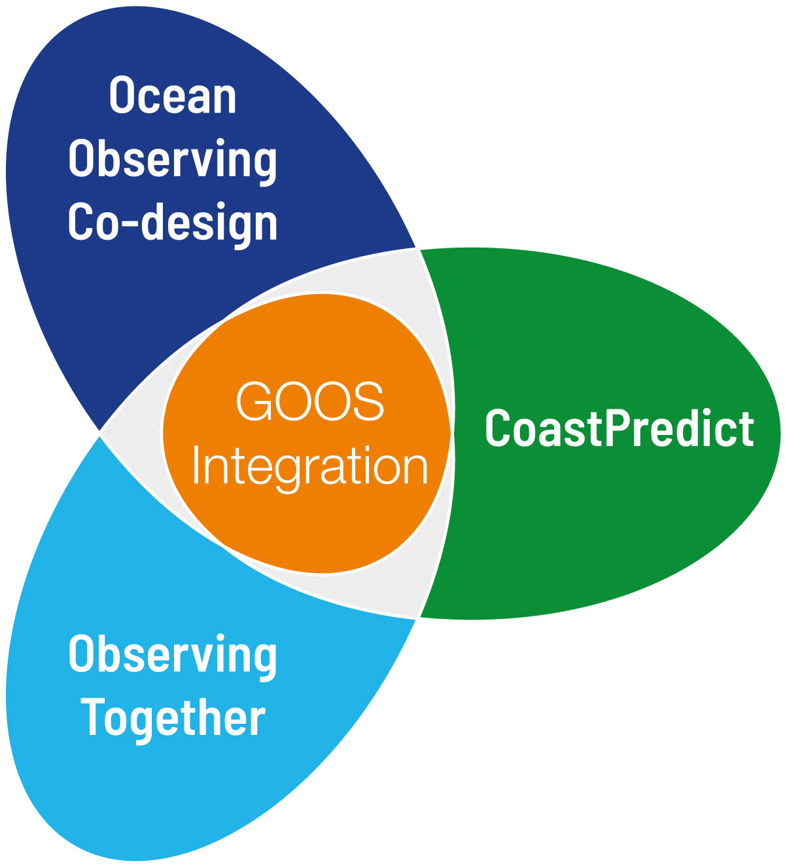

Structure & Standards
User focus – connecting down the value chain
Ocean Decade Programmes and Projects
WMO RRR work - first Ocean Applications Category >>> first Statements of Guidance
Digital Ecosystem
EOV Paper Submitted (Marine Policy)
11 GOOS endorsed best practices – SOT endorsed Best Practice
First GOOS-IODE Data Workshop Sept 2024 >>> IOC Architecture (concept IOC Assembly)
OCG Data Strategy Data TT work plays a key role, minimum metadata, ERDDAP nodes, EOVs, provenance

Slide 8



Carbon and Greenhouse Gas Plan
Biodiversity Plan
Developed under the BGC Panel with the collaboration of the Ocean Observing Co-Design Programme
An important plan in the GOOS response to the GCOS IP and the WMO G3W
Collaboration with other panels to coordinate carbon observations to complement inorganic carbon efforts
Collaboration with Ocean Observing Co-Design – pillar 3 of the plan
Goal of the plan: to serve as a roadmap to coordinate global efforts in marine biodiversity across all GOOS structures and components >>> IOC Biodiversity Plan
Integrated with IODE/OBIS
Collaborate key international partners active in marine biodiversity monitoring
2026-2027: Implementation of the GOOS Biodiversity plan

Slide 9





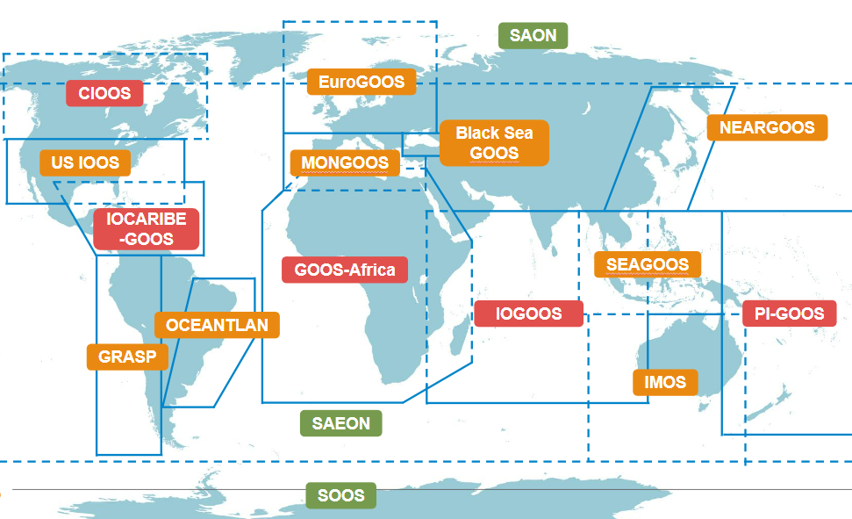

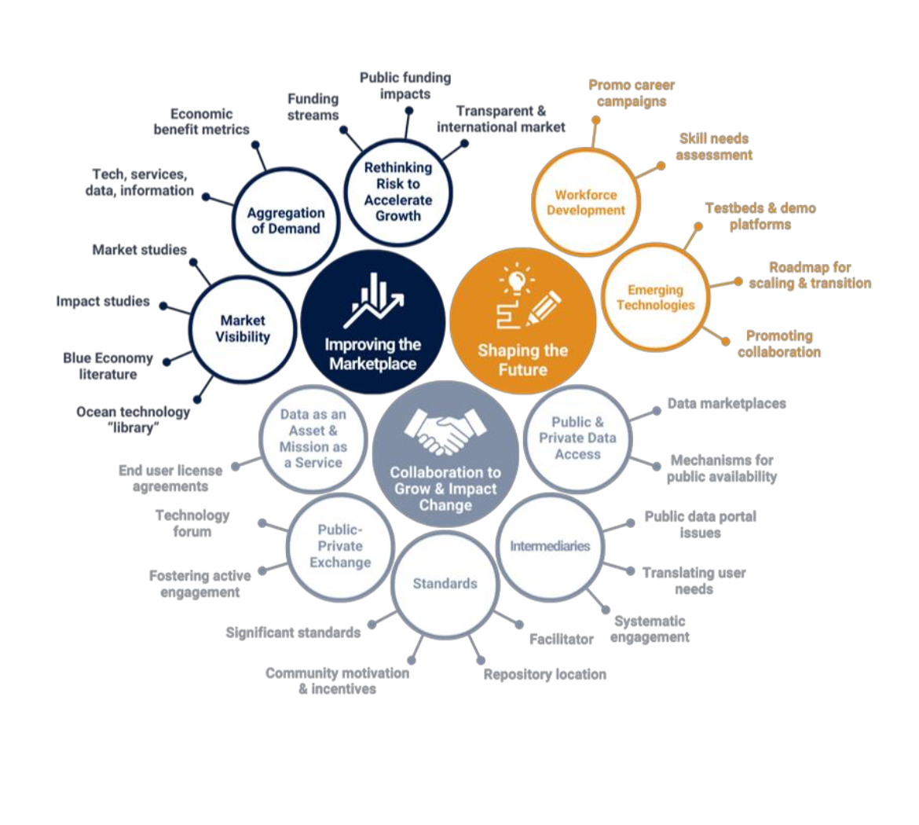

Collaboration with private sector
Tracking human impacts
National Focal Points & Regional activation
3 Essential Ocean Variables
77 GOOS National Focal Points
GRA regions being reinvigorated Africa, Caribbean (IOCARIBE), Pacific Islands, Indian Ocean
An opportunity to expand observing capacity, increase efficiency, and support blue economy
Marine debris
Ocean colour
Ocean sound

Slide 10
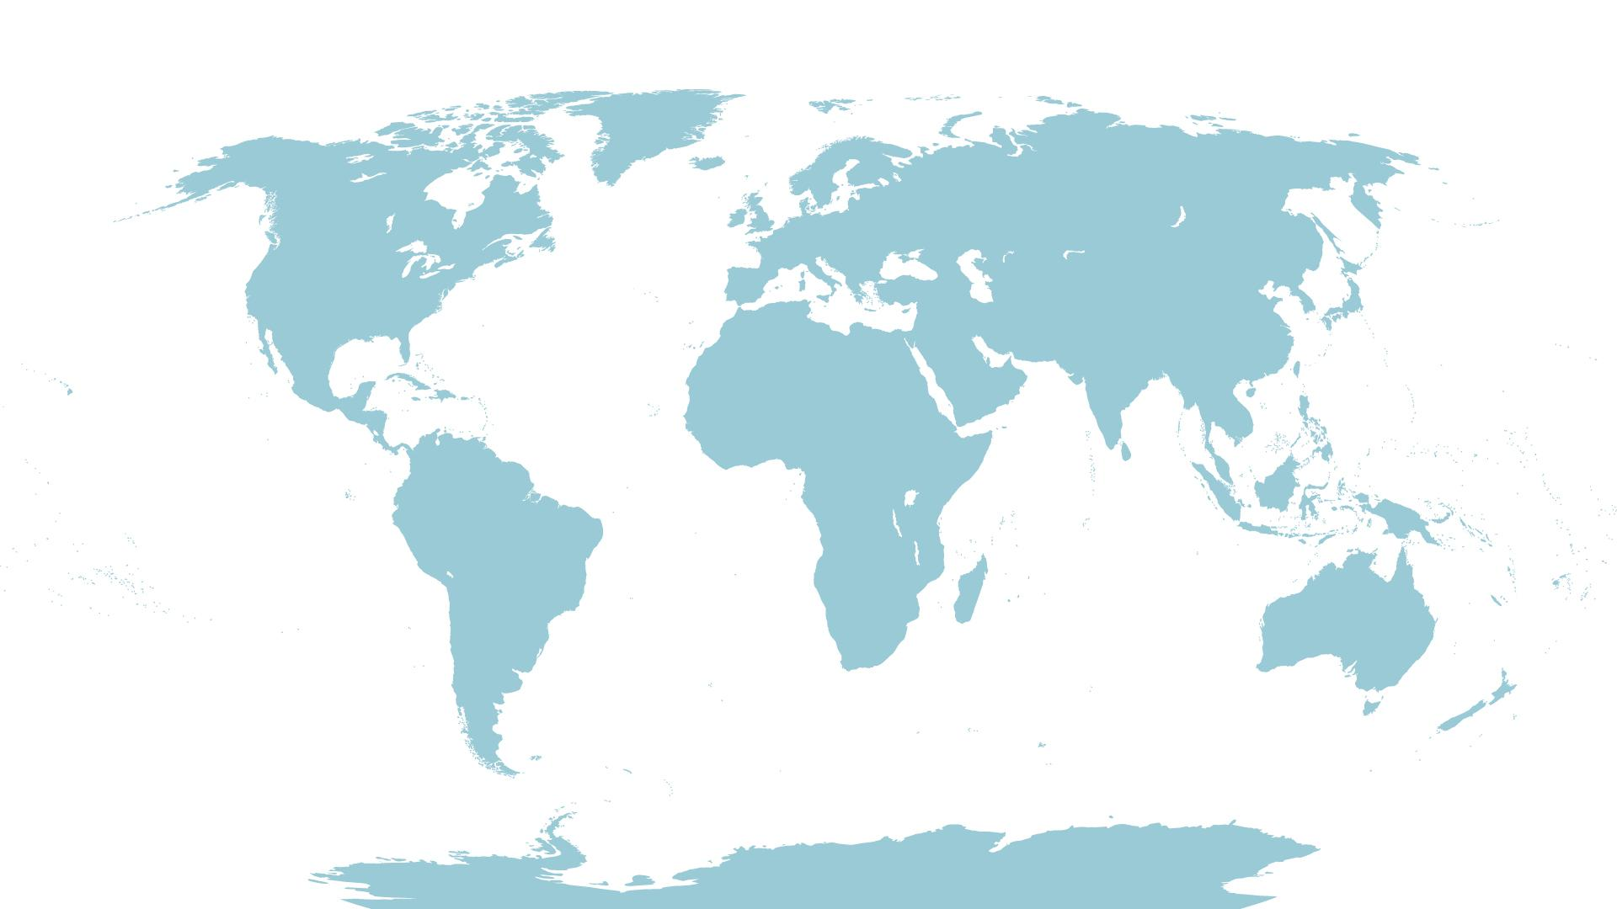





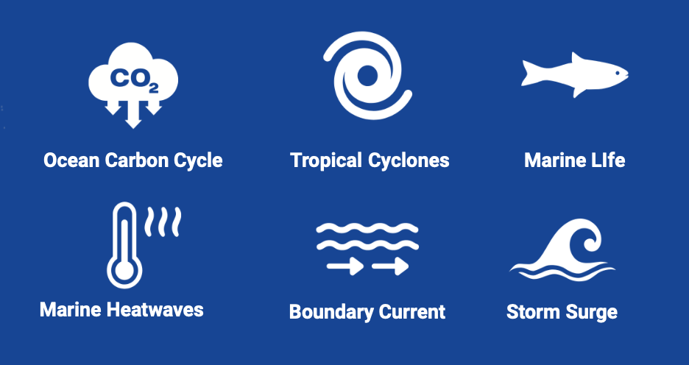
Co-Design Pilot Areas
Notes:
Suggested pilot areas for Ocean Obs Co-design
Looking forward to working with regions

Slide 11

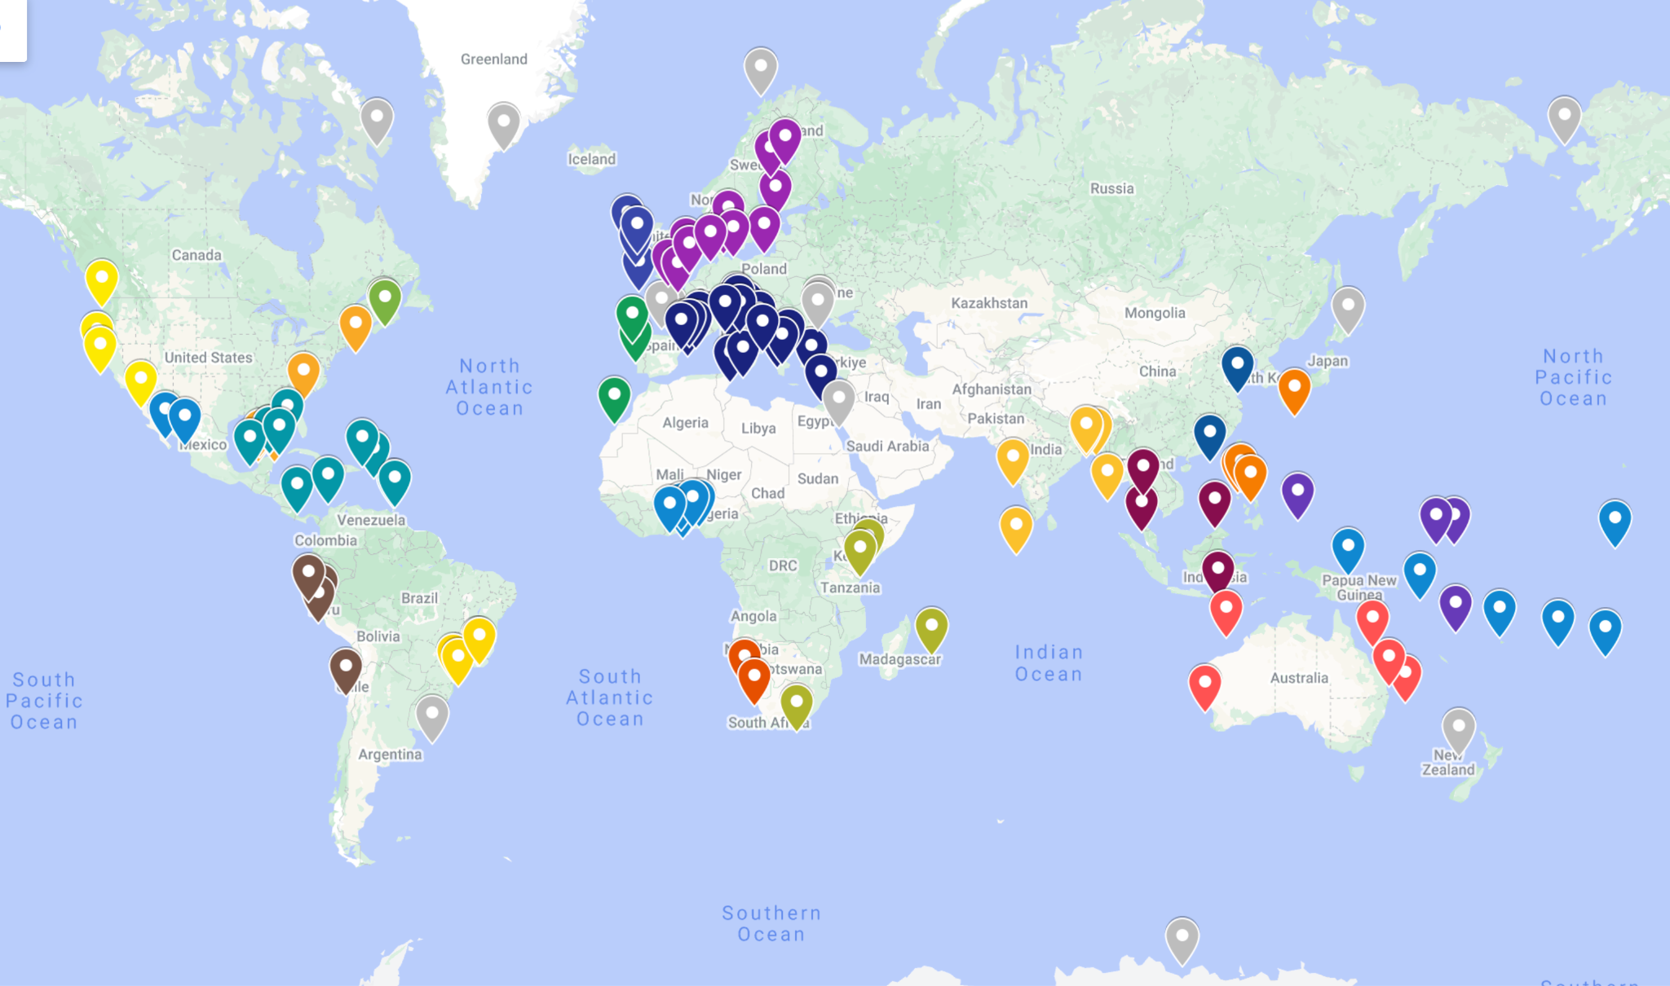
GlobalCoast Network and Adaptation Fund regional projects
‘Pacific Islands’
‘Caribbean’
‘South East Asia Seas’
Pilot Sites are areas of ~200 x 200 km² within Global Coastal Ocean Regions
Notes:
The Adaptation Fund has been identified as a suitable funding platform to fund implementation in certain regions.
The Adaptation Fund finances projects and programmes that help vulnerable communities in developing countries adapt to climate change. Initiatives are based on country needs, views and priorities.
Since 2010, the Adaptation Fund has committed about 1.25 billion for climate change adaptation and resilience projects and programmes, including 183 concrete, localized projects in the most vulnerable communities of developing countries around the world with about 45.8 million total beneficiaries.
The initial candidate regions are South East Asia Seas, Caribbean and Pacific Islands
The regional approach is taken because this is most pragmatic for oceanographic reasons and from a funding perspective regional projects will not reduce the national allocation allowable for each country under the Adaptation Fund

Slide 12
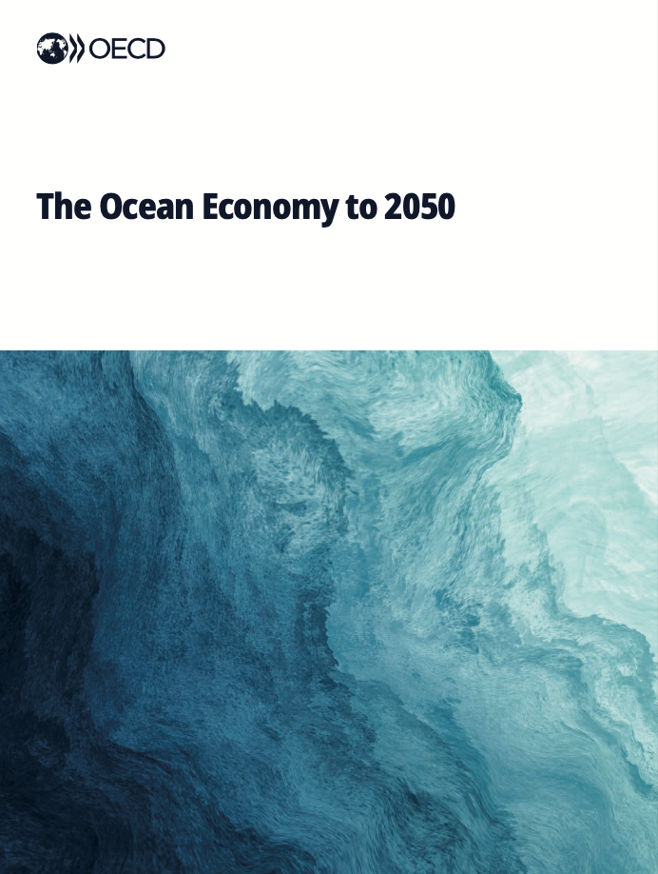
Ocean Observing as Critical Infrastructure
The current structure and funding of the Global Ocean Observing System (GOOS) are insufficient to provide the data needed to meet the requirements of Member States, which are, and will increasingly rely on this system for operational forecasting, preserving ocean health, sustainable ocean planning, climate change mitigation and resilience and the oce an economy.
Effective decision-making in the ocean economy depends on robust, real-time data. Strengthening ocean observation systems is crucial to addressing data gaps that limit the capacity to monitor ocean health and inform policy.

Slide 13
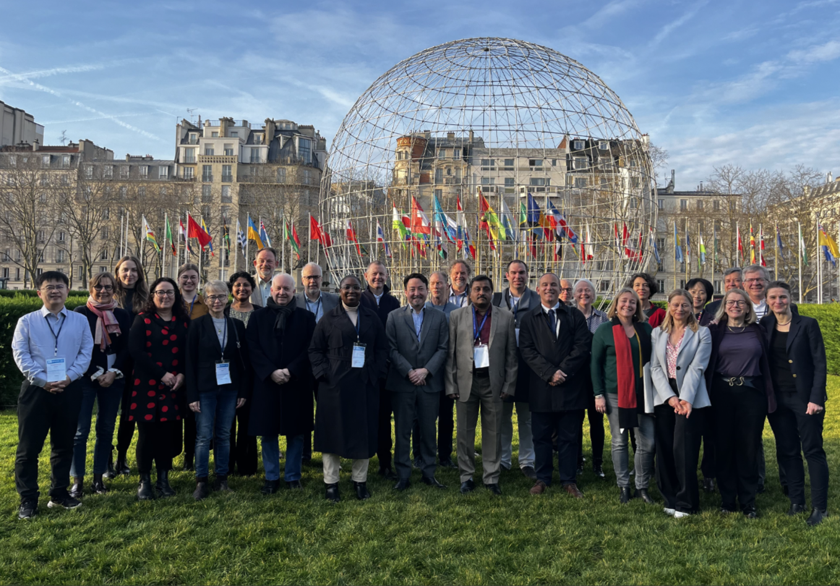
Fourteenth GOOS Steering Committee – Feb 2025
Key areas
RRR > Global Basic Observing System (Future JCB work)
Biodiversity Plan, Carbon Plan
Digital Ecosystem – IOC Data Architecture
Private Sector collaboration development – shipping companies/SOT, MEI, Ocean Decade
Partners - Science, Satellite, Government, UN
Communication – critical infrastructure, speaking with one voice
Integrating Ocean Decade work/pilots – co-design, new collaborations
GOOS REFORM
Strengthening alignment with IOC and WMO

Slide 14






GOOS Steering Committee Focus Areas 2025-2027
1. Core coordination
2. Observation system design and development
3. Strengthening data integration and delivery
4. Supporting implementation
5. Partners and communication
6. GOOS Reform
WMO / IOC
OceanOPS
GOOS Steering Committee
Expert panels (OOPC, BGC, BioEco)
Carbon Plan
Biodiversity Plan
WMO Rolling Review of Requirements (RRR) and Evolving GBON
Refining EOV-led indicators
IOC data architecture (cross-IOC sections)
Observations Coordination Group and GOOS Networks
OceanOPS
Bioeco Portal
Applications
National Focal Points
Global Regional Alliances
Projects
Partners (Science, Government, UN, Satellite, Private Sector)
Communication including toolkit
GOOS status report card
Double diamond approach
1. Mission & Scope – the Why and What
2. Users, Implementation and Communication – the How?
Ocean Decade Programmes

Slide 15
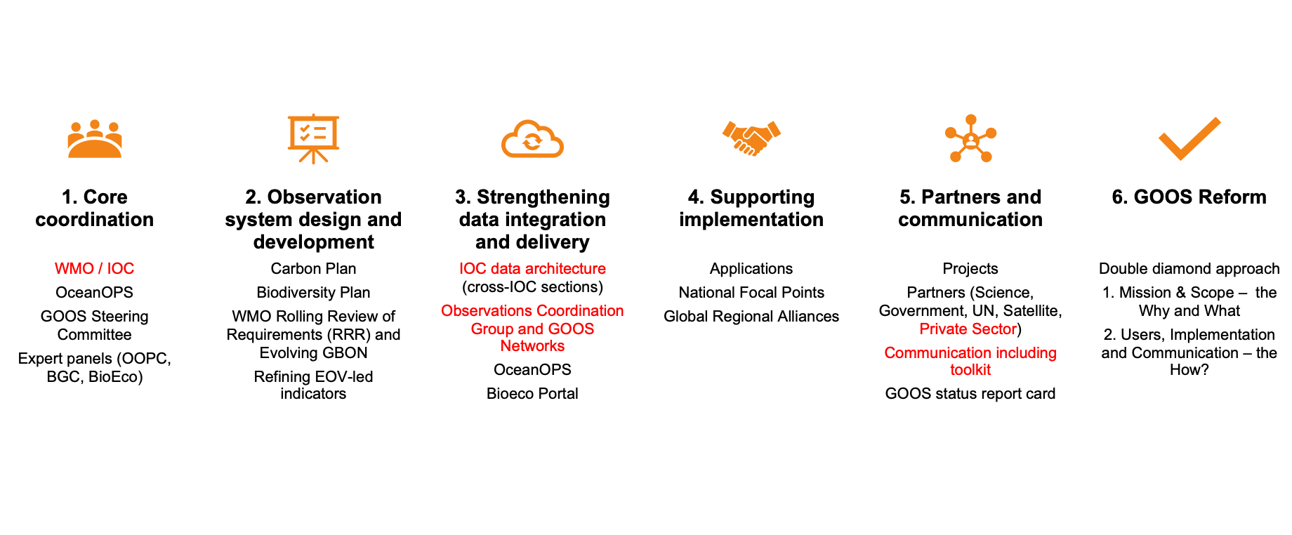
GOOS Steering Committee Focus Areas 2025-2027
Ocean Decade Programmes

Slide 16

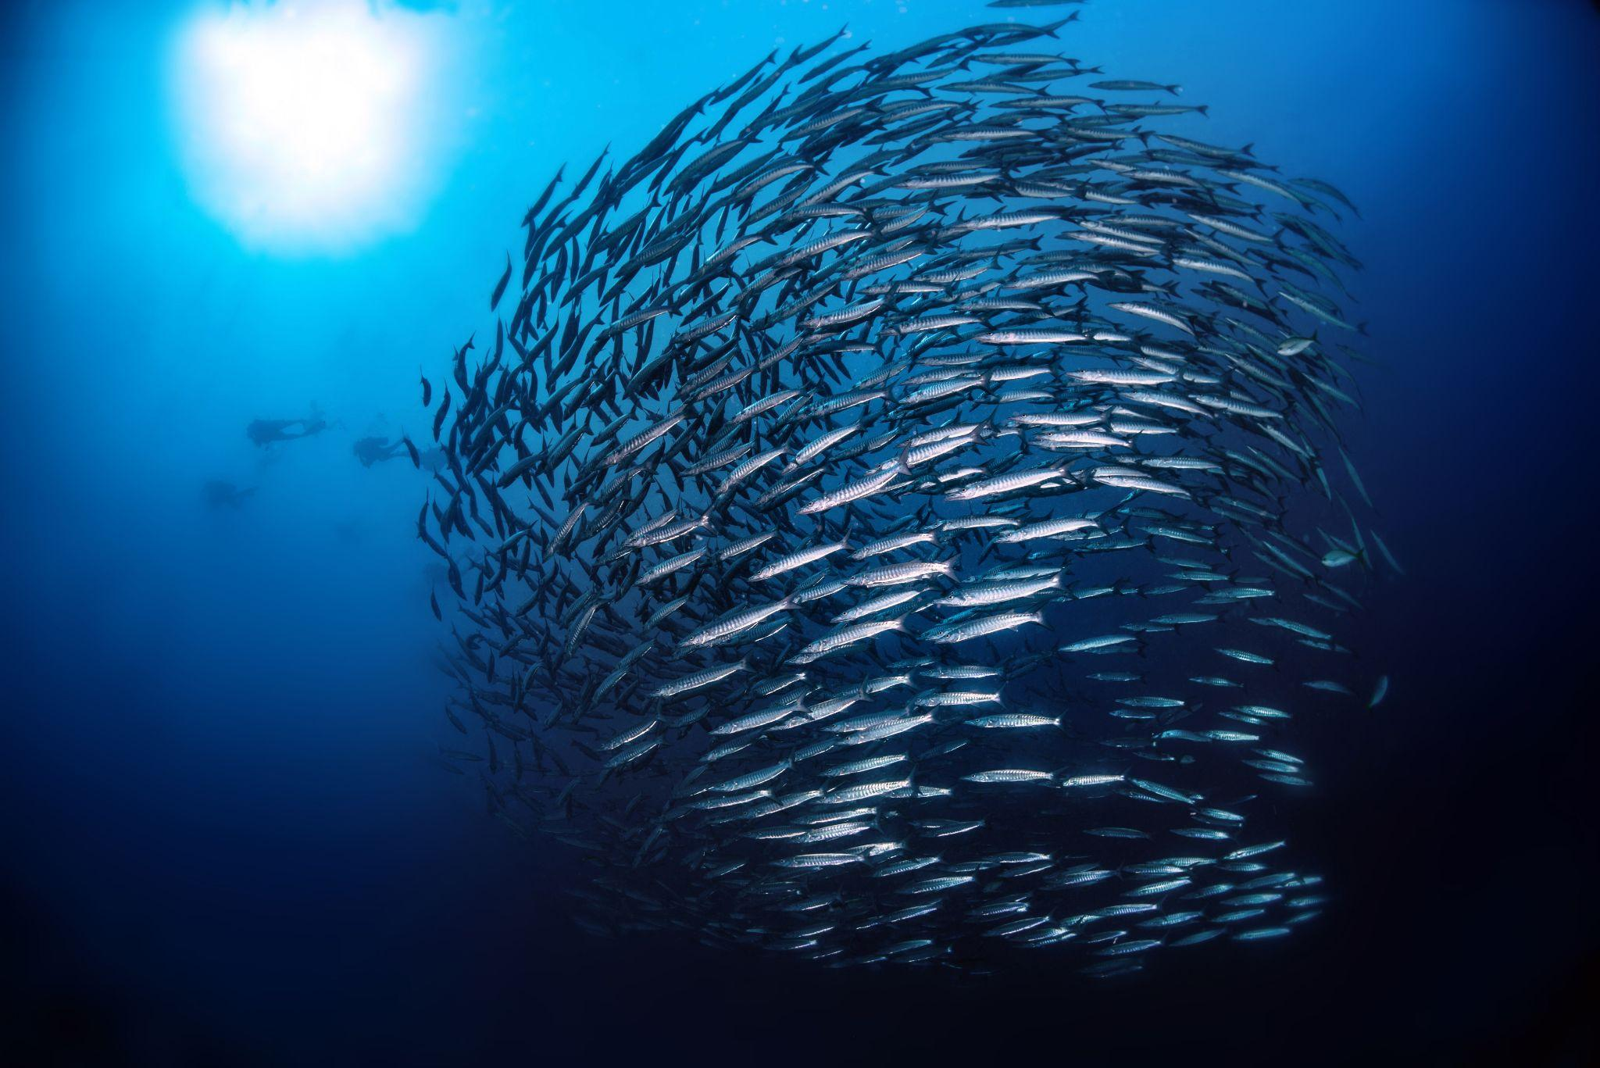
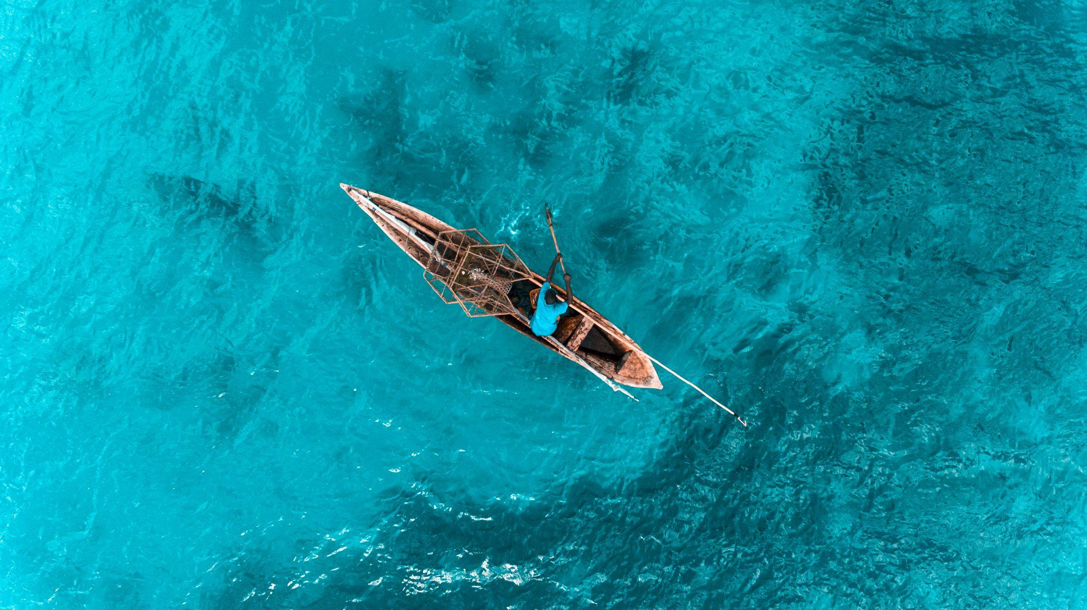

IOC Assembly (A33) June 2025
OONJ
WG reporting out - consider best practices - SOOP
JCB
WG Data, WG on GBON
OBPS
IODE-GOOS > IOC
IOC Data Architecture
GOOS Governance Reform
GOOS Workplan
IOC Medium Term Strategy
Sustainable Ocean Management and Planning (SOPM)

Slide 17
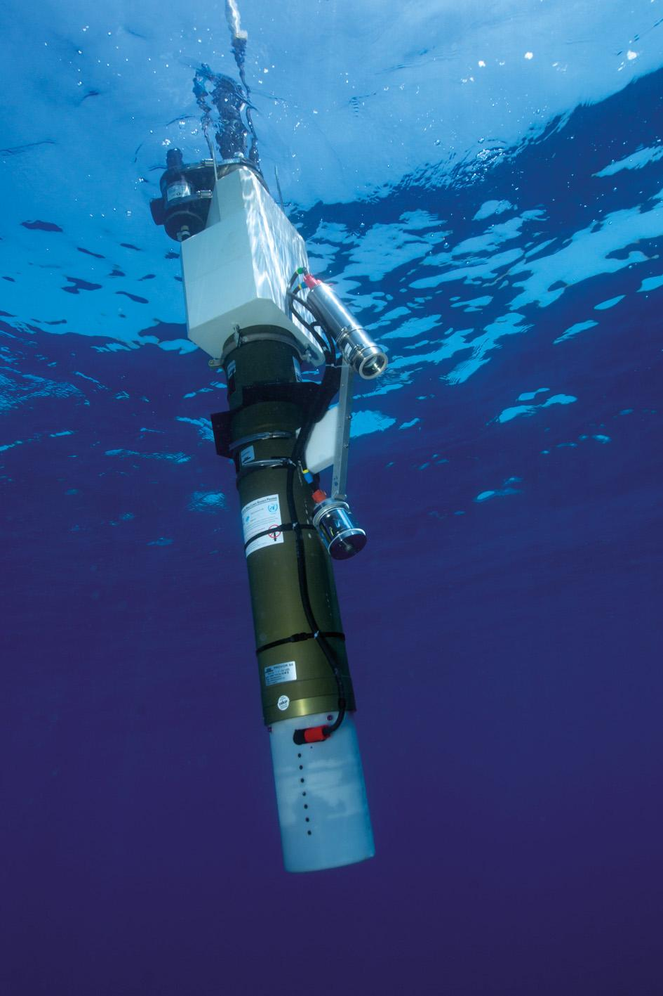
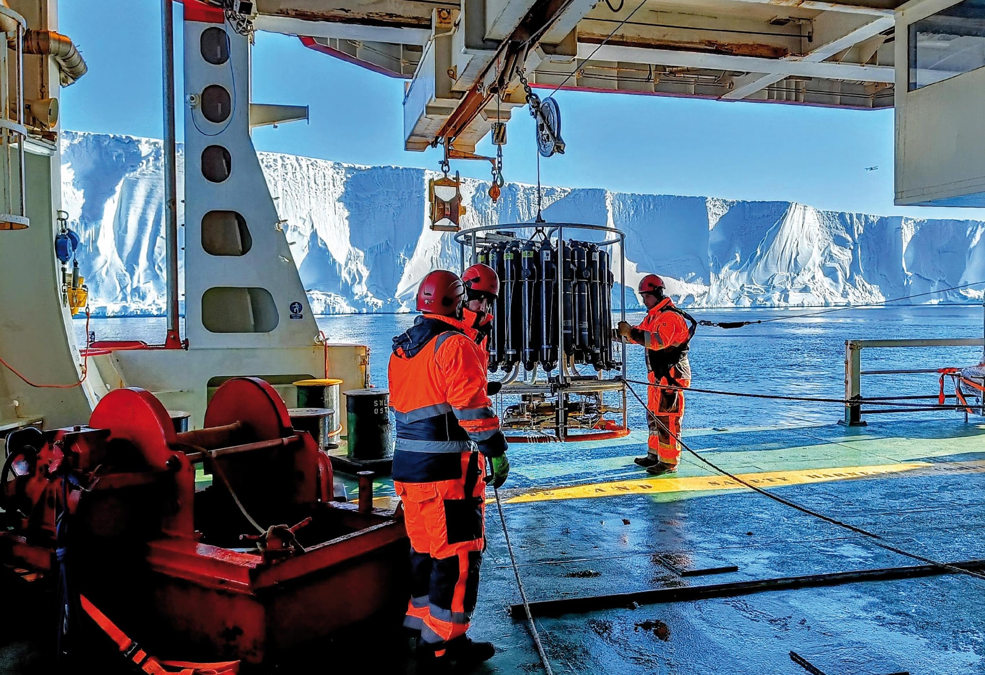
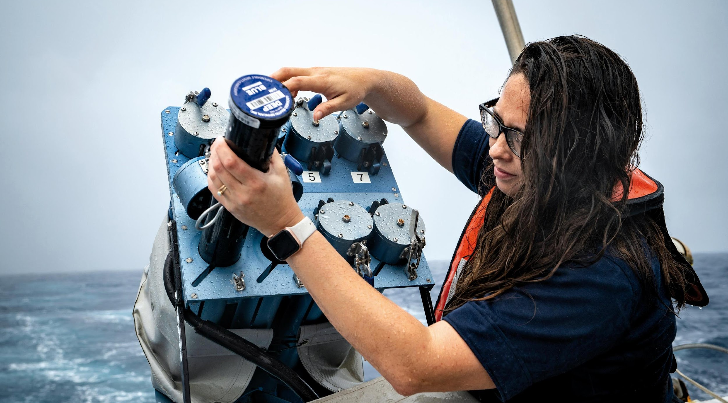
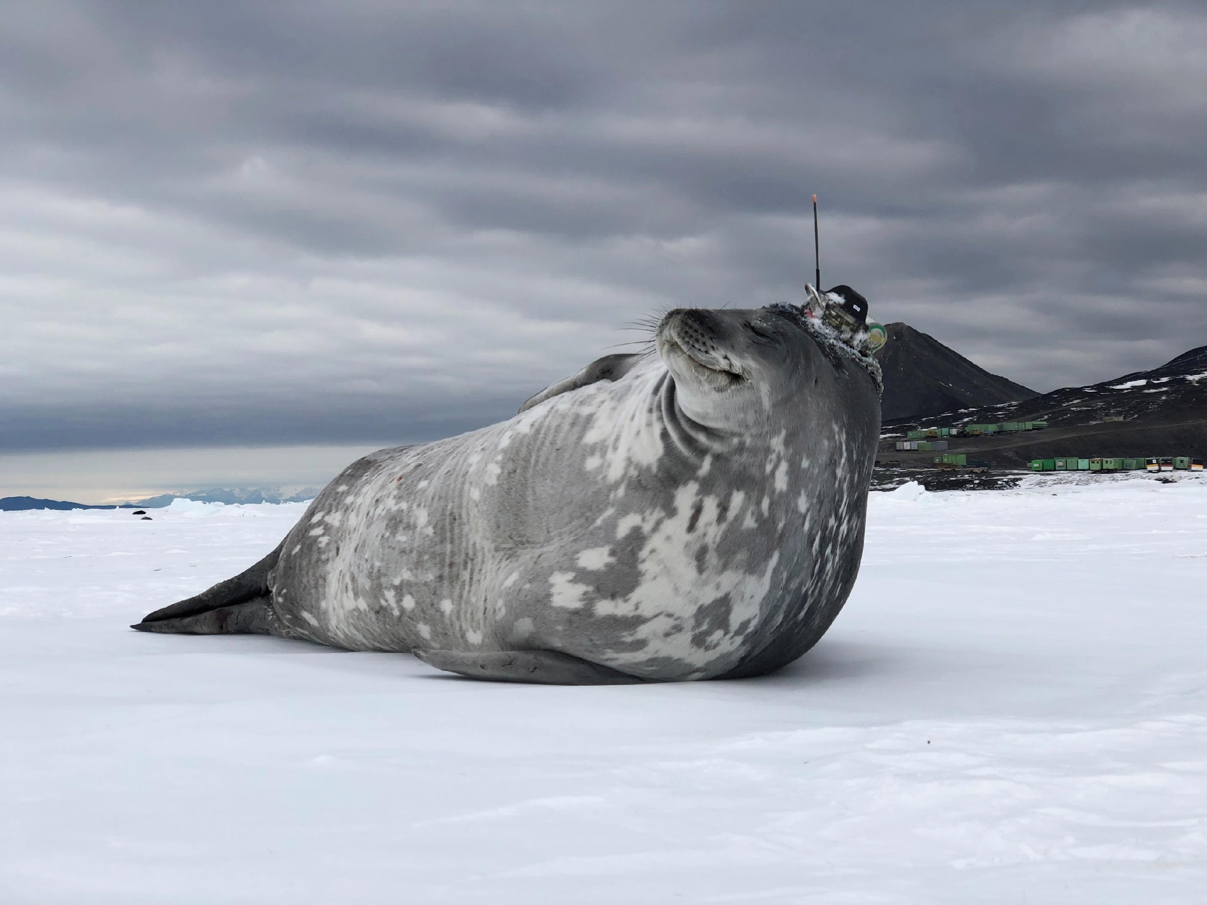
Thank you
goosocean.org

Slide 18
IOC Medium Term Strategy (2022-2029) High-level objectives and priorities
1. Healthy ocean and sustained ocean ecosystem services
2. Effective warning systems and preparedness for tsunamis and other ocean-related hazards
3. Resilience to climate change and contribution to its mitigation
4. Scientifically-founded services for the sustainable ocean economy
5. Foresight on emerging ocean science issues.

Slide 19


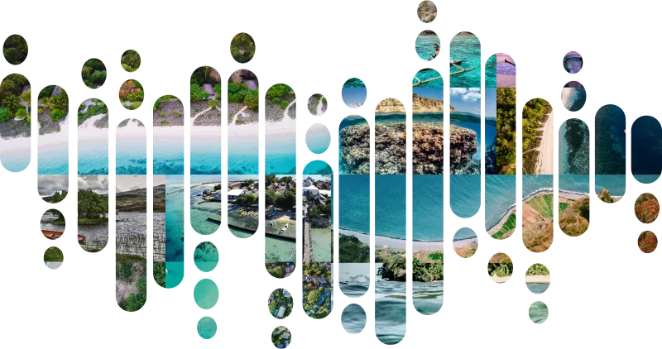

Ocean Observing
Co-Design
GOOS Decade Coordination Office: Ocean Observing
CoastPredict
11 Ocean Decade Programmes
91 Projects
30% Ocean Decade Actions
Co-Design observing-modeling-users
Establish clear investment priorities
Accessible ocean information
Effectively meet global challenges
6 Co-Design Exemplar Projects
GlobalCoast - implementation
125+ Pilot Sites
65+ countries
Multiple regions
Revolutionise global coastal observing and forecasting
Ocean Decade Challenge 7
Vision 2030 White Paper
https://oceanexpert.org/document/33599
Notes:
Finally, GOOS is very active in the Ocean Decade, using this to help transform GOOS, implement the 2030 Strategy and Ocean Decade - :
The Co-Design programme is tackling key areas in which we need more observations using co-design process with modelling and with users to ensure the observations are optimised, we can express their value, and reach their targets as services. There are 6 ‘first off the block’ Co-Design Exemplar Projects with several now maturing towards pilots including tropical cyclones, boundary currents, marine heatwaves and ocean carbon.
CoastPredict aims to revolutionize coastal observing, forecasting and service delivery, and GlobalCoast is the overarching implementation project, and has identified more than 120 pilot sites across the globe, covering 30 oceanographic regions and 65 countries.
Ocean observing is important to the Ocean Decade, it will underpin work towards a sustainable future and work of the other 9 challenges, expanding ocean observations is vital to the work of the Ocean Decade. GOOS supports the Ocean Decade Coordination Office for Ocean Observing (also supported directly by the Ocean Decade). This Decade Coordination Office for Ocean Observing connects and supports the ocean observing programmes - and this is quite a big job - there are 11 Programmes, 91 projects, which represents fully 31% of all Ocean Decade Actions. The DCO for Ocean Observing also connects to similar bodies for modelling and data to connect flow of data and information
GOOS will continue this transformative work with the Ocean Decade, but also looking to transforming GOOS and be an integral part of GOOS work in building for the future.

Slide 20
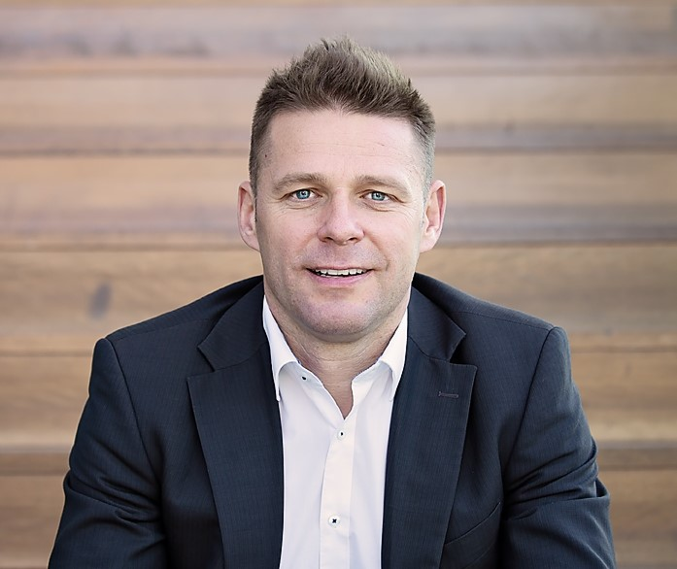
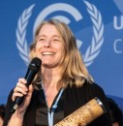
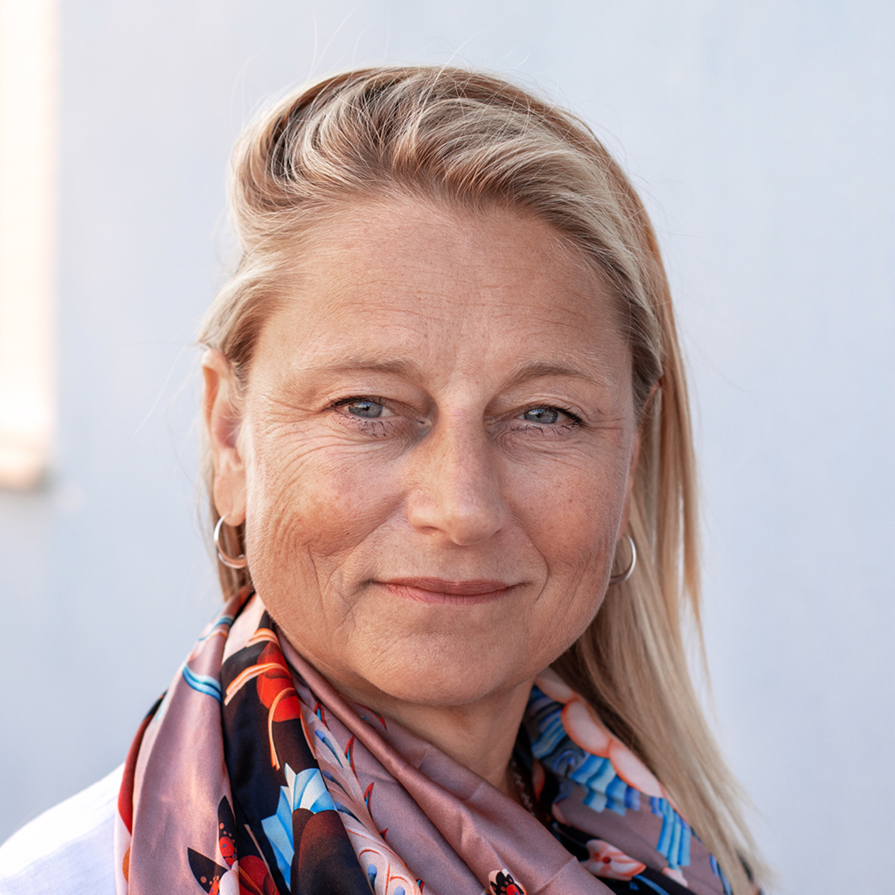

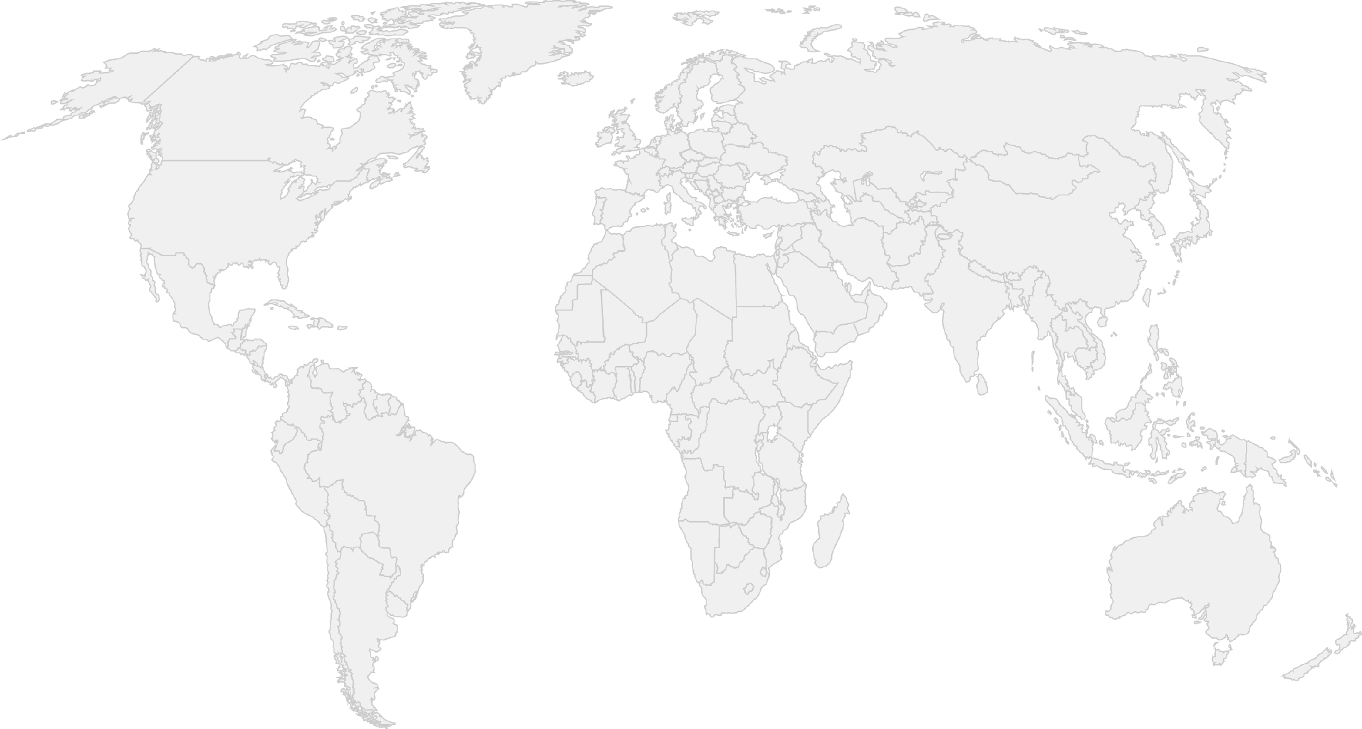
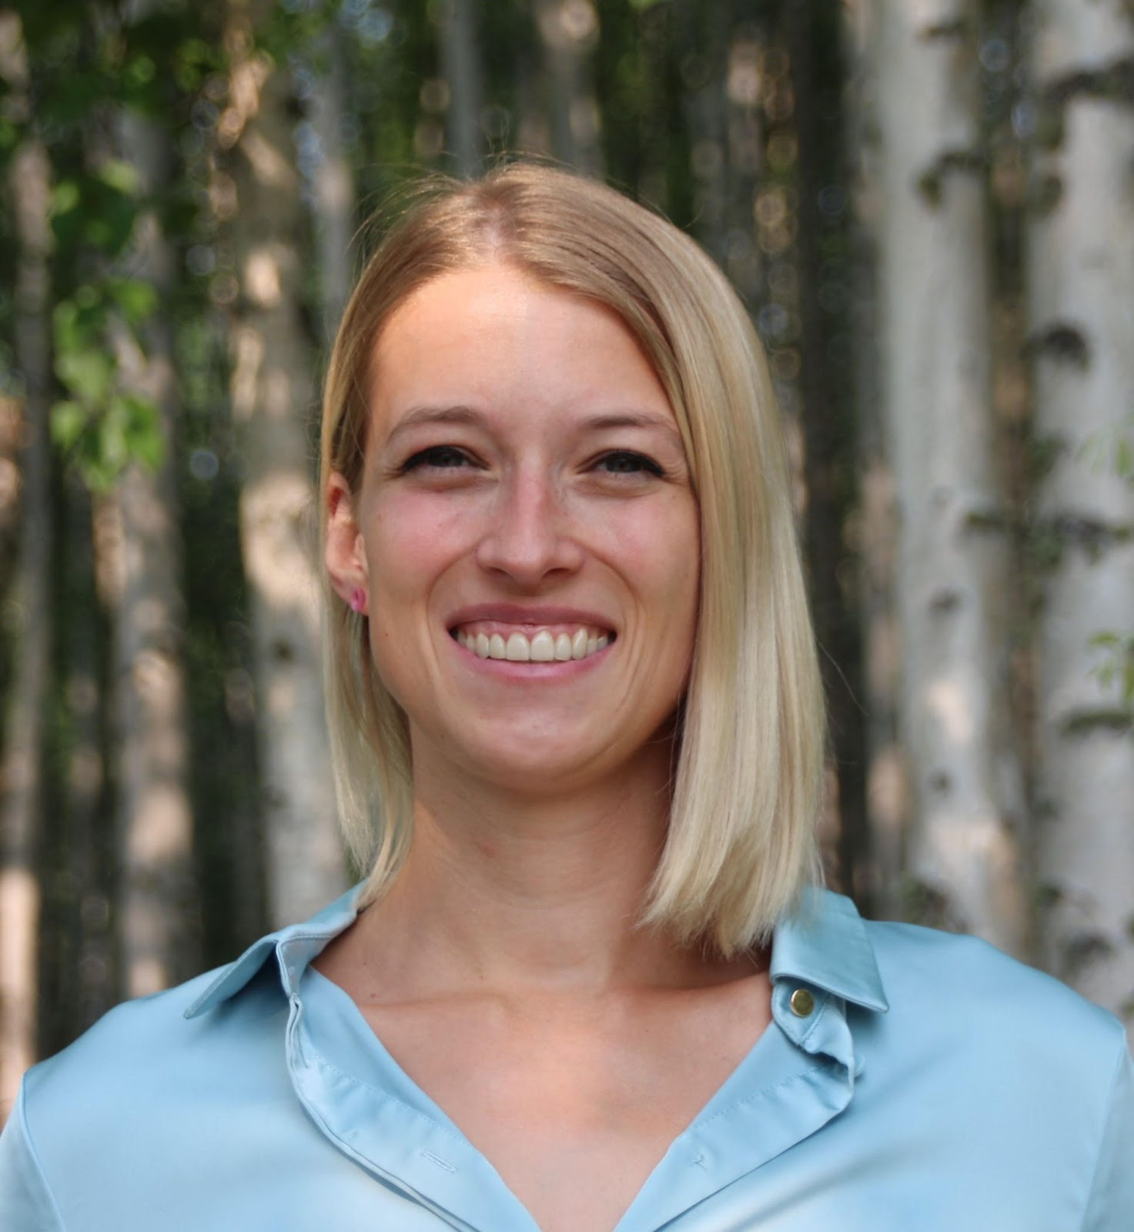

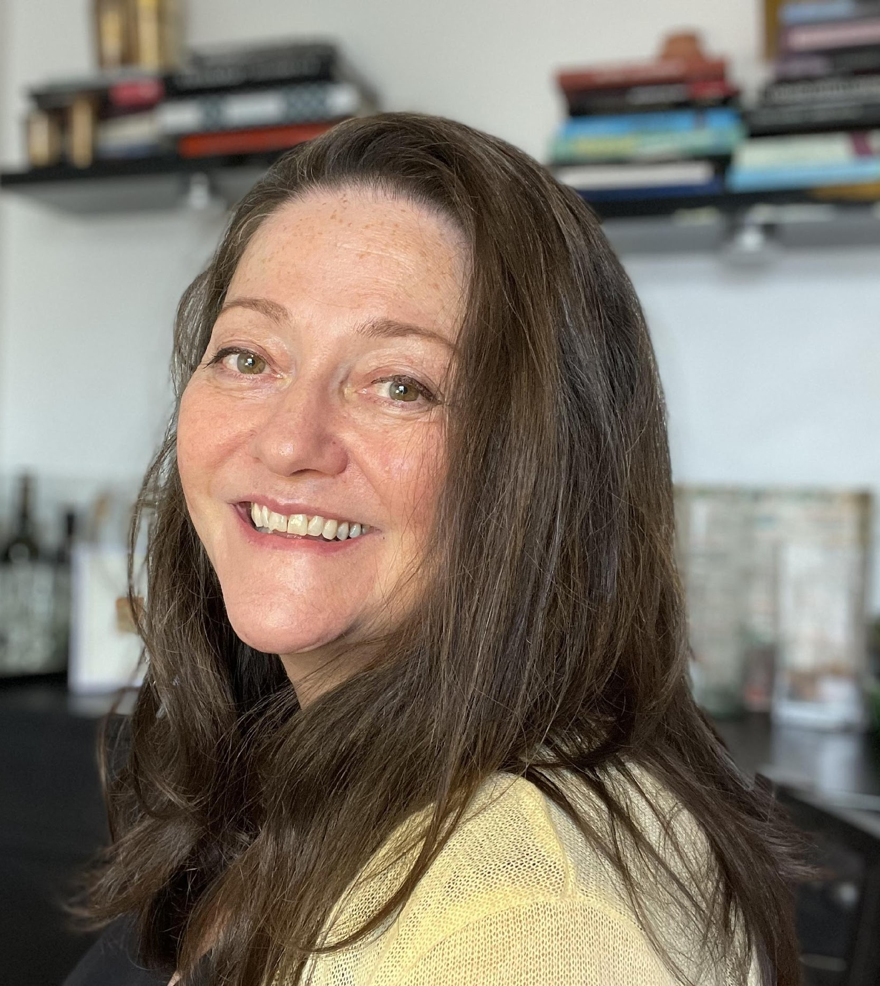

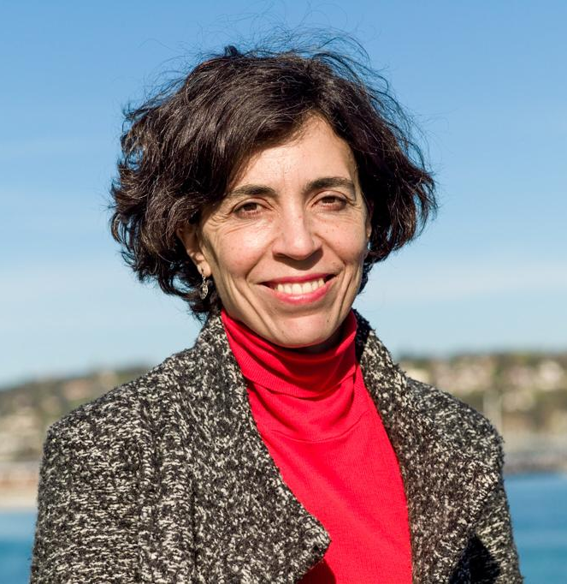
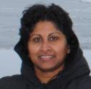
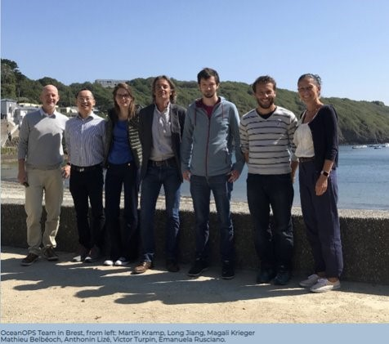
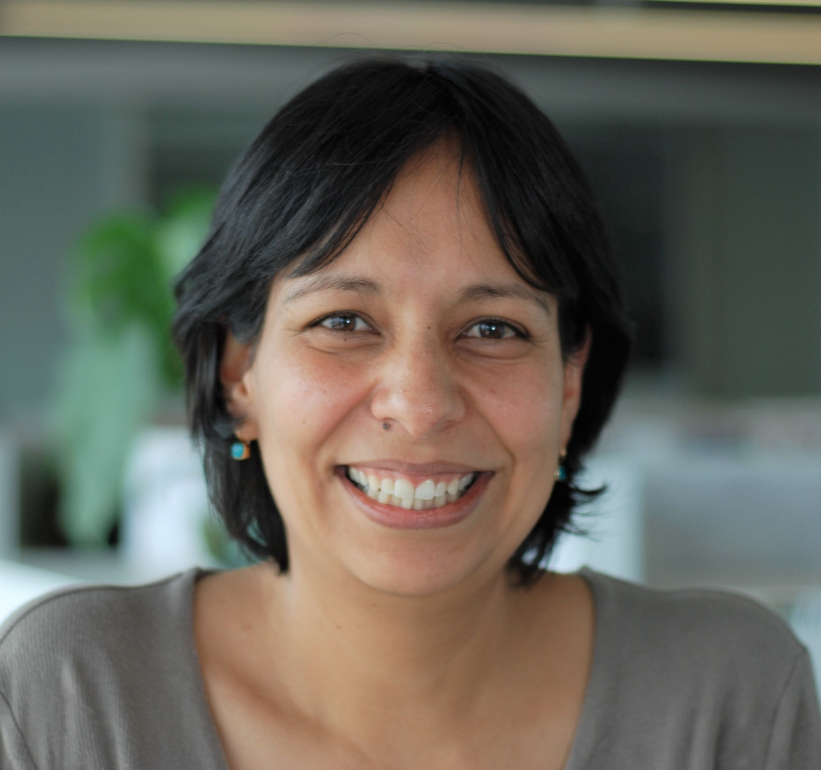
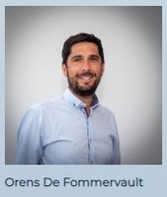
GOOS Coordination Office
Maciej Telszewski BGC Panel
IOCCP, Sopot, Poland
Ann-Christine Zinkann,
OCG / Networks NOAA, US
Joanna Post, Emma Heslop, Emily Smith
Yu Ting, Forest Collins
GOOS headquarter in Paris, France
Laura Stukonyte,
GOOS communication, Barcelona, Spain
Belen Martin Miguez, and Champika Gallage
OOPC Panel Networks/ Standards
WMO headquarter in Geneva, Switzerland
Ana Lara-Lopez
BioEco Panel Hobart, Australia
OceanOPS team, Brest, France
From left: Martin Kramp, Long Jiang, Magali Krieger, Mathieu Belbeoch, Anthonin Lize, Victor Turpin, Emanuela Rusciano and
Orens de Fommervault, Monaco, France

Slide 21



Ocean Observing Co-Design will develop a more user-focused co-design process to evolve a truly integrated, responsive ocean observing system.
CoastPredict will revolutionise Global Coastal Ocean observing and forecasting, offering open and free access to coastal information and predictions.
Notes:
GOOS has exciting and transformative programme in the ocean decade, aiming to transform GOOS and deviler the ocean we need for the future we want.
Co-design and CoastPredict
w

