Slide 1


OceanOPS
- Service Level Agreements -
J. Turton, A. Zinkann, M. Belbeoch and C. Gallage
OCG-16 Session, 07 - 11 April 2025
Ifremer, Brest, France
Notes:
Ann

Slide 2
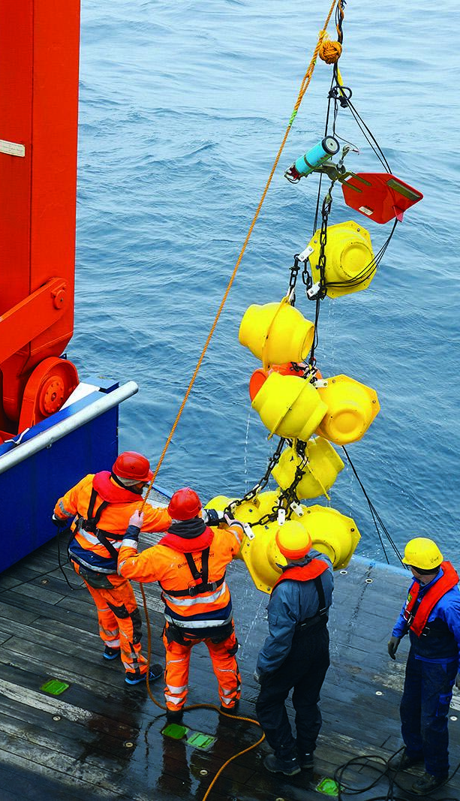
Vision & Objective
After the restructuring of OceanOPS it has been agreed that Service Level Agreements (SLAs) should be developed between OceanOPS and the GOOS OCG Networks to provide a framework for structuring OceanOPS services and identify priorities
The SLA should:
Determine responsibilities and expectations for OceanOPS and the GOOS Networks
Define the services that OceanOPS will provide to each network
Determine the tiers of services
Assist in identifying priorities
Align services with the resources allocated to OceanOPS
Notes:
Ann

Slide 3

Overview
ACTIONS
Discussions initiated at OCG-15
Establishment of the OceanOPS Development Task Team
Initial feedback from Networks on Services
Five Task Team monthly meetings to develop SLA outline with regular Network feedback
Bilateral network meetings mostly complete
OUTCOME/ACTIONS
Final SLA overview: 3 tiers - Baseline / Standard (+) / Advanced
Cost estimation by OceanOPS to be reviewed by OceanOPS Management Board and OCG Exec
Draft Letter of Agreement to be reviewed and signed
Notes:
Ann

Slide 4
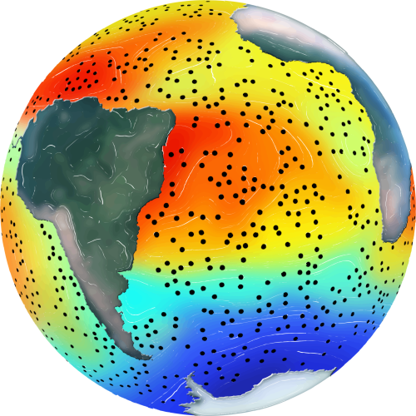
Timeline for OceanOPS TT
🌀 OceanOPS TT sessions
🌐 OCG session
🌎 OCG Roundtables
Strategic Plan retreat
2024 Q3
2024 Q4
2025 Q1
2025 Q2
2025 Q3
2025 Q4
🌀
🌀
🌀
🌀
🌀
🌎
🌐
Services Survey
Networks SLA #1
OceanOPS 3.0
OceanOPS 3.0
Marketing
Networks SLA #2
Define core/direct/new services
Gather initial Networks requirements and feedback
Refine Networks specifics and sign SLAs for 2025
Assess OceanOPS ability to meet SLAs
Draft SLAs for 2026 and synthesise needs
Develop conceptual approach to OceanOPS new and distributed services
Refine value proposition and messages
Further consult with GOOS/OCG, IOC, WMO, OceanOPS stakeholders
Develop 2026-30 Strategic Plan
Develop initial communication material and marketing plan
Implement marketing plan
Raise funds, collectively and individually
Sign renewed SLAs for 2026
Finalize OceanOPS Strategic Plan 2026-30
Continue fund raising
Notes:
Ann

Slide 5
SLA Responsibilities [see details in SLA document]
OceanOPS
Ensuring the availability of service as per the defined SLAs
Monitor and maintain the service level objectives, through defined performance metrics
Provide a yearly report at GOOS OCG session on service performance
Monitoring the SLA progress for each network
Tracking the dedicated FTE effectively provided
Tracking the incoming funds by Network
Network [see SLA document for specifics]
Access to required resources and information, metadata and data exchange from a global or local data/metadata node
Focal point (technical coordinator or project officer) who will contribute in-kind to the services if any
Promptly report any issues with the services
Ensuring the timely payment for the service rendered
Notes:
Ann

Slide 6

Tiers of Services
Baseline Services
Largely automated cross-cutting services applicable to all endorsed OCG networks
Core funding by IOC/UNESCO, WMO, non-network specific contributions, host (Ifremer)
Standard Service (and +)
Package of more advanced levels of services to those networks providing funding
Minimal technical coordination to ensure standard service delivery Standard Plus option enables the networks to secure services of a dedicated technical coordinator and optional Project Office support (0.25 or 0.5 FTE)
Advanced Services
Builds on Standard Services and are network-specific
Dedicated technical coordination (⩾0.75 FTE)
Notes:
Ann

Slide 7
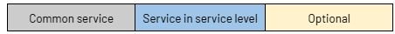
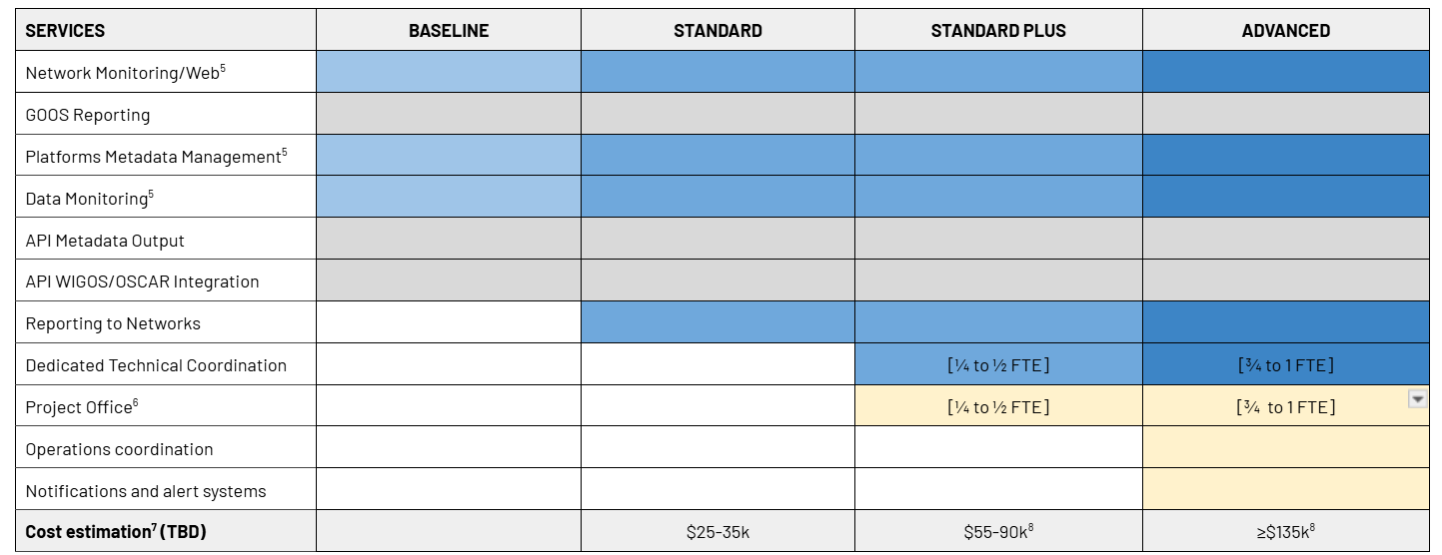
Tiers of Services
*Note that for advances services: The level of the direct services and dedicated network support is agreed with each network and reflects the level of financial support provided to OceanOPS by the network.
Notes:
Ann

Slide 8
GOOS Network Service Levels
3.75 networks Experts required: 2 (core staff) + 0.75 (in kind) + 1 (project recruitment)
NEXT STEPS
OCG to develop a collective marketing plan to assist in raising technical support to Networks
Assess SLA level now, where Networks might consider for 2026/7 or want to be and develop a gap analysis
Prepare the basis of 2026-2030 OceanOPS Strategic Plan
NETWORK | SLA
SOT-ASAP | Baseline
DBCP/TSU | Standard
FVON | Baseline
GLOSS | Baseline
AniBOS | Baseline
SmartCables | Baseline
HF Radars | Baseline
SOT-SOOP XBTs | Standard
GO-SHIP | Standard+
NETWORK | SLA
DBCP/NMBA | Standard
DBCP/GTMBA | Standard
SOT-VOS | Standard+
DBCP/GDA | Standard+
OceanSITES | Standard+
Argo | Advanced
OceanGliders | Advanced
SOCONET | Advanced
*Networks marked green have been consulted
Notes:
Ann

Slide 9
Cost Model
CONSIDERATIONS
50% of OceanOPS budget does not come from Networks (see agenda item 8.3)
To build on an existing infrastructure and past investments
To limit the cost to Networks to the minimum for sustainability of services
This model maximises core funding and allows a scalable pricing strategy for the individual SLAs, with contribution to core support through overhead
OVERHEAD
Service cost is composed of direct and overhead and Model and services scale up with FTE base
10% overhead from parent UN organization
15% overhead for participation to OceanOPS infrastructure, support for FTE, travel budget
NEXT STEPS
This Model needs to prove its efficiency and sustainability - OceanOPS Management Board will review
Notes:
Ann

Slide 10
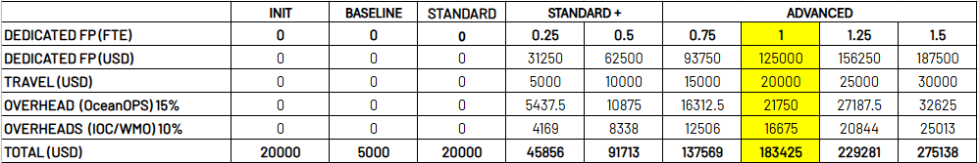
Cost Estimation Table
YEAR 1
To establish a Baseline SLA, OceanOPS will need specific efforts the first year, including:
A survey of existing capacity in data/metadata and network specificities
An improvement of baseline metadata standard (OceanOPS Passport)
  Synchronization with data/metadata nodes
  Baseline implementation for emerging networks will be done incrementally
FUTURE YEARS
Following years baseline services are expected to be fully automatic
Notes:
Ann

Slide 11
Considerations
Emerging Networks
Future revisions
Please note that for emerging networks to link to baseline automated services, OceanOPS (GOOS/WMO) will have limited capacity to support this.
To support faster integration emerging networks can provide funding in support of staff time and/or in-kind personnel support.
The SLA Document, funding levels and specific services shall be reviewed every other year and success assessed.
Letter of Agreement
A letter of agreement (LoA) is required to outline the level of services by each Network. Non legally binding terms and conditions will be spelled out in the LoA and reviewed every few years.
Notes:
Ann

Slide 12
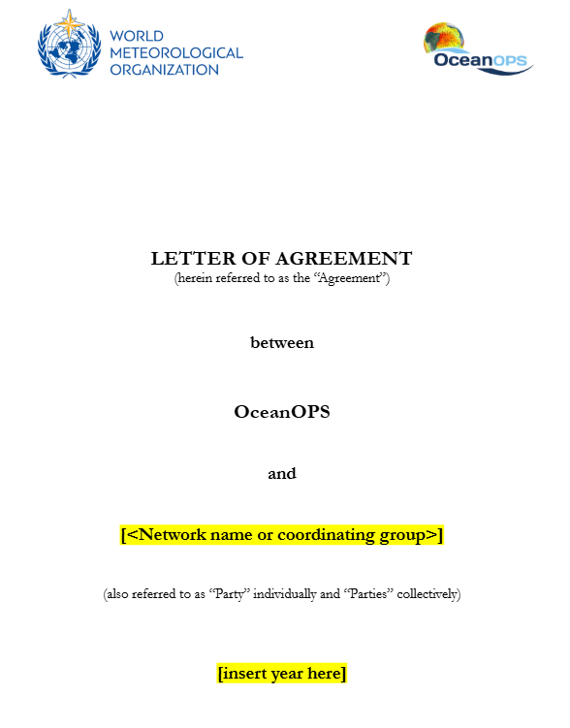
Letter of Agreement
Lightweight
Not contractually binding
The LoA outlines
  All the services, potential options, and in-kind support provided if any
  Conditions
  Termination
  Dispute procedures
  Review process
  Contact information
Review LoA
Determine a signing date and Agree on signatory
Notes:
Ann

Slide 13
Next steps
AT OCG
Agree and publish the SLA Framework
Review Draft Letter Of Agreement, confirm level and scope of work
Determine a signing date shortly after OCG-16
Agree on signatory - Suggestion: Network chairs and OceanOPS head
1-2 MONTHS AFTER OCG
Consider SLA level targets
WMO to proceed in hiring a dedicated Budget expert at WMO with reporting segments by Network
3-4 MONTHS AFTER OCG
Proceed with hiring at WMO of a new OceanOPS Network Expert completing SLA requirements
Assemble the marketing plan and ambitioned SLAs
Notes:
Ann

Slide 14
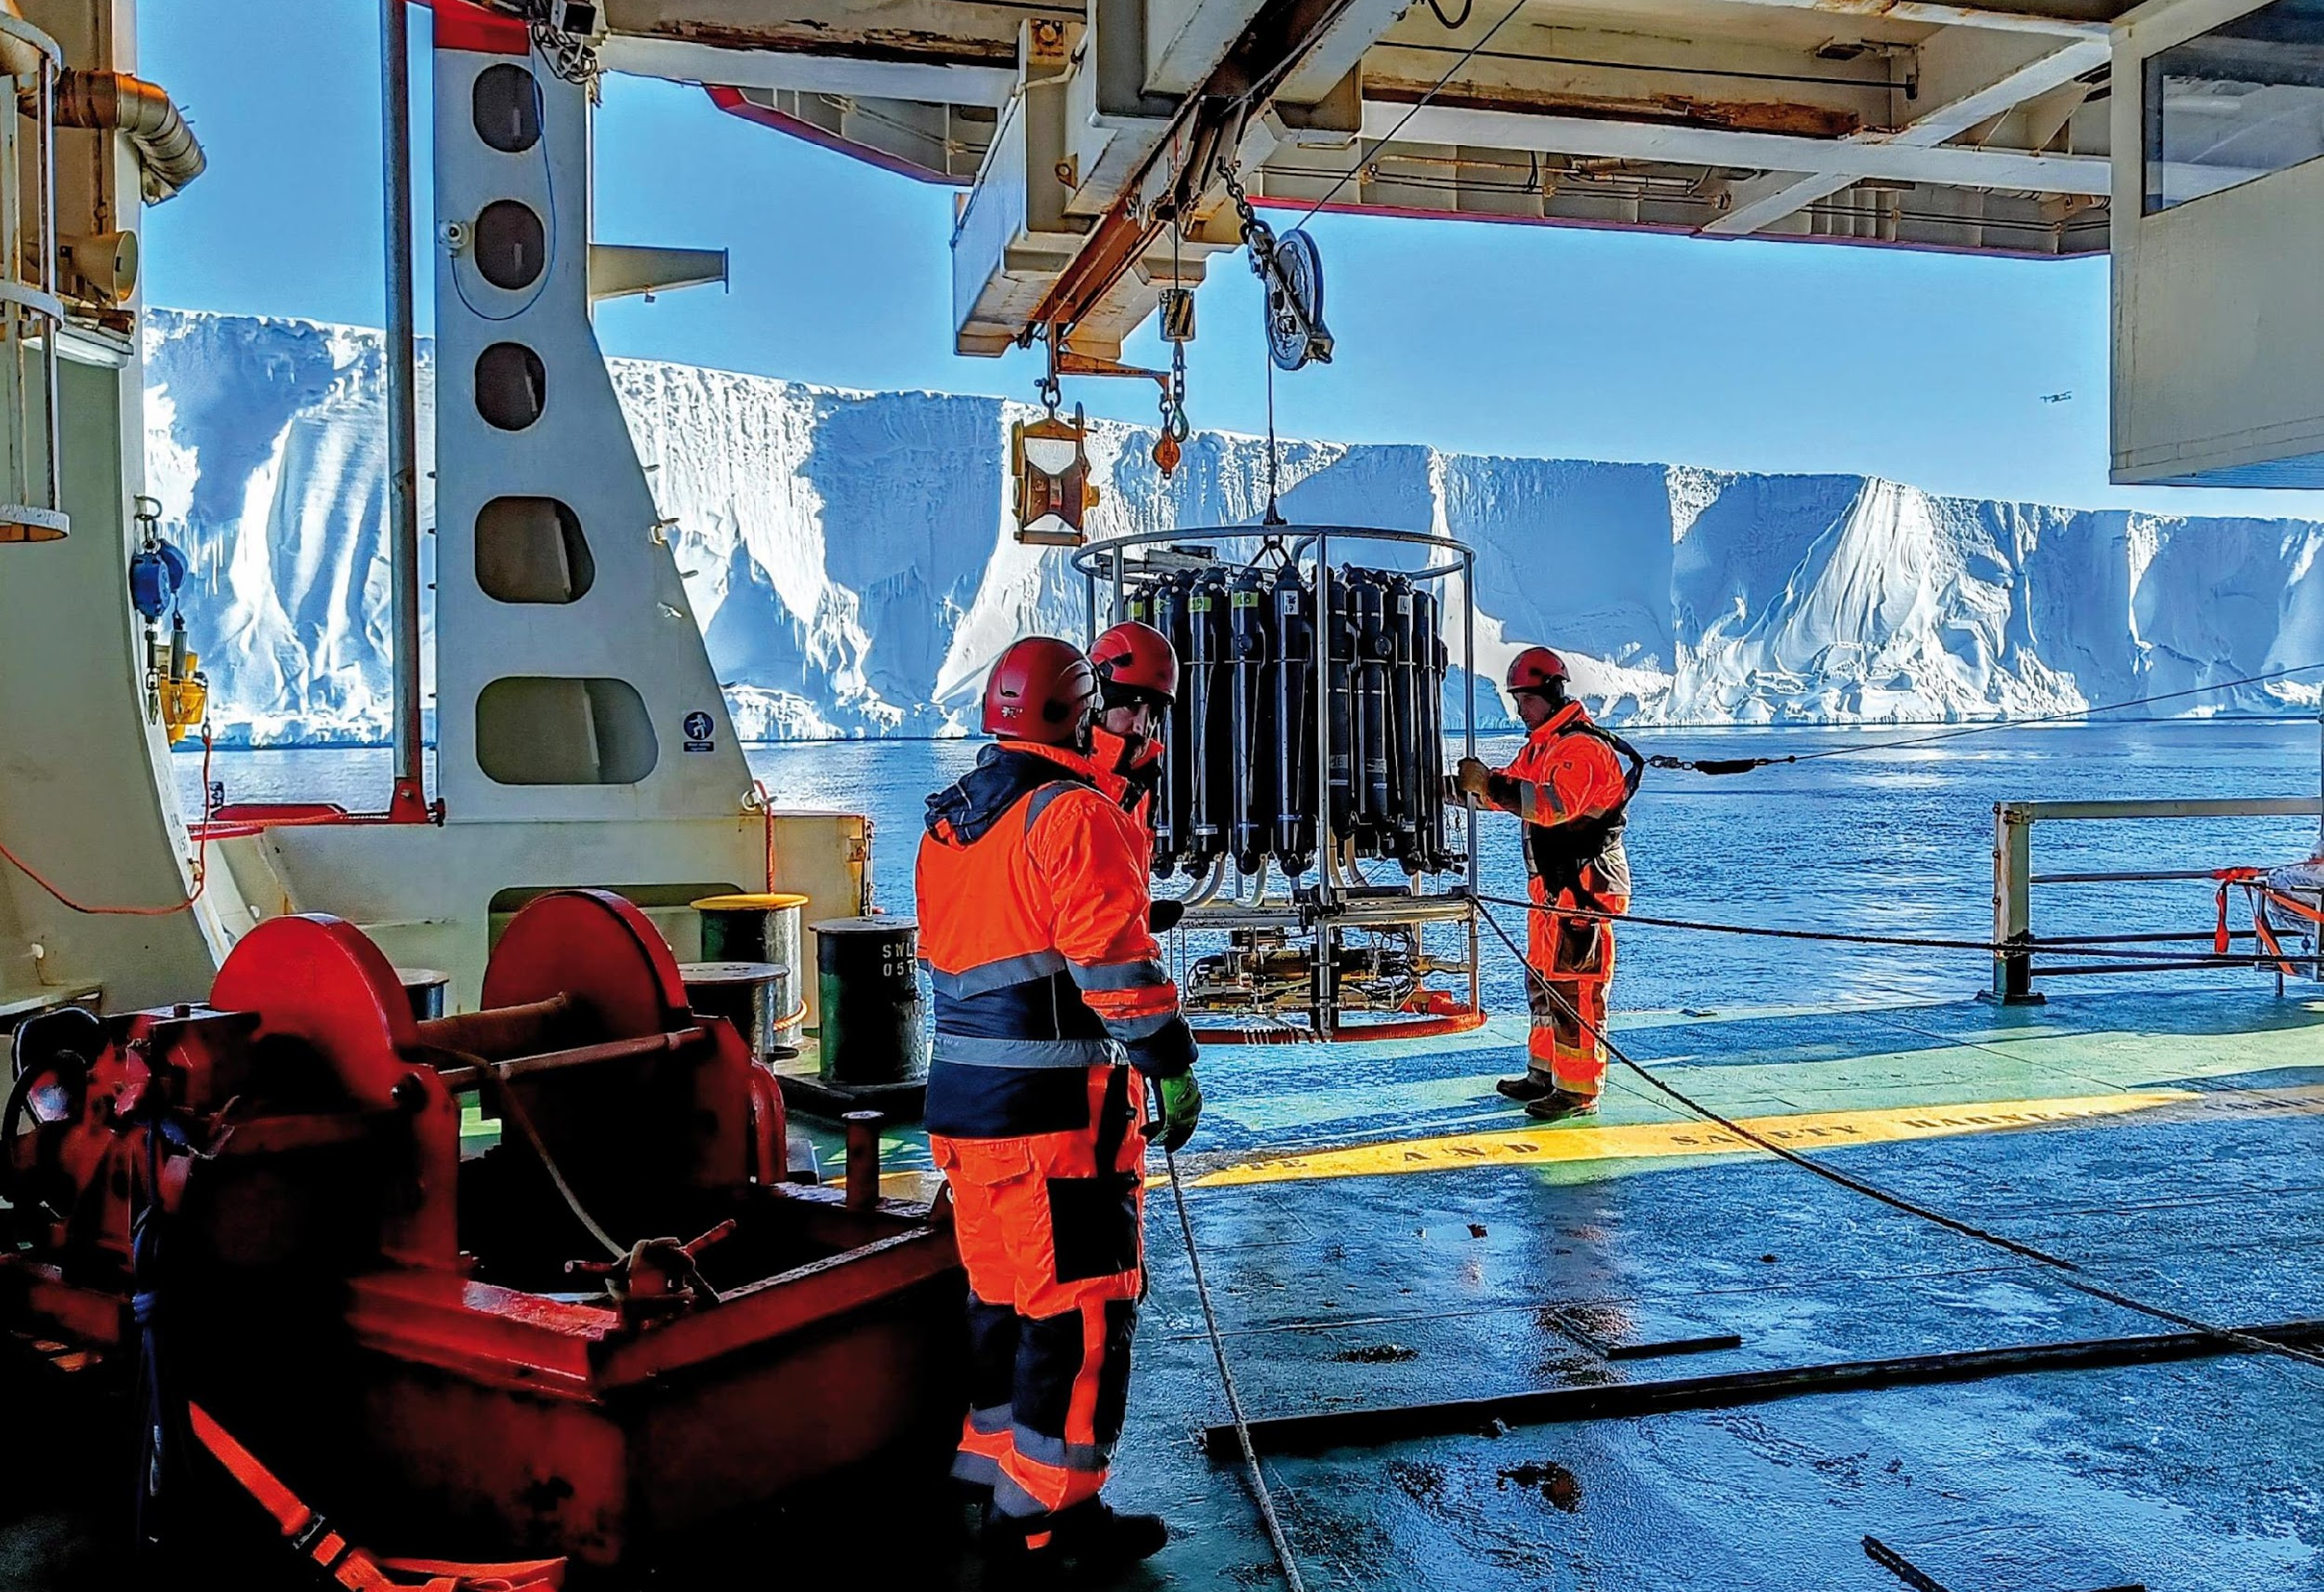
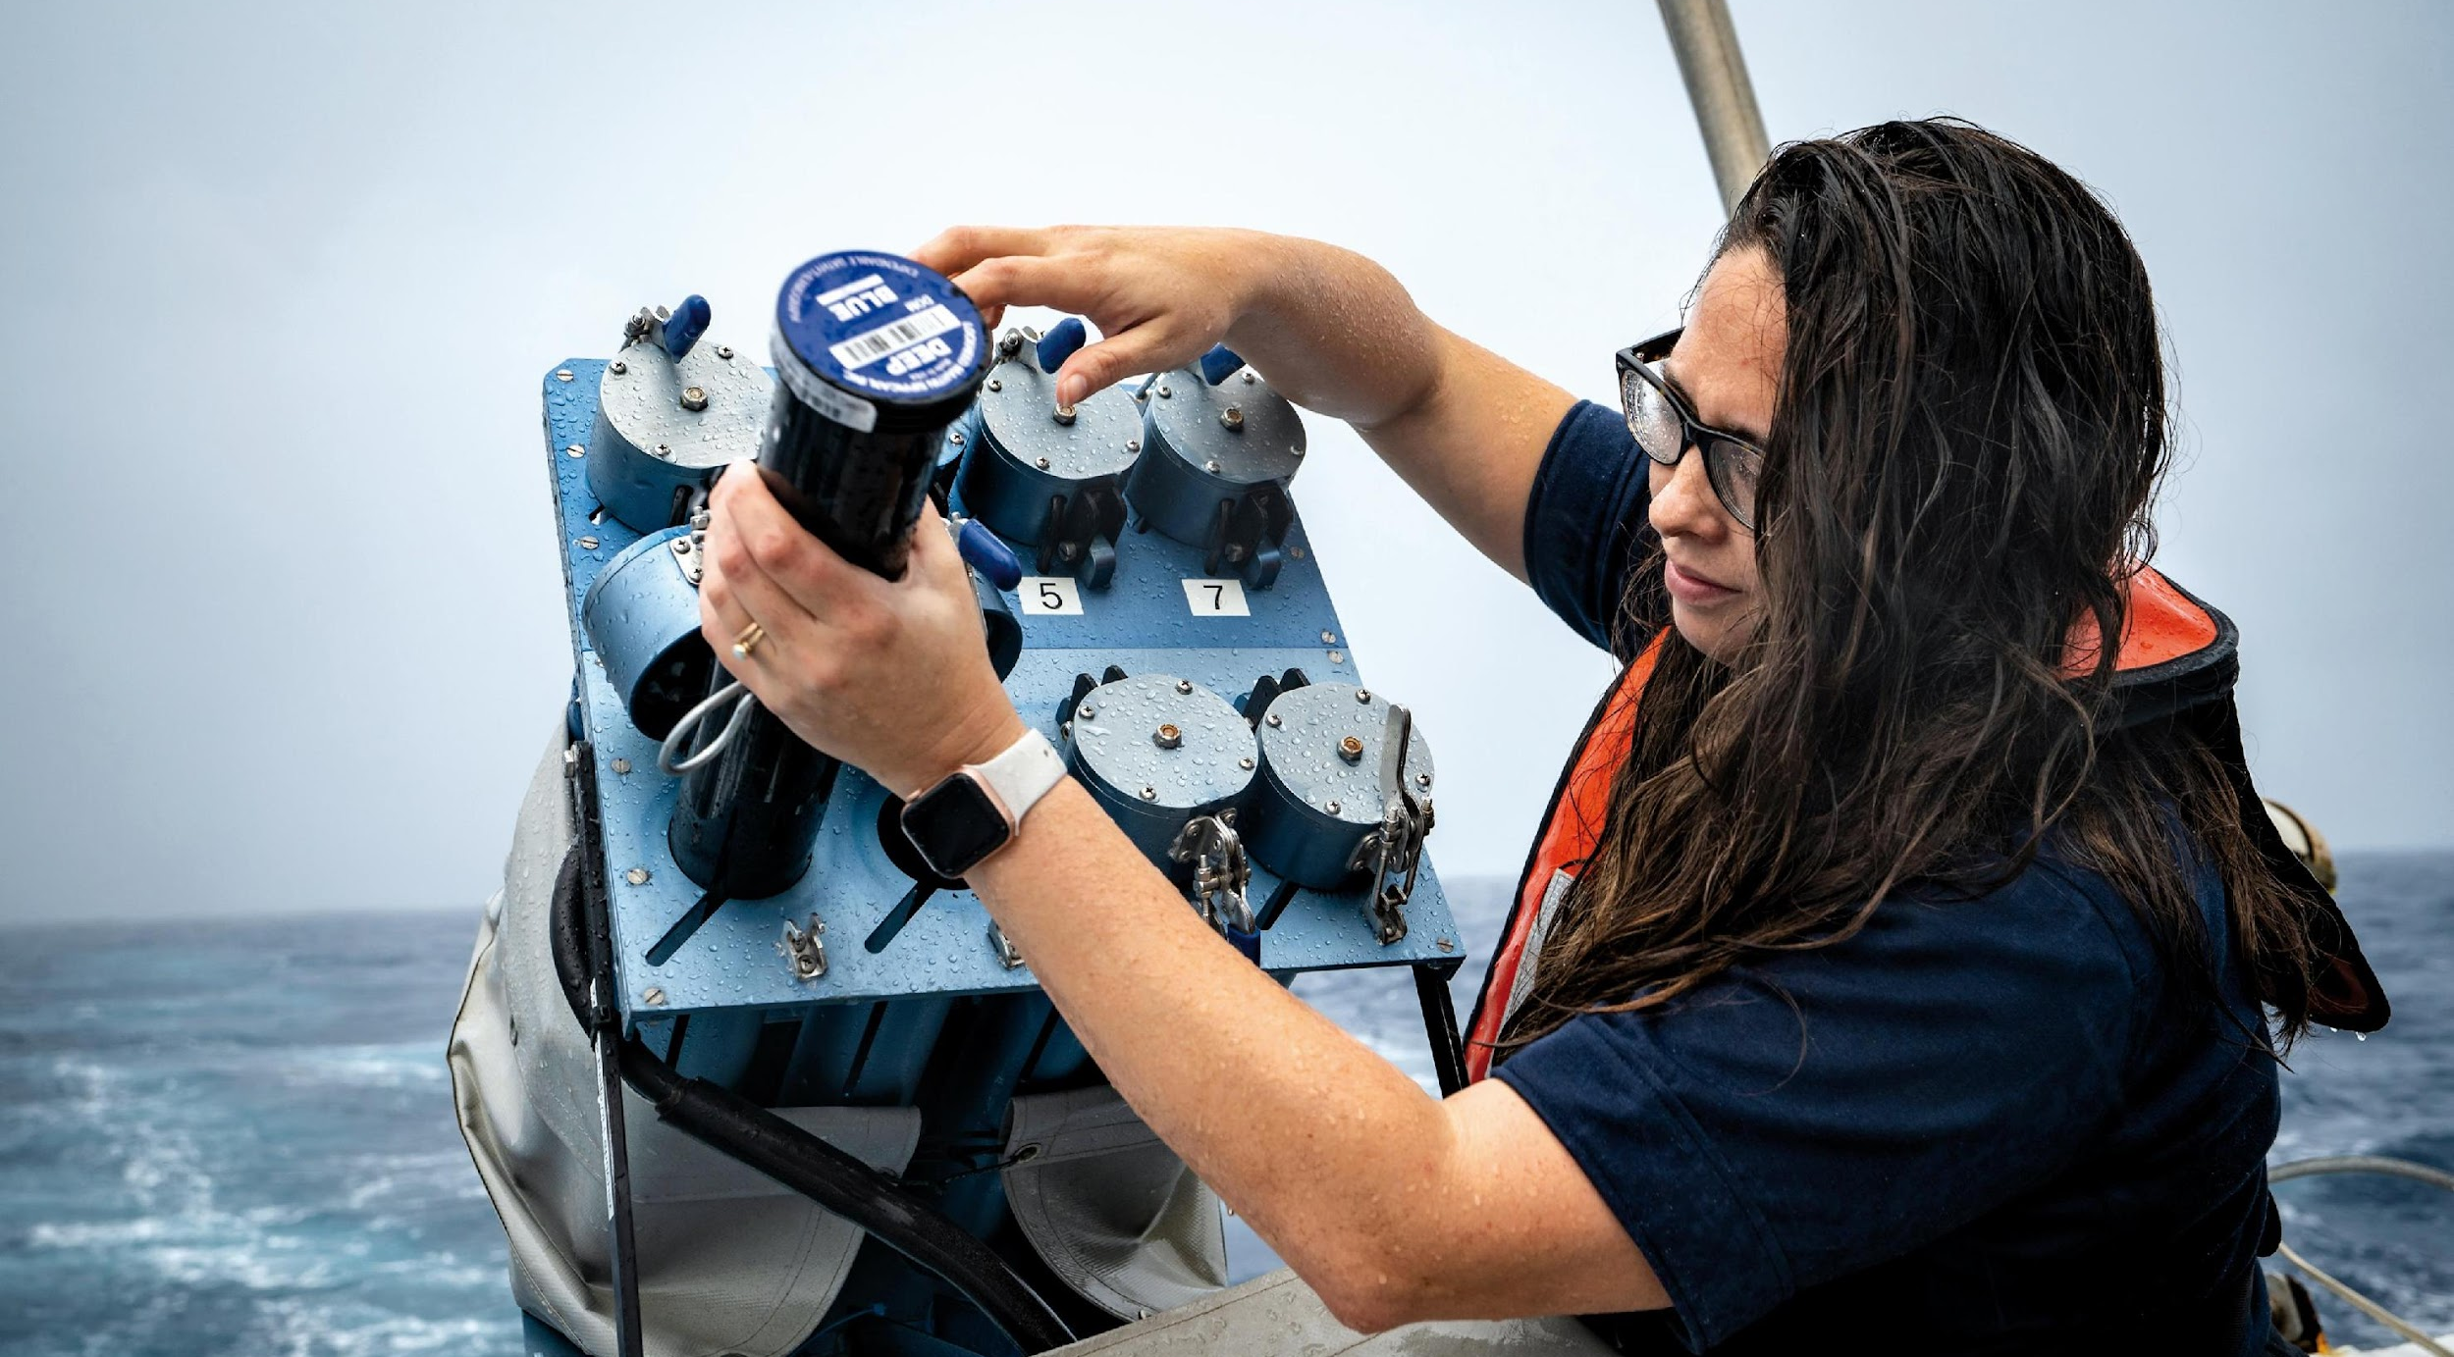

Thank you
goosocean.org
ocean-ops.org

