Slide 1

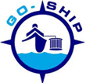
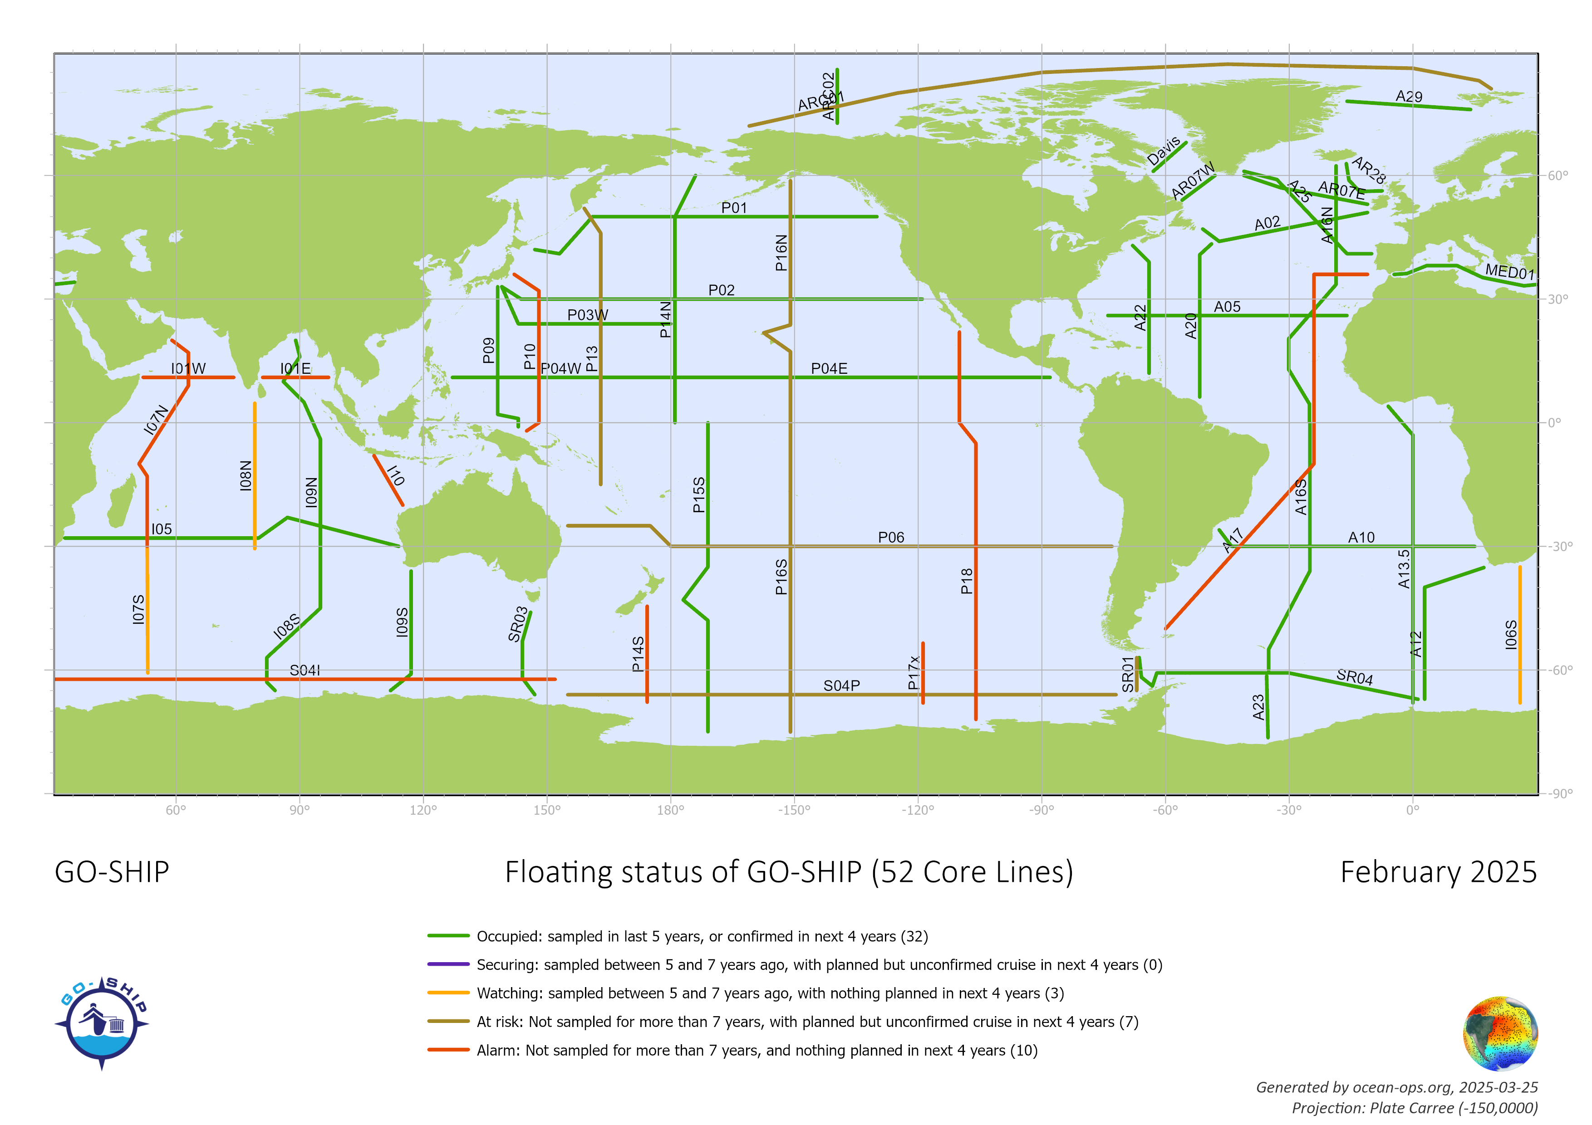
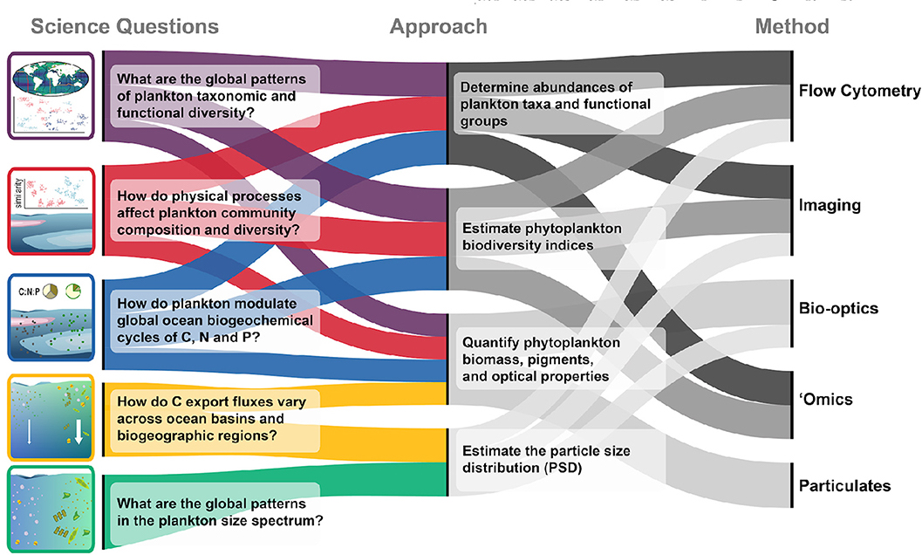
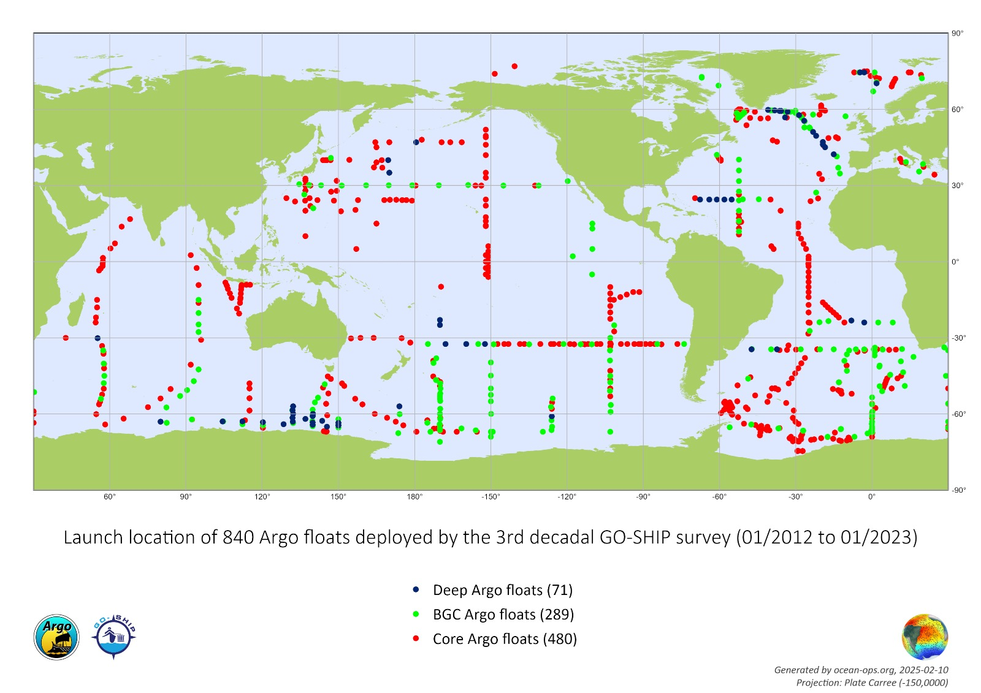

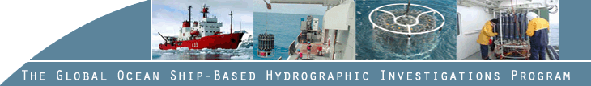
Observations Coordination Group (OCG)
GO-SHIP
Global Ocean Ship-based Hydrographic
Investigations Program -
Elaine McDonagh (elmc@norceresearch.no)¹; Leticia Barbero² (lbarbero@miami.edu)
¹Norce (Norway) | ²University of Miami (USA)
GO-SHIP
The Global Ocean Ship-based Hydrographic Investigations Program (GO-SHIP) brings together scientists with interests in physical oceanography, the carbon cycle, marine biogeochemistry and ecosystems, and other users and collectors of ocean interior data, and coordinates a network of globally sustained hydrographic sections as part of the global ocean/climate observing system including physical oceanography, the carbon cycle, marine biogeochemistry and ecosystems.
GO-SHIP network status
4th decadal survey began in 2024, 52 reference sections. So far 9 lines completed, one currently at sea.
Coast-to-coast, full depth, level 1 parameters
10 nations responsable for the core lines.
International steering committee and Data management Team
Best Practices
Left: Floating status of GO-SHIP reference lines as of February 2025, including upcoming and planned cruises
Future plans and opportunities
An updated version of the 2016 Talley et al. GO-SHIP review paper has been drafted and a proposal has been made to the Annual Review of Marine Science to include it in their next volume.
Presenting GO-SHIP at OOSC in Nice in June 2025.
Nascent BioGO-SHIP activity in multiple national contributors
Ocean Decade project ´GO-SHIP Evolve´
Increasing real time data delivery (CTD)
Above: Bio-GO-SHIP Science Plan. Figure from Clayton et al., 2022, doi:10.3389/fmars.2021.767443.
Left: Location of Argo floats deployed during GO-SHIP cruises during the 3rd decade of GO-SHIP reference sections.
Challenges/concerns
Sustained funding for shiptime and operations.
Check the QR code for GO-SHIP publications and references.

