Slide 1
Ocean Teacher
Global Academy (OTGA)
UNESCO-IOC
Tsunami Courses
Laura Kong
International Tsunami Information Centre

Slide 2


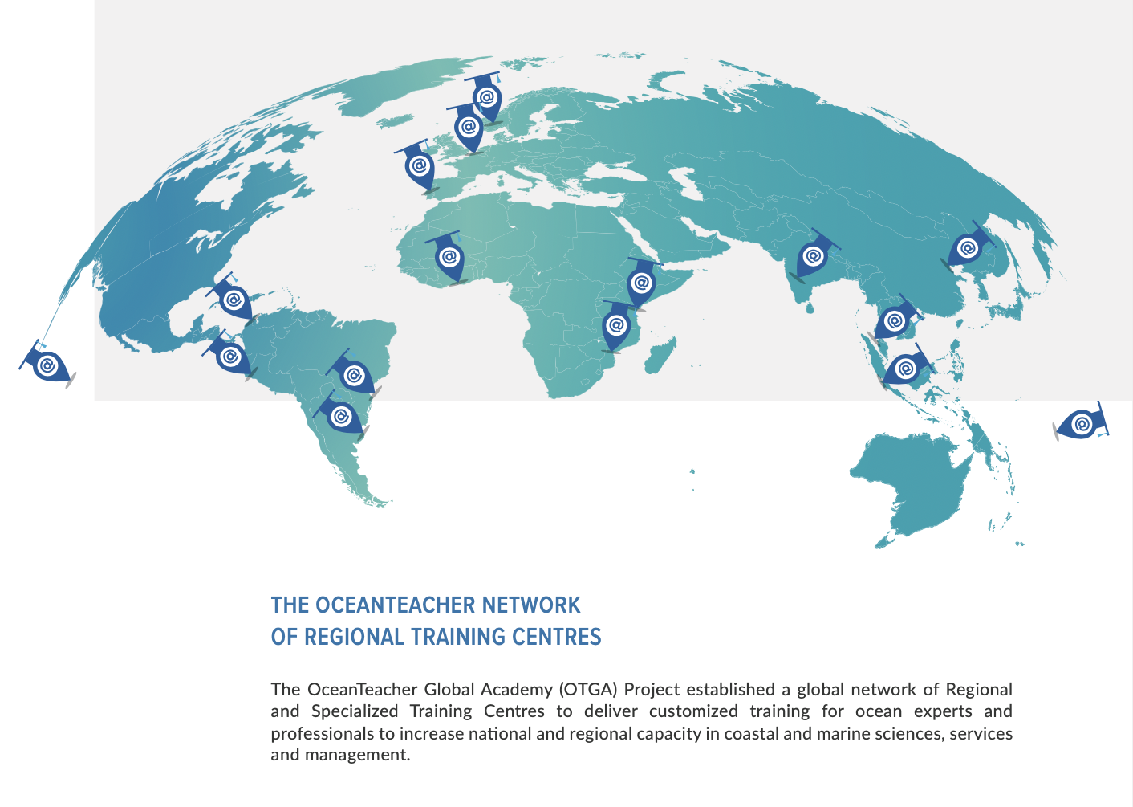
International Tsunami Information Centre (ITIC)

Slide 3
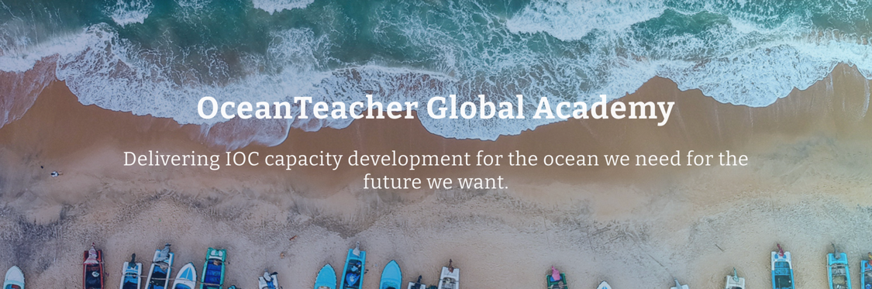
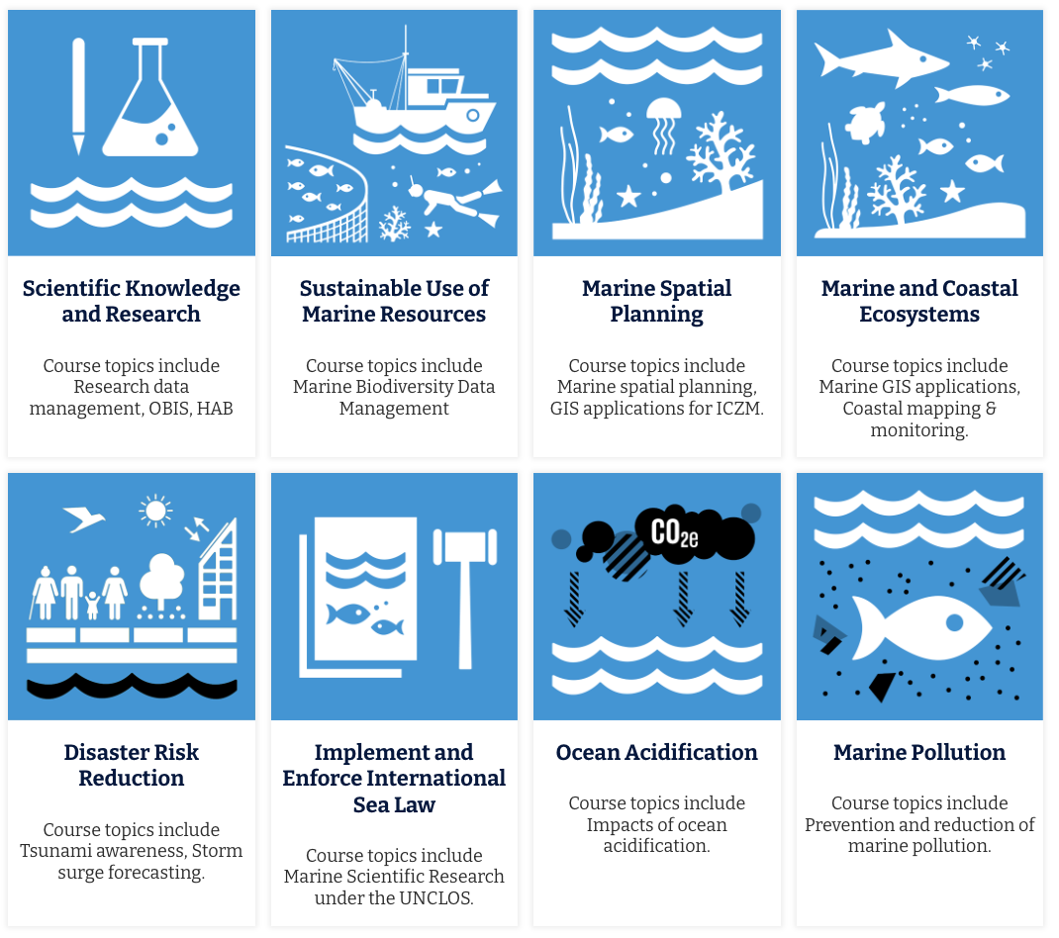
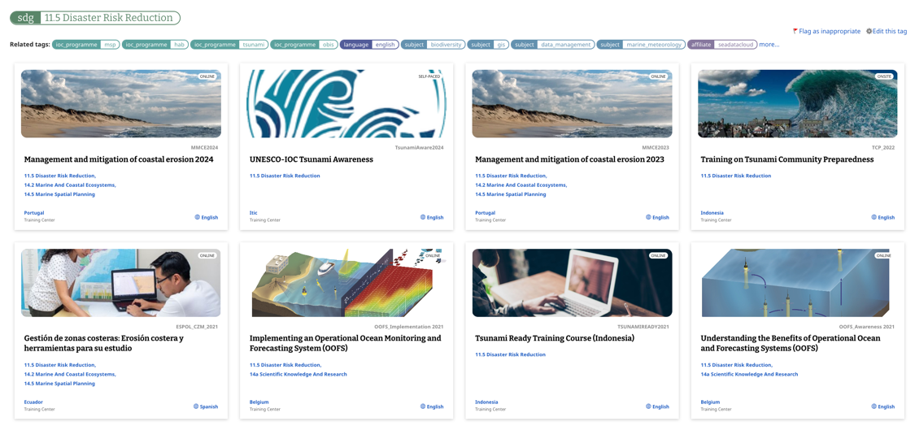
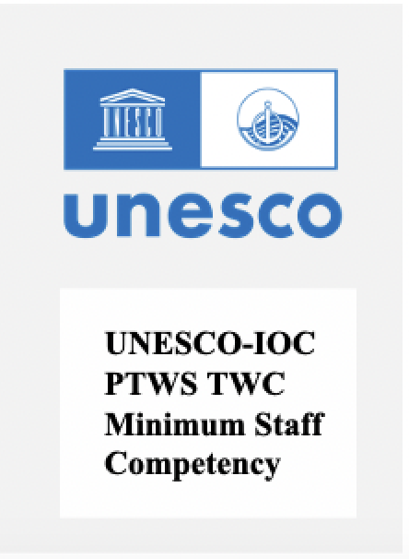

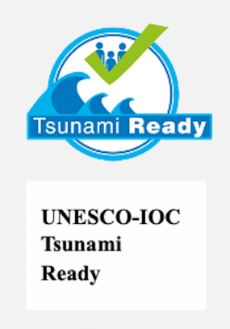

OTGA UNESCO-IOC Tsunami Online Courses
Q4 - 2025
Live
Live 28 Nov
https://classroom.oceanteacher.org/

Slide 4
UNESCO-IOC Tsunami Courses
ITIC and IOC TSR Joint work
ITIC STC courses will be collaborative IOC TSR
Course names start with UNESCO-IOC xxx
Self-paced, independent, no trainer interaction
  Tsunami Awareness (available)
  Tsunami Ready (live this week)
Hybrid and/or In-person
  Tsunami Warning Center Operations (multiple courses, 2025)

Slide 5

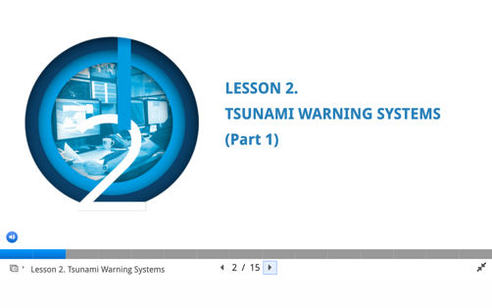
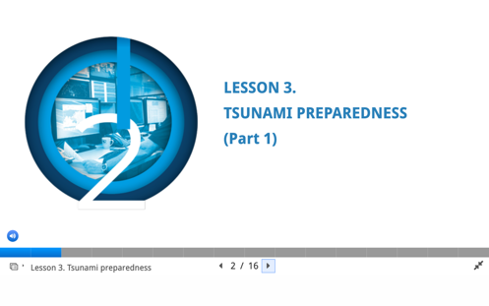
UNESCO-IOC Tsunami Awareness
ITIC and IOC TSR Joint work
Self-paced, no instructor – 6 hrs
UNESCO-IOC Tsunami Awareness certificate required for later UNESCO-IOC courses
Pre-Quiz
Lesson 1: Tsunami Basics (Parts 1 and 2)
Lesson 2: Tsunami Warning Systems (Parts 1 and 2)
Lesson 3: Tsunami Ready Preparedness (Parts 1 and 2)
Post-Test
Tsunami
Awareness
2 parts (18, 23 Slides)
2 parts (14, 18 Slides
2 parts (15, 23 Slides
All Lessons have Activities, Knowledge review checks, Narration

Slide 6
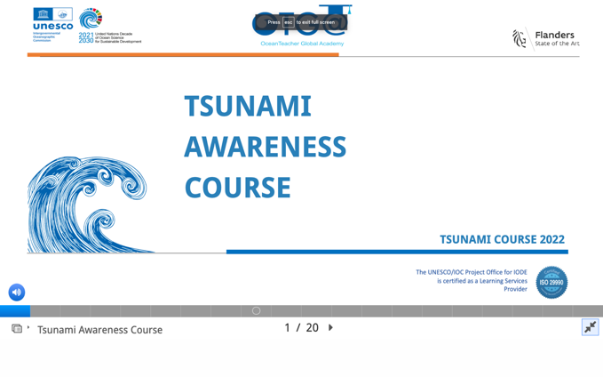
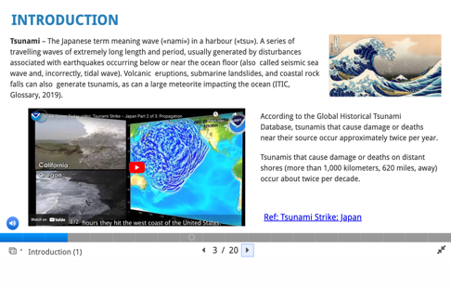
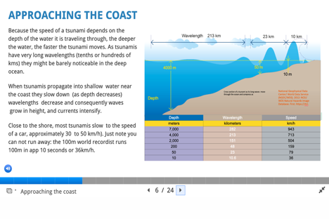
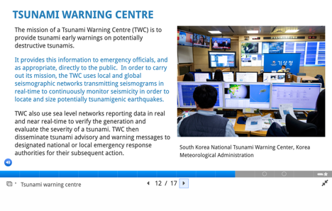
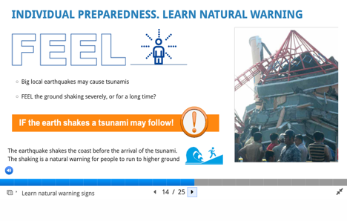
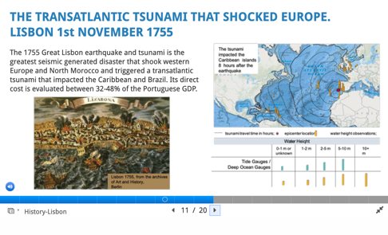
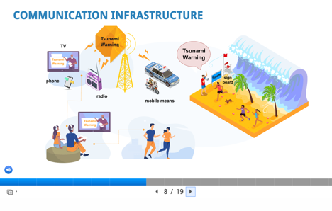
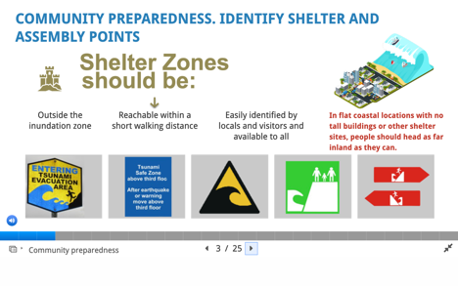
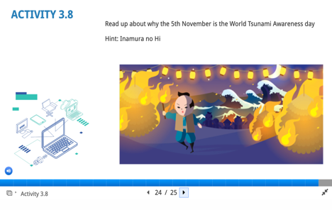
UNESCO-IOC Tsunami Awareness –
3 Lessons
Tsunami Basics – 1, 2
Tsunami Warning Systems – 1, 2
Tsunami Preparedness – 1, 2

Slide 7
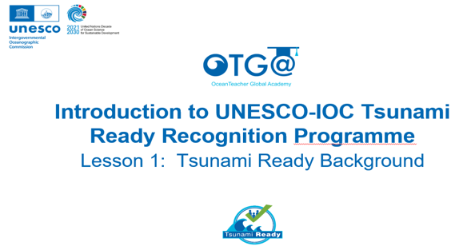
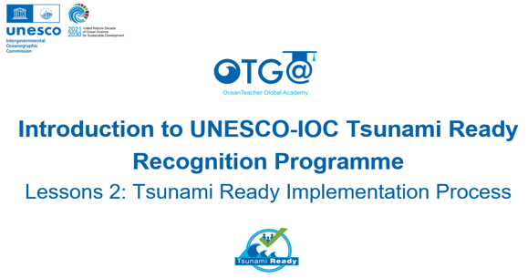
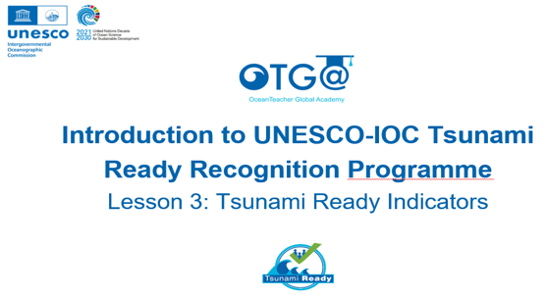
UNESCO-IOC Tsunami Ready
ITIC and IOTIC Joint work
Self-paced, no instructor – about 2-3 hrs
Course 1
Introduction to UNESCO-IOC Tsunami Ready Recognition Programe
Lessons 1: Tsunami Ready Background
Lessons 2: Tsunami Ready Implementation Process
Lessons 3: Tsunami Ready Indicators
Course 2
Facilitating Tsunami Ready
Lessons 1: Approach to Tsunami Ready Community Capacity Building
Lessons 2: Assessment Indicators
Lessons 3: Preparedness Indicators
Lessons 4: Response Indicators
planned
Course 1
23 Slides
19 Slides
22 Slides
All Lessons have Activities, Knowledge review checks, Narration

Slide 8
PTWS Tsunami Warning Center Staff Minimum Competencies Training - pilot
Competency Framework approved ICG/PTWS-XXX (2023)
ITIC create training, with country partners (USA NOAA-PTWC/PMEL, NZ, Australia, Japan, Chile with Pacific Island Countries (PIC))
Funding: USAID funding, IOC Ocean Training Intern (Q3 2024)
Series of courses - from self-paced to in-person housed under OTGA
In order to take next Lesson, must pass previous Lesson and Course. Start with OTGA Tsunami Awareness and Tsunami Ready
Finish and pilot in late Dec 2025/early 2026 with 1 small cohort (PIC)
Modules (to be individual OTGA, or US COMET MetEd courses)
    Core and Advanced Knowledge (multiple Lessons)
    Core and Advanced Operations (multiple Lessons)
    Core Agency (multiple Lessons)
Final training will be in-person (3-4 weeks at ITIC/PTWC)

Slide 9
