Slide 1


2024 Tsunami Preparedness Capacity Assessment in Asia and the Pacific
Prepared by Rick Bailey
Compiled by: Suci Dewi Anugrah

Slide 2
History of the Indian Ocean Capacity Assessment
Assessment of Capacity Building Requirements for an Effective and Durable Tsunami Warning and Mitigation System in the Indian Ocean in 2005
10th Session UNESCO-IOCICG/IOTWMS (Muscat,August2015) identified the need to conduct a reassessment of state of tsunami preparedness of the Indian Ocean Member States in order to evaluate progress since the2004 Indian Ocean Tsunami, as well as identify specific gaps and prioritise capacity development requirements at both the regional and national level.
11th Session UNESCO-IOC ICG/IOTWMS (Putrajaya, April 2017) established the inter sessional “Task Team on Capacity Assessment of Tsunami Preparedness” (TT-CATP) to oversee the capacity assessment of tsunami preparedness of the IOTWMS. The Task Team was chaired by Dr. Harkunti Rahayu (Indonesia) with representatives from Australia, India, Indonesia, Oman, Malaysia, Indian Ocean Tsunami Information Centre (IOTIC),the ICG/IOTWMS Working Groups, and invited experts from the Global Disaster Resilience Centre of the University of Huddersfield, UK.
Task Team designed an extensive online survey distributed to Member States by the Secretariat, covering all aspects of the end-to-end tsunami warning and mitigation system. The online questionnaire was built upon the ICG/IOTWMS National Report Template,Post-IOWave Exercise Surveys,UNESCO-IOCPost-Event Assessment Surveys
To renew the 2018 IOTWMS capacity assessment, expand to the PTWS, provide narrative on the progress made since the 2004 Indian Ocean Tsunami, and inform policymakers at the subregional level on the further needs for tsunami preparedness in Asia and the Pacific

Slide 3
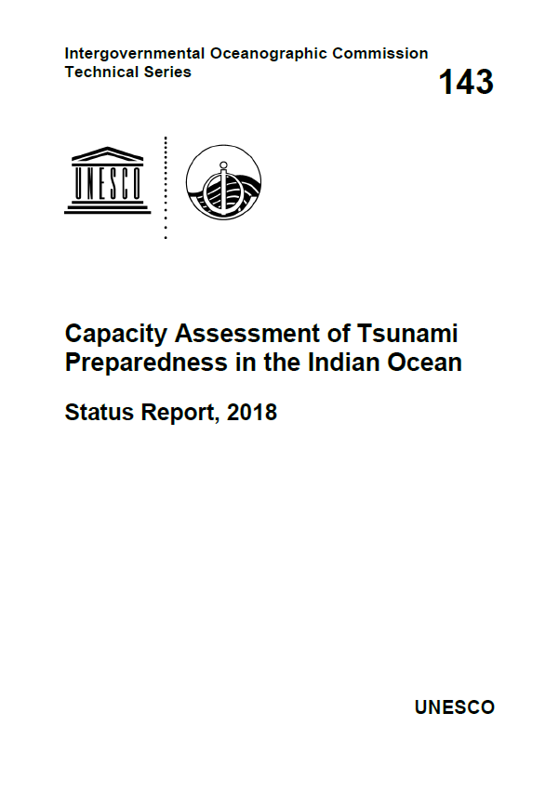
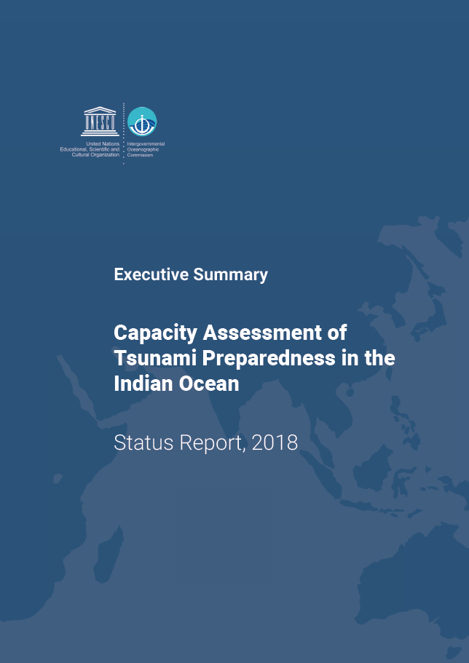
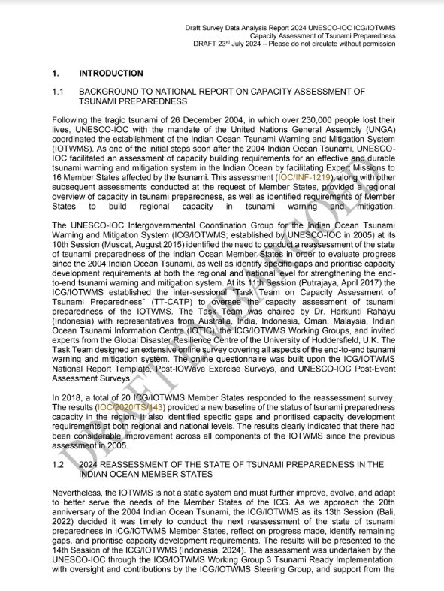
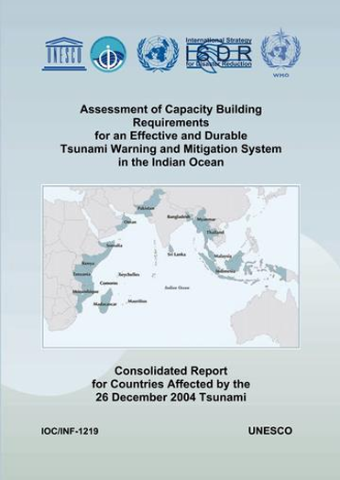
Previous Capacity Assessments
2005
Assessment of Capacity Building Requirements for an Effective and Durable Tsunami Warning and Mitigation System in the Indian Ocean
2018
Capacity Assessesment of Tsunami Preparedness in the Indian Ocean based on the 3 pilars:
Capacity assessment framework and tools already developed
2024
Tsunami Preparedness Capacity Assessment in Asia and the Pacific
Additional assessment on Tsunami Ready Capacity
Notes:
Several comprehensive capacity assessments have been undertaken for both the IOTWMS and PTWS:
The Australian Government in 2009/2010 conducted a capacity assessment of tsunami preparedness for 14 SW Pacific countries.
ESCAP in 2011 conducted a survey Immediately following the aftermath of the 2004 Indian Ocean tsunami, UNESCO-IOC in 2005 conducted a baselines capacity assessment of tsunami preparedness for the Indian Ocean.
To evaluate progress since 2005, in 2018 the ICG/IOTWMS conducted a 2nd capacity assessment of tsunami preparedness for the Indian Ocean.
In 2011

Slide 4
OBJECTIVES
To evaluate the existing capacity of the UNESCO-IOC Indian Ocean Tsunami Warning and Mitigation System (IOTWMS) (Phase 1) and Pacific Tsunami Warning System (PTWS) (Phase 2) and highlight the progress made since 2004 IOT and subsequent assessments.
To identify specific gaps and capacity development requirements at regional and national levels for strengthening the technical and policy aspects of the tsunami warning and mitigation systems in the region.
To provide recommendations for the next strategic phase of ESCAP's Trust Fund for Tsunami Disaster and Climate Preparedness, aiming to address the identified gaps through regional cooperation and mainstreaming science.

Slide 5




METHODOLOGY
National technical online survey: comprehensive technical survey managed by UNESCO-IOC, based on the 2018 IOTWMS capacity assessment exercise and further taking into account the latest UNESCO-IOC Tsunami Ready Indicators, to be completed by Member States with guidance from UNESCO-IOC, supported by expert teams visiting some high priority Member States to assist with national assessments and provide some in-situ capacity development training as opportunities arise, with sub-national findings to also be reported where possible.
Survey analysis: analysis of national survey data by UNESCO-IOC, including a comparison with previous capacity assessments, to understand the capacity building requirements across the ocean basin and progress over time, especially since the 2004 Indian Ocean Tsunami.
Validation consultation workshops: validation of analysis and sharing of good practices with UNESCO-IOC ICG/IOTWMS Steering Group and ICG/PTWS Steering Committee.
Endorsement: final review, endorsement, and adoption by the respective UNESCO-IOC ICGs for the IOTWMS and PTWS.

Slide 6
Output of the Capacity assessment of tsunami preparedness
2024 OUTPUTS - IOTWMS
1.A_ Member States Survey Analysis for IOTWMS (IOC)
1.B_ IOTWMS assessment summary and comparative analysis (IOC)
3.A_ Tsunami preparedness recommendations for ASEAN policymakers (UNESCAP)
3.B_ Tsunami preparedness recommendations for SAARC policymakers (UNESCAP)
2025 OUTPUTS - PTWS
2.A_ Member State Survey Analysis for PTWS (IOC)
2.B_ PTWS assessment summary and comparative analysis (IOC)
3.C_ Tsunami preparedness recommendations for PIF policymakers (UNESCAP)

Slide 7
Result Presentation
Results will be presented to:
UNESCO-IOC Member States at14th Session ICG/IOTWMS(Jakarta, Nov’24)
UNESCO-IOC 2nd Global Tsunami Symposium commemorating 20 years since Indian Ocean Tsunami of 2004 (Banda Aceh, Nov’24)
Other events commemorating the Indian Ocean Tsunami of2024
Asia-Pacific Ministerial Conference on Disaster Risk Reduction (Manila, Oct’24)
Association of South-East Asian Nations (ASEAN)
South Asian Association for Regional Cooperations (SAARC)
World Tsunami Awareness Day (WTAD) 2024 (Nov’24)
Early Warnings for All (EW4ALL) by 2027 initiative
Summary reports tailored for policy-makers and potential donors, containing recommendations on filling gaps and priorities for capacity development support
Research and scientific publications about early warning and mitigation system

Slide 8
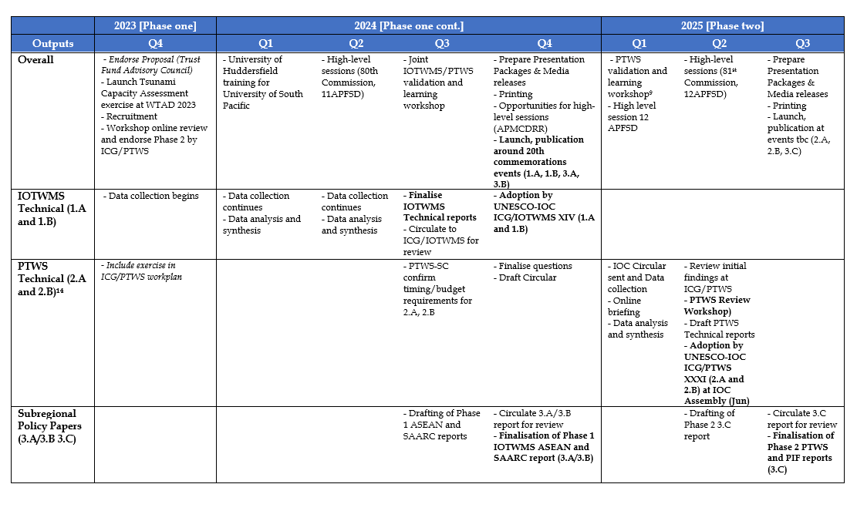
Schedule of the Project

Slide 9
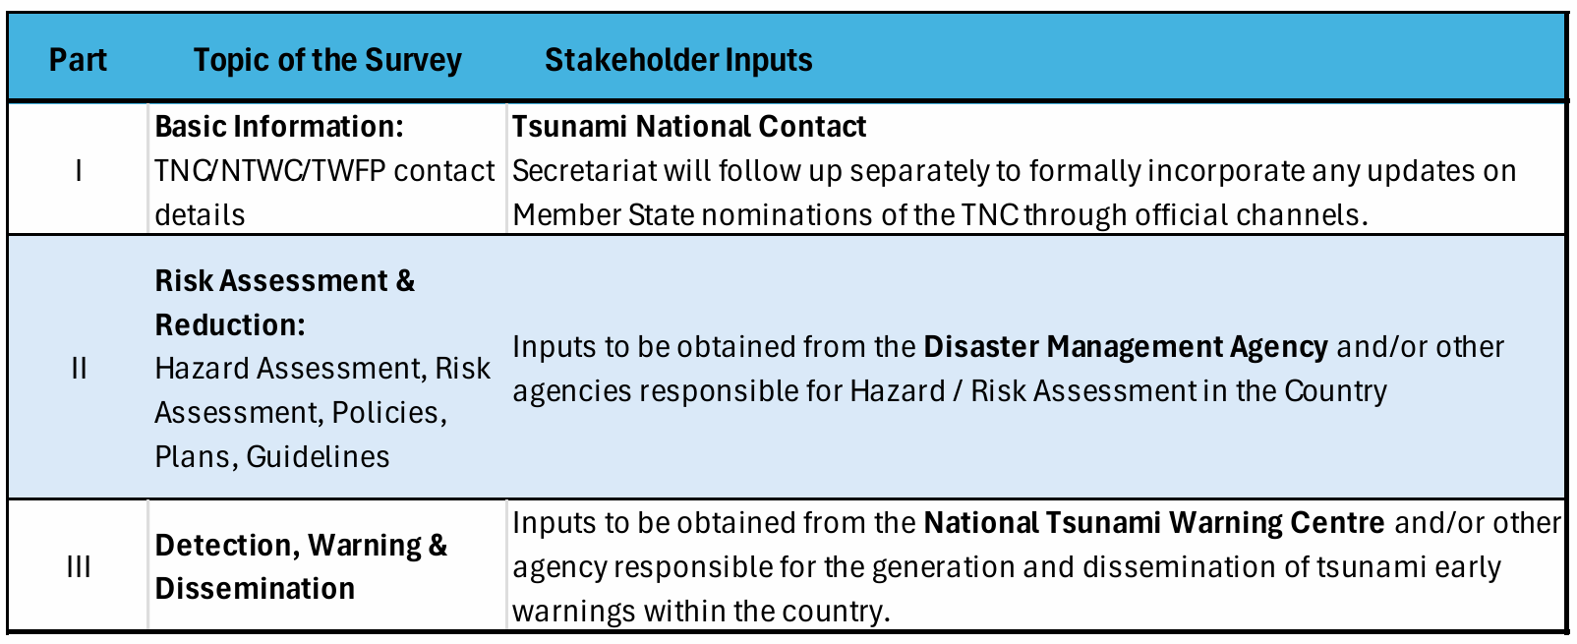
Survey Structure
The survey has six (6) distinct parts, which may need inputs from different stakeholders based on their national responsibility in the end-to-end tsunami warning and mitigation system

Slide 10
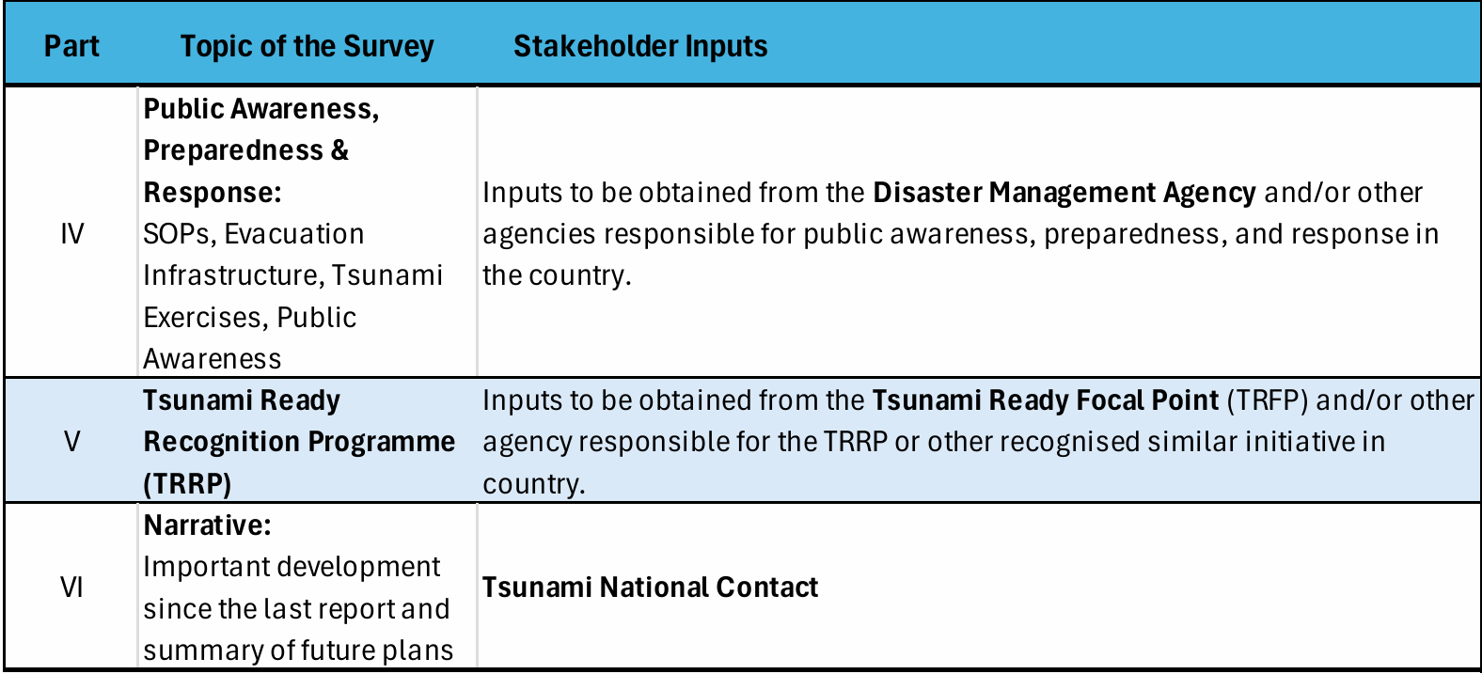

Slide 11
Remarks
Need more stakeholder engagements (NTWC, NDMO, Sea Level Monitoring Organization)
Validation of the result
Producing Result and Recommendation, invite Chair WG and Task Team, experts
Cross Cutting Recommendation
Final Recommendation Endorse by the ICG Steering Committees
Promoted in the Global Platform

Slide 12
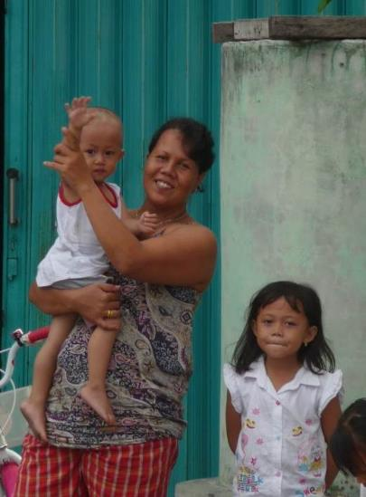


We all need work together to make the world’s at-risk coastal communities
Tsunami Ready

