Slide 1
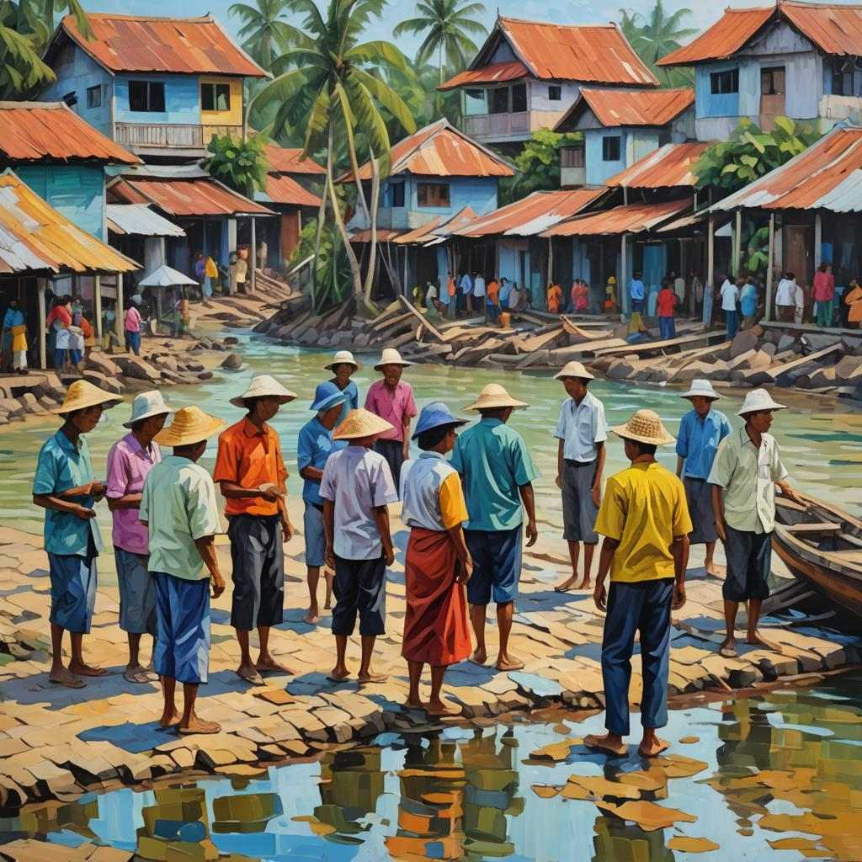
Learning from local experiences after tsunami events and exercises
Assessment Tool
for evaluating community tsunami preparedness capacity and response post tsunami event and exercise
(Presented by Harkunti P. Rahayu at WG1 during ICG IOTWMS XIV Meetings,
17-19 November 2024)
Inter ICG Task Team Meeting on Disaster Management and Preparedness of TOWS WG XVIII, Paris, 20-21February 2025
Notes:
[TW]: Zum BMZ Logo…auch nach Rückfragen mit der Unternehmenskommunikation habe ich- genauso wie viele andere GIKRMler vor mir- leider nicht abschließend klären können, wie genau nun mit dem Logo des BMZ auf PPT-Folien zu verfahren ist (Stichwort: GIKRM/BMZ/Kooperationslogo, ein Thema, welches ihr am Samstag ja auch angerissen habt).
Ich habe das Logo nun 2x in der Präsentation untergebracht. Einmal auf der Titelfolie (hier!) und auf der letzten Folie (Impressum)

Slide 2
Facilitate Learning from Experience…
Rapid and participatory assessments immediately after tsunami related incidents are important for capturing experiences and drawing lessons that can be learnt from the local perspective to improve tsunami preparedness and end-to-end tsunami early warning.
The tool can be used for a variety of incidents where
a tsunami was generated
an earthquake was strongly felt in a coastal community
a tsunami warning was issued, but ultimately no tsunami occurred
It can also be used to learn from community exercises
Inter ICG Task Team Meeting on Disaster Management and Preparedness of TOWS WG XVIII, Paris, 20-21February 2025

Slide 3
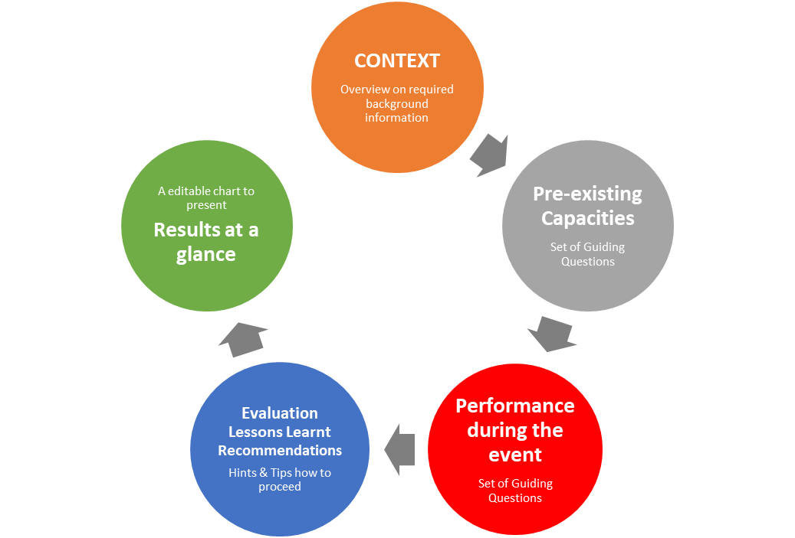
…in a structured and comprehensive way
Such an assessment always focus on a specific geographical area that has been affected or impacted by an incident. This may be a town, a district, a village or more than one of these.
Scope of Topics covered in the Assessment
Inter ICG Task Team Meeting on Disaster Management and Preparedness of TOWS WG XVIII, Paris, 20-21February 2025

Slide 4
Notes for practical application
Can be used either in an accompanied assessment process led by external experts or as a self-assessment tool for local stakeholder
Preferably shortly after an incident or exercise in order to ensure that fresh impressions and detailed information can be captured
Best in a participatory manner, involving all main stakeholder
Assessment methods may include
interviews with relevant authorities,
focus group discussions with stakeholder groups,
field observations,
questionnaires to capture community reaction and
study of reference documents (hazard, risk and evacuation maps, SOPs, disseminated warning messages) as well as media reports.
Inter ICG Task Team Meeting on Disaster Management and Preparedness of TOWS WG XVIII, Paris, 20-21February 2025

Slide 5
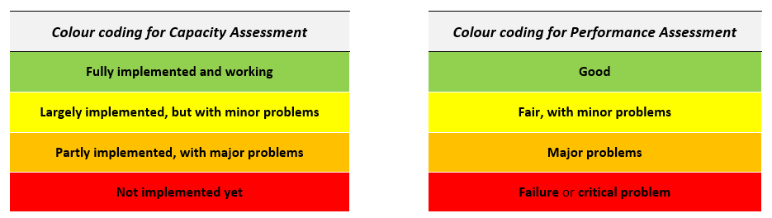
How to document and evaluate the results
Summary document with findings for each of the guiding questions and the context information following the structure provided by the assessment tool
Summary with key findings from the point of view of the assessment team and communities
To allow for a quick and comprehensive overview of the assessment results, a colour coding system has been proposed to rate each of the aspects of the capacity and performance assessment.

Slide 6
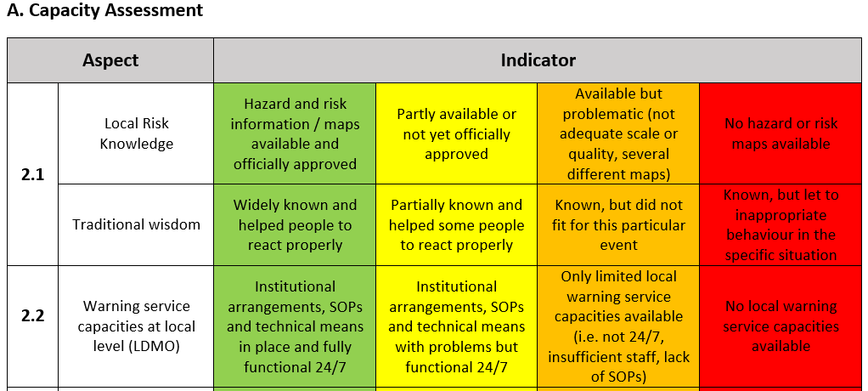
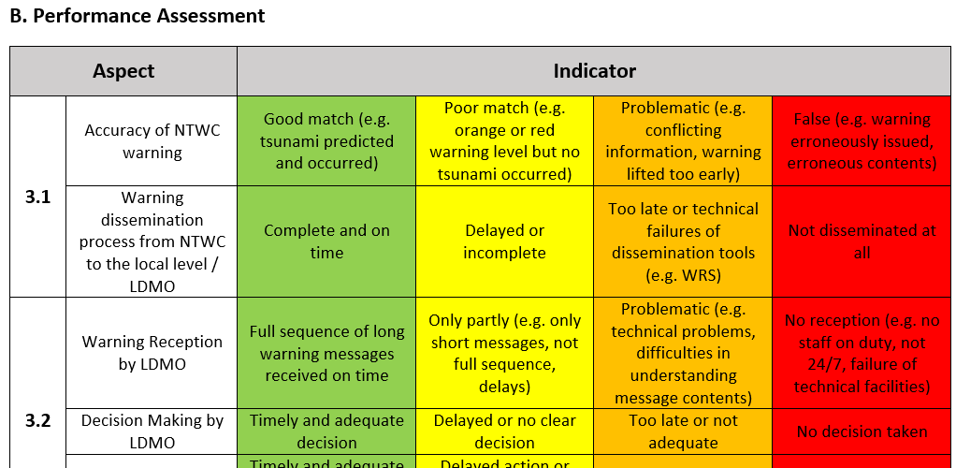
2 Sets of Indicators for colour coding

Slide 7
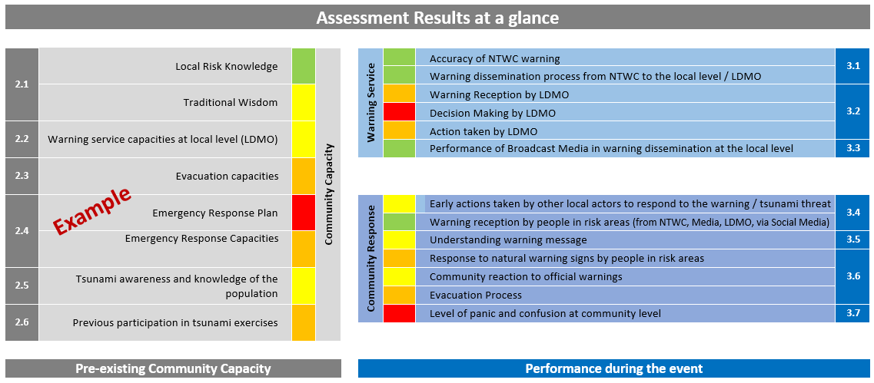
Overall Result Chart

Slide 8

Deriving lessons to be learnt & recommendations
Identify problematic issues that have occurred and need to be addressed to help prevent similar conditions occurring at future events.
Conduct a thorough analysis of the identified issues and the underlying causes.
Develop a set of recommendations for improvement.
These tasks should be done in close dialogue with local actors and national stakeholders.
Inter ICG Task Team Meeting on Disaster Management and Preparedness of TOWS WG XVIII, Paris, 20-21February 2025

Slide 9
The bigger picture
This tool has been developed within the TsunamiRisk project and is derived from the analytical framework used in a meta-study of tsunami events in Indonesia between 2006 and 2021.
The section on pre-existing capacities cover all elements included in the set of indicators developed and applied by the IOC Tsunami Ready Recognition Programme.
With its focus on the end-to-end warning chain and community response issues, it may complement the IOC Post-Tsunami Survey Guidelines, which look mainly at the impact of the tsunami after a destructive event.
The tool has been handed over to WG 1 ICG-IOTWMS for further discussion and promotion, including to TOWS WG.
Inter ICG Task Team Meeting on Disaster Management and Preparedness of TOWS WG XVIII, Paris, 20-21February 2025

Slide 10
Link to ITST Post-Tsunami Surveys
The International Tsunami Survey Team (ITST) Post-Tsunami Survey Field Guide (IOC Manual and Guides 37) provides guidance for conducting post event reconnaissance studies.
In the past, ITST surveys focused strongly on the tsunami impact after a destructive event and often from a scientific point of view.
In the 2nd Edition of the Guide (2014) eyewitness observations and social, human and economic impacts are included among the data types to collect. The guidebook also provides some background information for this as well as two interview templates.
However, there is still a lack of a systematic approach that comprehensively analyses the processes at local level directly before and during the event, particularly with regard to their role in the warning process as well as evacuation decisions and procedures.
To gain the maximum learning experience from such events in the future, we recommend to WG 1 ICG-IOTWMS:
Promote the comprehensive analysis of the specific preparedness capacities and response in affected communities as part of the ITST surveys
Apply the developed Assessment Tool in next tsunami related incidents in order to test the suitability for this purpose
Inter ICG Task Team Meeting on Disaster Management and Preparedness of TOWS WG XVIII, Paris, 20-21February 2025

Slide 11
Next steps: further validation and improvement of the Tool
This tool has been developed based on the validated analytical framework used in a meta-study of tsunami events in Indonesia between 2006 and 2021 and the set of indicators from the IOC Tsunami Ready Recognition Programme.
The tool as such has not yet been comprehensively tested in practice.
It is suggested to apply the tool in a next tsunami related incident that occurs in Indonesia or the Indian Ocean Region in order to test it and gain further experience with its applicability.
Such a test application should be accompanied and supervised by an expert team, with involvement of the team of authors, and preferably under the auspices of WG 1 ICG IOTWMS.
Inter ICG Task Team Meeting on Disaster Management and Preparedness of TOWS WG XVIII, Paris, 20-21February 2025

Slide 12
Thank you …
Contact
ICG IOTWMS
Vice Chair: Harkunti P. Rahayu | harkunti@gmail.com
Chair of WG1 : Dr. Weniza | weniza@bmkg.go.id
Harald Spahn ⎮ harald.spahn@web.de
Dr. Irina Rafliana ⎮ irina.rafliana@uni-bonn.de
Inter ICG Task Team Meeting on Disaster Management and Preparedness of TOWS WG XVIII, Paris, 20-21February 2025
Notes:
[TW]: Zum BMZ Logo…auch nach Rückfragen mit der Unternehmenskommunikation habe ich- genauso wie viele andere GIKRMler vor mir- leider nicht abschließend klären können, wie genau nun mit dem Logo des BMZ auf PPT-Folien zu verfahren ist (Stichwort: GIKRM/BMZ/Kooperationslogo, ein Thema, welches ihr am Samstag ja auch angerissen habt).
Ich habe das Logo nun 2x in der Präsentation untergebracht. Einmal auf der Titelfolie (hier!) und auf der letzten Folie (Impressum)

