Slide 1
TOWS-WG 18th Session
Task Team on Tsunami Watch Operation
21 – 22 February 2025
Agenda 10. Discussion on SOP for Tsunamis Generated by non-seismic sources
NISHIMAE Yuji
ICG/PTWS Chair

Slide 2
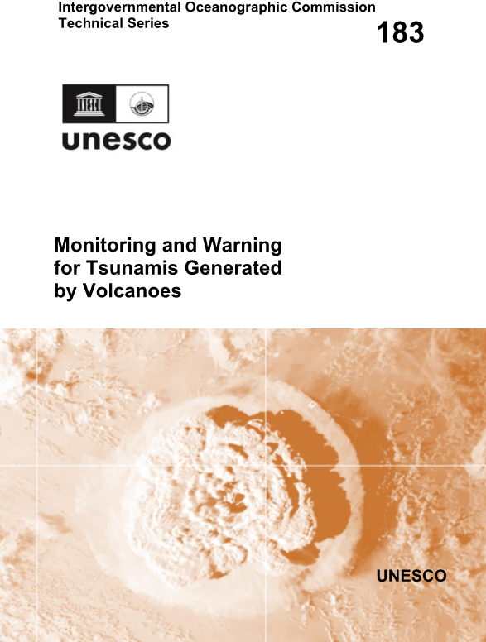
10.1. Tsunami Generated by Volcanoes (1)
“Monitoring and Warning for Tsunamis Generated by Volcanoes”
Prepared by the Ad Hoc Team on Tsunamis Generated by Volcanoes (TGV):
François Schindelé – Commissariat à l’Energie Atomique et aux Energies Alternatives, France
Emily Lane – National Institute of Water and Atmospheric Research, New-Zealand
Raphaël Paris – Université Clermont Auvergne, France Maurizio Ripepe – University of Florence, Italy
Vasily Titov – National Oceanic and Atmospheric Administration, USA
Laura Kong –International Tsunami Information Center
Rick Bailey –Intergovernmental Oceanographic Commission of UNESCO

Slide 3
10.1. Tsunami Generated by Volcanoes (2)
MONITORING AND WARNING
As a first step, organisation(s) should be designated for monitoring and warning of Tsunamis Generated by Volcanoes (TGV). The second and third steps are to install monitoring instrumentation and develop Standard Operating Procedures (SOPs) to handle volcanic tsunamis.
TGV monitoring and warning system should be implemented by, or in cooperation with the National Tsunami Warning Centre (NTWC) and regional Tsunami Service Provider (TSP) and national and regional Volcano Service Providers, where such exist.
All volcanoes mentioned in the TGV report should be monitored and have processes in place to warn for tsunamis. Should other, potentially tsunamigenic volcanoes begin erupting, these should also be monitored and included within the tsunami warning process.
Detect/warn geophysical (seismology, GNSS, tiltmeter, barometric and sea level data streams need to be available to the designated tsunami monitoring/warning agency (and possibly also to the volcano monitoring agency)
As well as monitoring systems for volcano activity and potential far-field propagation of sea level signal, a sea level gauges network with real-time continuous data transmission should be deployed close to each identified volcano to verify risk and then ongoing monitoring and warning. One second sampling with 1cm accuracy (< 1 mm sampling) is recommended sampling is recommended for recording and automatic detection. Data transmission through radio or microwave links, fiber optic, or dedicated telephone lines, or other modes should be implemented to ensure the data is transmitted and received and widely shared with international community in a timely manner.
Methods to also specifically alert persons in remote areas (such as scientific teams in the field, or recreational hikers) should be considered.
TGV SOPs for tsunami warning should be linked with existing Volcano Alert Activity scales.

Slide 4
10.1. Tsunami Generated by Volcanoes (3)
RISK ASSESSMENT AND PREPAREDNESS:
A TGV hazard and risk assessment should be undertaken to determine vulnerable areas.
For TGV, multi-stakeholder meetings should be convened that included science agencies, volcano and tsunami warning operations centres, and disaster management agencies. For each identified potential source, worst-case and credible scenario planning discussions should start as soon as possible.
During a period of heightened TGV hazard, consider closing access to vulnerable areas. When eruption is imminent and then tsunami hazard is high, consider evacuating populations from vulnerable locations.
Specific TGV signage and evacuation routes should be implemented in all areas that may be impacted by tsunamis generated by volcanoes.
TGV public awareness campaigns should be conducted regularly – the type and frequency of awareness activities may be different for the local population compared to transient populations such as tourists.

Slide 5
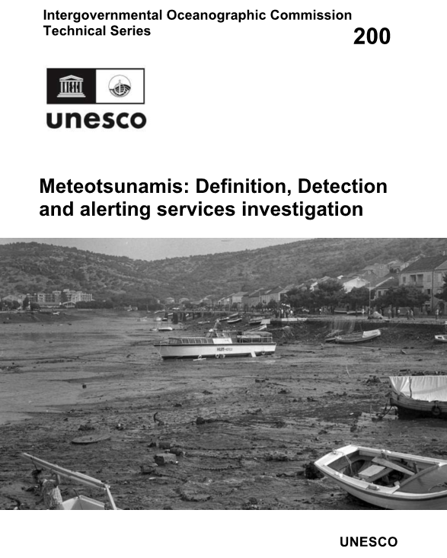
10.2 Meteo-tsunami (1)
Prepared by the Ad hoc Team on Meteotsunamis: definition, detection and alerting services investigation
IOC；
Mike Angove (Chair) National Oceanic and Atmospheric Administration, USA (2022–2023) and then consultant
Ivica Vilibić (Co-chair) Institute of Oceanography and Fisheries, Croatia Mohammad Heidarzadeh University of Bath, UK Sebastian Monserrat University of the Balearic Islands, Spain
Emile Okal Northwestern University, USA
Chari Pattiaratchi University of Western Australia, Australia
Alexander Rabinovich Institute of Oceanology of Russian Academy of Sciences, Russia
Jadranka Šepić University of Split, Croatia
Vasily Titov National Oceanic and Atmospheric Administration, USA
With the support of the IOC Secretariat:
Bernardo Aliaga – Head of Tsunami Resilience Section
Rick Bailey – Tsunami Resilience Section
WMO：
Allison Allen National Oceanic and Atmospheric Administration, USA
Nadao Kohno Japan Meteorological Agency, Japan
Nobuhito Mori Kyoto University, Japan
John Parker The Meteorological Service of Canada
Sung-Hyup You Korea Meteorological Administration, Republic of Korea
With the support of the WMO Secretariat:
Ray Canterford – Consultant to WMO
Thomas J. Cuff – Consultant to WMO
Sarah Grimes – World Meteorological Organization, Switzerland

Slide 6
10.2 Meteo-tsunami (2)
Organizational Relationships between TSPs, NTWC and Regional/National Hydro-Meteorological Services
Since 'MT' are hazards driven by weather conditions, warning responsibility lies solely with the servicing NMHSs.
However, since NWP-based 'MT' detection and forecast systems are imperfect, particularly as they do not normally provide direct tsunami detection and measurement, there are instances when monitoring tsunami-specific instruments such as deep ocean tsunameters and tsunami capable tide gauges can provide support to NMHSs.
And while operational tsunami forecast and warning activities such as IOC-designated Tsunami Service Providers (TSPs) or National Tsunami Warning Centres (NTWCs) will play no role in real-time operational alerting, the Ad Hoc Team on MT does advise that NMHS’ create working relationships with overlapping TSPs and/or NTWCs to become more familiar with monitoring tsunami-specific instrumentations.

Slide 7
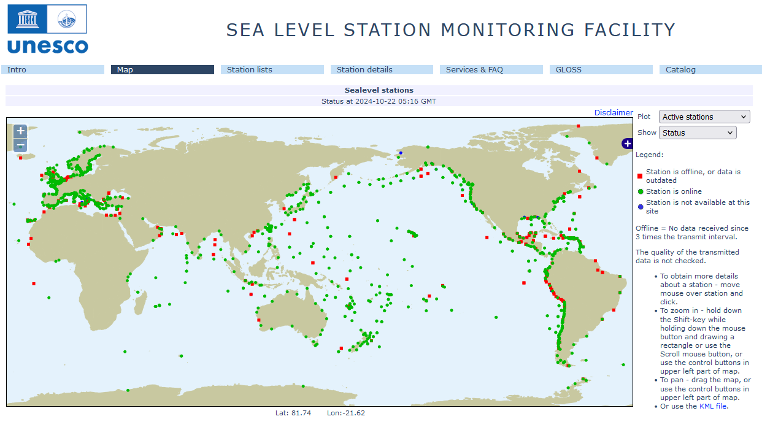
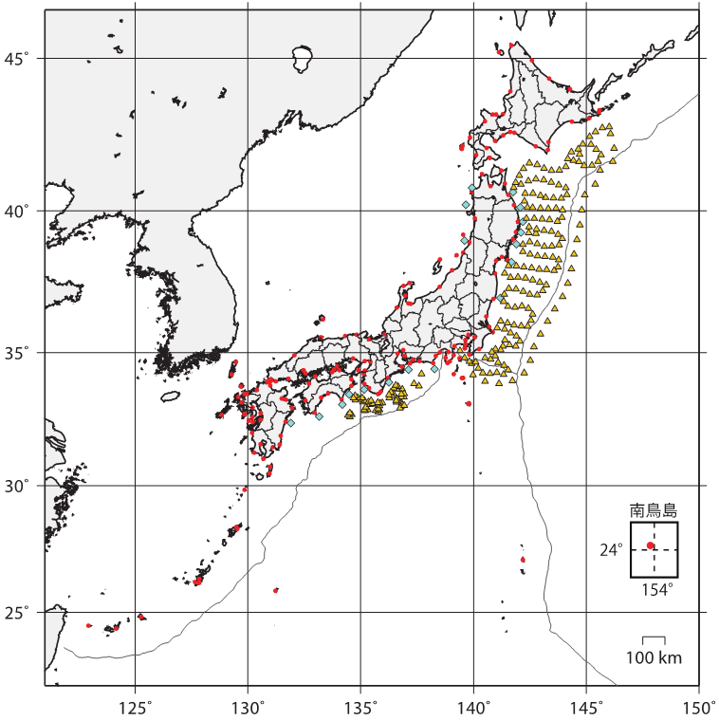
Sea Level Monitoring
Tide Gauge
・JMA
・Japan Coast Guard
・Port & Harbor Bureau
・Geospatial Information Authority of Japan
・Cabinet Office
・Municipality, Private sector
Offshore Tsunami meter
GPS type(PHB)
Pressure sensor
・JMA
・ERI
・NIED
S-net
DONET
from UNESCO Sea Level Monitoring Station Facility Map
Sea Level Monitoring Facilities monitored by the JMA

Slide 8
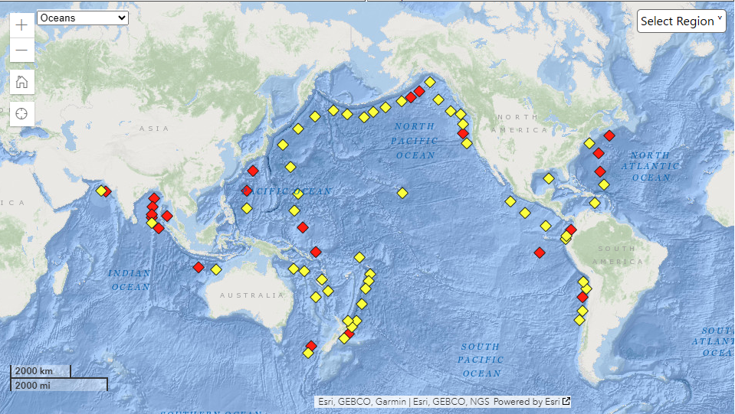
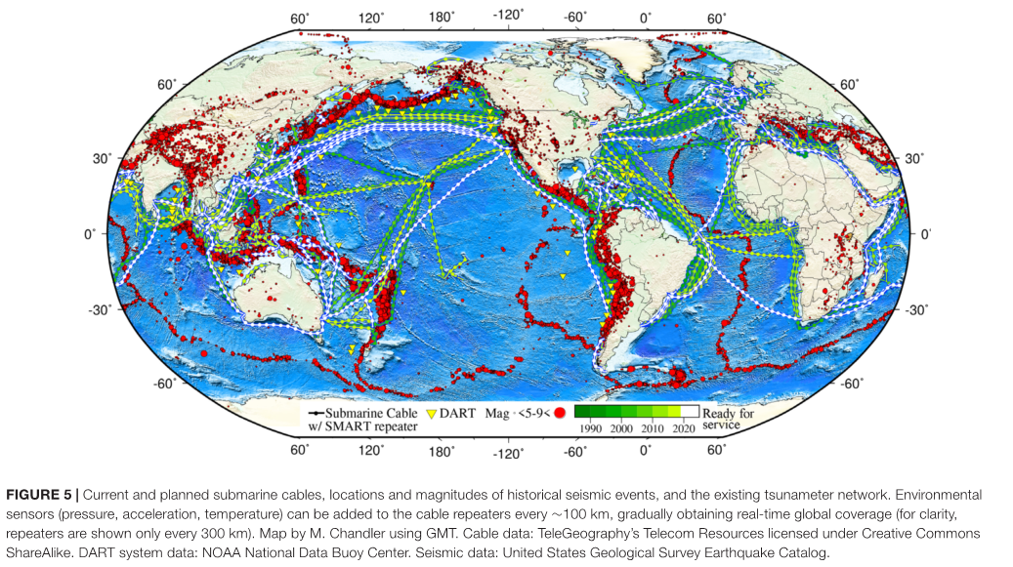
Use of offshore tsunami meters for early tsunami detection
DART® (Deep-ocean Assessment and Reporting of Tsunamis)
NOAA National Data Buoy Center (https://www.ndbc.noaa.gov/)
Offshore cabled networks in Japan (S-net and DONET)
S-net
SMART Cables (Angove et. Al (2019))
DONET
N-net

Slide 9
10.2 Meteo-tsunami (3)
Summary
While ’MTs’ are known to occur along many coastlines, only infrequently do they pose a significant risk to life and property. This typically occurs in areas where transiting weather disturbances move over shallow-water regions at precise speed and strength values as to create relatively large, long-wave resonances (e.g. the Mediterranean Sea, Great Lakes, Yellow Sea, East China Sea, and some areas of the North and Baltic Sea).
'MTs' only form under a narrow range of parameters related to water depth and the translational speed of the source disturbance. This makes it possible to characterize the 'MT' risk for virtually any coastline in the world. Local understanding of the 'MT' threat posed to a given coastline is critical to ensuring the phenomena is addressed.
Some guidance systems have been developed that rely heavily on identifying the meteorological parameters necessary for ’MT’ development through NWP schemes. These systems have shown promise in providing advance notice on 'MT' development. However, since they are based on forecasted parameters and not actual 'MT' detection, false alarm rates are not insignificant.
In some cases, tsunami-specific instrumentation can play a supporting role in terms of detection, though even in such rare cases, this will not typically be sufficient to fully characterize the wave field and support precise coastal impact forecasts. Nevertheless, there is value in creating relationships between NMHS’ and TSPs/NTWCs to ensure these instruments are correctly monitored and utilized.

Slide 10
10.2 Meteo-tsunami (4)
Recommendations
In consultation with the Joint WMO-IOC Collaboration Board (JCB), discuss use of the term ‘meteotsunami’, to understand its implications and ensure common vocabulary is agreed among UN agencies, recognizing the WMO’s role as the authoritative voice on climate, water, and weather and noting that the agency does not presently recognize the term. Although the IOC/TOWS-WG IOC Technical Series, 200 page 14 awaits further guidance on this issue from the JCB, it is the consensus opinion of the Ad Hoc Team on Meteotsunami that the responsibility for issuing public alerts based on ‘MT’ threats be addressed wholly through NMHSs under WMO guidance.
Consider detection of ‘MT' in global tsunami instrumentation strategy. Tsunami detection and measurement capabilities are rapidly improving, and this is expected to accelerate under the UN Ocean Decade. It is now possible to consider non-seismic tsunami sources in the global instrumentation strategy, including ‘MT’. Input from NMHS would be particularly useful as a new generation of tsunami detection and measurement networks are deployed.
Evaluate requirements and capabilities for improved early warnings and alerts. Combining the direct tsunami detection capability of tsunami-specific instrumentation with the NWP-based algorithms tuned to ‘MT’ prediction may deliver significant advances in NMHS’ global MT forecast and warning capability. However, current operational global NWP models are not capable of resolving adequate pressure disturbances for ‘MT’ generation, nor could they be developed and operationally run within presently available resources.

