Slide 1
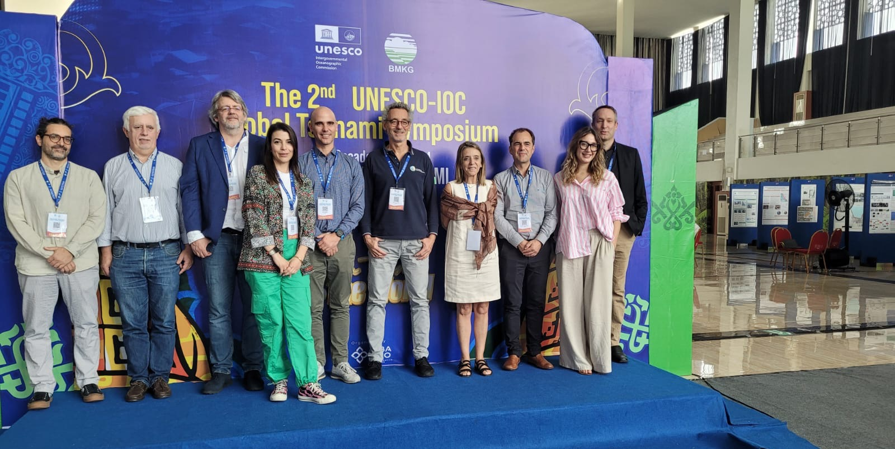
ICG/NEAMTWS
At the Global Tsunami Symposium in Banda Aceh, November 11-14, 2024

Slide 2

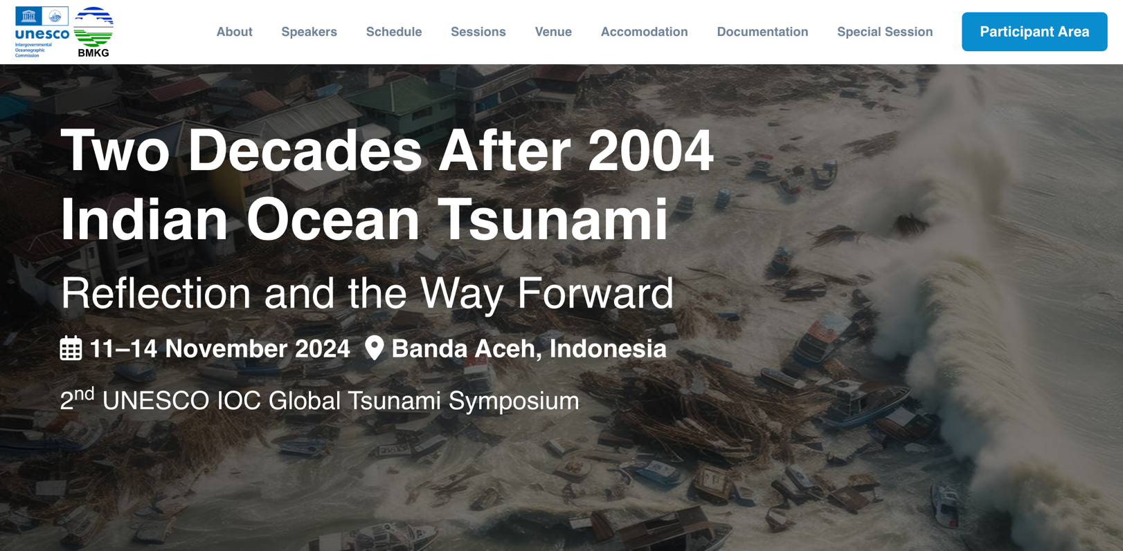
https://globaltsunamisymposium.bmkg.go.id/
Notes:
SLIDE 2
I will briefly report on the activities going on in the NEAM region, focusing on some recent achievements and relevant developments.
A detailed report of our last ICG Assembly held here at UNESCO HQ last February 2024 with Decisions and Recommendations is available on the IOC website.
I want to point out that our ICG is very active, many countries have increased their budgets for tsunami observation and risk mitigation, our Steering Committee is very productive and there are so many ongoing activities that it is impossible to report on all of them today.
I will try to remain within my 8 minutes, probably I will have to skip a couple of slides at the end, but will try not to speak too fast because I don’t want to complicate the lives of our translators who are doing a difficult job with great professionalism, and I take this opportunity to thank them for their hard work!
Our activities include the current continuous warning operations and the very intensive meeting activities al all levels: that of the ICG, of the WGs and TTs, and several meetings with local and national authorities in many countries. Many of these meetings were organized during the path towards the TSUNAMI ready recognition and on the occasion of the NEAMWave23 exercise and the World Tsunami Awareness Day. An important contribution to these activities was provided by the CoastWave project, whose Phase 1 has finished last month, whereas the Phase 2 has been approved and will start next month, July 2024.
We will also briefly take a look at the most recent technological developments in our region.

Slide 3
NEAM participation in the Global Symposium, Banda Aceh, Indonesia, November 11-14, 2024
ICG/NEAMTWS (Gaps, challenges, priorities in tsunami risk, detection, warning and dissemination, awareness and preparedness) – A. Amato
Strengthening and empowering communities at tsunami risk: Evacuation planning-based disaster risk reduction . I. Aguirre Ayerbe
Non-seismic Tsunami sources: Tsunami Warning @Stromboli - F. Romano
Tsunami Ready Recognition Programme in NEAMTWS – E. Daskalaki
Lessons-learned from the 2020 Samos-Aegean tsunami – N. Kalligeris
Global Tsunami Model – GTM – Development of a new global hazard model (F. Løvolt, S. Lorito, GTM Team)
Probabilistic Tsunami Forecasting – S. Lorito
Tsunami generated by volcanic source mechanisms, monitoring and warning system – F. Schindelé

Slide 4
NEAM participation in the Global Symposium, Banda Aceh, Indonesia, November 11-14, 2024 /Posters
Preparing teenagers for tsunami hazard – M.A. Baptista
Enhancing the Portuguese Tsunami Warning System (PTTWS) with the installation of the CAM smart cable – F. Carrilho et al.
Volcanic tsunamis and their Early Warning challenges: The global 2022 Tonga tsunami – R. Omira et al.
NEAM scientists also included Jorn Lauterjung, H. Spahn, N. Clark, R. Haigh, …

Slide 5
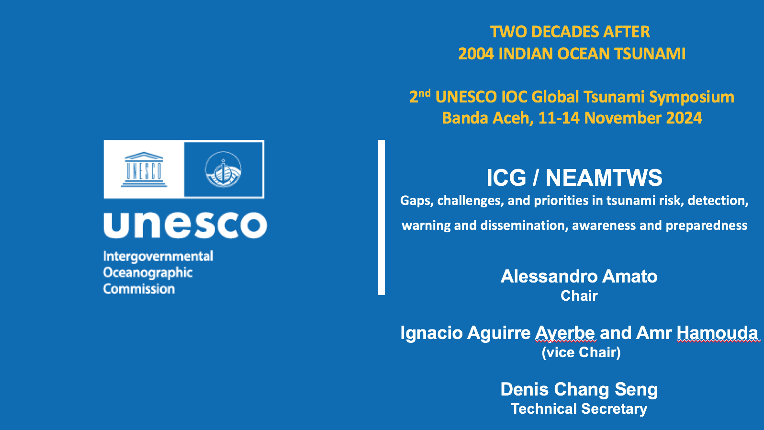
Notes:
SLIDE 1
Thanks Chair
Good morning, it is an honor for me to report for my first time - as NEAMTWS Chair - to the IOC Executive Council. I thank my two co-Chairs Amr HAMOUDA (who is here) and Ignacio Aguirre Ayerbe, and the Technical Secretary Denis Chang Seng who is also here, for their strong support, as well as our previous NEAM Chair, Maria Ana Baptista.

Slide 6
The ICG/NEAMTWS activities/advancements 2024
Continued operations (monitoring, warning, meetings, etc.)
6 recognized Tsunami Ready communities in 2024 (and others coming soon)
Improved response in the NEAMWave23 exercise
Closing of CoastWave project (2022-2024), Phase-2 started July 2024 (DG-ECHO)
Other projects on tsunami science and hazard - risk mitigation (+ EPOS, GTM, etc.)
New Task Team on non-seismic tsunami sources (Stromboli test case + WS)
Educational activities
New developments and technologies:
New tide gauges in several MS coastal areas (20 in Marmara Sea, Türkiye)
First cabled deep-ocean sensors connected to TSPs
Two DART-like buoys coming in the Ionian sea (2025) + 1 near Stromboli
Probabilistic Tsunami Forecasting - PTF implementation
Notes:
SLIDE 2
I will briefly report on the activities going on in the NEAM region, focusing on some recent achievements and relevant developments.
A detailed report of our last ICG Assembly held here at UNESCO HQ last February 2024 with Decisions and Recommendations is available on the IOC website.
I want to point out that our ICG is very active, many countries have increased their budgets for tsunami observation and risk mitigation, our Steering Committee is very productive and there are so many ongoing activities that it is impossible to report on all of them today.
I will try to remain within my 8 minutes, probably I will have to skip a couple of slides at the end, but will try not to speak too fast because I don’t want to complicate the lives of our translators who are doing a difficult job with great professionalism, and I take this opportunity to thank them for their hard work!
Our activities include the current continuous warning operations and the very intensive meeting activities al all levels: that of the ICG, of the WGs and TTs, and several meetings with local and national authorities in many countries. Many of these meetings were organized during the path towards the TSUNAMI ready recognition and on the occasion of the NEAMWave23 exercise and the World Tsunami Awareness Day. An important contribution to these activities was provided by the CoastWave project, whose Phase 1 has finished last month, whereas the Phase 2 has been approved and will start next month, July 2024.
We will also briefly take a look at the most recent technological developments in our region.

Slide 7
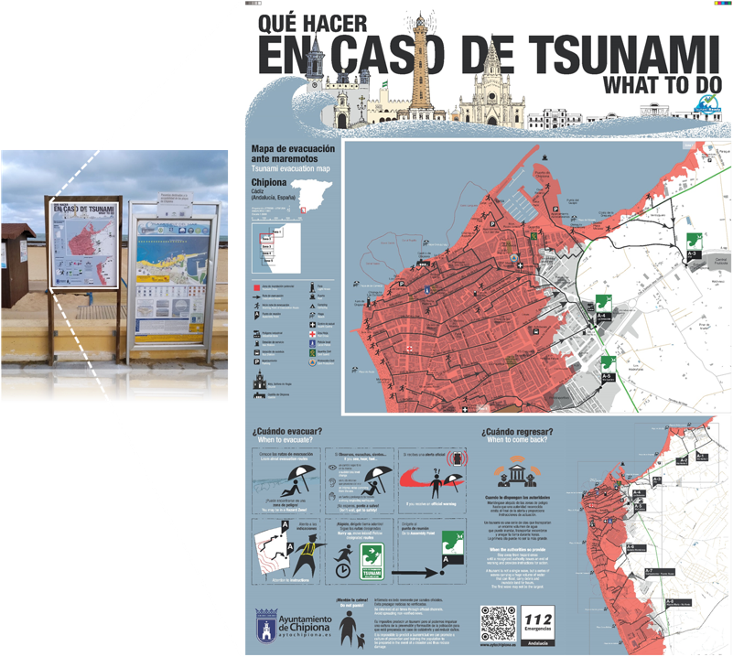

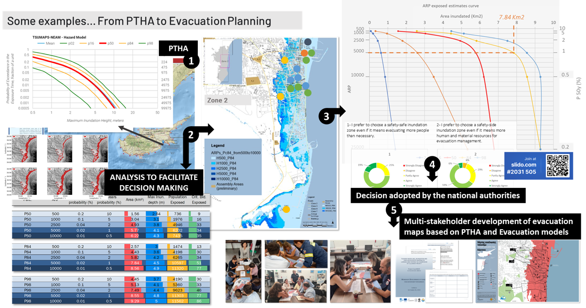


TSUNAMI: AN INTENSIVE RISK
Chipiona, Spain
Larnaca, Cyprus

Slide 8


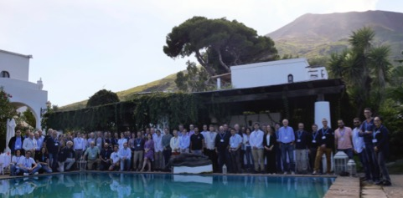
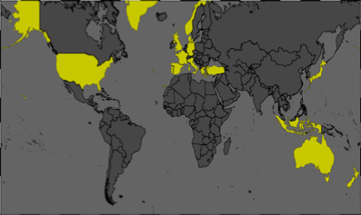
Non-seismic Tsunami sources: Tsunami Warning @Stromboli
F. Romano (INGV) during the 2nd UNESCO-IOC Global Tsunami Symposium (Banda Aceh, 11-14 November 2024)
Non-seismic tsunamis are a new challenge for TEWS after some recent events (e.g. Anak Krakatau, Hunga Tonga)
In Italy there are two TEWS, one for seismically induced tsunamis (CAT-INGV) and one for tsunami generated by the Stromboli’s volcanic activity that operate independently
moving towards a more comprehensive and unified approach to tsunami monitoring and tsunami risk management is necessary
Italian project promoted by Italian Civil Protection
A multi-hazard TEWS represents a challenge because it is necessary to address:
o Different types of observations with which the volcano and associated tsunami can be monitored
o Different types of numerical modelling of the generation and propagation phase of tsunamis generated by non-seismic sources
o Hazard analysis for volcanic tsunamis o Alerting and tsunami forecasting procedures for this type of events (including the integration in the national and regional TEWS)
In this framework INGV organised an international workshop
Endorsed by the TT on Non Seismic Tsunami sources for the ICG/NEAMTWS
Endorsed by the UN Decade of Ocean Science for Sustainable Development
The workshop aimed at inviting worldwide geophysical experts to:
Review the state of the art about Observations, Modeling, Hazard, and Forecasting for tsunami generated by volcanic events
Review what Italy has in place for the Stromboli TEWS
Present their ideas for improvements based in the current knowldege
Suggest new direction research

Slide 9

Summary of presentation on UNESCO-IOC Tsunami Ready Recognition Programme in NEAMTWS 2nd UNESCO IOC Global Tsunami Symposium by Elena Daskalaki
Overview of the North-East Atlantic and Mediterranean region, focusing on tsunamis and the coastal population exposure.
Presentation of The Tsunami Ready Recognition Programme (TRRP) in the NEAM region as a significant initiative which is implemented through the IOC-UNESCO EU DG ECHO CoastWAVE project along with various national initiatives.
11 Countries are applying the TRRP in NEAM with 6 communities already recognized as Tsunami Ready Alexandria-Egypt, Cannes-France, Samos-Greece, Minturno-Italy, Chipiona-Spain and Buyukçekmece-Türkiye.
Best practices & Innovations in regional TRRP implementation.
Main challenges in regional TRRP implementation.
Future steps for TRRP Implementation in the NEAM region – short introduction on IOC-UNESCO EU DG ECHO CoastWAVE 2.0 project.
Key aspects concerning tsunami detection, forecasting, dissemination of alerts, education, and awareness.

Slide 10
Lessons-learned from the 2020 Samos-Aegean tsunami (N. Kalligeris)
Proximity of fault rupture to the shoreline – tsunami warning effectiveness
Wave arrival times were short and left small effective tsunami warning window.
Room for improvement of upstream and downstream TWM dissemination.
The pilot use of Cell Broadcasting technology for tsunami warning had a positive impact in the case of Samos and enhanced self evacuation.
Density of regional tide gauge network
Aegean geomorphology requires a large number of stations to achieve early tsunami detection of near-field tsunamis.
Need for Tsunami Ready communities in the NEAM region – CoastWAVE projects and other national initiatives
Earthquake-shaking itself is a natural warning -> continue raising tsunami awareness in the region.
There is also a need to define tsunami hazard and evacuation zones for coastal locations.
Hazard mitigation, preparedness and response planning are key to save lives, especially for near-field tsunamis -> UNESCO global initiative towards building Tsunami Ready communities.

Slide 11












Probabilistic Tsunami Forecasting (PTF)
Stefano Lorito, INGV, Italy
w/ contributions by, at least:
2nd UNESCO-IOC Global Tsunami Symposium "Two Decades After 2004 Indian Ocean Tsunami: Reflection and the Way Forward"
Commemoration of 2004 Indian Ocean Tsunami
Banda Aceh, Indonesia, 11-14 November 2024

Slide 12
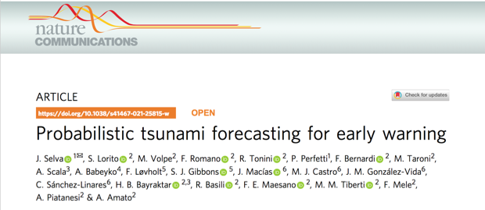
What PTF does
Probabilistic Tsunami Forecasting (PTF, Selva et al., 2021) is a recently introduced methodology that provides a forecast of a tsunami in terms of the probability distribution of a tsunami intensity measure at different forecast points within a few minutes after the occurrence of an earthquake.
Selva, Volpe, Lorito, Romano et al., Nature Communications, 2021
PTF is planned to become operational at CAT-INGV, Italy, NEAMTWS TSP in 2025. At least another NEAMTWS TSP, NOA, Greece, is considering its adoption.
INCOIS is considering PTF in the frame of the People-Centred Early Warning for the Indian Coastlines (PCTWIN) project coordinated by UCL, UK.
Others have started to use or develop ensemble modelling approaches which share some elements with PTF to consider uncertainties in the tsunami forecasting (e.g. New Zealand, Chile, USA NOAA).

Slide 13
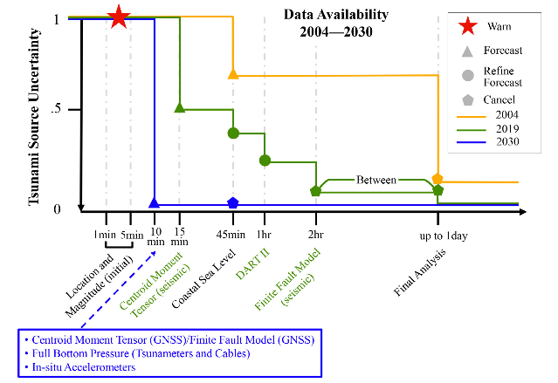
Conclusions. PTF is aligned with UN Decade Goals!
Uncertainty Quantification/Reduction for tsunami forecasting
Provide the decision-makers with actionable information
Account for tsunami propagation complexity (not only distance)
Avoid hard-thresholds → jumps of the alert levels
Angove et al., 2019
Notes:
goal 1 accuracy and timeliness

Slide 14
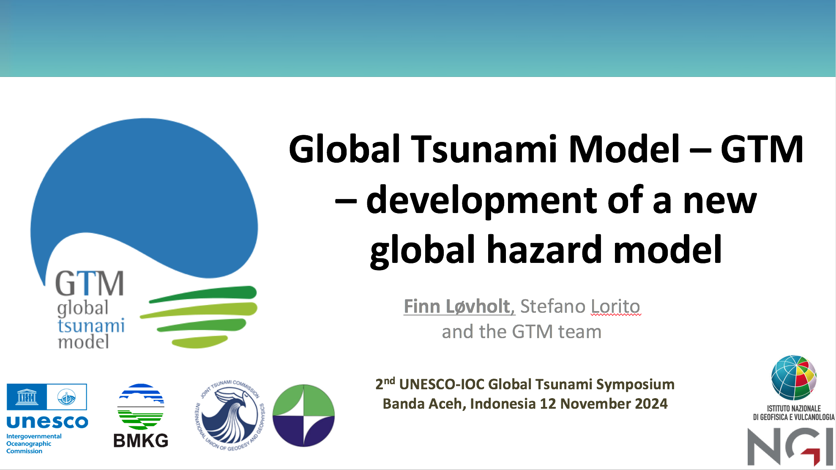

Slide 15
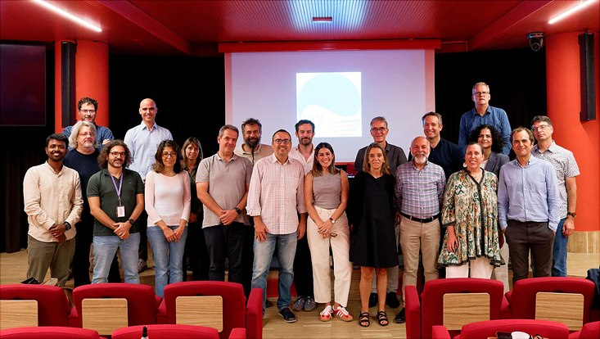
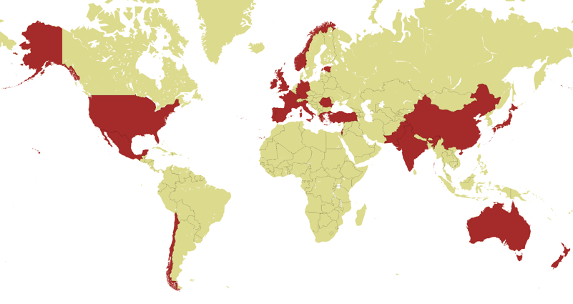
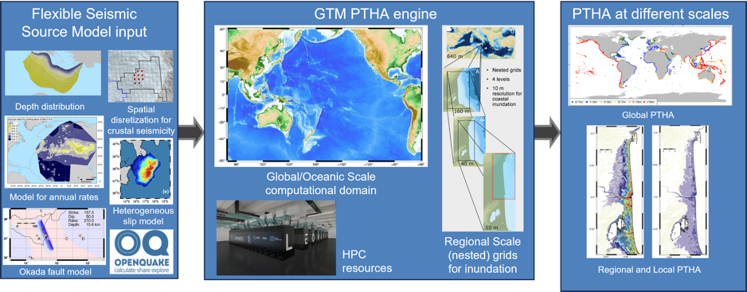
Global tsunami model presentation summary
GTM inauguration meeting at INGV in Rome September 2024
A short review of status before and after 2004 with respect to how tsunami hazard modeling is conducted
Presented the background and status of the Global Tsunami Model – past and near future – vision and mission
Announcement of the legal entity GTM Association – stressing the objective of the Association being the future focal point within tsunami hazard and risk modelling
Presented the ongoing work on GTM global tsunami hazard model including the following novelties
Covering multiple scales
Heterogeneous slip
Depth dependence
More comprehensive coastline coverage
Interoperability with GEM Input/Output
Incorporation of tides
Modelling future sea-level rise
Countries with subscribers of
Letter of Interest
Workflow of the Global tsunami hazard model

Slide 16
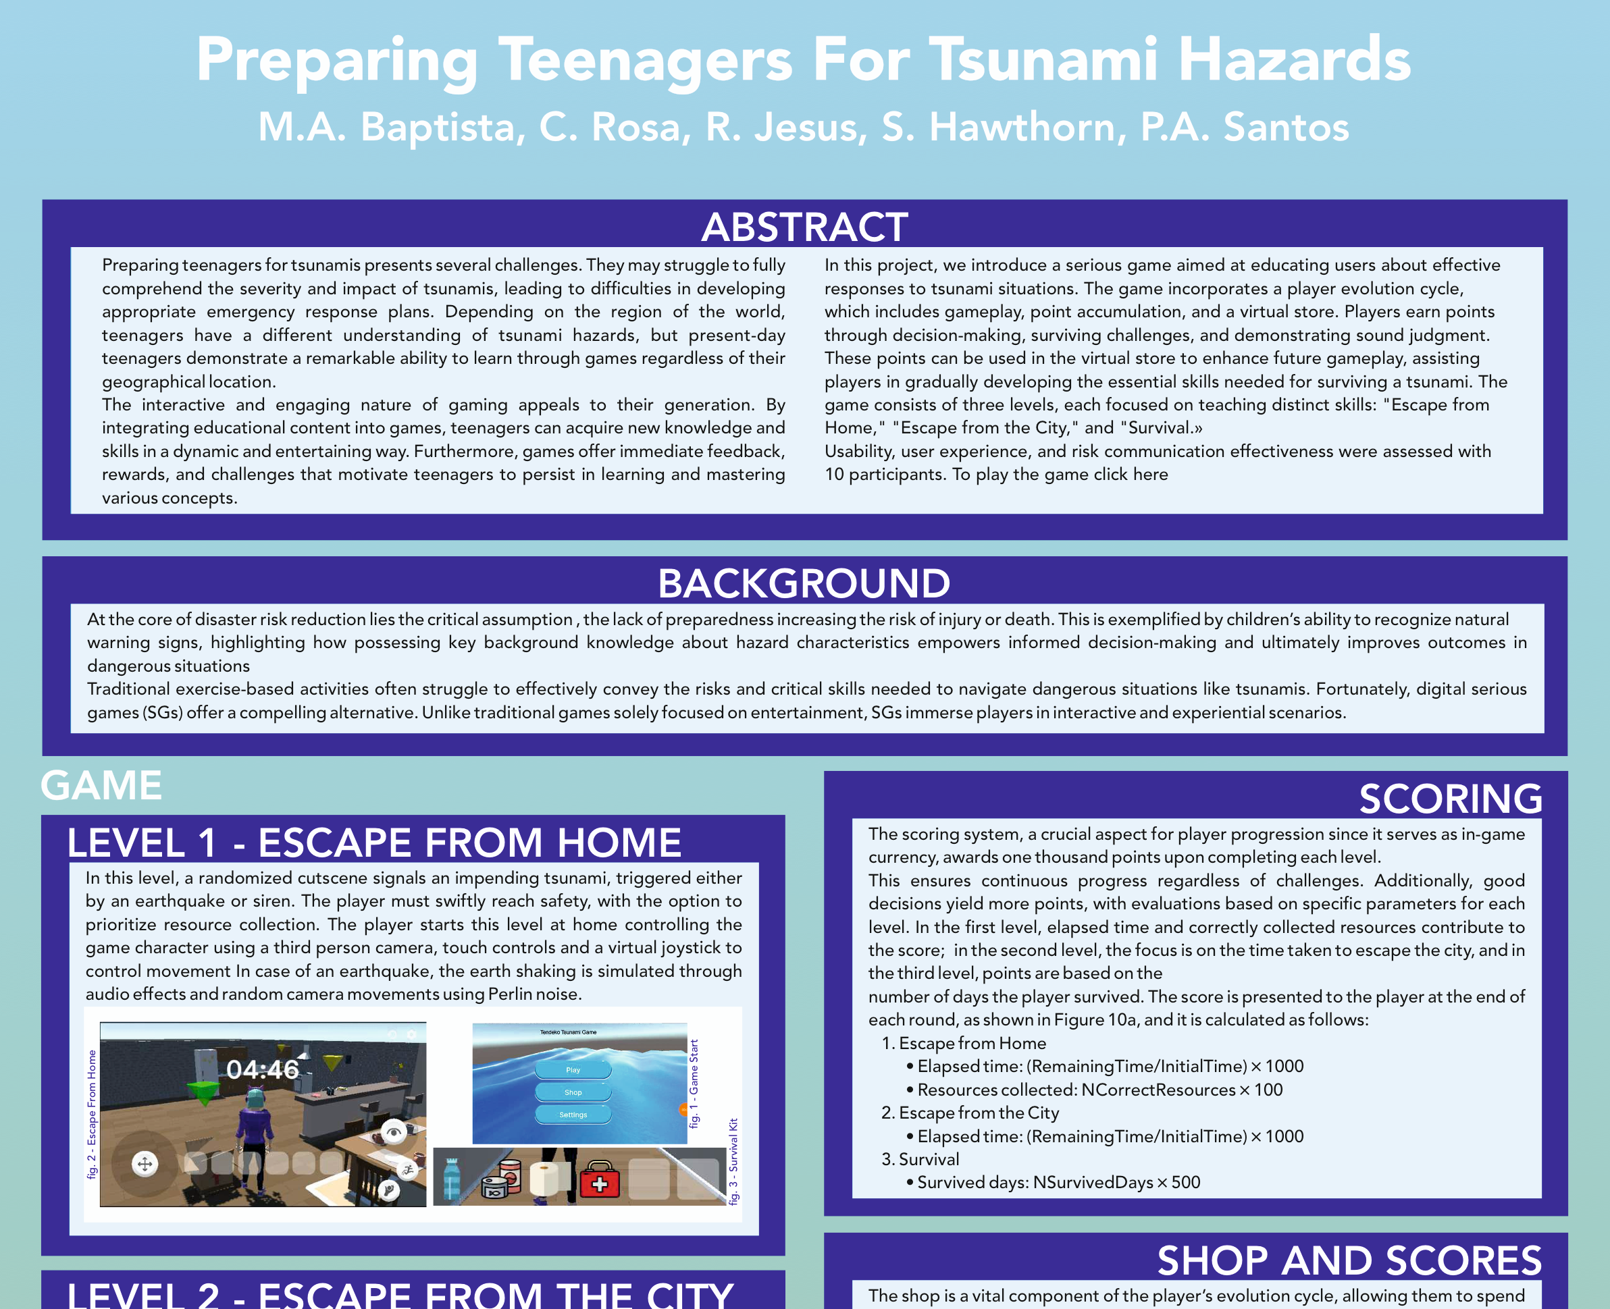

Slide 17
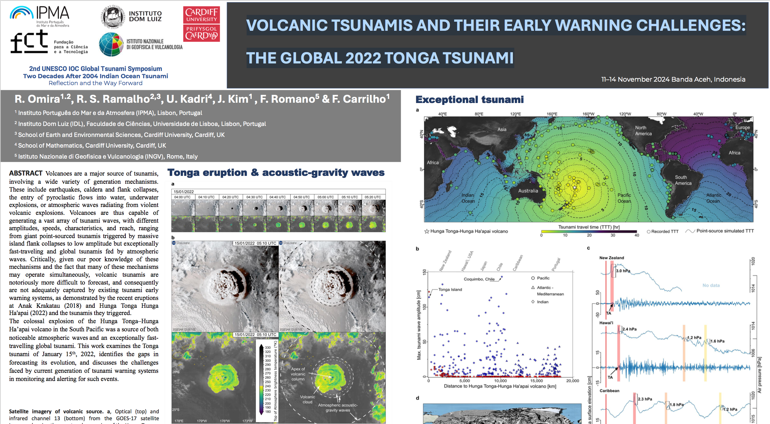

Slide 18
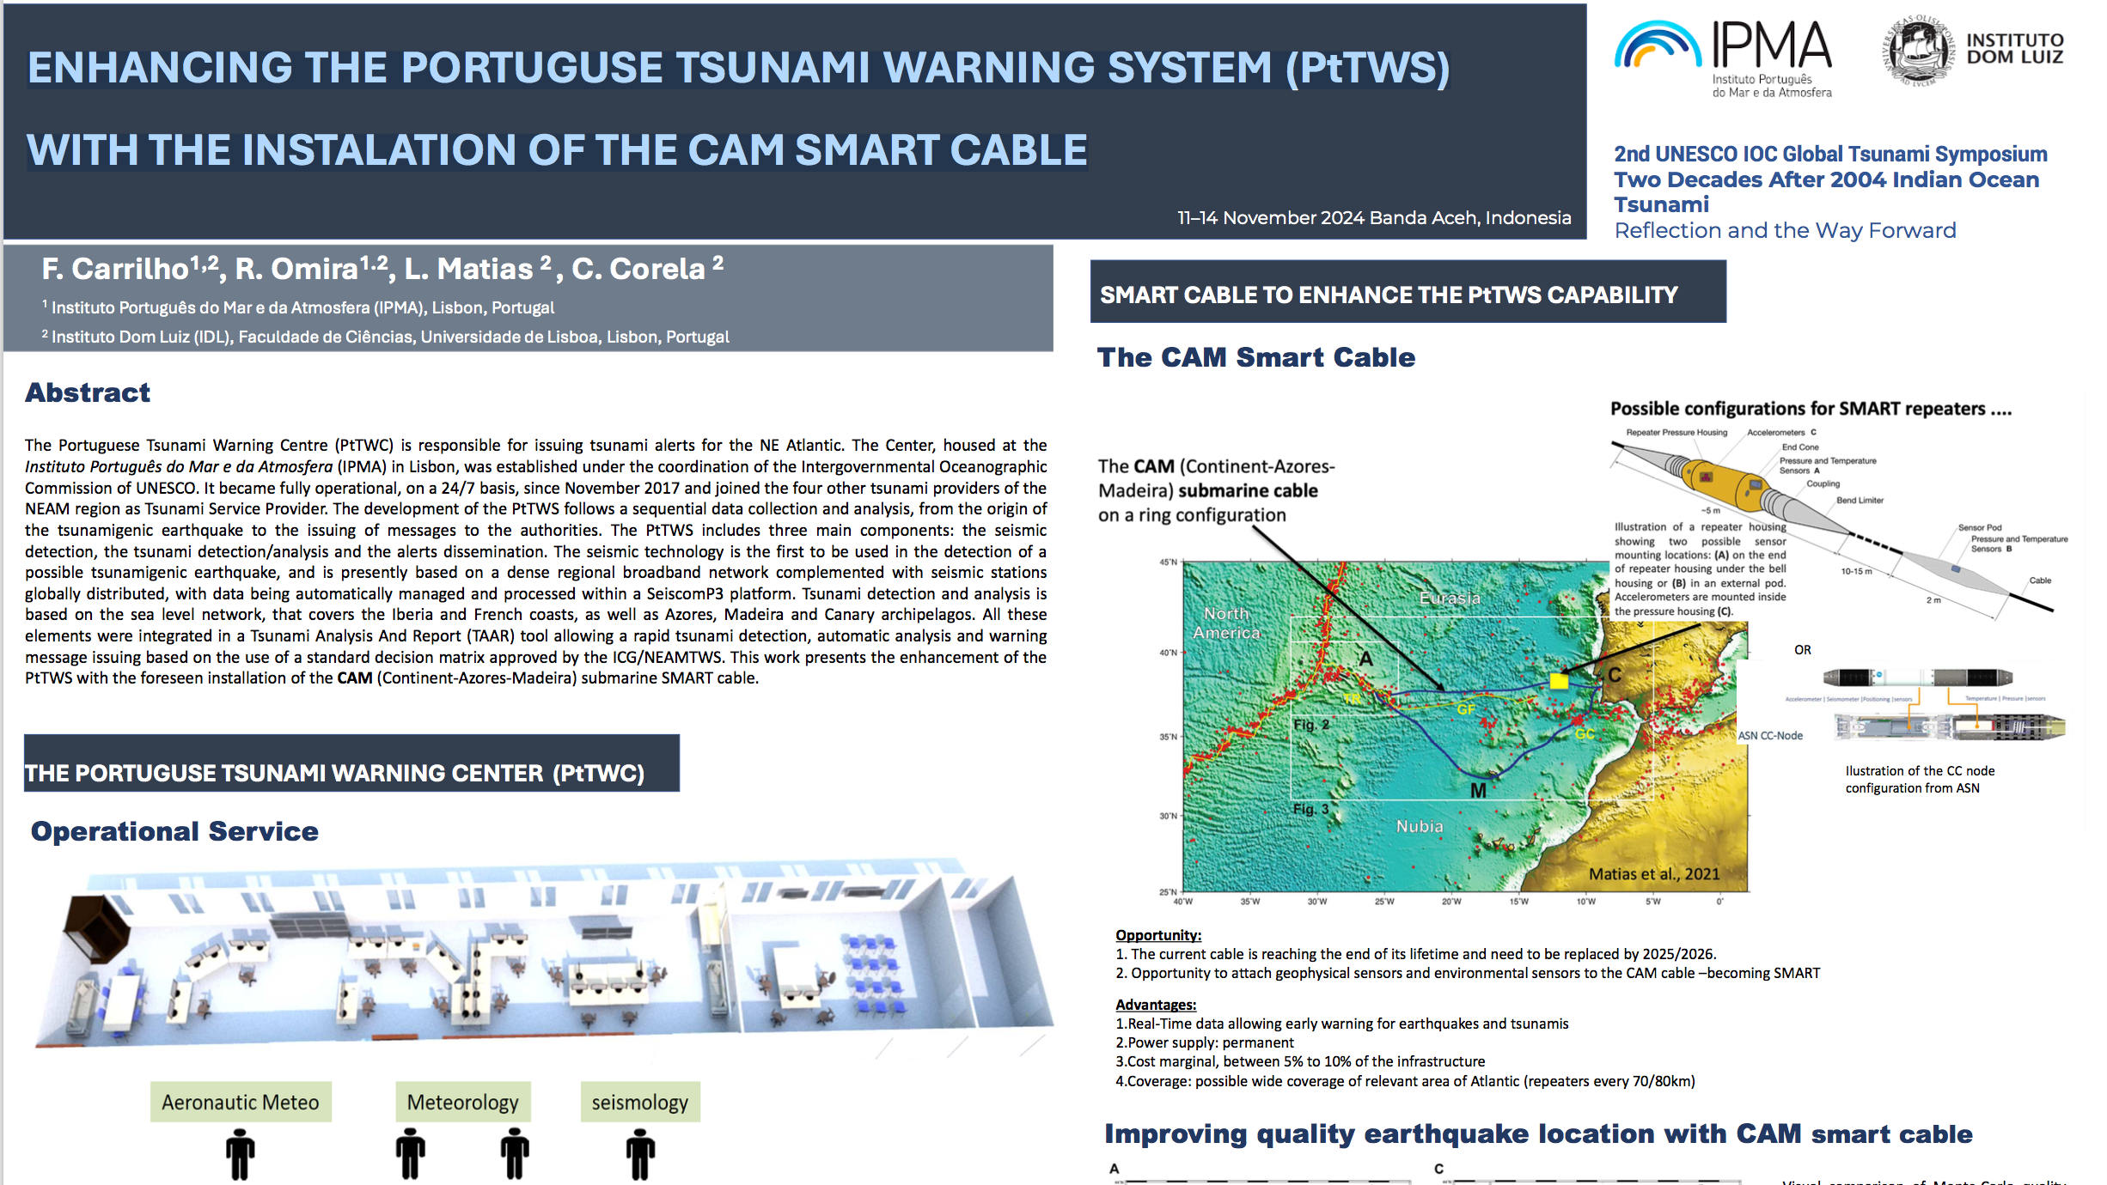

Slide 19
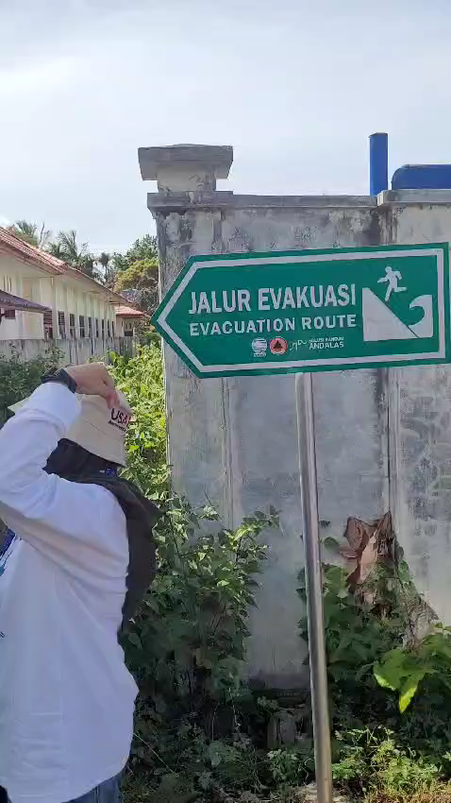
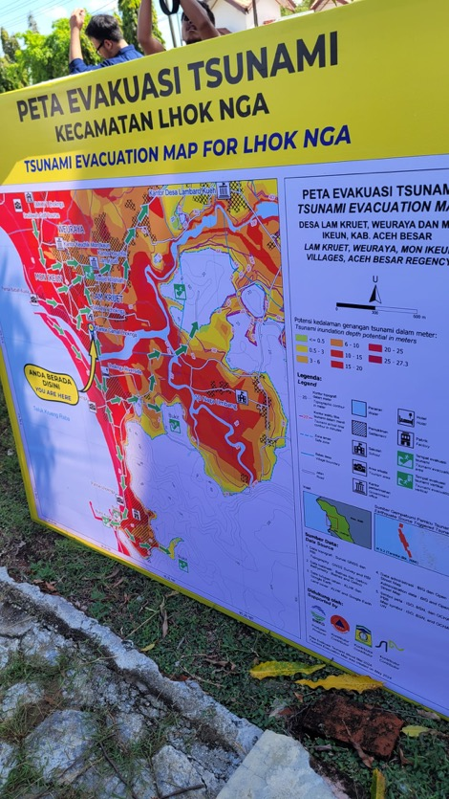
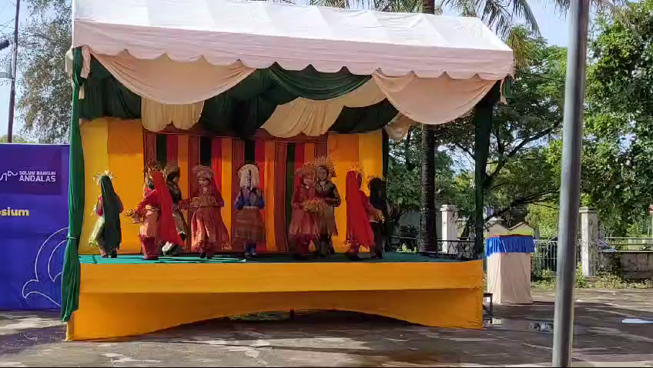
Field trip 1 – LHOK NGA Tsunami Ready village and drill

Slide 20
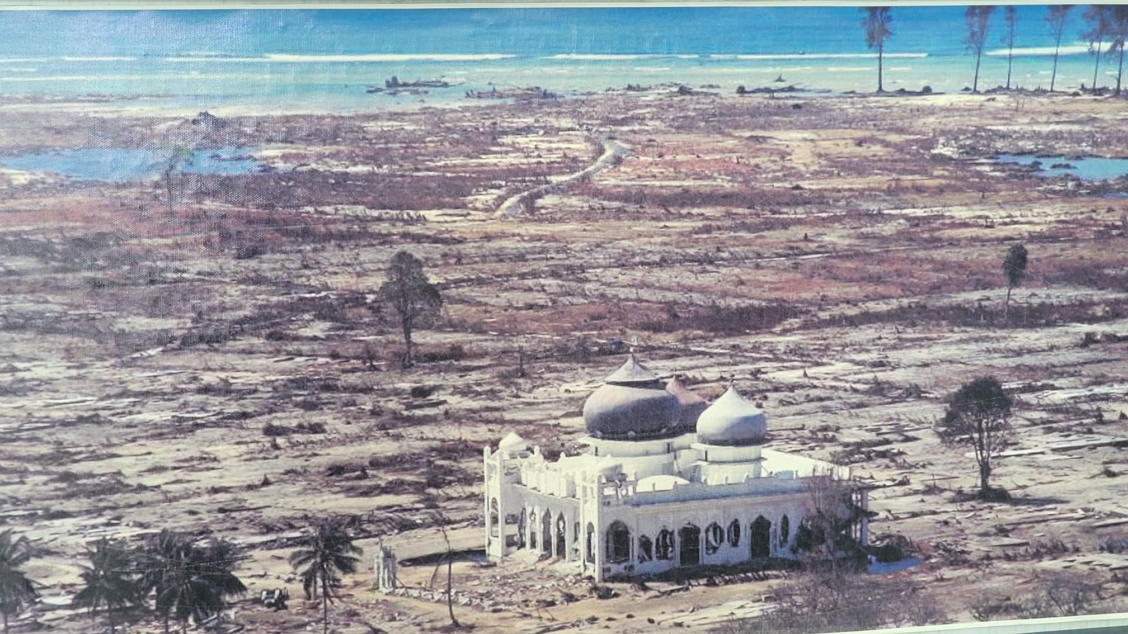
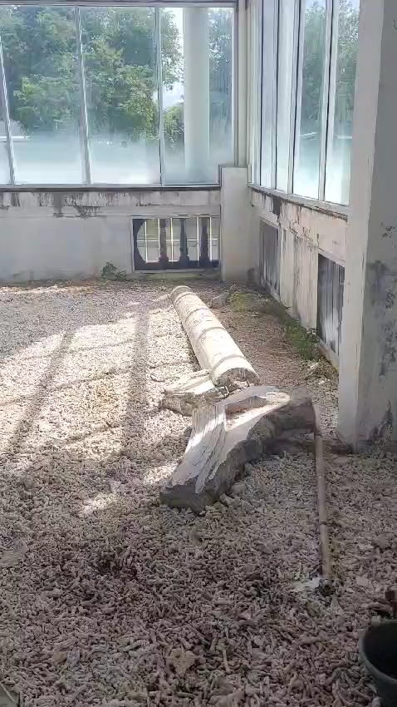
The Mosque that resisted the tsunami

Slide 21
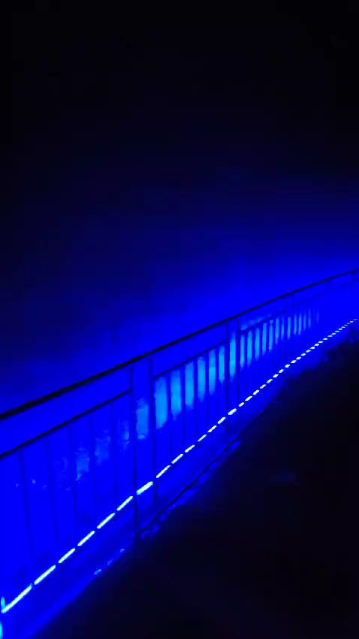
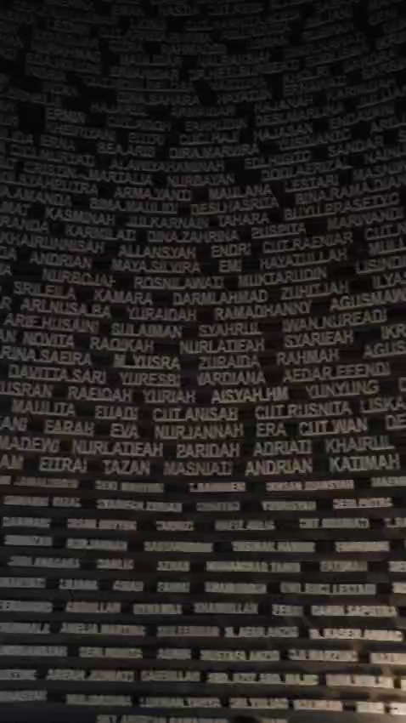
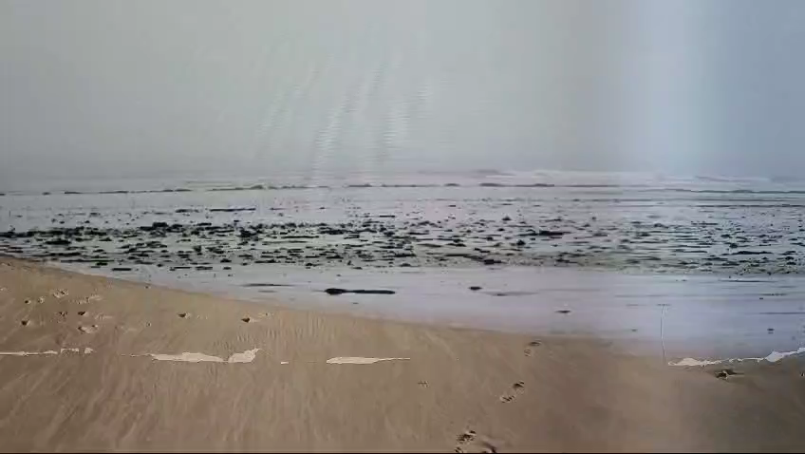
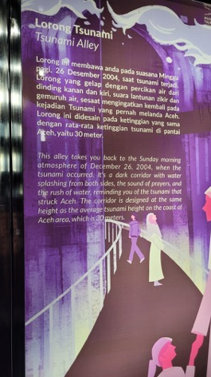
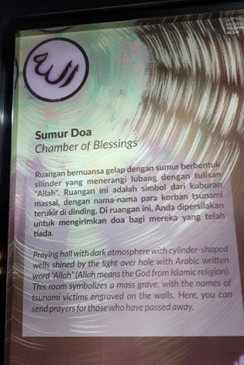
Field trip – Museum Tsunami Aceh

Slide 22
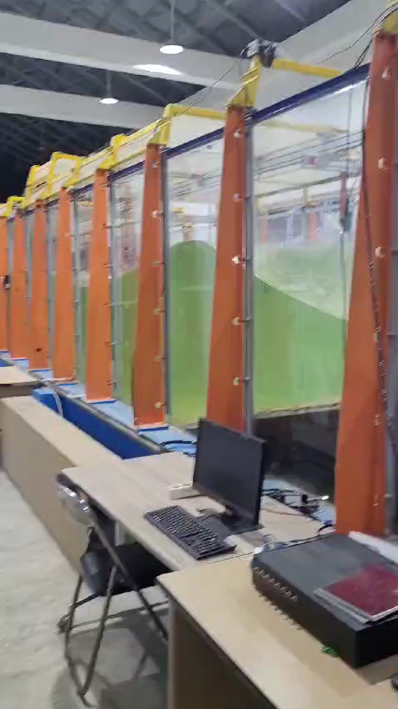
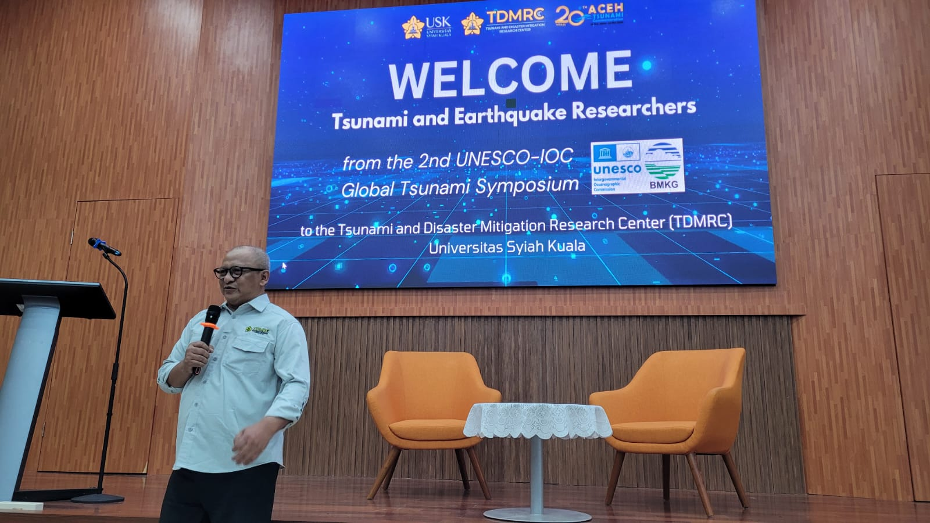
Visit to the TDMRC

Slide 23
In summary
The presence of NEAMTWS in the Global Symposium has been relevant in quantity and quality of the presentations
The topics brought by our ICG researchers were highly appreciated and aroused much interest
The participation to the field trip has been very emotional and touching
Impression of an unexpected reoccupation of the coastal areas devastated in 2004

Slide 24
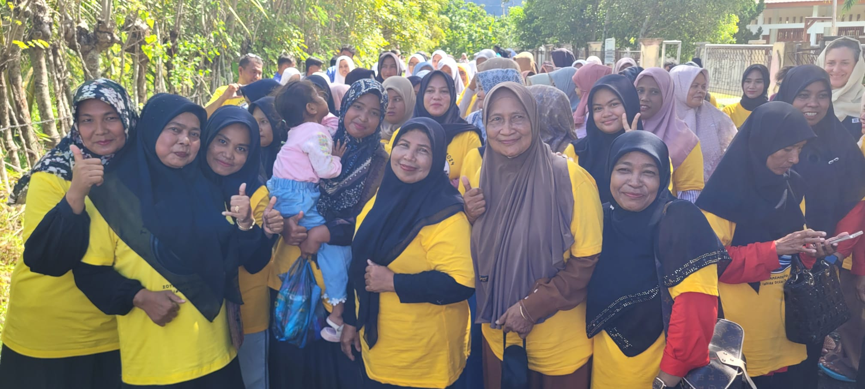
Terima Kasih
Thank you

