Slide 1

4.6 Report on NEAMWave23 Exercise
Coordinated by Task Team on Tsunami Exercise
(co-chairs: Ceren Ozer Sozdinler - Marinos Charalampakis)
19th session ICG/NEAMTWS
27 – 29 November 2024

Slide 2

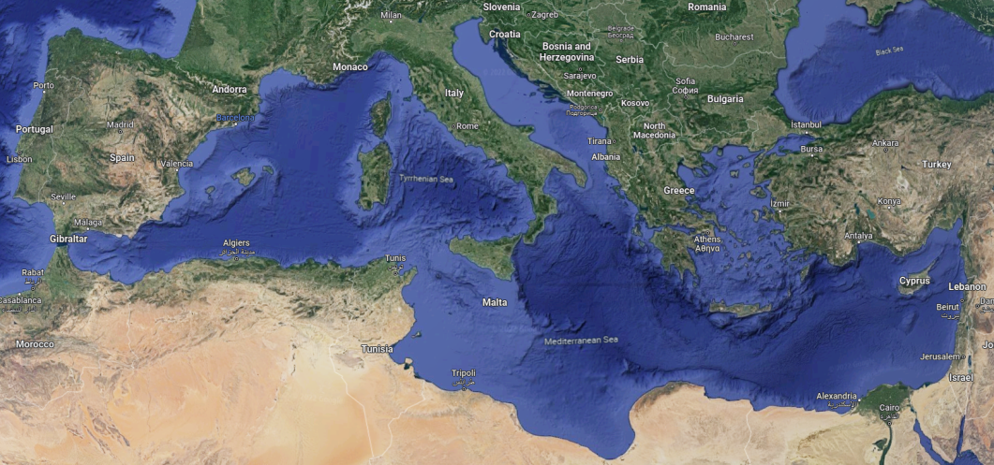
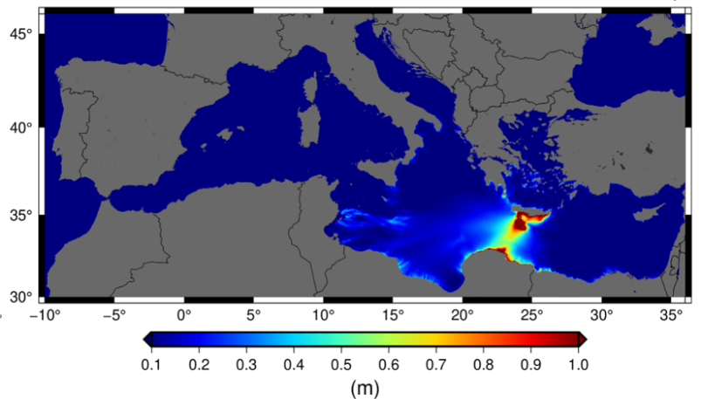
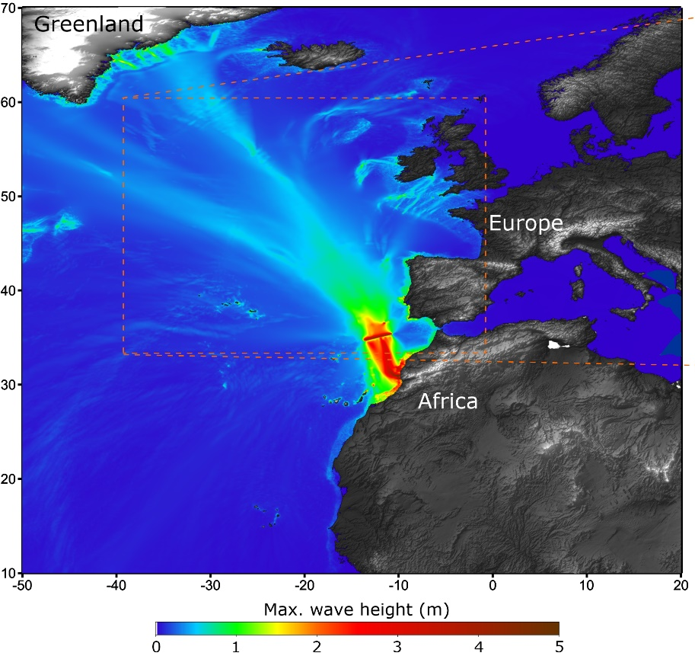
NEAMWave23
North-Eastern Atlantic
Joint scenario (Mw=8.5) by IPMA & CENALT
6 November 2023
08:00 UTC (6 hours)
Eastern Mediterranean
Joint Scenario (Mw=8.1) by INGV, NOA & KOERI
7 November 2023 08:00 UTC (3½ hours)
19th session ICG/NEAMTWS ● 27 – 29 November 2024

Slide 3
Participation Statistics
IOC CL 2950: “Very importantly, Member States registered as recipients of a Tsunami Service Provider are urged to also subscribe to the exercise through the online form”.
Country | NE Atlantic Scenario |  |  | Eastern Med. Scenario
 | Phase A | Phase B | Phase C | Phase A | Phase B
Cyprus |  |  |  |  | X (T)
Denmark | X | X (F)
Egypt |  |  |  |  | X (D)
Finland | X | X (O) | X
Germany |  | X (T)
Greece | X |  |  | X | X (T)
Israel |  |  |  |  | X (T)
Italy |  |  |  |  | X (D)
Lebanon |  |  |  | X
Malta |  | X (F) |  |  | X (F)
Monaco |  |  |  | X
Portugal | X | X (FS)
Romania |  |  |  | X | X (O)
Spain |  | X (FS)
Turkiye | X |  |  | X | X (T)
TOTAL | 5 | 6 | 1 | 5 | 8
19th session ICG/NEAMTWS ● 27 – 29 November 2024

Slide 4
Evaluation in numbers
44 Evaluation forms have been received.
Phase A (TSP): 5 Member States
France (CENALT), Greece (NOA), Italy (INGV), Portugal (IPMA) & Turkiye (KOERI)
Final Evaluation Reports were submitted by CENALT, NOA, INGV and KOERI.
Phase A (TSR): 9 Member States and 1 International body
Cyprus, Finland, France, Greece, Italy, Portugal, Romania, Spain & Turkiye and ERCC
Phase B: 14 Member States subscribed – 5 MS sybmitted evaluation forms
Cyprus, Greece, Italy, Spain & Turkiye
Phase C: 1 Member State
Finland
19th session ICG/NEAMTWS ● 27 – 29 November 2024

Slide 5
NEAMWave23 Subscription & Evaluation
Country | Eastern Mediterranean |  | North-eastern Atlantic
 | Sub. | Ev. | Sub. | Ev.
Cyprus | T | T
Denmark |  |  | F
Egypt | D
Finland |  |  | O
Germany |  |  | T
Greece | T | T + D
Israel | T
Italy | D | D
Malta | F |  | F
Portugal |  |  | FS
Romania | O
Spain |  |  | FS | FS
Turkiye | T | T
TOTAL | 8 | 5 | 6 | 1
Member States participation in NEAMWave23 Phase B exercise (Sub.: according to the subscription, Ev; according to the evaluation forms or the TSP evaluation report).
19th session ICG/NEAMTWS ● 27 – 29 November 2024

Slide 6
Phase A TSP comments
NEAMWave23 was a good opportunity for:
  checking the preparedness of the personnel on shift to manage the issuing of the messages,
  testing in almost real conditions some new features in the analysis and reporting software.
  Implementing the distribution of messages to a local level in the civil protection system
  updating the communication channels, verifying the TSPs operational system and raising awareness among the end-user community,
  testing both the procedures and the performance of TSPs
Some problems occurred in:
  dissemination for messages through fax system mostly due to the non-uniqueness of the fax number from where they are emitted.
  sending emails, showing the need of multi-technology message transmission
19th session ICG/NEAMTWS ● 27 – 29 November 2024

Slide 7
Phase A TSR comments
NEAMWave23 was very useful:
  to verify operational readiness of TSP as message recipient
  to assess transmission delays and evaluation of messages associated to large tsunami events.
  for having immediate and efficient communication between all agencies.
  for testing the communication channels
  for having chance to evaluate operating procedures and manuals
Some problems in email messages, i.e. incorrect name of TSP and its address
19th session ICG/NEAMTWS ● 27 – 29 November 2024

Slide 8
Phase B comments
Improvement of National Messages, because it seems that they are not well understood at local/municipality level.
More municipalities and local communities to be included in future NEAMWave exercises.
It could be useful to have a dedicated meeting before the exercise, with the rest of countries participating in the exercise, as well as the involved TSPs and the Task Team on Tsunami Exercise. – NEAMWave Preparation Meeting
A request for more complex scenarios (without being extreme), such as those with changing alert levels, or varying alert levels across different TSPs, where decision-making may not be straight forward.
19th session ICG/NEAMTWS ● 27 – 29 November 2024

Slide 9
Phase B comments
There were also comments on the content of the messages:
  The number of forecast points is different between TSPs
  Tsunami Arrival Times are sometimes too different between TSPs
  Cartographic products are not harmonized
  The messages are lengthy.
19th session ICG/NEAMTWS ● 27 – 29 November 2024

Slide 10
Phase C comments
Network problem experienced by ERCC during the exercise caused delay in actions and communication problems with Finland. It highlights the importance of making sure that the contact list of the national contact points is always up to date.
The purpose of the Phase C would be achieved better with the participation of at least one country requesting assistance and two or more offering. These could be set as minimum criteria for conducting Phase C.
Better involve Civil Protection authorities.
The ERCC highlighted the complexity of the Tsunami messages and proposed at least to list the “affected country” by wave arrival time.
For the next exercise, they should enhance their efforts to inform well in advance the civil protection community and aim at a bigger participation to Phase C.
19th session ICG/NEAMTWS ● 27 – 29 November 2024

Slide 11
NEAMWave23 & Tsunami Ready
Istanbul
NE Atlantic Scenario
(Mw=8.5) by IPMA & CENALT
Chipiona
Minturno
Samos
El Jadida
Larnaka
Malta
Eastern Mediterranean Scenario (Mw=8.1) by INGV, NOA & KOERI
Alexandria
19th session ICG/NEAMTWS ● 27 – 29 November 2024

Slide 12
NEAMWave23 & Tsunami Ready
CoastWAVE project activities created great synergy in NEAMWave23 PhaseB.
Project member states conducted drill, table-top and full-scale types of PhaseB exercises.
Type | MS-Subs. | MS- Particip.
Orientation | 0 | 0
Drill | 2 | 3
Table-top | 5 | 3
Functional | 3 | 0
Full scale | 2 | 3
Other | 2 | 0
Total | 14 | 9
Types of Phase B exercise of NEAMWave23, according to the subscription and participation (referring to the evaluation forms and ICG presentations) of the MS.
19th session ICG/NEAMTWS ● 27 – 29 November 2024

Slide 13
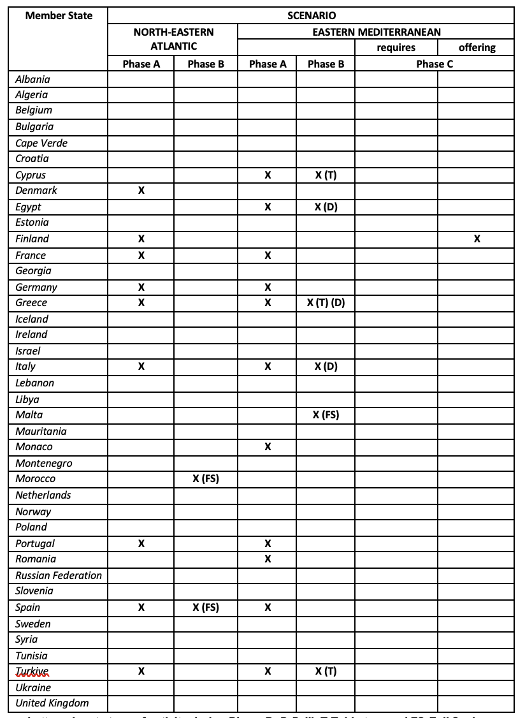
Member States participation in NeamWAVE23
15 out of 40 NEAMTWS Member States participated in the exercise.
19th session ICG/NEAMTWS ● 27 – 29 November 2024

Slide 14
TT-TE comments
The participation of CPAs is “indirectly” increasing with the synergy of CoastWAVE project.
Submission of exercise evaluation forms is highly important for TT-TE to better evaluate the functionality of NEAMWave (Subscription forms cannot be used as reference in the final evaluation report).
New Exercise Online Platform was more functional and user-friendly in NEAMWave23. Dissemination of exercise materials was delayed but was more effective due to the division of the exercise manual in two Parts.
A digital tool can be developed for managing and updating contacts both for preparing the exercise and for managing new subscriptions.
Subscription and evaluation need to be improved to better capture the need of partners at local level (and not only NEAMTWS related, i.e. TSPs, TWFPs,…)
It can be discussed with ERCC to set a number of minimum criteria for conducting Phase C; i.e. one country requesting and two or more countries offering assistance.
Clarification is necessary for the definition of Phase B exercise types by discussing with CPAs and/or ERCC.
19th session ICG/NEAMTWS ● 27 – 29 November 2024

Slide 15
NEAMWave25
Exercise Final Evaluation Report:
  It should be simplified in a way to be easier to prepare and more user-friendly to read.
TSP Final Evaluation Reports:
  There is no interaction between providers and recipients, thus reports are not describing the whole picture. They should be limited to a couple of pages with certain bullet-point content, including summary of exercise performance, suggestions and recommendations, in the following concept: objectives, success criteria, best practices, lessons learnt and actions for the future.
Subscription Mechanism:
  It should be only for providing “new” contact details “explicitly” for the exercise, if needed, and for registering new participants (other than the subscribers). Minimum information should be requested. We should find a way to also register “public” participants.
Evaluation forms:
  Statistics and assessment of the participation in the exercise will be made only by the evaluation forms and not by the subscription forms.
19th session ICG/NEAMTWS ● 27 – 29 November 2024

Slide 16
NEAMWave25
NEAMWave25 Scenarios - Options:
  5 scenarios, each one prepared jointly by 1 TSP and 1 NTWC.
  TSPs could prepare more than 1 scenarios (single or jointly) to accommodate MS needs.
  In a joint scenario TSPs disseminate messages with different alert level.
Implementation Date:
  Having NEAMWave26 in March 2026 to be parallel with Tsunami Ready activities (CoastWAVE Project)
  We also propose to have the exercise in a more relaxed schedule, for example one scenario per week.
Fax message dissemination:
  Manual should be updated to illustrate the termination of fax message dissemination. Should we also establish new ways of message dissemination, like the CAP-TSU and the SMS?
19th session ICG/NEAMTWS ● 27 – 29 November 2024

Slide 17
Following “Governance and Organization Discussions” in NEAMTWS…
Proposal from TT-TE:
Changing the name of Task Team on Tsunami Exercise to Task Team on NEAMWave Exercise (TT-NEAMWave)
Other ICGs:
- SC Task Team PacWave Exercises (SC-TT-PacWave)
- Task Team on Caribe Wave (TT-Caribe Wave)
- Task Team on IOWave Exercise
19th session ICG/NEAMTWS ● 27 – 29 November 2024

Slide 18
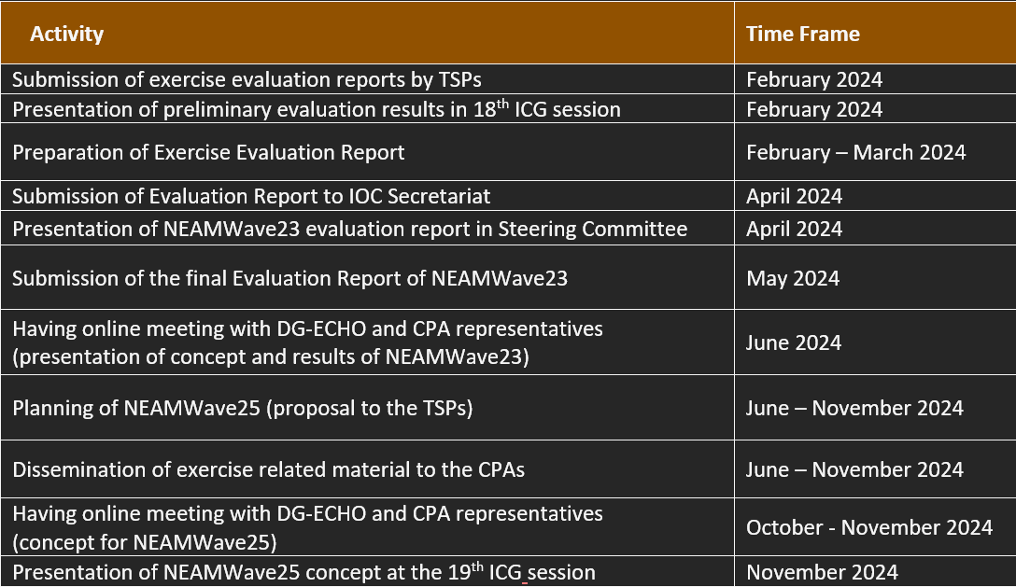
PoA of TT-TE for 2024
19th session ICG/NEAMTWS ● 27 – 29 November 2024

Slide 19
Thank you!
TT-TE co-chairs:
Ceren Ozer Sozdinler - Marinos Charalampakis
19th session ICG/NEAMTWS ● 27 – 29 November 2024

