Slide 1

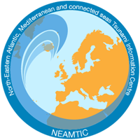
ICG NEAMTWS
Task Team on Tsunami Ready
Co chairs
Elena Daskalaki (Greece)
Maria Ana Baptista (Portugal)
ICG NEAMTWS XIX Session, 27 - 29 November 2024, Paris, France

Slide 2
Outline
PLAN OF ACTION AND UPDATES ON ACTIVITIES OF THE TASK TEAM
PROGRESS IN THE IMPLEMENTATION OF TSUNAMI READY IN THE NEAM
BEST PRACTICES AND MAIN CHALLENGES IN IMPLEMENTING THE TRRP IN NEAM
RECOMMENDATIONS BY ICG NEAMTWS TT-TR

Slide 3
TASK TEAM ON TSUNAMI READY: PLAN OF ACTION FOR 2023-2024
Objective 1
An update of ICG/NEAMTWS WGs and TTs members (November 2024)
    Total members of TT-TR = 15+2 co-chairs
An online list was shared by the Tech. Secretary to the TNCs-a review of the list during the ICG/NEAMTWS-XIX Session is needed
Objective 2
Participating in the CoastWave 2.0 Project Steering Committee (PSC) to provide strategic guidance on project activities, undertake review of project outputs, and regularly oversee project progress to ensure project quality and milestone delivery according to the work plan.
A jointly monitoring of TR projects is being carried out between TT-TR, Tsunami Resilience Section (TRS), Technical Secretariat of ICG/NEAMTWS and CoastWAVE (phase 1) project coordinators.
Advice and support was provided to Loulé (Portugal) Municipal Civil Protection to apply for the TRRP (meeting and emails exchange).

Slide 4
TASK TEAM ON TSUNAMI READY: PLAN OF ACTION FOR 2023-2024
2
Objective 3
Observations and contributions were made at the Inter ICG TOWS Task Team on Disaster Management and Preparedness – IOC UNESCO Feb. 2024
Identification of the main challenges faced by the countries of the NEAM region in the implementation of the TRRP.
Identification of critical points based on current TRRP initiatives in NEAM countries and other ICGs, looking into solutions and methodologies to address them.
Objectives 4 & 5
Participation and presentations at the 2nd UNESCO IOC Global Tsunami Symposium, Banda Aceh, Nov. 2024.
Participation at UNESCO-IOC DG ECHO Coastwave 2.0 Project Kick-off Meeting Nov 2024, as a member of the PSC.
Participation and presentations at the UNESCO-IOC/ICG/NEAMTWS XVIII Session, Paris, Feb. 2024.
Participation and presentations at the UNESCO-IOC/SC/NEAMTWS Meeting, Paris, Feb. 2024.
Participation (as observers) in the meeting of the Inter ICG TOWS Task Team on Disaster Management and Preparedness, Sendai, Feb. 2024.

Slide 5
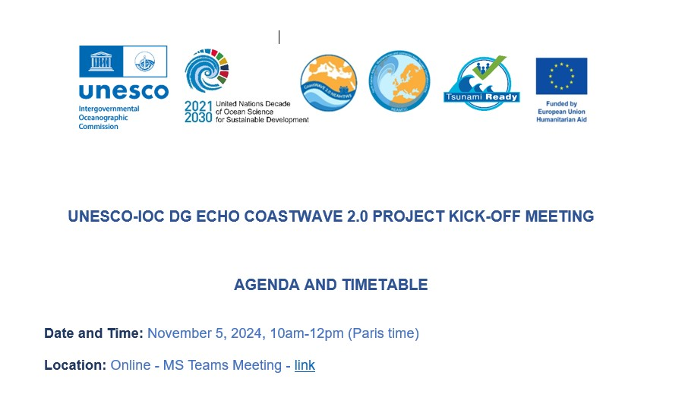
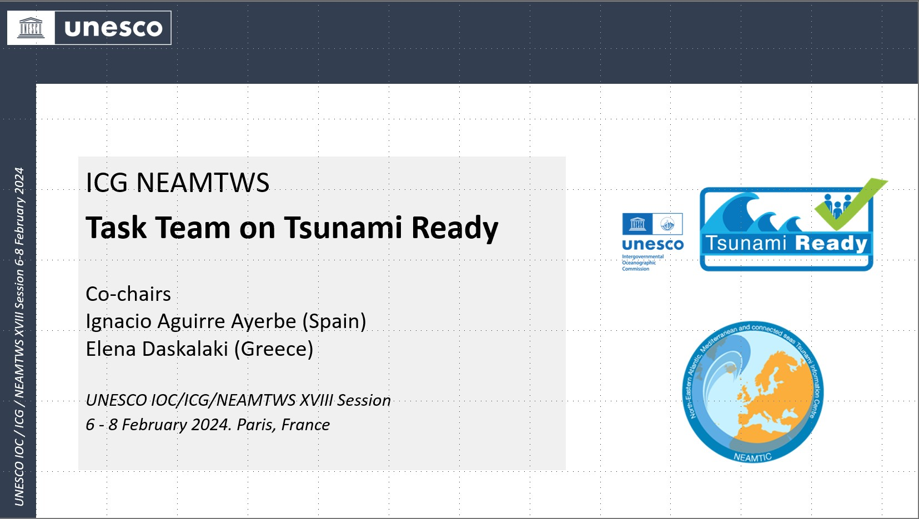
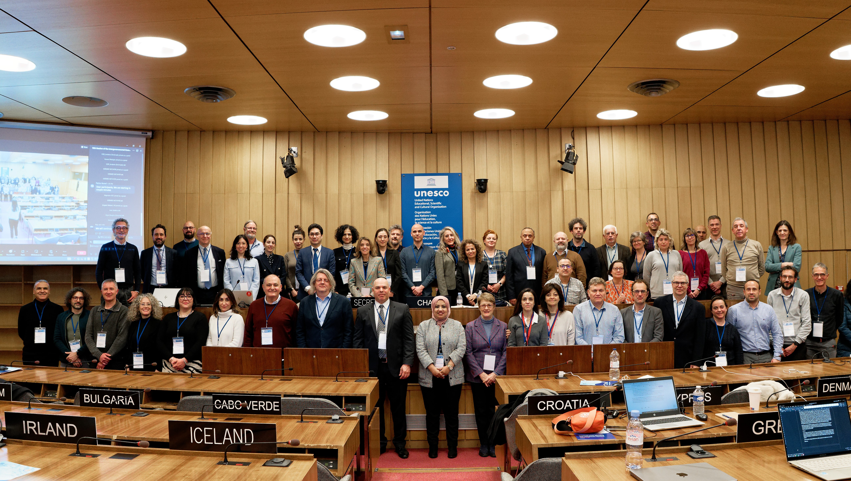
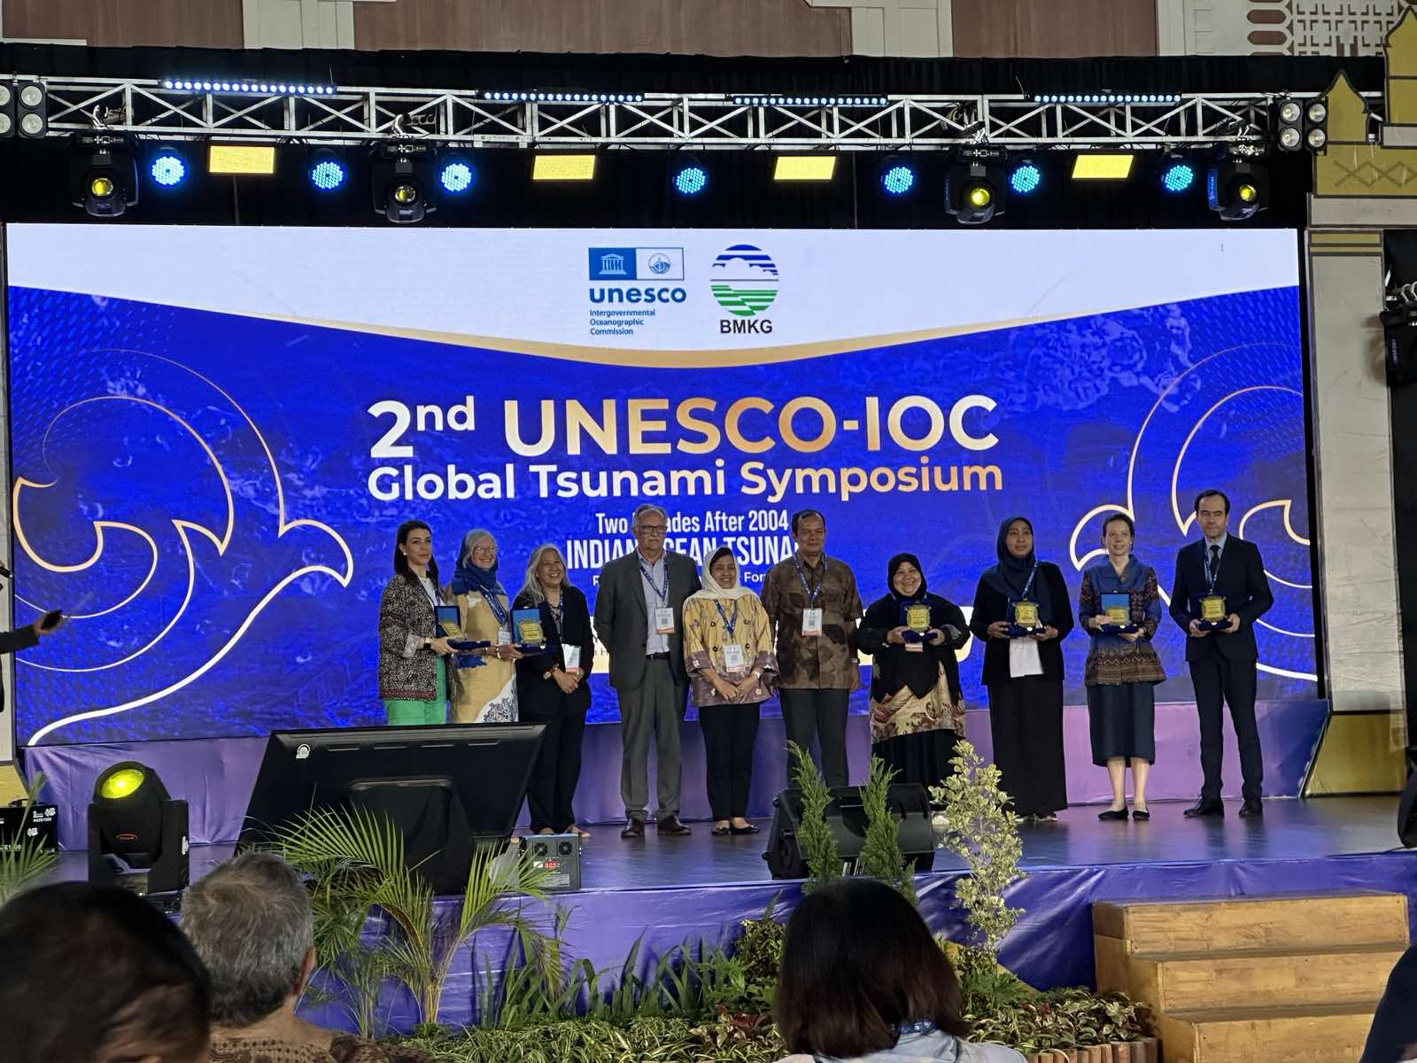
TASK TEAM ON TSUNAMI READY: PLAN OF ACTION FOR 2023-2024
2
Represent TT-TR at meetings scheduled throughout the year 2024.
Coastwave 2.0 Project Kick-off Meeting Nov 2024
ICG/NEAMTWS XVIII Session, Paris, Feb. 2024.
ICG/NEAMTWS Experts Meeting: Implementing NEAMTWS 2030 Strategy, opportunities and actions to explore. Naples, 28-30 Nov. 2022
Inter ICG TOWS Task Team on Disaster Management and Preparedness, Sendai, Feb. 2024
2nd UNESCO IOC Global Tsunami Symposium, Banda Aceh, Nov. 2024

Slide 6


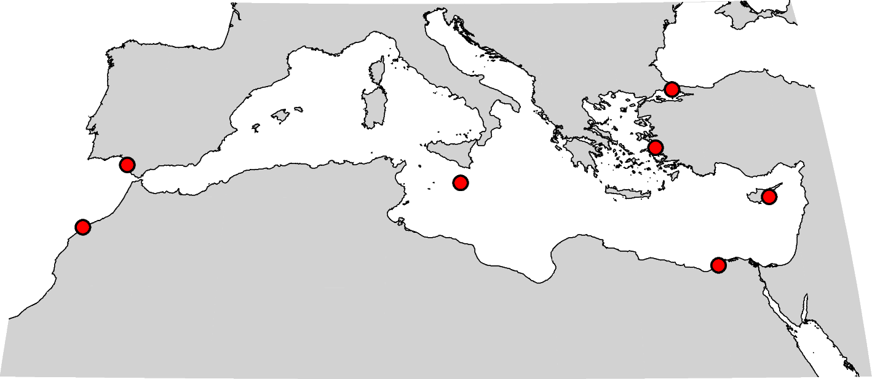

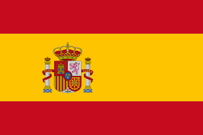






IOC-UNESCO CoastWAVE (Phase1)
Project DG ECHO
Tsunami Ready Recognition Programme
in NEAM REGION
CANNES
SAMOS
BUYUKCEKMECE
CHIPIONA
MINTURNO
LARNACA
MARSAXLOCK
EL JADIDA
ALEXANDRIA
National Initiatives

Slide 7

  11 Countries and more than 20 communities…
North Eastern Atlantic
Eastern Mediterranean
Morocco with El Jadida, Larache
Portugal with Quarteira, Cascais, Lisbon, Setúbal, Lagos, Portimão
Spain with Chipiona
  Cyprus with Larnaca
  Egypt with Alexandria
  Greece with Samos
  Israel
  Türkiye with Buyukçekmece, Istanbul, Izmir
Western Mediterranean
France with Cannes, Nice
Italy with Marzamemi-Pachino, Minturno, Palmi, Stromboli, Otranto
Malta with Marsaxlokk

Slide 8
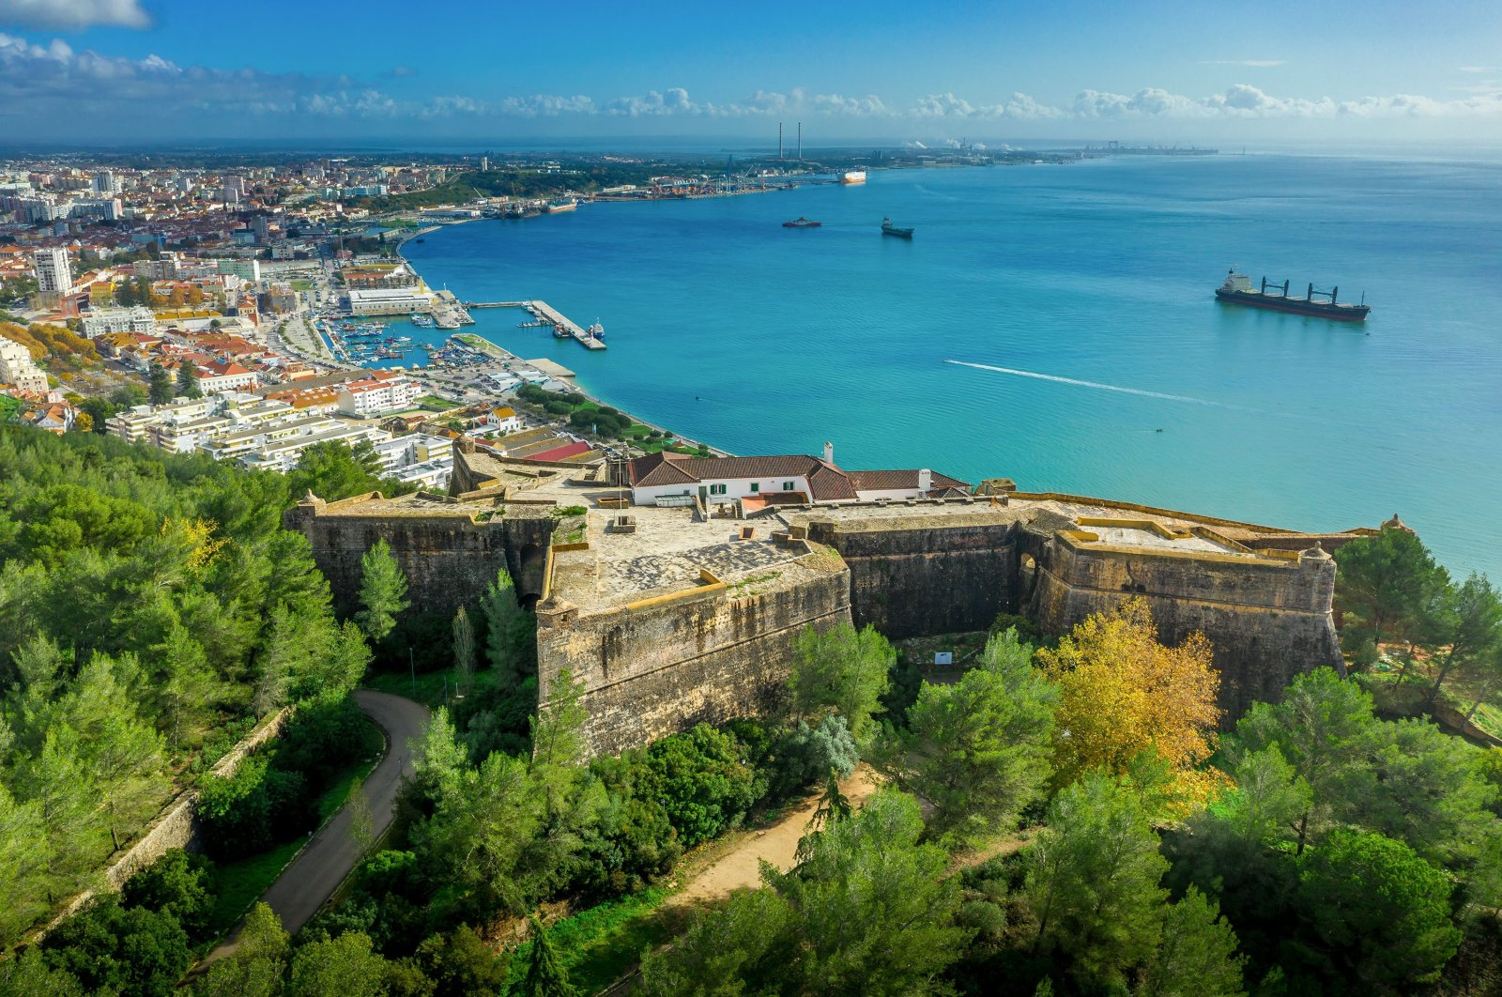
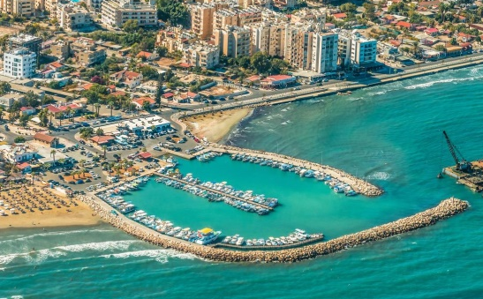
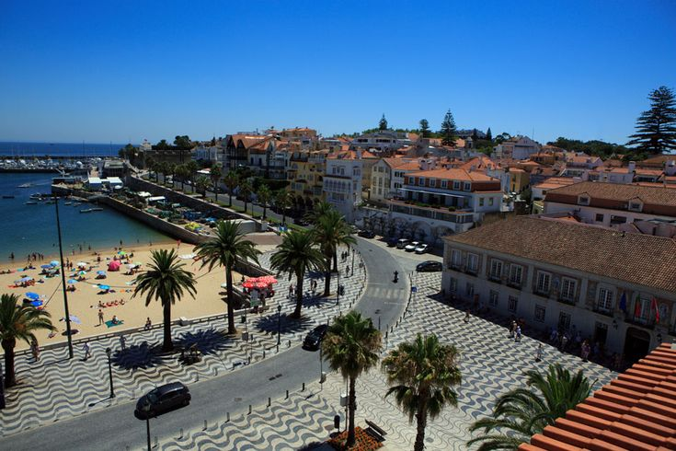
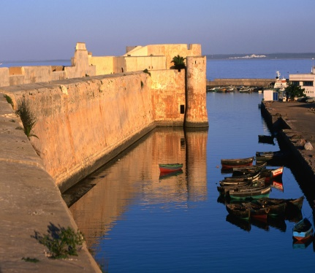
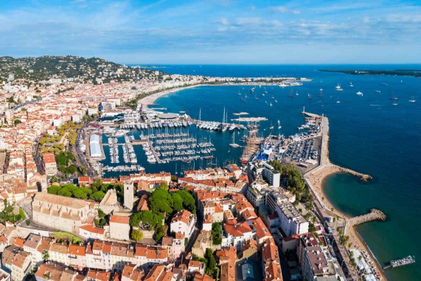
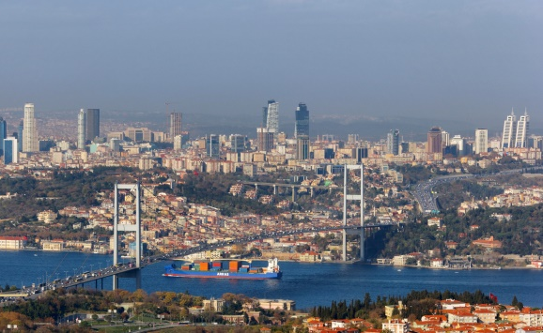
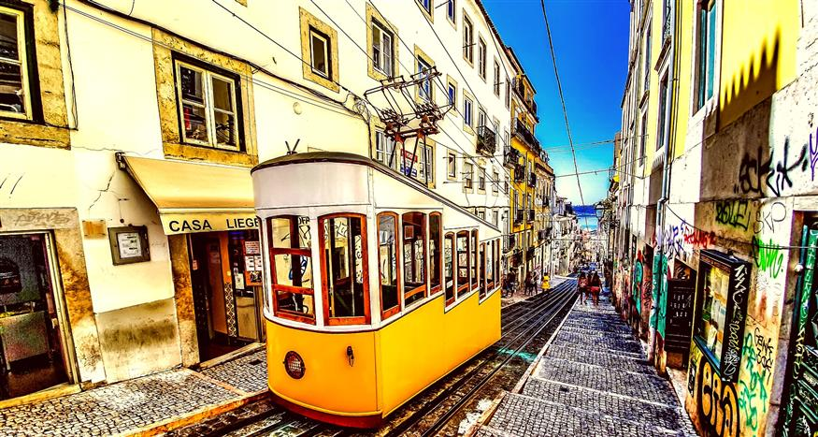
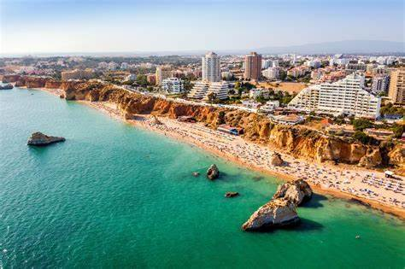
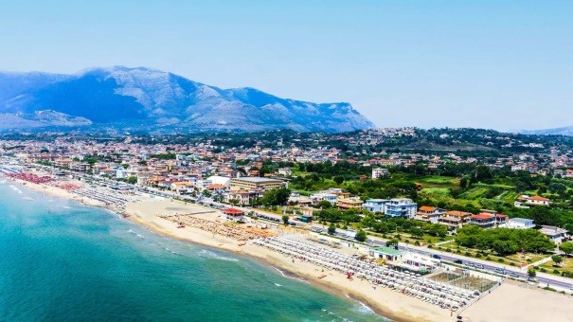
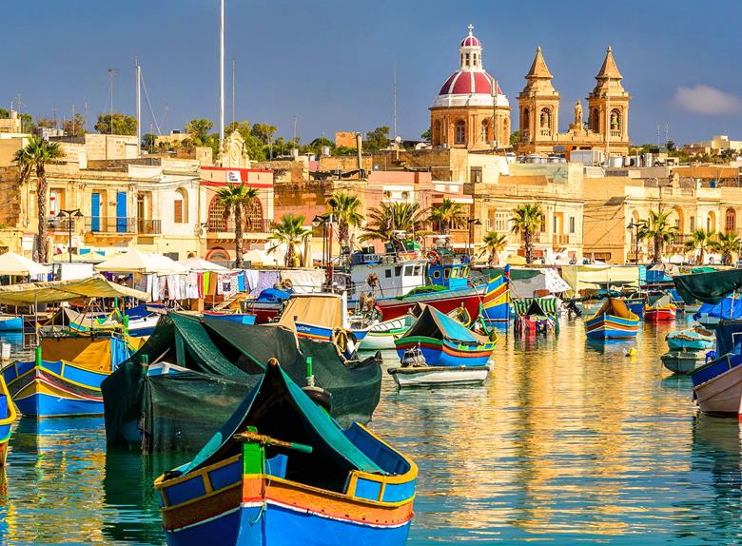
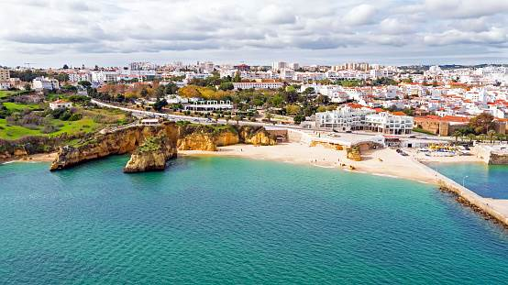
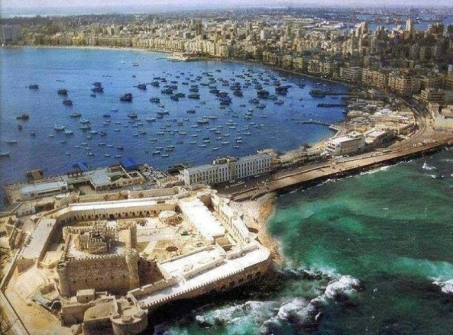
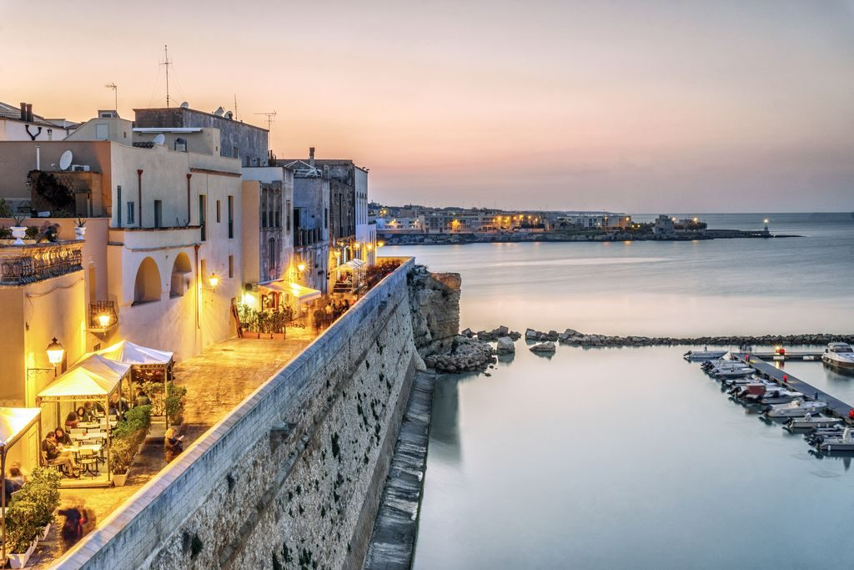
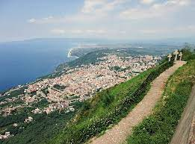
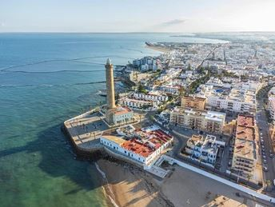
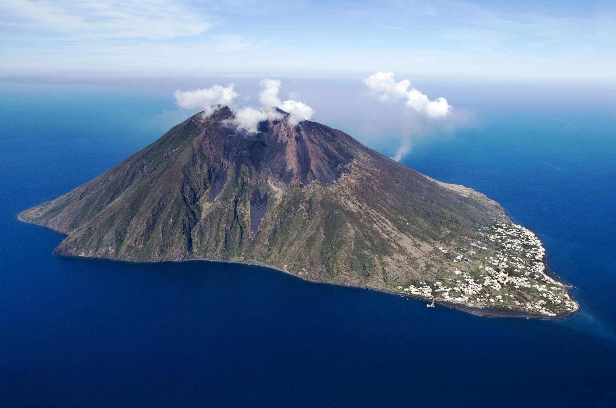
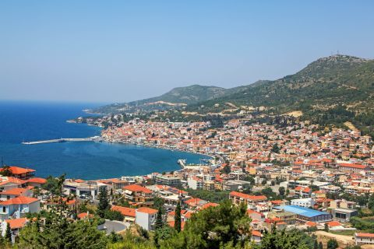
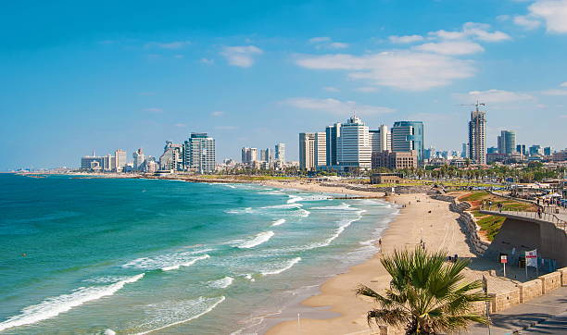
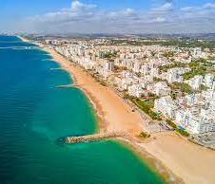
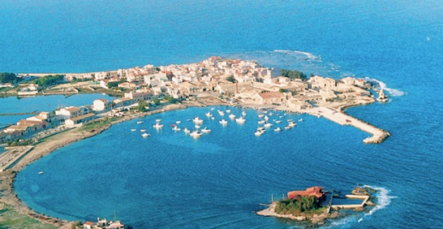
11 Countries
more than 20 Communities
…and still counting
Cascais
Setubal
Larnaca
El Jadida
Cannes
Büyükçekmece
Lisbon
Portimão
Minturno
Alexandria
Marsaxlokk
Otranto
Lagos
Chipiona
Palmi
Samos
Israel
Quarteira
Marzamemi
Stromboli
8

Slide 9













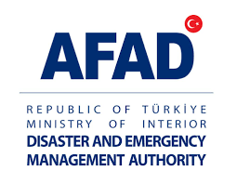
PROJECT main IMPLEMENTING PARTNERS

Slide 10
Best practices &
Innovations

Slide 11
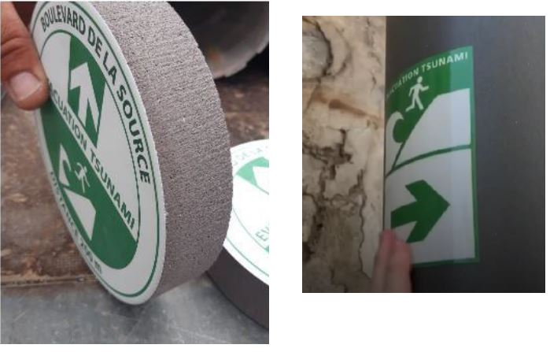
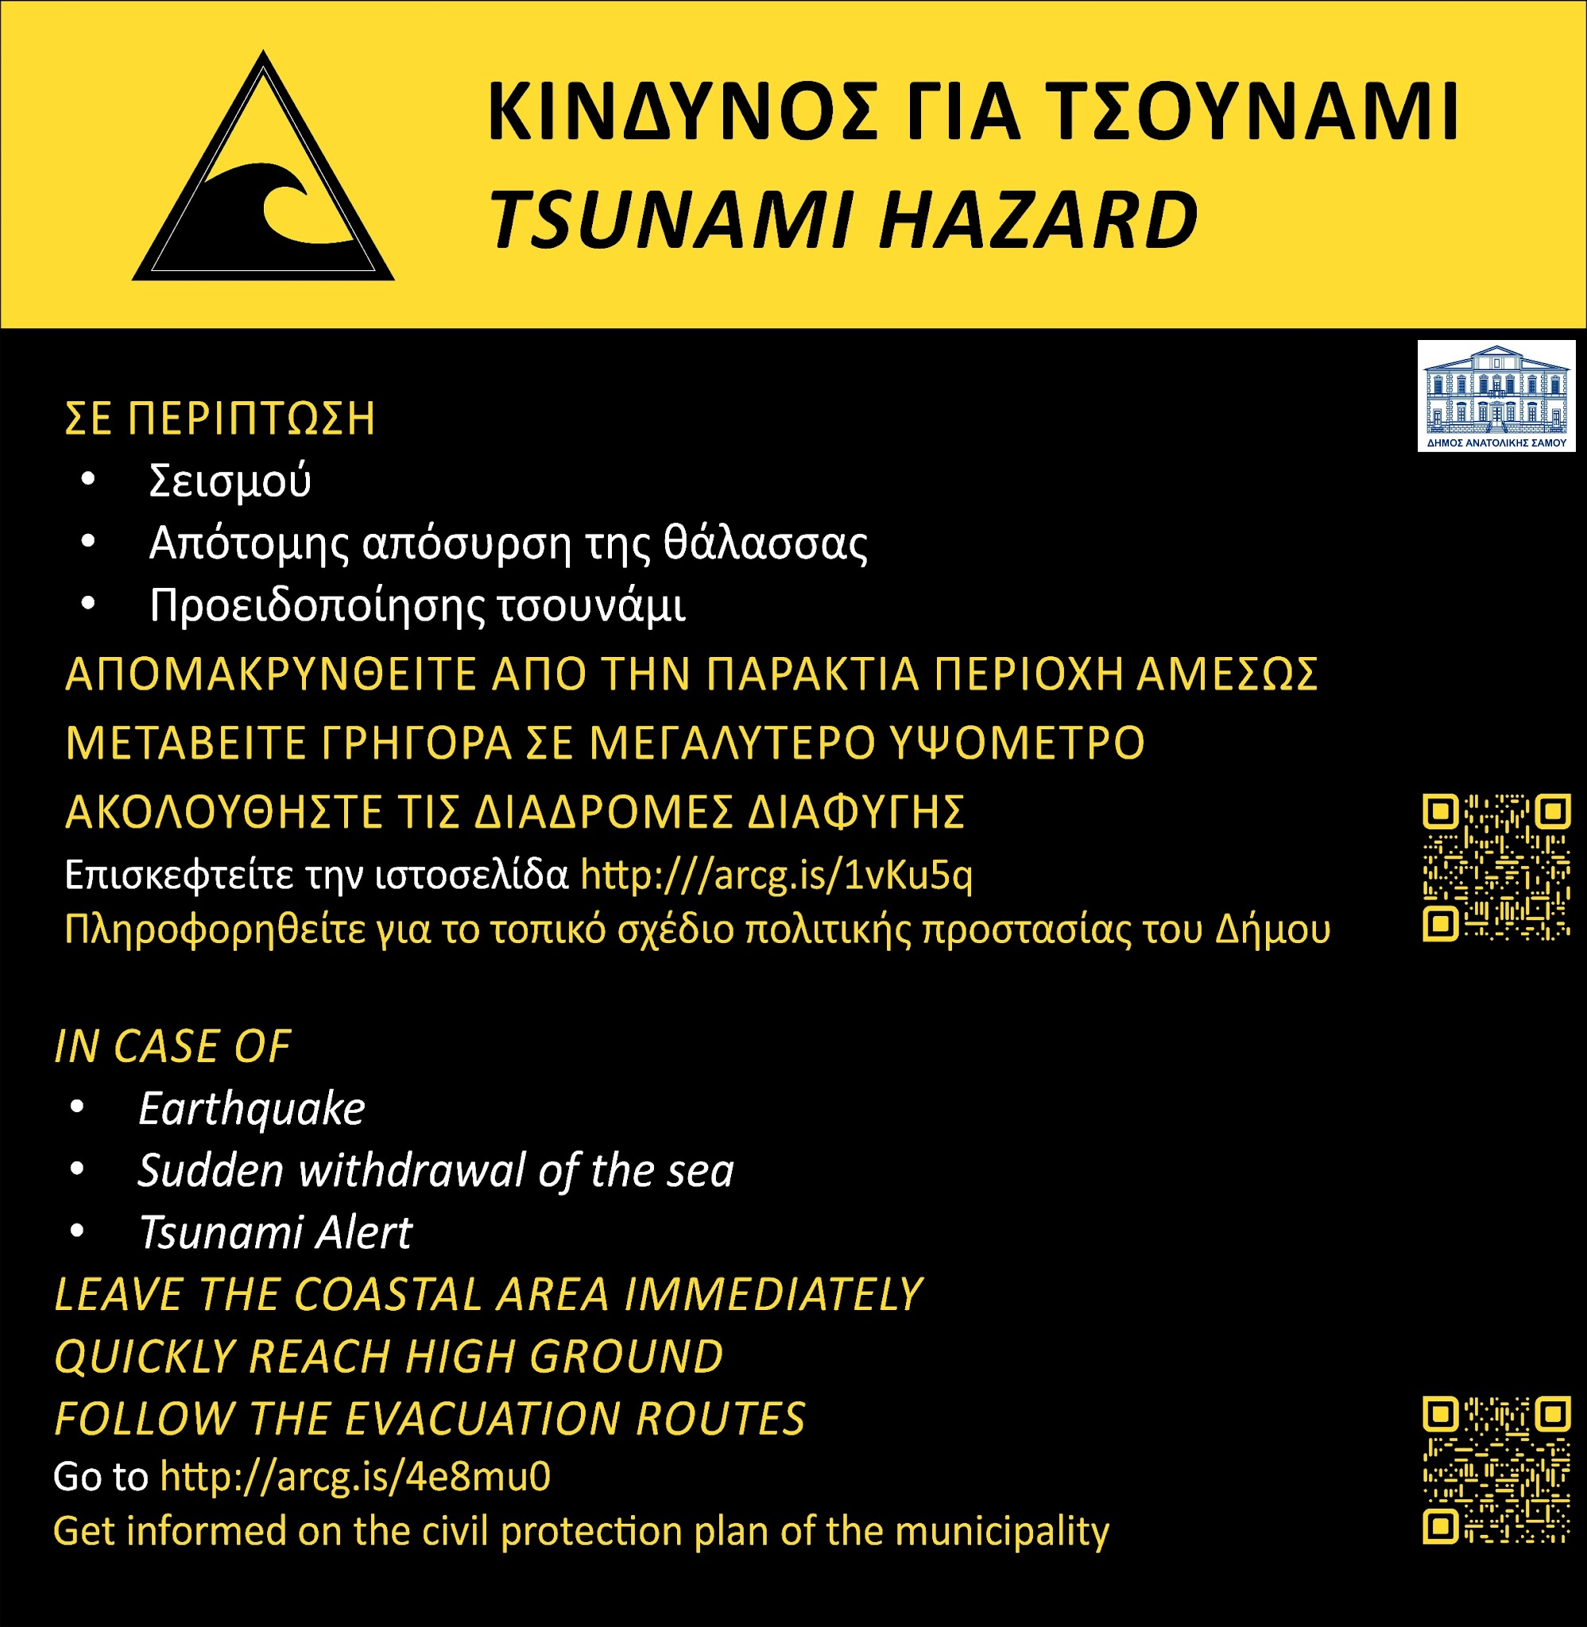
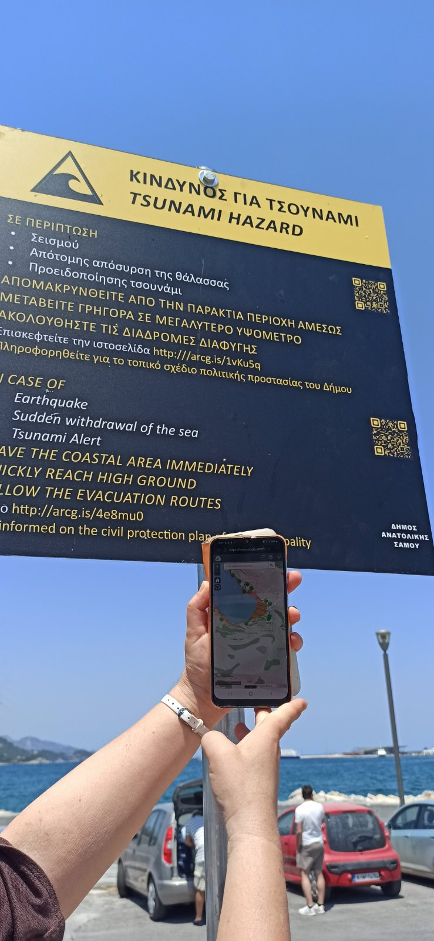
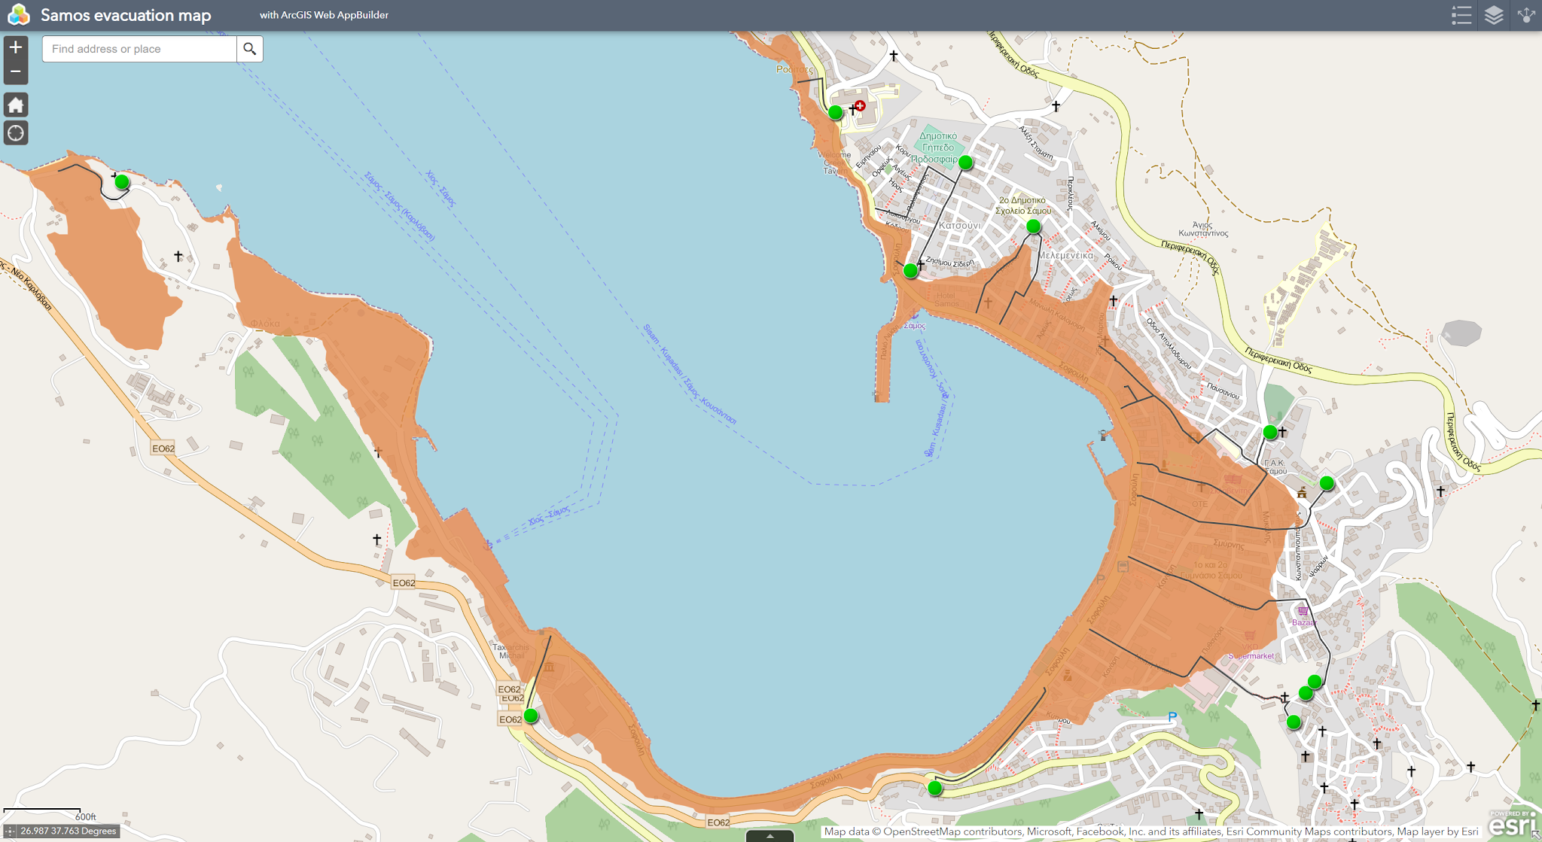
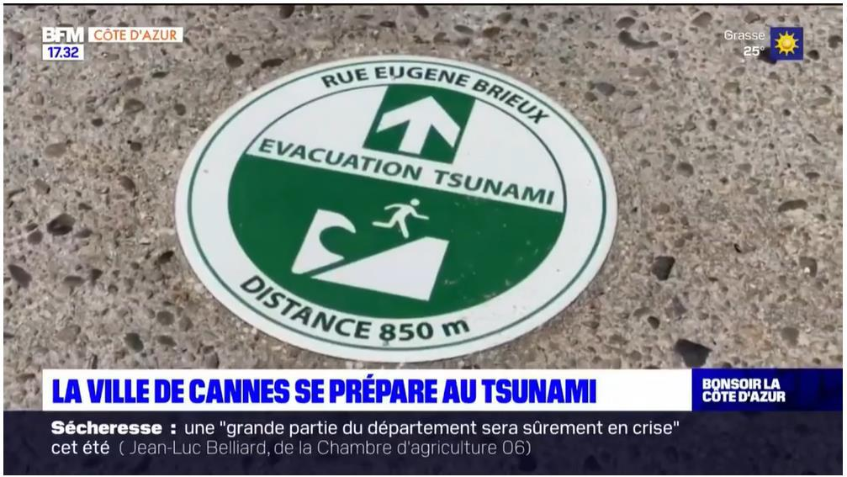
Cannes - France
Tsunami Ready Communities
Samos - Greece
Installation of tsunami evacuation signage (mosaic tile encrusted in the ground, stickers and aluminum support)
Online evacuation map assessable to the public through QR code and GIS based online cartography
The signage will also be adapted to the regulatory constraints imposed by the presence of a nature reserve. Wooden supports are being studied.

Slide 12
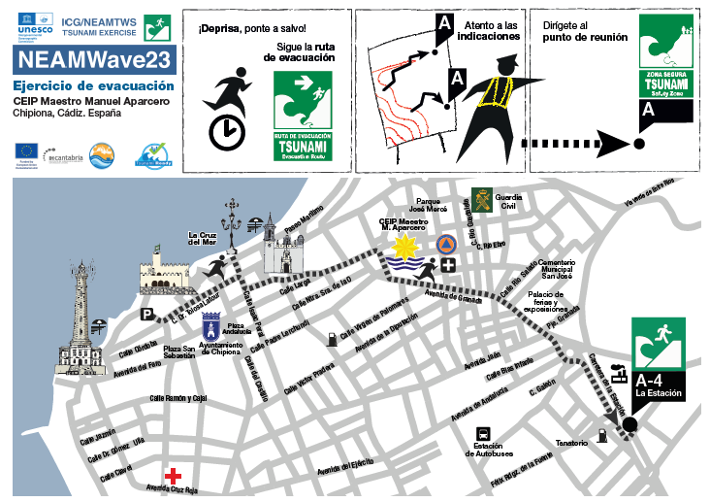

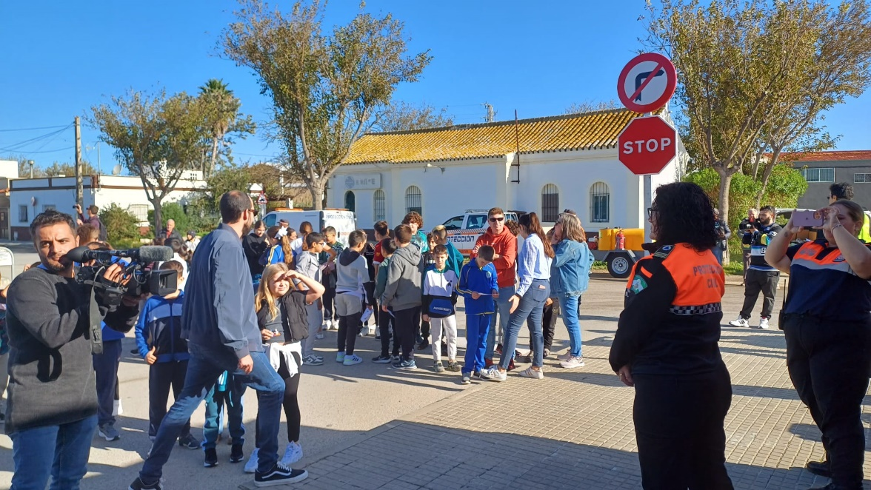
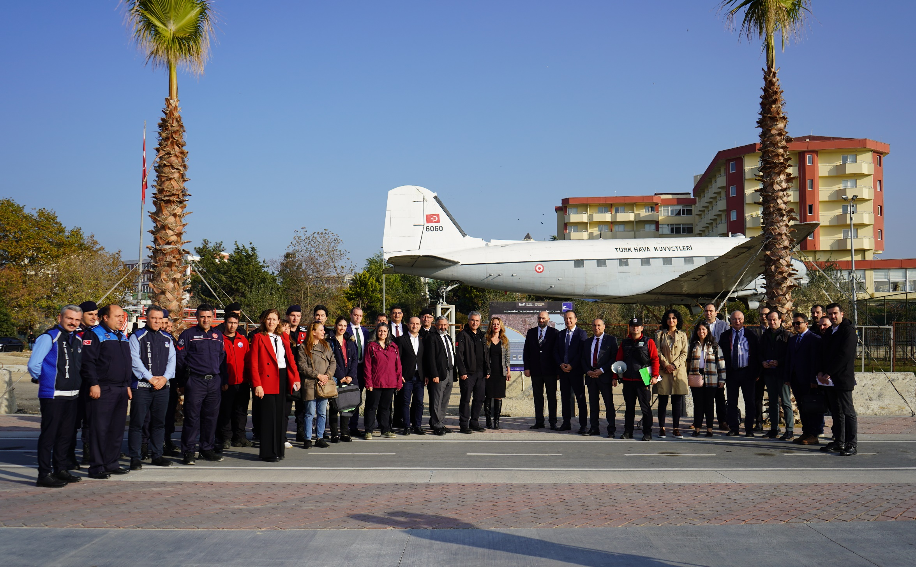
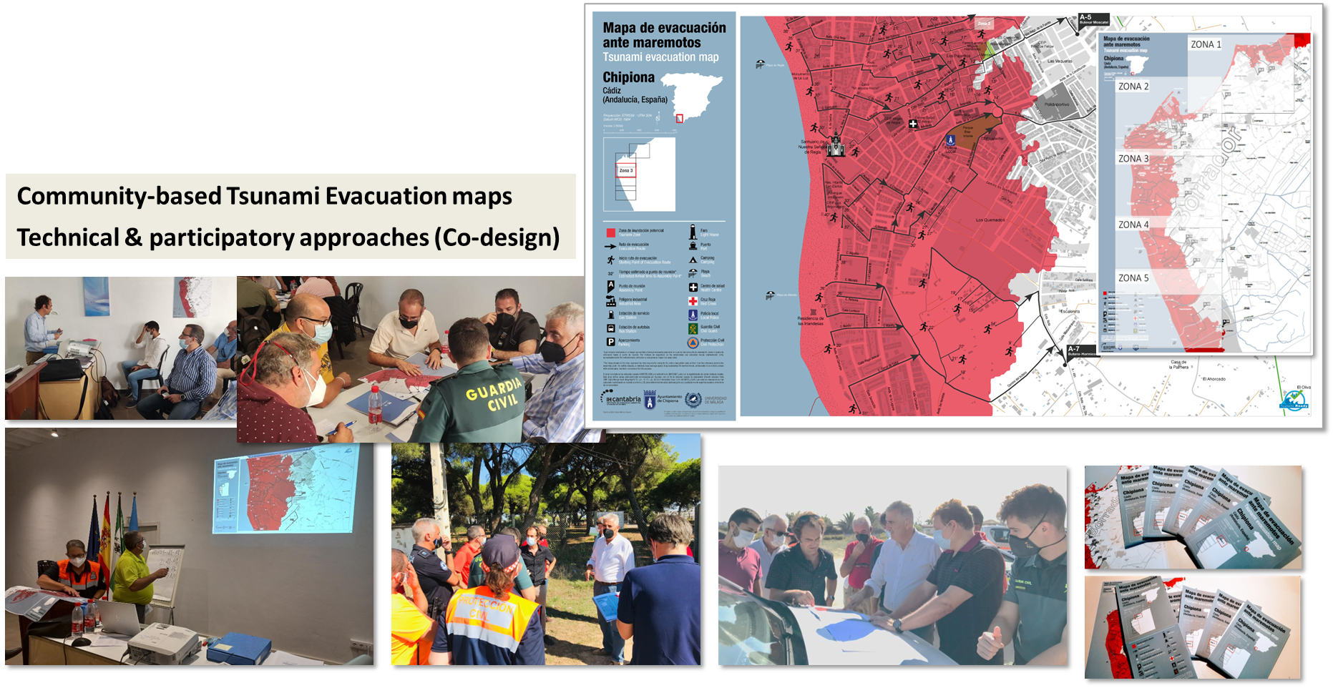
Tsunami Ready Communities
Chipiona - Spain
Büyükçekmece- Türkiye
Community-based Tsunami Evacuation maps Technical & participatory approaches (Co-designed)
Providing the opportunity to work in harmony by collaborating with all institutions and governmental offices; in local, province and national level
2024
ICG/NEAMTWS XIX Session, 27 - 29 November 2024. Paris, France
12

Slide 13
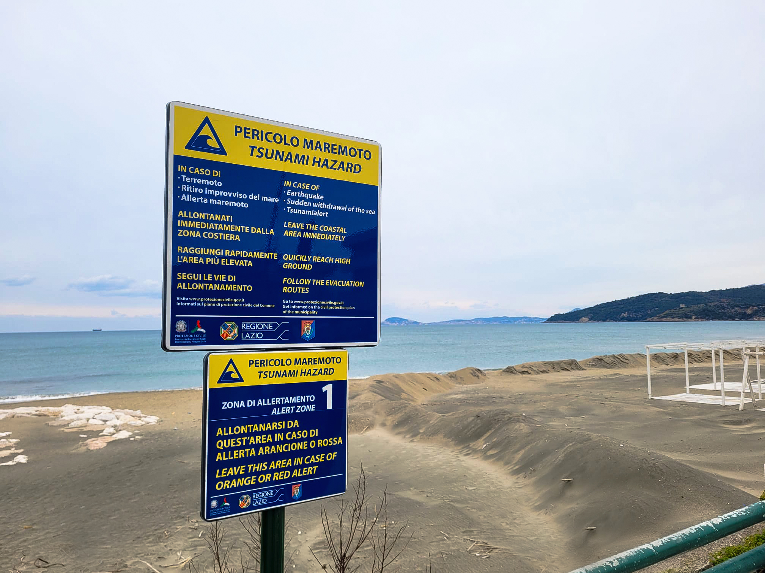
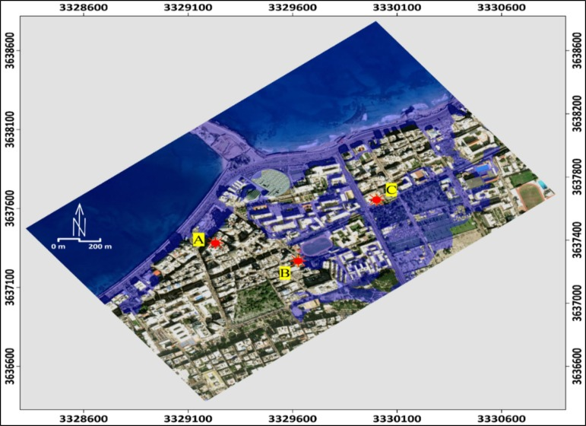
Tsunami Ready Communities
Minturno - Italy
Alexandria - Egypt
Vertical evacuation where tsunami inundation can reach further inland.
Buildings, labeled A, B, and C, serve as critical refuge points during a tsunami event. Hamouda et al.(2024)
Vertical evacuation drill at the a. De Santis’ state middle school activated with the contribution of local bodies in different school complexes.
The sound alert system and all the emergency signs have been installed, with the acquisition of the "ALERT SYSTEM", a mobile application, which allows the resident population to be alerted in the event of any type of alert.

Slide 14
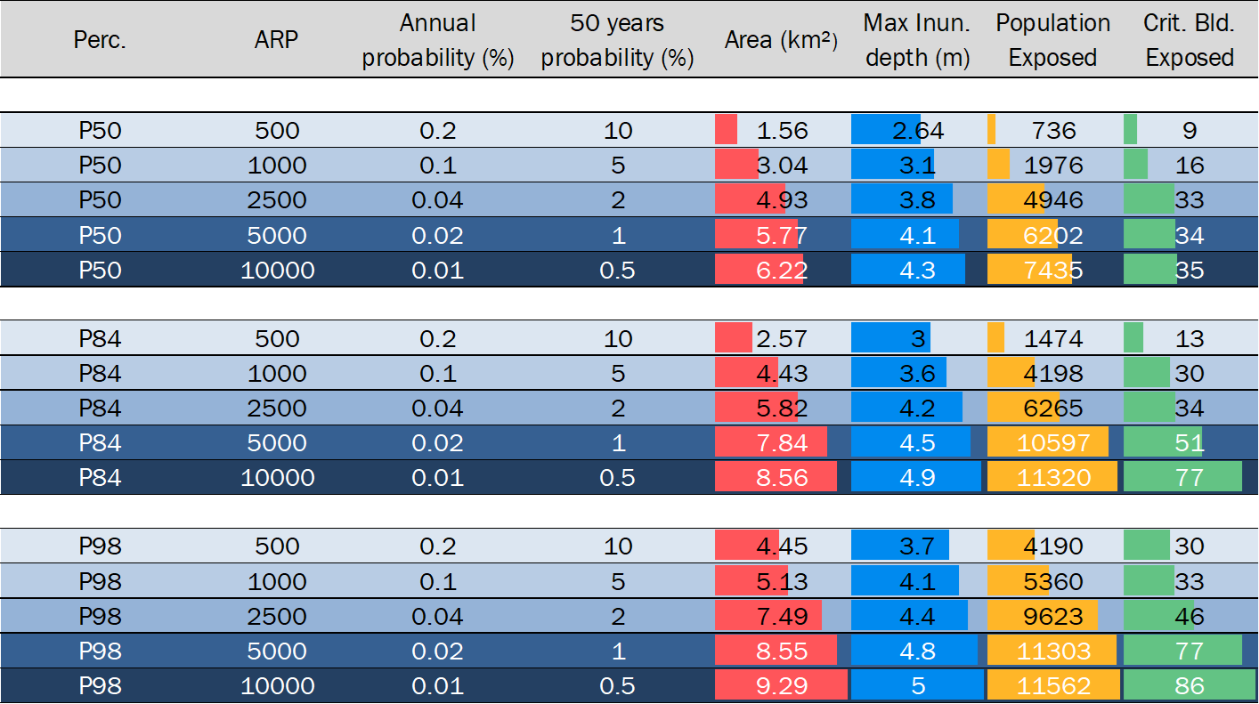
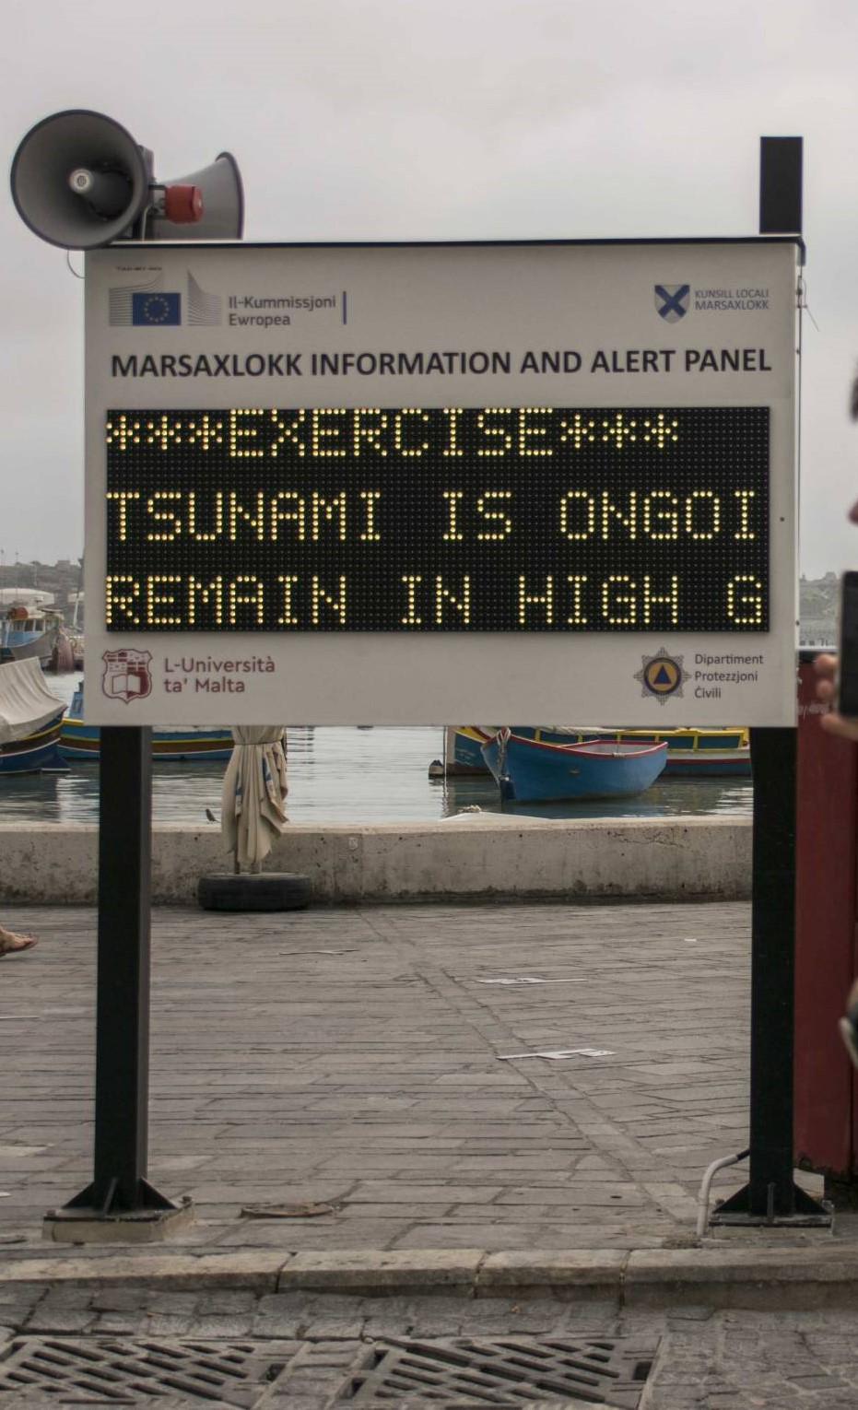
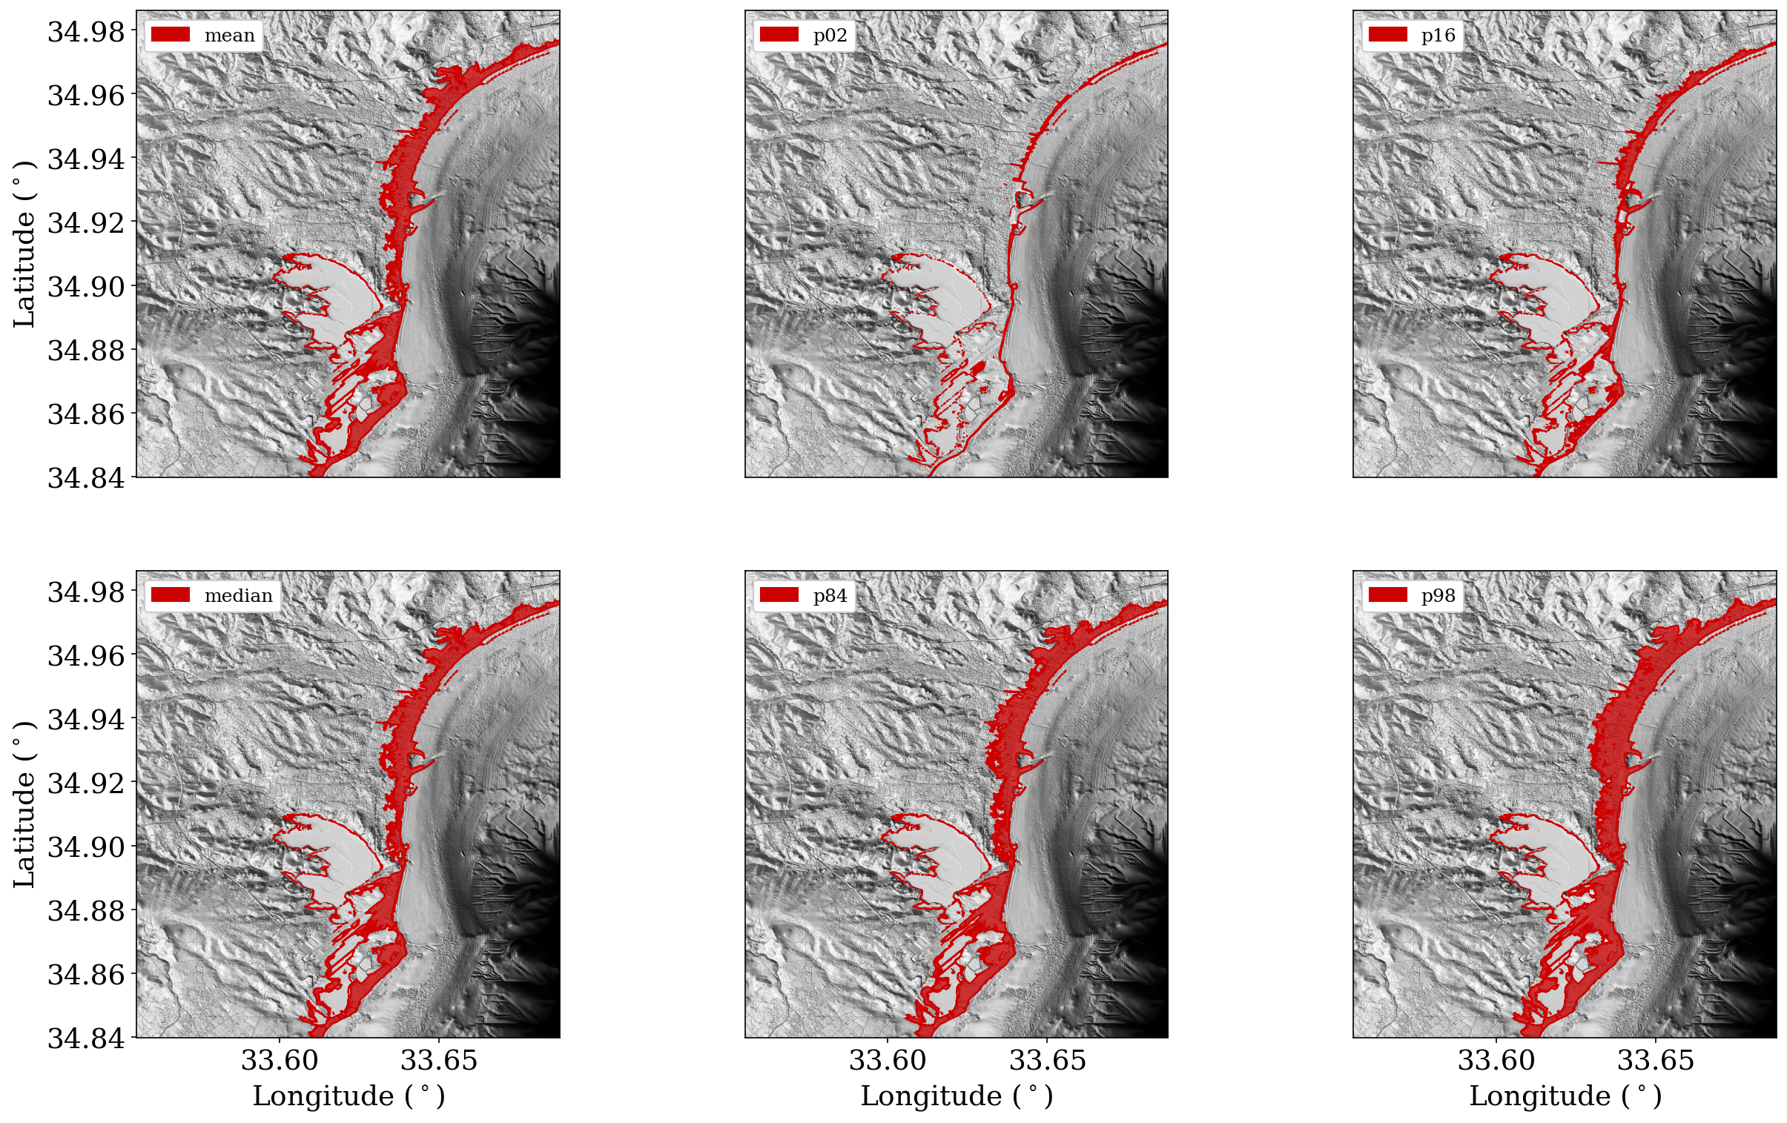
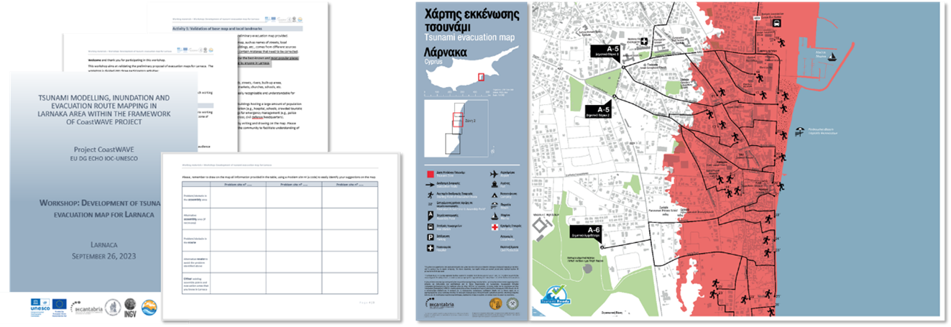
On going efforts towards Tsunami Ready
Larnaca - Cyprus
Marsaxlokk - Malta
PTHA
A tsunami alert device comprises a panel equipped with data receivers, a display, a siren and a loudspeaker.
It can be activated by Global Disaster Alert and Coordination System (GDACS) or local sea-level measurement systems to deliver warnings in at-risk areas in the event of tsunamis or other dangerous waves.
ARP 5000 years
Multi-stakeholder development of evacuation maps based on PTHA and Evacuation models

Slide 15
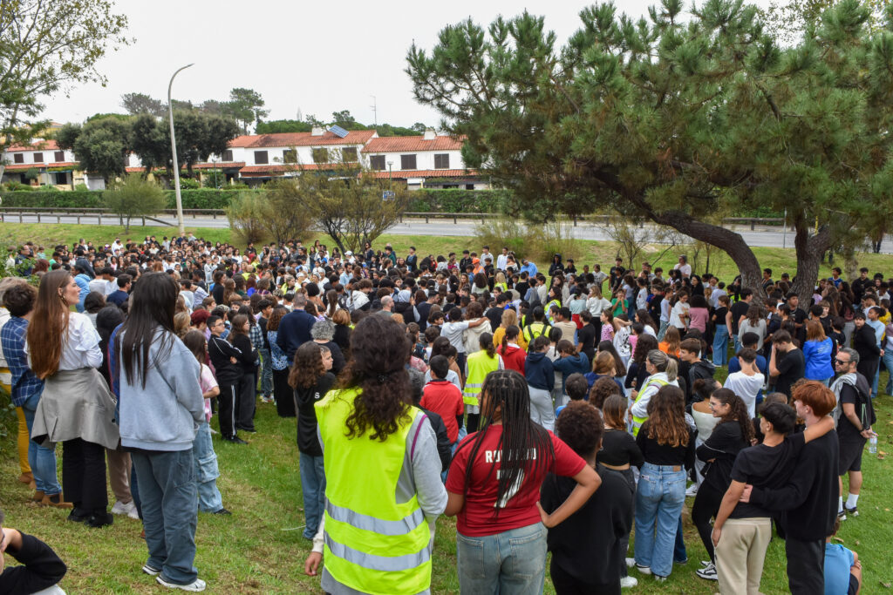
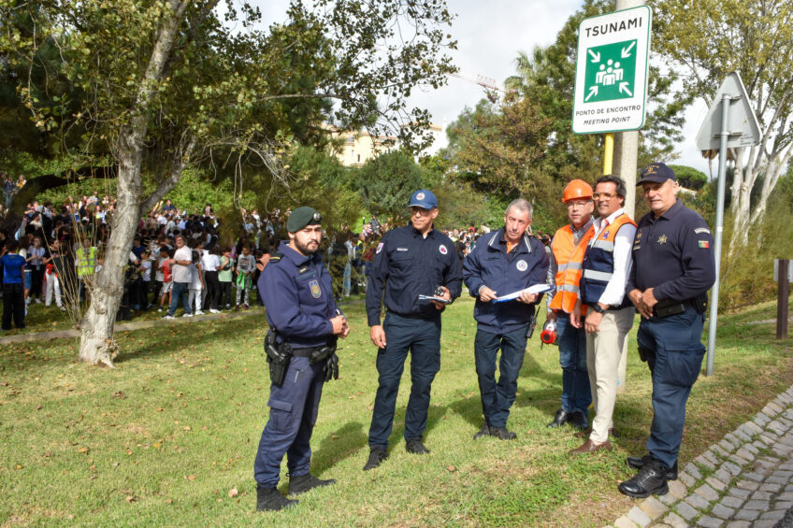
On going efforts towards Tsunami Ready
El Jadida - Morocco
Quarteira - Portugal
For the first time in the municipality of Loulé, a school was evacuated during a full-scale exercise.
Involved around 700 people
The 'tsunami walk' organized by the University of Chouai Doukkali (UCD) as part of the CoastWAVE project
By involving the media and students, the exercise not only educates participants about the dangers of tsunamis but also demonstrates the importance of following evacuation routes and reaching safe zones.
These initiatives were part of the nationwide public exercise called
“A TERRA TREME”

Slide 16
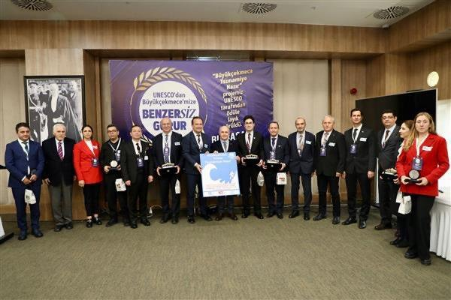
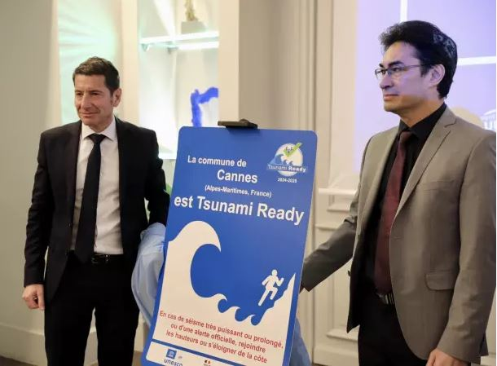
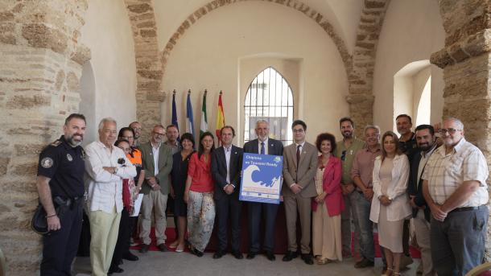
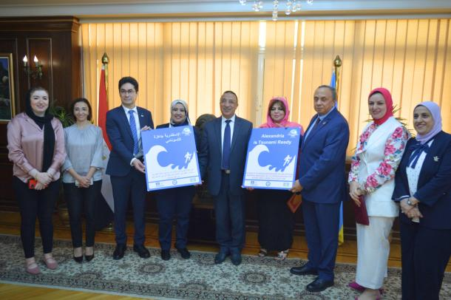
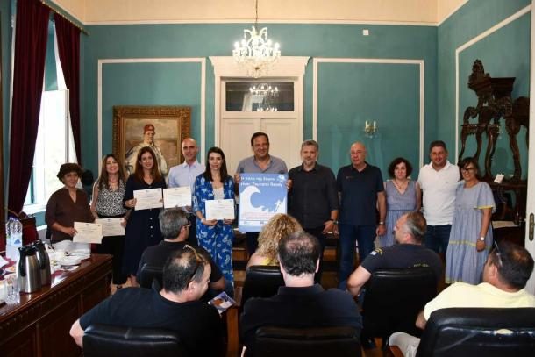

Cannes-France January 19, 2024
Chipiona-Spain
June 21, 2024
Büyükçekmece-Türkiye March 15, 2024
Alexandria-Egypt
May 25, 2024
Alexandria-Egypt
May 25, 2024
Samos-Greece
June 19, 2024
Minturno-Italy October 25, 2024
2024

Slide 17


Slide 18
Main challenges in TRRP implementation
Adaptation to Local Contexts: Adapting the TRRP to fit the specific needs and conditions of different communities can be challenging.
Coordination: Effective coordination between national, regional, and local authorities is essential.
Community Engagement: Gain the active participation and support of local communities.
Resource Allocation: Ensuring adequate financial and human resources for the implementation and maintenance of tsunami preparedness measures can be difficult.
Sustainability: Maintaining the momentum and ensuring the long-term sustainability of the programme requires continuous support from scientific and disaster/emergency experts, as well as ongoing funding and resources.
Compliance and Reporting: Ensuring that communities meet the established indicators and maintain compliance with UNESCO requirements involves regular monitoring, evaluation, and reporting, which can be administratively demanding.
Technological Integration: Implementing and maintaining advanced technologies for tsunami detection, forecasting, and alert dissemination can be resource-intensive and require specialized expertise.

Slide 19


Future steps for TRRP implementation
IOC-UNESCO DG ECHO CoastWAVE2.0 Project
Regional Initiatives for TRRP: NEAM-COMMITMENT EU Project
National Initiatives
              …..

Slide 20

Tsunami Ready Recognition Programme
List of Tsunami Ready Indicators organized within the categories of Assessment, Preparedness and Response (IOC Manual and Guides 74, 2022)

Slide 21
ICG NEAMTWS
Task Team on Tsunami Ready
Thank you
Co chairs
Elena Daskalaki (Greece)
Maria Ana Baptista (Portugal)
ICG NEAMTWS XIX Session, 27 - 29 November 2024, Paris, France

