Slide 1
The Italian Tsunami Service Provider CAT@INGV and the national System for Tsunami Warning
XIX ICG-NEAMTWS, Paris, UNESCO HQ, November 27-29

Slide 2
The Italian Tsunami Service Provider
and the national System for Tsunami Warning
Hazard and inundation mapping
Warning (current monitoring, new methods /PTF, and new instruments)
Stromboli TWS
Mitigation (Awareness and Response)

Slide 3
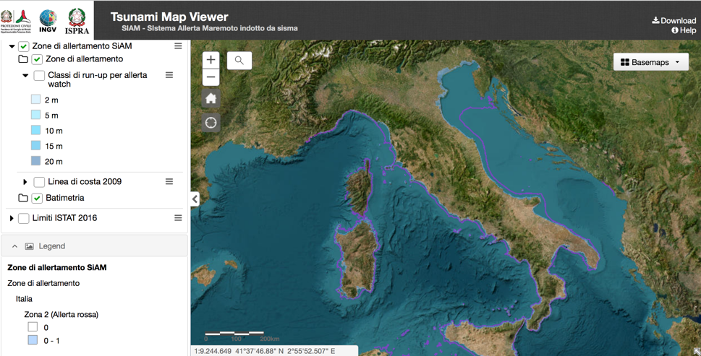
Inundation areas in Italy (ISPRA)
The functioning and updating of the webgis Tsunami Map Viewer has been ensured
Support to local authorities, especially civil protection authorities of Calabria, Sicily, Tuscany, Emilia-Romagna, Marche regions, as well as Fire Brigades (Vigili del Fuoco)
https://sgi2.isprambiente.it/tsunamimap/

Slide 4
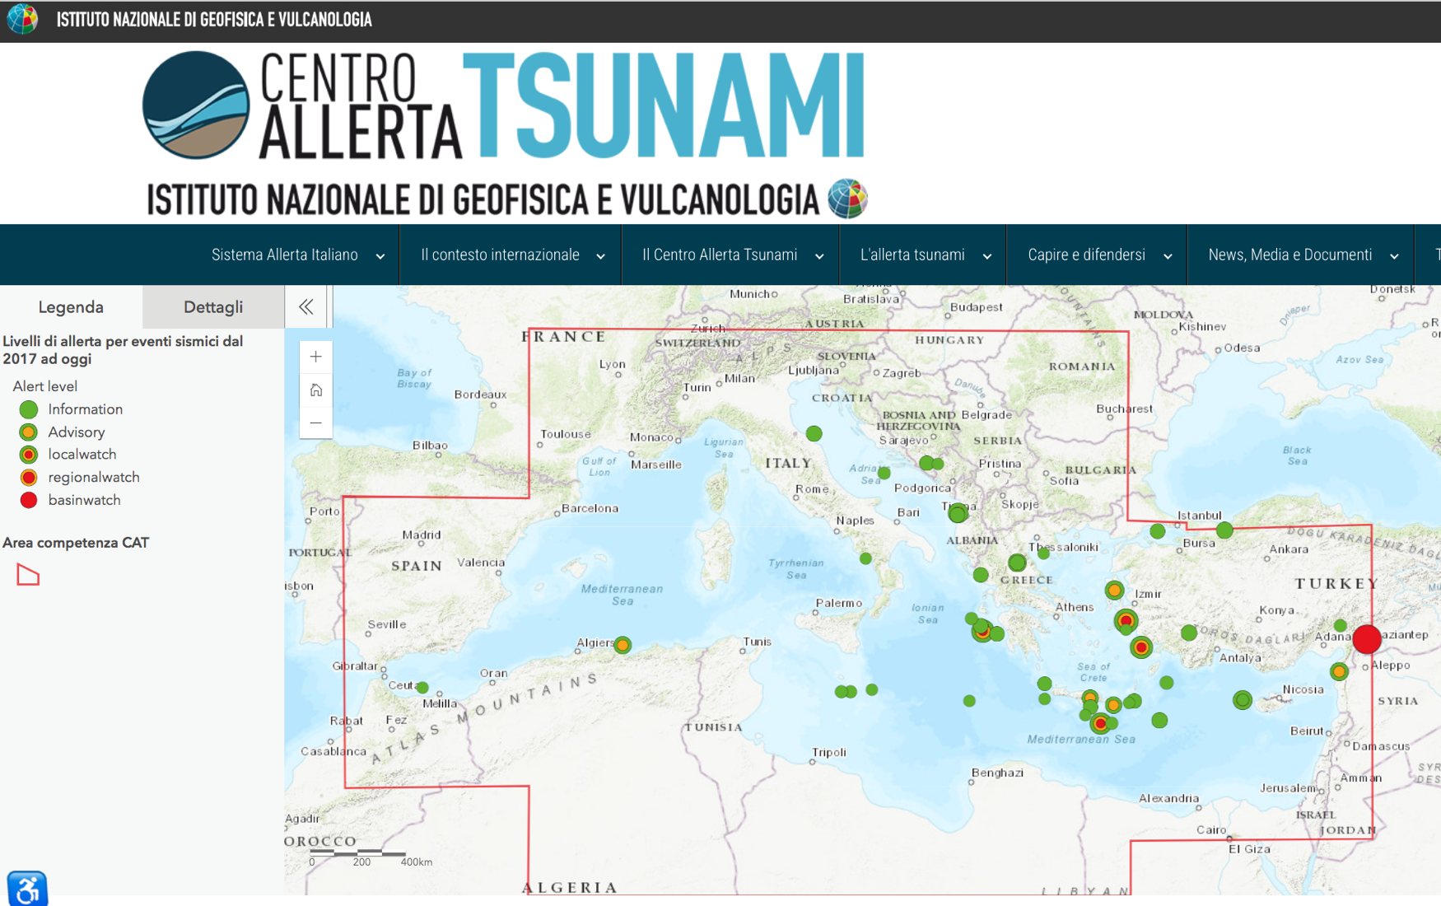
Only 2 events in 2024 (at Nov. 25), both INFORMATION
29/3/2024
Information
Mwp=5.8
5 minutes!!!
21/7/2024
Information
Mwp=5.5
9 minutes

Slide 5
PTF /Administrative (but also substantial) steps
Evaluation of the mehod by INGV Scientific Council (S.C), appointed by the Board of Directors (Consiglio di Amministrazione) in 2022
Scientific Council - - - > Panel of international experts (5)
Meetings with CAT members – 1° report
New meeting with new S.C. Sept. 2024 – 2° report
Final (positive) opinion by the S.C. in October 2024
Final decision by the Board of Directors (Consiglio di Amministrazione) expected on November 29, 2024

Slide 6
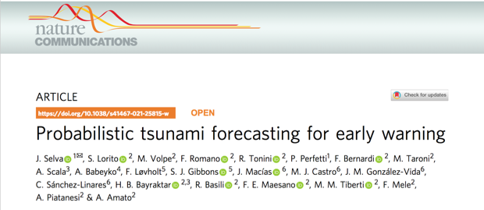
What PTF does
Probabilistic Tsunami Forecasting (PTF, Selva et al., 2021) is a recently introduced methodology that provides a forecast of a tsunami in terms of the probability distribution of a tsunami intensity measure at different forecast points within a few minutes after the occurrence of an earthquake.
Selva, Volpe, Lorito, Romano et al., Nature Communications, 2021
PTF is planned to become operational at CAT-INGV, Italy, NEAMTWS TSP in 2025. At least another NEAMTWS TSP, NOA, Greece, is considering its adoption.
INCOIS is considering PTF in the frame of the People-Centred Early Warning for the Indian Coastlines (PCTWIN) project coordinated by UCL, UK.
Others have started to use or develop ensemble modelling approaches which share some elements with PTF to consider uncertainties in the tsunami forecasting (e.g. New Zealand, Chile, USA NOAA).

Slide 7
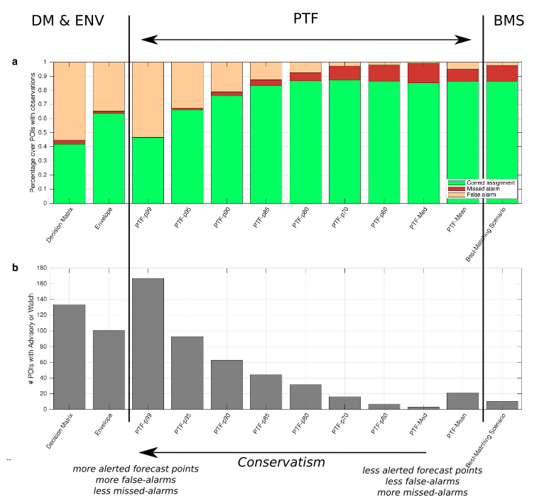
How PTF can be used
Alert levels - linked directly to response actions - can be defined based on the desired level of risk reduction, and they can be used in operational tsunami early warning or rapid post-event assessments.

Slide 8
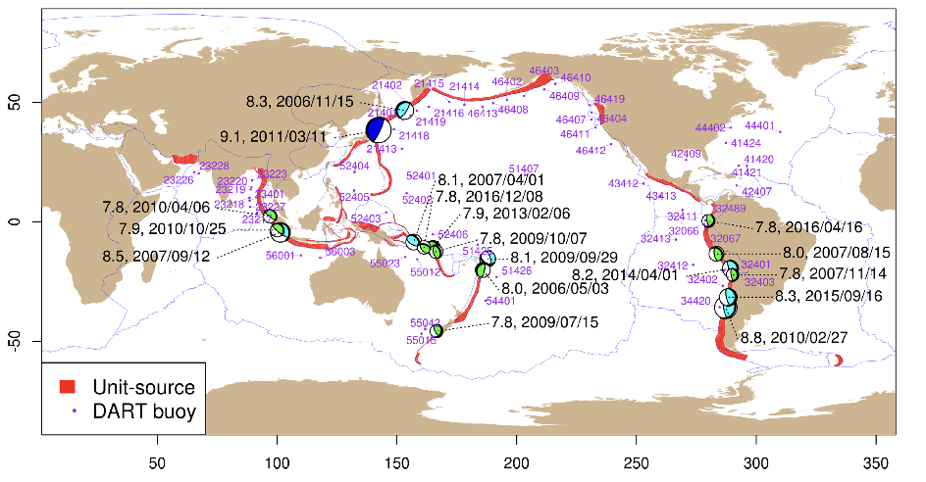
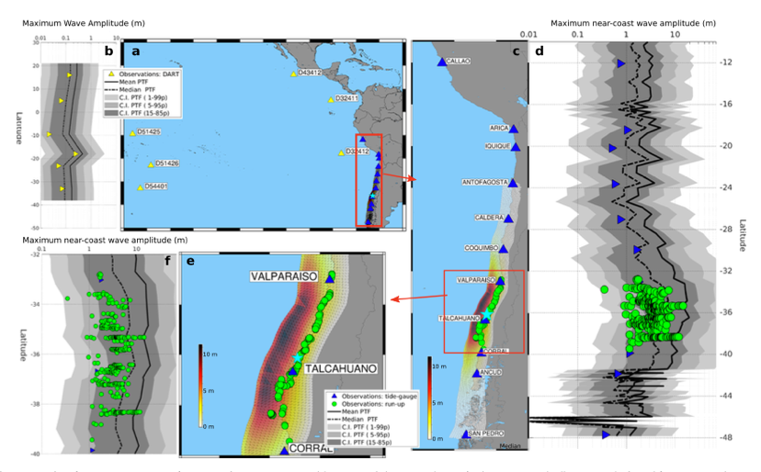
PTF calibration
2024: The PTF is being presently calibrated with tsunami observations and massive ensembles of synthetic tsunamis and it is expected to become operational at the CAT-INGV NEAMTWS Tsunami Service Provider in 2025.
Davies et al., 2019

Slide 9

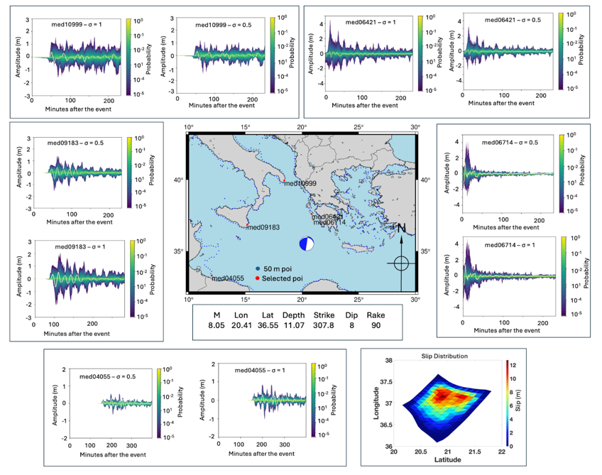
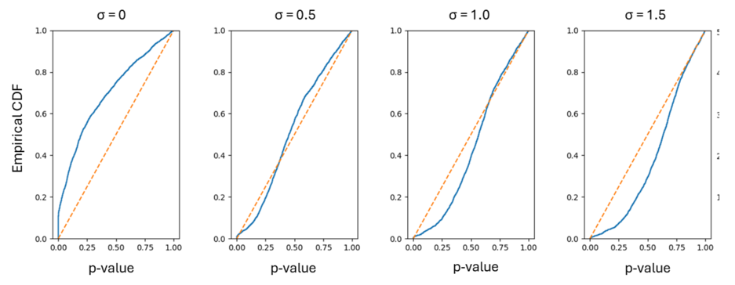
PTF calibration
2024: The PTF is being presently calibrated with tsunami observations and massive ensembles of synthetic tsunamis and it is expected to become operational at the CAT-INGV NEAMTWS Tsunami Service Provider in 2025.
200 kyr synthetic catalogue

Slide 10
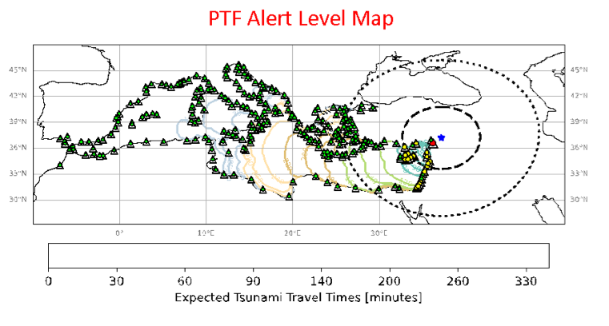
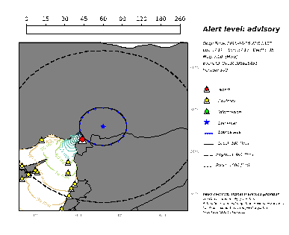
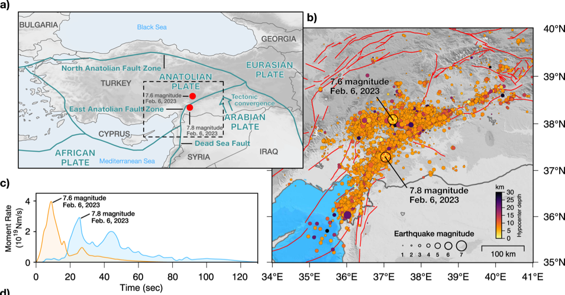
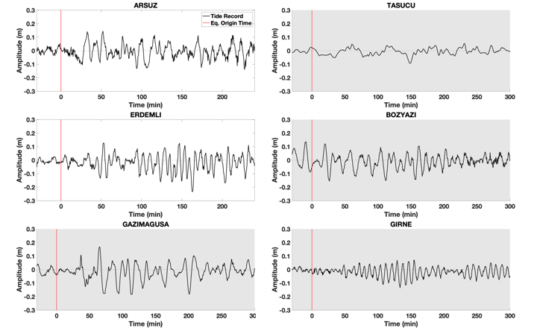
How PTF can be used: GNSS, Seismic, Tsunami data assimilation
The PTF can provide alerts in the near-field. If time allows, and if further data are available, such as the moment tensor and tsunami data, they can be assimilated in the PTF to refine the estimate.
Dal Zilio & Ampuero, 2023

Slide 11
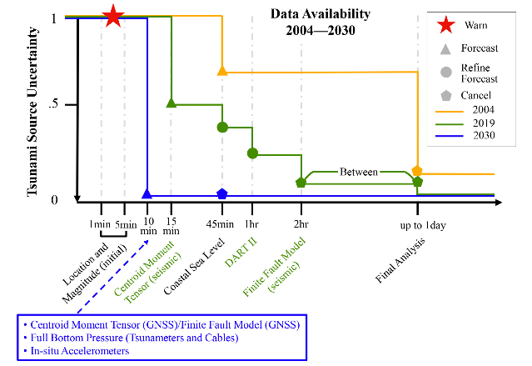
Conclusions. PTF is aligned with UN Decade Goals!
Uncertainty Quantification/Reduction for tsunami forecasting
Provide the decision-makers with actionable information
Account for tsunami propagation complexity (not only distance)
Avoid hard-thresholds → jumps of the alert levels
Angove et al., 2019
Notes:
goal 1 accuracy and timeliness

Slide 12
Warning Improving the sea level observations with new land and offshore instruments

Slide 13

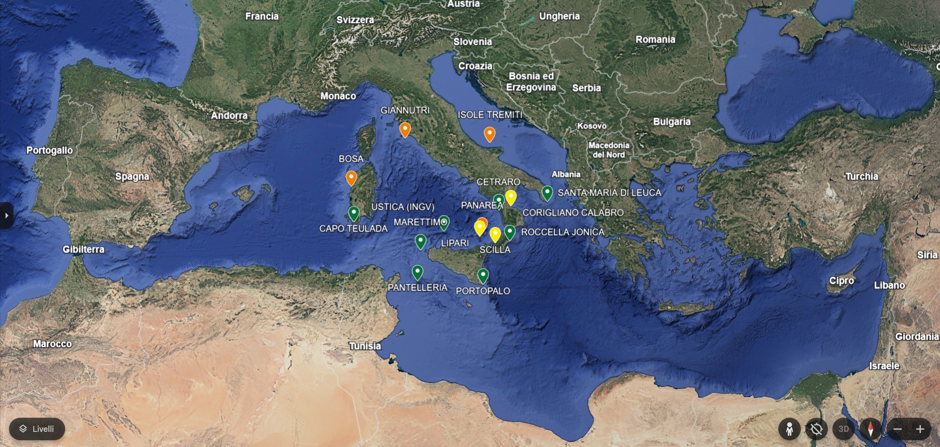
SiAM NETWORK GREEN = OPERATIONAL YELLOW = IN PROGRESS RED= PROGRAMMED 2025
Warning /1

Slide 14
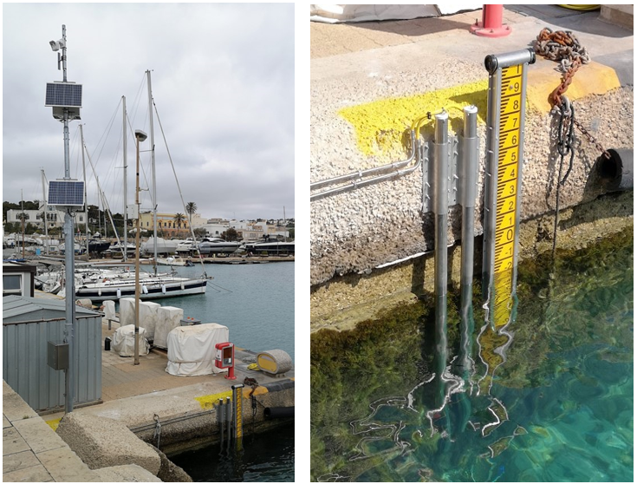
SiAM NETWORK UPGRADE
ISPRA’s new station - plus series - in Santa Maria di Leuca - 2024
3rd piezometric sensor (greater data redundancy) in a 2nd stilling tube
Backup Datalogger (electronic redundancy)
Independent power supply of the secondary system (backup)
in addition to the technical features common to the other ISPRA’s new stations in the SiAM network installed since 2021
Primary system with independent power supply, on-board camera,
Datalogger, control unit - transmits in real time the sea level (m) - sampling rate 15 sec. (FAST transmission) – 2 high precision piezometric sensors (integrated water thermistor ) with full scale of 10 and 20 meters
Data transmission system (transmission redundancy)
UMTS 4 or 5G channel - 2 SIMs on board with different providers
IRIDIUM satellite module - starts in case of absence of UMTS signal
Data storage and transmission system are protected in sealed and IP68 waterproof boxes, on a pole about 10 m high - all metal components in AISI 316 steel (resistance to severe operating conditions)
Objectives: Reduction of interruptions due to faults, increased stability of the data collection system and transmission service (operational continuity)
The plus series configuration increases the sea level survey points from 2 to 3 and the independent measuring stations from 1 to 2
tsunami.isprambiente.it
G. Giorgi – G. Arena - A. Barbano – C. Gera
(ISPRA-CN-COS- Technical-operational Section supporting the Italian National Tsunami Early Warning System (SiAM)

Slide 15

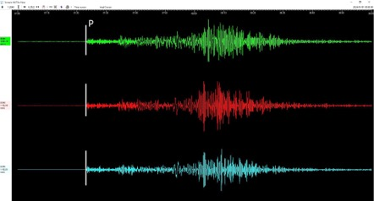
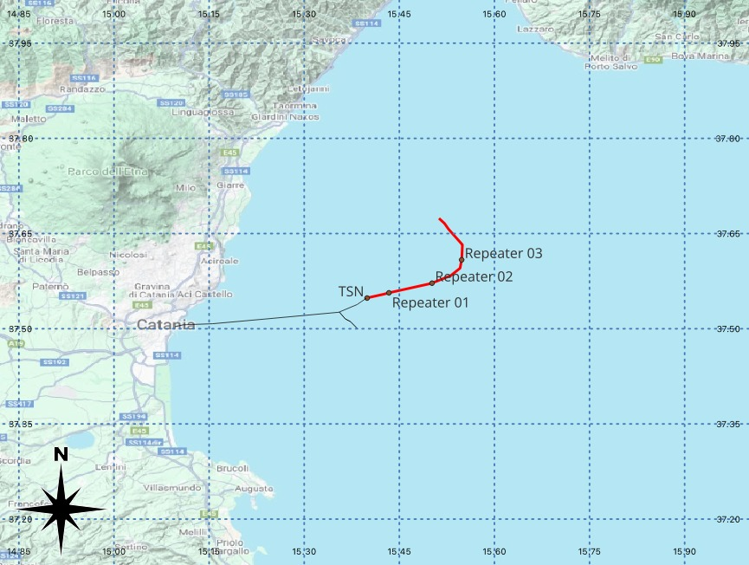
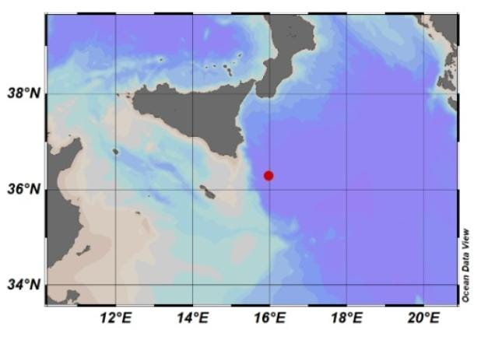
Warning /2
WESTERN IONIAN SEA INFRASTRUCTURE
Deployed December 2023
WEST COAST, EASTERN HONSHU, JAPAN
01/01/2024 07:10 M_{wpd} 7.4
Sicily
Calabria
Mt. Etna
INFN Km3NeT Observatory @ 3,500 m depth
Trillium 120s + hydrophone + P-T sensor (RBR)
Cabled with fiber optic to land (100km)
Courtesy of G. Marinaro (INGV)

Slide 16
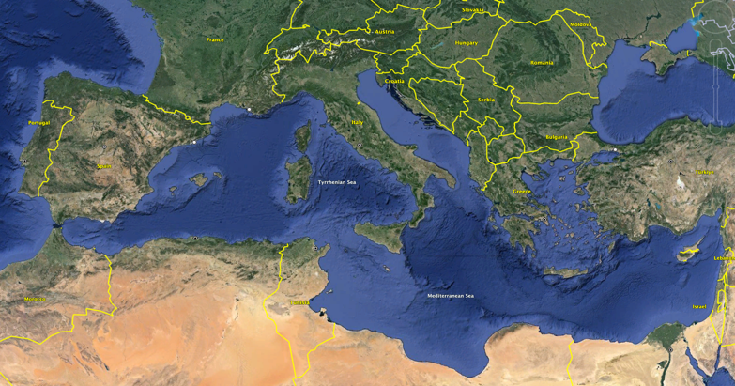
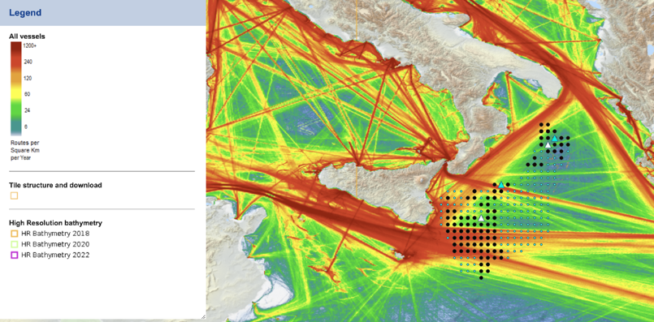
Warning /3
TSUNAMI BUOYS
2 tsunami buoys will be installed in the Ionian sea by Summer 2025 by MSM (Mediterráneo Senales Marítimas) that was awarded contract
Location and technical requirements decided based on possible tsunami sources and ship traffic (in Italian exclusive economic zone)
Funding (~2.8 M€) by the Italian Ministery of Research through the European contribution Next Generation EU - NRRP (National Recovery and Resilience Plan) “MEET”, coord. by INGV

Slide 17
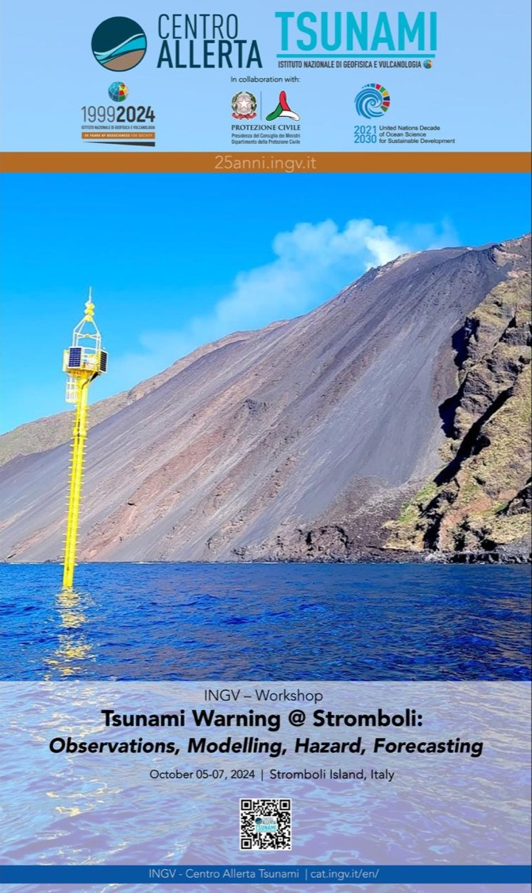
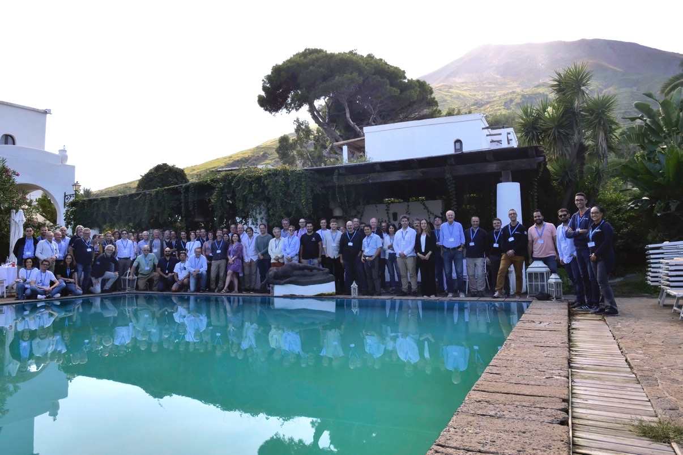
Stromboli tsunami workshop, Oct. 2024
See TT on non-seismic tsunamis

Slide 18
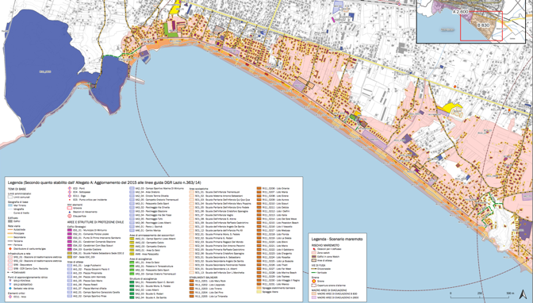
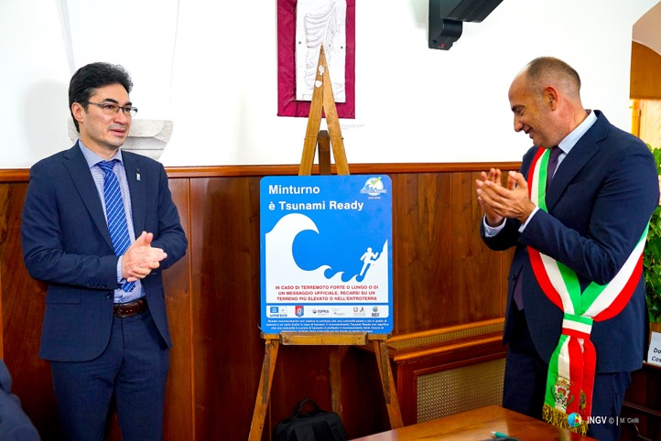
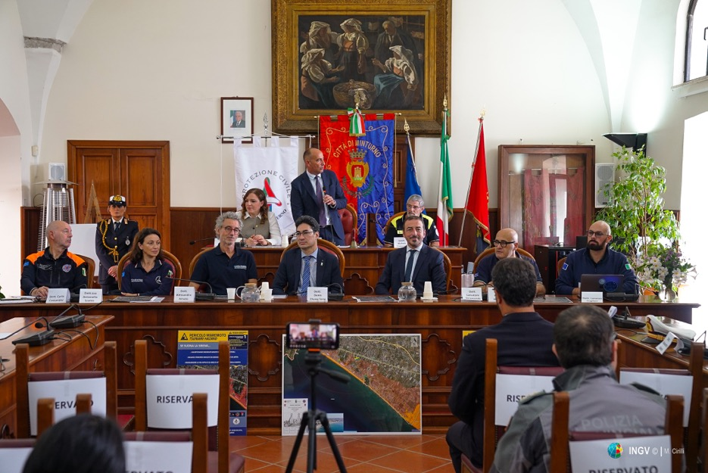
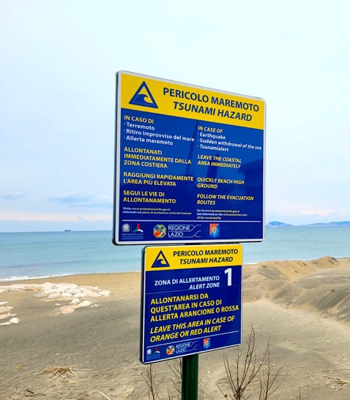
Minturno Tsunami Ready July 2024
TR recognition ceremony
October 2024
Notes:
Educational Video directed by Italian Civil Protection: “Io non rischio - Maremoto” in Italian and subtitled in English. To increase tsunami risk awareness in Italy. Published on YouTube and other official social platform
At the Genoa Science Festival (21 October to 3 November), a tsunami corner was set up with a didactic/interactive path for students and visitors. A tsunami video modelling in which the public could modify the physical parameters of using a leap-motion sensor was implemented. In this way, the visitors could change the height, length and consequent impact of the tsunami on the shore. (VIDEO PUBBLICO E VASCA)

Slide 19
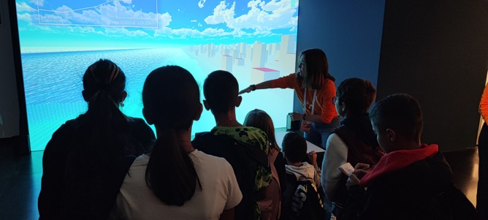
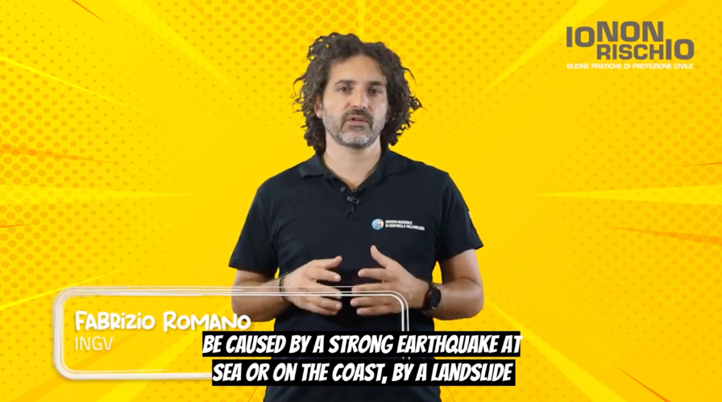
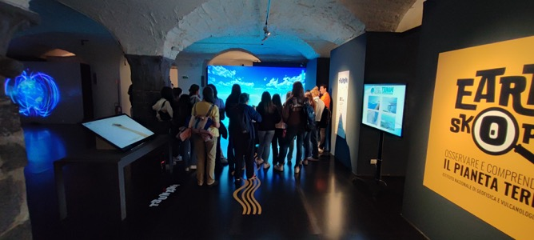
Education
Educational Video
directed by Italian Civil Protection:
“Io non rischio - Maremoto” in Italian and subtitled in English.
Genoa Science Festival (21 October to 3 November),
a tsunami corner was set up with a didactic/interactive
path for students and visitors.
Notes:
Educational Video directed by Italian Civil Protection: “Io non rischio - Maremoto” in Italian and subtitled in English. To increase tsunami risk awareness in Italy. Published on YouTube and other official social platform
At the Genoa Science Festival (21 October to 3 November), a tsunami corner was set up with a didactic/interactive path for students and visitors. A tsunami video modelling in which the public could modify the physical parameters of using a leap-motion sensor was implemented. In this way, the visitors could change the height, length and consequent impact of the tsunami on the shore. (VIDEO PUBBLICO E VASCA)

Slide 20
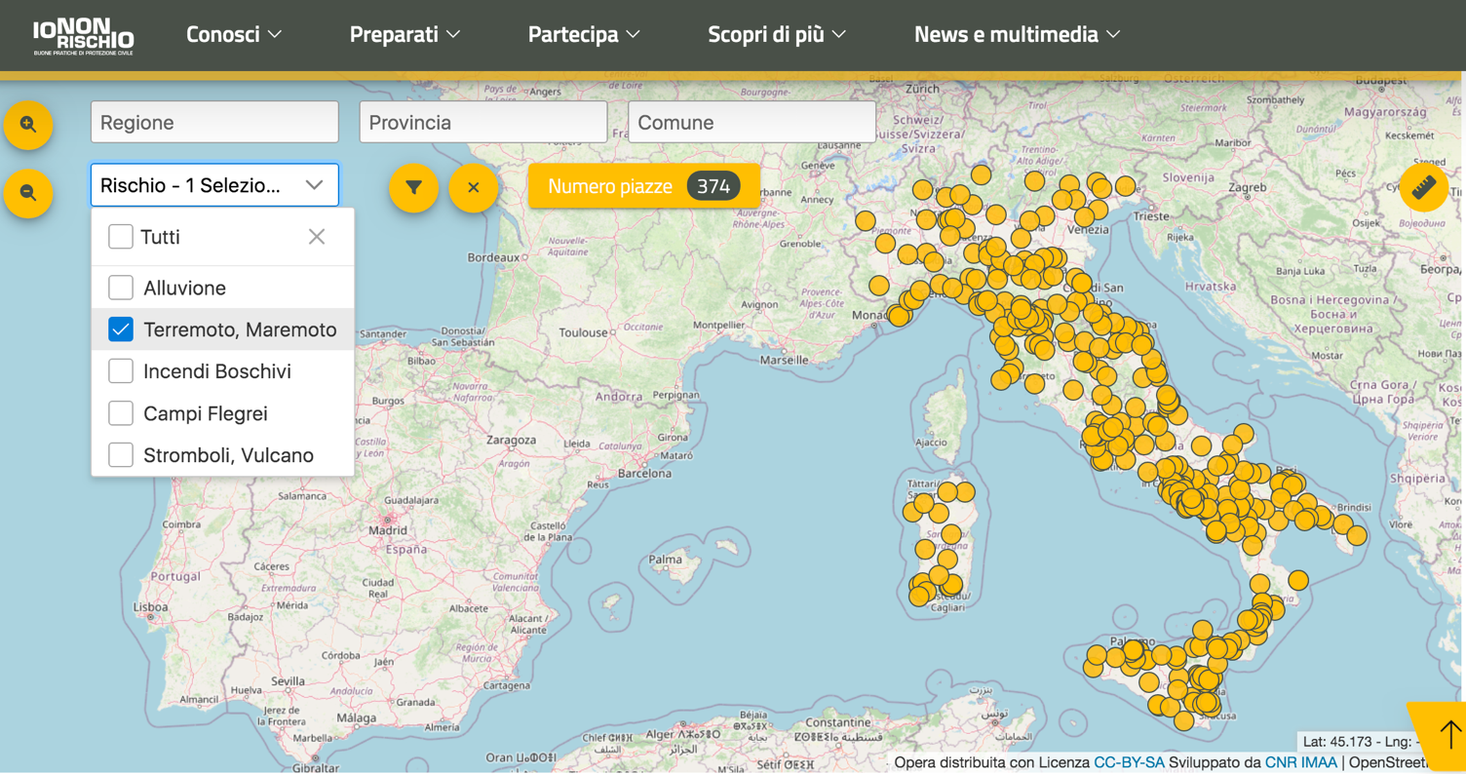
Education
‘Io Non Rischio - Maremoto’
National information campaign for tsunami risk mitigation in the squares of coastal municipalities.
Map shows coverage for the year 2024: 374 sqares out of 425 with tsunami risk
Notes:
With regard to the national Civil Protection campaign Io non rischio maremoto for tsunami risk mitigation, 374 squares were covered in 2024, as shown in the map.

Slide 21
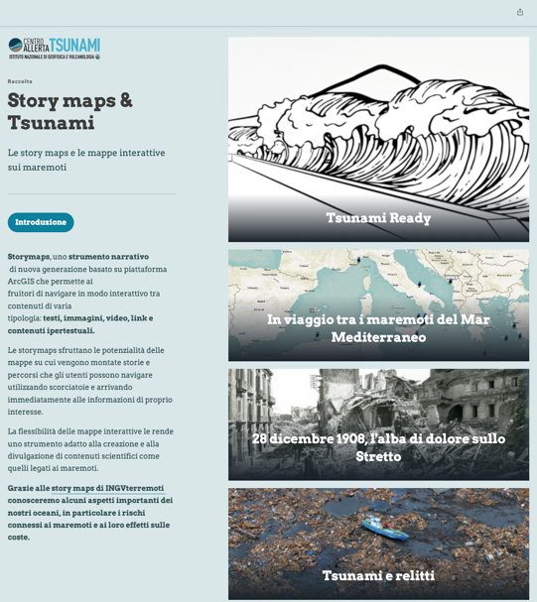
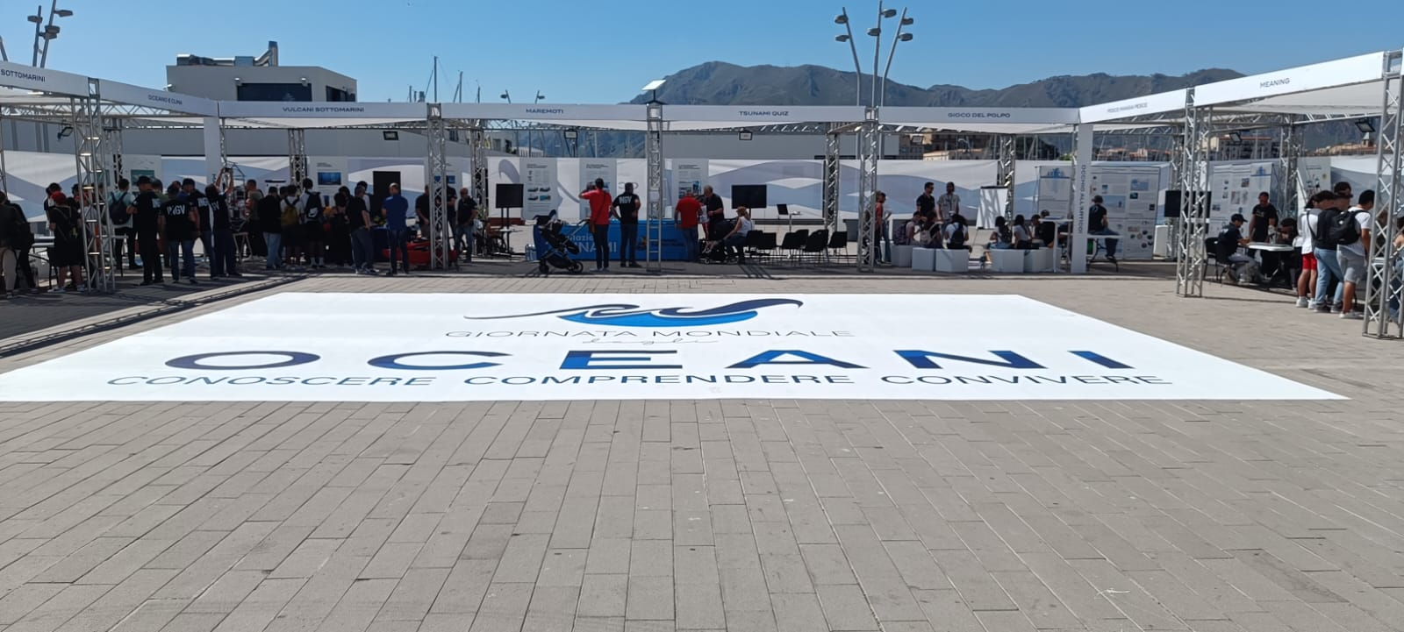
Education
Story Maps about:
Indian Ocean tsunami 2004;
Messina-Reggio 1908;
Wrecks of 2011 tsunami in the Pacific Ocean;
Tsunami Ready in Italy;
The 2004 Indian Ocean tsunami.
World Ocean Day (8 June)
public events were held at major INGV centres, also to raise tsunami risk knowledge and awareness.
Notes:
On the occasion of the World Ocean Day (8 June) public events were held at major INGV centres, also to raise tsunami risk knowledge and awareness. The largest events were held in Palermo, Sicily, and Rome, with the active involvement of the population. In Palermo, the tsunami tank and tsunami Quiz game were used. In Rome the Tsunami Quiz and tsunami storymaps were illustrated by researchers. The activities carried out during the day focused on the oceans and the risks connected to them at 360°.
Story Maps: Indian Ocean 2004; Messina-Reggio 1908; Relics of 2011 tsunami in the Pacific Ocean; Tsunami Ready in Italy; the 2004 Indian Ocean tsunami.

Slide 22
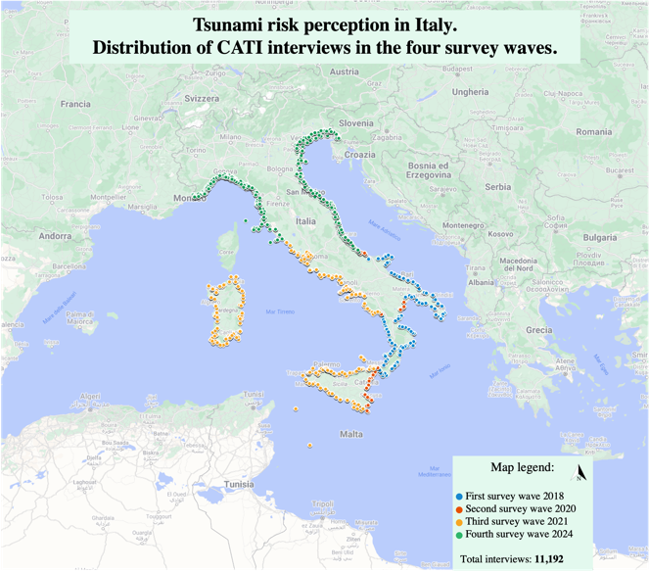
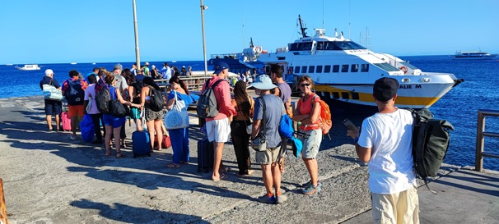
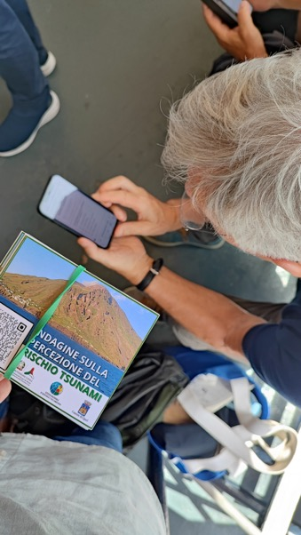
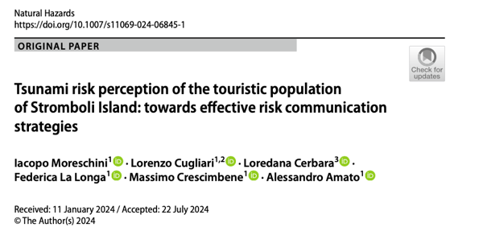
Risk Perception Assessment at national and local level
National Tsunami Risk Perception survey:
in 2024 we complete the survey by administering the tsunami risk perception questionnaire to the whole Italian population residing in coastal municipalities.
11.192 Questionnaire obtained
699 interviews on tsunami risk perception among tourists in Stromboli (Moreschini et al., 2024)
15 in-depth interviews to local residents
Notes:
Italian risk perception survey: in 2024 we complete the survey by administering the tsunami risk perception questionnaire to the whole Italian population residing in coastal municipalities. Finally we have an amount of 11.192 telephone interviews (CATI). Furthermore, in 2021 and 2024, tsunami risk perception was surveyed on two panels representing the entire Italian population, including inhabitants living in non-coastal municipalities. These additional surveys add 3000 cases to the sample and can be used as benchmarks for comparisons of tsunami risk perception (e.g. tourists/residents, those living on the coast, those living inland).
Between 2023 and 2024, 699 tourists visiting Stromboli Island were interviewed to assess their tsunami risk perception and knowledge of the warning systems on the island. The results were published in the paper by Moreschini et al., 2024. In addition, 15 in-depth interviews were conducted in June 2024 to survey tsunami risk perception and obtain more accurate information from Island residents. The texts of the interviews have yet to be analysed.

Slide 23
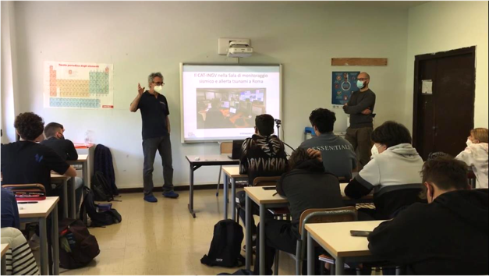
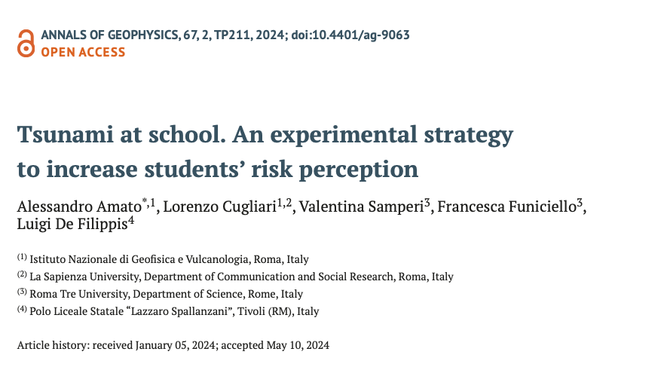
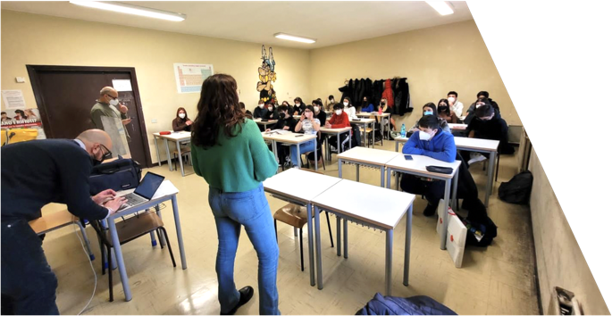
Risk Perception Assessment in schools
Repeated assessment (three stages) of tsunami risk perception studies in Tivoli’s High School (Amato et al., 2024)
Notes:
The paper on the time-repeated survey (longitudinal study) of tsunami risk perception among the students of a high school in Tivoli in central Italy has been published. In the same classes of this high school, the survey was conducted in three stages: before providing tsunami information to the students (tabula rasa), after providing the students with the information and the third time a year later. The results are published in Amato et al., 2024.

Slide 24
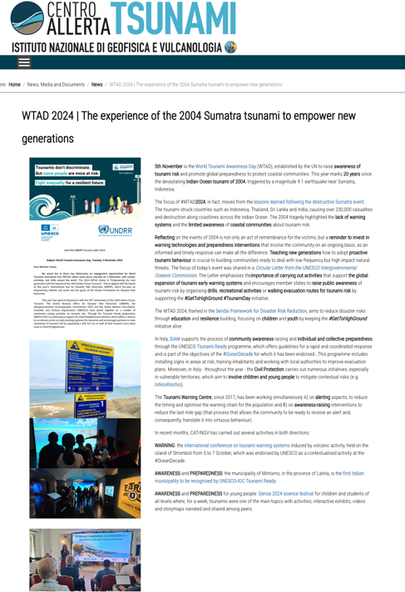
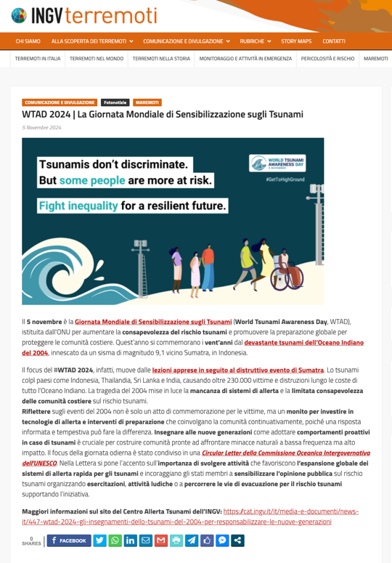
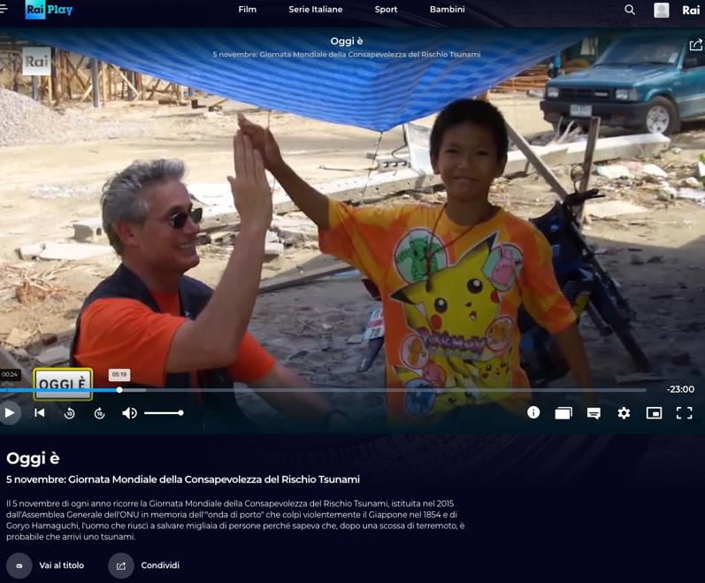
World Tsunami Awareness Day 2024
RAI Scuola documentary on the 2004 Indian Ocean tsunami
Notes:
WTAD 2024: Educational Video on tsunami for students and youth edited by RAI Public italian TV published on Nov. 5. Here are some activities that we have done to celebrate the WTAD: A news on Tsunami Alert Centre website in Italian and English also spread on social media A news on INGV Terremoti Blog shared on INGV platform On the national TV channel (RAI SCUOLA / RAI SCHOOL) a new episode of a television program was broadcast to celebrate WTAD and the 2004 tsunami 20th anniversary. The episode was recorded at INGV in October and tells about the Indian Ocean tsunami and how the warning system works today in our region. It was released on Nov. 5 at 6 pm, and is periodically transmitted on the channel. It is also freely available on demand

Slide 25
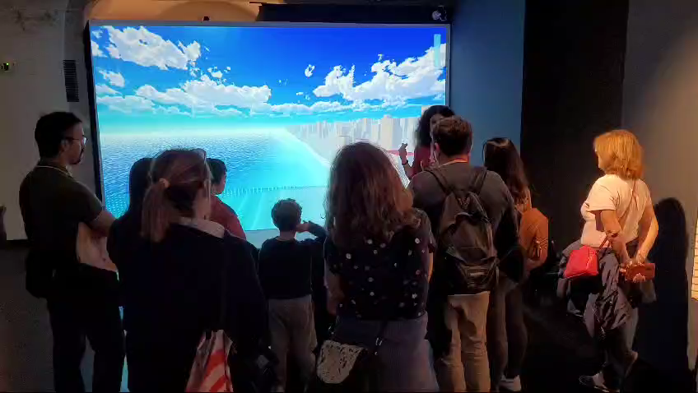
A new “virtual” tsunami pool (Genova, Oct. 2024)
https://storymaps.arcgis.com/stories/32091c82e42a4d30a2f24b1e7b5955b6
Notes:
… as well as several videos o produced on tsunami warning, exercises, educational material, and so on.
As an example (particularly well done) is this short 1’ video showing the SAMOS tsunami of October 2020, whish has been viewed 3.7 million times!
Another tool we are using for increasing people awareness is the Story Maps, through which we can tell stories about past tsunamis, warning procedures, etc.

Slide 26
Papers 2024
Abbate, A., González Vida, J. M., Castro Díaz, M. J., Romano, F., Bayraktar, H. B., Babeyko, A., and Lorito, S.: Modelling tsunami initial conditions due to rapid coseismic seafloor displacement: efficient numerical integration and a tool to build unit source databases, Nat. Hazards Earth Syst. Sci., 24, 2773–2791, https://doi.org/10.5194/nhess-24-2773-2024, 2024.
Amato, A., Cugliari, L., Samperi, V., Funiciello, F. and De Filippis, L. (2024) Tsunami at school. An experimental strategy to increase students’ risk perception, Annals of Geophysics, 67(2), p. TP211. doi: 10.4401/ag-9063.
Lay T., Romano F., Lorito S. (2024), Use of tsunami observations for resolving coseismic slip of recent and historic large submarine earthquakes, Annals of Geophysics, 67, 4, S427, doi:10.4401/ag-9142
Moreschini, I., Cugliari, L., Cerbara, L. et al. Tsunami risk perception of the touristic population of Stromboli Island: towards effective risk communication strategies. Nat Hazards (2024). https://doi.org/10.1007/s11069-024-06845-1
Scala, A., Lorito, S., Escalante Sánchez, C., Romano, F., Festa, G., Abbate, A., et al. (2024). Assessing the optimal tsunami inundation modeling strategy for large earthquakes in subduction zones. Journal of Geophysical Research: Oceans, 129, e2024JC020941. https://doi.org/10.1029/ 2024JC020941

Slide 27
Participation in projects
CoastWAVE Phase 2 (July 2024) ”Scaling up and strengthening the resilience of coastal communities….”;
New phase of COST Action AGITHAR - (Accelerating Global Science in Tsunami Hazard and Risk Analysis) to establish the Global Tsunami Model (GTM) organization;
Formal recognition of the TSUNAMI Thematic Core Service (TCS) within EPOS The European Plate Observing System (EPOS General Assembly in Dec. 2023);
Other projects funded by EU contributing to the advancement of Tsunami science, including both R&D (DT-GEO) and warning-oriented (EPOS, GeoInquire)
DG-ECHO project NEAM-COMMITMENT (coord. NOA, Greece) with other MS and relevant stakeholders (2025-2027)
Stromboli project funded by Italian Civil Protection Dept. for improving the local tsuanmi warning system and for hazard assessment (2022-2025): extension?
Notes:
Let me conclude mentioning some of the most important projects and initiatives that are going on in our region. Besides the already mentioned CoastWAVE project there are other initiatives funded by the European Community, like the Agithar Cost Action working for the Global Tsunami Model, the EPOS Thematic Core Service recently approved, and other projects.

