Slide 1

17 YEARS OF TSUNAMI RESEARCH AT THE NATIONAL INSTITUTE FOR EARTH PHYSICS, ROMANIA
Presenter: Partheniu Raluca,
Researcher at NIEP
ICG/NEAMTWS XIX, Paris, France, 27th - 29th November 2024

Slide 2
SUMMARY
INTRODUCTION
PROJECTS AND STUDIES
EDUCATIONAL MATERIALS (INTERNAL, TRANSLATED, WTAD)
INSTEAD OF CONCLUSIONS AND FUTURE WORK
ACKNOWLEDGEMENTS
SELECTED REFERENCES
CONTRIBUTION
Researchers: Moldovan Iren Adelina, Constantin Angela, Diaconescu Mihail, Ionescu Constantin, Victorin Toader, Tolea Andreea, Ghita Cristian
Public Relations: Dragan Mihaela
IT: Manea Liviu, Palangeanu Lucian
ICG/NEAMTWS XIX, Paris, France, 27th - 29th November 2024

Slide 3
INTRODUCTION
The National Institute for Earth Physics (NIEP) is the leading institution for seismology in Romania, doing acquisition and monitoring of the seismic, geophysical and geodetic data.
NIEP is Tsunami National Contact (TNC) and Tsunami Warning Focal Points (TWFP) of Romania for the Intergovernmental Coordination Group for the Tsunami Early Warning and Mitigation System in the North-eastern Atlantic, the Mediterranean and connected seas (ICG/NEAMTWS), participating at annual meetings and taking part in different tsunami exercises. We intend to become National Tsunami Warning Centre (NTWC) in the future.
NIEP is also part of the Global Tsunami Monitoring (GTM) group.
17 years of experience in tsunami research (since 2007), with a total number of 7 tsunami past projects, 2 active projects, few project proposals (in progress) and also other tsunami connected activities.
Numerous tsunami related scientific papers have been published by NIEP personnel, in different National and International Journals and Publishers (Diaconescu M., Malita Z., 2007, “Seismic sources in the Black Sea areal”, Natural hazard: Tsunami Events in the Black Sea, pp. 71-80, Partheniu R. et al., 2015, “Earthquakes and tsunamis monitoring in the western Black Sea area”, book chapter; Moldovan I.A. et al., 2017, “Probabilistic seismic hazard assessment in the Black Sea area”, Rom. Journ. Phys, 62, 809; Partheniu R. et al., 2018, “Comparison between tsunami modeling scenarios for Shabla Area (Black Sea) using two different software”, Studia UBB Ambientum, 64 (LXIV), 2; Partheniu R. et al., 2019, “Monitoring the Black Sea natural hazards using new technology and equipment”, Romanian Reports in Physics, 71, 704; Partheniu R., Tiganescu A., 2024. “Comparisons between tsunami measurements and simulations, for recent worldwide events (2020-2023), https://doi.org/10.5281/zenodo.14033020, pp. 65-89; Partheniu R. et al., 2024, Recent Worldwide Tsunamis (2020-2023) - Comparisons Between Modeling and Measurements”, Journal of the Polish Mining Engineering Society,Vol.1(53), 681–689).
Few approaches in seismic source zonation for Black Sea area were accomplished in the framework of different projects and articles by NIEP personnel (Diaconescu M. et al. 2007, Moldovan I.A. et al. 2017, Diaconescu M. et al. 2019, part I & II).
The Black Sea area is known for past tsunami activity, with 22 evidenced events, 4 of them in Shabla area, affecting the Romanian and Bulgarian shores. The most known tsunami was generated on 31st of March 1901, when an earthquake of Mw 7.2 triggered waves up to 5 m heights (Papadopoulos et al., 2011). The most recent event was triggered by a submarine landslide on 7th of May 2007 and lead to 1.2 m waves (Ranguelov B., 2008).
ICG/NEAMTWS XIX, Paris, France, 27th - 29th November 2024

Slide 4
PROJECTS & STUDIES
NIEP started approaching tsunami research since 2007, through numerous studies in past national and international projects, listed herein:
Multidisciplinary researches on natural hazards. Case study: tsunami type phenomenon in the Black Sea (PROFET) - National Project
Set-up and implementation of key core components of a regional early-warning system for marine geo-hazards of risk to the Romanian-Bulgarian Black Sea coastal area (MARINEGEOHAZARD) - Regional Project
Black Sea Earthquake Safety Net(work) (ESNET)- Regional Project
Global Tsunami Informal Monitoring Service (GTIMS) & Global Tsunami Informal Monitoring Service 2 (GTIMS 2) - International Projects
Assessment, Strategy And Risk Reduction for Tsunamis in Europe - Black Sea (ASTARTE) - International Project
All Risk Integrated System Towards the Holistic Early-Warning (ARISTOTLE) - International Project
Accelerating Global Science in Tsunami Hazard and Risk Analysis (AGITHAR) - International Project
Two active projects:
Long term multi-hazard ARISTOTLE-ENHSP (continuously since 2016)- International Project
The Research Center For Climate Change Due To Natural Disasters And Extreme Weather Events (REACTIVE) - National Project
COST Action Proposal: Tsunami Hazard and Risk Education through Accessible Training (THREAT) - International Project
ICG/NEAMTWS XIX, Paris, France, 27th - 29th November 2024

Slide 5
PROJECTS & STUDIES
Other activities only emphasize the tsunami phenomena but are more educational and/or based on different subject: Mobile Earthquake Exhibition (MOBEE), The Otherwise School Program, Researchers’ Night, Romanian Seismic Educational Network (ROEDUSEIS), “Increasing The Research Capacity In The Field Of Seismology Engineering At The Seismological Observatories And Stations Within The National Seismic Network” (CRESCENTO).
Project proposals 2024:
“Strengthening the Black Sea coastal community’s resilience throuGh real-time natURal hazard awareness” (SEAGUR), National Project, IN EVALUATION
“Tsunami Modeling for Black Sea area” (TIMO) ,GEO_ENQUIRE Transnational Access - International Project, REJECTED
“Actualizarea serviciilor tematice din domeniul seismologiei la standarde europene”, phase 9 “Imbunatatire si operationalizare Software pentru sistemul de alertare la tsunami” (Improving operation and software for the tsunami warning system) - National Project, IN PROGRESS
The regional tsunami warning system was implemented in 2013 in the framework of MARINEGEOHAZARDS project and a specific related website is available starting with 2016 http://ctwc.infp.ro/index.php
ICG/NEAMTWS XIX, Paris, France, 27th - 29th November 2024

Slide 6
PROJECTS & STUDIES
TSUNAMI RELATED PUBLISHED ARTICLES 2024
Partheniu, R., Tiganescu, A., & Placinta, A. O. (2024) Recent Worldwide Tsunamis (2020-2023) - Comparisons Between Modeling and Measurements. Journal of the Polish Mining Engineering Society,Vol.1(53), 681–689. https://doi.org/10.29227/IM-2024-01-79.
Partheniu R., Tiganescu A., 2024, Comparisons between tsunami measurements and simulations, for recent worldwide events (2020-2023), https://doi.org/10.5281/zenodo.14033020 in CHITEA F. (Ed) - Geoscience for sustainable development goals. Perspectives on natural hazards & earth-resources, ISBN 978-606-537-734-9, ISBN e-book pdf 978-606-537-735-6, Cetatea de Scaun Editorial House, Pp. 65-89.
TSUNAMI RELATED PRESENTATIONS AT CONFERENCES 2024
Partheniu R., Tiganescu A., Tolea A., Dinescu R., Comparison between tsunami modeling and measurements for the M 7.7 earthquake from 19th of May 2023 in Loyalty Islands, poster presentation at “ENVIRONMENT & PROGRESS, Natură – mediu – educație Marcian Bleahu – 100 de ani de la naștere”, 13-15 June 2024, Cluj-Napoca, Romania.
Partheniu R., Tolea A., “Tsunami education and research implemented by the National Institute for Earth Physics”, oral presentation at “ENVIRONMENT & PROGRESS, Natură – mediu – educație Marcian Bleahu – 100 de ani de la naștere”, 13-15 June 2024, Cluj-Napoca, Romania.
Partheniu R., Tiganescu A., Tolea A., Dinescu R., Molea R., Tsunamı propagatıon and sımulatıons for the Mw 7.4 Taıwan earthquake from 2ND of Aprıl 2024, poster presentation at GEOSCIENCE International Symposium, 9th Edition,14-16 November, 2024, Bucharest, Romania.
ARTICLES IN PROGRESS
Partheniu R., Diaconescu M., Craiu A., Constantinescu E., The 7.2 M earthquake from 1st of March, Shabla area, Black Sea.
Partheniu R., Tiganescu A., Tolea A., Dinescu R., Comparison between tsunami modeling and measurements for the M 7.7 earthquake from 19th of May 2023 in Loyalty Islands, to be published in Studia Ambientum.
Article to be published in an ISI Journal with the title“10 years evaluation of worldwide tsunamis (2014-2024)”, multiple authors (not decided yet).
ICG/NEAMTWS XIX, Paris, France, 27th - 29th November 2024

Slide 7
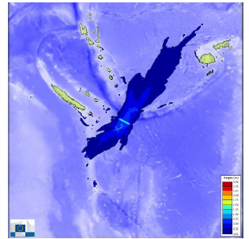
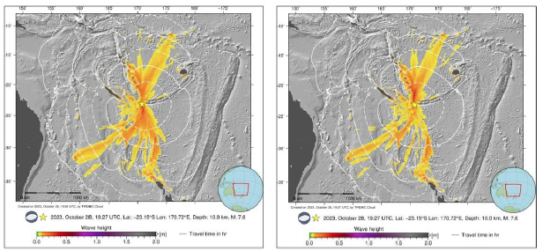
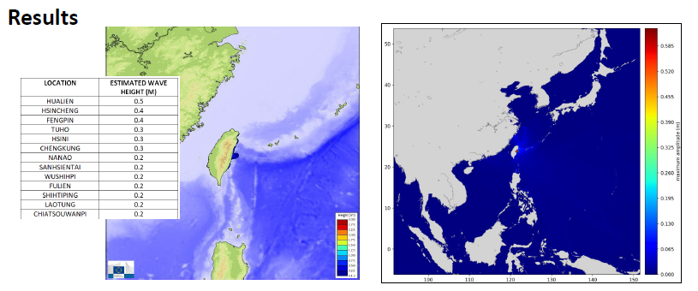
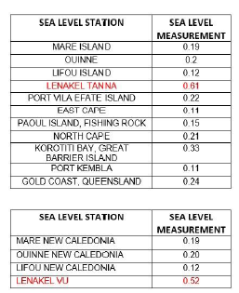
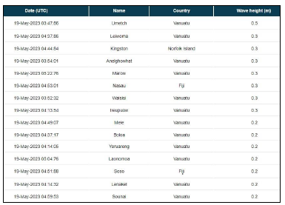
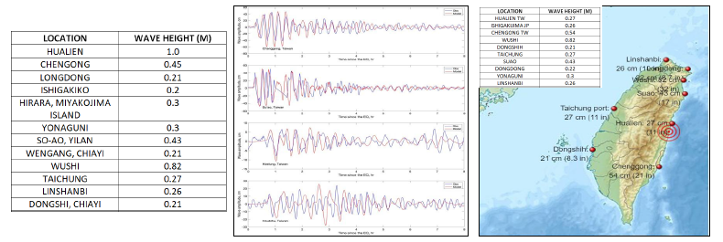
PROJECTS & STUDIES
Tsunami modeling simulations for worldwide events, using Tsunami Analysis Tool (TAT), TRIDEC Cloud and HySEA software, and comparison to sea-level measurements.
LOYALTY ISLAND EARTHQUAKE 19.05.2023, MW 7.7
MAX MEASURED WAVES: 0.61 M (NOAA), 0.52 M (ITIC)
TAIWAN EARTHQUAKE 2.04.2024, MW 7.4, MAX MEASURED WAVES: 1 M (NOAA)
ICG/NEAMTWS XIX, Paris, France, 27th - 29th November 2024

Slide 8
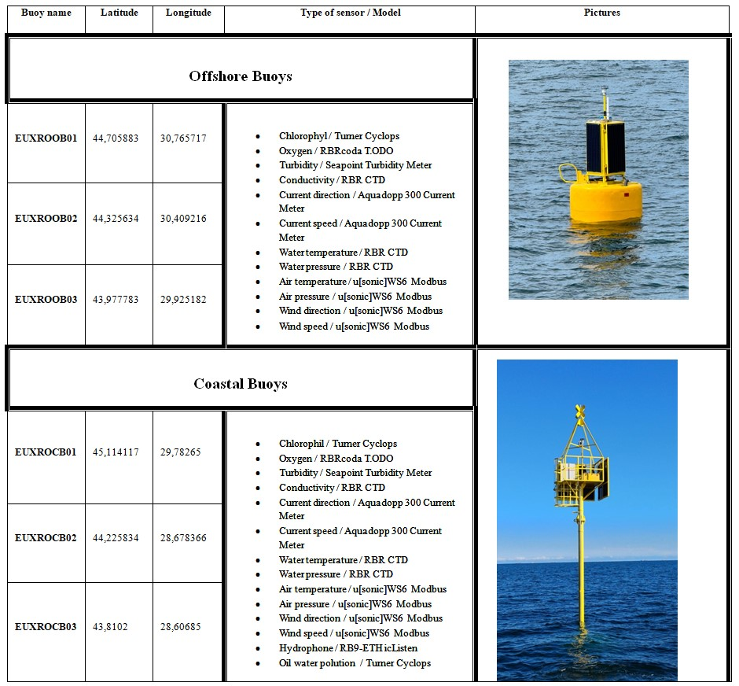
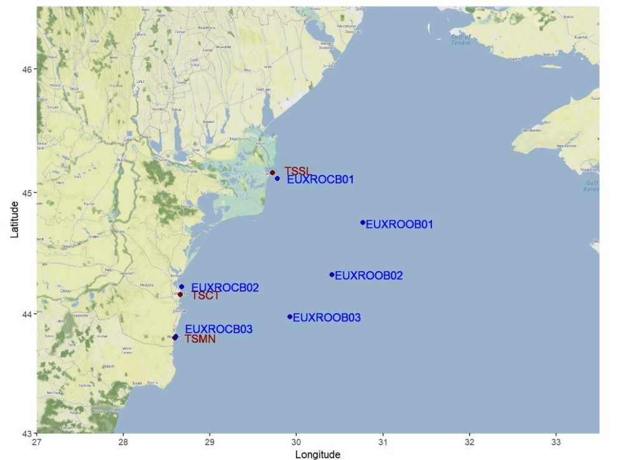
PROJECTS & STUDIES
ONSHORE AND OFFSHORE EQUIPMENT:
3 sea-level stations (belonging to NIEP) TSMN, TSCT and TSSL
6 DART buoys (belonging to GeoEcoMar (National Institute for Marine Geology and GeoEcology) EUXROCB01, EUXROCB02, EUXROCB03, EUXROOB01, EUXROOB02, EUXROOB03
Parts of the old equipment have been updated, and also new equipment offshore (3 buoys) have been recently installed by GeoEcoMar, close or in the same location as NIEP’s sea level stations.
ICG/NEAMTWS XIX, Paris, France, 27th - 29th November 2024

Slide 9
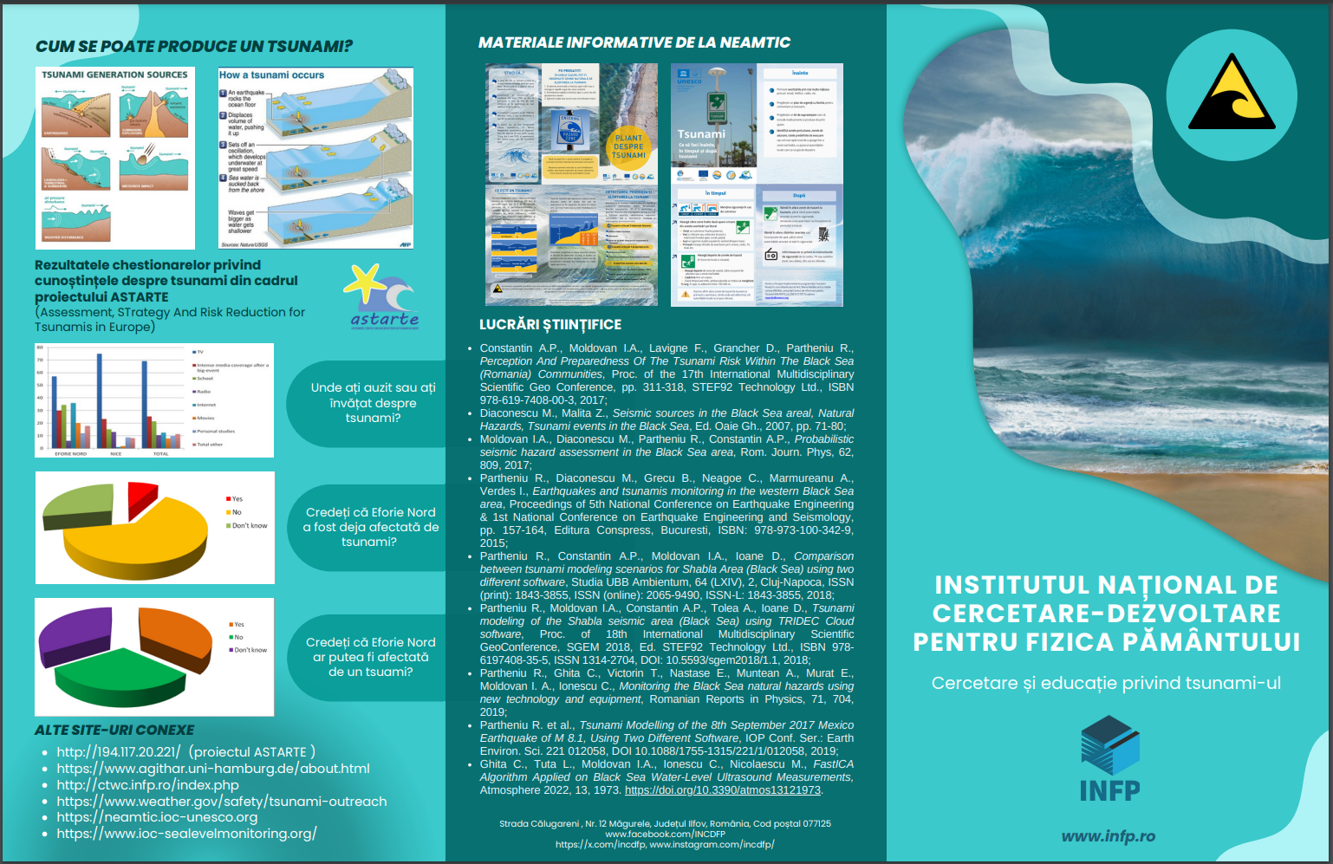
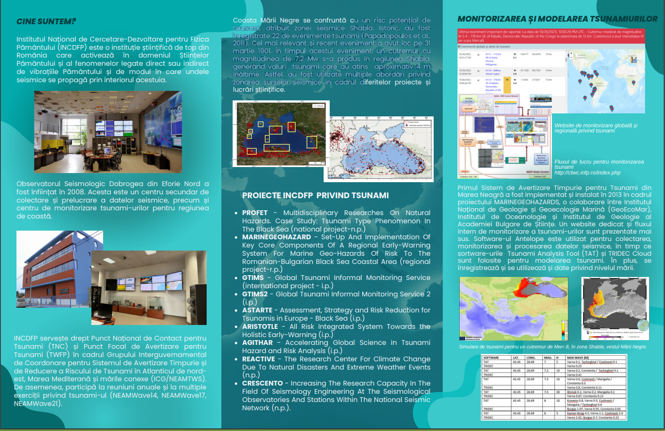
EDUCATIONAL MATERIALS
INTERNAL MATERIALS
One general flyer regarding NIEP’s tsunami activity was structured, both in Romanian and English (displayed at the last meeting in February only in English, herein in Romanian).
ICG/NEAMTWS XIX, Paris, France, 27th - 29th November 2024

Slide 10
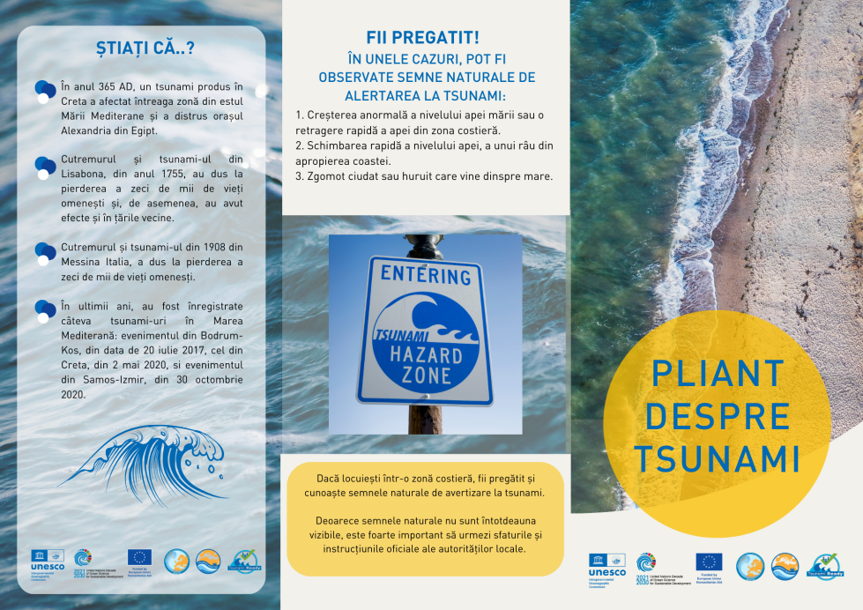
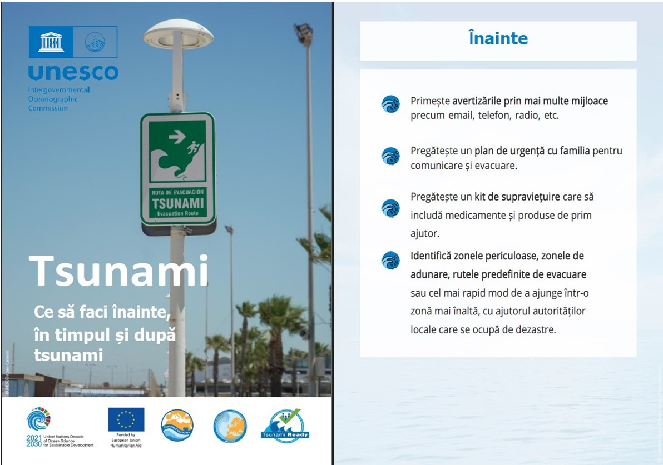
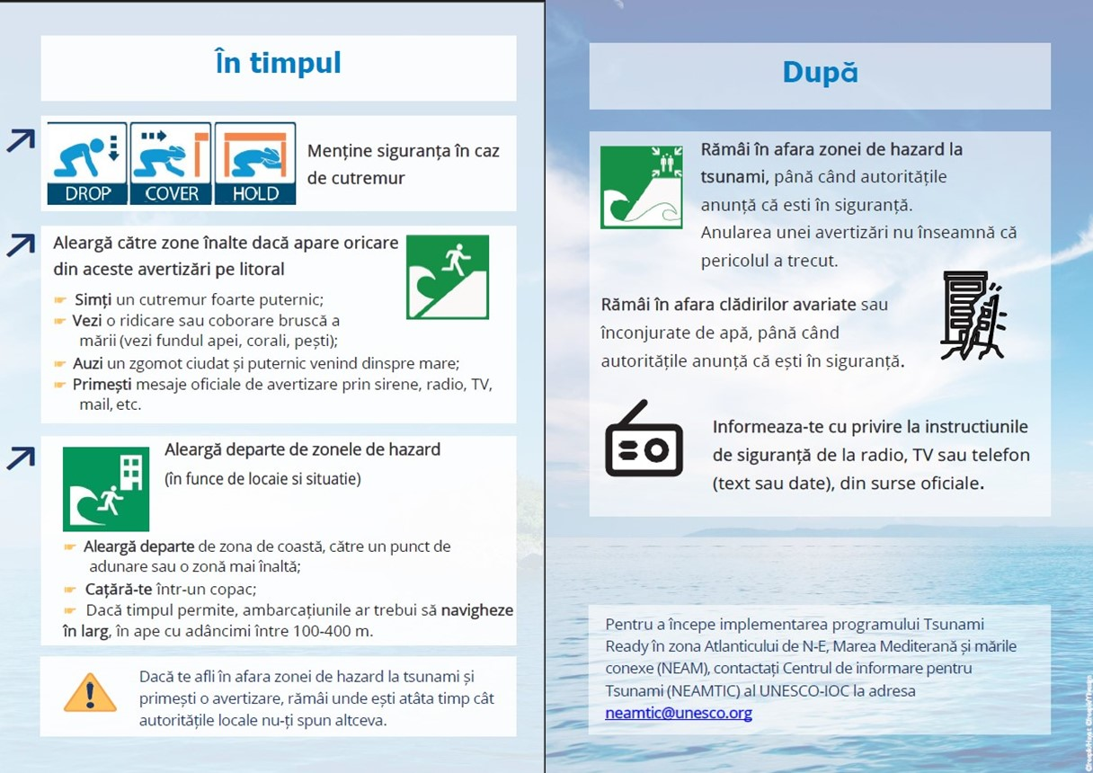
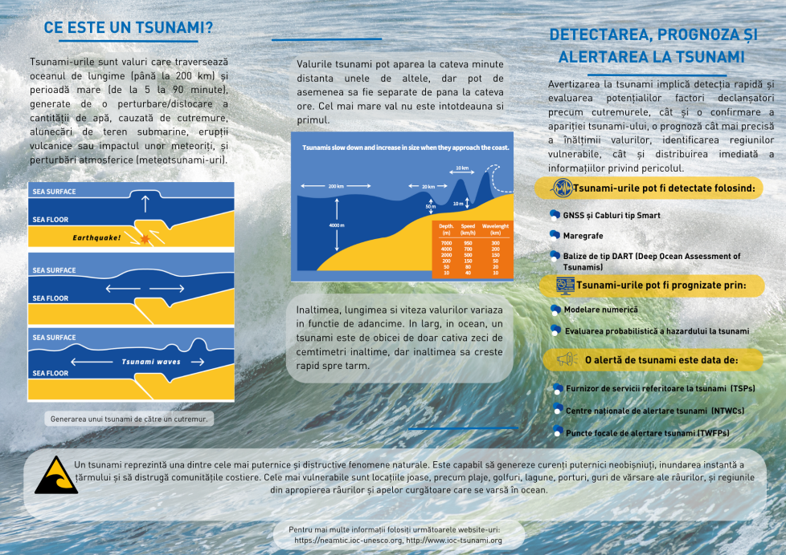
EDUCATIONAL MATERIALS
NEAMTIC MATERIALS -> TWO flyers have been translated in Romanian – TSUNAMI FACT SHEET and WHAT TO DO
ICG/NEAMTWS XIX, Paris, France, 27th - 29th November 2024

Slide 11
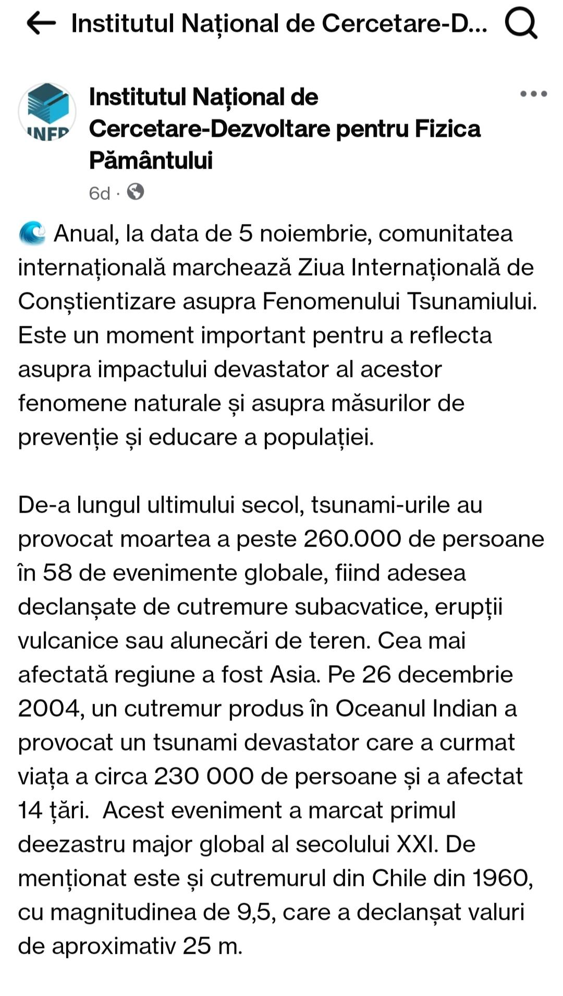
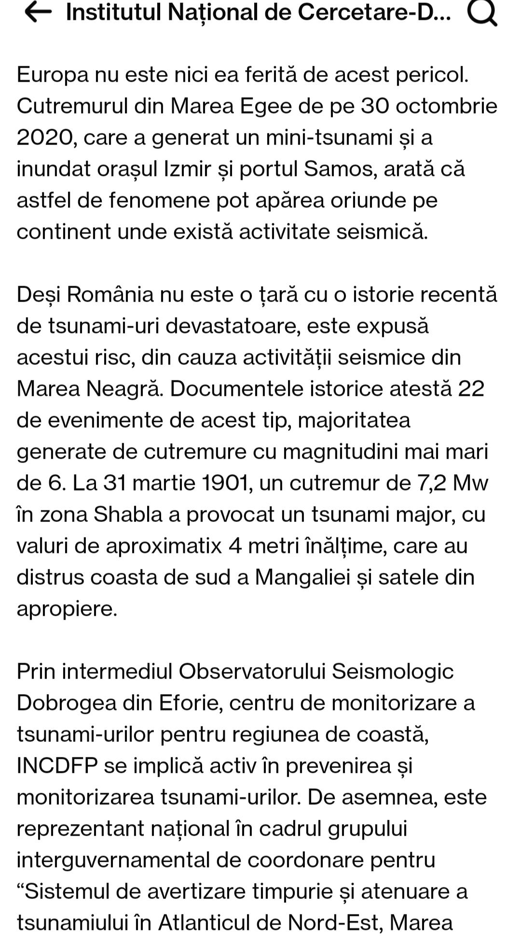
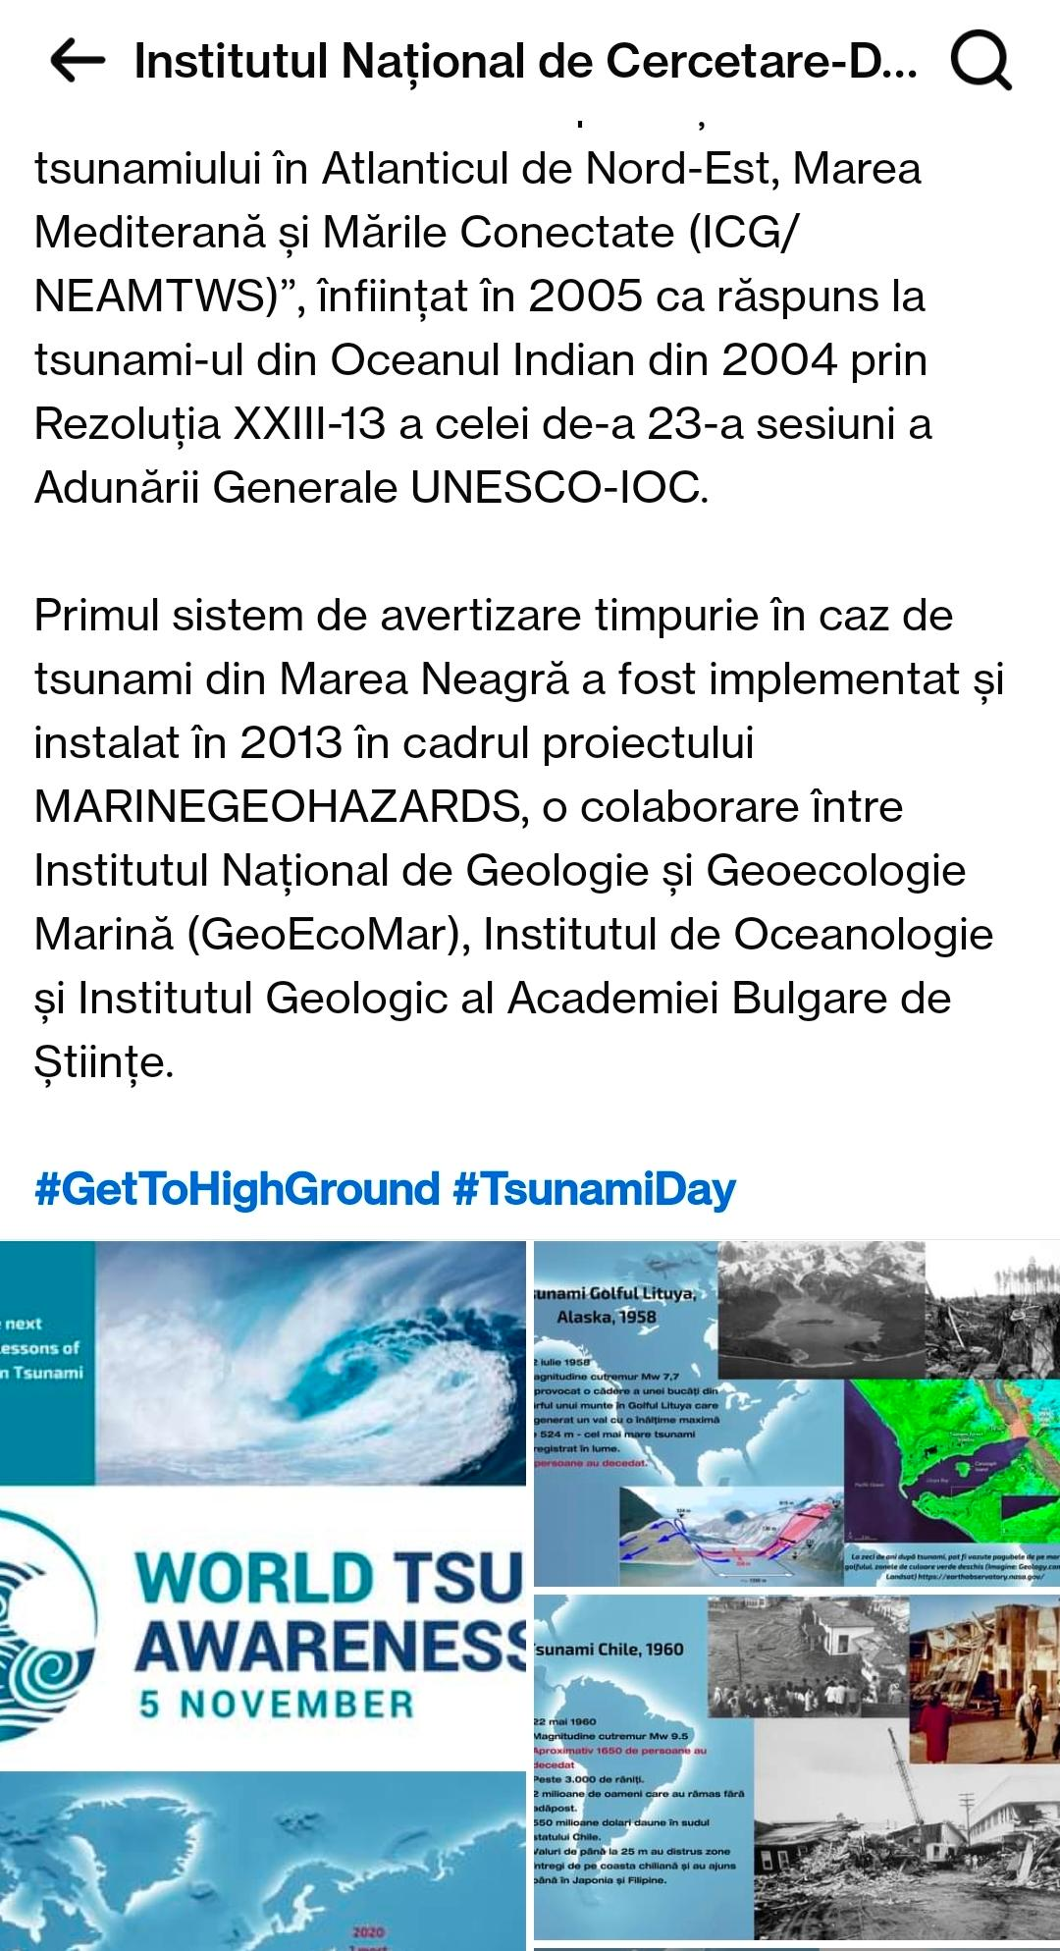
EDUCATIONAL MATERIALS
WORLD TSUNAMI AWARENESS DAY https://www.facebook.com/share/p/1B989SYXoe/
ICG/NEAMTWS XIX, Paris, France, 27th - 29th November 2024

Slide 12
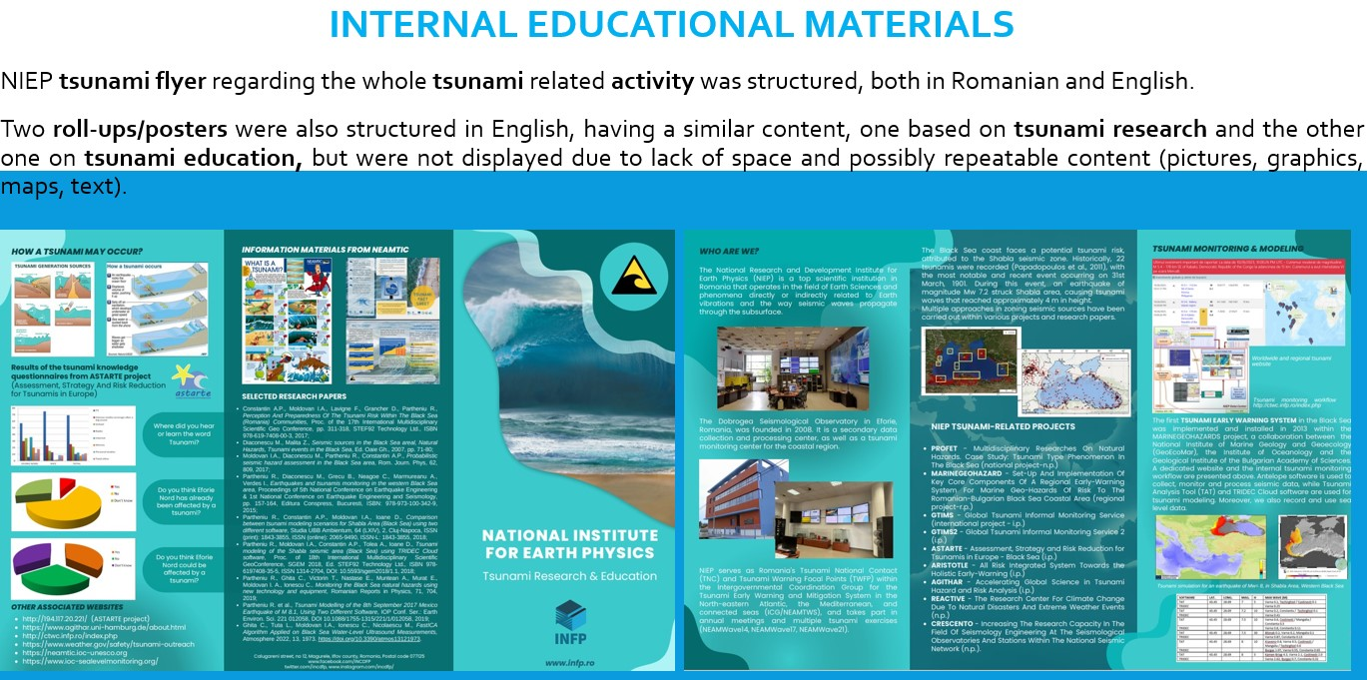

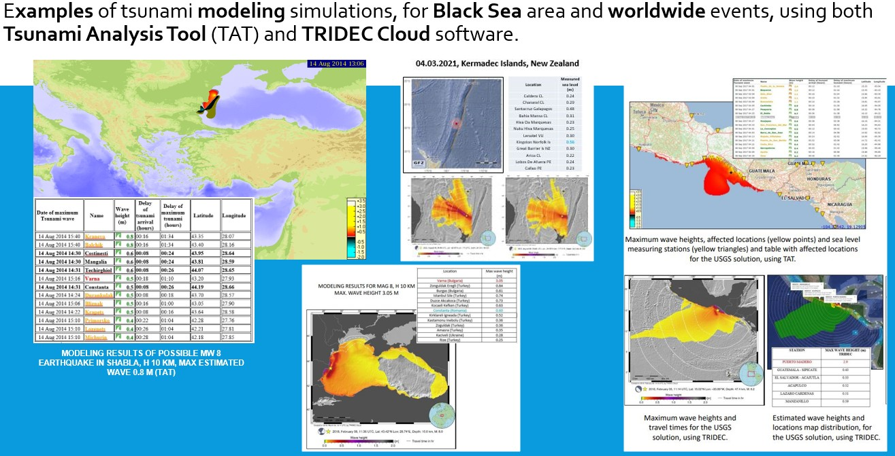
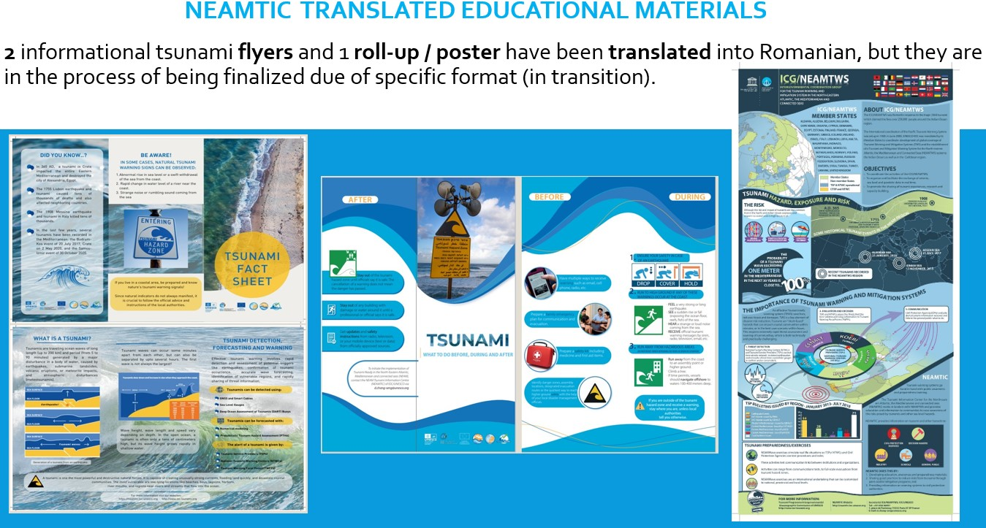
EDUCATIONAL MATERIALS
ICG/NEAMTWS XIX, Paris, France, 27th - 29th November 2024

Slide 13
INSTEAD OF CONCLUSIONS…
The tsunami related activity of NIEP was described through projects, studies, articles and current activities.
A flyer containing all NIEP’S research and education activity was structured (first in English, and recently in Romanian).
Some educational materials of the NEAMTIC and ICG/NEAMTWS group were translated in Romanian, “tsunami fact sheet” and “what to do”.
Publishing 2 articles and having 3 Conference presentations (in 2024) with the tsunami related research and studies.
Participating in COST Action Proposal: Tsunami Hazard and Risk Education through Accessible Training (THREAT)
NIEP is planning to use the Global Earthquake Monitoring Processing Analysis (GEMPA) software, with it’s tsunami related Tsunami Observation and Simulation (TOAST) in the framework of a future project (proposal in progress).
Installation of HySEA software and testing it with simulations for Black Sea area.
In the framework of the National Research Funding Program (NUCLEU 2023-2026), PHAZER - “The seismic phenomena, from global scale to local scale, in a multidisciplinary approach”, one phase has been finalized in 2024 “Implementing an Early Warning System (EWS) in the Black Sea”.
Work in progress -> “10 years evaluation of worldwide tsunamis (2014-2024)” article to be published in an ISI Journal (plan for 2025).
FUTURE WORK
Organizing local educational meetings, seminars, workshops, and applying for new projects.
In the framework of the National Research Funding Program (NUCLEU 2023-2026), PHAZER - “The seismic phenomena, from global scale to local scale, in a multidisciplinary approach”, there are two specific tsunami related phases: “Evaluating the seismic and tsunami hazard using multiple computation methods, integrating all the results in a real time complex platform” and also “Tsunami modeling scenarios for the Black Sea, using major past earthquake parameters”.
Romanian translation of more NEAMTIC flyers, posters, booklets, guides, on tsunami awareness and education, and distribution of these products in specific coastal areas on the Romanian shore.
ACKNOWLEDGEMENTS
This paper was carried out within: NUCLEU project SOL4RISC, supported by MCI, no. PN23360201 (NUCLEU 2023-2026) and Project PNRR- DTEClimate/REACTIVE no. 760008/31.12.2022
We acknowledge the whole contribution of our colleague Diaconescu Mihail (retired), to all the tsunami research studies and activity since 2007.
We acknowledge the assistance and collaboration of the ICG/NEAMTWS group and Secretariat, for providing the educational materials.
ICG/NEAMTWS XIX, Paris, France, 27th - 29th November 2024

Slide 14
SELECTED REFERENCES
Diaconescu M., Malita Z., “Seismic sources in the Black Sea areal”, Natural hazard: Tsunami Events in the Black Sea, Ed. Oaie, Gh., pp. 71-80, 2007.
Moldovan I.A, Diaconescu M., Partheniu R., Constantin A.P., “Probabilistic seismic hazard assessment in the Black Sea area”, Rom. Journ. Phys, 62, 809, 2017.
Diaconescu M., Craiu A., Toma-Danila D., Craiu G. & Ghita C. (2019), Main active faults from the Eastern part of Romania (Dobrogea and Black Sea). Part I: Longitudinal faults system. Romanian Reports in Physics, 71, 702.
Diaconescu M., Craiu A., Moldovan I.A., Constantinescu E. & Ghita C. (2019), Main active faults from Eastern part of Romania (Dobrogea and Black Sea). Part II: Transversal and oblique faults system. Romanian Reports in Physics, 71, 708
Partheniu R., Diaconescu M., Grecu B., Neagoe C., Marmureanu A., Verdes I., “Earthquakes and tsunamis monitoring in the western Black Sea area”, Proceedings of 5th National Conference on Earthquake Engineering & 1st National Conference on Earthquake Engineering and Seismology, pp. 157-164, Ed. Conspress, Bucharest, ISBN: 978-973-100-342-9, 2015.
Partheniu R., Constantin A.P., Moldovan I.A., Ioane D., “Comparison between tsunami modeling scenarios for Shabla Area (Black Sea) using two different software”, Studia UBB Ambientum, 64 (LXIV), 2, Cluj-Napoca, ISSN (print): 1843-3855, ISSN (online): 2065-9490, ISSN-L: 1843-3855, 2018.
Partheniu R., Ghita C., Victorin T., Nastase E., Muntean A., Murat E., Moldovan I. A., Ionescu C., “Monitoring the Black Sea natural hazards using new technology and equipment”, Romanian Reports in Physics, 71, 704, 2019.
Papadopoulos G. A., Diakogianni G., Fokaefs A., Ranguelov B., “Tsunami hazard in the Black Sea and the Azov Sea: a new tsunami catalogue”, Natural Hazards and Earth System Science, Vol. 11, pp. 945 - 963, 2011.
Ranguelov B., Tinti S., Pagnoni G., Tonini R. , Zaniboni F., Armigliato A., 2008, “The nonseismic tsunami observed in the Bulgarian Black Sea on 7 May 2007: Was it due to a submarine landslide?”, Geophysical Research Letters, https://doi.org/10.1029/2008GL034905
Partheniu R., Tiganescu A., 2024, Comparisons between tsunami measurements and simulations, for recent worldwide events (2020-2023), https://doi.org/10.5281/zenodo.14033020 in CHITEA F. (Ed) - Geoscience for sustainable development goals. Perspectives on natural hazards & earth-resources, ISBN 978-606-537-734-9, ISBN e-book pdf 978-606-537-735-6, Cetatea de Scaun Editorial House, 65-89.
Partheniu R., Tiganescu A., Placinta, A. O. (2024). Recent Worldwide Tsunamis (2020-2023) - Comparisons Between Modeling and Measurements, Journal of the Polish Mining Engineering SocietyVol.1(53), 681–689. https://doi.org/10.29227/IM-2024-01-79.
https://helmholtz.software/software/tridec-cloud
http://ctwc.infp.ro/index.php
https://neamtic.ioc-unesco.org/
https://edanya.uma.es/hysea/
ICG/NEAMTWS XIX, Paris, France, 27th - 29th November 2024

Slide 15
THANK YOU FOR YOUR ATTENTION!
ICG/NEAMTWS XIX, Paris, France, 27th - 29th November 2024

