Slide 1
IPMA National Tsunami Warning Center and TSP - Status
Fernando Carrilho
ICG/NEAMTWS, Paris
27-29 November 2024

Slide 2
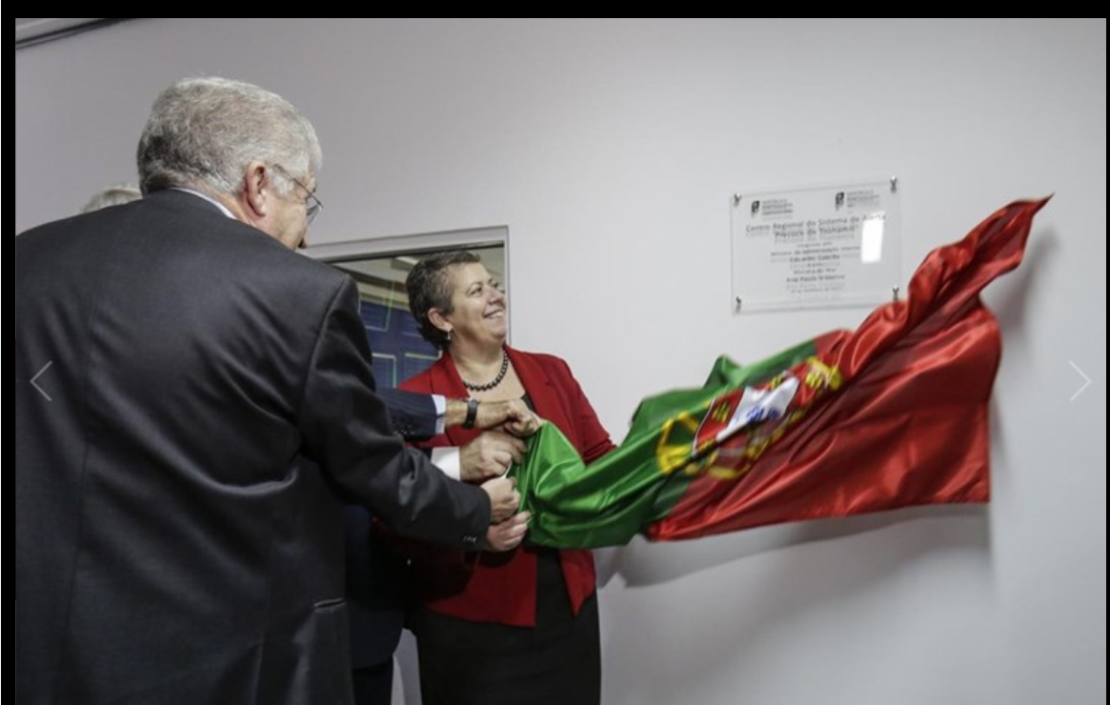
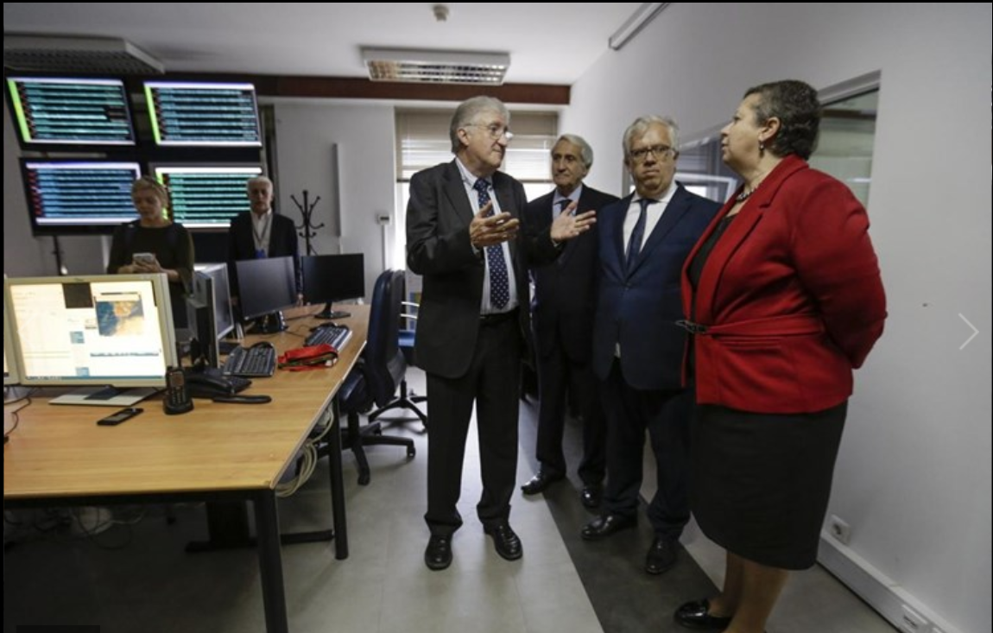
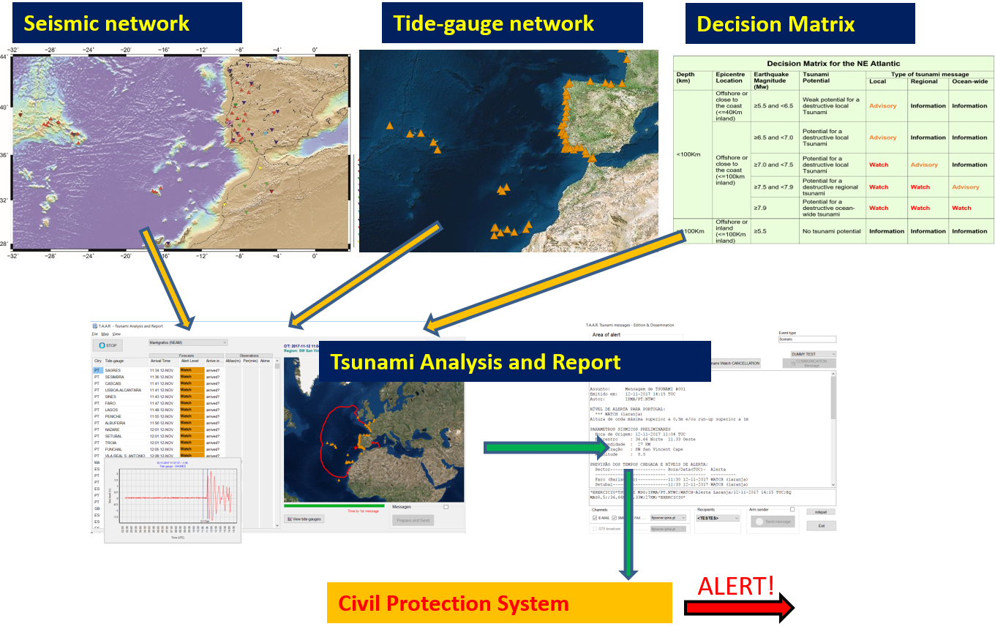
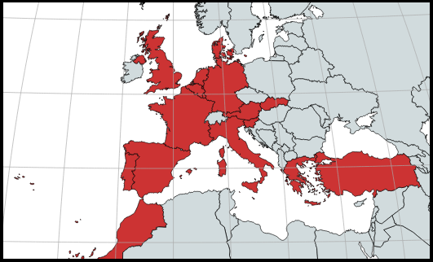
PT.NTWC
NTWC – November 2017
CTSP - January 2018
Accreditation as TSP on 2019
Subscribers:
Portugal, Spain, France, Morocco, Germany, UK, Denmark, Turkey, Italy and Greece
JRC, IOC, ERCC

Slide 3
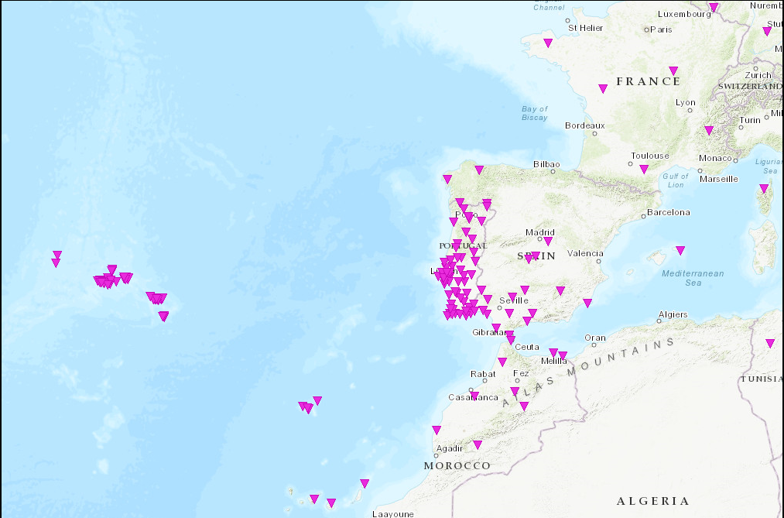
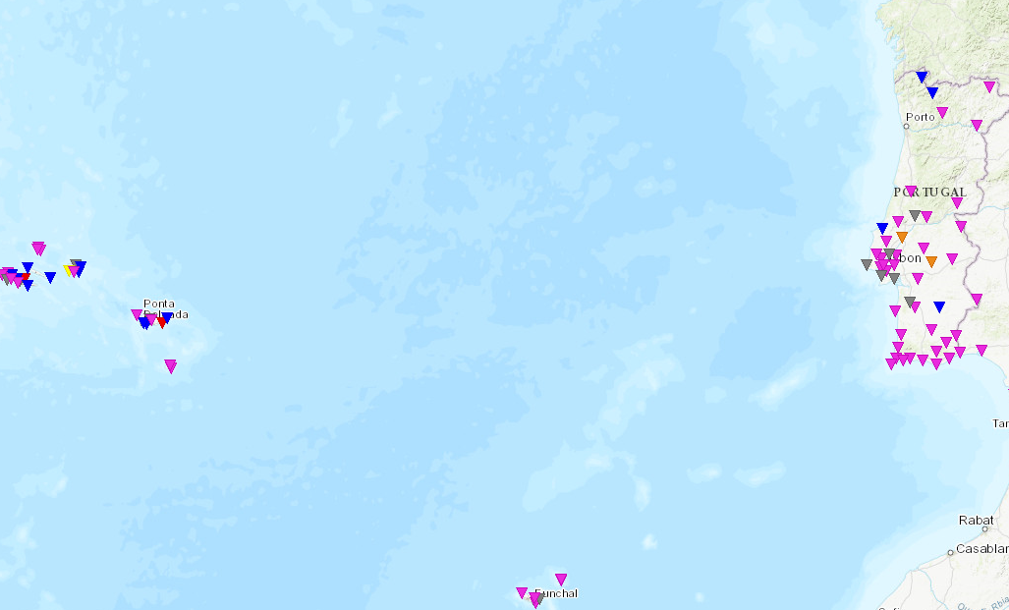
Seismic Network
VSAT
Internet
MPLS
IPMA broadband network (+ SM sensors co-located)
IPMA short-period network (+ SM sensors co-located)
IPMA/IST strong-motion network
Real-time, Internet (mobile, mini-link, fiber optic) & VSAT connection
Complemented with stations from other agencies: Portugal, Spain, Morocco, France and CTBTO (Internet, VPN and MPLS);
83 Broadband, 28 short-period and 97 accelerometers (real-time)
Broadband / Short-period
VSAT
Internet
Strong-motion

Slide 4
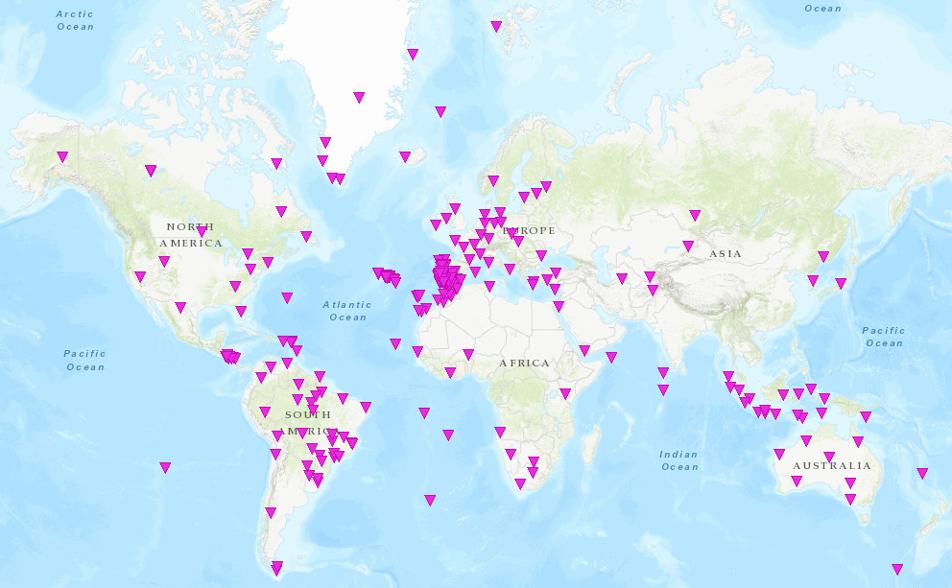
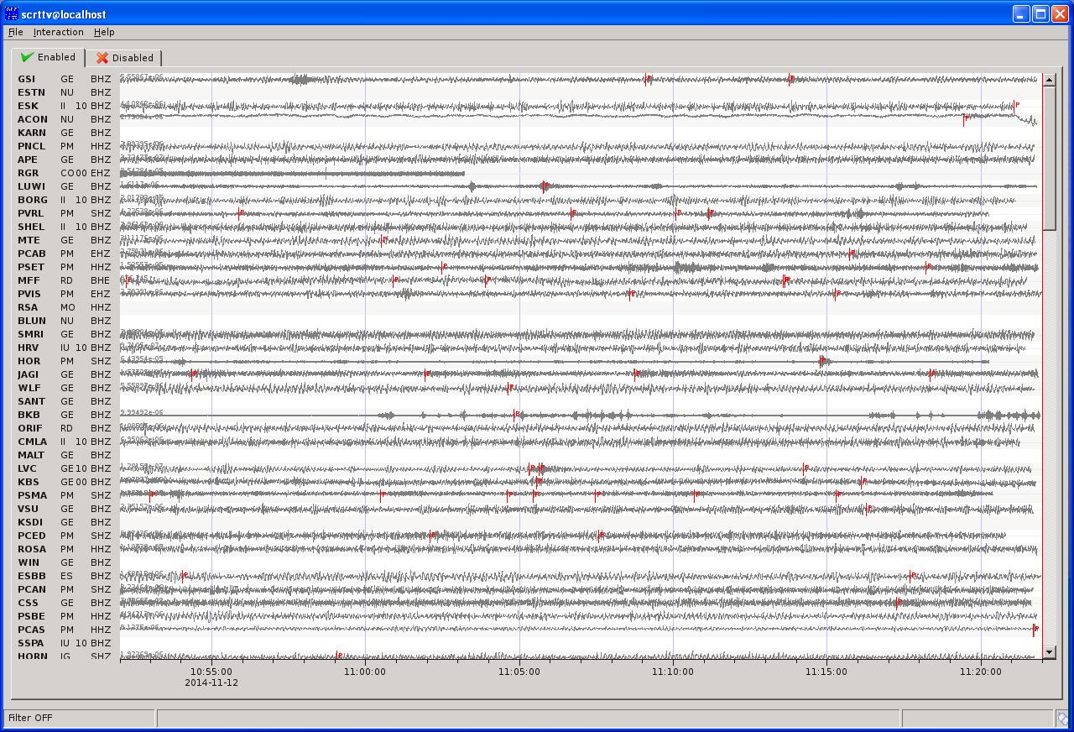
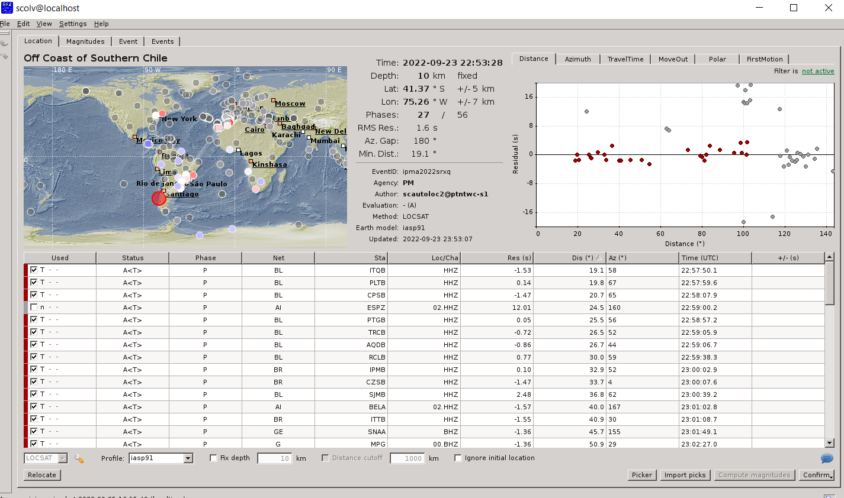
SeiscomP – Global Seismic Monitoring
Fast locations
Fast MW evaluations

Slide 5
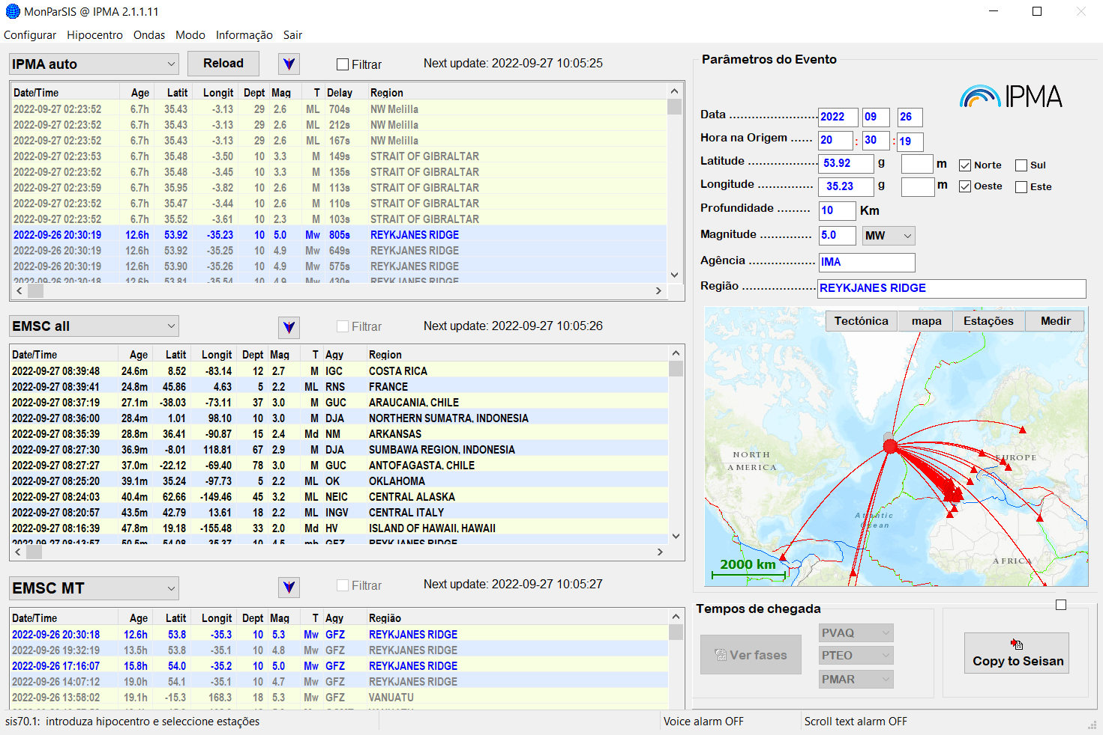
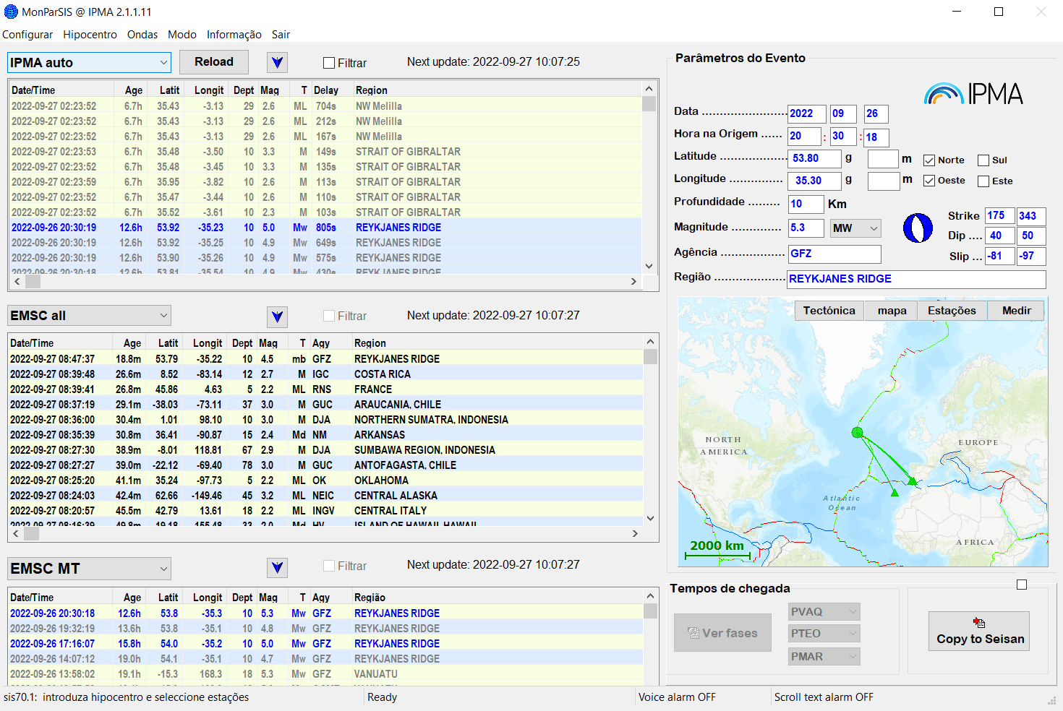
Seismic Monitoring
IPMA Automatic solutions
Other agencies solutions
(hypocenters/Mags/MT)

Slide 6
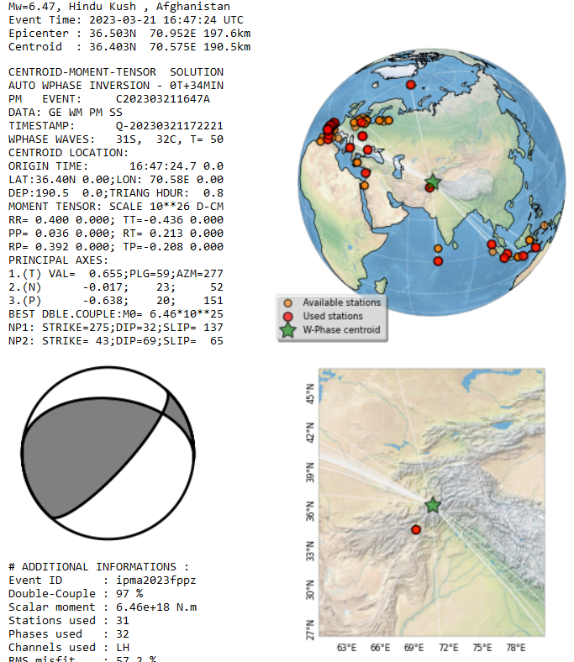
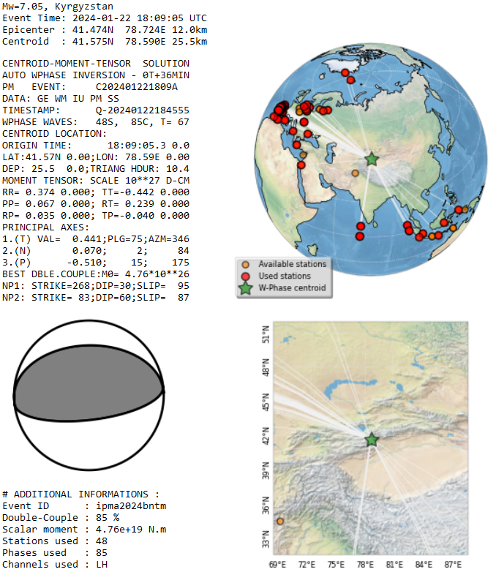
Seismic Monitoring
IPMA Automatic Mw & CMT
W-Phase method
Implemented on Seiscomp
in late Feb 2023
Contribution:
(Luis Rivera & Anthony Jamelot)

Slide 7
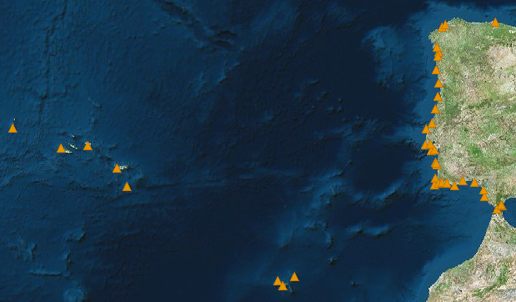
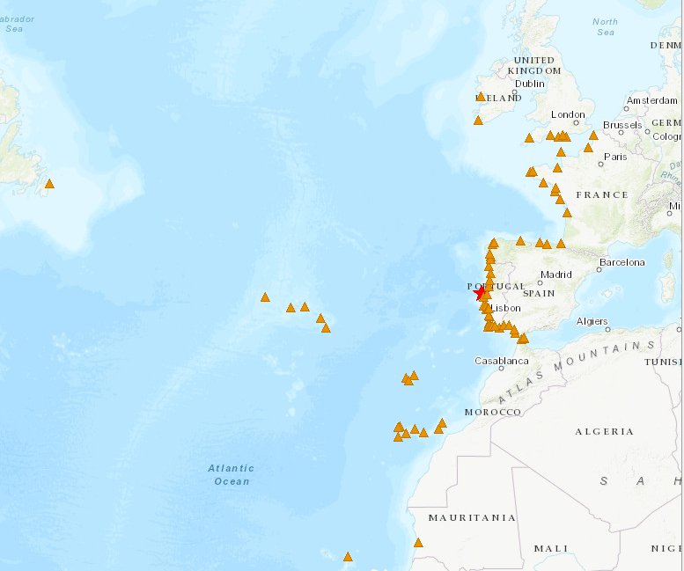

Tide-gauge network
Internet
MPLS
Internet
MPLS
71 stations
El Jadida
Sources:
CENALT, seiscomp/MPLS (SHAUM stations)
IH, webservice/Internet (Instituto Hidrográfico)
JRC, webservice/Internet
EMSO-PT/UBI/IPMA, webservice/Internet
DGT sites, webservice/Internet (Direção geral do Território)
IGN seiscomp/Internet (Puertos del Estado stations)
Instituto Hidrográfico
Puertos Del Estado (via IOC & IGN)
Direção Geral do Território
CNRST (via CNRST & JRC)
JRC (ipma & ign support)
IOC

Slide 8
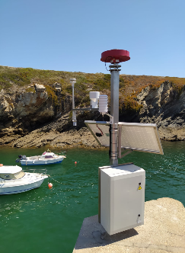
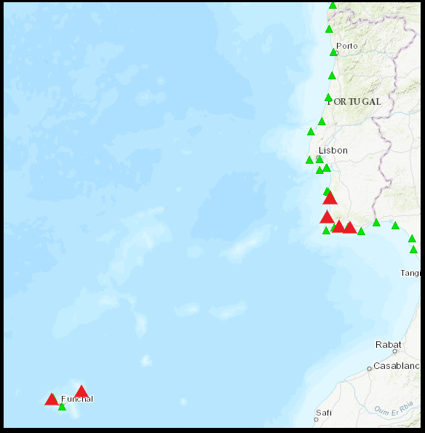
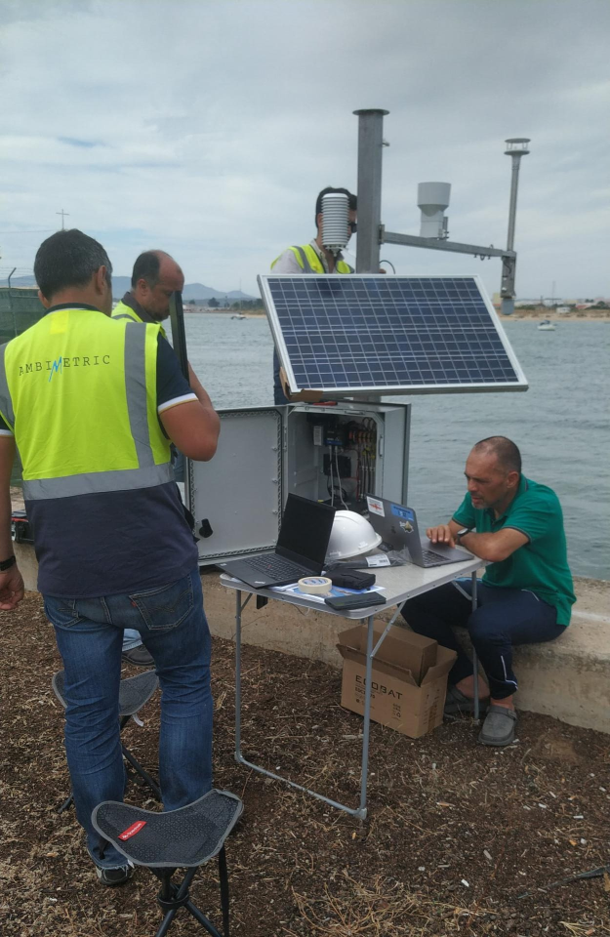
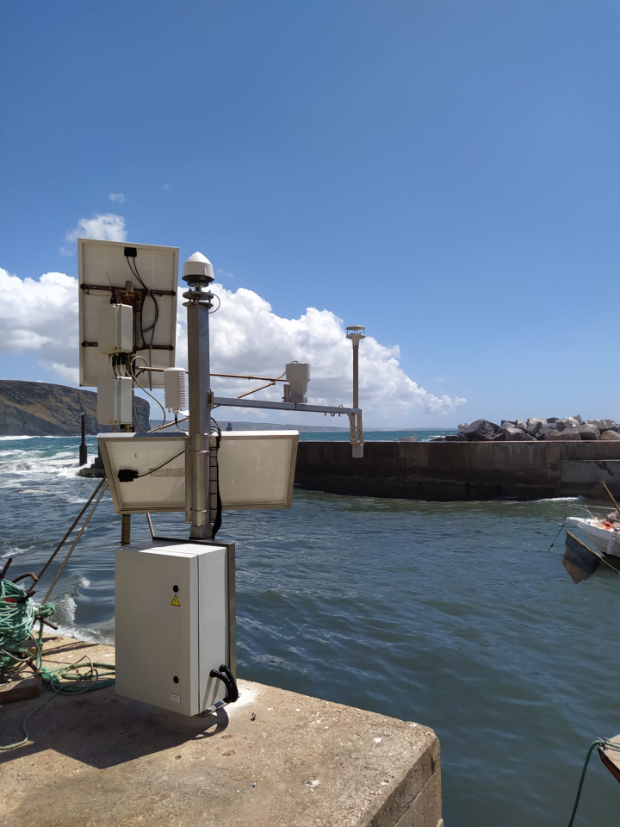
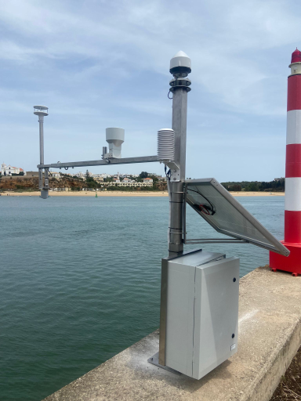
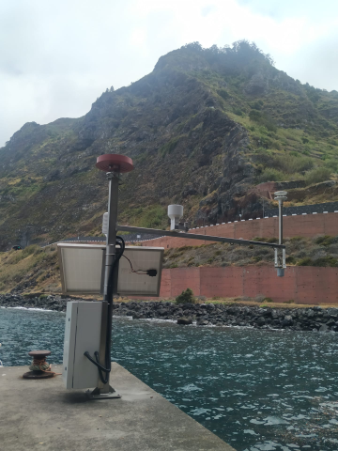
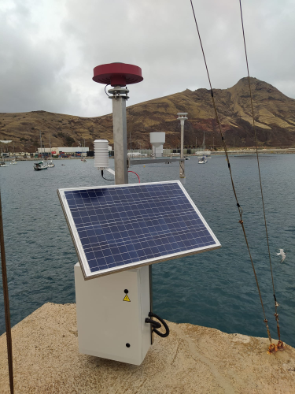
EMSO-PT
MultiParameter Stations
Porto Covo
Albufeira
GNSS
Tide-Gauge
Meteo
Atmospheric Pressure
Temperature
Humidity
Wind
Arrifana
Portimão
Solar Power
Mobile Internet
Local buffer
University of Beira Interior
Instituto Português do Mar e Atmosfera
Porto Moniz
Porto Santo

Slide 9
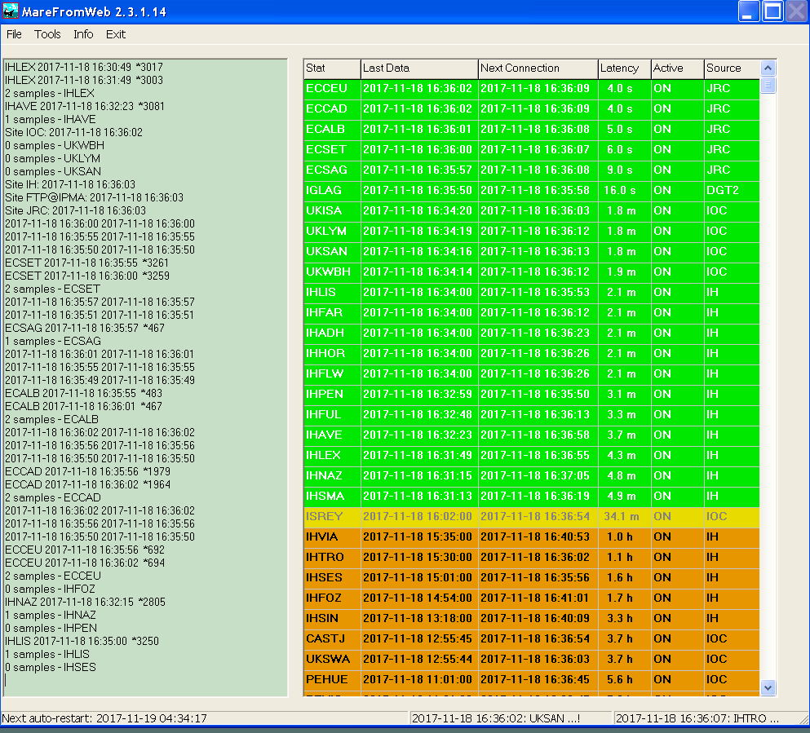
Tide-gauge data acquisition
and management
DGT
sites
IH
dataservice
JRC
dataservice
EMSO-PT/UBI/IPMA
ftp
IOC dataservice
CENALT
seiscomp
IGN
seiscomp
MareFromWeb
TREMOR01
Seiscomp

Slide 10
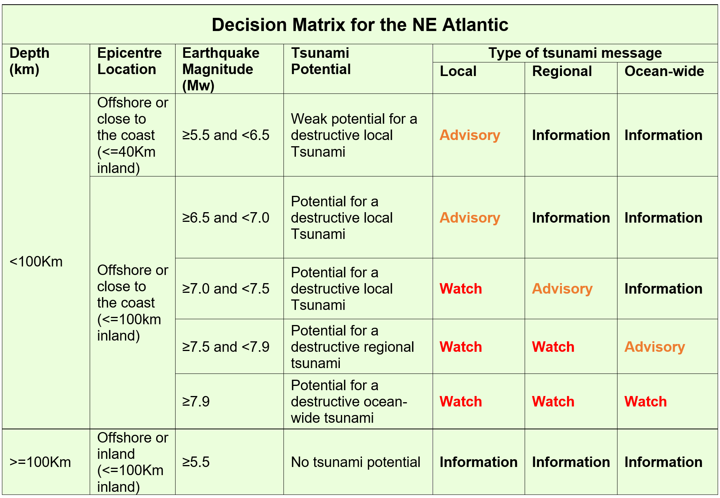
Decision Matrix

Slide 11
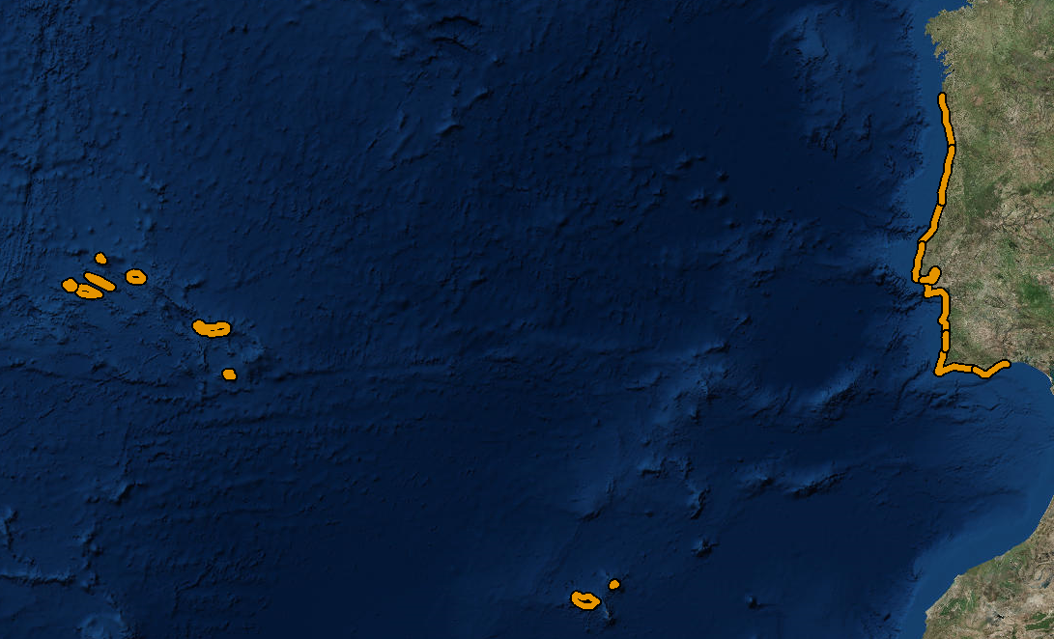
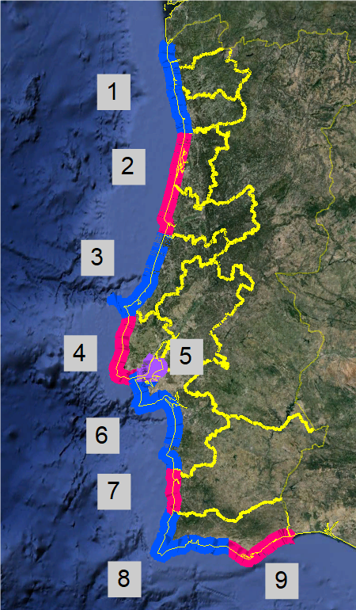
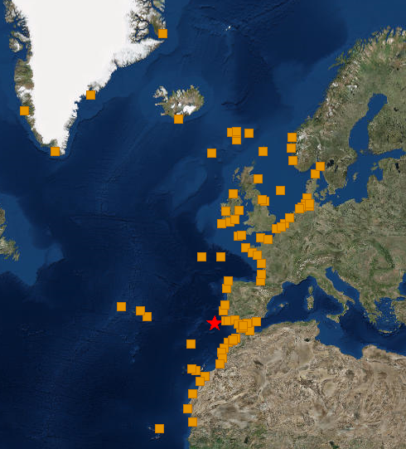
Forecast coastal segments (national)
Forecast points (regional)
Regional NEAM level
Islands
10-11. Madeira & Porto Santo
12-20. Azores islands
Mainland
1. Viana-Braga-Porto
2. Aveiro-Coimbra
3. Leiria
4. Lisboa Atlântico
5. Estuário Tejo
6. Setúbal
7. Beja
8. Faro Barlavento
9. Faro Sotavento
National level

Slide 12
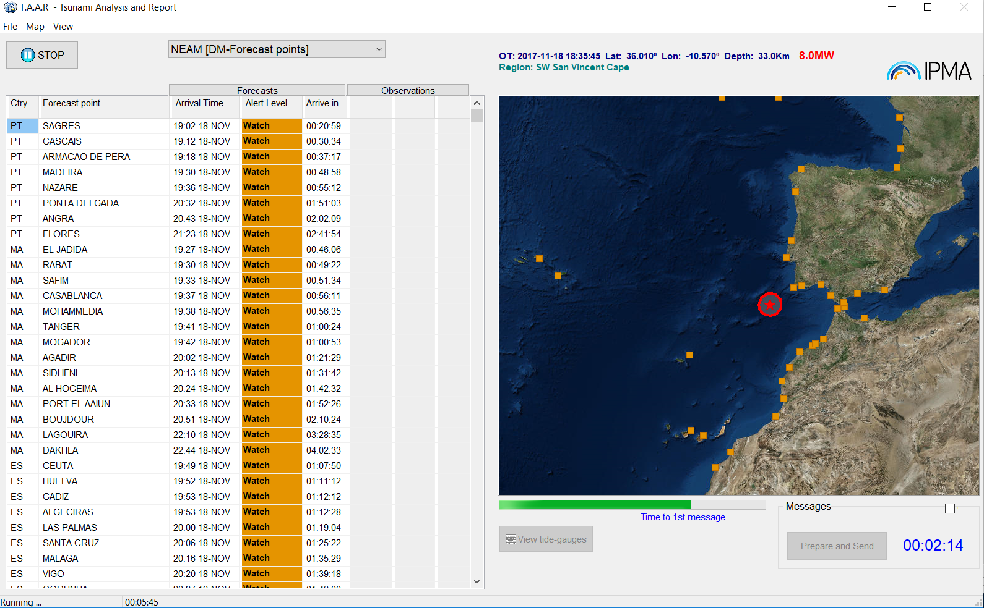
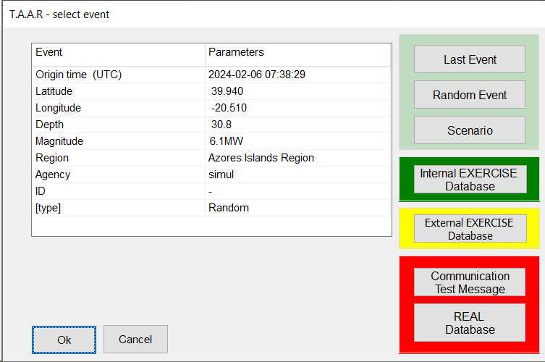
TAAR – Tsunami Analysis And Report
Testing purposes
(include random full scenarios)
Internal Exercise Mode
Exercise Mode
(Neamwave21, others)
Real events and
Communication tests

Slide 13
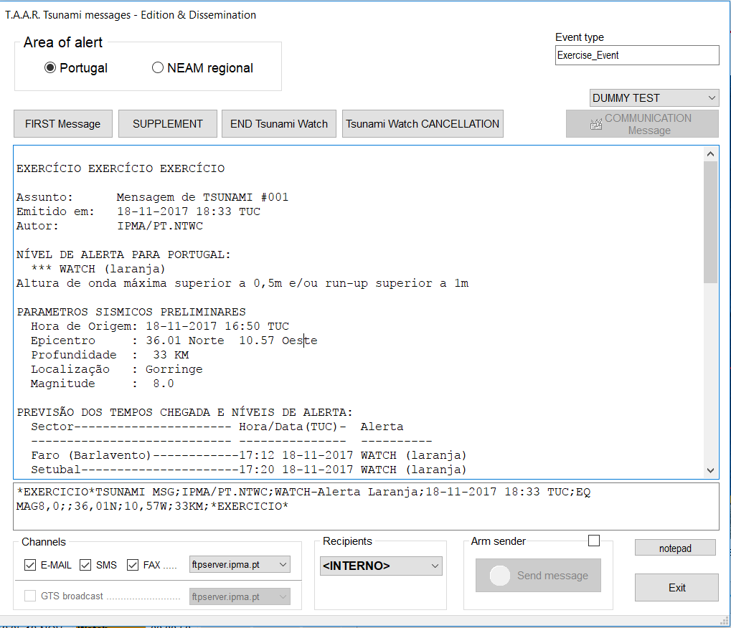
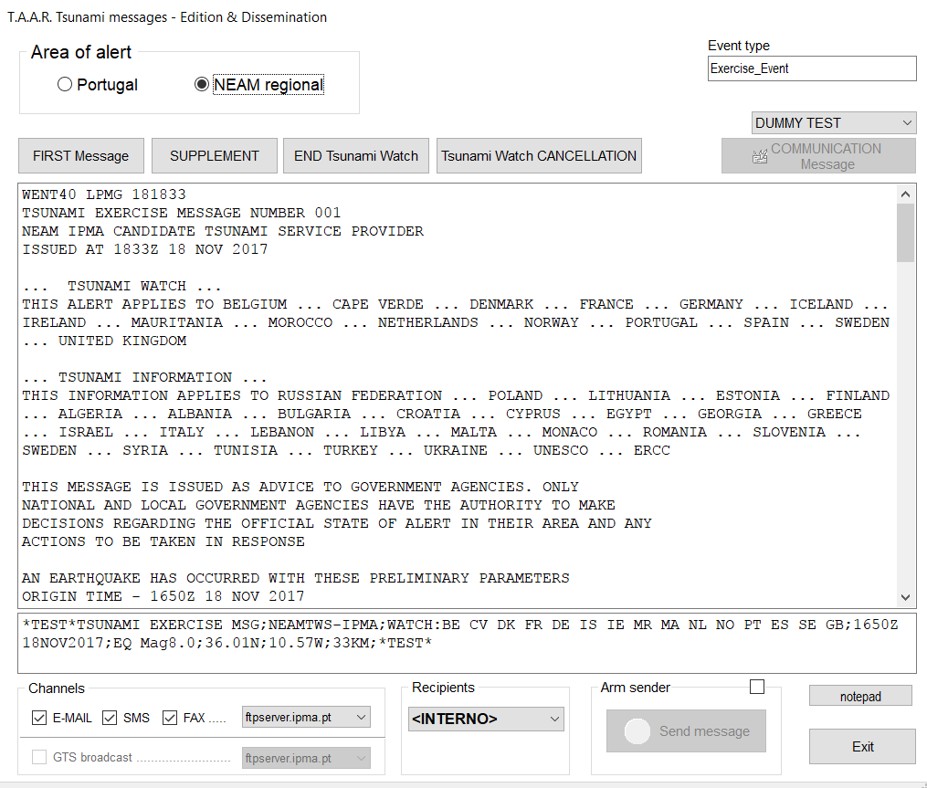
TAAR – Tsunami Analysis And Report
EMAIL
FAX
GTS
EMAIL
FAX
SMS
SMS

Slide 14
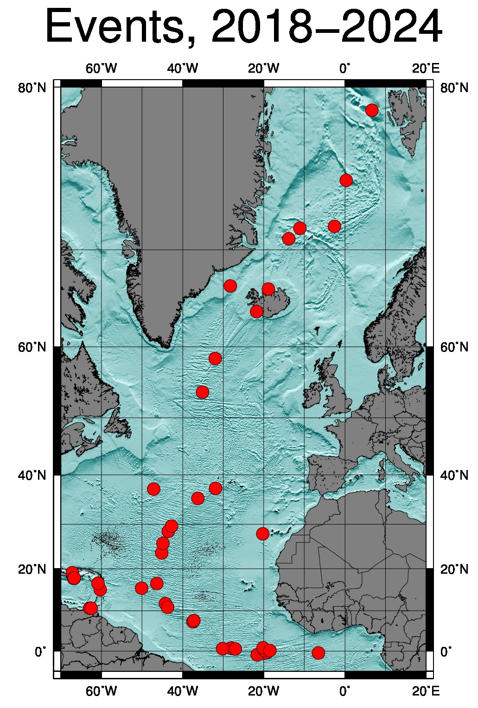
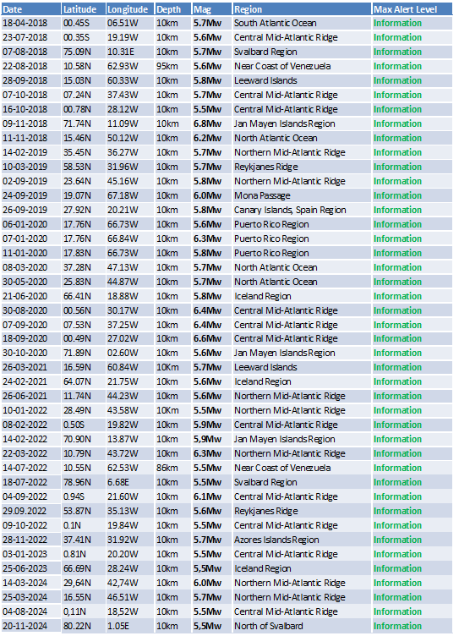
Regional level – TSP for NE Atlantic
43 Tsunami messages issued:
43 events

Slide 15
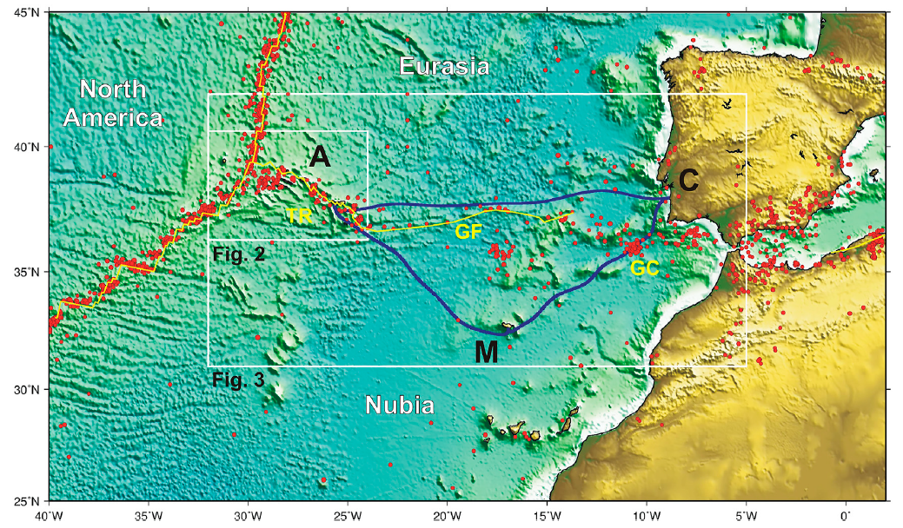


Atlantic SMART CAM
New Submarine Cable Ring connecting PT Mainland-Azores-Madeira –
opportunity for a SMART system (SMART CAM)

Slide 16
SMART CAM timeline
PRESENT situation:
13. Contract SIGNED on March 2024, between IP Telecom and ASN
14. Project under implementation, full operation on 2026
2025
14
2024
2023
13
2022
9
12
10
11
2021
7
8
2020
6
2019
5
~154 M€ (Telecom + Observer)
20 repeaters instrumented (accelerometer, BB seismometer, APG and thermometer)
3
4
2018
2
1

Slide 17

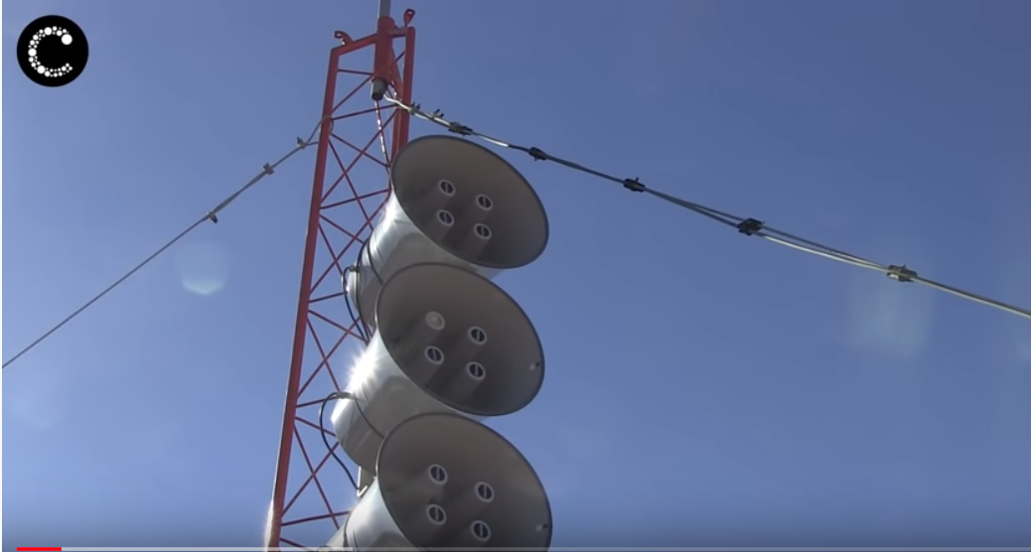
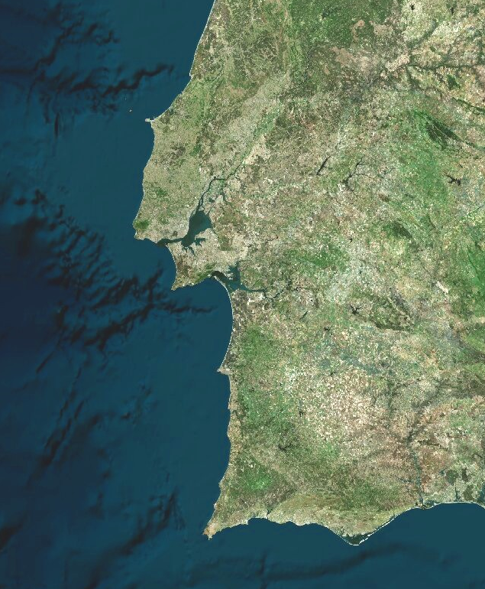

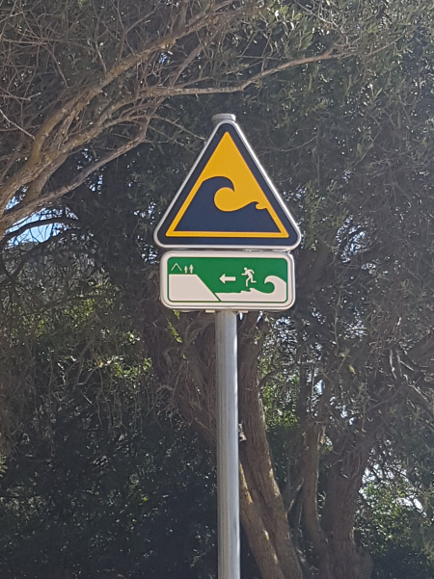
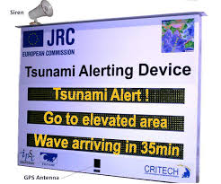
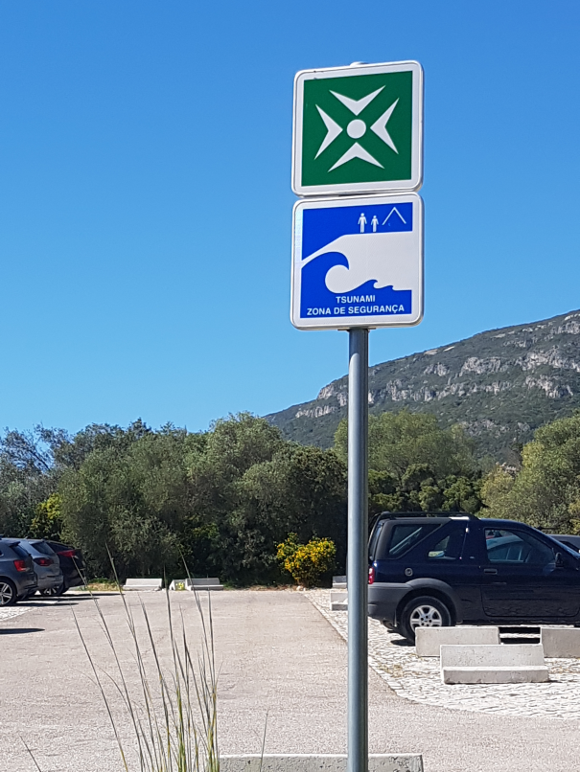

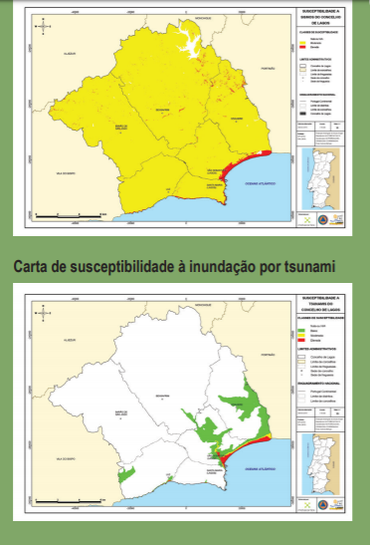

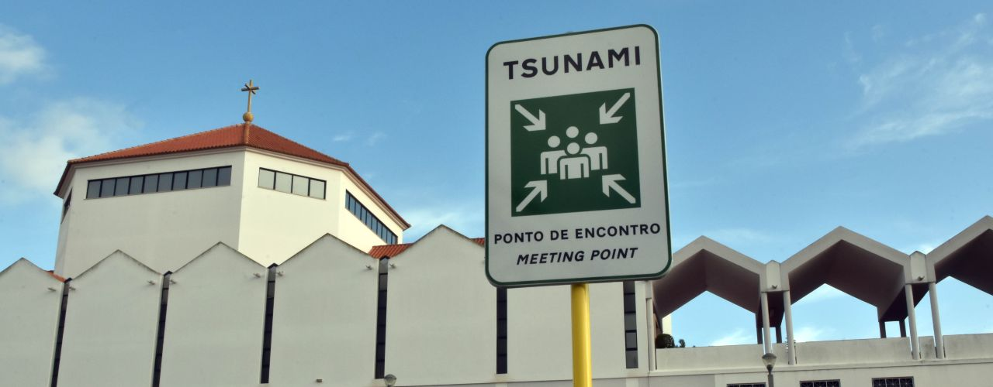

“Tsunami Ready” Initiatives
(Lourinhã)
Lisbon
to become
TSUNAMI READY
coastwave 2.0
Cascais
(Sesimbra)
Setúbal
Lagos
Portimão
Loulé

Slide 18
Thank you for your attention

