Slide 1
6th SESSION
GROUP OF EXPERTS ON
CAPACITY DEVELOPMENT
(GE-CD-VI)
----​
Item ​3.5.1 IOC-Led
Johanna Diwa-Acallar
IOC CD Assistant Coordinator
22-24 October 2024

Slide 2

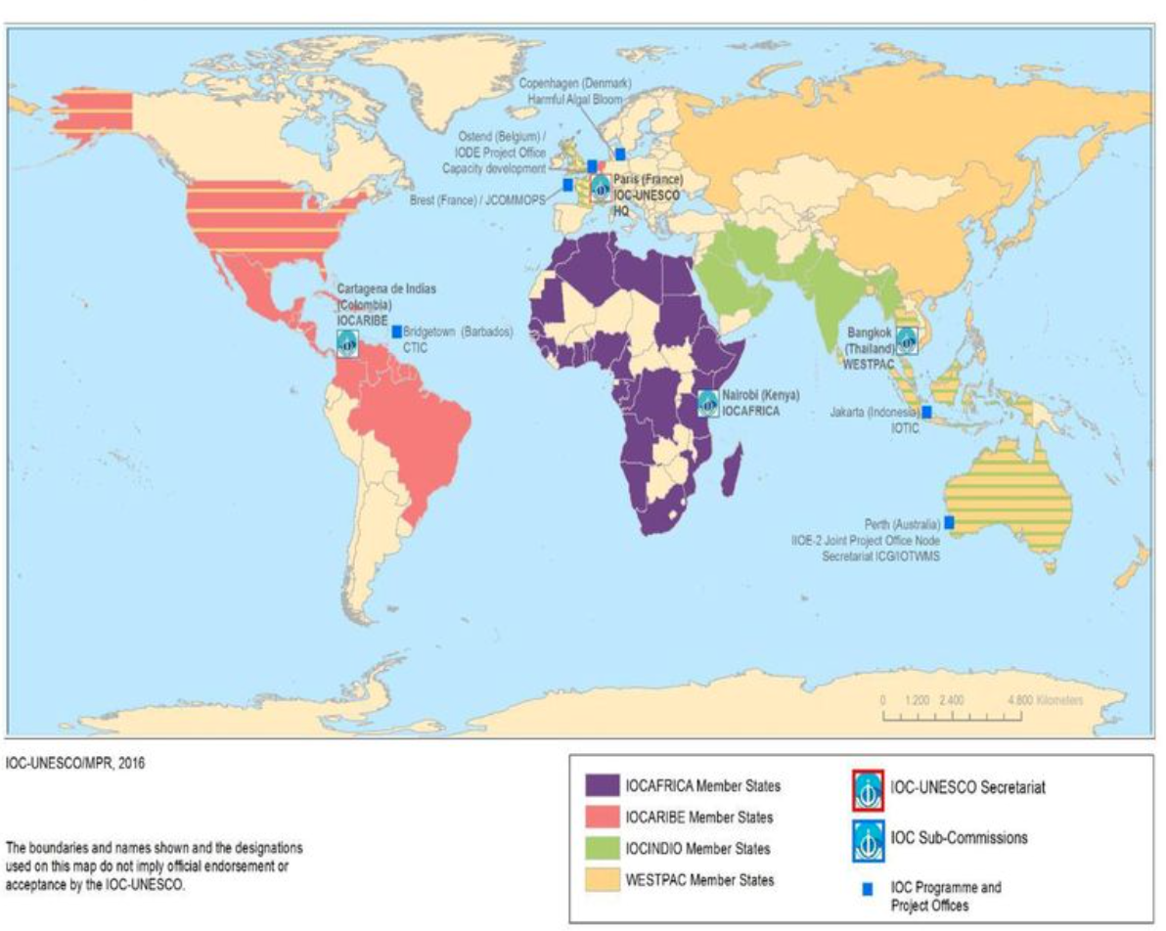
Capacity Development through the IOC Regional Subsidiary Bodies (RSBs)
IOC CD: cross-cuts all other IOC functions:
  all functions adopt and deliver IOC CD Strategy as a key output
  all RSBs adopt and deliver IOC CD Strategy as a key output
Regions are all different and have varying CD needs and societal priorities
Informed by regional needs assessments and regional webinar series and consultations
RSBs are key in the successful delivery and implementation of a cohesive and inclusive capacity development in the regions
2024-2025: develop regional workplans and implementation plans in cooperation with RSBs that responds to the IOC capacity development strategy

Slide 3
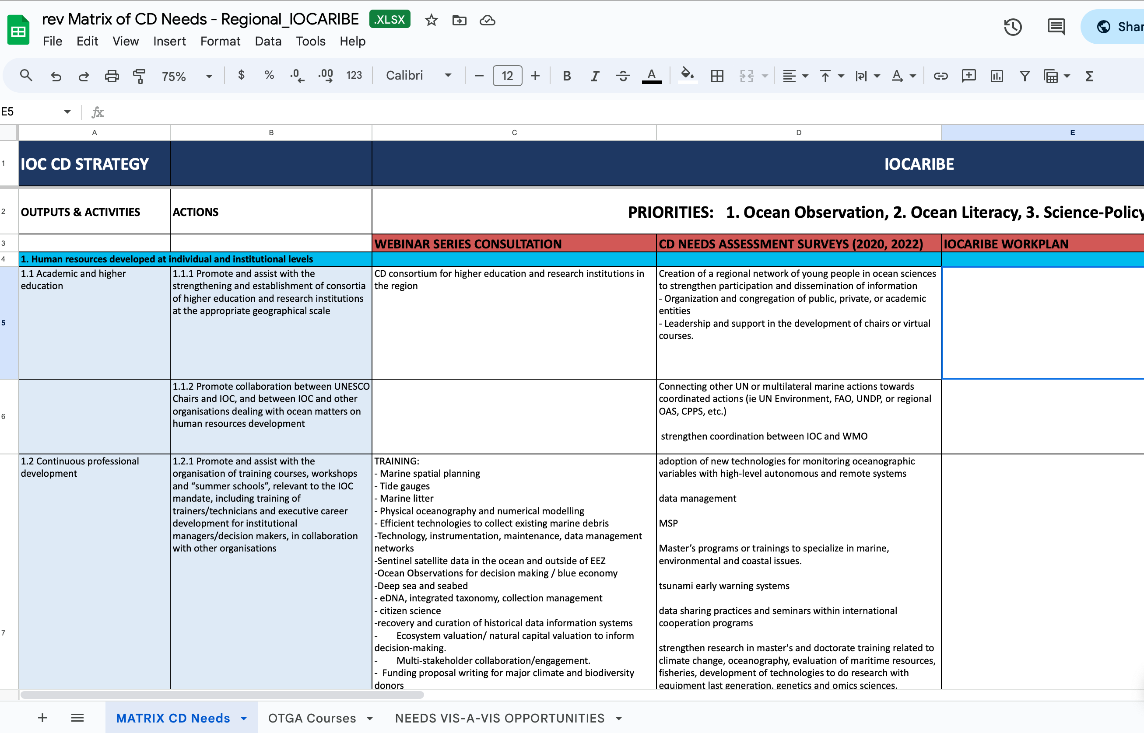
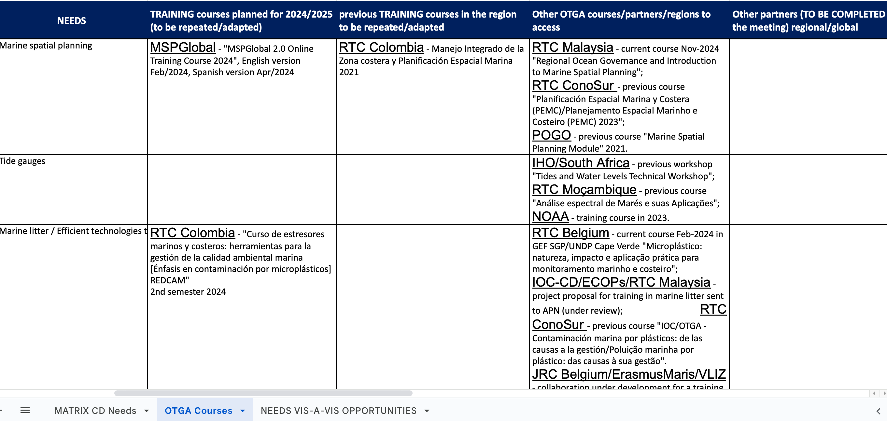
Regional Mapping Exercise
IOCARIBE
IOCAFRICA

Slide 4
IOC CD Strategy Outputs and Activities
Output | Activity | Action | IOCAFRICA | IOCARIBE
1. Human resources developed at individual and institutional levels | 1.1 Academic and higher education | 1.1.1 Promote and assist with the strengthening and establishment of consortia of higher education and research institutions at the appropriate geographical scale |  | CD consortium for higher education and research institutions in the region
 |  | 1.1.2 Promote collaboration between UNESCO Chairs and IOC, and between IOC and other organisations dealing with ocean matters on human resources development
 | 1.2 Continuous professional development | 1.2.1 Promote and assist with the organisation of training courses, workshops and “summer schools”, relevant to the IOC mandate, including training of trainers/technicians and executive career development for institutional managers/decision makers, in collaboration with other organisations |  | TRAINING NEEDS Marine spatial planning - Tide gauges - Marine litter - Physical oceanography and numerical modelling - Efficient technologies to collect existing marine debris -Technology, instrumentation, maintenance, data management networks -Sentinel satellite data in the ocean and outside of EEZ -Ocean Observations for decision making / blue economy -Deep sea and seabed - eDNA, integrated taxonomy, collection management - citizen science -recovery and curation of historical data information systems - Ecosystem valuation/ natural capital valuation to inform decision-making. - Multi-stakeholder collaboration/engagement. - Funding proposal writing for major climate and biodiversity donors - Train decision makers on use of data and information - Design and support on impact investment funding for the Caribbean - Science communication to decision makers for policy making, including materials and messaging - Training for policymakers on ocean observation and prediction - coordination skills and stakeholder engagement - policy brief writing/production, training course on strengthening science-policy interface - Scientific cooperation on over-nitrification (sewage treatment )
 |  | 1.2.2 Establish, or collaborate with other organisations to develop internship/fellowship and on-board training programmes
 |  | 1.2.3 Establish and collaborate with other organisations on visiting lecturer/scholar/researcher programmes and professional exchanges (peer to peer) | facilitating professional exchanges of personnel at institutional levels | Regional fishers and managers exchange programmes

Slide 5
Output | Activity | Action | IOCAFRICA | IOCARIBE
 |  | 1.2.4 Promote and assist with the establishment of regional training (and research) centres relevant to the IOC mandate | Training courses and workshops, using regional and national training centres (Ocean Teacher Global Academy RTCs, UNESCO Chairs and Centres of Excellence) on priority topics identified by IOCAFRICA and the respective Member states
 |  | 1.2.5 Promote the development and sharing of training materials and tools | targeted assistance from IOC global initiatives in the areas of technical support and the opportunity to engage with international specialists in ocean science, climate resilience, and heritage conservation to meet | Sargassum and harmful algal blooms, Coastal Hazard Early Warning Systems, Marine Spatial Planning Seven early endorsed regional projects
 | 1.3 Sharing of knowledge and expertise including through community building | 1.3.1 Establish a travel grant “fund”
 |  | 1.3.2 Establish or collaborate with other organisations on a mentoring programme | establish a mentoring programme (focusing on niche areas of the blue economy such as biotechnology and blue entrepreneurship) | workshops and webinars to foster capacity building in the TAC Region, as well as mentoring programmes in the TAC region through partnerships with local stakeholders.
 |  | 1.3.3 Promote and assist with the development and strengthening of IOC alumni networks, and professional networks including for youth leaders | strengthening of IOC alumni and professional networks, including those for youth leaders
 |  | 1.3.4 Promote funding, grant and scholarship programs to facilitate ocean research, technical development and scientific exchange through bringing visibility of opportunities via an online CD hub | online Capacity Development (CD) hub. This platform will centralise and highlight funding opportunities, grants, and scholarships for ocean science professionals in Africa.

Slide 6
Output | Activity | Action | IOCAFRICA | IOCARIBE
1. Human resources developed at individual and institutional levels | 1.4 Integration of ocean science in basic education | 1.4.1 Promote the integration of ocean science in curricula of primary and secondary schools
 |  | 1.4.2 Promote careers in ocean research and ocean management
 | 1.5 Improving gender, generational and geographic diversity | 1.5.1 Promote participation of women in ocean research |  | Gender and inclusion focus on ocean literacy activities focusing on indigenous people, integeneration, deaf communities
 |  | 1.5.2 Promote and support “young scientist” and “women in science” awards
2. Access to technology, physical infrastructure, data and information established or improved | 2.1 Facilitating access to technology and infrastructure | 2.1.1 Establish and maintain a register of infrastructure to facilitate access, and promote transfer of marine technology | organisation of a review meeting for consolidation and finalisation of the report on the state of the tide gauge network in the region Operationalise the African Coastal and Marine Atlases (ACMA) | Access infrastructure and develop ability for equipment maintenance
 |  | 2.1.2 Promote the development of regional collaboration on sustainable scientific infrastructure | establishing regional research hubs within universities and initiating joint research projects to promote regional collaboration on the development of low-cost technologies (e.g., Observation sensors) | CD vulnerabilities of marine-coastal ecosystems such as chemical and microplastic pollution, harmful algal blooms, eutrophication, ocean acidification and challenges like assessing blue carbon inventories
 |  | 2.1.3 Promote involvement of citizen science in ocean research | develop citizen science programs, launch educational campaigns, and create mobile applications to engage local communities in the ocean Early Warning System.
 | 2.2 Facilitating equitable access to and sharing of ocean data and information | 2.2.1 Promote the development and wide use of regional and global data and information systems | continuous assistance to national oceanographic data centers to help them create and manage compatible databases. enhancing the setup of NODCs setting up more regional and national OBIS nodes | essential data needs: 1) real time: tide-gauge, sea-level stations included buoy, submarine cables, GPS buoy… ; 2) very precise bathymetric data ; 3) water characterization: salinity, temperature ; 4) real or near real time satellite data: GNSS, photos

Slide 7
Output | Activity | Action | IOCAFRICA | IOCARIBE
 |  | 2.2.2 Promote the sharing of ocean data and information by stakeholders
3. Global, regional and sub-regional mechanisms strengthened | 3.1 Further strengthening and supporting secretariats of regional sub-commissions | 3.1.1 Improve staffing of secretariat of regional sub-commissions | professional development programs to enhance the skills and capabilities of new and existing staff members
 |  | 3.1.2 Reinforce budgeting of regional sub-commissions
 | 3.2 Enhancing effective communication between regional sub-commission secretariats and global programmes as well as other communities of practice (incl. other organisations) | 3.2.1 Establish an effective coordination and communication mechanism between the secretariats of the regional sub-commissions and the global programmes |  | contribute to IOCARIBE GOOS IODE Project Office including its strategies (OTGA, OBIS, CMA, CHM) IOC Harmful Algae Programme, IOC ocean science portfolio of activities

Slide 8
Output | Activity | Action | IOCAFRICA | IOCARIBE
3. Global, regional and sub-regional mechanisms strengthened | 3.3 Identifying specific national and regional capacity development needs through regular needs assessment | 3.3.1 Organise and conduct biennial capacity development needs survey | opportunity to collaborate with the IOC Global Programme in organising and conducting biennial capacity development needs surveys assistance with survey design and implementation, data analysis and reporting, workshops and training, resource development, and follow-up evaluation
 | 3.4 Encouraging regional and sub-regional organisations to be leaders in, and amplifiers of capacity development | 3.4.1 Reinforce engagement of regional and sub-regional organisations in consultation process and capacity development initiatives | support of financial resources, technical assistance, networking opportunities, resource sharing, and promotion and advocacy support to enable countries to actively participate in the ratification and implementation of the BBNJ Treaty, the Kunming-Montreal Biodiversity Strategy, and the Plastic Treaty
4. Development of ocean research policies in support of sustainable development objectives promoted | 4.1 Fostering the development of ocean research policies | 4.1.1 Compile and compare information on existing ocean research policies, and disseminate to Member States for their use

Slide 9
Output | Activity | Action | IOCAFRICA | IOCARIBE
 |  | 4.1.2 Assist and enable Member States with the development of ocean research policies, making use of the results of 4.1.1 | assistance in establishing connections with potential funders to back initiatives for African countries to develop their national and regional ocean science plans to promote the growth of their blue economy and sustainable ocean plans
5. Visibility, awareness and understanding on the roles and values of the ocean and ocean research in relation to human wellbeing and sustainable development increased | 5.1 Fostering the development of ocean related public information and communication services | 5.1.1 Encourage the development of public information (communication) departments in ocean research institutions | develop public information departments within ocean research institutions financial resources to organise workshops, develop communication toolkits, and launch public engagement campaigns | Public outreach
 | 5.2 Fostering the development of ocean literacy | 5.2.1 Assist with the strengthening and development of ocean literacy programmes at national and regional levels |  | Universal educational blue curriculum Expansion of Blue Schools program Engaging on ocean knowledge with local and indigenous communities
6. Sustained resource mobilization reinforced | 6.1 Enhancing sustained support (in-kind and financial) to the IOC for its international coordination role | 6.1.1 Foster partnerships to increase in-kind support opportunities | develop comprehensive partnership proposals, engage in outreach activities, and utilise online platforms to broaden our reach

