Slide 1

Did you escape the wave? Evacuation Drill, City of Viña Del Mar
RESULTS
UNESCO / IOC
INTERNATIONAL TSUNAMI INFORMATION CENTER (ITIC)
ITIC TRAINING PROGRAMME HAWAII (ITP-HAWAII)TSUNAMI EARLY WARNING SYSTEMS AND THE PACIFIC TSUNAMI WARNING CENTER (PTWC) ENHANCED PRODUCTS,TSUNAMI EVACUATION PLANNING AND
UNESCO-IOC TSUNAMI READY RECOGNITION PROGRAMME
19-30 August 2024 SHOA, Valparaíso, Chile
Matías Carvajal (1), Alejandra Gubler (2)
Pontificia Universidad Católica de Valparaíso (PUCV)
Research Center for Integrated Disasters Risk Management (CIGIDEN)

Slide 2
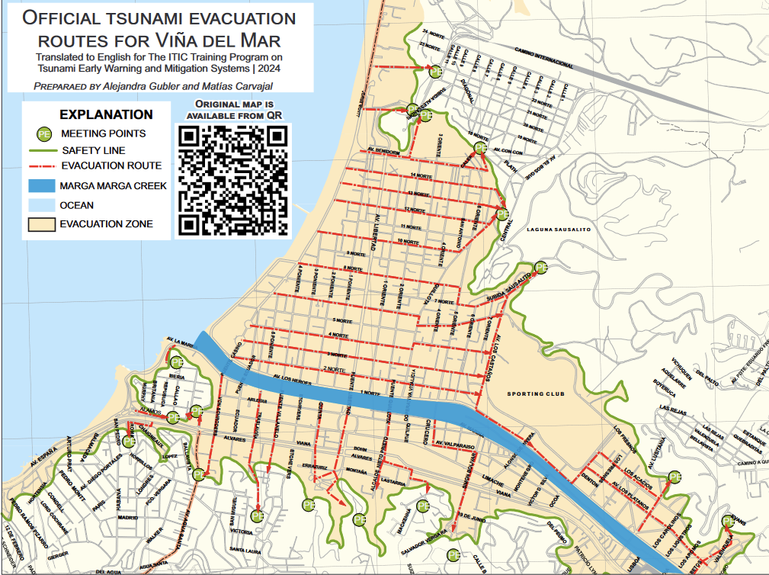
Goal
Assess the effectiveness and practicality of Viña del Mar's official evacuation routes

Slide 3
Each group (G) should start at the intersection of Avenida Peru with the following locations:
G1: Nogaró Restaurant
G2: Casino
G3: Bonafide Café
G4: 5 norte street
G5: 6 norte street
G6: 7 norte street
G7: 8 norte street
7
6
4
5
3
2
1

Slide 4
Exercise tasks
Each group has to go to their assigned starting point
Make sure you:
Know how the mobile App works before going to your starting point.
Once there, walk as a group to your meeting point following the official evacuation route:
Make sure you:
Start recording your route with the mobile App before leaving your starting point.
Follow the route indicated in the map, which might be different than what the official signs indicate.
On your printed map, mark the locations of any signs you encounter. Additionally, take note of any situations you consider positive or negative regarding the evacuation route
Stop and save the recording once you reach the meeting point.
Upload your .GPX file in the this shared folder, naming the file as GX_lastname_firstname

Slide 5
Exercise groups (same as previous activity)
GROUP 1
Julio Castro
Willberth Forero
Leanka RT Henry
Diminski Reweru
Dulce Calan
GROUP 2
Claudia Collao
Igor Olivares
Darcy Luuga Naivins Chan-Kum Tong
Muhammad Harvan
Hita Zabi Ortiz
GROUP 3
Jaime Corales
Steven Aguilera
Linda Tonowane
Kassia Johnson
Luis Fernando Alconero
GROUP 5
Carolina Henríquez
Andres Romero
Mabius Francis
Joji Malodali
Juritzy Pérez
GROUP 4
Jasna Haro
Rodrigo Andres Asenjo Paredes
Denisse Llacuachaqui
Filimone Qaloyawa Rokoiri
Christiam Gómez
GROUP 6
Alejandro Marabolí-Quezada
Francisco Uribe
Lisi Seumanutafa Uini
Fabian Hinds
Grenfel Defoe
GROUP 7
Cesar Nuñez
Valeria Tapia
Mohammed Ahmed Al Madhani
David Cruz
Danielle Jalisa Howell

Slide 6
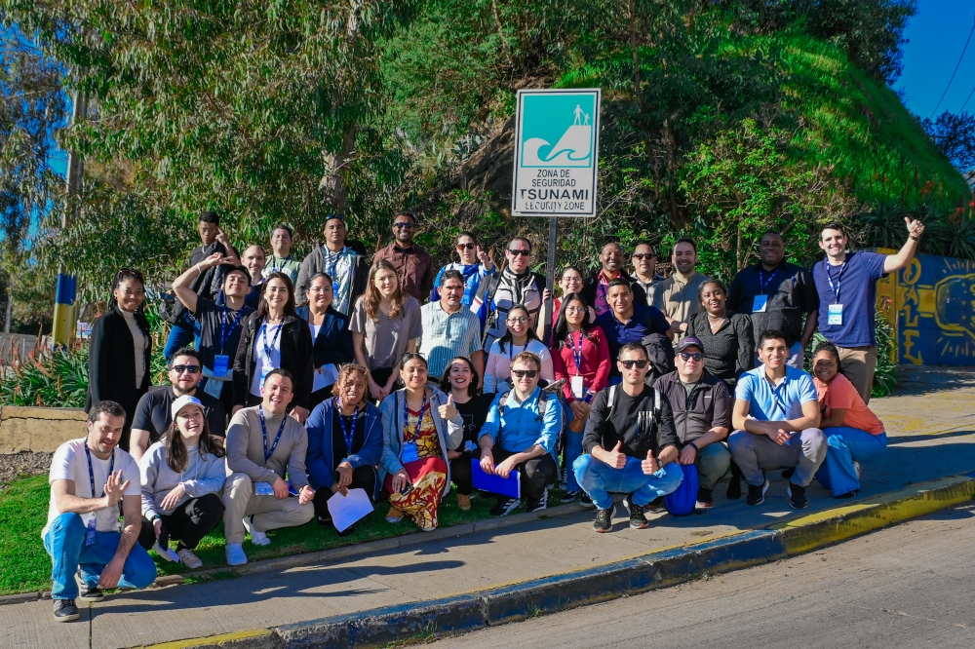
The Exercise Start

Slide 7
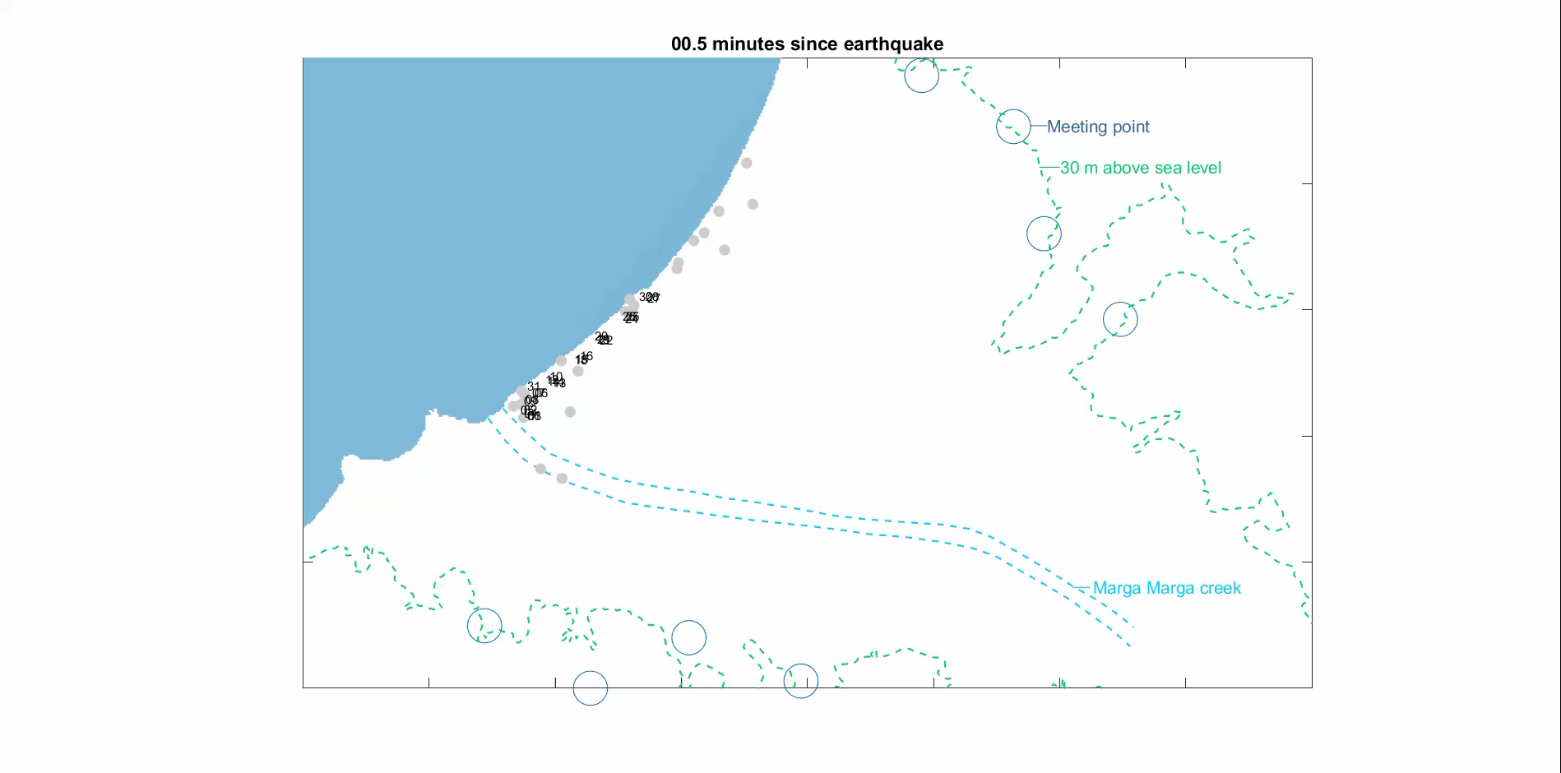
Group movement – 3 min delay in evacuating
Everyone is safe !

Slide 8

Group movement - 8 min delay in evacuating
A few people get ‘wet’ but everyone looks safe !

Slide 9

Group movement – 15 min delay in starting
Many people get ‘wet.’ Some may ‘drown’?
LESSON – PREPARE AHEAD. DON’T DELAY TO EVACUATE!

