Slide 1

Implementation of Tsunami Ready in Indian Ocean
TTDMP-TOWS 2024
19=13 February 2024
IRIDES – Tohoku University
Ardito M KODIJAT
UNESCO-IOC Indian Ocean Tsunami Information Centre
National Professional Officer DRR (SC/IOC)
Disaster Risk Reduction and Tsunami Information Unit
UNESCO Office Jakarta
a.kodijat@unesco.org

Slide 2
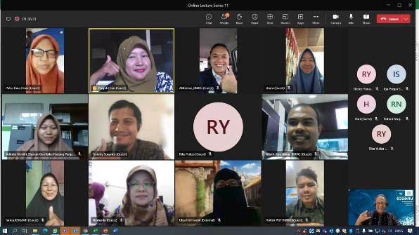
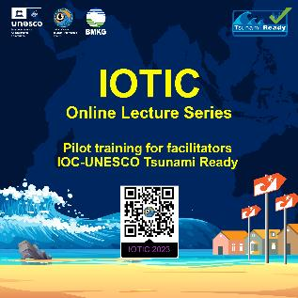
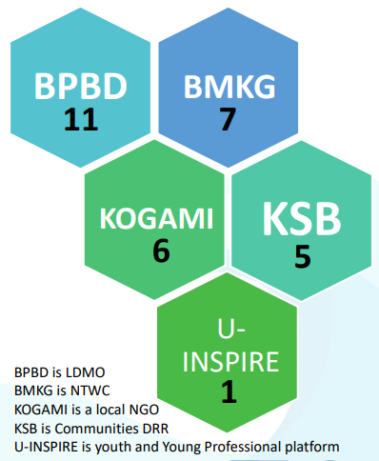
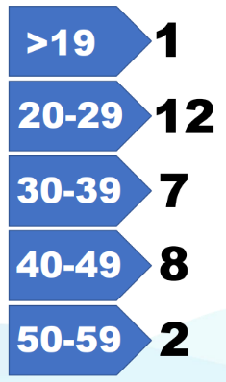

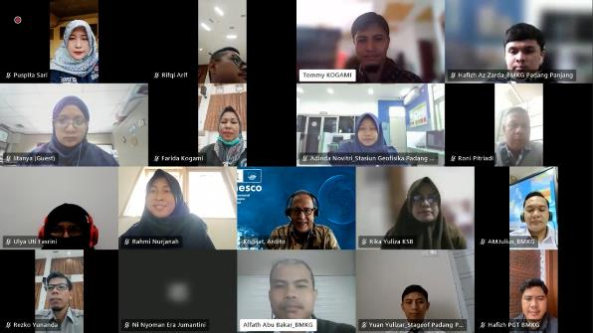
Tsunami Ready in IO 2023
Tsunami Ready Training for Facilitators in Indonesia
(February 2023 - Online)
Online sessions: 11 lecture meetings (10 January - 24 February 2023).
Every Tuesday and Friday at 08:30 - 10:30 (2 hours).
Training in Bahasa Indonesia, materials in English.
Quizzes and work assignment after every meeting/lectures

Slide 3
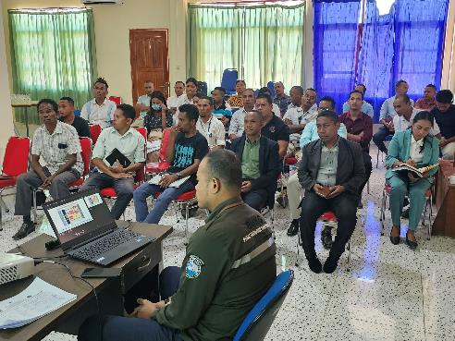
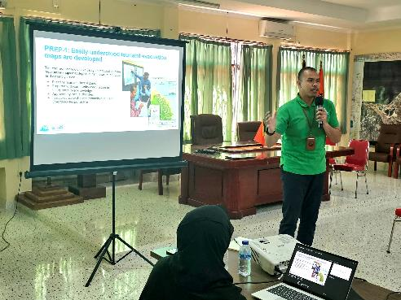
Tsunami Ready in IO 2023
National Tsunami Ready Training in Timor-Leste
(July 2023)
Jointly with Chair of WG-3
36 Participants from Timor-Leste Civil Protection Agency, Ministries Representatives, NGO, and UN agencies.
2 Days training on Introduction to Tsunami Ready
Interest to implement Tsunami Ready in villages in Dili. Follow ups:
Adapting NTRB function to existing disaster coordination mechanism
Identifying Tsunami Ready Community for implementation
Need external technical and expertise support
Indicator 1: Development of Hazard Map
Indicator 4: Development of Evacuation Map, Plans, and Procedures
Indicator 5: Tsunami Signages
Indicator 8: Planning Exercise
Indicator 9: Tsunami Emergency Response – SOP
Indicator 10 – 11: Receiving and Disseminating Warning

Slide 4
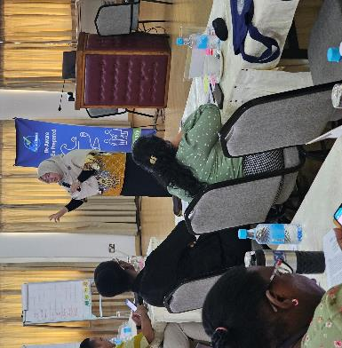
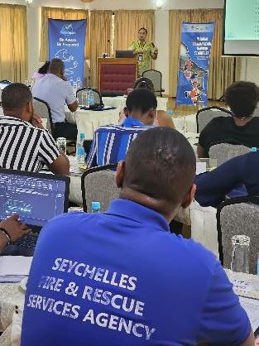
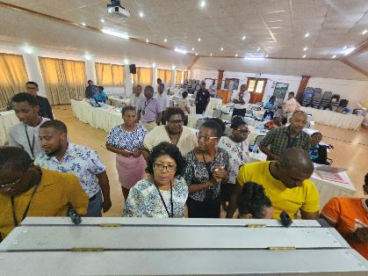
Tsunami Ready in IO 2023
National Tsunami Ready Training in Seychelles
(November 2023)
Jointly with Chair of WG-3
40 Participants from Seychelles DRMD, Local Government and Communities, Other Ministries and Agencies,
3 Days training on Introduction to Tsunami Ready
Interest to implement Tsunami Ready in villages in Dili. Follow ups:
Adapting NTRB function to existing disaster coordination mechanism
Identifying Tsunami Ready Community for implementation
Need external technical and expertise support
Indicator 1: Development of Hazard Map
Indicator 4: Development of Evacuation Map, Plans, and Procedures
Indicator 5: Tsunami Signages
Indicator 9: Tsunami Emergency Response – SOP
Indicator 10 – 11: Receiving and Disseminating Warning
https://www.youtube.com/watch?v=t0SCOU7oEzY&t=8s
https://www.youtube.com/watch?v=3VBPDhl8sWk&t=17s
https://twitter.com/UNDRR_Africa/status/1749306531487588612

Slide 5
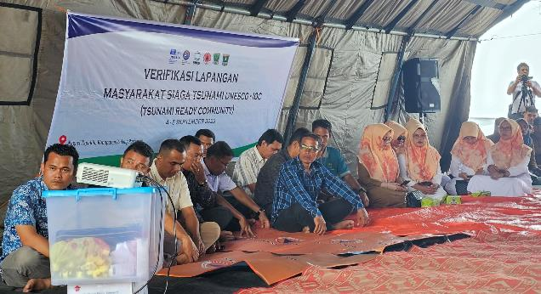
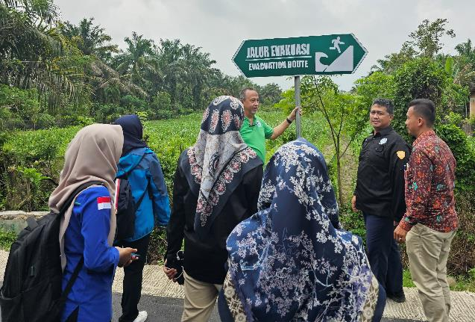
Tsunami Ready in IO 2023
Field Verification Nagari Tapakih in Indonesia
(September 2023)
Nagari Tapakih received National Tsunami Ready Recognition.
Requested IOTIC for Field Verification
Field Verification recommendation for improvement of the 12 indicators.
In west Sumatera, IOTIC worked with KOGAMI (local NGO since 2006) for the community preparedness capacity development based on the 12 Indicators.
KOGAMI and BMKG Office of Padang Panjang in cooperation with BPBD conducted 3 months capacity development.
December 2023 Nagari Tapakih Community requested for UNESCO-IOC Tsunami Ready Recognition.
20 December 2023 Nagari Tapakih Received UNESCO-IOC Tsunami Ready Recognition.

Slide 6
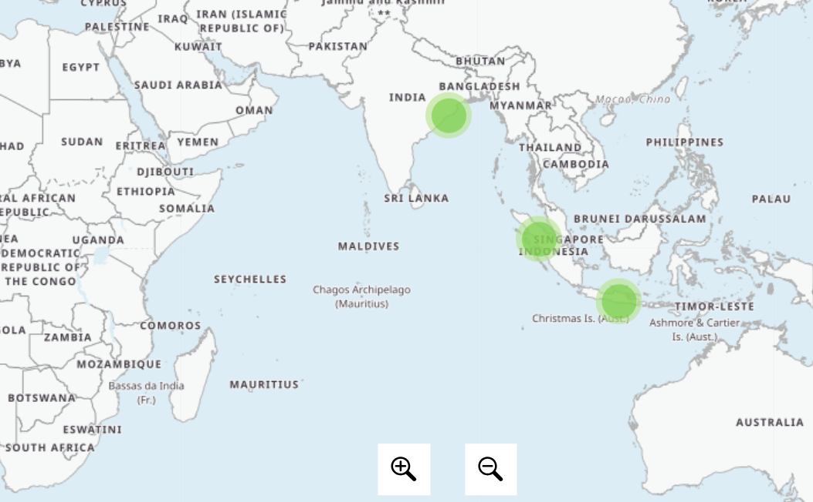
Tsunami Ready in IO 2023
Tsunami Ready in Indian Ocean
India
Noliasahi, August 2020
Venkatraipur, August 2020
Indonesia
Tanjung Benoa, 24 May 2022
Glagah, 5 September 2022
Tambak Rejo, 3 October 2022
Kemadang, 12 December 2022
Kuta Mandalika, 12 December 2022
Pangandaran, 12 December 2022
Panggarangan, 12 December 2022
Lolong Belanti, 20 December 2022
Purus, 20 December 2022
Nagari Tapakih, 20 December 2023
https://tsunamireadyviewer.ioc-tsunami.org/

Slide 7
Tsunami Ready in IO 2024
National Tsunami Ready Training Focus for SIDs
Maldives (confirmed) in August 2024 ➔ IOTIC-BMKG Funding Support.
(including Documenting Eyewitness Stories of 2004 Tsunami in Maldives)
Mauritius or Sri Lanka (TBD) ➔ depending on funding availability.
Tsunami Ready Training for Facilitators in Indian Ocean (Online) - TBC
Online sessions: 10 lecture meetings
Quizzes and work assignment after every meeting/lectures
Tsunami Ready Training for Field Verification in Indonesia - TBC
Hybrid: 2 days
Quizzes and work assignment after every meeting/lectures

Slide 8
Tsunami Ready in IO 2024
Follow up with Timor-Leste and Seychelles:
The establishment of NTRB function within the existing national coordination mechanism.
Support in country on the implementation of selected community
Timor-Leste: Dili
Seychelles: Anse Royale
Support the process of application and field verification of Tsunami Ready Recognition Request of IO Member States
Indonesia: 14 Communities
India: 24 – 61 -381 Communities
Timor-Leste: 1 Community
Seychelles: 1 Community
Maldives: ?

Slide 9
Tsunami Ready in Odisha - India
Tsunami Ready in India 2024
Preparation of Tsunami Risk Reduction and Tsunami Management Plan in the 24 Villages will be completed by 15th of February-2024.
Installation of Tsunami Signages will be completed by 29th February-2024
Orientation on Tsunami Preparedness at Urban Local Bodies level will be organized in Feb-March-2024.
Risk Informed Village Disaster Management Plans will be prepared in 61 Tsunami Prone Coastal Villages under the World Bank assisted Odisha State Resilient Growth and Capability Project.
Tsunami Preparedness Programmes and IOTR Programmes are also being implemented in 381 Tsunami Prone Villages/Wards
381 Villages/Wards will be Tsunami Ready Villages/Wards by end of December-2024
Source: Indian NTRB - OSDMA

Slide 10
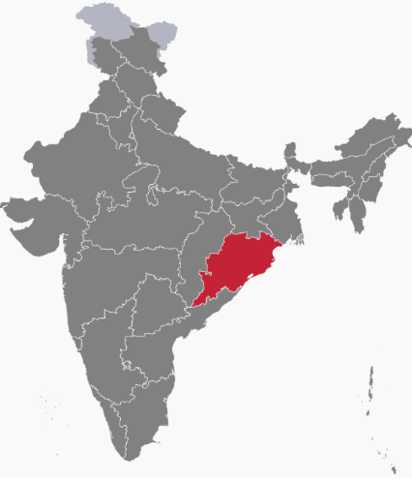
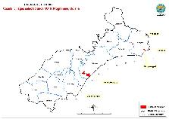
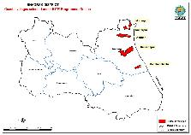
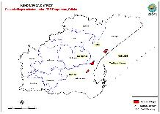
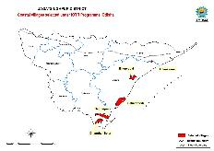
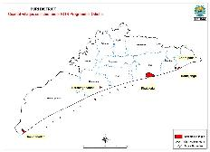
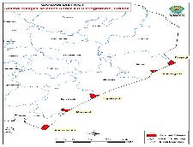
24 Coastal Villages in Odisha - India
Tsunami Ready in India 2024
Sl No. | District | Block | GP | Village
1 | Kendrapada | Mahakalpada | Suniti | Kantilo
2 |  |  | Lanjuda | Tantiapal Sasan
3 |  | Rajnagar | Hatina | Kaitha
4 |  |  | Dera | Chinchiri
5 | Bhadrak | Basudevpur | Podhuan | Mohanpur
6 |  |  | Adhuan | Adhuan
7 |  |  | Balimunda | Badahabelisahi
8 |  |  | Sk Pur | Krushnapur
9 | Jagtsinghpur | Balikuda | Baramundali | Bagheipur
10 |  | Balikuda | Marichipur | Dhanuharbelari
11 |  | Erasama | Padmapur | Shadabedi
12 |  | Erasama | Gadakujanga | Bhuyanpala
13 | Puri | Astaranga | Sisuo | Keutjanga
14 |  | Bramhagiri | Ambapada | Narasinghpatana
15 |  | Gop | Sutan | Khalakata
16 |  | Kakatpur | Bangurigaon | Chhotipada
17 | Balasore | Bahanaga | Baripada | Jagannathpur
18 |  | Balasore | Jayadevkasaba Pahi | Jayadevkasaba Pahi
 |  | Bhogarai | Sahabajipur | Sahapur
19 |  | Bhogarai | Sahabajipur | Sahapur
20 |  |  | Sradhhapur | Kanyanagari
21 | Ganjam | Chhatrapur | Kalipalli | Uppulaputi
22 |  | Ganjam | Ramagada | Prayagi
23 |  |  | Paliabandha | Kantiagada
24 |  | Rangeilunda | Markandi | Markandi
Source: Indian NTRB - OSDMA

Slide 11
Tsunami Ready in Indonesia 2024
16 Coastal Villages in Indonesia
Desa Pangastulan, Buleleng, Bali
Kalurahan Parangtritis, Bantul, Yogyakarta
Kalurahan Tirtohargo, Bantul, Yogyakarta
Kalurahan Srigading, Bantul, Yogyakarta
Kalurahan Gadingsari, Bantul, Yogyakarta
Kalurahan Poncosari, Bantul, Yogyakarta
Desa Hative Kecil, Ambon, Maluku
Desa Galala, Ambon, Maluku
Nagari Tapakis, Padang Pariaman, Sumatera Barat
Recognized by National Tsunami Ready Board, Will request for UNESCO-IOC Tsunami Ready Recognition
Yogyakarta, Ambon, Bali, West Sumatera
Waiting for recognition by National Tsunami Ready Board, and will request for UNESCO-IOC Tsunami Ready Recognition
West Java & Banten
Will be submitted to National Tsunami Ready Board
Aceh
PT KSP, Cilegon, Banten
Cikakak, Sukabumi, Jawa Barat
Citepus, Sukabumi, Jawa Barat
Aceh :
Mon Ikeun, Aceh Besar
Lam Kruet, Aceh Besar
Deah Glumpang, Banda Aceh
Gampong Jawa, Banda Aceh

Slide 12
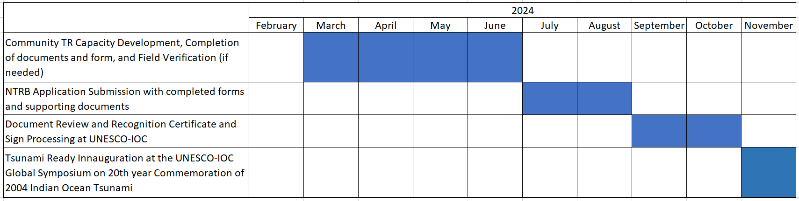
Tsunami Ready in IO 2024
Tsunami Ready Recognition Process in line with the 20th Year Commemoration of the 2004 Indian Ocean Tsunami

Slide 13







Thank you
Follow us
iotic.ioc-unesco.org
www.iotsunami.org
facebook.com/iotsunami
Ardito M. KODIJAT
a.kodijat@unesco.org
iotsunami
@iotsunami
UNESCO-IOC Indian Ocean Tsunami Information Centre
IOTIC-BMKG Programme Office
Disaster Risk Reduction and Tsunami Information Unit
UNESCO Jakarta Office
youtube.com/iotsunami
iotic@unesco.org

