Slide 1

World Tsunami Awareness Day (WTAD) 2024
Rosalind Cook
Head of Campaigns, Communications Unit, UNDRR
February 2024

Slide 2


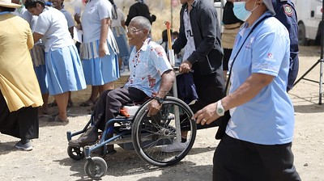
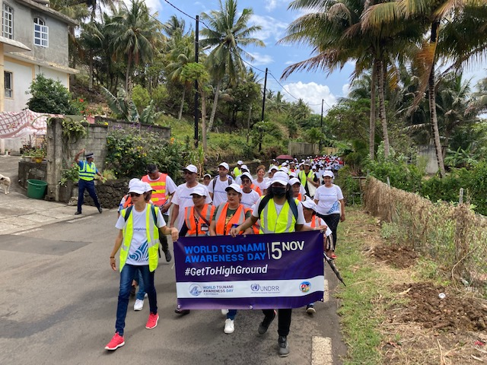
WTAD 2023: Thank you for the great collaboration!
#GetToHighGround Campaign mobilizing action globally
#GetToHighGround- with UNESCO IOC, our public facing campaign engaging citizens to run/walk the tsunami evacuation routes. Focus on inclusion and leave no one behind
Since 2022, events in Seychelles, Tonga, Cook Islands, Barbados, Fiji, Cook Islands, Mauritius, Portugal Indonesia, Samoa, Ecuador, and more.
Boosts implementation: new/revised strategies on tsunami risk, updated evacuation routes, new tsunami warning sensors and warning systems installed

Slide 3
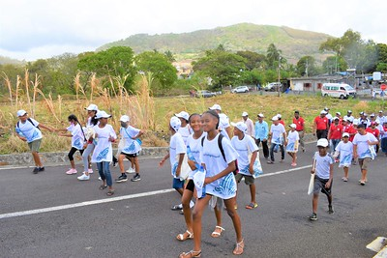
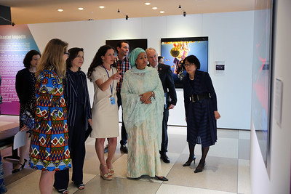

2024: Key activities commemorating the 20th anniversary and engaging children and youth
Major events commemorating the 20th anniversary in Asia Pacific, including at the Asia Pacific Ministerial Conference on DRR and the Africa Regional Platform on DRR
Strengthened collaboration with UNESCO IOC with programme of activities and steering group for implementation
Global Exhibition bringing the story of eyewitness survivors, progress since 2004, art and hope for a resilient future
Schools and community dialogues, youth advocates, engagement and #GetToHighGround activations

Slide 4
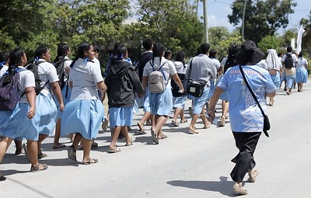
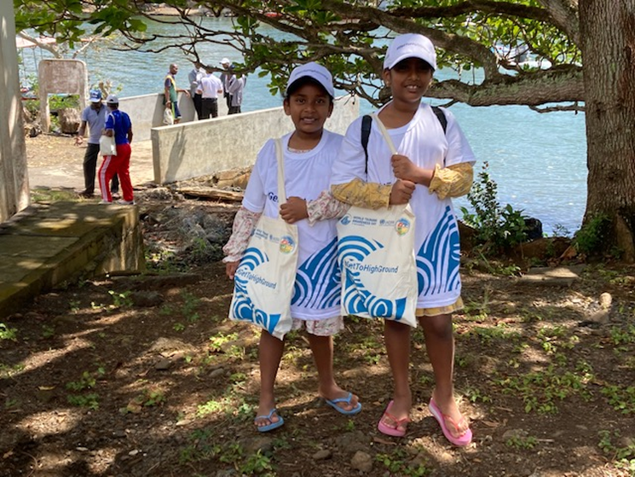
2024 WTAD Theme
Empowering children and youth, ensuring the next generation is tsunami prepared #TsunamiDay #OurResilientFuture

Slide 5
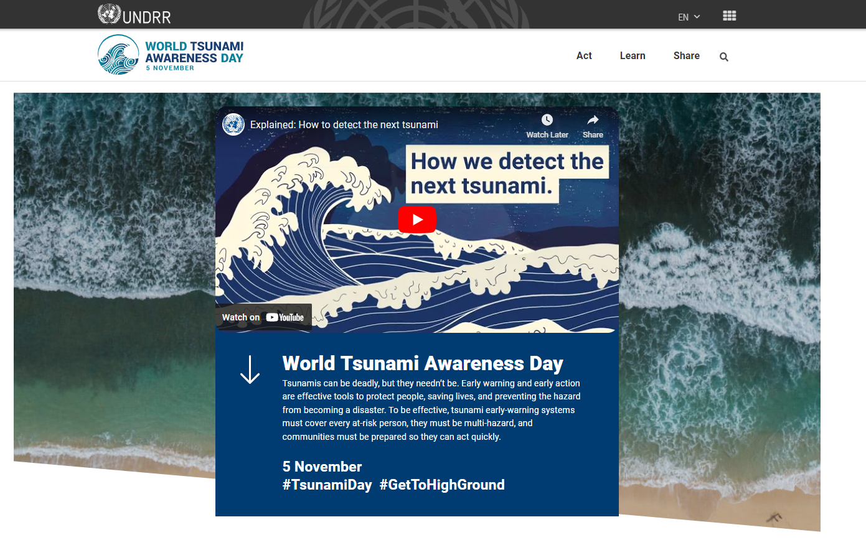
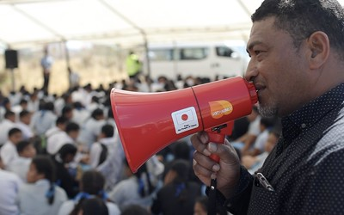
2024: Key activities commemorating the 20th anniversary and engaging children and youth
Global media engagement on tsunami documentaries
Innovative tools, games and stories for reduction (Stop Disasters Game)
Social and Digital Activation toolkit with social cards, customizable cards, videos, dedicated WTAD webpage
Video collaboration UNESCO IOC
Early Warning for All Initiative interlinkages

Slide 6
Key events
2024
UNESCO Intergovernmental Oceanographic Commission Executive Council, Paris, 24-28 June
Asia-Pacific Ministerial Conference on Disaster Risk Reduction, Manila, Philippines, 14-17 October
Africa Regional Platform on Disaster Risk Reduction, October 2024.
ASEAN ministerial and commemorative event (Oct-Dec)
UNESCO IOC Scientific Conference, November
UNDRR High Level Advocacy WTAD event, 5 November
2025
10th anniversary of the Sendai Framework for Disaster Risk Reduction, March
Global Platform for Disaster Reduction, May, Geneva

Slide 7
Please reach out to us to collaborate on WTAD 2024
Rosalind.cook@un.org

