Slide 1
STATUS OF
TOWS-WG Task Team Tsunami Watch Operations
(TT TWO)
By Rick Bailey
UNESCO/IOC Technical Secretary
4th Ocean Decade Tsunami Programme
Science Committee Meeting,
Paris, 25-26 January 2023

Slide 2
Terms of Reference
Provide a mechanism to the ICGs for coordination of tsunami watch operations among the Tsunami Warning Systems;
Maintain an inventory of current and proposed products and their dissemination methods;
Recommend and promote harmonised terminology;
Maintain an inventory of areas of responsibilities, geographical coverage, system architectures, and other relevant characteristics;
Recommend operational standards, procedures and guidelines for regional and national providers of tsunami forecast information;
Share and harmonise methods of detection and characterisation, forecasting techniques and dissemination to enhance the accuracy and effectiveness of tsunami forecast information for users;
Monitor status of the regional provision of tsunami forecast information;
Report to TOWS-WG.
2

Slide 3






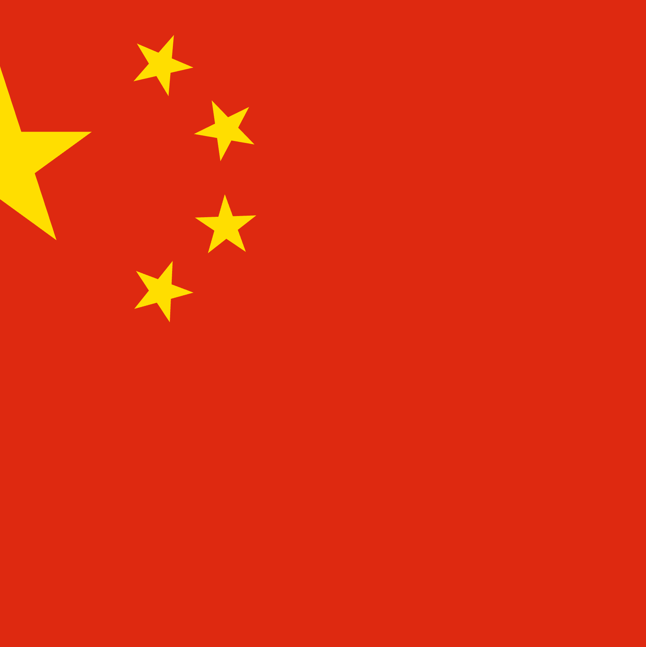
Membership 2024
Yuichi Nishimae
Chair
Intergovernmental Coordination Groups (ICGs) rRpresentatives
Elizabeth Vanacore
Charles McCreery
ICG/CARIBE EWS
ICG/CARIBE EWS
The representatives to the Inter-ICG Task Team on Tsunami Watch Operations shall be nominated by their respective ICG Chairpersons. The membership shall consist of two representatives from each ICG and include representatives from the regional providers of tsunami threat information. The IOC Chair will appoint the Chair of the Task Team.
.
J Padmanabham
Noura AlKaabi
ICG/IOTWMS
ICG/IOTWMS
Helene Hebert
Alessio Piatanesi
ICG/NEAMTWS
ICG/NEAMTWS
Yuichi Nishimae
Dakui Wang
ICG/PTWS
ICG/PTWS
This Photo by Unknown Author is licensed under CC BY-NC

Slide 4
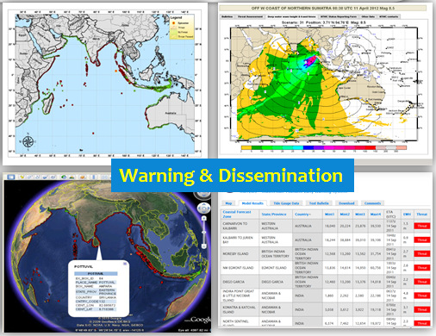
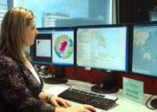
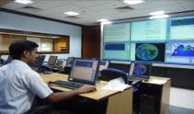
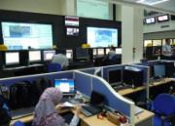



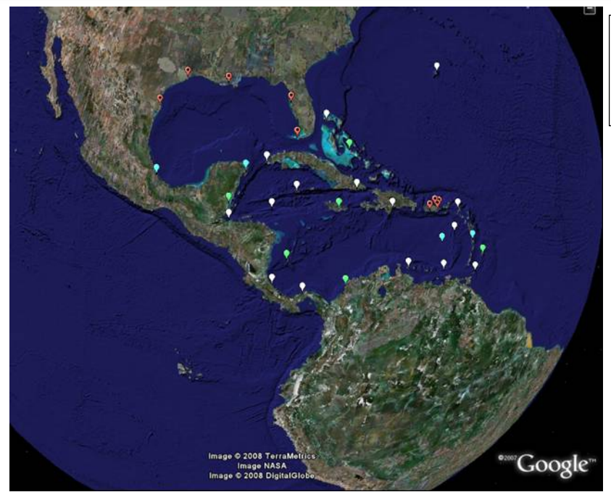
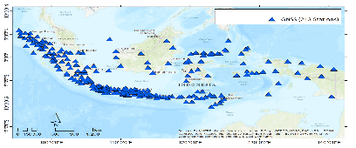

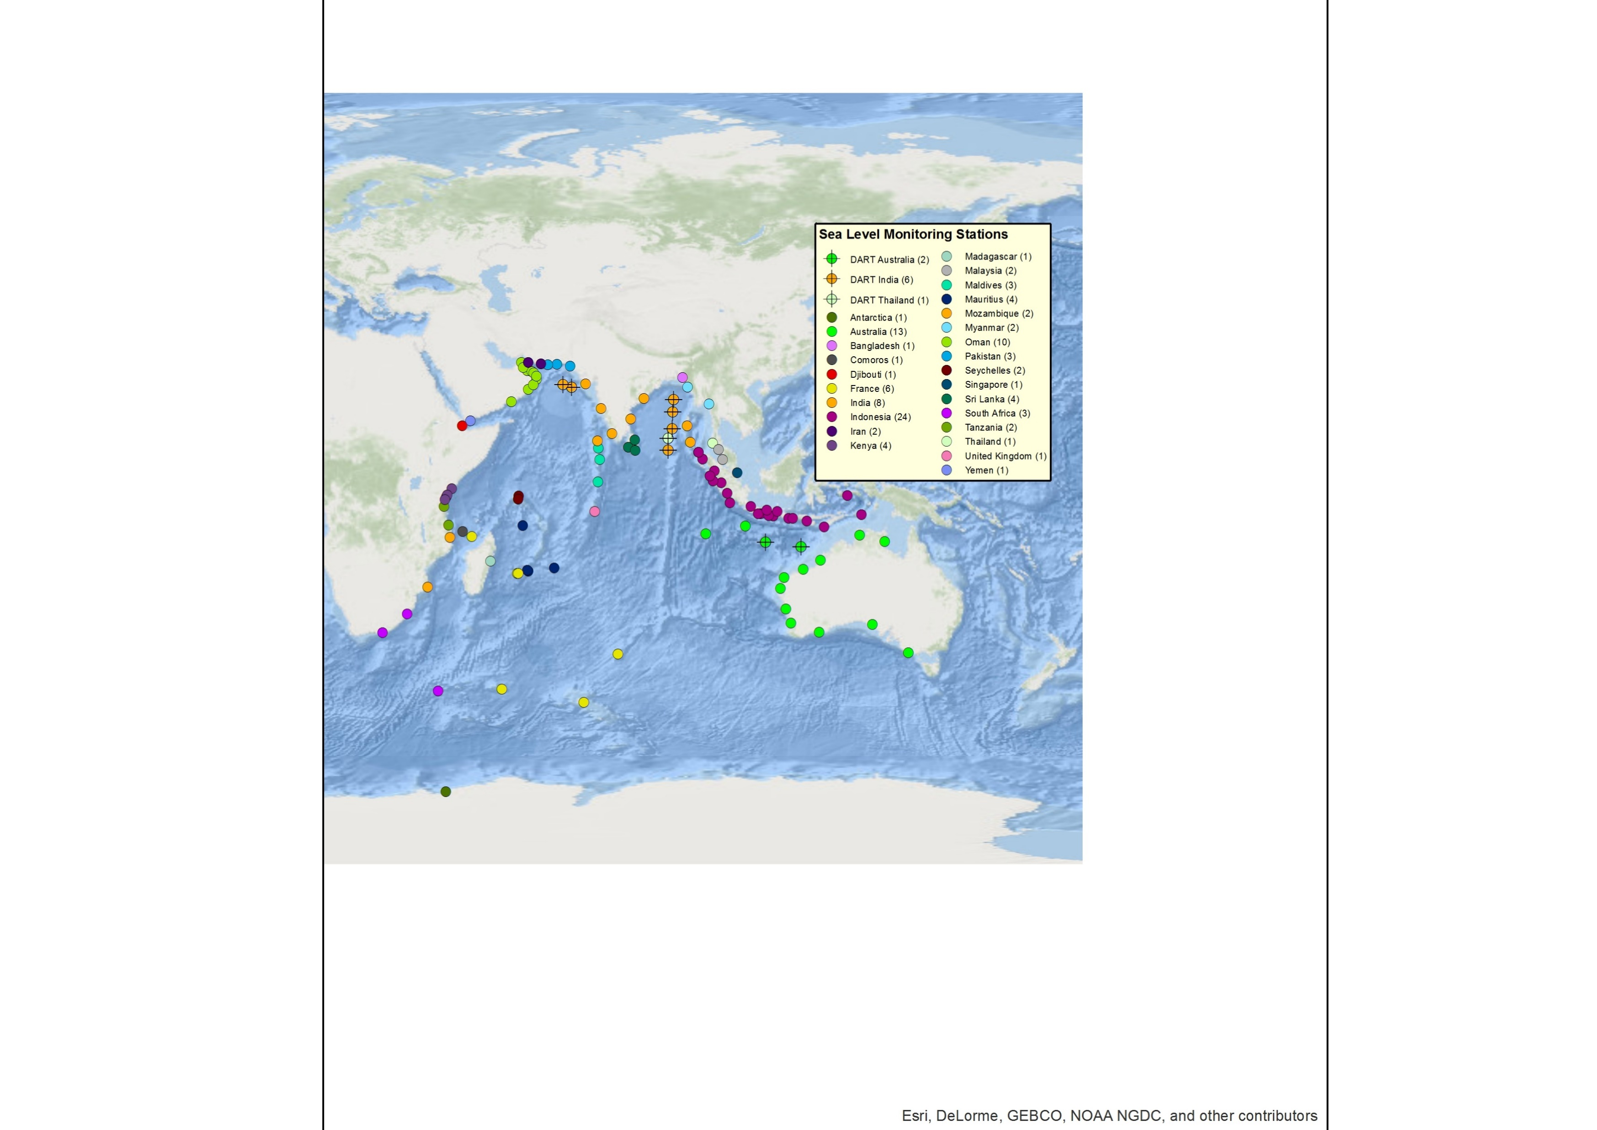
Current Work Programme
Trial and implement TSP products for NAVAREAs for maritime users
Develop a global CAP template for all TSPs, not for public exchange, but to facilitate exchange of bulletins between basin TSPs and their NTWCs, and between TSPs of different basins
TSPs to not list countries with threat less than minimum threshold, subject to review and approval by each ICG as relevant
Develop a recommended basic tsunami warning product/template for use in eg radio
Review of definition of near-field
Finalise reports of Ad Hoc Team on Tsunamis Generated by Volcanoes and Ad Hoc Team Meteo-tsunamis
Routinely monitor and report on status of sea level and seismic networks (like CARIBE-EWS currently does) to better understand data availability and work with operators to resolve instrument issues, in order to help improve present tsunami forecasts and help identify needs and monitor implementation of enhanced data systems to meet UN Ocean Decade goals
Monitor and update TT TWO on US and NZ efforts to explore specific design of risk-based grid integrated monitoring network in support of UN Decade Objectives, recognising the role of the TT TWO in helping implement enhanced monitoring and warning aspects of the Global Tsunami Warning and Mitigation System
Review and update of Global Service Definition Document (GSDD)
4

