Slide 1

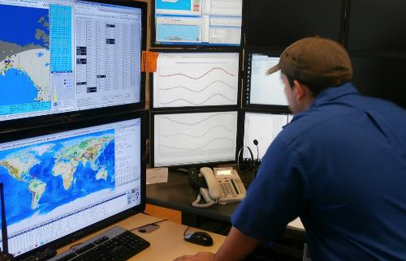
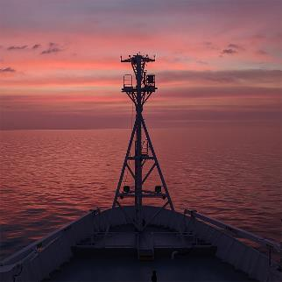
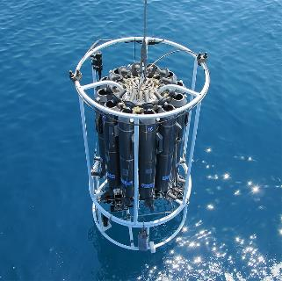
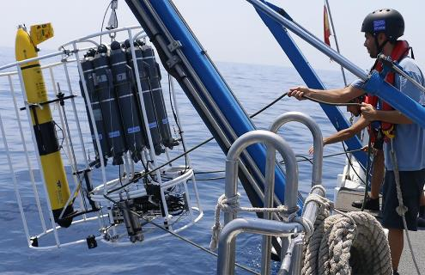
OBPS NewsFlash
Work Package 5
Virginie van Dongen-Vogels & Rachel Przeslawski
www.oceanbestpractices.org

Slide 2
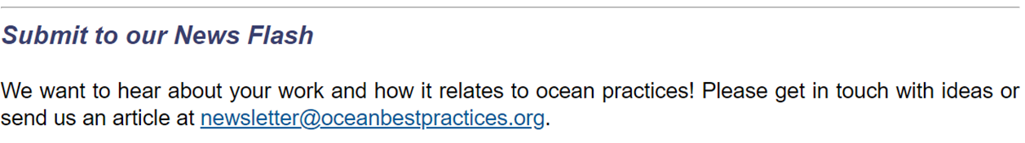
OBPS Newsletter / News Flash (Good, Better, Best)
Since 2022 : - new naming, bi-monthly, co-editors (Rachel & Vinnie) + Jay
515 subscribers (+20), with an open rate of 42% and click rate of 15% → >30% is very good
Old (6 News Flash in 2022 + 1 in 2023) to ‘New’ (IOC’s) Mailchimp account
        → issue to compare metrics from previous years.
Content → Divers sections (SG Updates, From the Repository, Stories, Other News, Meeting summary, Events)
      → not always easy to get, in particular for success stories
New sections: ‘Image of the month’ → ‘The Bad, the worse, and the ugly’

Slide 3
Social Media
Facebook → agreed closing (2022 SG meeting), replaced with LinkedIn
Twitter / X → no participation from WP5 Co-Chairs, account administered by Nick Roden
→ As of 7th Dec: 412 people following the account, 739 followers.
→ However, no new posts…
https://twitter.com/OceanPractices
Recommendation: SG discuss retiring Twitter / X account or identifying other administrators that can assist with posting and engagement on this platform.

Slide 4
Social Media
LinkedIn → started in 2023 (2022 SG meeting), more suitable for target audiences.
→ As of 7th Dec: 225 followers.
→ 38 original posts, 3 reposts, with most popular reaching 18 likes.
→ 220 reactions, 8 comments, and 42 reposts.
(most downloaded article from the journal research theme)
→ New followers and page views occur after every original post, particularly if that post tags other institutions or individuals.
https://www.linkedin.com/company/ocean-best-practices/
Recommendation: Another SG member join Rachel to post regular content on LinkedIn.

Slide 5
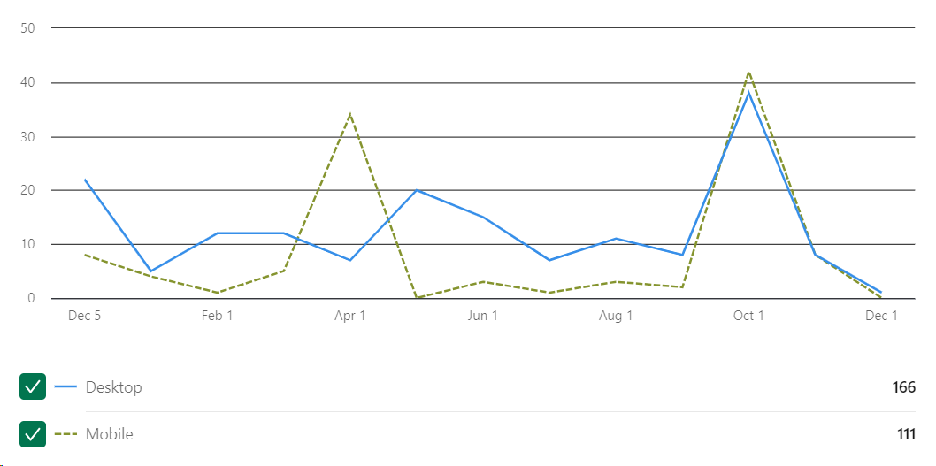
OBPS LinkedIn page views from the past year from desktop and mobile devices. There were 277 page views.

Slide 6
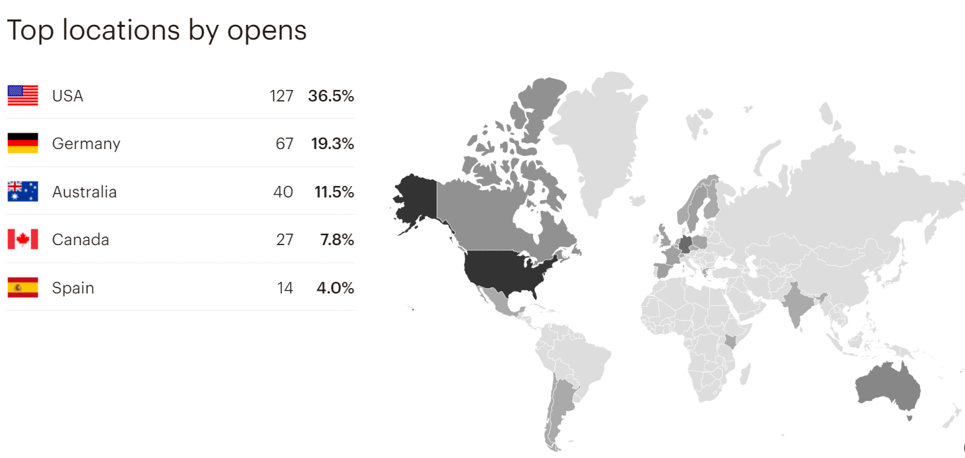
News Flash: Are we reaching our target audiences?
April 2023

Slide 7
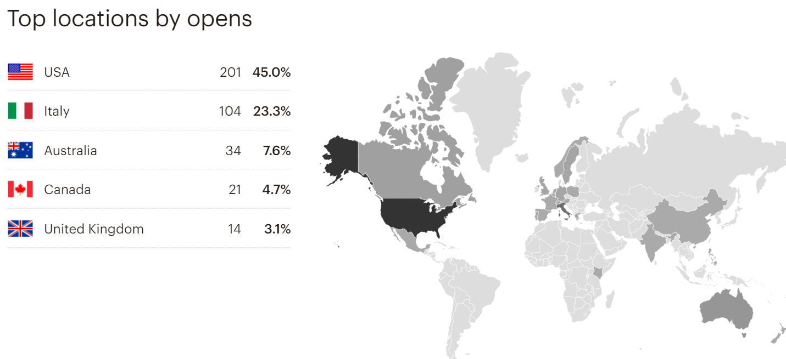
Are we reaching our target audiences?
June 2023

Slide 8
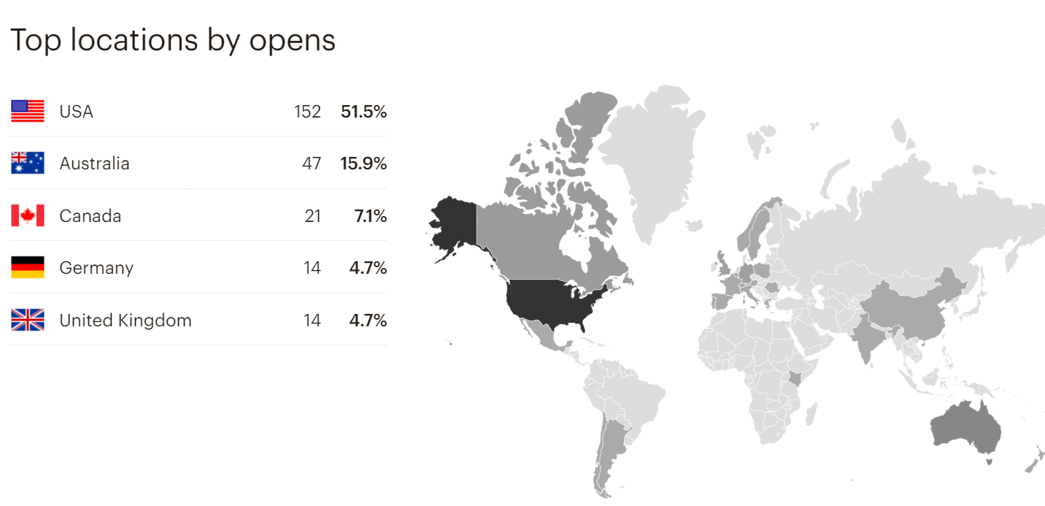
Are we reaching our target audiences?
August 2023

Slide 9
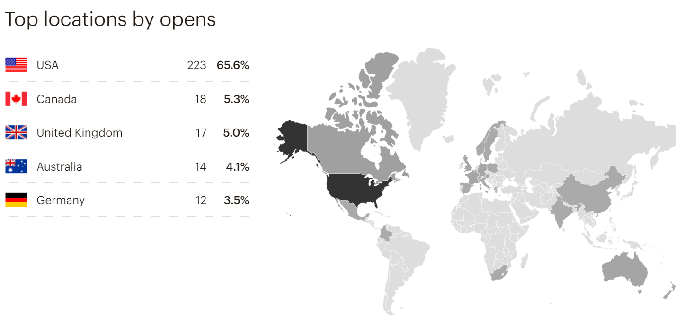
Are we reaching our target audiences?
October 2023

Slide 10
Editor’s Note | Summary of editor’s thoughts and/or issue content [3-5 sentences]
Updates from the Steering Group | Notifications of activities, papers, and updates from the OBP Steering Group [each update 1-3 sentences]
From the Repository | Summary of metrics or discipline from the OBP Repository, purpose is to highlight the uses of the Repository and the diversity of best practices within it [1-3 paragraphs]
Success Story | Article showcasing a successful use of best practices and/or how the OBPS helped research outcomes [1-3 paragraphs]
Feature | Article on other topic related to best practices or of likely interest to the OBP community
Good Bad Ugly | Article describing a mistake, accident, or failure which resulted in learnings applicable to the OBPS community [1-2 paragraphs]
Image of the Month | Any photo, artwork, or diagram that can be related to ocean best practices, along with a brief summary describing it [1 paragraph]
Other News | Brief notifications of other activities, products, or discussion topics. These are often summarised from other newsletters and programs [each update 1-5 sentences]
Poet’s Corner | An original or appropriately credited poem about oceans, science, or marine observations
Meeting Summary | Summary of a recent workshop, conference, or meeting [1-2 paragraphs]
Upcoming Events | Brief list of upcoming international workshops, conferences or meetings

Slide 11
Discussion
News Flash → improving flow of news’ uptakes
→ what would improve number of subscribers?
→ getting knowledge from available statistics
Social Media → LinkedIn / X, should we have multiple SGs or ambassadors providing feeds?
Else?
Activities will include the production and dissemination of promotional material of the OBPS to the community via the website, social media, conferences journal articles, and the monthly community newsletter Good, Better, Best.

Slide 12
Discussion
News Flash → improving flow of news’ uptakes
→ what would improve number of subscribers?
→ getting knowledge from available statistics
Social Media → LinkedIn / X, should we have multiple SGs or ambassadors providing feeds?
Else?
Activities will include the production and dissemination of promotional material of the OBPS to the community via the website, social media, conferences journal articles, and the monthly community newsletter Good, Better, Best.

