Slide 1

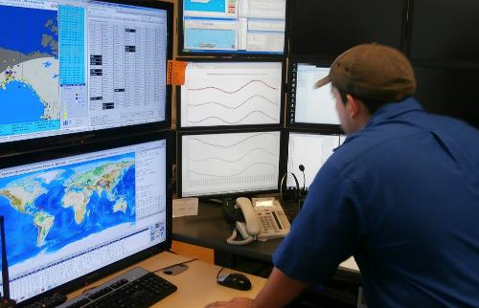
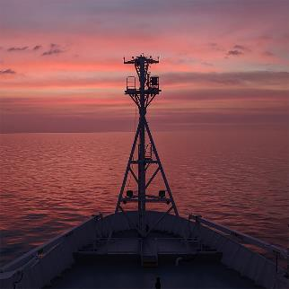
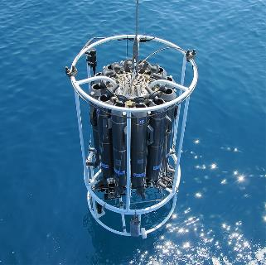
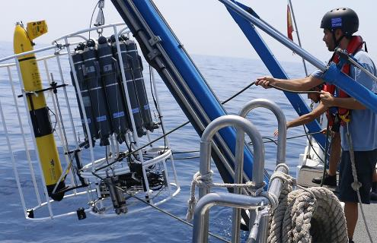
OBPS Website
Work Package 5
Rachel Przeslawski
www.oceanbestpractices.org

Slide 2
Need for Rebuild
Increased security and easy maintenance
Modern format
Accessible from desktops, tablets, mobiles
Streamlined content
Accurate and current content
Consistent design and content

Slide 3
Process
1) RFQ, developer chosen (BTSA)
2) SG engaged for menu structure
3) SG voted on website theme (NicePage)
4) Content and images requested from SG
5) Content revamped for new website
6) Developer completed staging website, SG provides comments
7) Staging website completed
8) Training session completed

Slide 4
Outcome
Increased security and easy maintenance
Modern format
Accessible from desktops, tablets, mobiles
Streamlined content
Accurate and current content
Consistent design and content

Slide 5
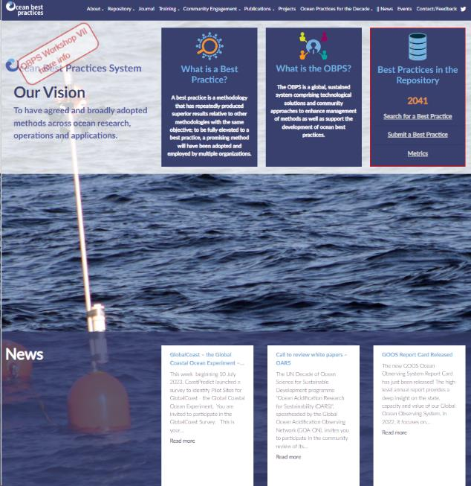
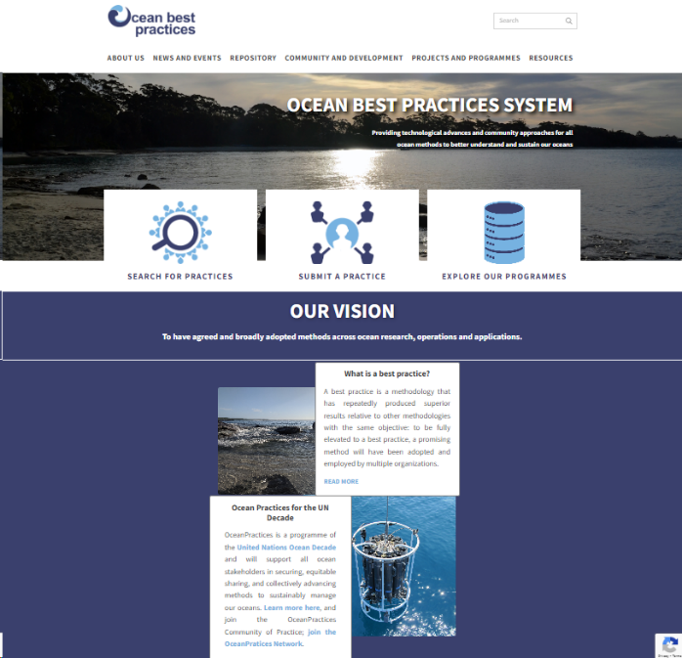
Outcome
PREVIOUS VERSION
NEW VERSION

Slide 6
Future
Log immediate edits in google doc: https://docs.google.com/document/d/1kk9t-02uBWiA6rnSEx0pQd84zs3Yd_JcWCI2udhDv8U/edit?usp=sharing
Guide for administrators (supplied by developer)
  Project manager (Pauline)
  Technical coordinator (Arno)
  WP5 leads (Rachel, Vinnie)
Guide for content creators

Slide 7
Guide for content creators
Only the project manager, technical coordinator and WP5 co-chairs have admin access to make changes to the website.
No new pages will be created without justification provided to the project manager or WP co-chairs
Images must be high resolution (e.g. look good on full size monitor, at least 72 ppi)
Graphics must be professionally designed.
The website is not an archive. Links to resources (e.g. pdfs, videos) must be accurate and professional. Outdated or superseded material should not appear or be linked to on the website without good justification.
Avoid acronyms and jargon (both scientific and corporate). Wherever possible, use language that is understandable by a broad global audience. If you must include acronyms (e.g. funding requirement), make this font small and unobtrusive.

