Slide 1
4.1 {Insert Country} Report
from National Workshop
Name(s)
Organisation(s)
Email(s)
ICG Indian Ocean Tsunami Warning & Mitigation System SOP Workshops July 2023

Slide 2
National Tsunami Warning Chain Status Update
XX Min
XX Min
Timeline for the first warning message (Minutes after EQ)
Insert your country’s national tsunami warning chain (example provided).
Comment on any updates.
LDMO
PUBLIC
Community at risk
TSP
Tsunami
Service
Providers
Not for the first warning during
near-field threats
NTWC
National
Tsunami
Warning
Centre
NDMO
Local
Radio / TV
National
Radio / TV
International
National
Local
Agency responsible to decide on official call for evacuation
Country
DD/MM/YYYY
Information
Warning
Warning
and Advice
Official call
for evacuation
Feed Back

Slide 3
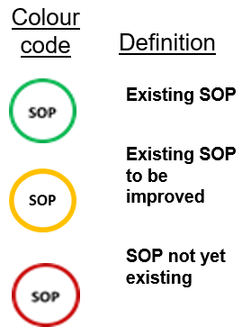
Standard Operating Procedure Status Report
XX Min
XX Min
Timeline for the first warning message (Minutes after EQ)
Indicate your country’s SOPs status with regards to the tsunami warning chain (example provided).
Comment on any updates.
SOP
SOP
SOP
SOP
SOP
LDMO
PUBLIC
Community at risk
TSP
Tsunami
Service
Providers
Not for the first warning during
near-field threats
NTWC
National
Tsunami
Warning
Centre
NDMO
Local
Radio / TV
SOP
SOP
National
Radio / TV
International
National
Local
Agency responsible to decide on official call for evacuation
Country
DD/MM/YYYY
Information
Warning
Warning
and Advice
Official call
for evacuation
Feed Back

Slide 4
Issues for follow-up and future work
…
…
…

Slide 5
Exercise IOWave23 Plans
Modify as appropriate.
Scenarios: Andaman trench (4 Oct), Makran trench 11 Oct), Heard Island volcano (18 Oct), Java trench (25 Oct)
Exercise types: Full-scale exercise, Functional exercise, Tabletop exercise, Drill, Orientation exercise
Key players: NTWC, NDMO, P/LDMO, emergency response agencies, media, communities, etc.
Evacuation: Names of communities evacuating and approximate number of people (if known)

