Slide 1

4.4 Working Group 4 Preparedness, Readiness, and Resilience ICG CARIBE EWS XVI Session April 25-28, 2023 Costa Rica
Christa von Hillebrandt-Andrade - Chair
Antonio Aguilar - Vice Chair Public Awareness
Patrick Tyburn - Vice Chair Resilience

Slide 2
Agenda
Introduction
Summary of Activities
Recommendations
Work Plan
Leadership

Slide 3
Introduction

Slide 4
Current Terms of Reference (on meeting website)
Established: 2007
Purpose: To advise and recommend to the ICG strategies to enhance awareness,
Education and resilience capacities and to develop the necessary recommendations,
tools and procedures.
Functions:
Identify the public awareness and education strategies and tools that the Member
States can integrate into their risk reduction and emergency management programs.
Support the development of guidelines for preparedness, response and recovery
plans for communities and local governments and organisations, which should
include sharing of training and evacuation best practices.
To closely cooperate with the Caribbean Tsunami Information Centre (CTIC)
in carrying out its mandate and in the implementation of its program.

Slide 5
Membership: Christa von Hillebrandt-Andrade, Puerto Rico, USA (Chair, 2018-2023)* Antonio Aguilar, FUNVISIS, Venezuela (Vice Chair, 2020-2023)* Patrick Tyburn, France (Vice Chair, 2018-2023) * Corinne Leysner, Curacao John Kimbrough, USA* Juan Jose Reyes, COPECO, Honduras Elizabeth Riley (or her nominee), CDEMA Raul Salazar (Jair Torres, in representation), UN Office for Disaster Risk Reduction (UNDRR) Regional Office for the Americas and the Caribbean* Claudia Herrera Melgar, CEPREDENAC Stacey Edwards, Seismic Research Center, Trinidad and Tobago* Paul Martens, Sint Maarten Wagner Rivera, ONAMET, Dominican Republic* Jasen Penn, British Virgin Islands, UK Kerry Hinds, Department of Emergency Management, Barbados Julia Rawlins-Bentham, Government Information Service, Barbados Susan Hodge, Department of Disaster Management, Anguilla, UK* Fabio Rivera, Universidad Nacional, Costa Rica* Gregory Jabol, Collectivité Territoriale de Guyane, France (Pending Confirmation). Marie-Noëlle Raveau, Collectivité Territoriale de Martinique, France* Stéphane NISSLE, EMIZA, France (Martinique) Mathieu Perroche, Université Paul-Valéry Montpellier 3, France* Alison Brome, CTIC (Ex-Officio) * Bernardo Aliaga, CARIBE EWS Technical Secretary, UNESCO-IOC (Ex-Officio) * Silvia Chacón, CARIBE EWS Chair (Ex-Officio) * * Have provided feedback during the intersessional period
Had 2 Virtual Meetings, other business conducted through Email
At ICG XVI need to elect new Chair and 2 Vice Chair (Christa and Patrick have completed their terms and Antonio indicated can’t continue.
Need to confirm membership.

Slide 6
Summary of Activities

Slide 7
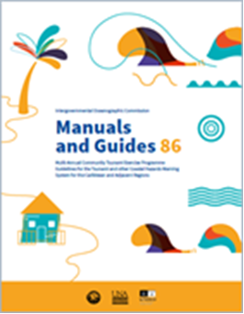
UNESCO/IOC Manual and Guide 86
Finalized the “The Multi-Annual Community Tsunami Exercise Programme: Guidelines for the Tsunami and other Coastal Hazards Warning System for the Caribbean and Adjacent Regions”. Translated into French. Spanish translation pending
Socialized in CARIBE WAVE 22 and 23 and Ocean Decade Safe Ocean Lab
Plans for Workshop – TBC June 2023

Slide 8
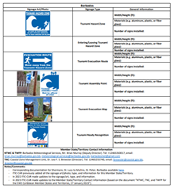
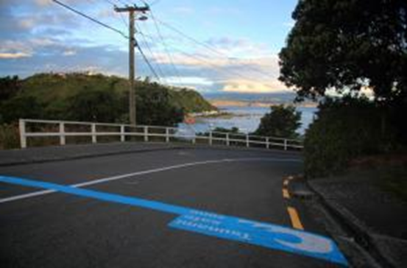
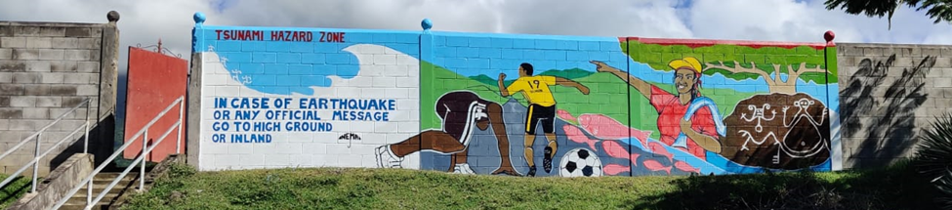

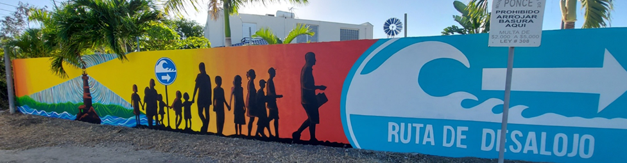
CARIBE EWS Inventory and report on tsunami signage
Updated in 2023
Includes traditonal signage, Alternative Public Display of Tsunami Hazard Information and Previous Event Signs
Currently signage for 66% of the MS/Territories is included (up from 50% in 2021)

Slide 9
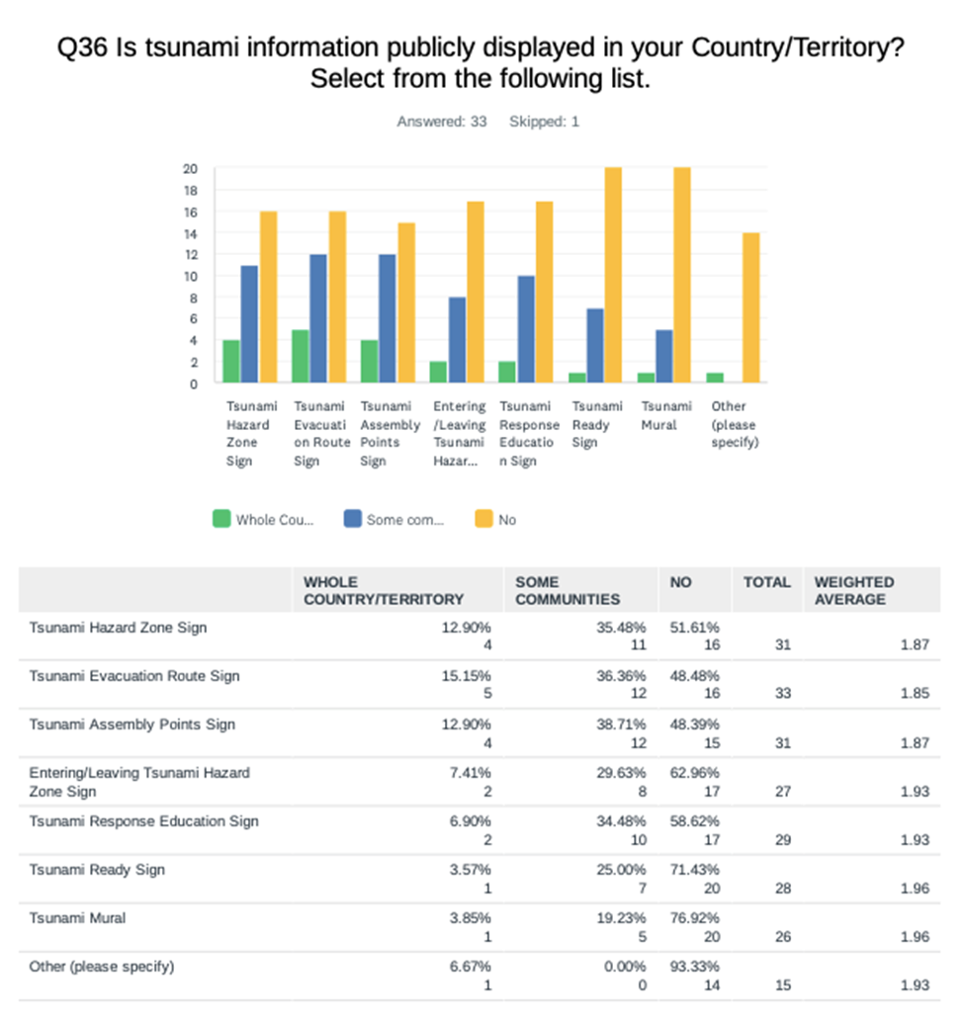
CARIBE WAVE 23 Questionnaire

Slide 10

World Tsunami Awareness Day (WTAD) November 5
CTIC is the lead, members of WG collaborate
Themes
2021-Substantially enhance international cooperation (Sendai F)
2022 - increasing the availability of and access to multi-hazard early warning systems and disaster risk information (Sendai G)
2023 - vulnerable populations, including people with disabilities
Video Production – links on ITIC website - tsunamiwave.org
Logo Change

Slide 11

UNESCO IOC Tsunami and Other Hazards Related to Sea Level Working Group (TOWS)
Alison Brome and Christa von Hillebrandt-Andrade represented CARIBE EWS Task Team on Disaster Management and Preparedness
Ocean Teacher Global Academy
Leads are Indian Ocean Tsunami Information Centre (IOTIC) and International Tsunami Information Centre (ITIC)
Topics
Tsunami Awareness
Tsunami Ready and
Tsunami Evacuation Maps, Plans and Procedures (TEMPP)
Tsunami Warning Center Competencies
TOWS has requested the IOC Tsunami Secretariat to facilitate the finalization of the OTGA basic tsunami training materials as soon as possible.
Meeting to be held in June to finalize Tsunami Ready module
Once finalized WG could help evaluate and test
Ocean Decade
Endorsement and draft implementation plan of the UN Ocean Decade Tsunami Programme Research, Development and Implementation Plan
Objective 2: 100 Percent of communities at risk to be prepared for and resilient to tsunamis by 2030 though the UNESCO/IOC Tsunami Ready Programme and other like initiatives.

Slide 12
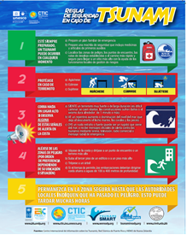
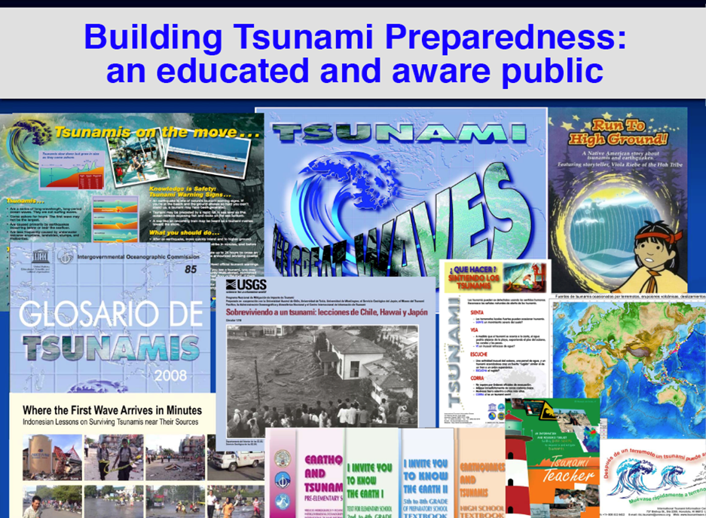

Tsunami Awareness
Order Form for ITIC Materials – shipping coordinated thru ITIC-CAR and paid with funds from USAID/BHA Tsunami Ready project
Update of CTIC Flyers with support of ITIC-CAR and USAID/BHA funding for Tsunami Ready

Slide 13
OTHER
CARIBE WAVE 2022 and 2023 - questionnaires include questions on Tsunami Preparedness, Readiness and Resilience
Ocean Decade - participation in the 2021 and 2022 IOCARIBE Tropical Americas and Caribbean planning events, Ocean Decade Safe Ocean Laboratory and formulation of endorsed Project Integrating Coastal Hazards Early Warning System for the Tropical Americas and Caribbean (iCHEWS)
Article Database on the Social Dimension of Disaster Risk Reduction, updated in 2023 - over 150 references. One of the additions was the English translation of the Costa Rica Training Manual on Community Tsunami Risk Management.

Slide 14
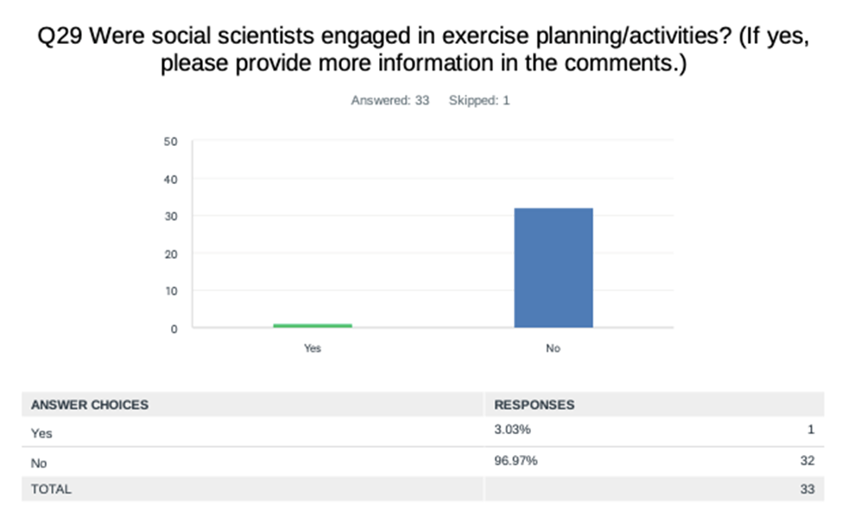
CARIBE WAVE 23 Questionnaire

Slide 15
Key considerations/challenges/opportunities
COVID 19, funding and human resources
Other Hazards - Impacts and risks of other hazards on coastal communities – hurricanes, storm surges, sargassum, volcanic eruptions, floods, etc. Compete for resources
Lack of financial and human resources - delays to implement actions of the WG 4 eg. Workshop on MG 86
Limited engagement of members in WG activities – leads to burnout of active members
Complacency - Tsunamis are low frequency events
Language – lack of availability of ITIC educational and outreach materials in languages other than Spanish and English, noting French, Dutch and other languages in the Caribbean
Strong and Visible Tsunami Efforts - CARIBE WAVE, WTAD and Tsunami Ready
Multi Hazard Framework - Ocean Decade Tsunami Programme, Ocean Decade Project Integrating Coastal Hazard Early Warning Systems in the Caribbean and Adjacent Regions, CARIBE WAVE, WTAD and Tsunami Ready, Regional Action Plan for the Implementation of the Sendai Framework for Disaster Risk Reduction 2015-2030 in the Americas and the Caribbean and the UN Early Warnings for All Initiative (EW4ALL)

Slide 16
Recommendations for ICG/CARIBE EWS XVI

Slide 17
Recommendations for ICG/CARIBE EWS XVI
Recognizes the actions of the Working Group IV towards the advancement of tsunami preparedness, response and resilience.
Highlights the importance of the active participation of all its members and
Invites Member States to nominate members to actively engage in the Working Group.

Slide 18
Recommendations for ICG/CARIBE EWS XVI (cont)
Notes the endorsement and draft implementation plan of the UN Ocean Decade Tsunami Programme Research, Development and Implementation Plan and its Objective 2: 100 Percent of communities at risk to be prepared for and resilient to tsunamis by 2030 though the UNESCO/IOC Tsunami Ready Programme and other like initiatives.
Further notes the endorsement of the IOCARIBE Ocean Decade Project Integrating Coastal Hazards Early Warning Systems in the Tropical Americas and Caribbean (iCHEWS).
Additionally notes the UN Early Warnings for All Initiative (EW4ALL) launched in November, 2022 and
Recalls the Regional Action Plan for the Implementation of the Sendai Framework for Disaster Risk Reduction 2015-2030 in the Americas and the Caribbean and the 2023 updates,

Slide 19
Recommendations for ICG/CARIBE EWS XVI (cont)
Urges the WG 4 and Member States to consider in its tsunami actions the UN Ocean Decade Tsunami Programme and other relevant Ocean Decade actions, the Regional Action Plan for the Implementation of the Sendai Framework for Disaster Risk Reduction 2015-2030 in the Americas and the Caribbean, the UN Early Warnings for All Initiative (EW4ALL).

Slide 20
Recommendations for ICG/CARIBE EWS XVI (cont)
Recommends the following changes in its terms of reference to align with the Ocean Decade, Sendai Framework and EW4All:
Edit Name of WG to: Preparedness, Response and Resilience
Edit the focus area of the Vice Chair for Tsunami Awareness to Vice Chair for Awareness, Preparedness and Response
Edit Purpose: To advise and recommend to the ICG strategies to enhance awareness, education, preparedness, response and resilience capacities and to develop the necessary recommendations, tools and procedures.
Edit Function 2: Support the development of guidelines and capacity development on preparedness, response and recovery planning for Member States, at risk communities and organisations, which should include sharing of training and evacuation best practices.
Add the following functions:
Consider UN Ocean Decade Tsunami Programme and other relevant decade actions, the Regional Action Plan for the Implementation of the Sendai Framework for Disaster Risk Reduction 2015-2030 in the Americas and the Caribbean and the UN Early Warnings for All Initiative (EW4ALL)

Slide 21
Recommendations for ICG/CARIBE EWS XVI (cont)
Acknowledges with appreciation France, the National University of Costa Rica and the International Tsunami Information Center Caribbean Office for their contributions to the finalization of the Manual and Guide 86 “The Multi-Annual Community Tsunami Exercise Programme: Guidelines for the Tsunami and other Coastal Hazards Warning System for the Caribbean and Adjacent Regions” and its translation into French.
Notes that a CARIBE EWS training on MG 86 is to be co-organized by CTIC and ITIC CAR in June 2023 in Barbados with funding from USAID/BHA as part of the Tsunami Ready projects,
Requests the IOC Tsunami Secretariat to finalize the translation of MG 86 into Spanish,
Recommends the Working Group Four with CTIC to develop a communications strategy that considers the exchange of information with the other ICG CARIBE EWS Working Groups and Task Teams, social media communication platforms and the promotion and distribution of existing CARIBE EWS and other IOC tsunami materials and guides.

Slide 22
Recommendations for ICG/CARIBE EWS XVI (cont)
Notes the 2023 update of the Tsunami Signage and Public Displays employed in the region and its support to the implementation of the Tsunami Ready Recognition Program;
Notes that 32 of the 48 Member States and territories have contributed examples of the signage used;
Requests the Member States to review and provide updates to the International Tsunami Information Center Caribbean Office, including the location metadata, artwork and photographs of installed signs for inclusion in the signage database.
Reminds Member States on importance of developing and maintaining an inventory of the signage installed in the country in coordination with the relevant stakeholders and authorities.
Appreciates and requests the International Tsunami Information Center Caribbean Office to coordinate with IOC and CTIC the posting and distribution of the current version and provide an update of the Signage Inventory for the next ICG.

Slide 23
Recommendations for ICG/CARIBE EWS XVI (cont)
Acknowledges the leadership of CTIC and collaboration with the UNDRR leading to increasing participation and visibility of WTAD in 2021 and 2022
Notes that the focus for WTAD 2023 will be on vulnerable populations, including people with disabilities, which was also addressed in CARIBE WAVE 23.
Recommends CTIC to continue to engage with UNDRR, Working Group 4 and CARIBE EWS Member States to engage, plan and take action for the WTAD 2023.
Requests UNDRR to inform on the theme for WTAD at least a year in advance to also consider in the planning of CARIBE WAVE exercise and have the same annual theme for both events.

Slide 24
Recommendations for ICG/CARIBE EWS XVI (cont)
Recalls the initial work in identification of social science resources through the preparation of the social science database.
Recommends again for the WG 4 to engage social scientists for a tsunami risk perception study in the CARIBE EWS
Notes the efforts of the Indian Ocean Tsunami Information Centre (IOTIC) and International Tsunami Information Centre (ITIC) in preparing Tsunami Awareness, UNESCO/IOC Tsunami Ready and Tsunami Evacuation Maps, Plans and Procedures (TEMPP) training through the Ocean Teacher Global Academy (OTGA) platform and hybrid training workshops and training videos.
Further notes TOWS has recommended that the IOC Tsunami Secretariat to facilitate the finalization of the OTGA basic tsunami training materials as soon as possible.
Recommends that once the modules are available, the WG 4 to help facilitate the testing and use of the trainings.

Slide 25
Recommendations for ICG/CARIBE EWS XVI (cont)
Recognizes COVID 19, Climate Change as well as multiple recent, ongoing and future emergencies and disasters and their cascading effects as a manifestation of the systemic nature of risks, and its impact on human and financial resources for disaster risk reduction.
Urges the IOC Secretariat to work with the CARIBE EWS officers to develop a strategic plan to mobilize funding and in-kind support for Tsunami Preparedness, Response and Resilience Activities with a particular focus for LDC’s and SIDS.

Slide 26
WG IV Work Plan
ACTION | Lead | DEADLINE
Socialize new terms of reference of WGIV and Update Membership | Chair/Co-Chairs WG4 | August 2023
Provide input and evaluate outcomes for the proposed regional workshop on MG 86 Methodological guidelines for community tsunami exercise planning. | WG4 | ICG XVII
Update Tsunami Signage Database. | ITIC-CAR | ICG XVII
Develop a strategic plan to mobilize funding and in-kind support for Tsunami Preparedness, Response and Resilience Activities and the UN Decade Actions | CTIC CARIBE EWS Secretariat | ICG XVI
Provide recommendations to CTIC on how to increase awareness, and engagement of Member States for WTAD 2023 | CTIC | November 2023
Review and provide recommendations on the regional implementation of the Tsunami Preparedness and Response element of the Ocean Decade Tsunami Programme | WG4 | ICG XVII
Upon availability test and use of the OTGA tsunami modules by the Member States | WG IV | Upon availability of OTGA modules
Develop a communications strategy that considers the exchange of information with the other ICG CARIBE EWS Working Groups and Task Teams, social media communication platforms and the promotion and distribution of existing CARIBE EWS and other IOC tsunami materials and guides. | WGIV CTIC | ICG XVII
Engage social scientists to study tsunami risk perception in the CARIBE EWS, include integration of results of CARIBE WAVE exercises and questionnaires used by other countries and regions. | WGIV CTIC ITIC-CAR | ICG XVII

Slide 27
Leadership
Existing and Outgoing
Chair: Christa von Hillebrandt-Andrade
Vice Chair Awareness – Patrick Tyburn
Vice Chair Resilience – Antonio Aguilar
Proposed
Chair: Silvia Chacon Barrantes (Costa Rica)
Vice Chair Preparedness and Response:
Vice Chair Resilience: Susan Hodge (UK – Anguilla)

Slide 28

Gracias – Thank you – Merci – Danke - Obrigado
Christa von Hillebrandt-Andrade
Patrick Tyburn
Antonio Aguilar

