Slide 1
SEA LEVEL STATION MONITORING FACILITY
Francisco Hernandez (tjess@vliz.be)
Bart Vanhoorne
Flanders Marine Institute (VLIZ)
Belgium
www.ioc-sealevelmonitoring.org

Slide 2
Accessing data from SLSMF
Metadata
Status information
Performance statistics
Data

Slide 3
Sources
Website
Station catalogue
Link to plot
Geoserver WFS
KML file
Rest API
R shiny app :
Planned :
Bulk download, R package, HPC access, Mobile friendly

Slide 4
Website
http://www.ioc-sealevelmonitoring.org/station.php?code=mnza

Slide 5
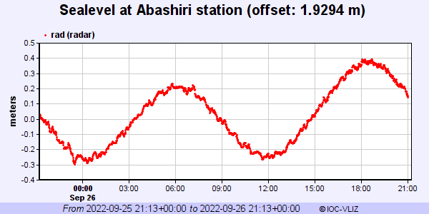
Direct link to plot
http://www.ioc-sealevelmonitoring.org/station.php?code=abas&taboption=plot&period=1

Slide 6
Sealevel Station Catalogue
http://www.ioc-sealevelmonitoring.org/ssc/service.php?format=help

Slide 7
Data content
raw sealevel data = as received, no qc
no levelling information : not for sealevel change
research quality data in progress
Detiding
Mean sealevel
Bulk dowload

Slide 8
Geoserver service
OGC / WFS standard
https://geo.vliz.be/geoserver/Sealevels/ows?service=WFS&version=1.0.0&request=GetFeature&typeName=Sealevels:sealevels
https://geo.vliz.be/geoserver/Sealevels/ows?service=WFS&version=1.0.0&request=GetFeature&typeName=Sealevels:sealevels&outputformat=csv
Format | Syntax | Notes
GML2 | outputFormat=GML2 | Default option for WFS 1.0.0
GML3 | outputFormat=GML3 | Default option for WFS 1.1.0 and 2.0.0
Shapefile | outputFormat=shape-zip | ZIP archive will be generated containing the shapefile (see Shapefile output below).
JSON | outputFormat=application/json | Returns a GeoJSON or a JSON output. Note outputFormat=json is only supported for getFeature (for backward compatibility).
JSONP | outputFormat=text/javascript | Returns a JSONP in the form: parseResponse(...json...). See WMS vendor parameters to change the callback name. Note that this format is disabled by default (See Global variables affecting WMS).
CSV | outputFormat=csv | Returns a CSV (comma-separated values) file

Slide 9
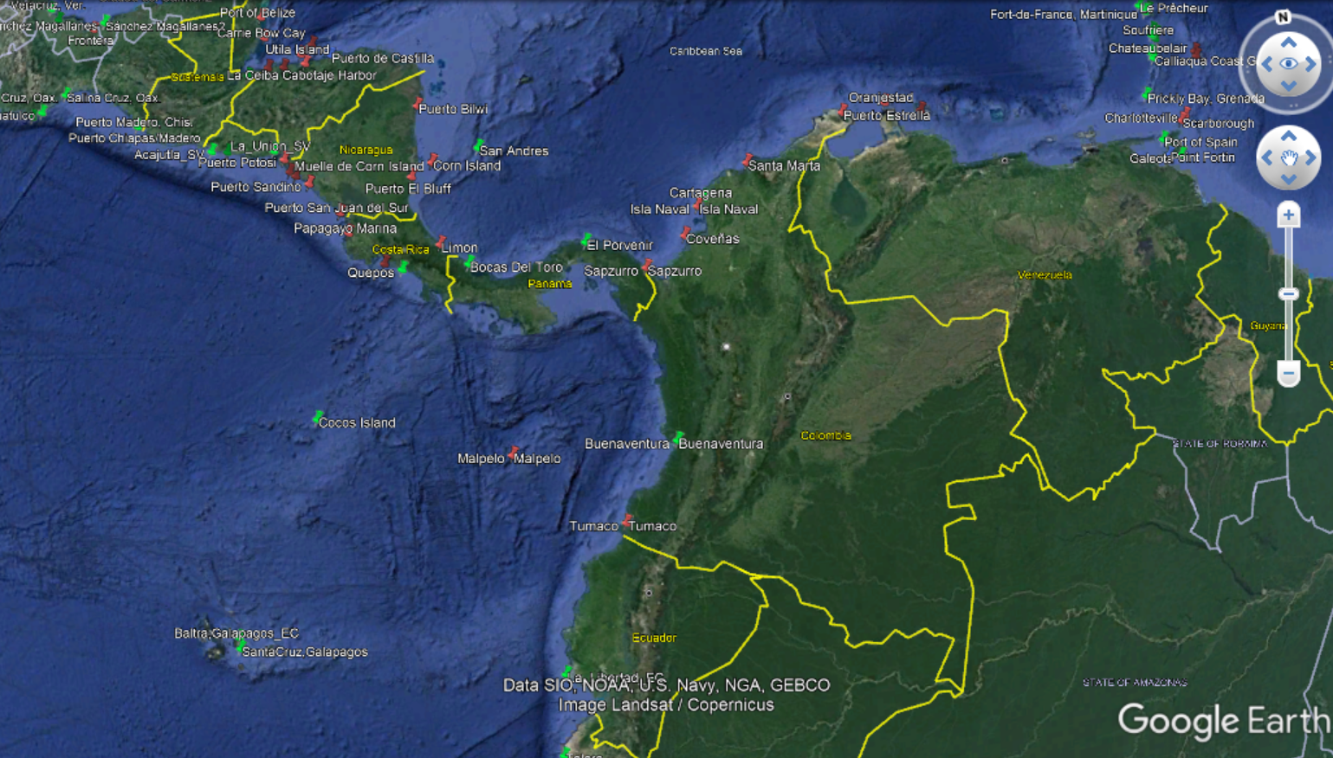
KML file
http://www.ioc-sealevelmonitoring.org/stations.kml

Slide 10
Webservice API
http://www.ioc-sealevelmonitoring.org/service.php?query=help
Machine to machine
REST
Standard format: JSON/XML/ASCII
Registration
Simple: 4 data types:
data
stationlist
Sensorlist
Station

Slide 11
Query parameters

Slide 12
REST API Examples
All station metadata in CSV
http://www.ioc-sealevelmonitoring.org/service.php?query=stationlist&format=ascii
All GTS stations in JSON format
http://www.ioc-sealevelmonitoring.org/service.php?query=stationlist&format=json&showall=gts
Data from Tonga 2022-01-14 – 2022-01-19
http://www.ioc-sealevelmonitoring.org/service.php?query=data&format=ascii&code=nkfa&timestart=2022-01-14&timestop=2022-01-19

Slide 13
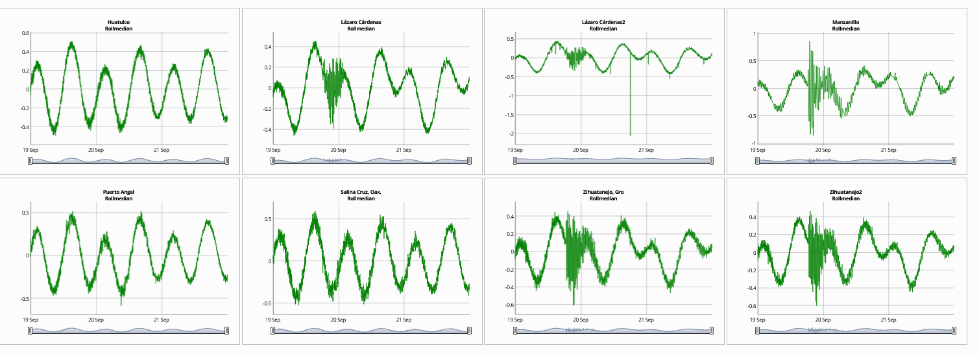
Data explorer
https://rshiny.vsc.lifewatch.be/sls-data/
https://rshiny.vsc.lifewatch.be/sls-data/?_state_id_=6cd89e2e6012d630

Slide 14
More demos
https://rshiny.vsc.lifewatch.be/file-data/
Tonga event
https://rshiny.vsc.lifewatch.be/sls-data/?_state_id_=01a9b6e33aa04b34

Slide 15
Thank you
www.ioc-sealevelmonitoring.org
info@ioc-sealevelmonitoring.org

