Slide 1
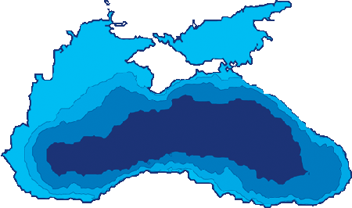
Last projects and activities
SG-ODINBLACKSEA – 16 December 2021, WEB meeting

Slide 2

OUTLINE
Objectivities
Last activities
Last projects
Activities in projects concerning all OdinBlackSea partners
SG-ODINBLACKSEA – 16 December 2021, WEB meeting

Slide 3
Objectivities
To collate oceanographic data, archive and store it and maximize its utilisation
To enhance the availability of high quality oceanographic data for a wide group of users
To promote data exchange on national and international level
SG-ODINBLACKSEA – 16 December 2021, WEB meeting

Slide 4
European Union (EU) Horizon 2020:
SeaDataCloud
Copernicus programme:
Black Sea – Monitoring and Forecasting Centre (BS MFC)
CMEMS InSitu TAC
Emodnet:
Bathymetry
Ingestion
Chemistry
Seabed Habitats
SG-ODINBLACKSEA – 16 December 2021, WEB meeting

Slide 5
Data types
Hydrophysical data:
CTD-profiles
Current speed and direction
Hydrochemical data
[water sample (CTD rosette bottles and Nansen bottles) analyses]:
Dissolved oxygen
Nitrate
Nitrite
Phosphate
pH
Hydrodynamics and lithodynamics data:
Sea waves
Wave velocities
Sea level
Bathymetry
Geological and geomorphologic data:
Bathymetry
Sediments
Biological data:
Plankton
Benthos
Chlorophyll-a
Ichthyology
SG-ODINBLACKSEA – 16 December 2021, WEB meeting

Slide 6
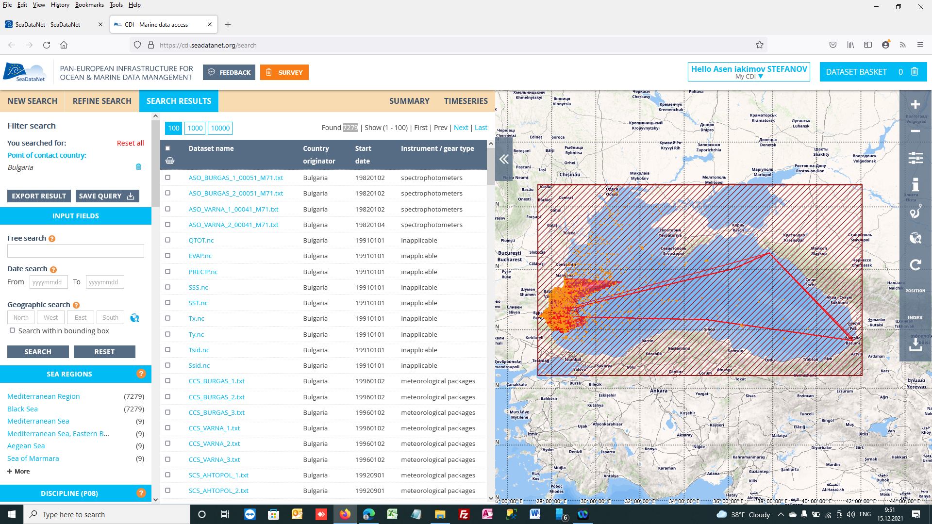
SeaDataNet
Contribution: CDI’s -4876;CSR-172;EDMED -36;EDMO-32;EDMERP=28
SG-ODINBLACKSEA – 16 December 2021, WEB meeting

Slide 7
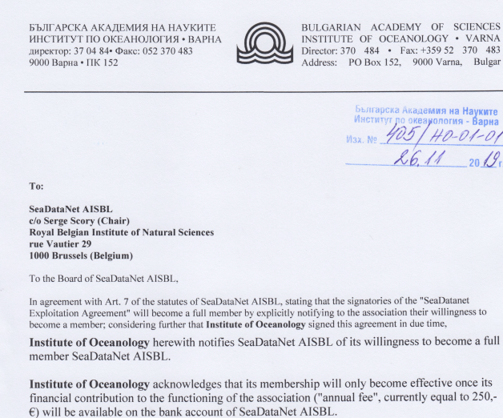
SeaDataNet AISBL
SeaDataNet AISBL aims to work in the collective interest of its members to improve the quality and effectiveness in the management, the processing and the dissemination of oceanographic data at national, regional and global levels.
In 2021 IO-BAS became member of AISBL
SG-ODINBLACKSEA – 16 December 2021, WEB meeting

Slide 8
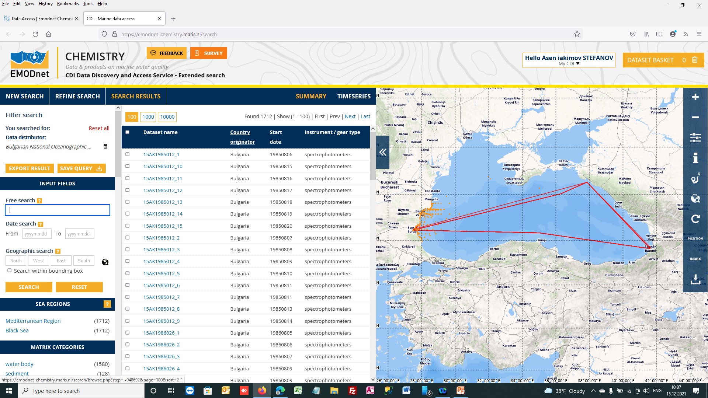
EMODNET Chemistry
Contribution: CDI’s -1376
SG-ODINBLACKSEA – 16 December 2021, WEB meeting

Slide 9
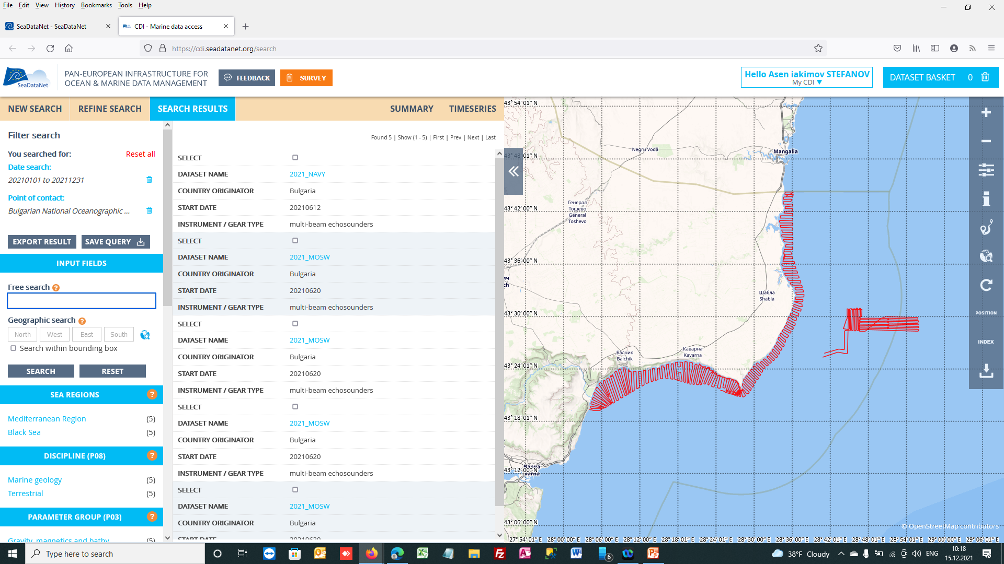
EMODNET Bathymetry
Contribution: CDI’s - 12
SG-ODINBLACKSEA – 16 December 2021, WEB meeting

Slide 10
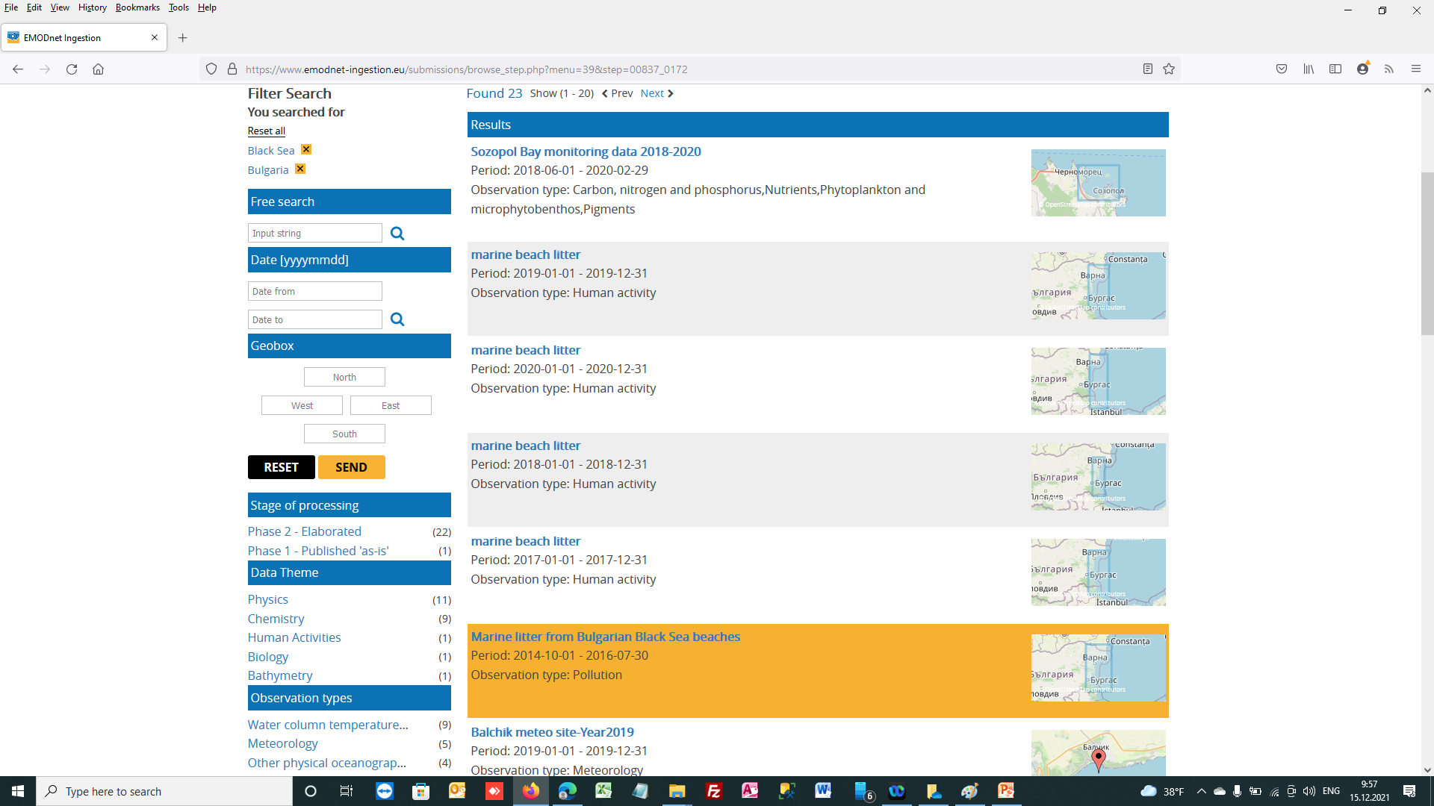
EMODNET Ingestion
Contribution: 23 submissions in phase II 2 in phase I
SG-ODINBLACKSEA – 16 December 2021, WEB meeting

Slide 11
EMODnet Ingestion Country case: (Bulgaria)
Date of case submission: 04.2021
Name & email of the EMODnet Ingestion partner (data ambassador):
IO-BAS , a.stefanov@io-bas.bg (Partner 20)
Name of the data provider:
Black Sea-Danube Coastal Association for Research and Development (BDCA)
Type of submitted data and time range:
Collecting coastal bathymetry data for a fishing port (08.2019)
Link to case:
https://www.youtube.com/watch?v=J9RrdplTwEc
Link to submissions:
https://www.emodnet-ingestion.eu/submissions/submissions_details.php?menu=39&tpd=193&step=00837_0172:
The submission above is included in more successive stories of the project
SG-ODINBLACKSEA – 16 December 2021, WEB meeting

Slide 12
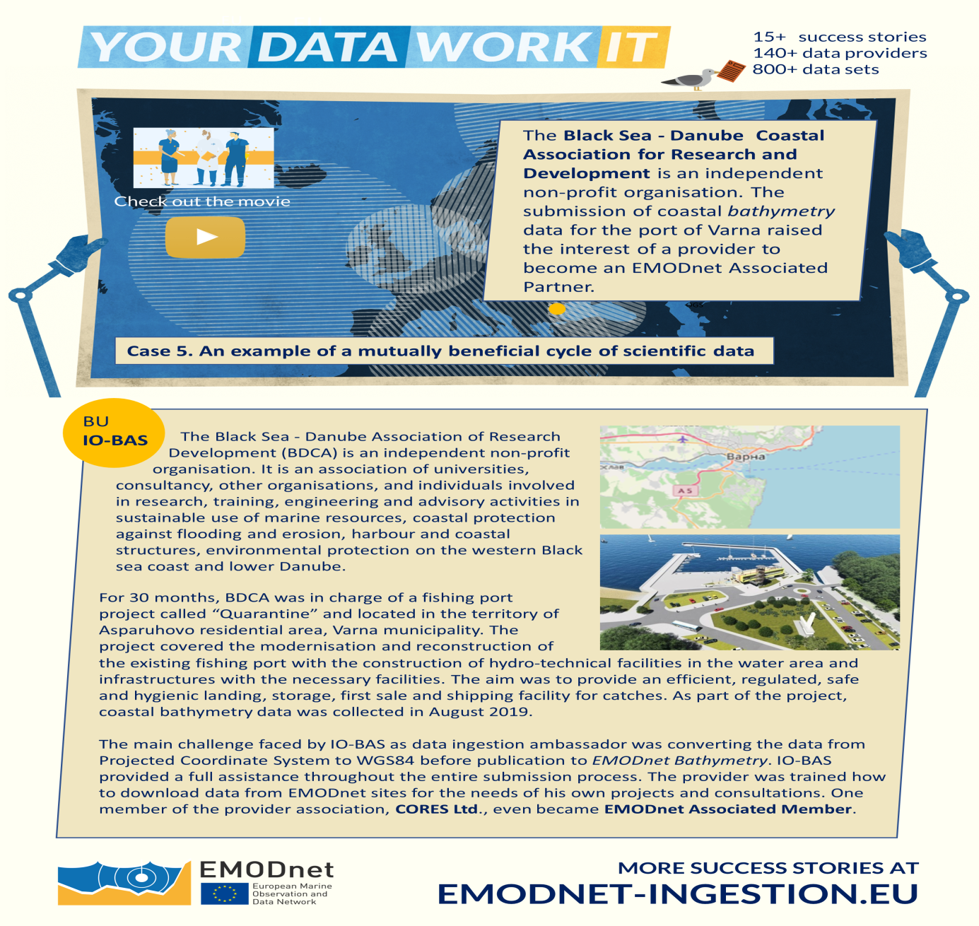
SG-ODINBLACKSEA – 16 December 2021, WEB meeting

Slide 13
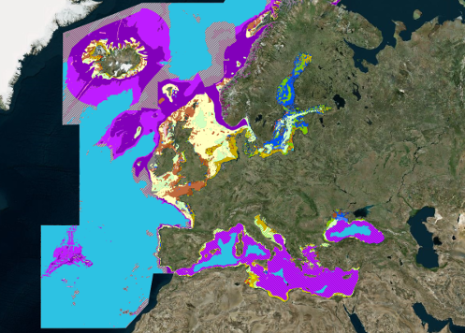
EMODnet Seabed Habitats
Contribution: Seabed habitat maps of Bulgarian coast
SG-ODINBLACKSEA – 16 December 2021, WEB meeting

Slide 14
DOORS project
DOORS (Developing Optimal and Open Research Support for the Black Sea) is a €9m EU research project will link citizens, science, and industry for critical Black Sea regeneration, stimulating a new wave of ‘blue economy’ opportunities. The project is bringing together the best expertise and technology from 37 institutions from the Black Sea region and European countries to address the human and climate change impacts in the marine ecosystem.
BRIFGE-WS project
The EU-funded Horizon 2020 Programme project BRIDGE-BS is being implemented with 33 partners around the Black Sea, through Middle East Technical University’s coordination. BRIDGE-BS project will map, monitor and model ecosystem services and their responses to stressors in order to support development of a sustainable and climate-neutral blue economy in the region.
these two projects unite all partners from OdinBlackSea
communication between well-known partners is very easy
SG-ODINBLACKSEA – 16 December 2021, WEB meeting

Slide 15
Thank you !
SG-ODINBLACKSEA – 16 December 2021, WEB meeting

