Slide 1
IODESTEERING GROUP FOR THE ODIN-BS PROJECT, 10th Session, online meeting, 16th Dec. 2021, 10:00 CET
introduction to the database and the data collection templates
Oleksandr neprokin
o.neprokin@gmail.com
Ukrainian Scientific Centre of Ecology of the Sea
Notes:
BRIDGE-BS (Advancing Black Sea Research and Innovation to Co-Develop Blue Growth within Resilient Ecosystems) is a Research and Innovation Action funded under Horizon 2020 it has officially started as of the 1st of June 2021.
BRIDGE-BS is a multi-partner and international consortium with the overarching aim of assessing the present state of Black Sea ecosystems, their services, their resilience to the multi-stressors, and creating the means necessary to sustainably manage these ecosystems.

Slide 2
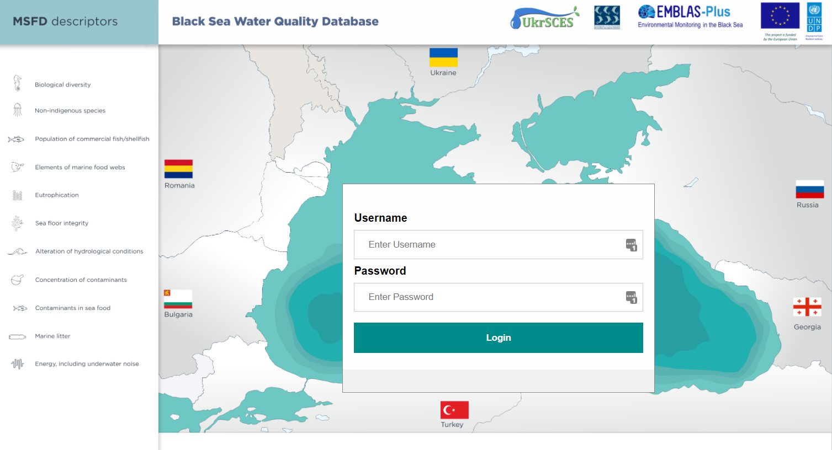
Water Quality Data Base (WQDB)
Notes:
The idea of WQDB was born during the first phase of the BMLAS Project in 2011, the development started within the EMBLAS II Project (in 2016) and was continued in EMBLAS Plus with the overall need of fine-tune and improvement according to EU Marine Strategy Framework Directive (MSFD), EU Water Framework Directive (WFD) and Black Sea Strategic Action Plan (2009). The further database development was planned within the BRIDGE project.
The essential amount of the data purchased during the monitoring activities both of the EMBLAS Project (2nd phase), EMBLAS Plus and ANEMONE were collected, processed and organized to the Water Quality database (WQDB). The data base contains also the historical data provided by the EMBLAS participants.

Slide 3
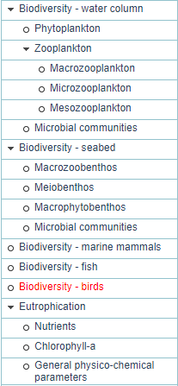
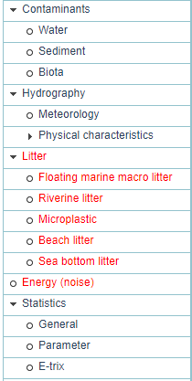
WQDB interface: Groups and features (MSFD ecosystem approach)
Menu frame:
Groups for the MSFD Descriptors
Subgroups and features for the Indicators within the corresponding MSFD Descriptor
Group for Statistics (number of records with the parameter’s filters; GES integral values calculated using the data base parameters (under development))
Notes:
During the design and development of the data base the MSFD ecosystem approach was used. Graphic web-interface of the database provide an access to the data stored in the catalogues. These catalogues organized in accordance with the MSFD indicators of the corresponding Descriptors and presented in the Menu frame as the features in the groups and subgroups. The groups corresponds to the MSFD Descriptors. Data catalogues covers the majority of the MSFD Descriptors and indicators except Microplastic, Sea bottom litter and Energy (noise). These catalogues to be developed in the future activities.

Slide 4
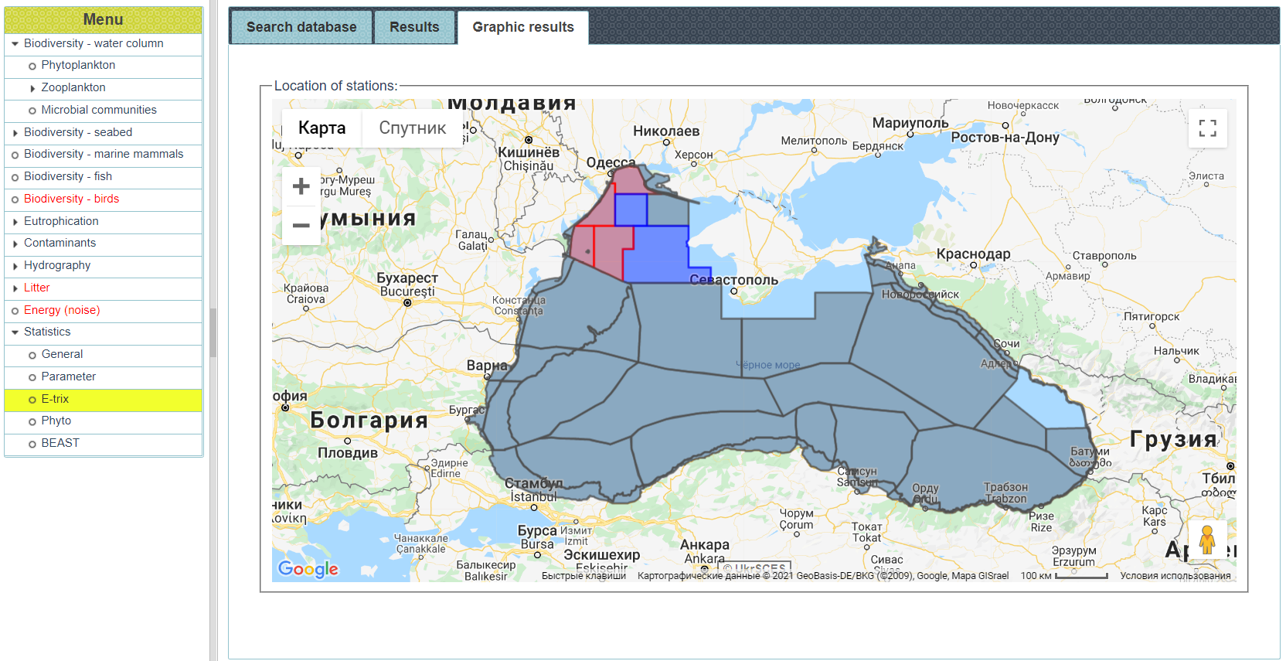
WQDB interface: Statistical tools
Notes:
The set of statistical tools also available via the web interface. Some tools represents the contents of the database. Another were developed to show the environmental state integral values (for example E-TRIX, the indicator showing trophic level). The calculations are limited by the MSFD defined polygons of the Black Sea and show the value for selected polygon or set of polygons. The work on the scientific evaluation database tools development is expected to be continued within the BRIDGE Project and other activities.

Slide 5





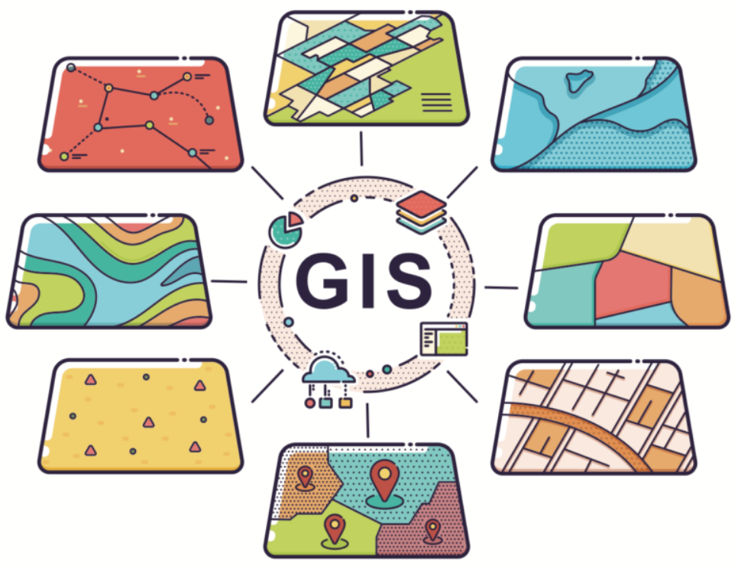


Compatibility issues
AphiaID
ISO19115
ISO19139
FGDC
CRUISE SUMMARY REPORTS CSR
MARINE RESEARCH PROJECTS EDMERP
MARINE RESEARCH ORGANISATIONS EDMO
MARINE DATA SETS EDMED
DESCRIPTIVE METADATA
COMMON DATA INDEX CDI
The NERC Vocabulary Server (NVS)
Notes:
The data base was designed taking to account different data and metadata interoperability issues. The data and metadata catalogues developed to be SeaDataNet and EMODNET-compliant. It is mean that both data and metadata catalogues are able to contain all the appropriate information required to prepare SeaDataNet or EMODNET metadata catalogues, or datasets, or prepare spatial data and metadata following the GIS standards, etc. and to make work smooth during the data exporting processes. For example, all the biotic records in the data base should be linked to the AphiaID (it is mandatory condition). AphiaID is the unique and persistent identifier for the marine species
The Aphia platform is an infrastructure designed to capture taxonomic and related data and information, and includes an online editing environment. Aphia is the core platform that underpins the World Register of Marine Species (WoRMS) and its more than 80 related global, regional and thematic species databases.
During the BRDIGE-BS we are planning to expand export automation ability of our data base. We already have the experience in this field using the SEADATANET API to build the datasets for EMODNET Biology and ODIS.
Another issue that should be solved to make current data base more uniform and data/metadata more readable is adding lists of controlled terms from the NERC vocabularies to better data descriptions.

Slide 6
Free access now
http://blackseadb.org/
Notes:
The data base is now open and available by this link.
Except the issues I’ve already mentioned we are also planning to redesign it’s interface, to expand the database catalogues, etc.

Slide 7
Data collection templates (DCT)
1. DCT_Metadata
2. DCT_Hydrology-Chemistry
3. DCT_Target_Sea_Water
4. DCT_Target_Sea_Sediment-Biota
5. DCT_Phytoplankton
6. DCT_Macrozooplankton
7. DCT_Microzooplankton
8. DCT_Mesozooplankton
9. DCT_Macrozoobenthos
10. DCT_Meiobenthos
11. DCT_Macrophytobenthos
12. DCT_Chlorophyll
13. DCT_Fish
14. DCT_Marine mammals
15. DCT_Beach litter
16. DCT_River floating litter
17. DCT_ Sea floating litter
18. DCT_ Ichthyoplankton
19. DCT_Microbial communities_water
20. DCT_Microbial communities_sediment
Notes:
As the most modern databases the WQDB using data collecting templates or DCTs to import the data.
Templates were developed in Microsoft Excel using formulas, filters, dropdown lists and other options for more convenient usage.
For now 1 metadata and 19 observation types DCT’s have been developed.

Slide 8
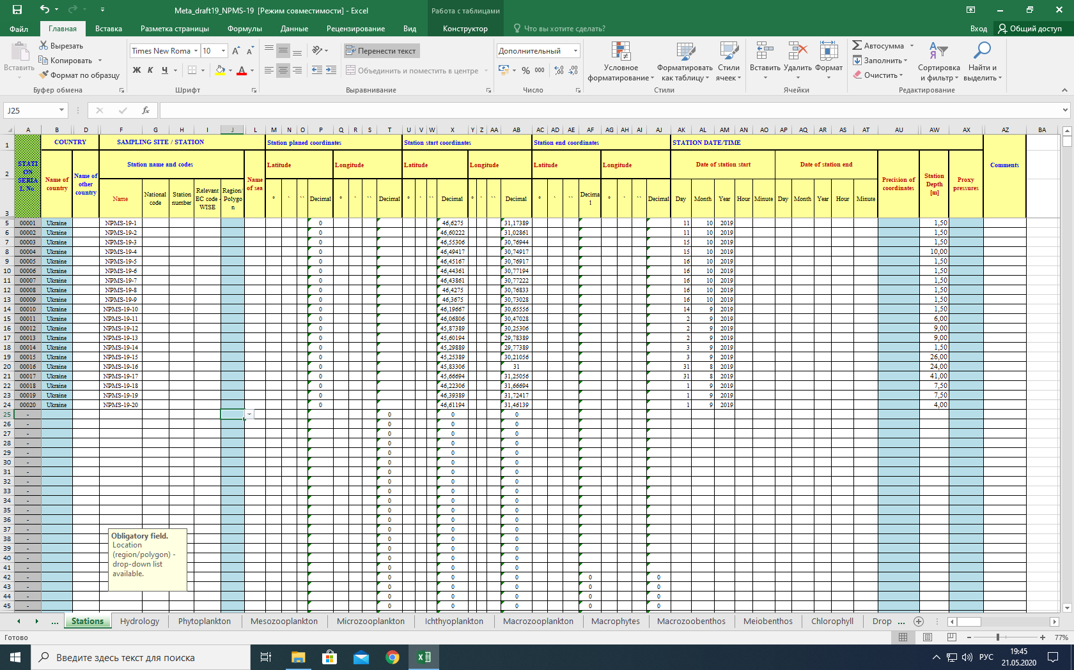
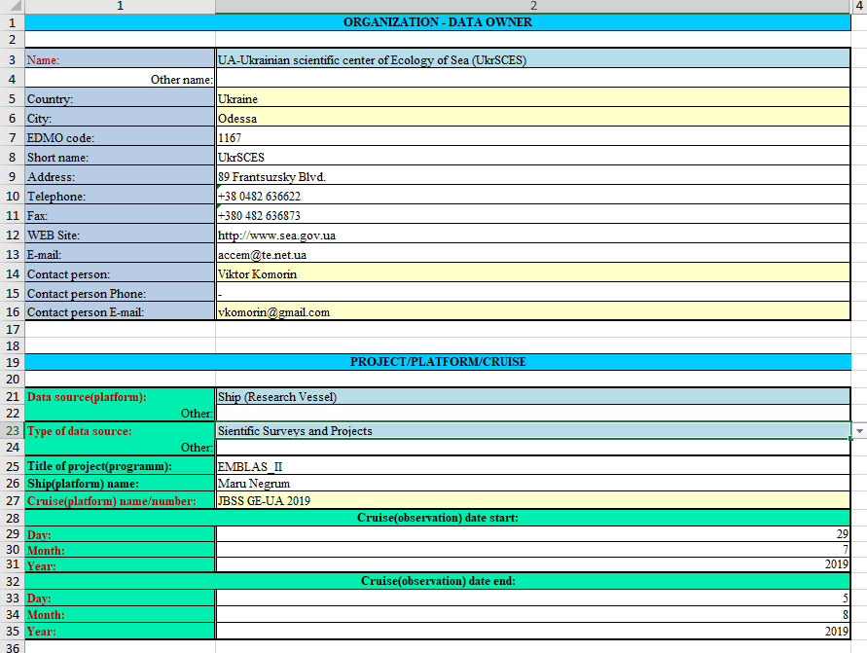
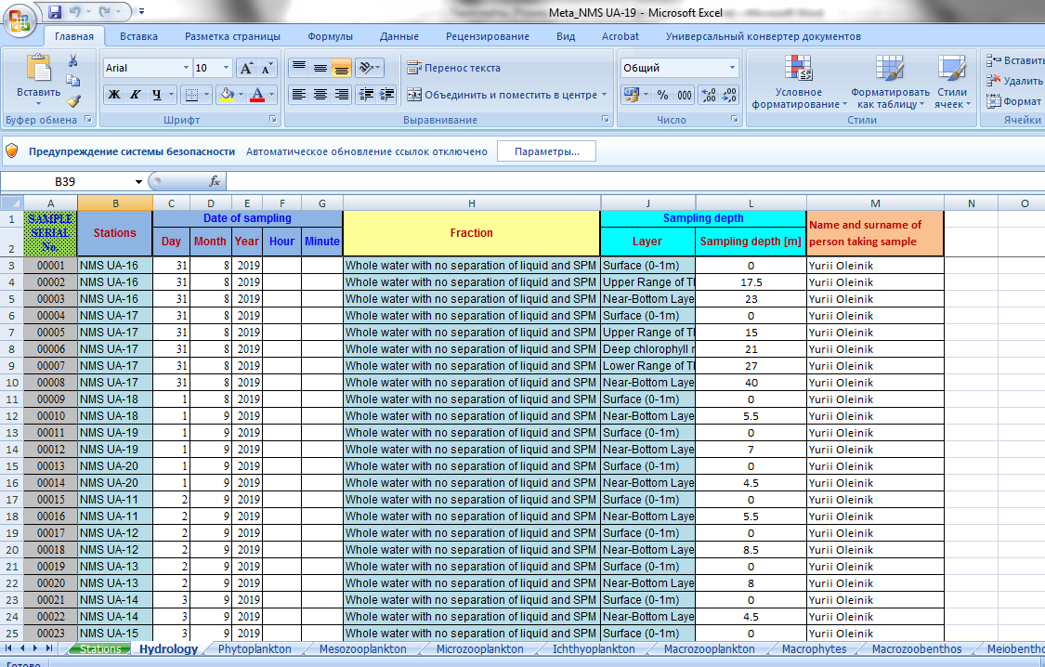
How to fill DCT: Metadata template first
Notes:
The data base common data model is focuses on describing data collections by means of fields for What, When, Where, Who, and additional fields for querying more detailed metadata at each source and for facilitating access by means of querying the data base.
The data provider should prepare the general metadata template first (for the whole cruise). There are few metadata catalogues to be filled:
ORGANIZATION - DATA OWNER
PROJECT/PLATFORM/CRUISE
STATION
All the mandatory fields in DCTs are marked in red. Some fields can be field with the values from the dropdown lists, some generating from another fields values.
For example, the serial number of the station is generating automatically and will be a link for the observation type catalogues.
After first 3 general catalogues filled we can move to the observation type metadata.
For example in the Hydrology metadata template. In this catalogue we are filling the information related to the sample, sampling layers, fractions, Sampling depths, responsible persons, etc.
The station numbers now available from the dropdown list linked to the values from the station catalogue. The sampling numbers generated automatically and most of other values can be picked from the dropdown lists.

Slide 9
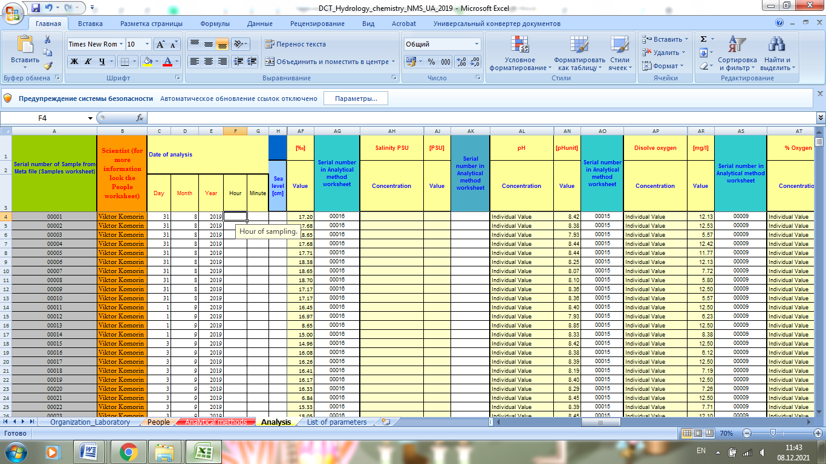
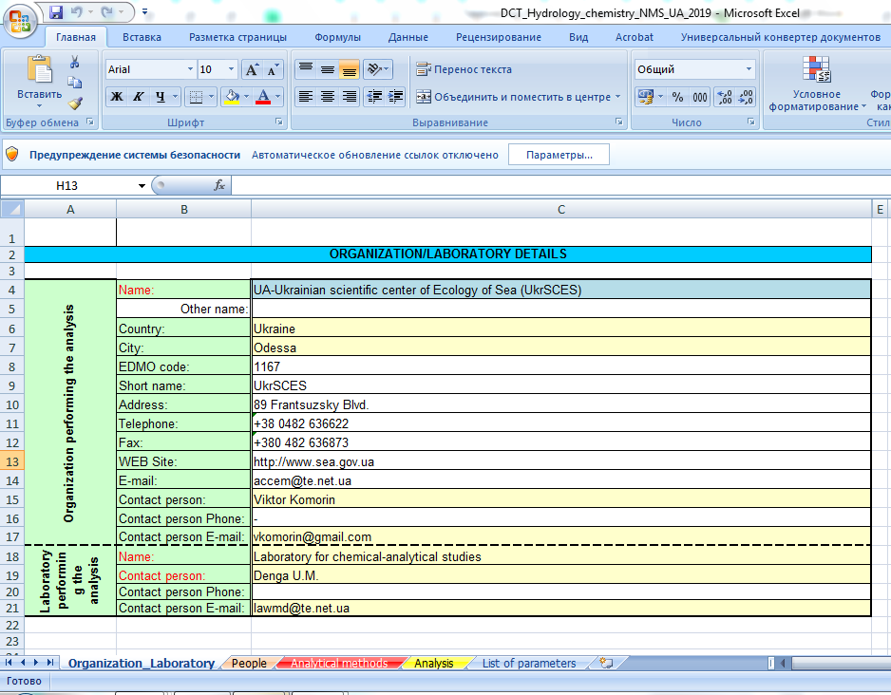
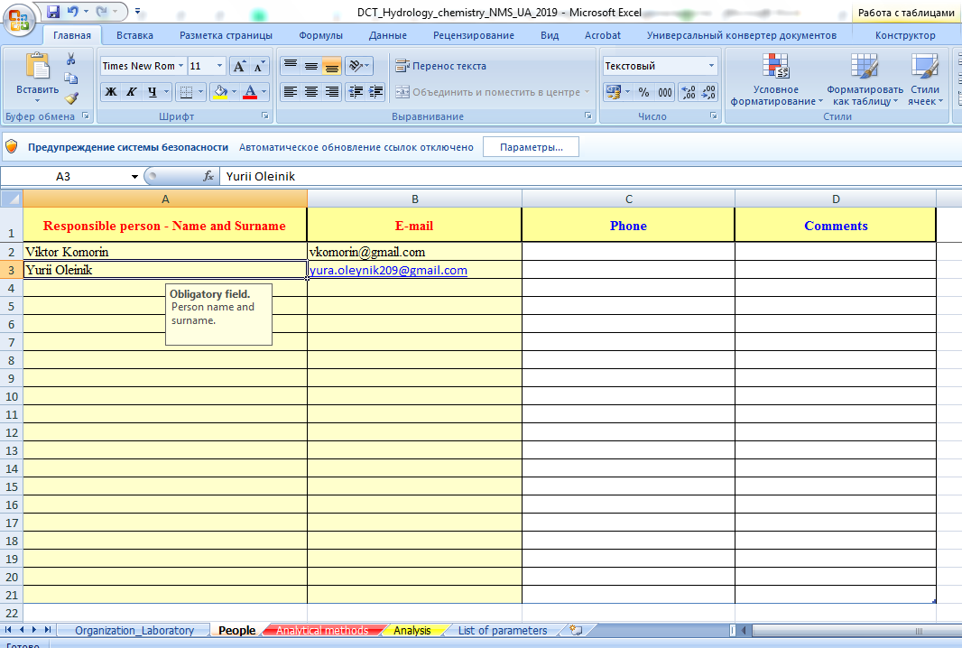
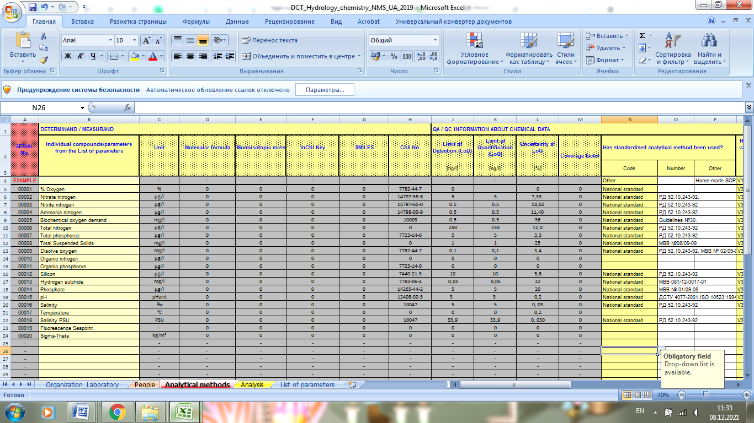
How to fill DCT: Describing and filling the data
Notes:
Next step is filling the processed samples data and metadata. We will continue the observation type Hydrology as an example.
First to be filled the metadata catalogues related to the sample processing results.
Оrganization/Laboratory details goes first
People involved in the samples processing – the second.
Analytical methods – third. We need to indicate the list of parameters observed in the samples of the cruise we are describing. We also enter the information on each parameter - its detection limits, units of measurement, research method, etc.
And finally we are filling the data itself.
We are copying sample numbers from the hydrology metadata catalogue, this way we link the sample metadata to the data.
After inserting the sample number we fill in all the information on the parameters measured in this sample – the person performed analysis (from the drop-down list), the date of sample analysis, meteorological information on the station and the data on the parameters themselves. Three fields are provided for each hydrology parameter: Concentration, Value and Serial number in Analytical method worksheet. The Concentration field provides values ​​from the drop-down list: Individual Value, Less than LoD (Limit of Detection), Less than LoQ (Limit of Quantification).The Value field is the value of the measured parameter itself. And the Serial number in Analytical method worksheet is the parameter number in the Analytical method catalogue, for linking with all the declared information on the parameter.
Hydrology templates is the most extensive among others DCTs.
Other templates to be filled approximately the same way. We are planning to make them available on the BRIDGE_BS web-portal ASAP.

